Slide 1
Part 3 Understand Some HPMS Data Items and Other Related Concepts
Notes:
We will now discuss some H-P-M-S data items and other related concepts that are important to understand as they are useful in preparing the Vehicle Summary Data.
As will be seen, much of the information a State requires to prepare Vehicle Summary Data are contained in the State’s annual H-P-M-S submittal.
Using these data to prepare Vehicle Summary Data requires transforming selected H-P-M-S data elements and augmenting these data elements with vehicle classification counts from other sources.

Slide 2
Some Basic HPMS Concepts
Full Extent Data: Full Extent Data refers to a set of data item that are reported for an entire road system by functional class.
For example, AADT includes a set of Full Extent Data covering each and every segment of I-95 (functional class 1).
Notes:
First, let’s discuss some basic H-P-M-S concepts.
H-P-M-S data include a set of items describing the characteristics of the road system.
Full Extent Data refers to a set of data items that are reported for an entire road system by functional class
For example, A-A-D-T includes a set of Full Extent Data covering each and every segment of I-95
I-96 is functionally classified as Interstate, or functional class 1.

Slide 3
Some Basic HPMS Concepts
Sample Panel Data: Sample Panel Data is a set of data that is reported for a selected portion of a given roadway system.
For example, State Road 180 (US Highway 18) is functional classified as 2 with a total length of 214 miles and a total of 92 segments.
The AADT_Combination_Truck data only coves 24 of the 92 segments, and 36 miles of the 214 miles (some segments, and limited length).
The AADT_Combination_Truck data is called Sample Panel Data for FC 2 roadway here.
Notes:
Sample Panel Data is a set of data that is reported for a selected portion of a given roadway system.
For example, State Road 180 (or US Highway 18) is functional classified as Other Freeway or Expressway, or functional class 2, with a total length of 214 miles and a total of 92 segments.
The available A-A-D-T combination truck data only covers 24 of the 92 segments, and includes 36 miles of the 214 miles (some segments, and limited length).
The A-A-D-T Combination Truck data is called Sample Panel Data for a Functional Class 2 roadway here.

Slide 4
HPMS - AADT
Functional System |  | 1 | 2 | 3 | 4 | 5 | 6 | 7
 | NHS | Int | OFE | OPA | MiA | MaC | MiC | Local
Rural | FE+R | FE+R | FE+R | FE+R | FE+R | FE+R
Urban | FE+R | FE+R | FE+R | FE+R | FE+R | FE+R | FE+R
FE = Full Extent
R = Ramp
Notes:
In H-P-M-S, A-A-D-T are reported at the link level for all urban and rural roadways on the National Highway System (N-H-S) as well as all of the following functionally classified rural roadways:
Interstates (Int)
Other Freeways and Expressways (OFE)
Other Principal Arterials (OPA)
Minor Arterials (Mia)
Major Collectors (MaC)
Finally, A-A-D-T are reported for all of the following functionally classified urban roadways:
Interstates (Int)
Other Freeways and Expressways (OFE)
Other Principal Arterials (OPA)
Minor Arterials (Mia)
Major Collectors (MaC)
Minor Collectors (MiC).
Statewide summary tabular data are included in H-P-M-S for V-M-T covering:
Rural minor collectors (Functional Classifcation 6) and local roads (Functional Class 7) as well as urban local roads (Functional Class 7).

Slide 5
HPMS - Urban or Rural Identification Data – Urban Code
Functional System |  | 1 | 2 | 3 | 4 | 5 | 6 | 7
 | NHS | Int | OFE | OPA | MiA | MaC | MiC | Local
Rural | FE+R | FE+R | FE+R | FE+R | FE+R | FE+R
Urban | FE+R | FE+R | FE+R | FE+R | FE+R | FE+R | FE+R
FE = Full Extent
R = Ramp
Notes:
Similarly, Urban and Rural Identification Data are reported in H-P-M-S for the National Highway System (N-H-S) as well as all of the following functionally classified rural roadways:
Interstates (Int)
Other Freeways and Expressways (OFE)
Other Principal Arterials (OPA)
Minor Arterials (Mia)
Major Collectors (MaC)
Finally, Urban and Rural Identification Data are reported for all of the following functionally classified urban roadways:
Interstates (Int)
Other Freeways and Expressways (OFE)
Other Principal Arterials (OPA)
Minor Arterials (Mia)
Major Collectors (MaC)
Minor Collectors (MiC).

Slide 6
HPMS - AADT_SUV ( Single Unit Vehicle)
Functional System |  | 1 | 2 | 3 | 4 | 5 | 6 | 7
 | NHS | Int | OFE | OPA | MiA | MaC | MiC | Local
Rural | FE | FE | SP | SP | SP | SP
Urban | FE | FE | SP | SP | SP | SP | SP
FE = Full Extent
R = Ramp
SP= Sample Panel
Notes:
In H-P-M-S, Single Unit Vehicles, or S-U-Vs, include both Buses and Single Unit Trucks.
S-U-Vs are reported for all road segments on the N-H-S as well as urban and rural Interstates.
However, S-U-Vs are reported only on sample panel sections on remaining functionally classified rural and urban roads with the exception of all local roads and rural minor collectors.

Slide 7
HPMS - AADT_CU (Combination Vehicle)
Functional System |  | 1 | 2 | 3 | 4 | 5 | 6 | 7
 | NHS | Int | OFE | OPA | MiA | MaC | MiC | Local
Rural | FE | FE | SP | SP | SP | SP
Urban | FE | FE | SP | SP | SP | SP | SP
FE = Full Extent
R = Ramp
SP= Sample Panel
Notes:
Reporting of Combination Vehicle A-A-D-T in H-P-M-S is identical to the reporting of S-U-V A-A-D-T.
Combination Vehicle A-A-D-T are reported for all road segments on the N-H-S as well as urban and rural Interstates.
However, Combination vehicle A-A-D-T are reported only on sample panel sections on remaining functionally classified rural and urban roads with the exception of all local roads and rural minor collectors.

Slide 8
Spatial Intersecting Concept
117.2 miles
.2
10.1
49.3
52.5
5.1
County
Leon=17
Castle=23
Route K is divided into 5 segments
Notes:
This slide summarizes the characteristics of segments comprising a hypothetical route called “Route K”.
Route K is 117.2 miles in length and consists of five segments: a 52.5 mile long segment, a 0.2 mile segment, a 5.1 mile long segment, a 10.1 mile segment, and a 49.3 mile long segment.
Route K also travels through a rural area and an urban area as well as through two counties.

Slide 9
Spatial Intersecting Concept
117.2 miles
County
Leon=17
Castle=23
ID=K
FC=1
TL=4
UC=R
L=52.5 miles
County=17
AADT=180,684
ID=K
FC=1
TL=4
UC=R
L=0.2 miles
County=17
AADT=210,124
ID=K
FC=1
TL=4
UC=R
L=5.1 miles
County=23
AADT=210,124
ID=K
FC=1
TL=6
UC=R
L=10.1 miles
County=23
AADT=260,766
ID=K
FC=1
TL=8
UC=R
L=49.3 miles
County=23
AADT=260,826
Notes:
The characteristics of each of these five segments are summarized in the lower portion of this slide.
For example, for segment one:
I-D = K
F-C = 1
T-L = 4
U-C = R
L = 52.5 miles
County = 17
A-A-D-T = 180,684
The information presented provides an example of how the features of each segment comprising Route K is related to specific characteristics that can be used to prepare Vehicle Summary Data.
We will see how Urban Code, County Code, and A-A-D-T data are used to prepared Vehicle Summary Data using the Spatial Intersector Tool.

Slide 10
HPMS Spatial Intersector Tool
Notes:
The H-P-M-S Spatial Intersector Tool can be used to develop a similar data set for the H-P-M-S data submitted by a State.
As shown in the following slides, these data can be used prepare H-P-M-S Vehicle Summary Data by extracting specific data elements and manipulating the results to create new variables.

Slide 11
HPMS Spatial Intersector – Output Data
An ArcGIS dataset including all line work data (shp files) and associated characteristics data in a dbf file.
Notes:
The output data from the HPMS Spatial Intersector Tool are an Arc G-I-S dataset including all line work data (or shape files) and associated characteristics data in a data base or d-b-f file.
This d-b-f file can be input into an Excel spreadsheet for manipulation to create new variables, summarize quantities, and analyze results.

Slide 12
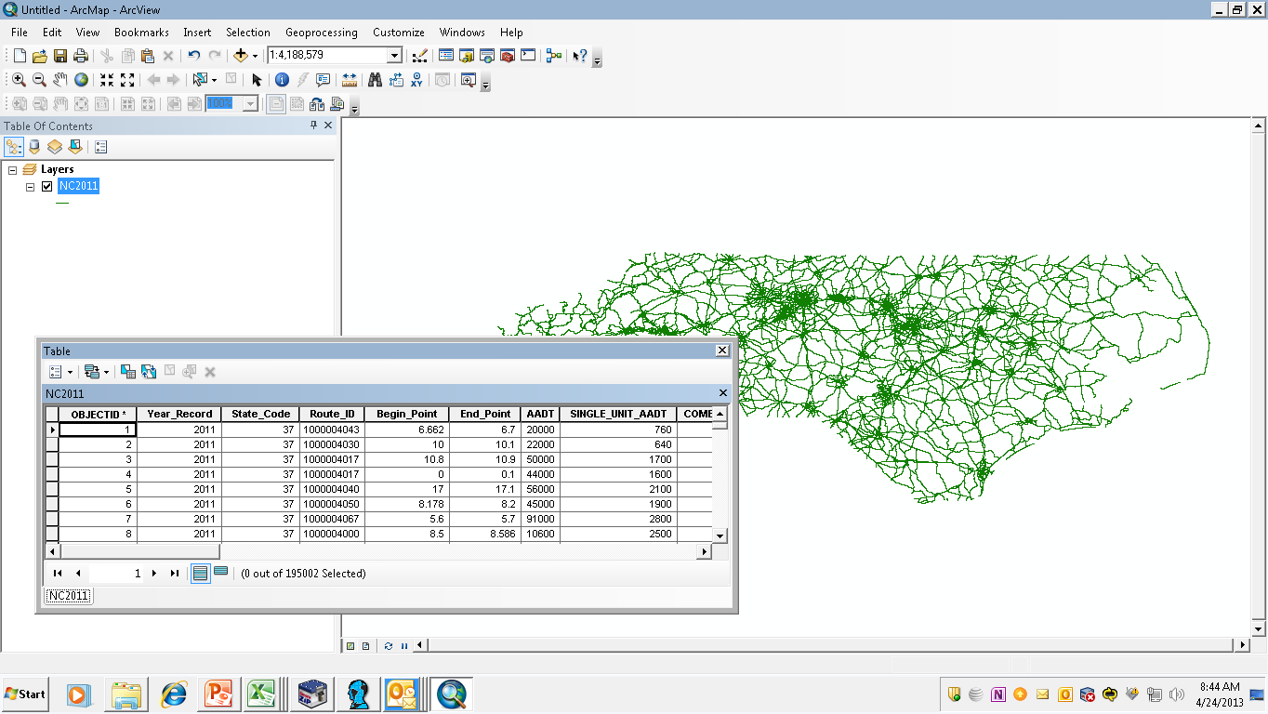
HPMS Spatial Intersector – Output Data – ArcGIS Dataset
Notes:
Let’s look at an example using an Arc G-I-S dataset for the State of North Carolina.

Slide 13
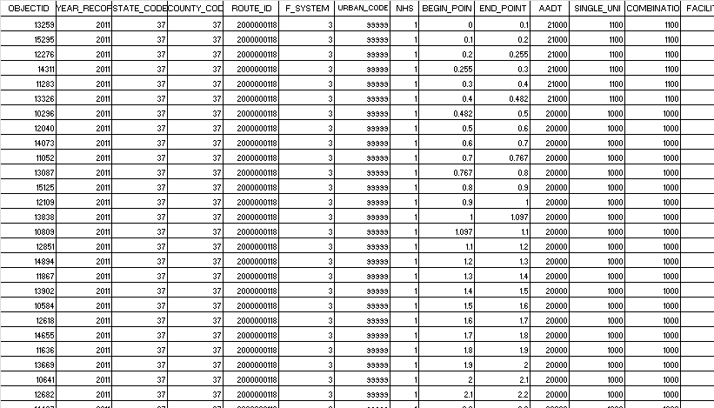
HPMS Spatial Intersector – Output Data – .dbf File
Notes:
Here is an extract of the data base file for North Carolina developed from the Spatial Intersector Tool.
Each row represents an individual route segment and each column represents selected characteristics of these segments.
First, notice the data represents condition in the year 2011.

Slide 14
HPMS Spatial Intersector – Output Data – .dbf file
Notes:
Note that the State Code indicates that these records are for the State of North Carolina (State Code = 37)

Slide 15
HPMS Spatial Intersector – Output Data – .dbf file
Data can be analyzed
by individual county
Notes:
The records shown on this side are for County 37.
Of course, the entire data set includes records for all counties which means that data can be analyzed on an individual county unit of geography.

Slide 16
HPMS Spatial Intersector – Output Data – .dbf file
Data can be analyzed
by individual route,
FC and area type
(99999=rural,
all others =urban)
Notes:
Data can be analyzed by individual route, functional classification and area type, rural or urban.

Slide 17
HPMS Spatial Intersector – Output Data – .dbf file
A segment’s length
=End_point - Begin_point
Notes:
Because the begin and end points for each segment are also included, a segment’s length in miles can be calculated.

Slide 18
HPMS Spatial Intersector – Output Data – .dbf file
A segment’s VMT= segment length x Flow Rate
Notes:
A segment’s total V-M-T can be calculated by using the segment length and the traffic flow rates the segment.
In addition, note that flow data are also available for Single Unit Vehicles and Combination Vehicles.
Therefore, V-M-T for these vehicles types can also be developed.

Slide 19
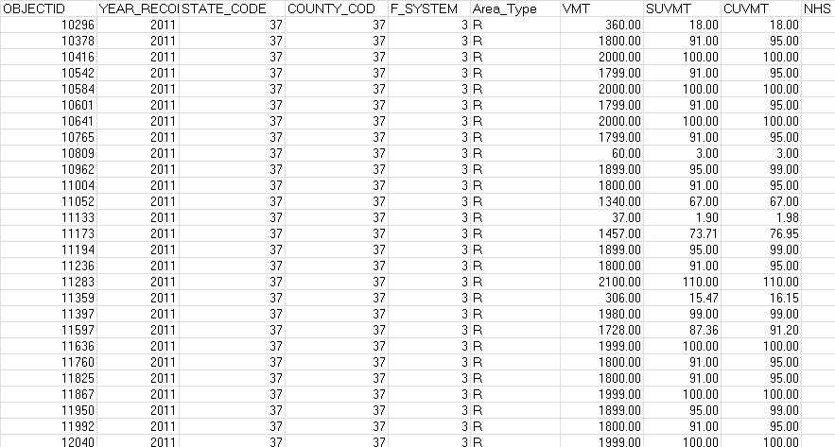
Re-organized Output Data Table
Notes:
The results of calculating the Total V-M-T, the Single Unit Vehicle V-M-T, and Combination Truck V-M-T are shown here for a set of segments.
Note that the inclusion of the County Code and Functional Classification for each segment means that records may be summarized using both of these characteristics.

Slide 20
Re-organized Output Data Table
Notes:
Also note that the inclusion of Area Type means that data can be summarized by urban or rural location.
In sum, we now have a data set containing estimates of total V-M-T, Single Unit Vehicle V-M-T, Combination Vehicle V-M-T that can be summarized in a number of ways including area type (urban or rural), county, or functional classification.

Slide 21
Summary
Full Extent vs. Sample Data
AADT, AADT_SUV, AADT_CU
Spatial Intersecting –tool and outputs
VMT by county, roadway functional class and by vehicle types (all, SUV, CU)
Notes:
This section described the characteristics of “Full Extent” and “Sample Data” available in H-P-M-S.
It described functional classification coverage for A-A-D-T, Single Unit Vehicle A-A-D-T, and Combination Vehicle A-A-D-T in H-P-M-S
It has introduced the Spatial Intersector Tool and showed how data can be extracted from the State’s H-P-M-S data can be used to estimated V-M-T by county, roadway functional class, and vehicle Single Unit Vehicle and Combination Vehicle types.
The next section outlines how Vehicle Summary Data can be prepared by applying these concepts, tools, and data sources.

