Slide 1
Part 4 HPMS Vehicle Summary Data Computation
Notes:
This section presents an example of how Vehicle Summary Data can be prepared using data available from the State’s H-P-M-S submittal supplemented with vehicle classification count data.

Slide 2
Additional Columns
Ucode=if(urban_code=99999, “Rural”, “Urban”)
VMT=(end_point-begin_point)*AADT
SUVMT=(end_point-begin_point)*SUAADT
CTVMT=(end_point-begin_point)*CTAADT
Notes:
Recall the earlier example.
We can use some simple formulas to develop variables to classify segments as “Rural’ or “Urban” as well as to calculate V-M-T, Single Unit Vehicle V-M-T, and Combination Vehicle V-M-T using segment lengths and vehicle flow data.
Here we see an Excel formula that can classify segments in urban or rural depending on the value of the variable Urban Code.
We also see formulas to calculate V-M-T quantities using by subtracting the segment beginning point from the segment ending point and multiplying by the vehicle flow rate.

Slide 3
Step 1: Calculate VMT using HPMS data by county and Function class (facility = 1, 2, 3)
Notes:
We first calculate total V-M-T using the A-A-D-T values available at the segment level by ucode, county and functional class.
Recall that A-A-D-T values are available for functional classifications 1 to 6 in urban areas and functional classifications 1 to 5 in rural areas.
We see in this slide is the V-M-T for segments with Ucode=2, County = 5, and Functional Classification = 4.
The total V-M-T for the first segment is equal to 200.

Slide 4
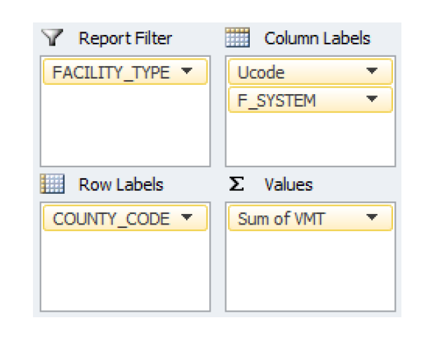
Pivot Table Layout
Notes:
Using this pivot point table layout, and an Excel sheet containing the appropriate segment values, we can develop a summary of total V-M-T for all available functional classifications and counties

Slide 5
Step 1: VMT by County and Function Class
Notes:
The results of this calculation for rural roadways are shown in this Excel sheet.
These results shown are for rural segments and for all counties and available functional classifications.
There is also a summary table generated using this pivot table layout for roadways located in urban areas.
Because these are rural segments, only Functional Classifications 1 to 5 are shown.
Notice that the total V-M-T for County “1” is 709,246.
Note also there are a number of empty cells. This indicates that there we no segments falling into these categories.

Slide 6
Step 2: Select * if IS_Sample=1 or AADT_Combination_vn<>0
Notes:
In addition to full extent data, we can use sample panel data to determine the V-M-T for Single Unit Vehicles (S-U-V-M-T) and Combination Vehicle (C-T-V-M-T) by selecting sample sections from the H-P-M-S data base for the state.

Slide 7
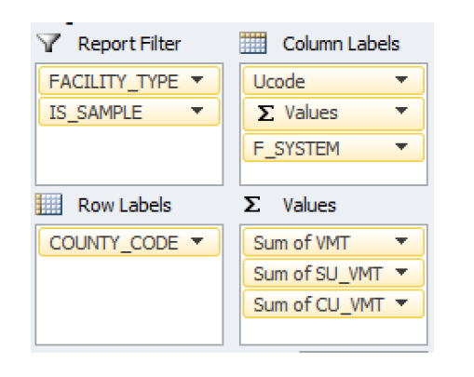
Pivot Table Layout
Notes:
We then use this pivot table layout to summarize the segment data.

Slide 8
Truck VMT for Sample Panel Data
Notes:
This is the resulting table from this filter.
S-U-V-M-T and C-T-V-M-T for sample segments.
Recall that S-U-V-M-T includes both Single Unit Truck and Bus V-M-T.

Slide 9
Step 2 – Continue Truck VMT% for Sample Panel Data
Notes:
We can summarize the results to determine the percentages of Single Unit Vehicles and Combination Trucks by functional classification and county.
Here we see that 6.24% of the VMT for county 1 and Functional Classifications “3” are Single Unit Vehicles.
This is only for two vehicle types. We need to make a total of six.

Slide 10
Step 3. Vehicle Class Data Analysis
It is recommended to use annualized count or adjusted count to a common time period: per day or per 48 hour
It is extremely important to use the same time period for all stations
Use simple average of vehicle % within county is not recommended
Notes:
As mentioned previously, Vehicle Classification count data provide a basis to estimated Vehicle Groups.
However, it is important that a consistent set of count data be used for all stations.
Specifically, It is recommended to use annualized count or adjusted count to a common time period such as per day or per 48 hour
The use average of vehicle percentages within county is not recommended.

Slide 11
Vehicle Class Data Analysis – Annualized and Seasonal Adjusted AADT and Vehicle Count Data
Notes:
Here we have set of Vehicle Classification count data collected for several counties.

Slide 12
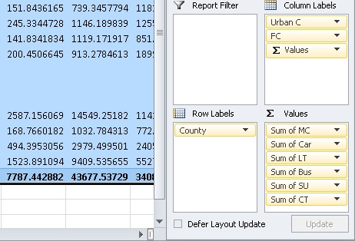
Pivot table layout
Notes:
We can summarize these data by vehicle classification using this pivot table layout.
The result is the annualized total count by vehicle by functional class by county

Slide 13
Total Daily Counts by County and Function Class Pivot Table
Notes:
This table shows the resulting total values for each vehicle class, county and rural functional classification.

Slide 14
Daily Count Vehicle %
Notes:
This table show the percentages of vehicle classes using the sum of the daily values for each county and functional classification.
We need to combine these results with our V-M-T estimates for Combination Trucks and Single Unit Vehicles. Recall that S-U-V includes both Single Unit Trucks and Buses.

Slide 15
Step 4: Combine Class Data and Truck AADT% Data
Adopt MC%, Car%, Light Truck% and Bus% data from class data
Single Unit Truck% = Single Unit Vehicle% – Bus%
Passenger Car% = 1 - MC% - LT% - Bus% - SUV% - CT%
Borrow vehicle % data from similar county if no there are no data available
Notes:
We can use the final step to combine vehicle classification count data with the A-A-D-T V-M-T data calculated earlier to estimate the V-M-T percentages by Vehicle Group.
First, we adopt the percentages calculated from the Vehicle Classification data for
Motorcycles
Passenger Cars
Light Trucks and
Buses
Next, we determine the Single Unit Truck percentage by subtracting the Single Unit Vehicle percentage calculated from the AADT data from the bus percentage calculated from the Vehicle Classification Count data.
We then calculate the passenger car percentage by subtracting the sum of the motorcycle percentage, light truck percentage, single unit truck percentage, and combination truck percentage from one.
Note that if no Vehicle Classification count data are available for a county, then Vehicle Count percentages can be borrowed from another county.

Slide 16
Function Class 1, 2, 3 and 4
Notes:
This slide summarizes how data from the Spatial Intersector Table and the Vehicle Classification Count are combined to estimate VMT Vehicle Group percentages.
First, the column highlighted in purple (Daily VMT) comes directly from the AADT data available from the Spatial Intersector Table for Rural Functional Classification = 1 (Rural Interstates).
Next, the columns highlighted in green (Single U Vehicle and CT) come directly from sample panel data analyzed from the Spatial Intersector Table for Rural Interstates.
Next the values for Motorcycles, Light Trucks, and Buses are transferred directly from the analysis of the Vehicle Classification Count data for Rural Interstates.
We see that the columns highlighted in yellow are derived from the formulas specified.

Slide 17
R5, U5 and U6
Notes:
This table highlights similar calculations for Rural and Urban Major Collectors as well as Urban Minor Collectors.
If you have enough sample panel data use this approach.

Slide 18
Or R5, U5 and U6
Notes:
Alternatively, this table could be used for Rural and Urban Major Collectors as well as Urban Minor Collectors
Daily V-M-T comes from our previous analysis (should be a pink column)
Class data comes from our class data analyze.

Slide 19
R6, R7 and U7 (VMT data are statewide so no weighting)
Notes:
This table shows the results for Rural Minor Collectors as well as Urban and Rural Local streets.

Slide 20
Group VMT of Functional Classes (FC) to FS_Group
Notes:
Once all calculations are performed, the results are aggregated by Functional System Group as shown in this slide.

Slide 21
Step 5: Produce Vehicle Summary Data
Notes:
The final step summarizes this result.

Slide 22
Summary
VMT by county and function class (total VMT)
Truck VMT% for sample panel data (sample panel VMT)
Vehicle class count data analysis (common time period)
Combine AADT truck % data with vehicle class count data for all road function classes
Derive the VMT by vehicle for all function class
Group VMT by function class group and vehicle class group to obtain VMT and VMT%
Notes:
This section has summarized an approach to develop Vehicle Summary Date.
The steps include:
Calculate VMT by county and function class (total VMT)
Derived Truck VMT% for sample panel data (sample panel VMT)
Analyze Vehicle class count data (common time period)
Combine AADT truck % data with vehicle class count data for all road function classes
Derive the VMT by vehicle for all function class
Group VMT by function class group and vehicle class group to obtain VMT and VMT%

Slide 23
Thank You! Office of Highway Policy Information FHWA 1200 New Jersey Avenue, SE, Washington, DC 20590

