Slide 1

The Surface Transportation Environment and Planning Cooperative Research Program
STEP
Presents
“Air Quality and Climate Change”
Webinar
September 28, 2010
12:00 p.m. to 1:30 p.m.

Slide 2
Webinar Moderator
Lisa Colbert, Acting Team Leader
Research and Financial Service Team
FHWA Office of Human Environment

Slide 3
Webinar Housekeeping Tips
Asking Questions
  Designated time at the end of presentation for questions and answers
    Phone
      Please state name and affiliation
    Chat feature
      If using the chat please send all questions to Lisa Colbert

Slide 4
Welcome and Overview
Welcome to the STEP Webinar on Air Quality and Climate Change
Agenda
STEP Overview and Stakeholder Feedback
Air Quality and Climate Change Initiatives
Polling Questions
Question and Answers

Slide 5
What is STEP?
Surface Transportation Environment and Planning Cooperative Research Program
Federally-administered nationally orientated research program
Improve the understanding of the complex relationship between surface transportation, planning and the environment
Identify, address and reassess national research priorities for environment, planning and realty
A variety of procurement mechanisms are used to award STEP funds

Slide 6
Who Gets STEP Money?
State Governments
Metropolitan Planning Organizations
Local Governments
Universities
Federal Agencies
Private Sector

Slide 7
Stakeholder Involvement
Outreach and stakeholder feedback are used to refine and implement national research agenda
Partnerships are formed to leverage funds
  Federal, State and Local agencies
  National Cooperative Highway Research Program
  Future Strategic Highway Research Program
  Pooled funds and foreign jurisdictions

Slide 8
STEP Feedback and
Submitting Lines of Research
Requests Suggested Lines of Research for FY11
Feedback Period Open Until September 30
Review Proposed FY11 Implementation Strategy www.fhwa.dot.gov/hep/step/strategy.htm
Develop and submit feedback on suggested lines of research related to the proposed STEP research priorities at http://knowledge.fhwa.dot/cops/step.nsf/home

Slide 9
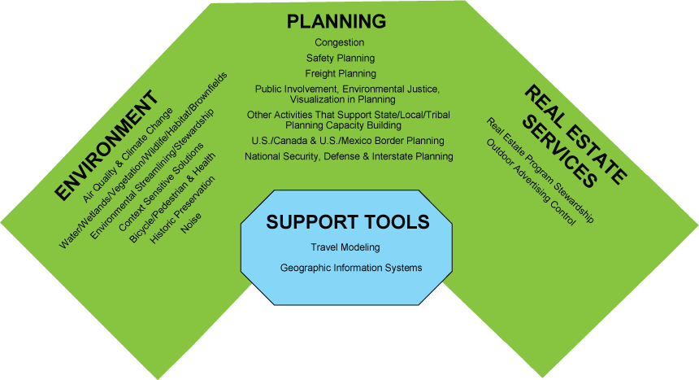
STEP Emphasis Areas

Slide 10
STEP Emphasis Areas for Today
Air Quality
Climate Change

Slide 11
Air Quality and Climate Change
Emphasis Area Overview
Cecilia Ho, Team Leader
Air Quality and Transportation Conformity Team
FHWA Office of Natural Environment

Slide 12
Transportation and Air Quality
Transportation and Air Quality Emissions Analysis
  Regional and project level hot-spot analysis
Model implementation and tools development
  MOVES implementation training and technical assistance
  Air quality dispersion models
Mobile Source Air Toxics near roadway Study
  Near roadway air quality data collection
Air Quality and health impacts

Slide 13
Climate Change and Transportation
Adaptation Research
  Gulf Coast Study
  Vulnerability assessment pilot
Mitigation Research
- Mitigation guidebook/carbon calculator tool
- Operational strategies

Slide 14
Sustainable Highways
Sustainable Highways Criteria and Tools Project
- Initiated to assist State and local transportation agencies understand and use sustainability criteria and tools in the planning, design, and construction of roads and highways
- Development of criteria and tool

Slide 15
Research Outreach & Communications
Provide technical assistance
  Webinar
  Symposium
  Training
Outreach communications, publications

Slide 16
STEP Funding for Air Quality and Climate Change Research
Since 2006, STEP provided a total of $7,606,900 and funded 26 Air Quality and Climate Change Research projects.
Research ideas received from many different stakeholders:
  Federal: EPA, USGS, USDA, NOAA, DOE
  State/Local: State DOTs, State Environmental agencies; State Air agencies; MPOs; Cities
  Others: stakeholder groups (AASHTO, AMPO etc); universities, research entities

Slide 17

MOVES Implementation
Cecilia Ho
FHWA Office of Natural Environment
and
Kanok Boriboonsomsin, Ph.D., P.E.
Center for Environmental Research and Technology, University of California

Slide 18
MOVES Implementation
Funded 3 projects through a Broad Agency Announcement
A total of 20 proposals received
More than half are MOVES related

Slide 19
Advances in Project Level Analysis (Pechan)
Demonstrate a methodology to use micro-simulation modeling output to create VSP profiles as inputs to MOVES model under two scenarios:
  A series of congested conditions for different facility types (e.g., V/C ratio’s 0.7 to 1.2)
  Conditions typical of intermodal and port facilities.
Work is expected to be completed in November 2010.

Slide 20
Improving Vehicle Fleet, Activity, and Emissions Data for On-Road Mobile Sources Emissions Inventories
(UC Riverside)
The study will cover the following data issues related to MOVES:
  Review of the currents state of practice and identify limits of truck data;
  Evaluate use of vehicle identification number (VIN) decoders in conjunction with license plate surveys and vehicle registration databases to derive vehicle fleet data;
  Evaluate the use of electronic control modules data to derive truck activity data;
  Develop data fusion methods to combine truck activity data from multiple sources;
  Measure emissions from heavy-duty trucks with various loaded vehicle weights.
Work is expected to be completed in May 2011.

Slide 21
Modifying Link-Level Emissions Modeling Procedures for Applications within the MOVES Framework (Eastern Research Group (ERG))
Recreated the emissions inventory used for the Houston SIP based on data provided by TTI from the travel demand model and MOVES
Recreated the emissions inventory used for the Houston SIP based on HPMS activity data and MOVES
Used the Kansas City data to produce real world drive cycles and recreated both the travel demand model and HPMS based inventories for Houston with the new drive cycles
Compared the results of new inventories produced against the original inventories developed using MOBILE.
Documented lessons learned from transitioning from MOBILE6 to MOVES for regional analyses.
Work is expected to be completed in September, 2010

Slide 22
MOVES and Its Implementation
MOVES is now the EPA’s official regulatory model. MPOs are adopting this new model in place of MOBILE6.2.
Challenges:
  New modeling approach, i.e. VSP-speed bins
  New software architecture & user interfaces
  New input data format & requirements
Support & assistance:
  MOVES training (EPA & FHWA)
  Converter tools (EPA)
Notes:
New input data format & requirements → e.g. extended idling
22

Slide 23
Ongoing Research at UC Riverside
Tools for developing local input data
  New data sources that are potentially useful
  New methodologies to utilize existing data sources effectively
Validation of selected MOVES emission factors
  Those based on “hole filling” methods
Modeling issues that affect emission inventories
  Effect of out-of-domain vehicles
  Effect of heavy-duty trucks’ container weight
Notes:
23

Slide 24
Vehicle Fleet Distribution Data
Needs: Current practice relies heavily on state vehicle registration databases.
  Not accounting for out-of-domain vehicles
  Not able to capture temporal variation well
Solutions: Vehicle license plate survey
Notes:
In project-level analysis (e.g. at multi-modal terminals), vehicle fleet is unique and needs to be characterized properly.
24

Slide 25
Heavy-Duty Truck Activity Data
Needs: Heavy-duty truck activity data is more limited compared to that of light-duty vehicles.
  HPMS → no speed information
  GPS data loggers → only a few studies
  Freight flow models → not well validated yet
Solutions:
  Other existing data sources (e.g. weigh-in-motion (WIM) stations)
  New data sources (e.g. Electronic Control Units (ECU), fleet monitoring systems)
Notes:
Issues: And what about off-network activity & extended idling?
25

Slide 26
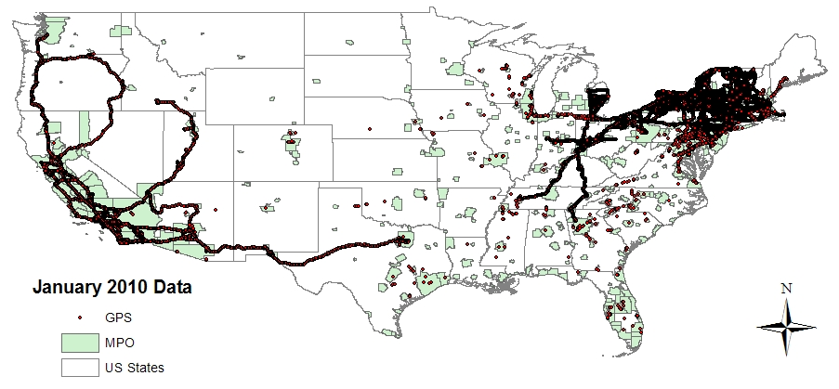
Nationwide Truck Telemetry Data
A collective fleet of more than 2000 class 8 trucks
Notes:
26

Slide 27
Heavy-Duty Truck Emission Factors
Needs: Some emission factors in MOVES are based on “hole filling” methods.
  Future vehicle model years
  Alternative vehicle fuels and technologies
  Vehicles with no existing emission test data available
Solutions: Limited emission testing program
  The new state-of-the-art heavy-duty chassis dyno
  2 trucks → 2007-2009 standard & 2010 standard
  Effect of container weight (i.e. empty, half-full, full)
Notes:
27

Slide 28
Expected Products of Research
Summary of current state of the practice
Guidance document on conducting vehicle license plate survey to supplement on-road mobile source emissions modeling and analysis
A set of tools & methodologies:
  Accounting for out-of-domain vehicles in vehicle fleet distribution inputs
  Developing truck activity inputs from WIM data, ECU data, truck telemetry data, etc.
Notes:
28

Slide 29

National Near Road MSAT Study
Victoria Martinez
Air Quality and Transportation Conformity Team
FHWA Office of Natural Environment
Sue Kimbrough
Environmental Protection Agency (EPA)

Slide 30
Program Background
NDOT Agreed to do monitor and filtration study at near-by schools
FHWA Agreed to monitor concentrations of NAAQS and MSAT in the near road environment

Slide 31
Monitoring Protocol
Pollutants (CO, NO, Black Carbon, PM_{2.5}, Acetaldehyde, Acrolein, Benzene, 1,3-Butadiene, Formaldehyde)
Methodologies & Measurements
Distances (10 m, 100 m, 300 m and background/upwind)
Schedule: Both Continuous and Canister Samples - Las Vegas = nine 1 hour samples every 12 days. Detroit = peak commute times. Samples will be collected on a quarterly basis with 5 samples collected during the quarter and 2 samples being collected on sample days.

Slide 32
EPA Interagency Agreement &
Pooled Fund
EPA & FHWA Interagency Agreement
  Monitoring in Las Vegas Complete. Detroit monitoring underway. Together we have over $6 m invested or planned over the next 12 months
Pooled Fund
  6 states contributing funds (AZ, CA, MI, NV, NY and WI)

Slide 33
More Information
Website:
www.fhwa.dot.gov/environment/airtoxicmsat/index.htm

Slide 34

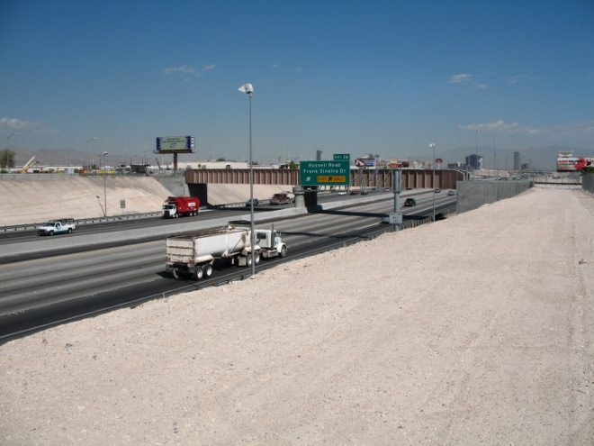
EPA/FHWA Near Road
Collaboration Project

Slide 35
EPA/FHWA Near Road
Team Members
Project Team:
Strategic Project/Science Management
  Dan Costa
  Carlos Nunez
  Doug Mckinney
  Richard Baldauf
  David Kryak
  Alan Vette
NRMRL – Project Management
  Sue Kimbrough
  Richard Shores
EPA/FHWA Technical Working Group (including above)
  Victoria Martinez (FHWA) -- IAG Project Officer)
  Dan Vallero (EPA IAG Project Officer)
  Bill Mitchell
  Donald Whitaker
  Richard Baldauf
  Gayle Hagler
  James Hirtz
  Jason Herrington
  Paul Solomon
  Other EPA technical staff as needed……..

Slide 36
Why are we involved in this project?
--- Key Science Questions ---
What is the spatial and temporal variability of traffic-related pollutants near roadways?
How do traffic (volumes, speeds, fleet mix, etc.) and environmental (meteorology, topography, etc.) conditions affect vehicle emissions and near road air quality?
What marker(s)/metric(s) can be used to identify exposures to traffic-related emissions?
What tools are available, or can be produced, to identify the relationship from traffic emissions to population exposures to adverse health effects for use in regulatory decision making and transportation planning?
What are the concentration gradients at a fine(er) scale resolutions?
How does urban topography and barriers impact these gradients?
Are there mitigation techniques that can reduce exposures to susceptible populations?

Slide 37
What do we hope to get out of this effort?
Outcomes | Stakeholders
Provide FHWA with data necessary to comply with Settlement Agreement. | FHWA
Understanding the relationship between traffic, meteorology and near road air quality | FHWA, NRMRL/NERL
Identify metrics used to relate traffic emission impacts on air quality and adverse health effects for inclusion in risk and health assessments | FHWA, OTAQ, OAQPS, NHEERL, HEI, states
Provide improved air quality dispersion algorithms for near-road assessments and upgrade EPA’s regulatory dispersion model AERMOD | OTAQ, OAQPS, NOAA, FHWA, DOE, states

Slide 38
Site Selection Criteria

Slide 39
Instrument Deployment - Overview

Slide 40
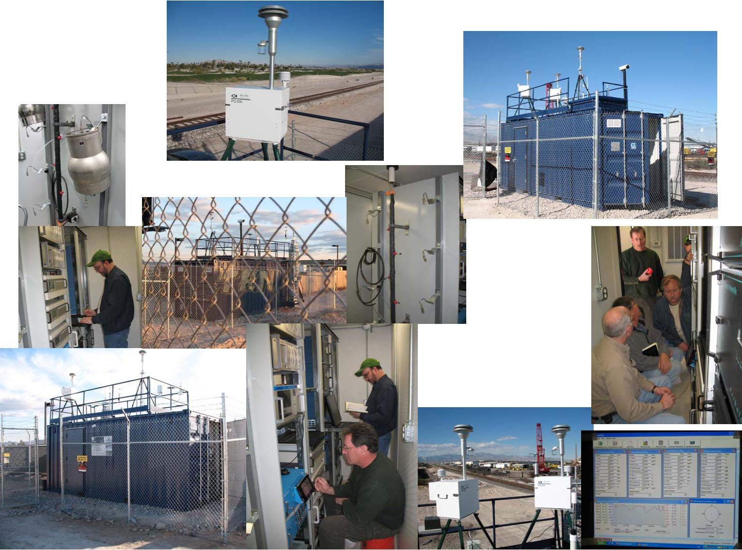

Slide 41
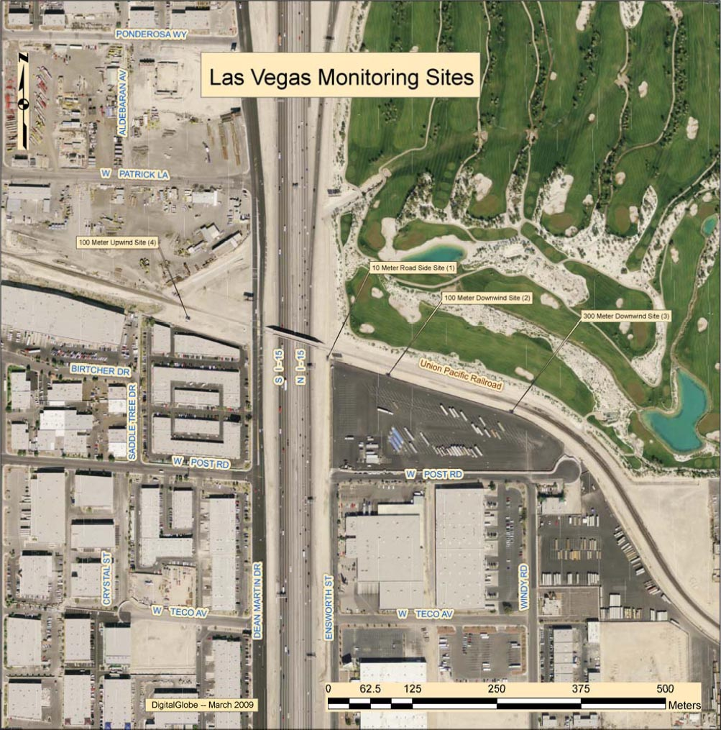
I-15 Monitoring Site:

Slide 42
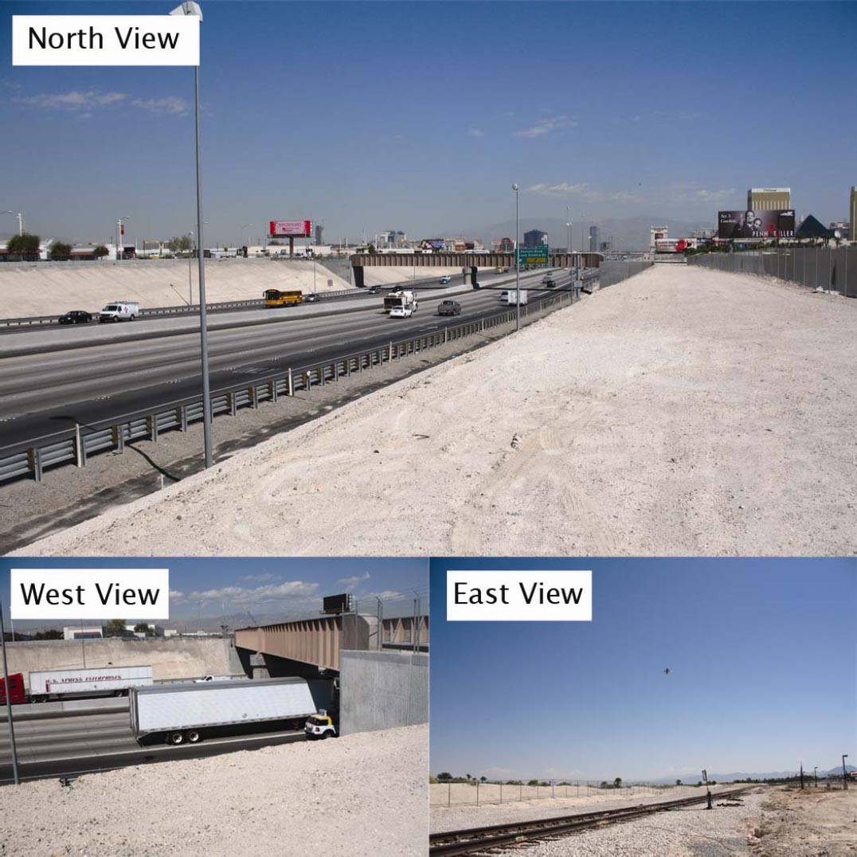
I-15 Site

Slide 43
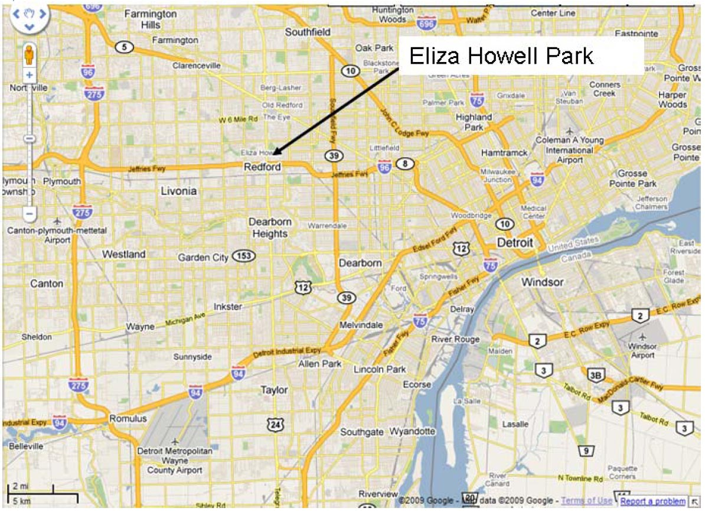
Overview Map of Detroit

Slide 44
Where do we go from here?
Shelters In Place
Quality Assurance Project Plan
Detroit Data Collection – Imminent

Slide 45
Vulnerability/Risk Assessment Conceptual Model and Pilots
Becky Lupes
Sustainable Transport and Climate Change Team
FHWA Office of Natural Environment

Slide 46
Peer Exchanges and Survey
Peer Exchanges conducted in 2008 and 2009
Preceded by survey
Survey results indicated that while some States were actively addressing adaptation, many States were just beginning to consider adaptation, or were not planning to in the near future

Slide 47
Vulnerability/Risk Assessment
Conceptual Model
Goal: help transportation decision makers identify assets:
  most exposed to the threats from climate change; and/or
  could result in the most serious consequences as a result of those threats
Draft Conceptual Model Completed
Pilots - Use by State DOTs and MPOs
Finalize
Notes:
The goal is to help transportation decision makers (particularly transportation planners, asset managers, and system operators) identify which assets (a) are most exposed to the threats from climate change and/or (b) could result in the most serious consequences as a result of those threats
FHWA developed a conceptual model for conducting vulnerability assessments.
It is a joint effort between the Office of Planning, Environment & Realty and the Office of Infrastructure.
The conceptual model consists of three primary components:
Develop inventory of infrastructure assets;
Gather climate data; and
Assess risk and vulnerability of assets and the transportation system as a whole to projected climate change.
FHWA is helping fund pilots of the framework.
5 pilot locations were chosen, they will be implementing the framework over the next year.

Slide 48
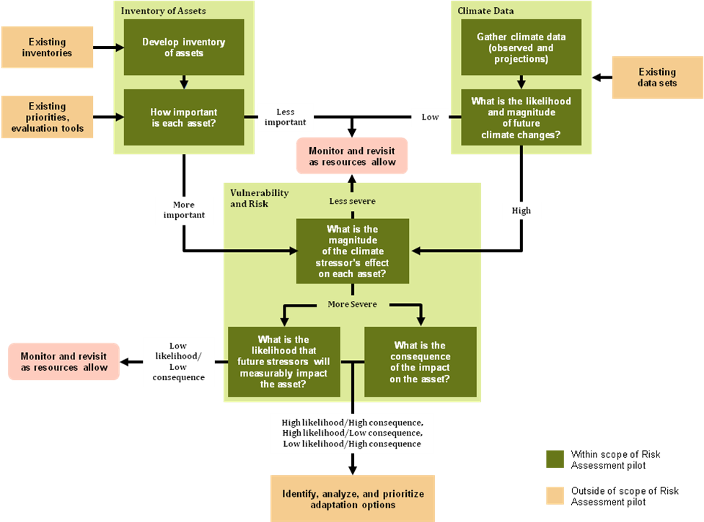
Vulnerability/Risk Assessment
Conceptual Model
  Develop inventory of infrastructure assets
  Gather climate data
  Assess risk and vulnerability of assets to projected climate change
  Analyze, prioritize adaptation options
  Monitor and revisit
www.fhwa.dot.gov/hep/climate/conceptual_model62410.htm
Notes:
1. Develop asset inventory and prioritize (importance)
2. Gather climate data: including certainty, likelihood, and magnitude of projected changes
3. Assess risk and vulnerability of the assets and the system as a whole to climate changes
4. Identify, Analyze, and Prioritize Adaptation Options
5. Monitor and Revisit

Slide 49
Pilots Selected
MTC (San Francisco)
Virginia DOT
Washington State DOT
New Jersey DOT
Oahu MPO

Slide 50
Metropolitan Transportation Commission
Focus on San Francisco Bay
Complements a NOAA funded sub-regional project
Partners:
  MTC,
  CalTrans District 4,
  San Francisco Bay Conservation and Development Commission,
  NOAA,
  Association of Bay Area Governments,
  Bay Area Air Quality Management District
Notes:
$300,000 to MTC

Slide 51
Virginia DOT
Focus on Hampton Roads
Asset Management, Security Perspective
Partners:
  Virginia Transportation Research Council (VDOT)
  Hampton Roads Planning District Commission,
  UVA Center for Transportation Studies,
  UVA Center for Risk Management of Engineering Systems,
  Hampton Roads Transportation Planning Organization
Notes:
$250,000 to VDOT

Slide 52
New Jersey DOT
Study Areas:
  New Jersey Coastal
  Central New Jersey
Partners:
  New Jersey DOT
  North Jersey Transportation Planning Authority,
  South Jersey Transportation Planning Organization,
  Delaware Valley Regional Planning Commission,
  New Jersey Department of Environmental Protection
Notes:
$150,000 to NJDOT

Slide 53
Washington State DOT
Statewide geographic scope
Studying WSDOT owned and managed facilities potentially at risk to a range of impacts:
  Sea-level rise inundation areas
  Rivers and stream channel migration, melt effects
  Extreme temperature effects
  Drought threats to wetland creation, mitigation sites, roadside vegetation, soil moisture/flux, invasive species, worker health, wildfire
  Precipitation changes- threats to slope stabilization, stormwater management, erosion control, landslides, “road survivability”
  Wildfire – safety, emergency response
Notes:
$189,500 to WSDOT

Slide 54
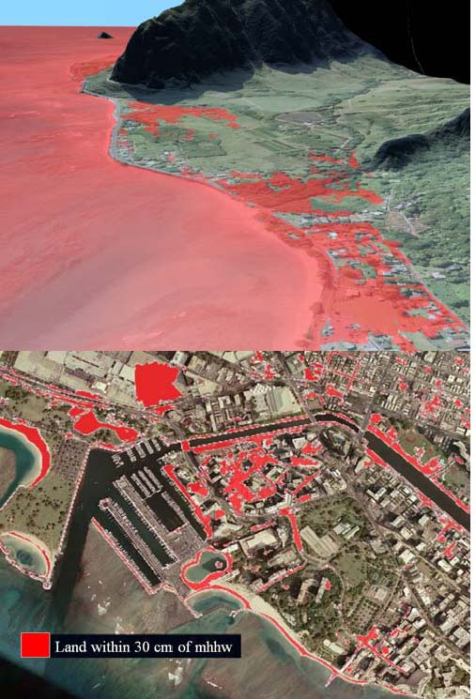
Oahu MPO
Scope: Island of Oahu, HI
Consultant will perform risk assessment of identified transportation assets
Public input meetings
Partners:
  OahuMPO
  HI DOT
  HI Dept. of Business, Economic Development, and Tourism
  HI State Civil Defense
  City and County of Honolulu
  U. of HI Center for Island Climate Adaptation and Policy
  The Pacific Disaster Center
  People’s Advocacy for Trails Hawaii
Notes:
$82,000 to Oahu MPO

Slide 55
Next Steps
Conduct pilots over the next year
Work to improve model, given info from pilot testing

Slide 56
Gulf Coast Study, Phase 2
Rob Kafalenos
Sustainable Transport and Climate Change Team
FHWA Office of Natural Environment

Slide 57
Gulf Coast Study: Goals
Comprehensive assessment of how climate change will affect transportation in the Gulf Coast area
Phase I
  Overview of climate change impacts on transportation infrastructure, and general options for addressing these challenges
  Mobile to Houston, completed in 2008 (http://www.climatescience.gov/Library/sap/sap4-7/default.php)
Phase II
  Seeks to develop:
    More definitive information about multimodal impacts at the local level in a single MPO
    Precise tools and guides on how to adapt to climate impacts; determine vulnerability for key links for each mode; assess risk
  Test in Mobile area, with intent to make process transferable to other MPOs
  Timeframe: 2010-2012
Notes:
57
http://www.climatescience.gov/Library/sap/sap4-7/default.php

Slide 58
Gulf Coast Study, Phase 2:
Overview
Focus on the Mobile, AL Metropolitan area
  Identify "critical assets" in Mobile region
  Evaluate projected climate change effects & stressors
  Determine vulnerability of key links and assets; conduct vulnerability assessment & detailed engineering analyses for selected assets
  Develop risk assessment & risk management tools
  Work with stakeholders in Mobile throughout project; take lessons learned & identify tools to make process, lessons learned, & methods accessible to other MPOs
  Include major findings in a final report
Notes:
58
What are the key transportation assets in Mobile, AL?
How can we screen these assets to establish a list of “critical” transportation assets for further analysis?
What climate change effects are projected for Mobile?
Given projected changes in climate and observed impacts for similar weather-related events which assets are most vulnerable?
What are the costs of inaction?
What strategies exist to reduce vulnerability among the most vulnerable assets and how much will they cost?

Slide 59
Task 1:
Identify Critical Transportation Systems
Determine Subset of Entire Transportation Network on Which to Perform Vulnerability Assessment and Identify Adaptive Measures
Need a process applicable to all modes in study area: Highways, Rail, Airports, Ports, Pipelines, and Transit
Notes:
59
ICF and PB are developing a preliminary list of critical assets:
Review MPO Model & other available modal or special purpose models
Review plans & programs, interview staff
Collect & review asset data & asset management tools in use
(Other measures of “criticality”: importance to local economy, providing connectivity for community interactions)
Operational Considerations: functional class, activity, key freight route, hazardous materials
Emergency Preparedness: Evacuation, disaster relief/recovery
Socio-economic assessments: Redundancy, serves key regional centers, provides key connections
One of the first steps in doing adaptation planning is identifying those components of the transportation system are most critical, where critical could be defined in many different ways.
Three characteristics of critical infrastructure have been identified:
Connections: Network connectivity is critical to Mobile’s economy as well as to the national and state economic activities dependent on Mobile’s transportation system. Links that provide this connectivity are considered “critical” infrastructure.
Purpose: Some components of a transportation system are considered themselves as serving important purposes, such as distribution centers or multimodal centers. Because of the important purpose they play in the transportation system itself, they are considered critical infrastructure.
Function: Many transportation system components are important not for themselves, but simply for the fact that they connect to important economic or community centers. For example, roads or rail lines leading to major distribution centers or chemical refineries would be considered critical because of the purpose they serve in the region.

Slide 60
Task 1:
Identify Critical Transportation Systems
Recent Activity:
Conducted in-person interviews with Mobile port and rail representatives to obtain data on facilities and operations
Conducted criticality assessment on all major transportation modes
Assembling a memorandum outlining critical transportation assets
Conducted a careful review of relevant transportation models
Developing GIS layers of critical transportation assets, for later study tasks
Notes:
some early lessons……
Data collection for all modes is a serious challenge
Proprietary data is often not willingly provided
Many databases do not have common referencing systems
The data that is available represents historical or today’s conditions….not necessarily what will exist in some future year when adaptation issues might be of greater concern
If you are not careful in how your criteria are applied, everything becomes “critiical.”
The community has a role to play in helping identify critical infrastructure

Slide 61

Task 2: Collect Climate Data and Assess Transportation Exposure & Sensitivity
Three main areas of work:
Collect historical and projected weather and climate data
  Assistance from USGS
Conduct storm surge and wave modeling, SLR analysis, and estimate potential inundation of transportation assets (i.e., exposure
Assess the extent to which particular transportation systems are affected by climate variations (i.e., sensitivity)
Approach will be different than Phase I, e.g.
  Focused explicitly on Mobile
  Use of more advanced models (e.g., downscaling)
  Estimation of near-term, mid-term, and end-of-century futures
Notes:
61
Interagency agreement to get subsidence data, temp/precip projections.
1. Observations and model projections
temperature • precipitation
winds • runoff
waves • sea level rise
storm surge • storm events
Will examine changes in both means and extremes
3. Assess the extent to which particular transportation systems are affected by today’s climate variations (i.e., sensitivity)
Collecting data that illustrates damage associated with past weather events by transportation mode
Using information obtained from:
Interviews with local experts
Scientific literature on the extent to which specific, exposed
transportation systems have been affected by past climate variations
Past estimates of storm damage
Engineering specifications of transportation infrastructure
Results will be used to screen out relatively insensitive transportation components, and to inform the subsequent risk analyses in Task 3.
Need say something about the purpose of this, like developing impact relationships—we’re doing this to understand how the relationship between past weather events and resulting damage. These relationships—impact relationships—can then be applied to estimate the impacts of future changes in climate. [Ties in to “Conduct engineering analysis and assessment” under task 3, next slide]
Results of the sensitivity analysis being presented in a large matrix with climate variables (columns) and transportation modes (rows)

Slide 62
Tasks 3 & 4:
Vulnerability & Risk Management
Task 3: Determine Vulnerability for Key Links & Assets in Each Mode
  Apply Task 2 results to critical structures identified in Task 1 to determine link- and asset-specific vulnerability
  Assess role of each asset in system vulnerability
  Multiply criticality & vulnerability scores to create a prioritized list of structures
  Conduct engineering analysis and assessment
Task 4: Develop Risk Management Tools
  Could be GIS maps of infrastructure overlaid with vulnerable infrastructure; Excel-based or web-based decision-support tool; or a guidance document detailing best practices for MPOs to assess climate-related risks & identify transportation options
  Consistent with tools & approaches in use within region; developed in consultation with MPO, region, and state
Notes:
62

Slide 63
Task 5: Working with Mobile
Engage Mobile MPO, local and state partners, other key groups & the public throughout the project to ensure:
  The most important transportation assets & links are identified
  Analysis tools are developed in a way that will be most useful to transportation agencies and operators, and decision-makers
  The importance of planning for adaptation is understood & incorporated into MPO and partner agencies’ approach
  Public outreach incorporated at appropriate times
Notes:
63

Slide 64
Upcoming Air Quality, Climate Change & Sustainability Activities
Diane Turchetta
Sustainable Transport and Climate Change Team
FHWA Office of Natural Environment

Slide 65
Air Quality Research Activities
Support Regional and Project level (hot-spot analysis)
  Research to support CO and PM hot-spot categorical findings
Emissions and air quality models implementation technical assistance, training and research
  MOVES implementation support (training; technical assistance)
  Air Quality models (CAL3QHCR and AERMOD)
Near Roadway air quality data analysis
Air Quality Outreach and Communications Strategies

Slide 66
Climate Change: Mitigation Activities
  Effectiveness of Transportation Strategies in Reducing Greenhouse Gas Emissions
    Mitigation Guidebook/Carbon Calculator
    Research on Operational Strategies
  Workshops to help Integrate Climate Change Considerations into the Scenario Planning Process (mitigation and adaptation)
    FDOT
    WSDOT
    ARC – Atlanta, GA
    CCMPO – Burlington, VT
    LCOG – Lane County, Eugene, OR
    Cape Cod, MA
  Capacity Building
    Peer Exchanges (3 mitigation and 3 adaptation)

Slide 67
Climate Change: Adaptation Activities
  FHWA Adaptation Working Group
    Developing a strategy to address adaptation to climate change effects
  Vulnerability/Risk Assessment
    Development of a conceptual model on conducting assessments of transportation infrastructure vulnerable to the effects of climate change
      Implementation Pilots for Framework
  Gulf Coast Study – Phase 2

Slide 68
Sustainability: Activities
  FHWA Sustainable Highways Initiative
    Evaluate and establish criteria of a sustainable highway
    Develop a self-evaluation tool to assist in applying criteria
    Establish an evaluation method to demonstrate progress & measure benefits of a sustainable project
  FHWA Sustainability Working Group
    Lead, coordinate, promote, and communicate FHWA sustainability activities

Slide 69
Air Quality and Climate Change Resources
FHWA Climate Change Website
    www.fhwa.dot.gov/hep/climate/index.htm
US DOT Transportation and Climate Change Clearinghouse Website
    www.climate.dot.gov/index.html
    FHWA Air Quality Website
    www.fhwa.dot.gov/environment/aqupdate/index.html
    STEP Website
    www.fhwa.dot.gov/hep/step

Slide 70
Questions and Answer Session
The discussion is open to questions
    Via phone
    Via chat feature
Stakeholders share experiences and answer questions about submitting lines of research to STEP

Slide 71
  For Additional Information
    If you have general questions about STEP or this webinar, contact Lisa.Colbert@dot.gov
    STEP emphasis contacts:
    www.fhwa.dot.gov/hep/step/contacts.htm
    Air Quality and Climate Change Information
    Cecilia.Ho@dot.gov
    Diane.Turchetta@dot.gov

