Slide 1
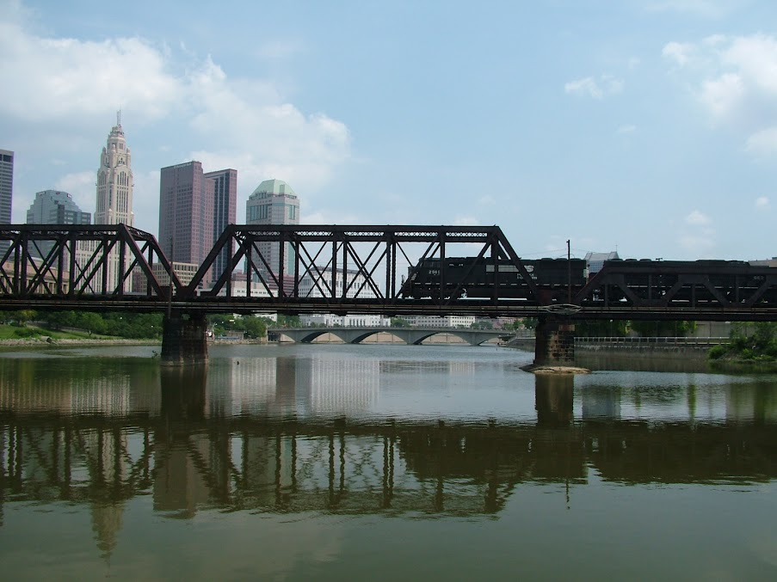
THE OHIO RAIL DEVELOPMENT COMMISSION + THE CSX NATIONAL GATEWAY
FHWA Talking Freight Webinar April 17, 2013

Slide 2
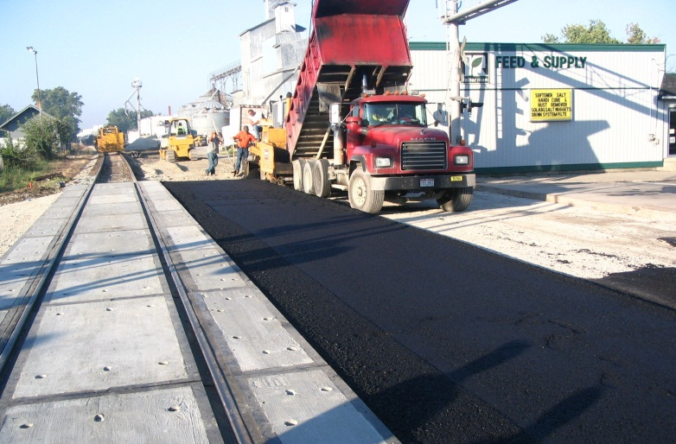
ORDC
WHO WE ARE
Commission
15 Commissioners
18 staff
Created
in 1994 under Ohio Revised Code Chapter 4981
Mission
to plan, promote, and implement the improved movement of goods and people faster and safer on a rail transportation network connecting Ohio to the nation and the world

Slide 3
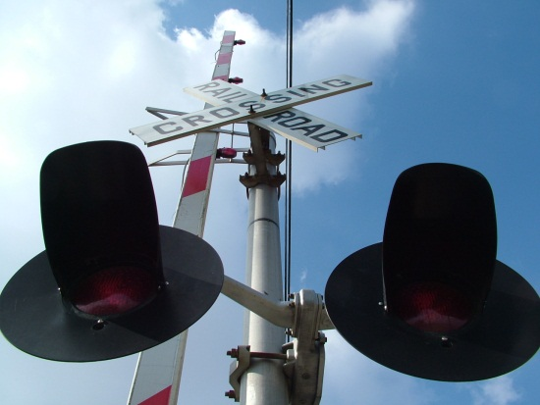
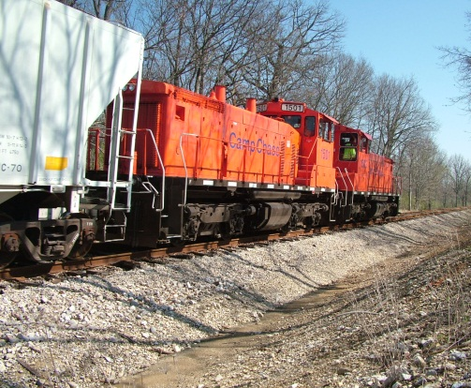
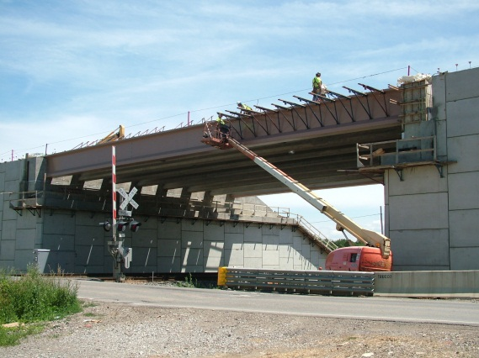
ORDC
WHAT WE DO
Grade Crossing Safety
Direct Freight Rail Project Assistance
Special Freight Projects: National Gateway

Slide 4
SPECIAL PROJECTS
CSX NATIONAL GATEWAY
The National Gateway is an $842 million public-private partnership consisting of multiple rail infrastructure and intermodal terminal capacity projects. When complete, the National Gateway will create a highly efficient freight transportation link between the Mid-Atlantic ports and the Midwest, improving the flow of goods between the eastern and western rail networks.
The National Gateway Initiative:
Will help yield nearly $10 billion in net public benefits
More than $22 in public benefits for every $1 spent

Slide 5
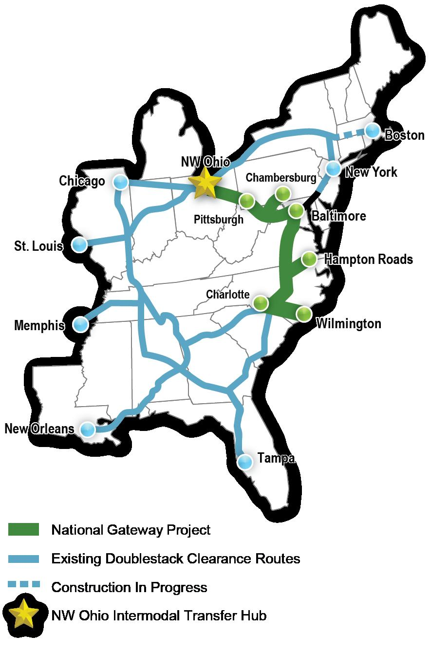
61 Clearance Locations
Ohio: 18
Pennsylvania: 17
Maryland: 10
West Virginia: 5
Virginia: 5
District of Columbia: 6
Image source: www.mdot.maryland.gov
Notes:
Describe the three phases of the project

Slide 6
OVERALL BENEFITS
CSX NATIONAL GATEWAY
Over the next 30 years, benefits associated with the National Gateway include:
Public roadway congestion cost savings of nearly $400 million
Public roadway pavement cost savings of over $670 million
Nearly $3.4 billion in shipper cost savings
More than $150 million in logistics savings
Additional capacity on major highway corridors, including I-95, I-76, I-66, I-64, I-270, I-70 and I-81
Public roadway accident cost savings of more than $900 million
Nearly two billion gallon reduction in fuel use
Improved connectivity between existing transportation modes

Slide 7
WHY ORDC GOT INVOLVED
CSX NATIONAL GATEWAY
$175 million Northwest Ohio Terminal Facility (North Baltimore)
Approximately 300 jobs created
Improved intermodal service for Ohio businesses
CSX Buckeye Yard expansion
Marion Intermodal Center expansion
The National Gateway will:
Deliver nearly $1.7 billion in public benefits to Ohio;
Create more than 20,000 jobs;
Save more than $350 million in shipping and logistics costs;
Reduce the state’s highway congestion, saving more than $70 million in highway maintenance costs; and
Reduce CO₂ emissions by nearly 2 million tons.

Slide 8
PHASE I FUNDING
CSX NATIONAL GATEWAY
Funding Source | Funding Administrator | Amount Administered
Tiger I Grant | ORDC | $98.0 million
Ohio ARRA Allocations and Congressional Allocation | ORDC | $20.5 million
Ohio Logistics & Distribution Stimulus | Ohio Department of Development | $10.0 million
PA Transportation Assistance Program | Commonwealth of Pennsylvania | $35.0 million
Private Investment | CSX | $25.1 million
Phase I TOTAL Costs |  | $188.6 million

Slide 9
TIMELINE
CSX NATIONAL GATEWAY
May 1, 2008 – CSX announces the National Gateway Initiative
February 17, 2010 – TIGER Award Announced
December 22, 2010 – USDOT & ORDC execute TIGER agreement
First Quarter, 2011 – Phase I construction begins
May 18, 2011 – CSX commits funding to complete all National Gateway clearance projects
July 31, 2013 – Anticipated completion date for Phase I projects
2015 – Anticipated completion date for all NG clearance projects
Notes:
Applied for TIGER in September 2009. FONSI November 2010.

Slide 10
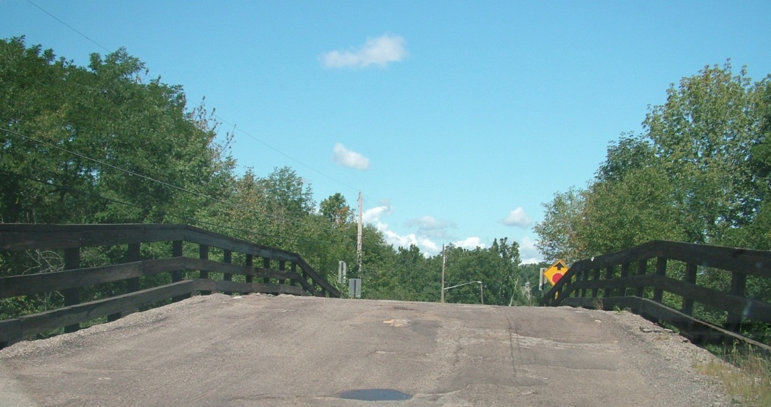
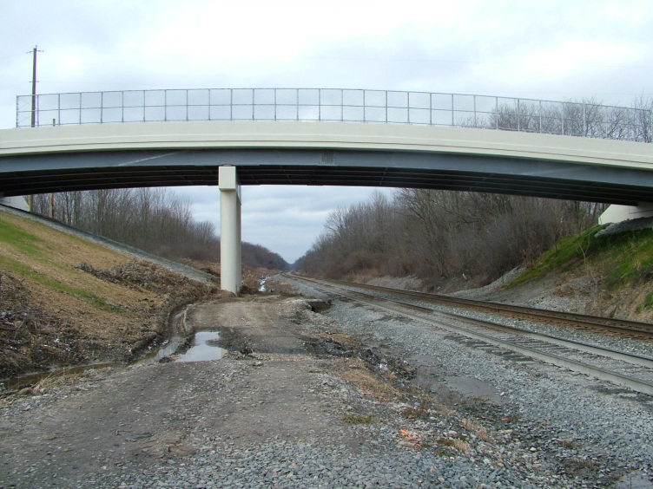
OPPORTUNITIES
CSX NATIONAL GATEWAY
Multi-state coalition supports National Gateway Initiative: OH, PA, MD, VA, WV, NC, District of Columbia
Multi-state Memorandum of Agreement regarding Phase I
Private funding of project oversight costs for TIGER Award
Maintain coalition communication through e-mails, phone updates
Leveraging private investment for public benefit
Rock Springs, OH - BEFORE
Rock Springs, OH - AFTER

Slide 11
CHALLENGES
CSX NATIONAL GATEWAY
Environmental process: Modal agencies have individual procedures approved by CEQ
Significant geographic and financial scope of the project
Only EFLHD had complete jurisdiction for the multi-state corridor
Private funding of project oversight by EFLHD: CSX couldn’t pay EFLHD directly
CSX grant to ORDC
ORDC grant to EFLHD
PPP contracting challenge
ORDC – Only entity with clear legal ability to sign for a multi-state award

Slide 12
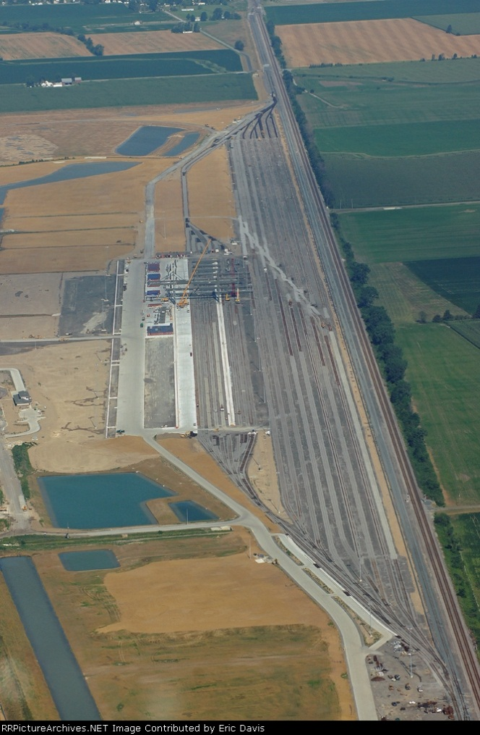
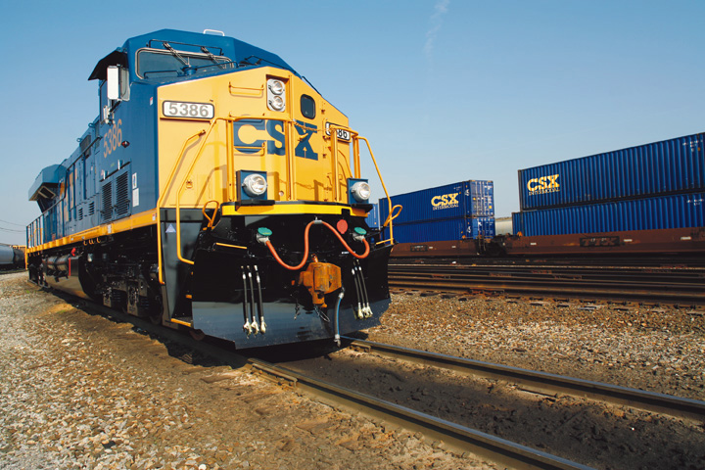
THE OHIO RAIL DEVELOPMENT COMMISSION
Questions?
Megan McClory
megan.mcclory@dot.state.oh.us
614-644-0289
IMPROVING RAIL TODAY FOR TOMORROW’S ECONOMY

