Slide 1

DOE’s Vehicle Technologies Program
Clean Cities deployment overview
FHWA “Talking Freight”
February 20, 2013
Mark S. Smith
National Clean Cities Program

Slide 2
US DOE Clean Cities Primary Goal and Results
PRIMARY GOAL:
Mass market adoption of alternative fuel and advanced technology vehicles and smarter driving habits
  Reduced Petroleum Use in Transportation
  Reduced Greenhouse Gas Emissions
PRIMARY GOAL RESULTS
  Reduced Dependence on Foreign Oil
  Improved US Energy, Economic, and Environmental Security

Slide 3
Clean Cities Parallel Approach
Implement national policies and initiatives by facilitating change on a National and Local basis
Local
Develop a Franchise model (designate CC coalitions) so that approach and message are consistent everywhere, but with attention to local market conditions and priorities (provide strategic direction and comprehensive training to franchisees)
National
Provide a national unbiased source of info
Provide tools, experts to address barriers and solve problems
Develop Corporate Partnerships with Industry and National Fleets
Increase awareness and publicize success through mass media and outreach
Provide financial assistance to jump start markets and incentivize private investment

Slide 4
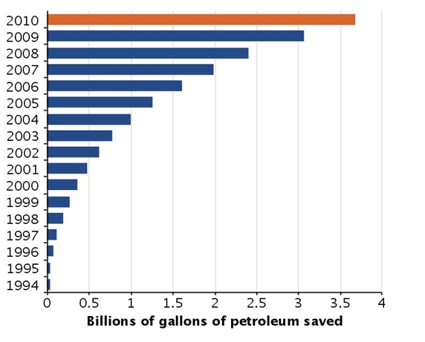

Clean Cities Efforts Get Results !
Over 3.5 Billion Gallons of Petroleum Reduction since 1993
Over 800,000 AFVs on the road
12,000 alternative fueling and charging stations (CC influenced >70%)
Long term goal of 2.5B gal/year by 2020
Notes:
4

Slide 5
Clean Cities
Portfolio of Technologies
Alternative Fuels
Electric Vehicles
Biodiesel
Ethanol
Hydrogen
Propane
Natural Gas
Fuel Economy
More Fuel efficient vehicles, adopting smarter driving and vehicle purchasing habits
Hybrids
Light- and heavy-duty
Electric hybrids
Plug-In hybrids
Hydraulic hybrids
Replace
Reduce
Idle Reduction
Heavy-Duty Trucks
School & Transit Buses
Light-Duty Vehicles
Eliminate

Slide 6
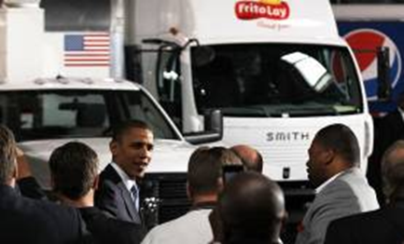
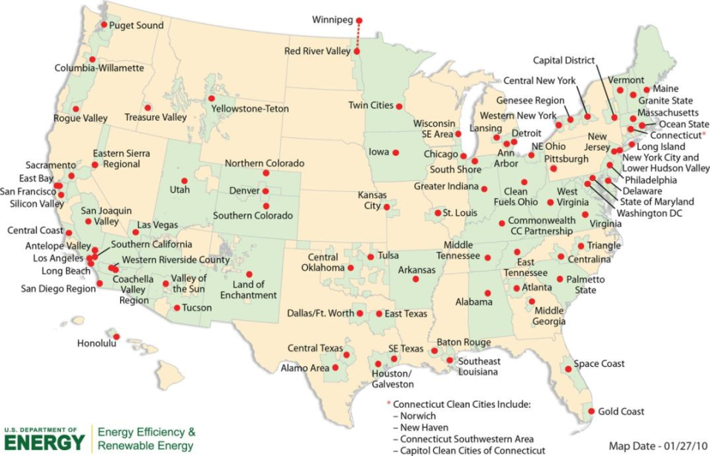

Local Coalition Support / Partnership Development
Coordination with key community and business leaders,
Identification of potential fleet and funding partners
Facilitating Infrastructure development projects,
Collecting data and tracking progress
Coalition technical training and strategy implementation,
~100 coalitions serving 78% of the US population

Slide 7
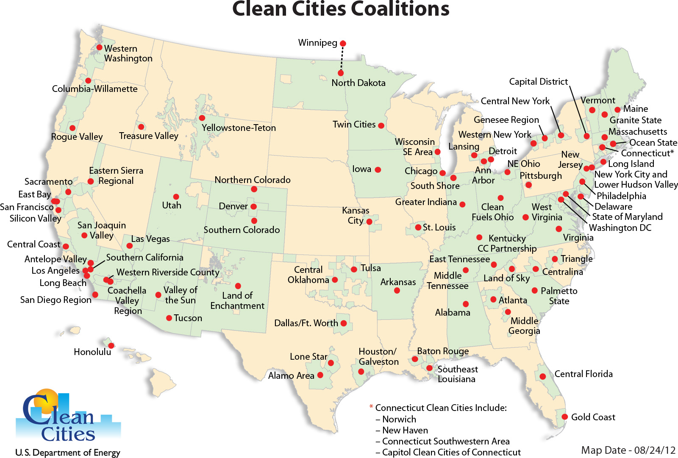
Forming Local Community Partnerships:
(Clean Cities Coalitions)
Thousands of stakeholders from businesses, city & state governments, transportation industry, community organizations, fuel providers
Notes:
7

Slide 8
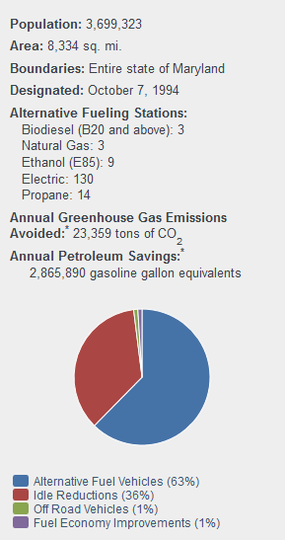
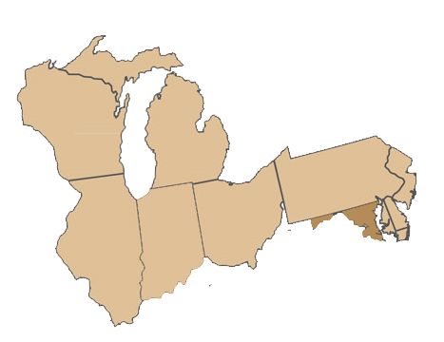

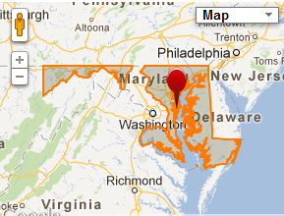
State of Maryland Clean Cities
Chris Rice
Coordinator

Slide 9
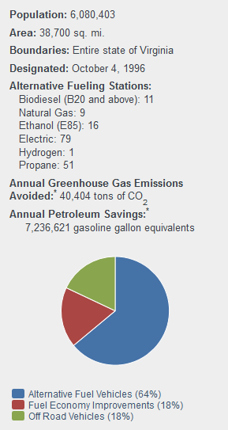
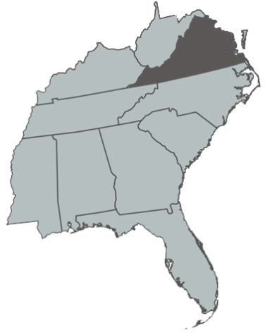

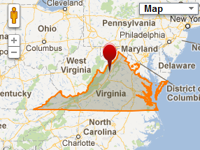
Virginia Clean Cities
Alleyn Harned
Coordinator

Slide 10
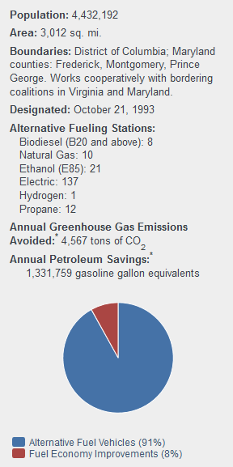
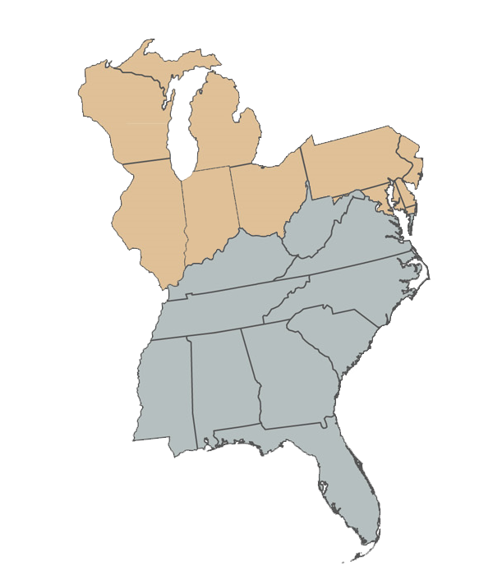

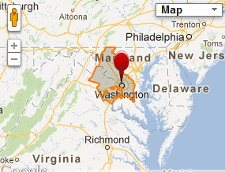
Greater Washington Region Clean Cities
Ron Flowers
Coordinator

Slide 11

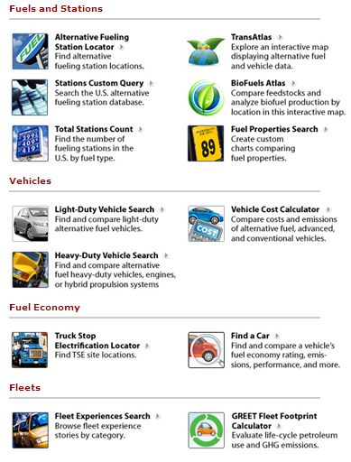
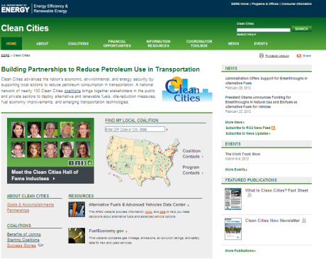

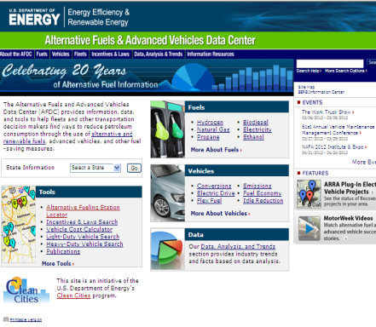
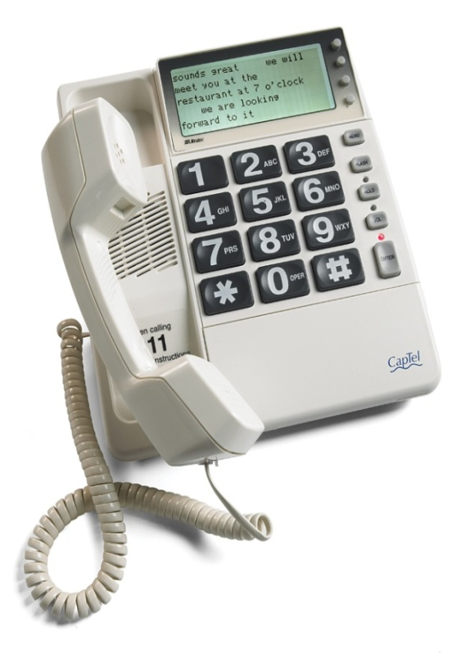
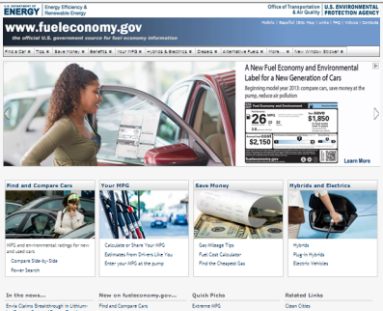
National Outreach, and Education, and Information
Non-biased source of VT data and information
Fuel Economy Guide (FE.gov), Alt-Fuel Data Center (AFDC)
On-line tools and cost calculators, other web resources
Training for first responders and public safety officials
Technical response service
Public workshops, webinars, industry technical conferences
Technical Response Service
Websites
On-line Tools

Slide 12
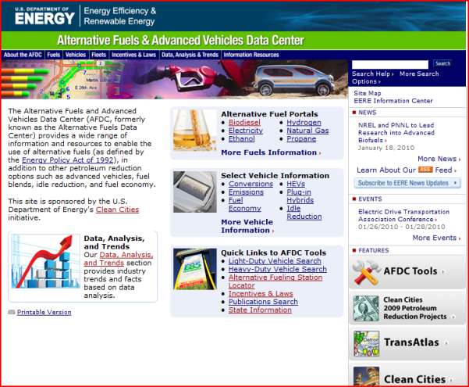












Tools, Publications, Data, and much more !
Web Based and Mobile Versions of Powerful Clean Cities Tools
Access all of the tools and information at http://www.afdc.energy.gov/afdc/info_resources.html

Slide 13
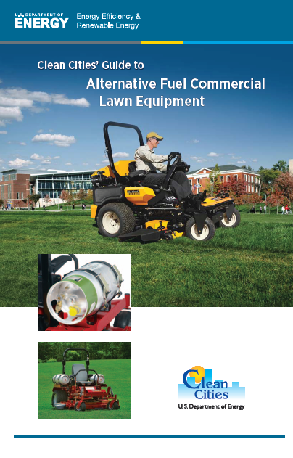
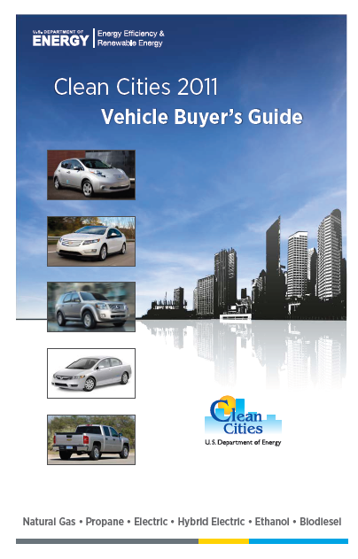
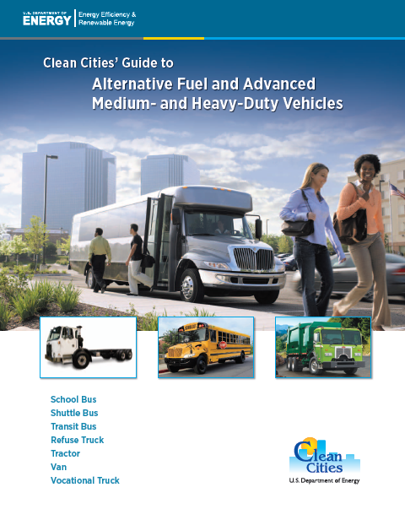
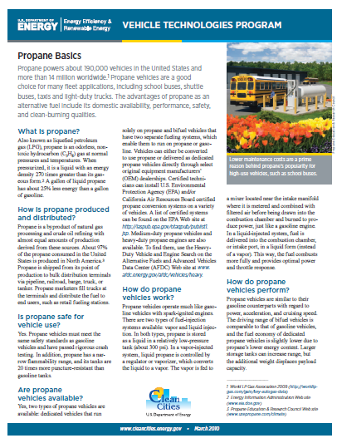
Publications
Propane Basics
Natural Gas Basics
Guide to Alternative Fuel and Advanced Medium- and Heavy-Duty Vehicles
Guide to Alternative Fuel Commercial Lawn Equipment
Clean Cities Vehicle Buyer’s Guide
Guide to Aftermarket Vehicle Conversions (coming soon)
Notes:
Clean Cities has many publications available that focus on propane entirely or feature it prominently.
Propane Basics is a fact sheet that answers frequently asked questions about this alternative fuel. It is also available in Spanish.
Clean Cities has also published guides to using alternative fuels, including propane, in medium-duty vehicles, heavy-duty vehicles, and commercial lawn mowers.
Each year, Clean Cities publishes a vehicle buyer’s guide that lists commercially available alternative and advanced vehicle models, including those that run on propane. This guide contains information on price, engine size, greenhouse gas scores, and fuel economy, allowing readers to compare vehicles across all manufacturers.
This summer, Clean Cities will publish A Fleet Manager’s Guide to Aftermarket Vehicle Conversions, which contains a section on converting conventional vehicles to run on propane.
The Clean Cities website and its Alternative Fuels and Advanced Vehicles Data Center website both have publications searches where you can find these documents and others that contain information about propane.

Slide 14
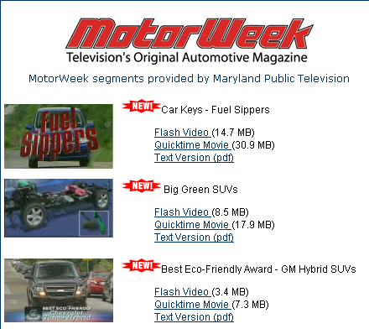
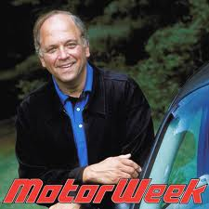
Partnership with National
Public Television
MotorWeek
  > 100 segments on alternative fuels, advanced vehicles, fuel economy, EcoCar Challenge
  Clean Cities’ success stories
  Link to Clean Cities’ websites or EcoCAR websites
14
Notes:
14

Slide 15
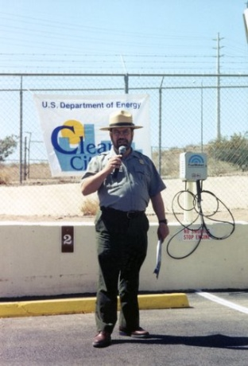
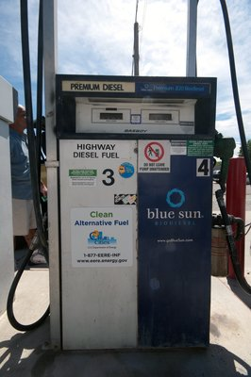


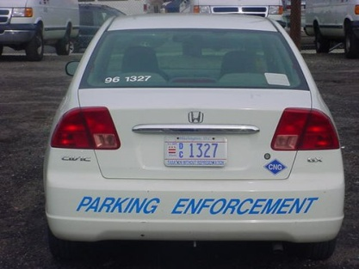
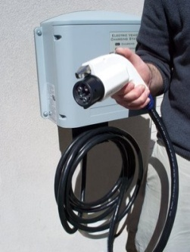
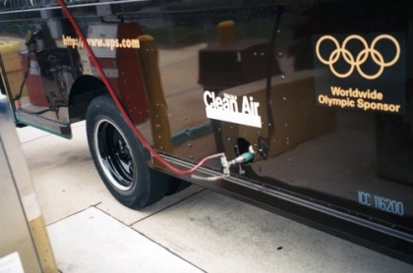
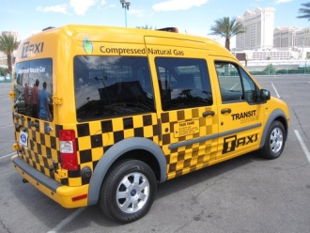
Financial Assistance
Competitively-Awarded Financial Assistance:
encourages private sector match and long-term investment
Community Readiness and Policy Development
Infrastructure Development (fueling/charging stations)
Vehicle Deployment (incremental cost)
Curriculum Development (safety and technical courses)

Slide 16
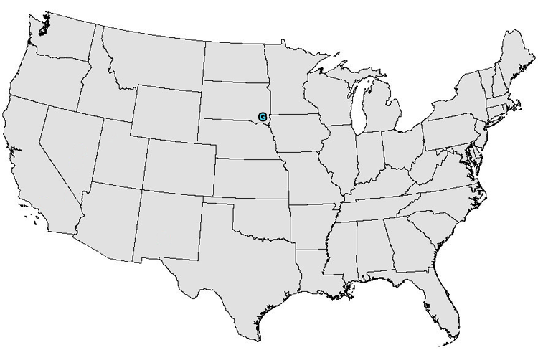
Clean Cities ARRA Program Summary
Puget Sound
Clean Air Agency
$14,999,770
Washington
Clean Energy Coalition
$14,970,144
Michigan
NYSERDA
$13,299,101
New York
Greater New Haven
Clean Cities
$13,195,000
Connecticut
State of Wisconsin
$15,000,000
Wisconsin
The Treasure Valley Clean Cities
$5,519,862
Idaho
State of Indiana
$10,125,000
Indiana
Kum & Go, LC
$1,000,000
Iowa
Greater Long Island Clean Cities
$14,994,183
New York
SCAQMD
$5,591,611
California
City of Chicago
$14,999,658
Illinois
Clean Fuels Ohio
$11,041,500
Ohio
Utah Clean Cities
$14,908,648
Utah
Metropolitan Energy
Information Center
$14,999,905
Missouri
NJ Clean Cities
$14,997,240
New Jersey
SCAQMD
$9,408,389
California
Kentucky Dept.
of Education
$12,980,000
Kentucky
North Central Texas Council of Governments
$13,181,171
Texas
Maryland Energy Administration
$5,924,190
Maryland
Triangle J Council
of Governments
$12,004,175
North Carolina
CA DGS
$6,917,200
California
Railroad Commission
of Texas
$12,633,080
Texas
Virginia Department of Mines, Minerals, and Energy
$8,605,100
Virginia
Texas State
Technical College
$12,299,828
Texas
San Bernardino Associated Governments
$9,950,708
California
Center For Clean Transportation
$14,983,167
Georgia
16

Slide 17
Clean Cities FY 09-10 Awards
(non-ARRA)
State of Wisconsin
$1,000,000
Wisconsin
ALA MN
$377,350
Minnesota
Kum & Go, LC
$1,000,000
Iowa
NAFTC
$1,600,000
West Virginia
Temecula Valley Unified School District
$150,000
California
Groot Industries
$500,000
Illinois
Kum & Go
$1,000,000
Iowa
Renewable Fuels Association
$1,600,000
District of Columbia
Clean Energy
$500,000
CA, TX, GA
Utah Clean Cities
$150,000
Utah
National Biodiesel Foundation
$729,761
Missouri
University of TN
$818,091
Tennessee
MD Grain Producers Utilization Board
$469,364
Maryland
State of OK DGS
$500,000
Oklahoma
SCAQMD
$150,000
California
City of Tulsa
$300,000
Oklahoma
SCAQMD
$500,000
California
City of San Antonio
$260,000
Texas
NC State University
$401,852
North Carolina
City of Dallas
$150,000
Texas
Regents of Univ of CA San Diego
$500,000
California
Clean Fuel USA
$600,000
Texas
Schwan’s Texas
$500,000
Texas
Protec
$900,000
FL, GA, AL
17

Slide 18
Clean Cities 2009 Awards
Refueling Infrastructure
Infrastructure Type | Station Count
CNG | 147
EV | 804
LNG | 9
LPG | 407
E85 | 302
Biodiesel | 157
H2 | 1
TOTAL | 1,827
Based on FY2012 Q2 reports

Slide 19
Clean Cities 2009 Awards
Vehicle Distribution
Vehicle Type | LDVs | HDV/MDV | Total
CNG | 1,168 | 2,137 | 3,250
EV | 402 | 220 | 617
NEV | 80 | 0 | 82
HEV | 656 | 815 | 1,409
LNG | 0 | 366 | 417
LPG | 2,394 | 811 | 3,330
PHEV | 4 | 36 | 30
TOTAL | 4,704 | 4,385 | 9,089
Based on FY2012 Q2 reports

Slide 20
Competitively-Awarded Financial Assistance:
Encourages private sector match and long-term investment
Recent Awards - helped deploy over 1,500 stations and 8,500 vehicles
Future Directions - Community Readiness, Barrier Reduction, and Sustainable Policy Development
Sep 2011 - 16 electric vehicle projects in 24 states totaling $8.5 million were announced (currently being implemented).
May 2012 - $5M funding opportunity announced for community based “Implementation Initiatives to Advance Alternative Fuel Markets.” (awards anticipated by end of FY12).

Slide 21
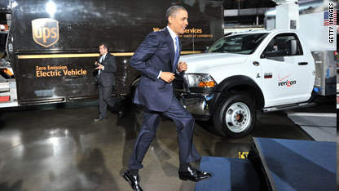
National Clean Fleets Partnership
April 2011 - President Announces Clean Fleets Partnership with 5 charter partners
Challenge top fleets across the country to adopt alternative fuels and advanced vehicles
April 2012 –
Program grown
To 20 National
CF Partners
  Direct Impact: The l00 largest commercial fleets account for more than 1 million vehicles. Every 2,000 vehicles converted to alternative fuel = 1M gal/year petroleum displacement.

Slide 22
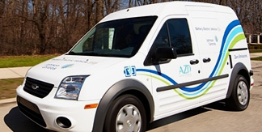
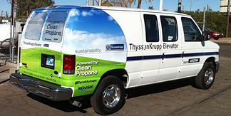
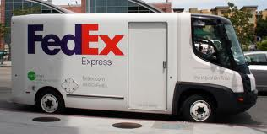
National Fleet Outreach – National Clean Fleets Partnership (NCFP)
Supporting the President’s goal to reduce America's imported oil
Helps large private fleets significantly reduce their petroleum use
Provides fleets with tools, expertise and technical support to incorporate alternative fuels and fuel-saving measures into their operation
Clean Fleet Partners are pace-setters for other fleets to follow
Demonstrate how petroleum reduction efforts can be practical and make good business sense
Notes:
The NCFP program is another example of the role CC is playing by providing technical assistance to some of the largest commercial fleets in the US.
Just in case they ask, NCFP Is not a funding source for partners.

Slide 23
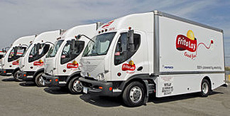
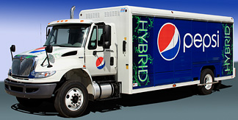
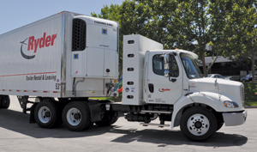
NCFP Benefits
NCFP partners coordinate with all coalitions via a single point of entry at DOE
Unbiased, accurate technical assistance and market resources through National Labs
Experts help to create individual petroleum reduction plans
Access to new and existing Clean Cities tools
Recognition at national and local level
Potential for driving product R&D, consolidated vehicles sales and strategic infrastructure development
Notes:
Follow-up slide that discusses the general benefits of organizations joining the NCFP.

Slide 24

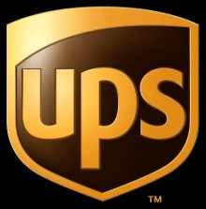




















National Clean Fleet Partners

Slide 25

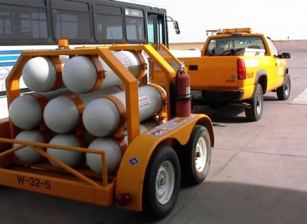
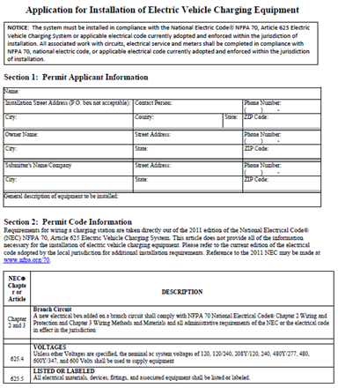
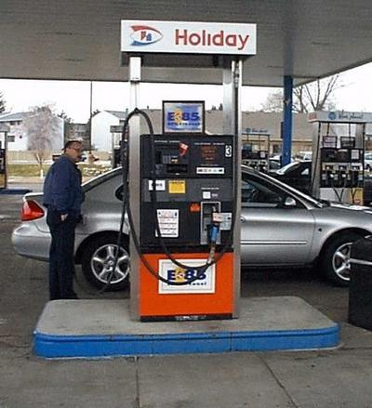
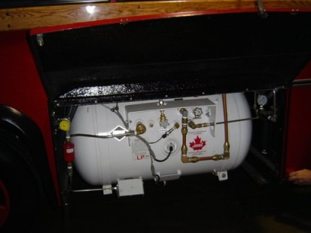
Technical & Problem Solving Assistance
Address unforeseen permitting and safety issues,
Identify chronic vehicle or infrastructure field problems
Incident investigations (technology failures)
Capture lessons learned and develop best practices
http://www.afdc.energy.gov/afdc/pdfs/EV_charging_template.pdf
(NREL stock photos)

Slide 26
Contact Information & Important Links
Mark S. Smith
National Clean Fleets Partnership Manager
  Office: (202) 287-5151
  E-mail: Mark.Smith@ee.doe.gov
Clean Cities Website: www.cleancities.energy.gov
Clean Cities Coordinators: www.eere.energy.gov/cleancities/progs/coordinators.php
Alternative Fuels & Advanced Vehicles Data Center: www.afdc.energy.gov
Fuel Economy Guide and related tools: www.FuelEconomy.gov
Notes:
26

