Slide 1
Supporting the DOE and the NCFP: NREL Fleet and Transportation Research Activities
Talking Freight Seminar
Kevin Walkowicz
February 20, 2013

Slide 2
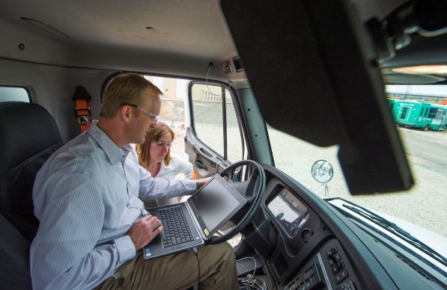
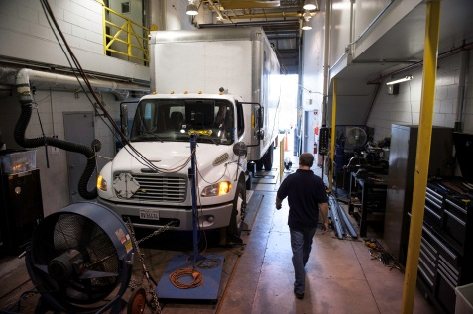
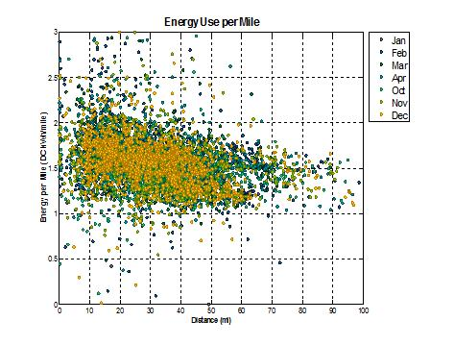
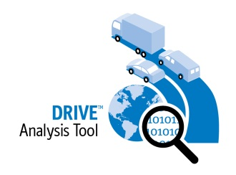


NCFP Supporting Activities: Resources Available to NCFP
MD & HD Field Testing and Evaluation Efforts
  Electric Hybrid
  Hydraulic Hybrid
  Battery Life
  Electric Vehicle Deployment
MD & HD Data Collection and Analysis
  Recovery Act Data Analysis
  Smith, Navistar: EV Delivery Trucks
  Cascade Sierra: Truckstop Electrification
Tools and Data
  Fleet DNA
  DRIVE
  FASTSim

Slide 3
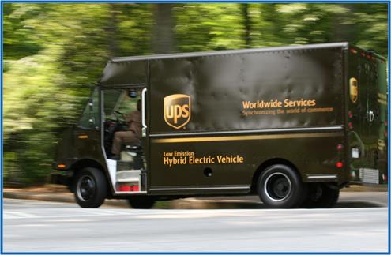
MD Field Testing & Evaluation Example: UPS HEV Gen II
Project Background & Accomplishment:
On-road evaluation of Eaton’s latest next-generation hybrid electric system in package delivery application at UPS. Final report in May 2012.
Data collected – 18 months of operation:
Fuel economy and maintenance records
Engine control unit (ECU) records downloaded regularly
  Miles traveled
  Fuel consumed
  Percent idle time
  DPF regenerations
GPS route data logging
ReFUEL dynamometer testing
Details:
Minneapolis location
Eleven 2010 hybrid vans (2007 emissions)
Eleven 2010 conventional vans (2007 emissions)

Slide 4
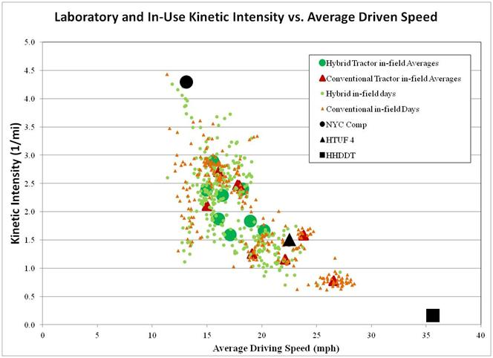
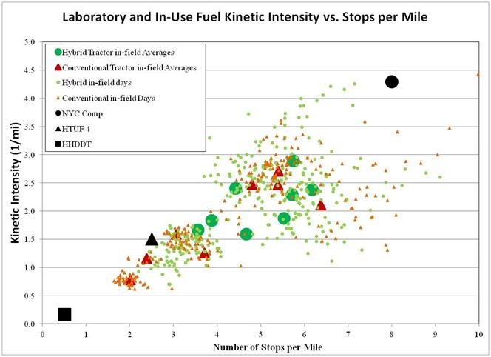
Laboratory Test Cycle Selection: Understanding Usage
r
Routes in same location show driving variability

Slide 5
HEV Dyno Testing: Realistic Cycles in a Controlled Setting
Laboratory Chassis Dynamometer: Route Variability Translates to MPG Variability
In the laboratory, hybrids demonstrated a statistically significant 21% to 45% improvement in ton-mi./gal fuel economy, 13% to 36% on an mpg basis

Slide 6
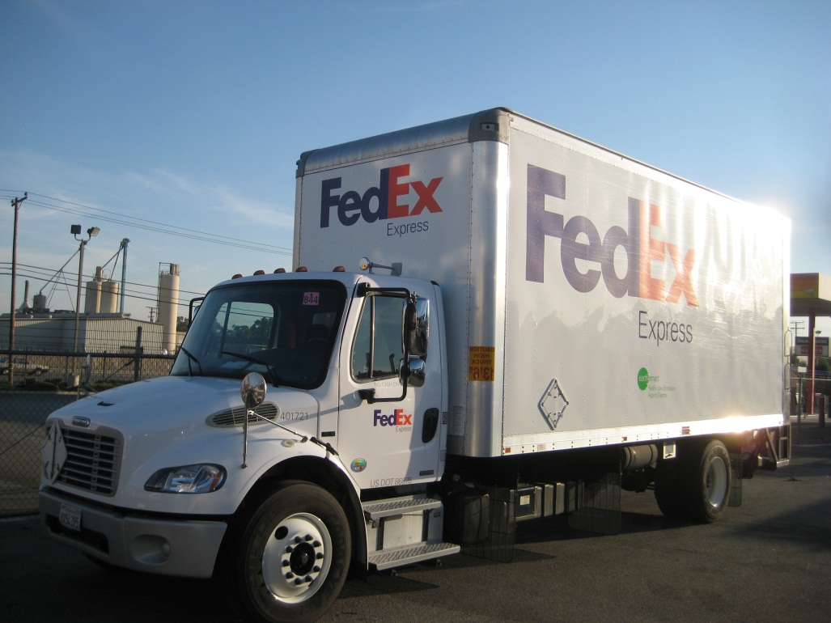
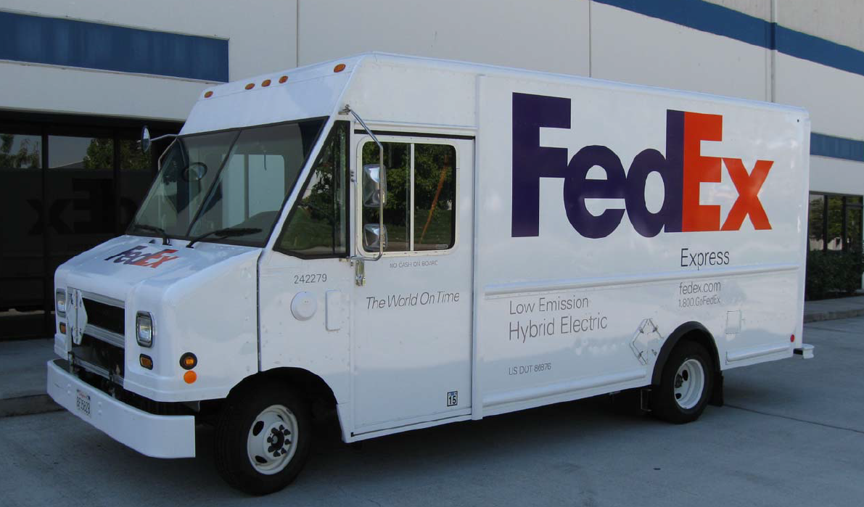
FedEx HEV Field Test Example: LA Delivery Vans + Ontario Box Trucks
Ontario, CA HEV Box Truck vs conventional 2010 diesel
Completion in March 2013
Dyno data only available now
Los Angeles, CA Gasoline HEV vs conventional diesel delivery van – completion in Dec. 2010
Complete report available

Slide 7
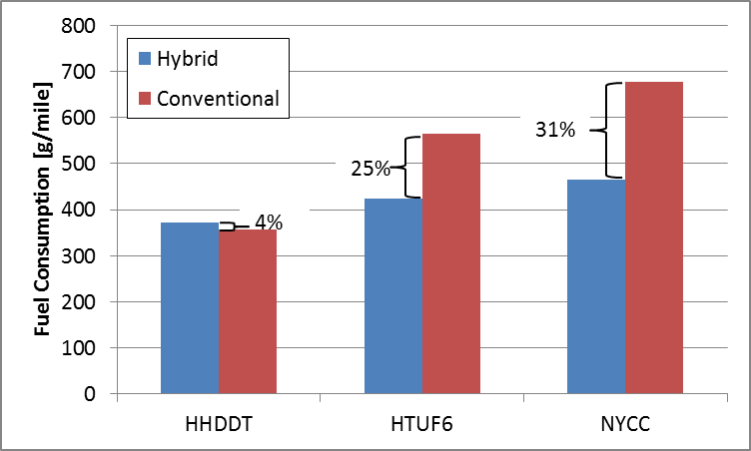
Chassis Dyno Test Results – FedEx Box Truck

Slide 8
In-Use Fuel Consumption Analysis – FedEx Box Truck

Slide 9

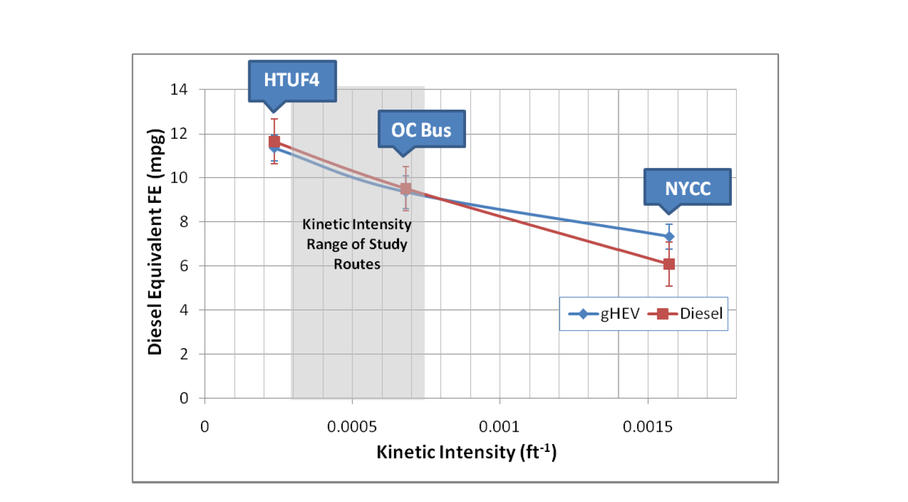
Gasoline HEV Van: Chassis Dyno + Field Data
Slight hybrid advantage on one cycle in laboratory..

Slide 10
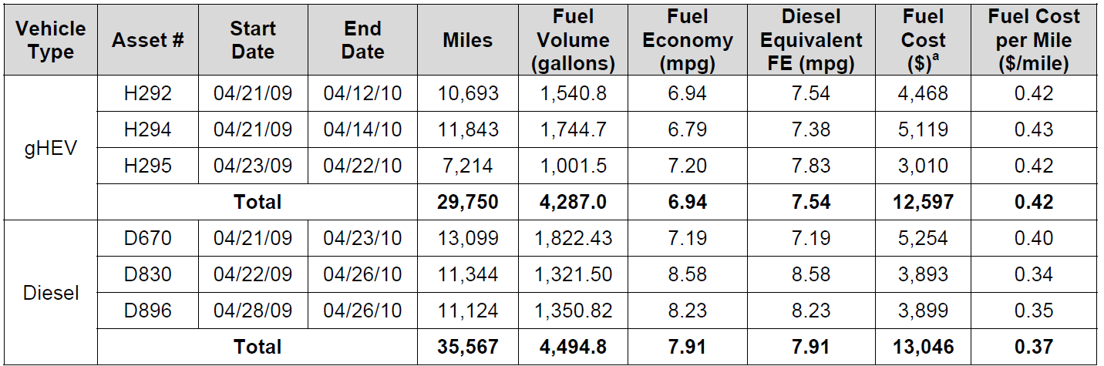

Gasoline HEV vs diesel vans– on road observations

Slide 11

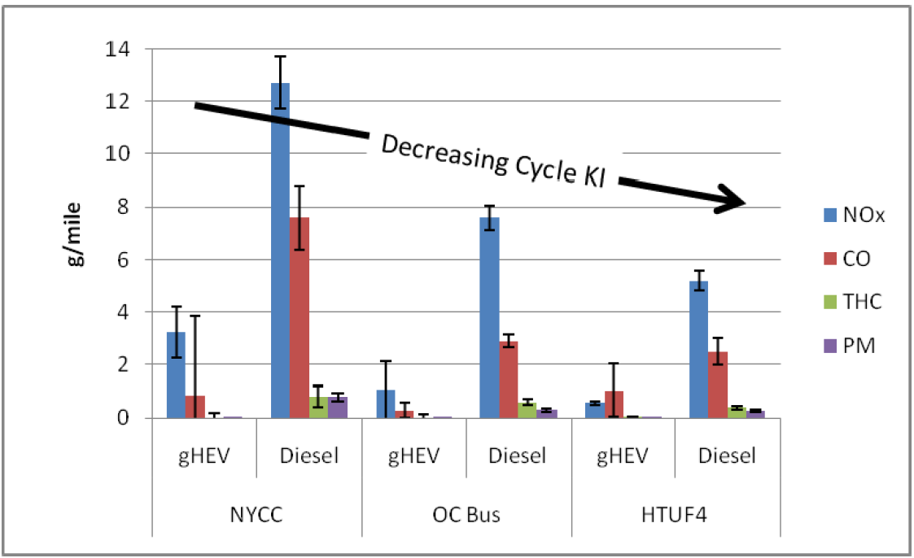
Gasoline HEV Van vs diesel – Telling the Whole Story

Slide 12
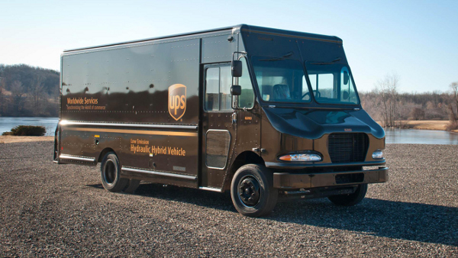
Field Testing & Evaluation Example: Hydraulic Hybrid
20 Parker HHV’s –vs- 20 conventional diesels in Baltimore and/or Atlanta
HHV’s and Conventional will run on similar routes to avoid a route switch among vehicles to make a fair comparison
Data:
Fuel economy and maintenance records on all vehicles – 12 months
Engine ECU “image” data (taken monthly)
Dynamometer testing: test cycles chosen to match proposed GPS study results
Monthly Analysis:
  Service Records
  Warranty
  Driver Fueling Logs
  Vehicle Downtime / Availability
  Road Calls
Starts in March 2013

Slide 13
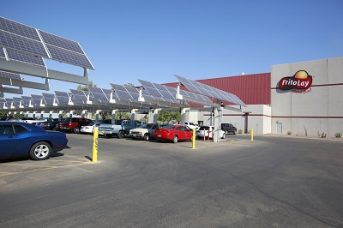
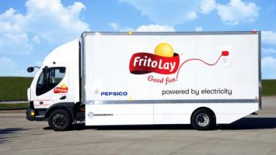
Field Testing & Evaluation Example: EV Deployment
Frito Lay EV’s Study
Case study’ of EV deployments (Smith vehicles) at two Frito Lay distribution centers
Study will compare EV’s versus 2010 diesel operation
Will focus on:
  Installation experience
  Overall costs (conventional vs. EV)
  Battery degradation & range: test batteries on-site to determine rate of degradation vs. usage
  Use patterns: Drive cycle & intelligent deployment
  V2B opportunities (demand charge reductions)
  Grid Integration Study? Show effects of plugging in larger numbers of vehicles at one location at same time.

Slide 14
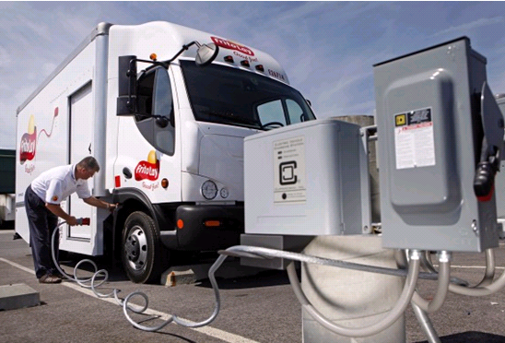
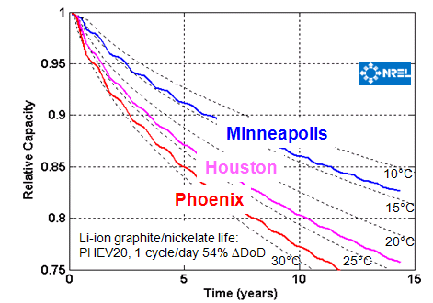
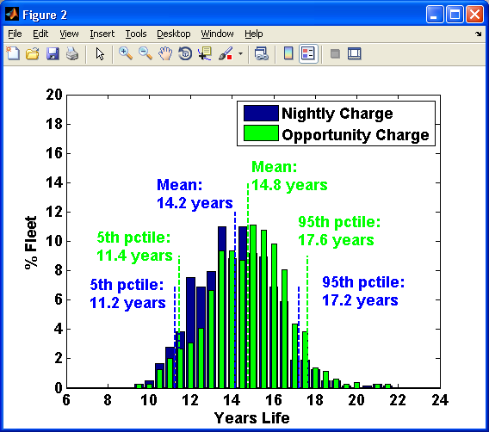
NCFP Interests: Battery Life Prediction
Life model developed based on laboratory test data for many duty-cycles and temperature conditions
Model is extensible to other duty-cycles, but requires field validation to understand variables
Battery Life Model
Simulation Studies
PHEV40,
Phoenix
782 drv cycles

Slide 15
Recovery Act Data Analysis
ARRA funds helped deploy vehicles and EVSEs, some of which were MD/HD focused:
    Smith Electric Vehicles - Newton (500 vehicles)
    Navistar - eStar (up to 950 vehicles)
    South Coast Air Quality Management District / EPRI – Utility bucket trucks and class 3 service vans (~350 vehicles)
    Cascade Sierra Solutions - sleeper cab trucks and electrified truckstops (50 sites and 5000 trucks)
DOE Program collecting and analyzing data to understand usage, barriers and challenges
    ~30 channels of 1hz data collected and stored at NREL
    ~30 distinct data analysis products produced as data received
    Quarterly reports published on basic usage statistics – similar to INL format on LD EV’s
Quarterly and cumulative summary results are available on the Fleet Test and Evaluation subsite,
http://www.nrel.gov/vehiclesandfuels/fleettest/

Slide 16
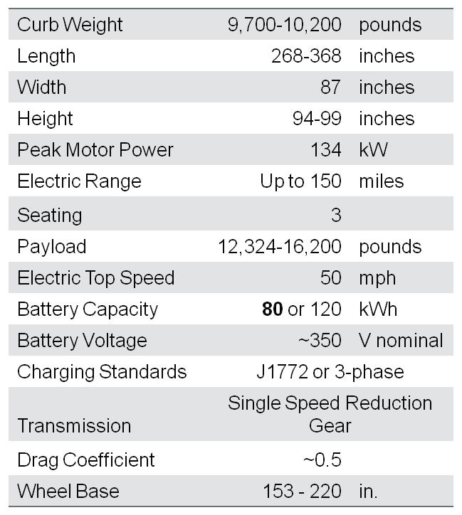
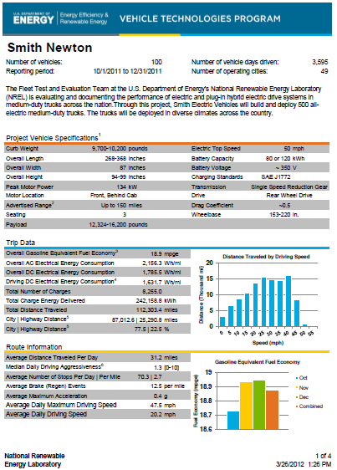
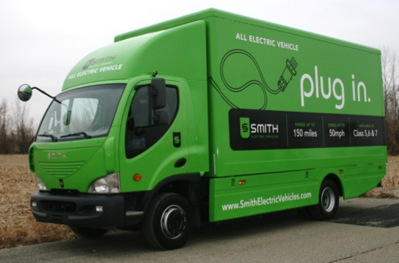
Smith Electric Vehicle – ARRA Data Analysis
500 Newtons being deployed in U.S.
  Manufactured in Kansas City, MO
  $32 Million ARRA award
  100 mile electric range required (cycle dependent)
  Deployment plans included 20 launch partners including:
    Frito-Lay
    Coca Cola (NY)
    Kansas City Power and Light (MO)
    AT&T (MO)
    Staples (CA, OH)
    PG&E (CA)
    FedEx

Slide 17
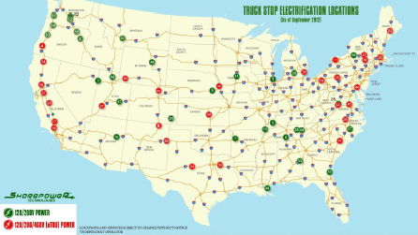
Cascade Sierra: Truckstop Electrification Analysis
50 TSE sites with Shorepower Technologies
Idle reduction technologies rebated (5000)
  Auxiliary power units/ generator sets
  Battery air conditioning systems
  Thermal storage systems, evaporative coolers
  Trailer transport refrigeration units
  Straight truck cold plate and refrigeration systems
  Plug-in adapter kits.
Data collected will include:
  # of plug in events
  Total kWh used
  Fuel Saved
  GHG avoided
  Time of day, length of use, etc
Data Reporting to Start in March 2013

Slide 18
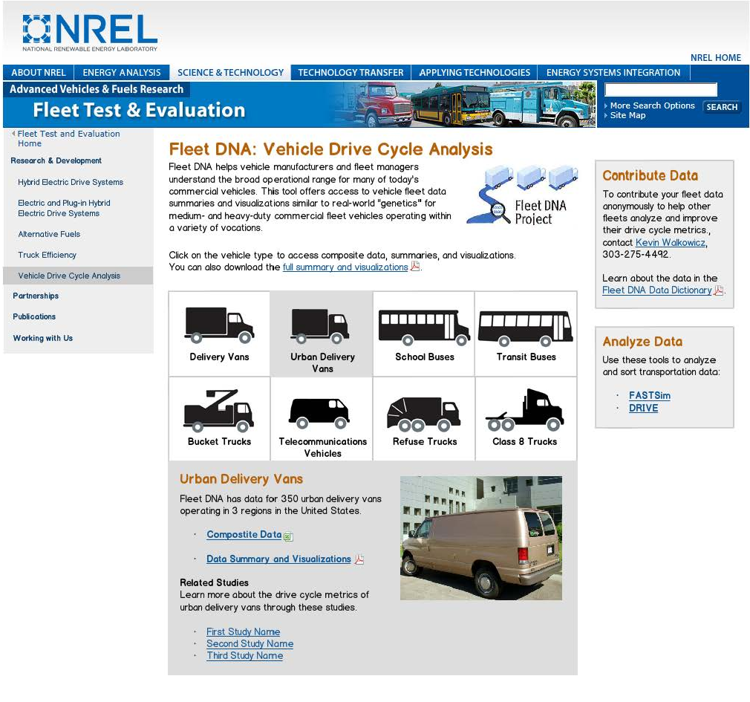
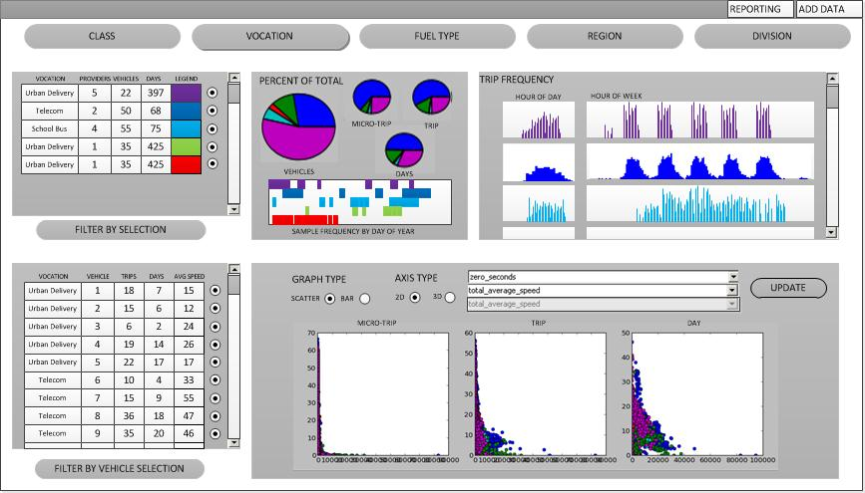
Tools for Fleets: Fleet DNA
Online vocational database of vehicle-use information
Phase 1: Presorted Data Sets
Phase 2: Sortable Data Sets
Users can custom sort and graph:
Class
Vocation
Fuel type (or drivetrain)
Region (4)
Sub-region (based on census map)
Notes:
Tell what Fleet DNA is here.
Fleet DNA is a DOE-funded online tool developed by NREL in partnership with ORNL…

Slide 19
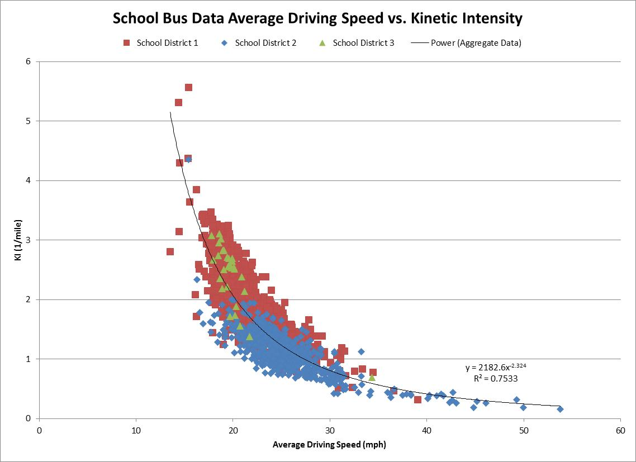
Fleet DNA Benefits
OEMs
  Better understanding of customer-use profiles
Fleets
  Determine maximum ROI from investment
Funding agencies
  Optimize impact of financial incentive offers
Researchers
  Data source for modeling and simulation
Fleet DNA features:
Aggregated and anonymous data
  Fleets are not identified
20-plus high-value metrics
Data products for each vocation
Data for industry drive-cycle development

Slide 20


Fleet DNA Data Sets
Class 4-6 Delivery Vans Parcel, food, uniform
Class 3-4 Light Aerials Telecom service
Class 5-6 Aerial
Utilities
Class 3 Service Vans
Telecom
Class 8 Tractor Trailers Beverage delivery
Class 6 Box Trucks
In-city delivery
EV MD Delivery Vans
Multiple uses
Class 8 OTR Tractor Trailers
Transit Buses
Shuttle Buses
Airport, specialty
Refuse Trucks
Multiple types
Tow Trucks
Class 8 OTR Tractor Trailers
Transit Buses
Shuttle Buses
Refuse Trucks
Tow Trucks
High PTO Use Work Trucks
DOE’s Data Priorities:
National fuel consumption
Payback/ROI success
Scalable or transferable technology

Slide 21
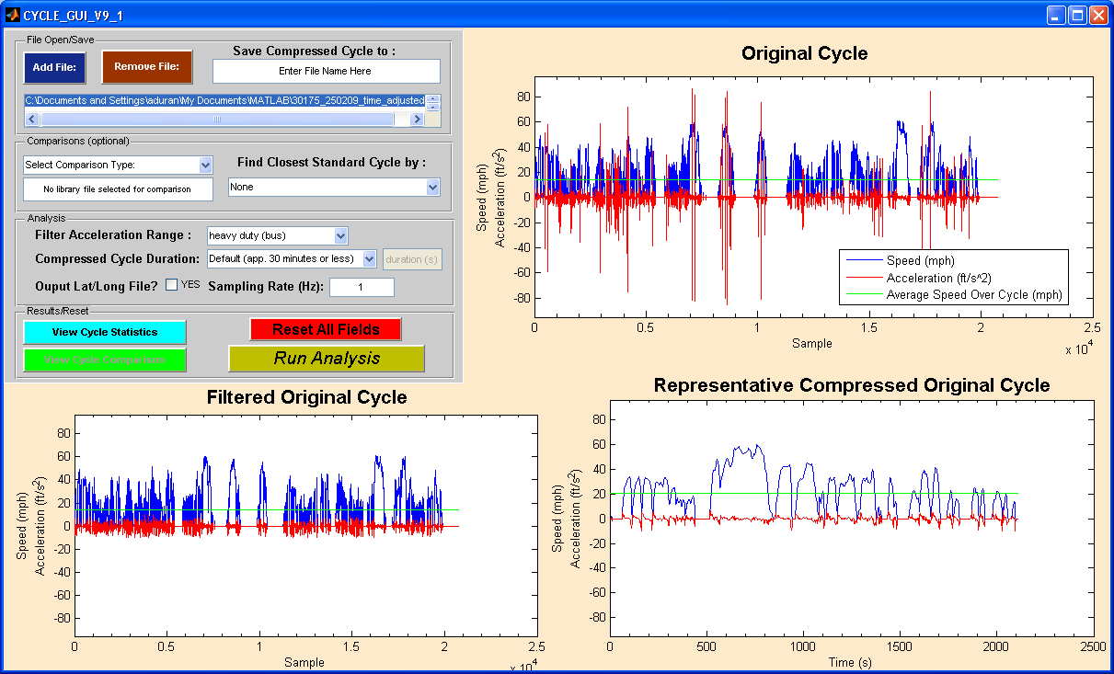
Tools for Fleets -Data Analysis: DRIVETM
Helps fleets, OEMs understand vehicle use
  For proper placement, design, and testing
Combines large amounts of user data
  Filters/creates new cycles
Quickly processes/analyzes data
Integrates with Fleet DNA for public use
Notes:
over 150 metrics
histograms
scatter plots
Creates custom cycle
Recommends standard cycles

Slide 22
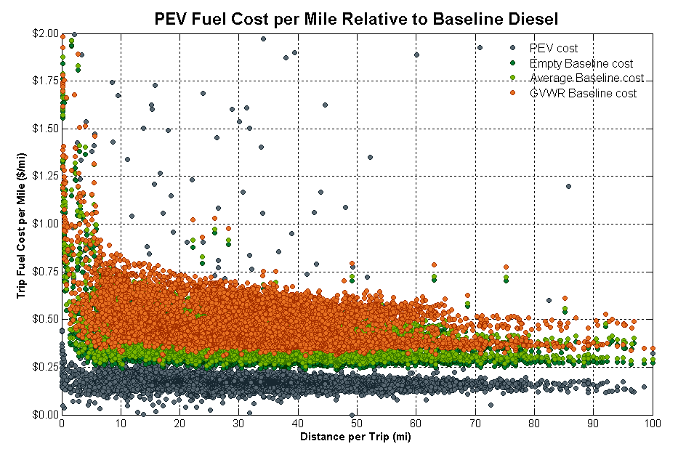
Tools for Fleets - Data Analysis: Simulation
FASTSim
  Vehicle modeling tool
  Well suited for large
  data sweeps
  Short run time in
  accessible Excel environment
  Validated performance outputs
    Fuel economy
    Cost results

Slide 23
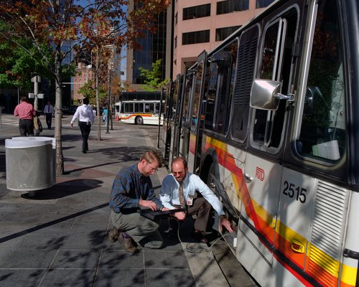
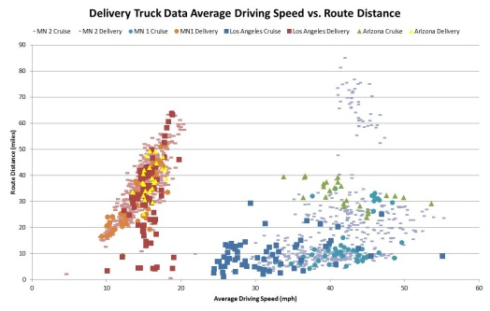
Verizon & DOE NCFP Goal: Calculated Decision Making
    Using Data Capabilities to Support the NCFP Fleets: Fleet Analysis - Verizon Example
    “Quick” Assessment of Fleet to Identify Best Technology for Application
Capture key operational data from 40 “light aerial boom trucks” and service vans operating in three locations within Verizon fleet
Provide analysis & produce key metrics from acquired data to allow Verizon to develop strategic procurement / deployment plans within Verizon fleet
Provide recommendation for appropriate drive cycles for analysis and testing of advanced technologies
Use data and FASTSim to simulate advanced technologies across observed drive cycles
NREL PIX 06118
Captured Vehicle Data
Analysis of Data
Drive Cycle Recommendation / Smart Deployment
Notes:
Provides NCFP fleets, OEMs, and researchers with refined data
and analysis of need-specific options
Creates/maintains accessible database for public use
Recommends drive cycles
Identifies most appropriate technologies for observed
drive-cycle data

Slide 24
Thank you!
Kevin Walkowicz
Fleet Testing and Evaluation Team Lead
National Renewable Energy Laboratory
Golden, Colorado
kevin.walkowicz@nrel.gov

