Slide 1
Talking Freight Webinar
National Clean Fleets Partnership
Keshav Sondhi
February 20, 2013

Slide 2
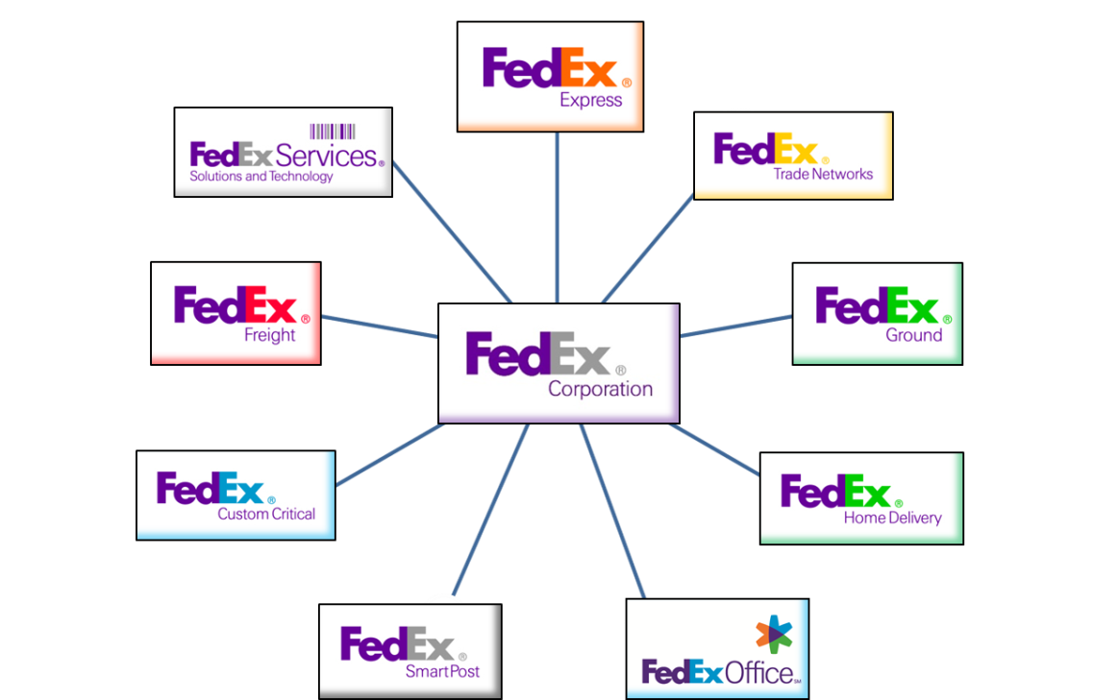
Who We Are
Founded in 1971
FY2012 Revenue - $42 billion
Average Daily Volume – More than 8.5 million
Service Area – More than 220 countries and territories
Workforce – More than 290,000 team members
Transportation Fleet:
    688 aircraft
    More than 90,000 motorized vehicles

Slide 3

Environmental & Energy Security
CONNECT THE WORLD RESPONSIBLY AND RESOURCEFULLY
Dependence on foreign oil threatens national and economic security
  Oil price shocks have wreaked havoc on the global economy
  There is no free market for oil
  American dependence on other oil-producing nations distorts foreign policy
Transportation sector accounts for 70% of total oil consumed by US
FedEx Goal: Improve vehicle efficiency by 20% by 2020

Slide 4

Taking A Leadership Role
Existing Technology
Eye On The Future
Products / Energy Sources
Right-size the truck fleet
Maximize fuel economy
Improve design & performance
Leading edge product design
On-going product evaluation
Infrastructure requirements

Slide 5
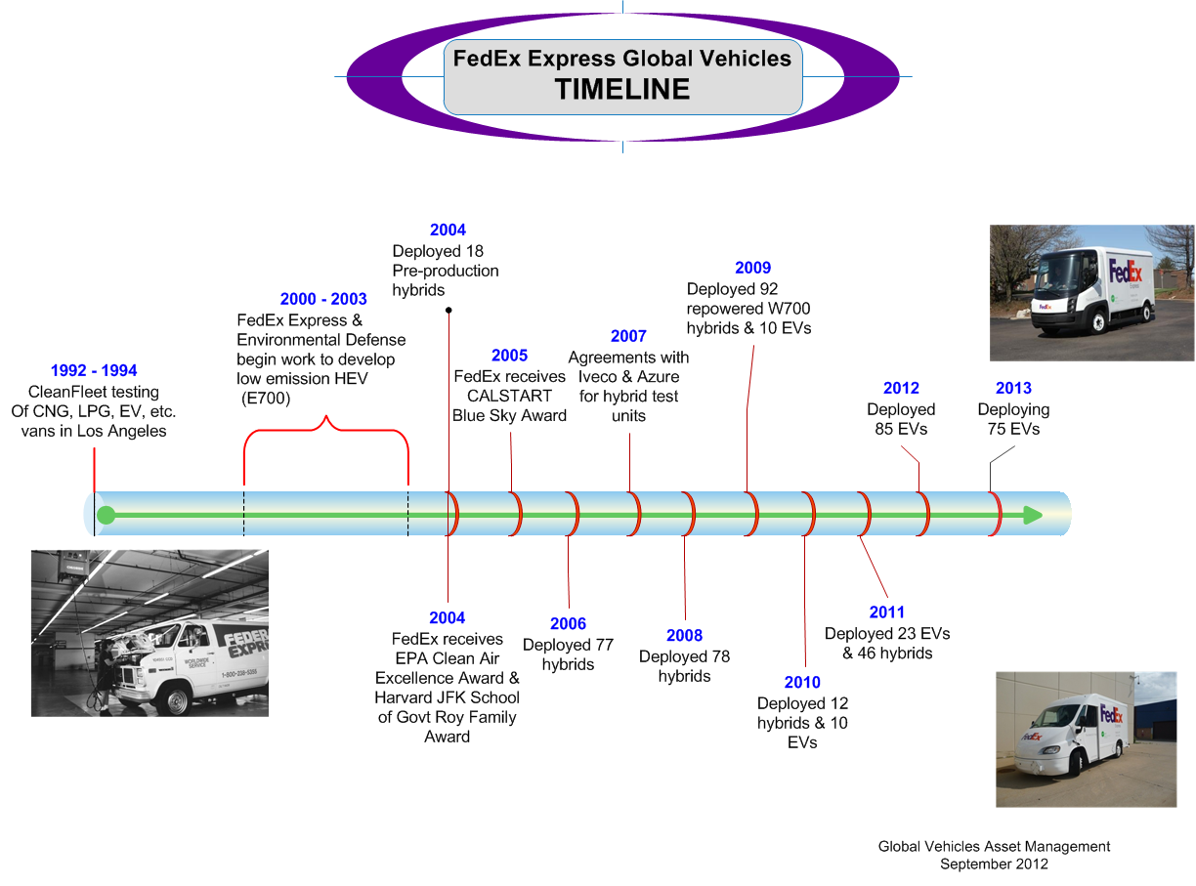

Slide 6
Right Vehicle – Right Route

Slide 7
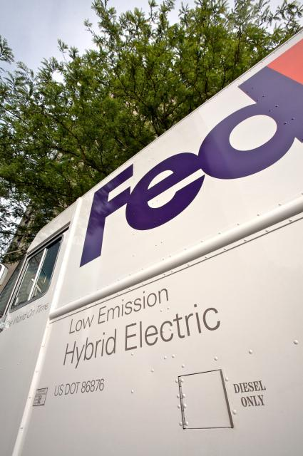
TOPICS
Power Requirements
  Route/duty cycle definition
  Power/torque computations
Fuels/Energy Sources
  Conventional
    Optimize engine sizes
    Reduce body material weight
    Hybridize
  Electric
    Pure Electric
    Plugin Hybrid
  Gaseous
    Vehicle Needs
    Building Needs

Slide 8
Power/Energy requirements

Slide 9
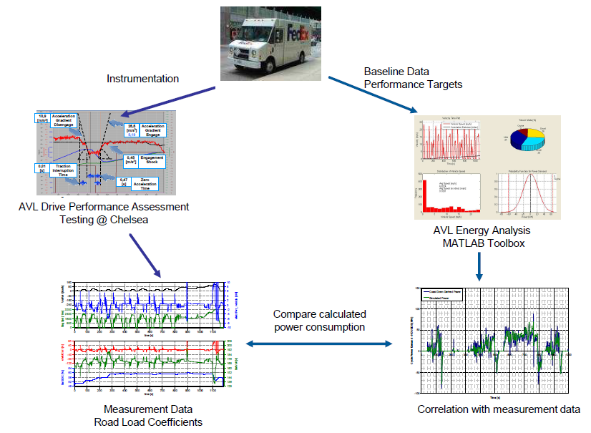
Power Analysis Report

Slide 10
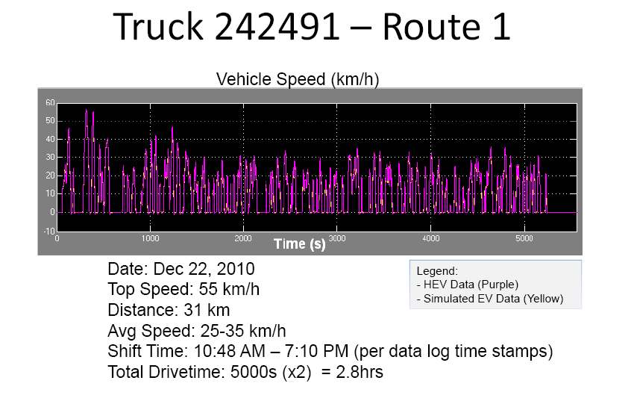
Route Level Duty Cycle

Slide 11
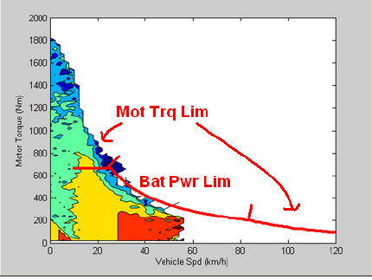
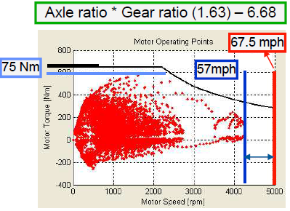
Vehicle Power/Torque Requirements

Slide 12
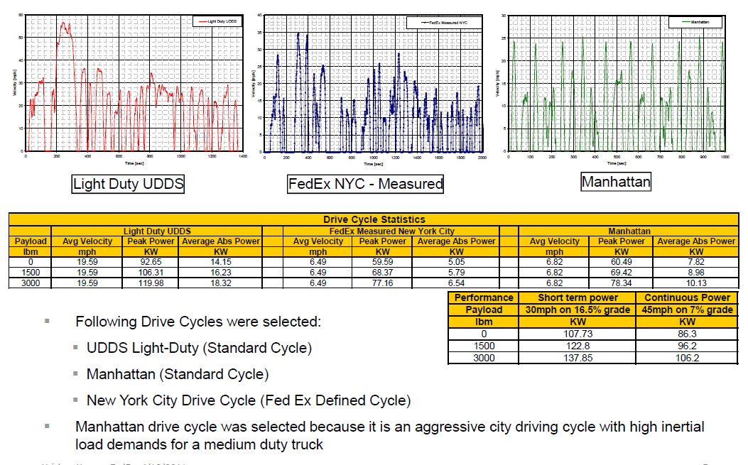
Cycle Analysis Overview

Slide 13
Fuel Economy Improvement - Goal
20% by 2020
% Improvement from FY05

Slide 14
Conventional fuels

Slide 15

Optimized Diesel Walk-ins
Improve Fuel Economy Further
Testing and evaluating alternatives
    different OEMs
    different power trains
International models will be prototypes for US

Slide 16
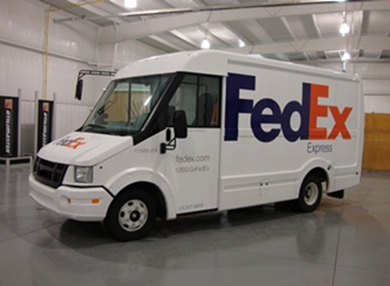
Utilimaster/Isuzu Reach
Composite panels
Optimized engine
Alternative to W700

Slide 17
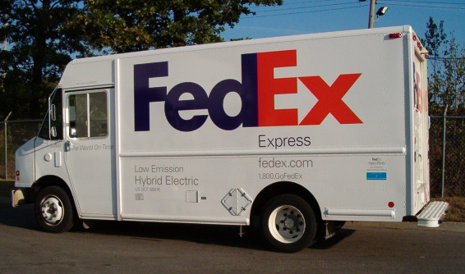
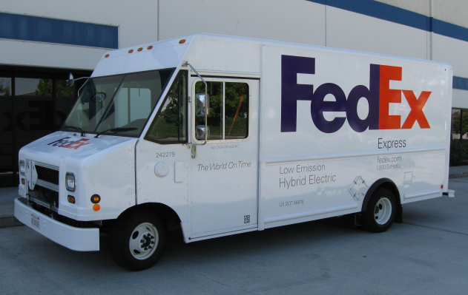
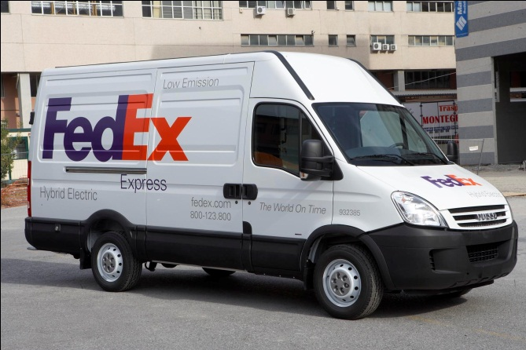
PUD Hybrids
FCCC/Eaton W700
Ford/Azure W700
Iveco Hybrid

Slide 18
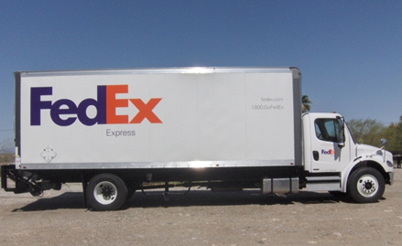
NREL Evaluation: FCCC M2 Hybrid
Summary Facts
Engine | Cummins 6.7L ISB, Inline 6-cyl Diesel, 250 HP, Federal 2010 Emissions Certified,
 | Exhaust aftertreatment - Diesel Particulate Filter (DPF) and
 | Selective Catalytic Reduction Catalyst (SCR)
Hybrid Drive System | Eaton automated manual 6-speed transmission with 44kW
 | permanent magnet electric motor/generator (60 HP),
 | 340V DC (nominal) 1.8 kW-hr Lithium-Ion battery pack
Max. Speed: | Max Road Speed limited to 67 MPH
Wheelbase: | 252 in
GVWR: | 32,000 lb
Load Volume: | 1300 ft³
Curb Weight | 19,400 lb
Maximum Payload | 12,600 lb
Tires: | 295/75 R22.5
Dimensions
External: | Overall Length = 33 ft 2 in
 | Overall Width = 8 ft 6 in
 | Overall Height = 13 ft 6 in
Internal: | Cargo Area Length = 22 ft
 | Cargo Area Width = 8 ft 2 in
 | Cargo Area Height = 8 ft 10 in
 | Rear Loading Floor Height = 4 ft 2 in
 | Rear Door Opening Height = 8 ft 4 in
 | Rear Door Opening Width = 8 ft 1 in (1700 mm)

Slide 19
Electric vehicles

Slide 20
Electrification
of Transportation
Vehicles & Technology
Support Functions
Evaluate & Develop Best Vehicle
Develop Ideal Support Functions
Chicago (GYYA) project
NYC (WTCA) project –
GE+ConEd+Columbia University
Evaluate competing types of EVs on regular city routes
Smart Grid charging
Optimum vehicle specs for
package delivery application
Interface with FXE Properties
Charger placement at station
Vehicle Retrofit Project
Electrical upgrades
Replace conventional drivetrain (diesel/gas) in older FXE PUD vehicles with new all-electric drivetrain
Local building codes, fire codes, etc.
Interface with FXE Safety
OSHA regulations
Incidence response
Disabled vehicle retrieval
Interface with FXE Technology Services
Smart Grid systems

Slide 21
EV Testing
Argonne National Laboratories
CALSTART/CALHEAT

Slide 22
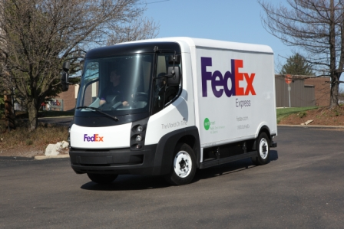
Navistar eStar Electric
Summary Facts
Traction Battery | A123 Lithium-Ion Battery Cassette, 80 kW-hr
Traction Motor | 102 HP (76 KW), 221 lb-ft (300 N-m) permanent magnet electric motor
Range: | 100 Miles
Max. Speed: | 50 mph (80 km/h)
Battery Charger | On-Board Charger for Traction Battery
 | 220V Single Phase
Wheelbase: | 142 in (3600 mm)
GVWR: | 12,100 lb (5500 kg)
Load Volume: | 434 ft³ (12 m³)
Curb Weight | 8800 lb (4000 kg)
Maximum Payload | 3300 lb (1500 kg)
Tires: | 215/75 R17.5
Dimensions
External: | Overall Length = 20 ft 10 in
 | Overall Width = 6 ft 5 in
 | Overall Height = 8 ft 10 in
Internal: | Cargo Area Length = 14 ft
 | Cargo Area Width = 6 ft 2 in
 | Cargo Area Height = 6 ft 5 in
 | Rear Loading Floor Height = 2 ft 2 in
 | Rear Door Opening Height = 5 ft 10 in
 | Rear Door Opening Width = 5 ft 1 in

Slide 23
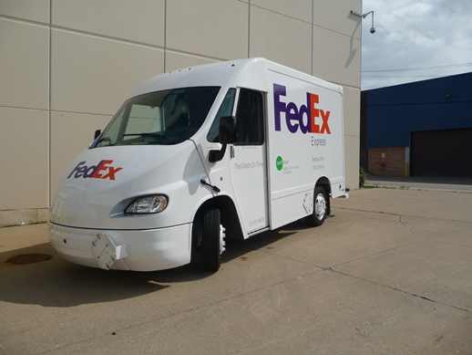
FCCC eCell Electric

Slide 24

Smith Newton Electric
Summary Facts
Traction Battery | A123 Lithium-Ion Battery Cassette, 80 kW-hr
Traction Motor | 107 HP (80 KW), 480 lb-ft (650 N-m) permanent magnet electric motor
Range: | 100 Miles
Max. Speed: | 63 mph (101 km/h)
Battery Charger | On-Board Charger for Traction Battery
 | 240V Single Phase
Wheelbase: | 153.5 in (3900 mm)
GVWR: | 16,500 lb (7500 kg)
Load Volume: | 700 ft³ (20 m³)
Curb Weight | 11,000 lb (5000 kg)
Maximum Payload | 5500 lb (2500 kg)
Tires: | 225/70 R19.5
Dimensions
External: | Overall Length = 22 ft 10 in
 | Overall Width = 8 ft
 | Overall Height = 9 ft 11 in
Internal: | Cargo Area Length = 13 ft
 | Cargo Area Width = 7 ft 10 in
 | Cargo Area Height = 6 ft 9 in
 | Rear Loading Floor Height = 3 ft
 | Rear Door Opening Height = 6 ft 3 in
 | Rear Door Opening Width = 5 ft 2 in

Slide 25

EV Testing – Boulder EV
6 prototypes on order
Wheelbase and handling should be similar to Sprinter
4,000 lb. payload - close to W700

Slide 26

EV Testing - Smith Edison
10 Smith Edison all-electric for Hong Kong, 4 Germany, 4 Italy
FedEx will be first courier company in Hong Kong to use EVs for PUD service

Slide 27
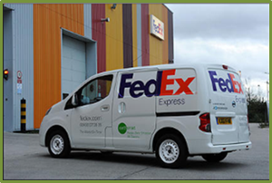
Nissan EV Testing – NV200
Collaborating with Nissan to evaluate prototype all-electric vehicle in London, Japan, Brazil, US
Similar powertrain and battery to Nissan Leaf

Slide 28
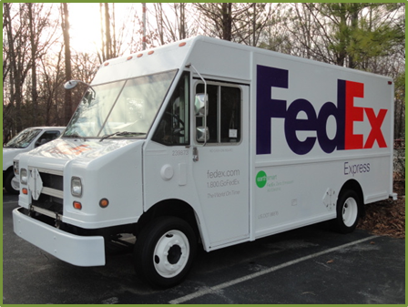
EV Retrofit W700 Projects
FCCC
  2 units completed and in MEM for Engineering evaluation
Smith Electric
  2 units in production at Smith

Slide 29
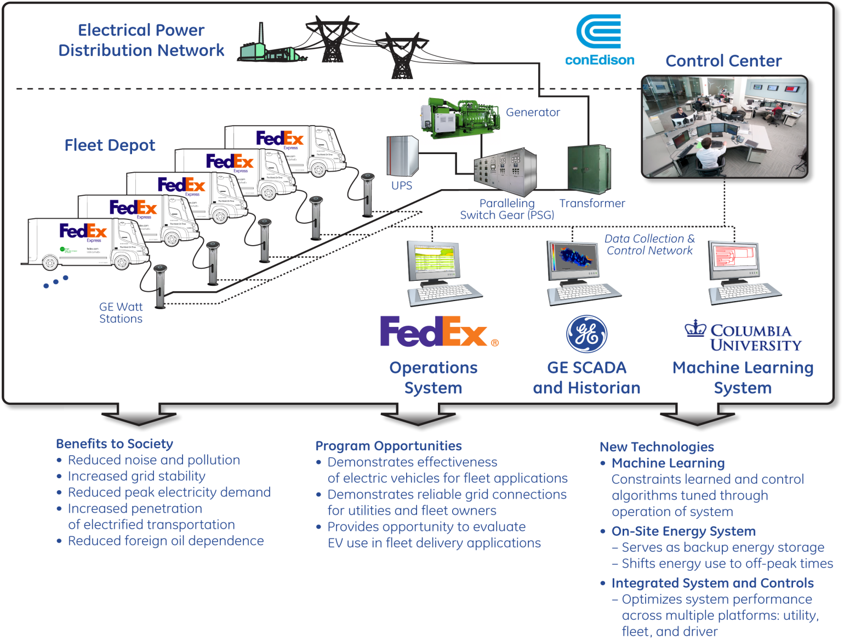
New York EV Smart Grid Project

Slide 30
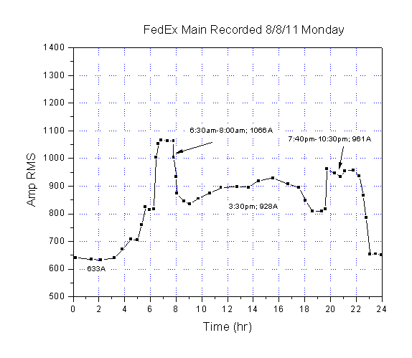



Infrastructure & Demand Charges
EVs add significant load
Graph depicts the electrical load in amps during a typical day at a 120-van station
Charging just 10 EVs during “off peak” will increase the “off peak” load to “peak” or higher level, that could result in:
      Additional infrastructure costs besides just EVSEs
      Additional “demand” rate charges

Slide 31
Gaseous fuels

Slide 32
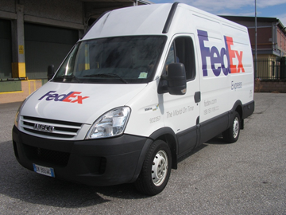
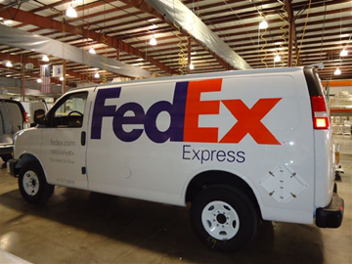

CNG Vehicles
Currently operating CNG vehicles in US, Italy and Japan
Requires significant building/facility modifications
Properties group exploring requirements for indoor parking

Slide 33
Summary
Conservation
      Find out what “stuff” the fleet does
        - work/power analysis
        - match/right size
      Optimize on energy used
        - irrespective of energy source
  Keep innovating!

