Slide 1
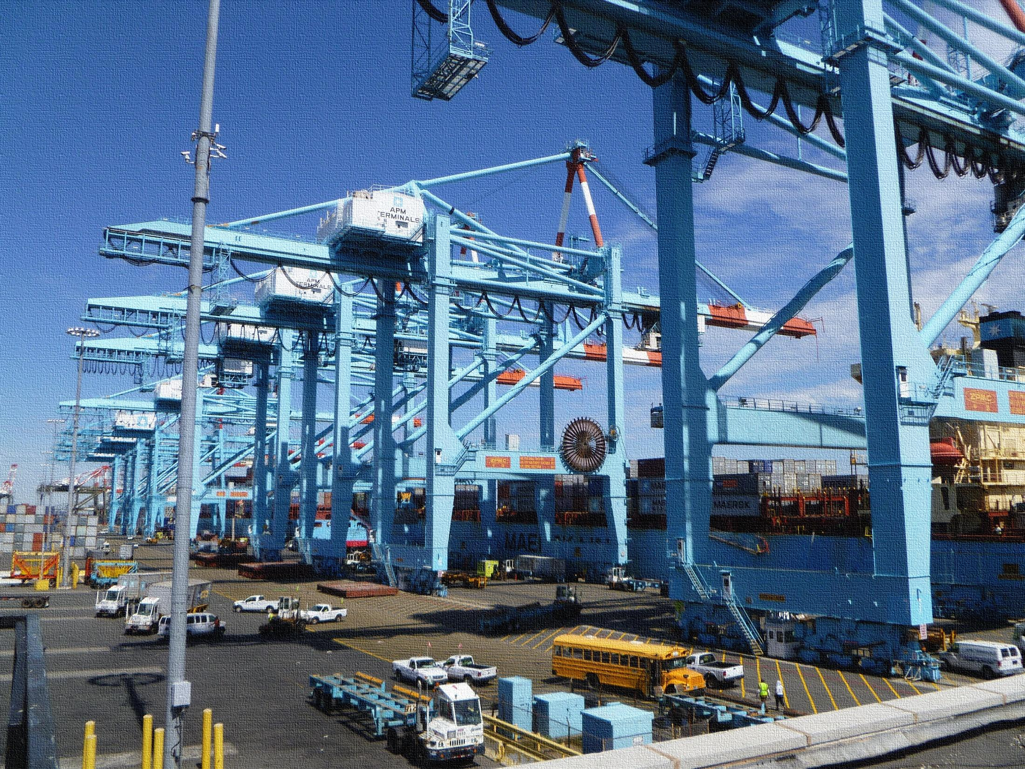

Superstorm Sandy
Framing the Discussion of a Supply Chain Disruption and Transportation Outlooks

Slide 2
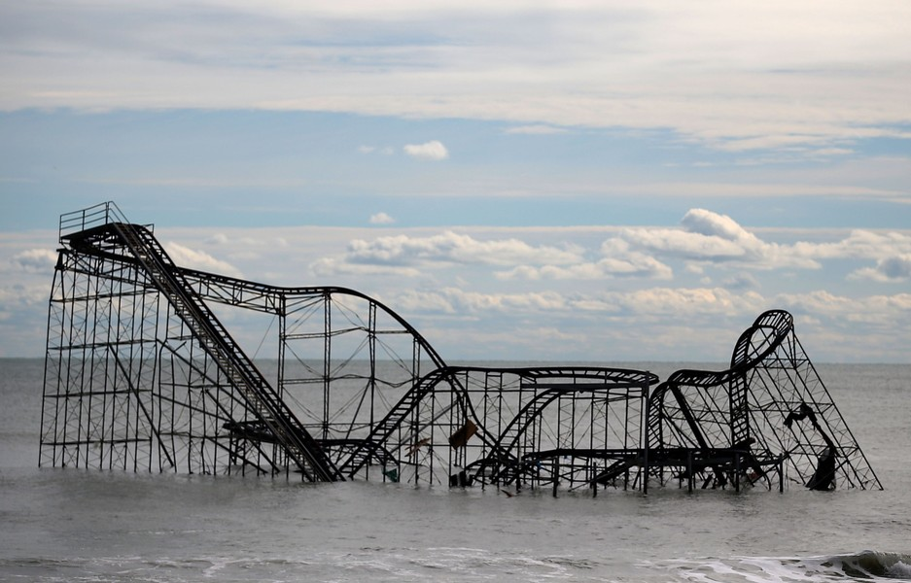
Why is it Important to Frame the Discussion?
Learn what worked and didn’t work
Understand how agencies and organizations worked together
Differentiate between the shorter- and longer-term impacts
  Short term impacts and recovery affect immediate capital needs and operations
  Longer term impacts affect outlooks and long term positions

Slide 3
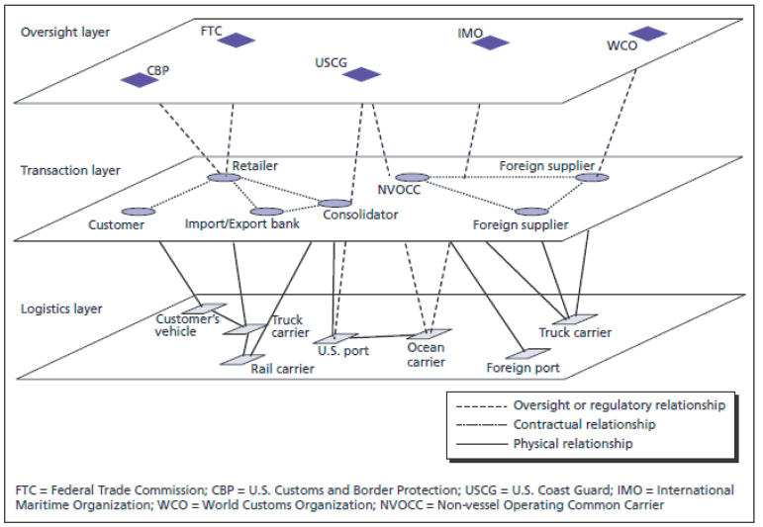
Define the Supply Chain Disruption
What is the geographic scope?
What facilities are disrupted?
What modes are impacted?
What commodities/ shipments are affected (time sensitivity, temperature controlled, etc.)?
What is the likely time frame/length of the disruption?
From: Methodologies to Estimate the Economic Impacts of Disruptions to the Goods Movement System, NCHRP 732 (2012)

Slide 4
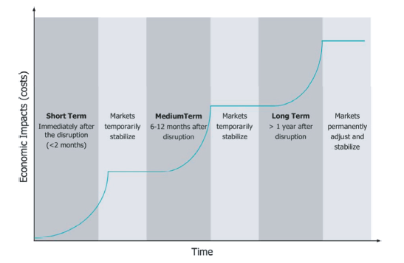
Short- and Longer-Term Impacts
Rebuilding, Clean Up and Recovery
Supply Chains Responses
  Short term – keep things moving
  Medium term – re-examine existing practices
  Long Term – potentially change supply chain operations permanently
From: Methodologies to Estimate the Economic Impacts of Disruptions to the Goods Movement System, NCHRP 732 (2012)

Slide 5
Lessons from the CSX Howard Street Tunnel Fire
July 18, 2001 – CSX train derailed in the Howard Street Tunnel under downtown Baltimore, MD
  11 cars derailed, 4 of which contained hazardous material
  Fire lasted five days
  Happened during evening rush hour as a baseball game was about to be played, caused a major water main break, disrupted Baltimore transit, caused public sirens to sound, caused power outages, and temporarily closed the Inner Harbor.
  No loss of life
  Freight train traffic resumed on July 24, 2001.
From: Methodologies to Estimate the Economic Impacts of Disruptions to the Goods Movement System, NCHRP 732 (2012)

Slide 6
CSX Howard Street Tunnel Fire
Short-Term Impacts
  CSX rerouted some trains and delayed others in yards along the eastern seaboard. Delays ranged from 18 to 35 hours.
  The railroads worked together to reroute high priority/time sensitive trains, such as the Tropicana Orange Blossom Special.
  Significant impacts on the community.
Long-Term Impacts
  No impact on rail freight movements
  Led to significant discussions on the movement of haz mat materials.

Slide 7
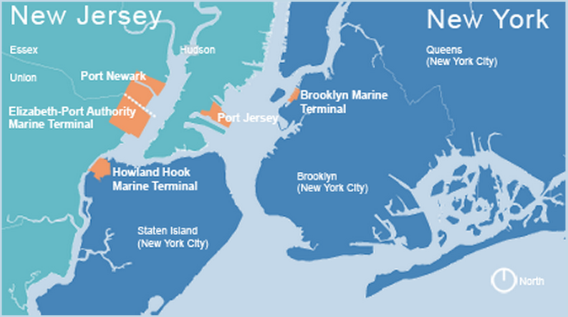
The Port of New York and New Jersey
Source: Port Authority of New York and New Jersey (PANYNJ)

Slide 8
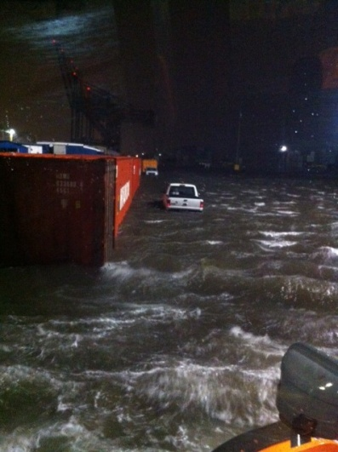
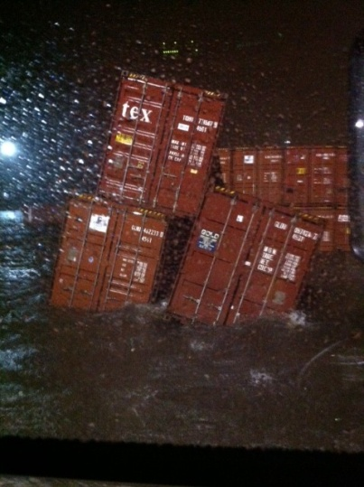
Port Preparation
Notification to tenants began Thursday, Oct. 25 (USCG Sector NY Hurricane/Severe Weather Plan + PA’s Emergency Op’s. Plan)
  PA Emergency Operations Center activated on Oct. 28
  Until Sunday, Oct. 28th, there was a false sense of security
  Oct. 28 National Weather Service briefing indicated surge of 6-11’ above normal high tide
  PA decision to close terminals to all but essential personnel by 2359 hours
Mon -Oct. 29 –1200 hours ---all tenant personnel and PA contract security ordered off port; Port Commerce and PAPD staff vacated at 1915 hours (just prior to surge)
Mon., Oct 29 –2000 hours ---NOAA reported water levels at the Battery and Bergen Point @ 9-10’ above MHW; winds @ 80-90 mph; surge 13 -14’.
Source: PANYNJ Presentation at 11/30 NAIOP/CSCMPNJ seminar

Slide 9
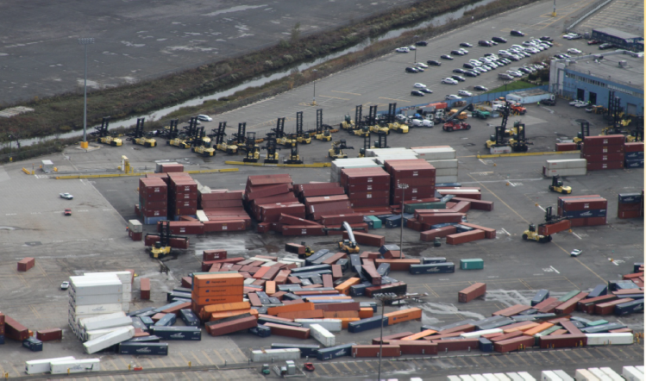
Immediate Return to Operation Time Line
Tues, Oct. 30 – Assessment, response, recovery and restoration begins
Friday, Nov. 2:
  USCG re-opens Port to deep draft commercial traffic
  First vessel arrival at PA facilities - Brilliance of the Seas at Cape Liberty
Sat. Nov. 3 – Power restored at Elizabeth
Sun. Nov. 4 –Maher / APM work 5 vessels
Mon. Nov. 5 –Truck gates at all container terminals opened for business
Mon./Tues. Nov. 5 & 6 –All remaining container terminals work their first vessels
Source: PANYNJ Presentation at 11/30 NAIOP/CSCMPNJ seminar

Slide 10
Port Damage
Extensive infrastructure damage
  Flooding (Water level in buildings @ 3-5’)
  Utilities ---general commercial power, motors, controllers
  Sewage/fire pump motors and controllers
  Loss of rail relays and switches
  Security fencing and guard booths destroyed
  Damage to cranes and cargo handling equipment
  Debris in roadways, channels and berths
  Road and rail track damage
  Total loss of rail car float and rail transfer bridge at Greenville
Cargo impacts
  Toppled container stacks
  Lost containers
  Autos destroyed by flooding and fire
Cruise Passenger Auto Damages
Source: PANYNJ Presentation at 11/30 NAIOP/CSCMPNJ seminar

Slide 11
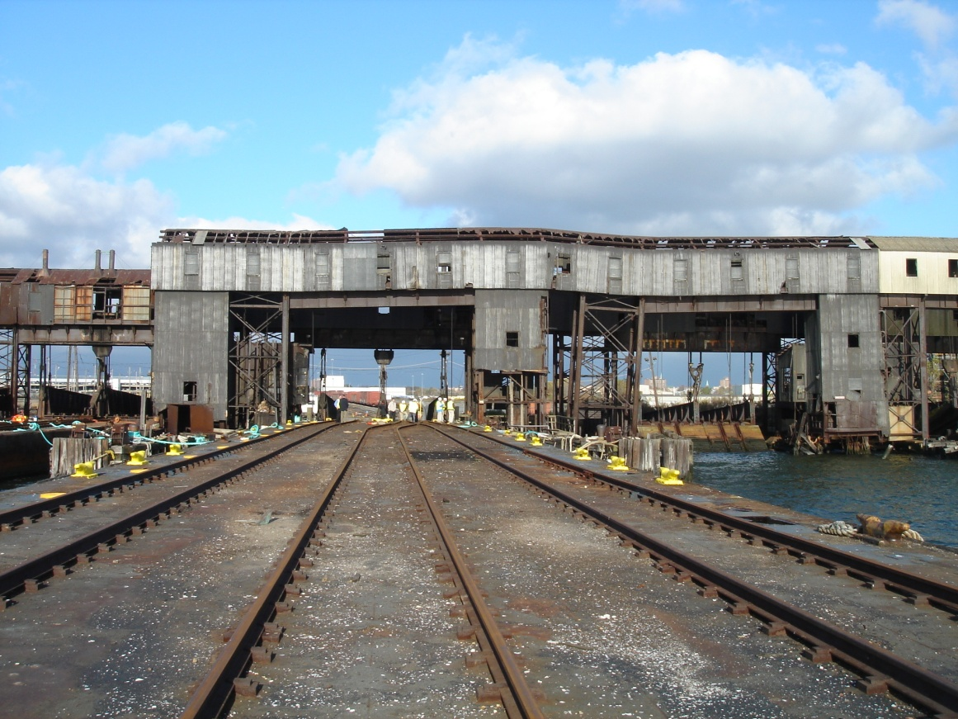
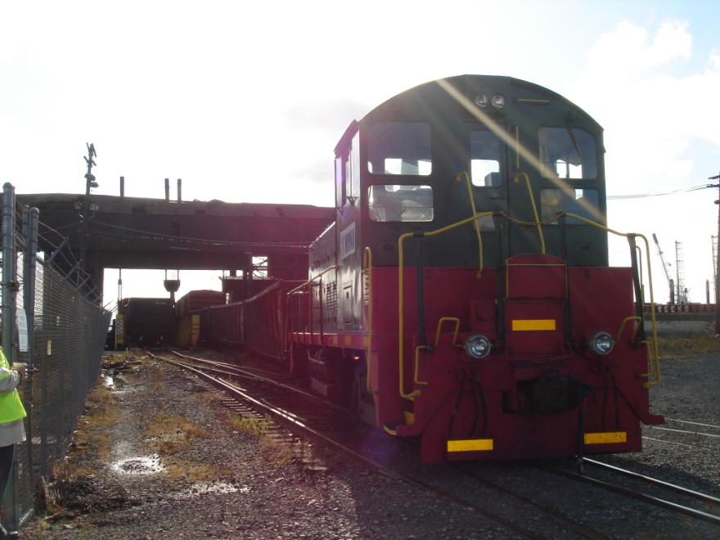
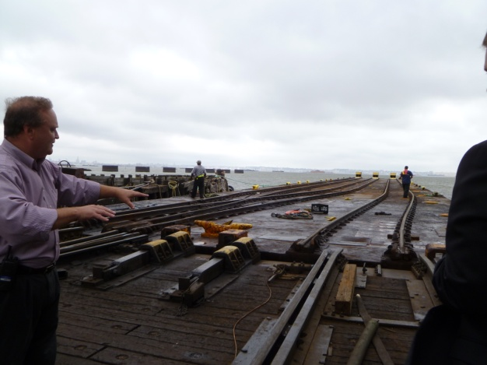
Greenville Yard – Before
Source: A. Strauss-Wieder, Inc.

Slide 12
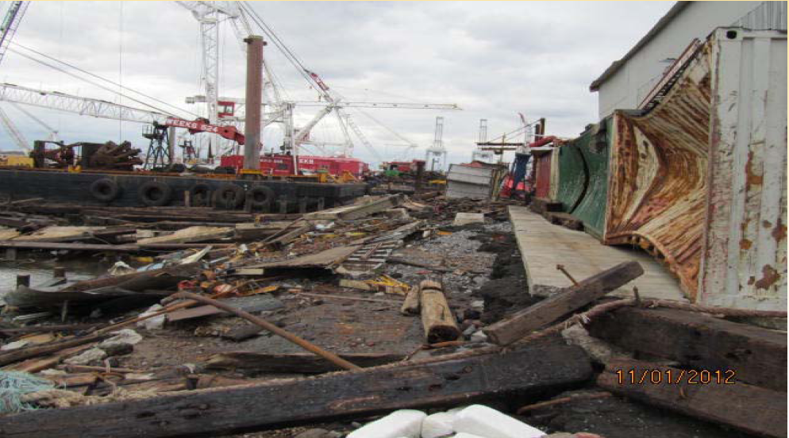
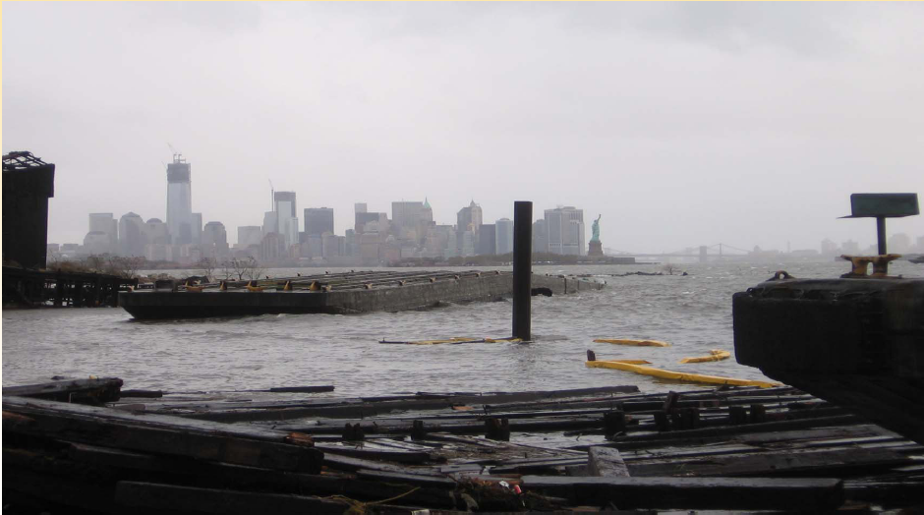
Greenville – After Superstorm Sandy

Slide 13
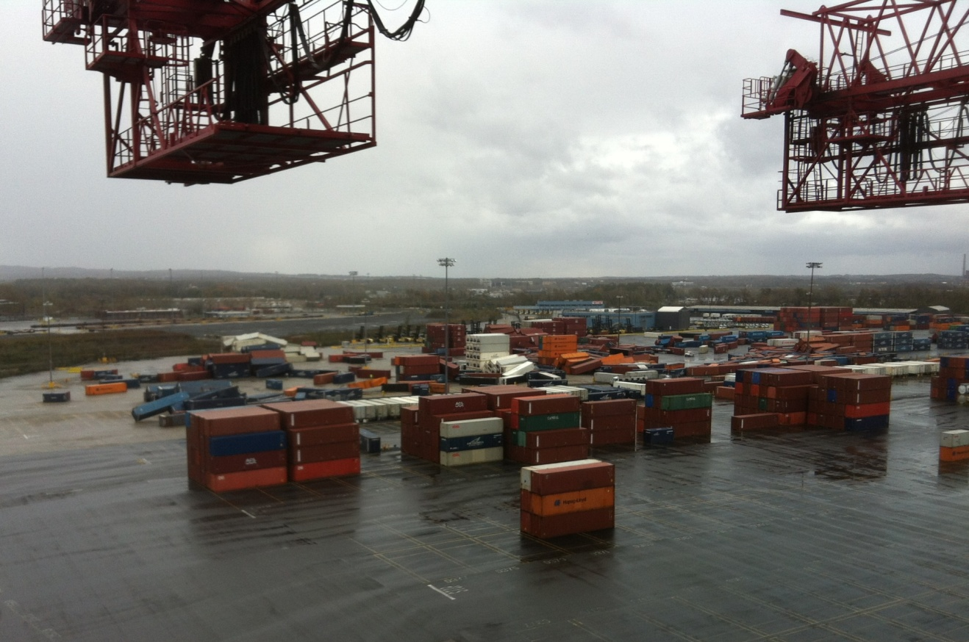
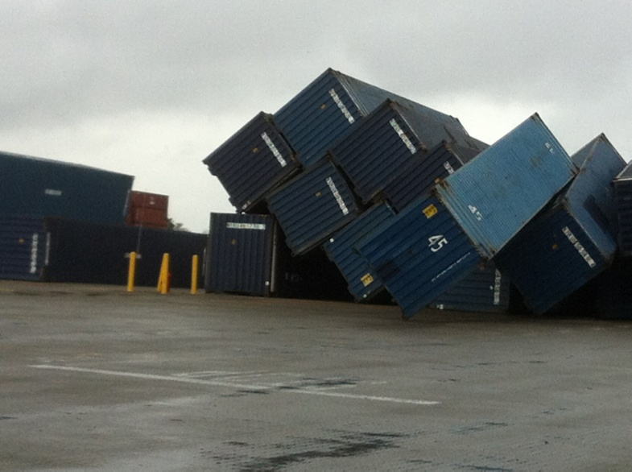
Terminals

Slide 14
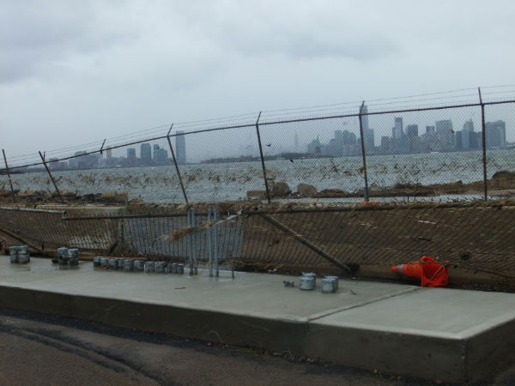
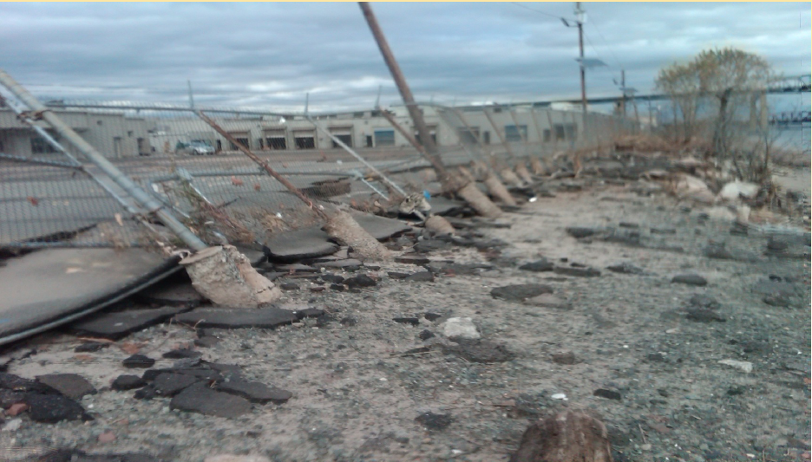
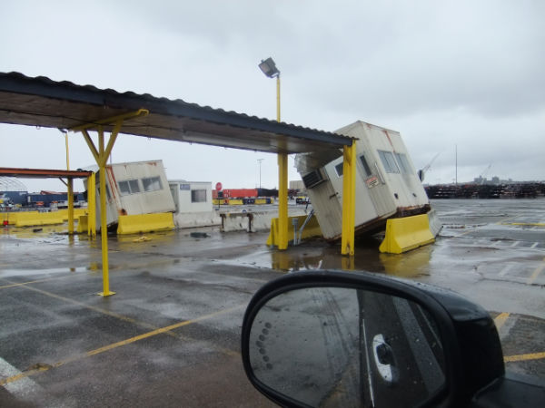
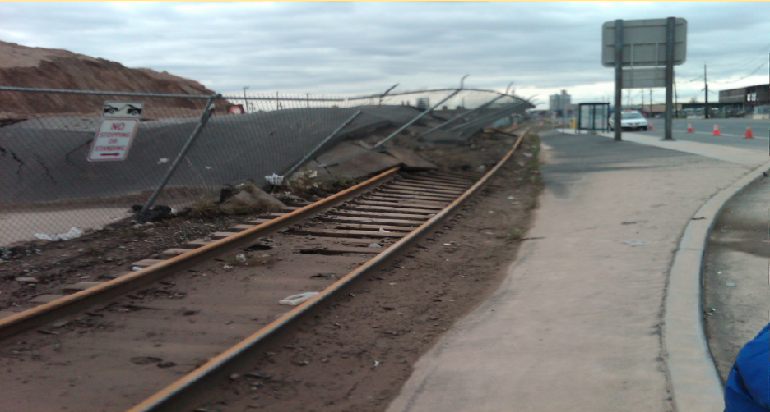
Security Fencing and Gate Houses

Slide 15
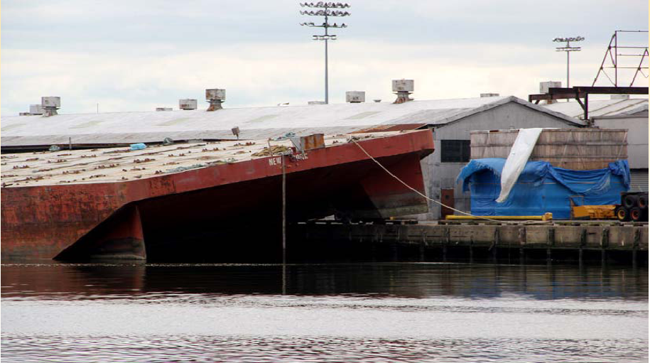
Red Hook Barge at/on Berth 6

Slide 16
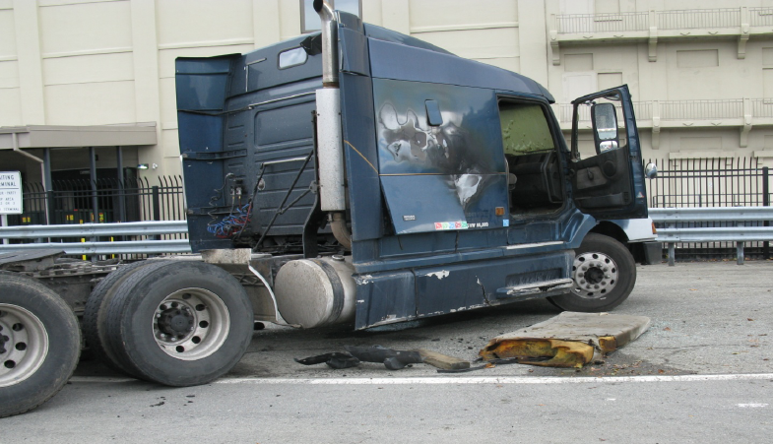
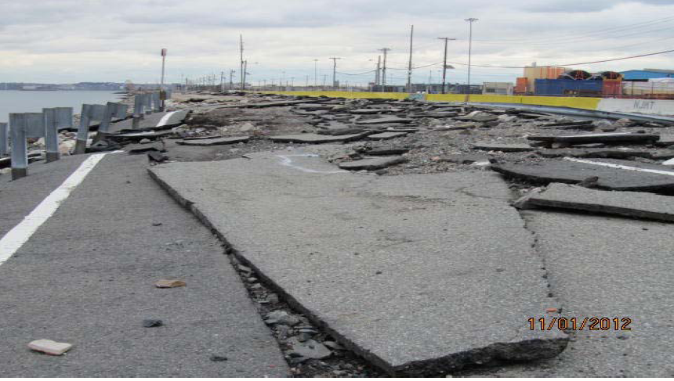
Access Road and Drayage Truck Damage

Slide 17
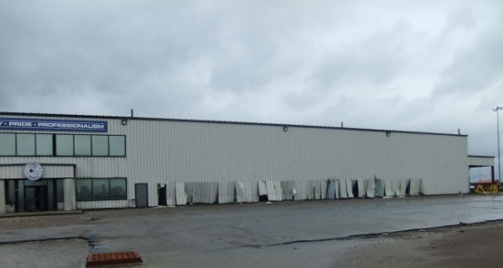
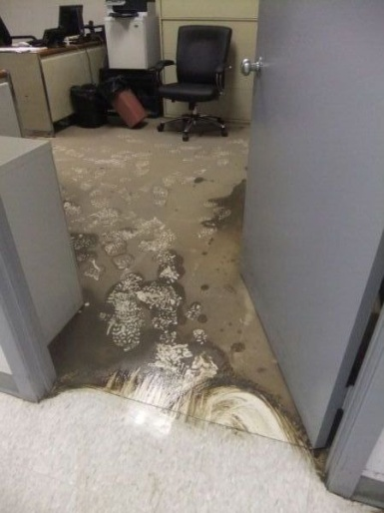
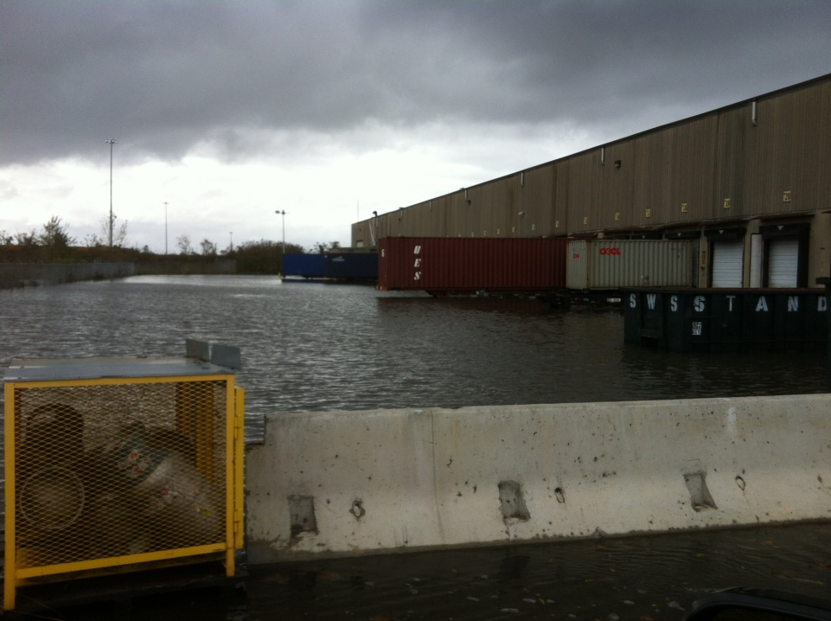
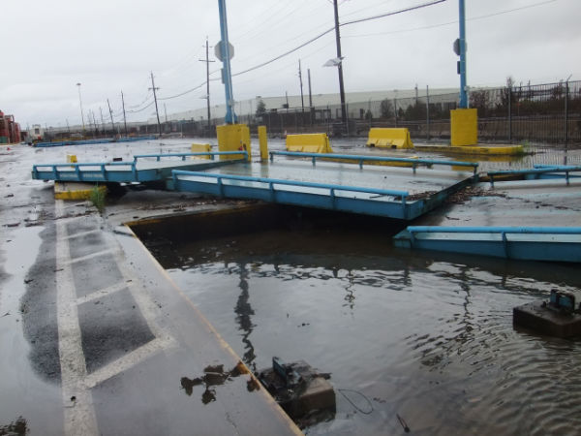
Building Damage and Flooding

Slide 18
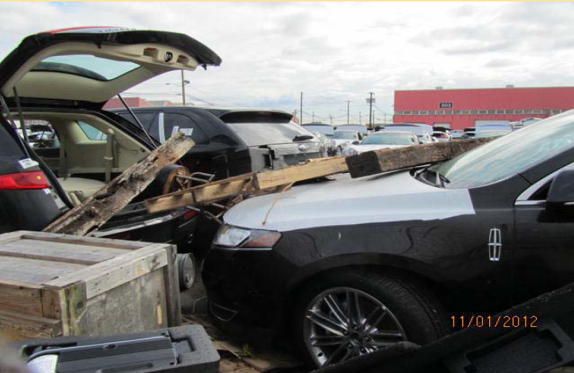
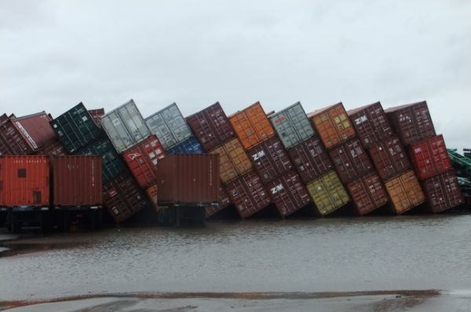
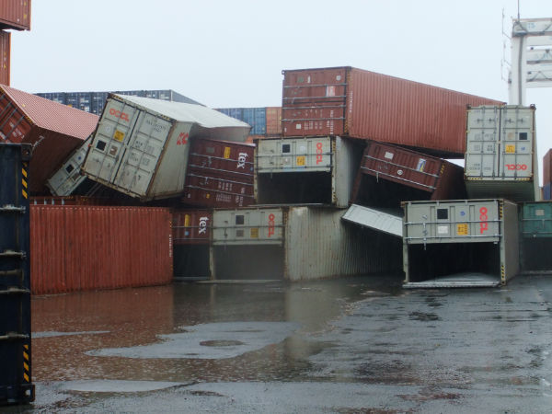
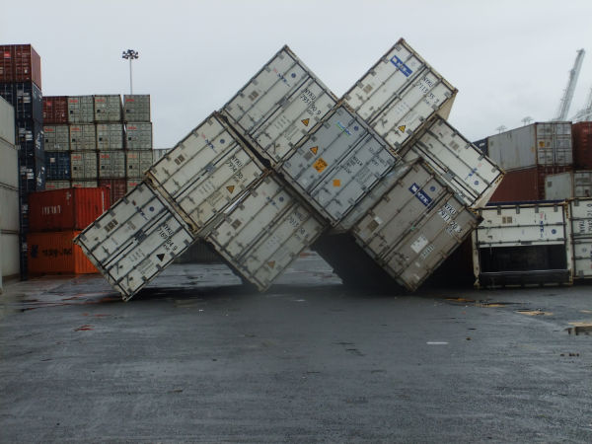
Cargo Impacts

Slide 19
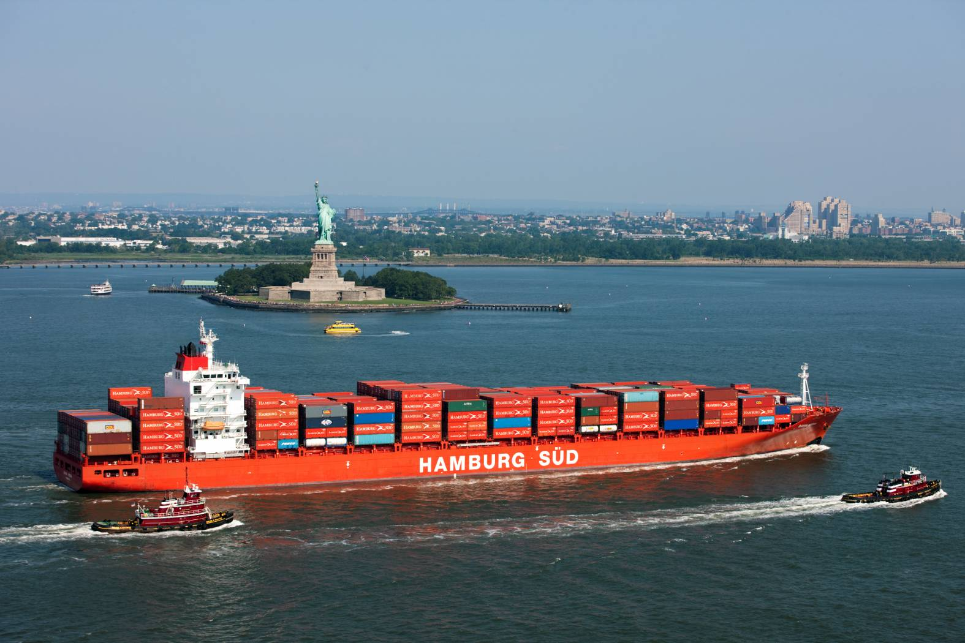
Next Steps
Continue recovery and reconstruction efforts while maintaining port operations.
Begin to articulate:
  Lessons learned
  Immediate changes in capital improvements underway
Identify longer term capital investments and operational changes.

Slide 20
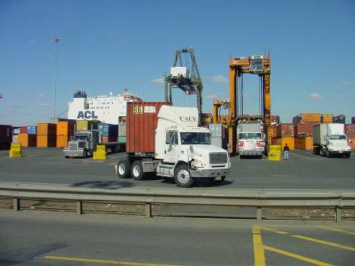
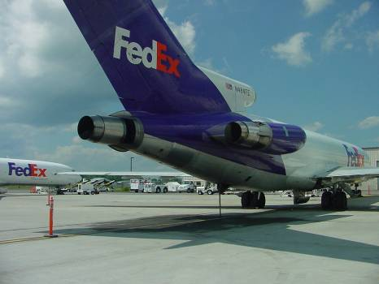
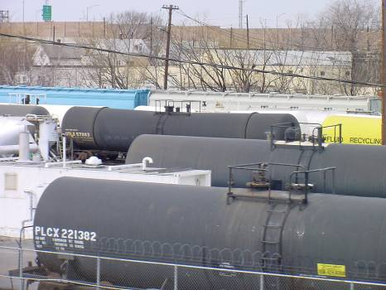
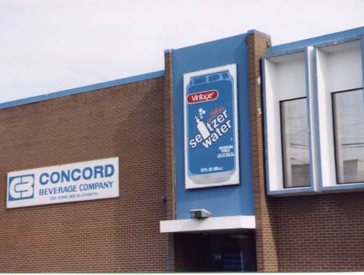
Thank you!
Anne Strauss-Wieder
A. Strauss-Wieder, Inc.
asw@as-w.com
www.as-w.com

