Slide 1
Impact of OCU Strike on Port Operations
Don Snyder, Director of Trade Development

Slide 2
Compare & Contrast
2002 labor lock-out
2004 congestion situation
2012 OCU strike

Slide 3
Eight-Day Strike by Office Clerks
First major work stoppage since 2002
First strike since 1972
600 clerks idled 10 of 14 terminals at POLB/POLA

Slide 4
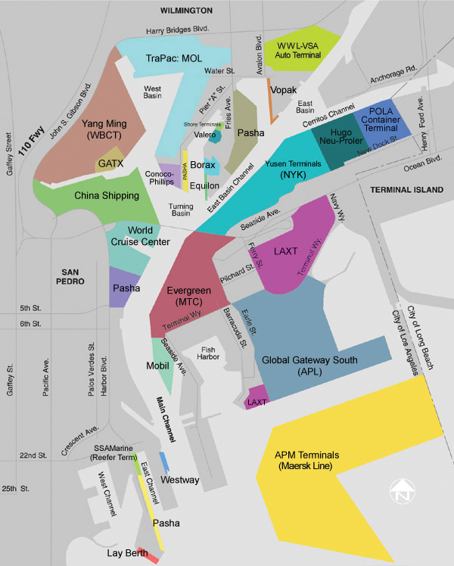
San Pedro Bay Ports

Slide 5
Impacts
Information Flow
Cargo Flow
Trucks
Cargo Owners
Rail
Vessel Diversion
Business Continuity
Notes:
Thank you.
I’m happy to speak to you today.
We have a huge impact on the region, so it’s important for everyone to understand what we do, and the key issues that we face.
Let’s me begin with a brief introduction of who we are.
The Port of Long Beach is run by the City of Long Beach on behalf of the State of California.
We are not supported by tax dollars, but operate like a real estate development company.
We build shipping terminals, and lease them to private companies who import and export goods.
The rents we collect are reinvested in continually upgrading our facilities.
So we promote trade and support jobs – more than 300,000 in Southern California, including 30,000 in Long Beach.
We’re the 2nd busiest in the U.S. , after only the Port of Los Angeles.
We transport consumer products manufactured in Asia, and export largely raw materials produced in the U.S.

Slide 6
Minimal Impact in Long Beach
3 of 6 terminals worked through strike
After settlement, terminals caught up quickly
Capacity to handle surges in cargo
Notes:
Thank you.
I’m happy to speak to you today.
We have a huge impact on the region, so it’s important for everyone to understand what we do, and the key issues that we face.
Let’s me begin with a brief introduction of who we are.
The Port of Long Beach is run by the City of Long Beach on behalf of the State of California.
We are not supported by tax dollars, but operate like a real estate development company.
We build shipping terminals, and lease them to private companies who import and export goods.
The rents we collect are reinvested in continually upgrading our facilities.
So we promote trade and support jobs – more than 300,000 in Southern California, including 30,000 in Long Beach.
We’re the 2nd busiest in the U.S. , after only the Port of Los Angeles.
We transport consumer products manufactured in Asia, and export largely raw materials produced in the U.S.

Slide 7
Impact on Operations
Nearly $1 billion in cargo a day delayed
Tens of thousands of jobs impacted: longshoremen, truckers, rail yard and warehouse workers

Slide 8
Lost Business Opportunities
17 ships were diverted from the Port of Los Angeles
Ships diverted to Oakland, Mexico and through Panama Canal

Slide 9
Busiest December for Imports

