Slide 1
Federal Highway Administration, Talking Freight Webinar
Guy Welton, Vice President of Operations

Slide 2
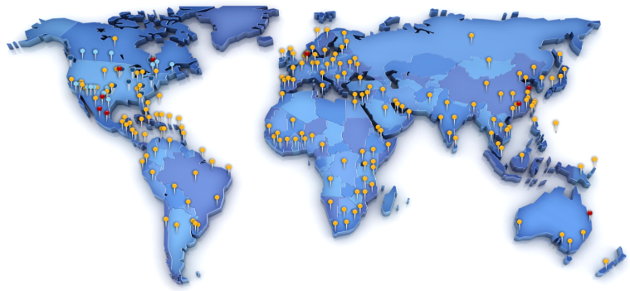
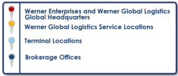
Company Profile
Premium provider of transportation and logistics services, specializing in Truckload, Intermodal, LTL, Ocean and Air services.
2012 Revenue: $2 billion 2012 Net Income: $103 million
NASDAQ: WERN Alliance Carriers: 8,500
Trucks: 7,300 Trailers: 23,380

Slide 3
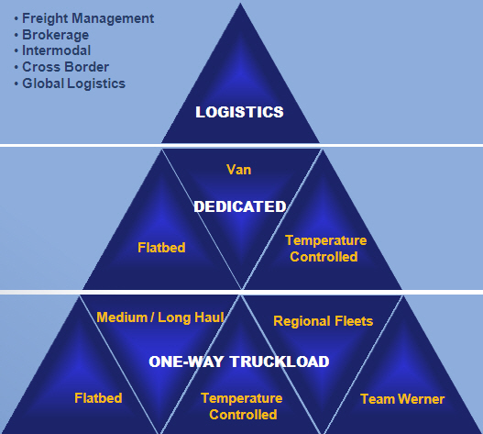
Company Profile Strategy
28% of revenue
Asset-Light
37% of revenue
3,350 trucks
Asset-Intensive
35% of revenue
3,950 trucks
* Revenue / Truck Counts as of last quarterly release

Slide 4
Trucking Traveler Information
Conventional/Personal Communication
Truck On Board Communication
Navigation Tools
Improvement Opportunities

Slide 5
Conventional/Personal Communication
Sources
Weather Websites
DOT Websites
News
Driver Feedback
Email Communication
Methods
Phone Communication with Drivers
On Board Communication

Slide 6
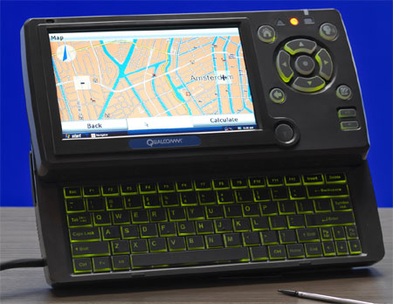
On Board Communication – Qualcomm MCP200

Slide 7
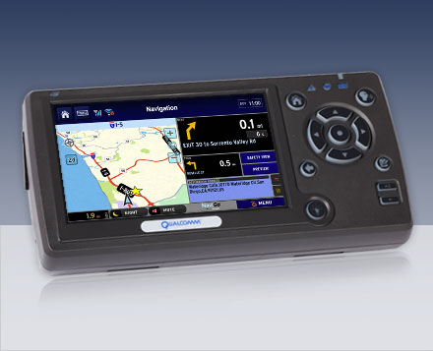
Navigation – Truck Specific Routing

Slide 8
How Navigo Works – Routing 101
NaviGo - How we understand the road network
All Roads belong to a Class
Class 0 – Interstates
Class 1-US Routes
Class 2 – State Routes
Class 3 – County Roads
Class 4 – Local Roads
Standard Personal
Navigation Device
(Garmin/Tom Tom)
Truck
Enabled
GPS
(Teletype)
NaviGo
Each Road has a set of attributes
Speed Limit
Mileage
Height Restrictions
Legal Restrictions
Weight Restrictions
Elevation
Number of Turns
Turn Type (Right/Left
Turn Radius
Intersections
Historical congestion
STAA Road Network Information
Many, Many, Many More

Slide 9
Navigation – Telogis navigation Summary
Accurate Data: Ability to update data in real-time
Company Routing Preferences
Driver Feedback
Weather/News
Road Closures
Catastrophic Events
State DOT Websites
Community Concept: Social Navigation
Road network keeps getting better
Feedback from drivers and back office users
Flexible Environment
Tunable at the Fleet, Sub-fleet, Driver level
Road Modifiers
POIs: Custom Notes, Yards, Modifiers

Slide 10
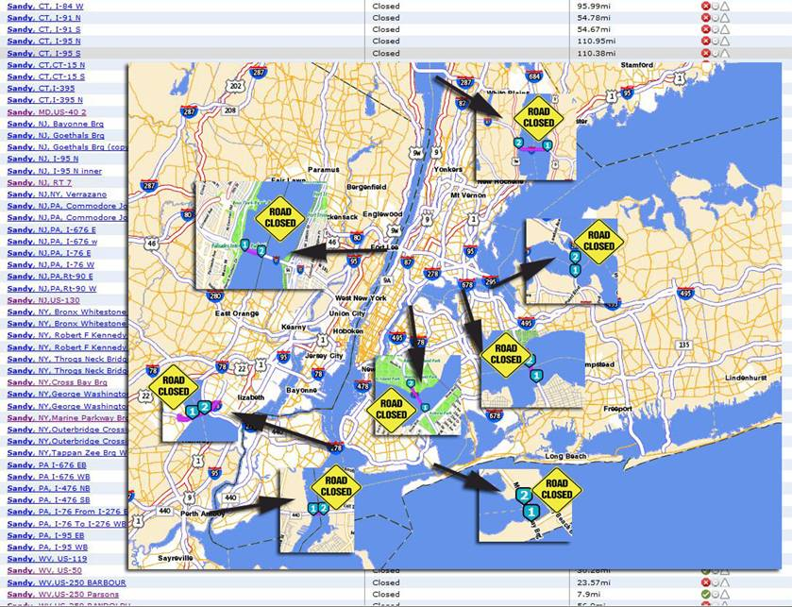
Road Manager: Hurricane Sandy Response
Updates every 1 -2 hours
Tracked 55 Major Road Closures
Affected 1,165 miles of freeway

Slide 11
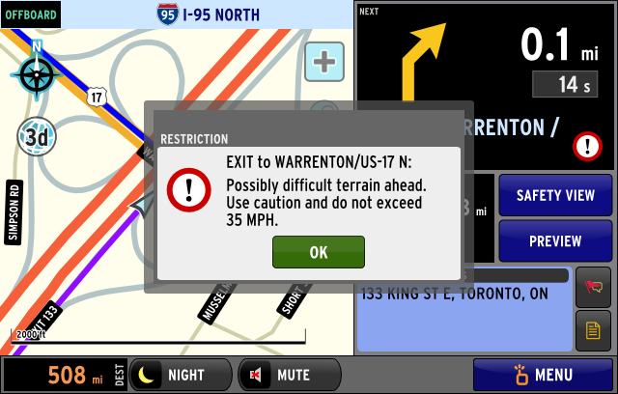
Navigation – Future Industry Improvement Opportunity
Next version of Navigation powered by Telogis to include
the following client features:
Posted speed limit notification
Driver warnings related to difficult road conditions, sharp turns, etc…
Driver Coaching
Signage as Real
Junction View
Traffic and Weather data

Slide 12
Thank You
For more information visit: www.werner.com
Follow us on Facebook and Twitter

