Slide 1
Talking Freight
Trucking Industry Traveler Information
A small carrier’s perspective
Joyce Brenny, President, Brenny Transportation, Inc.
Sarah Hanebuth, Safety Director, Brenny Transportation, Inc.
July 17, 2013

Slide 2
Joyce Brenny, Founder & CEO Brenny Transportation, Inc.
30 years in the trucking/logistics industry
Immediate past chair MN Trucking Assoc.
BA Organizational Behavior & Psychology from St. Scholastica
BOD Women In Trucking Foundation
WIT Most Influentional Woman in Trucking
BOD St. Christopher's Driver Relief
TIA Samaritan winner

Slide 3
50 power units
Flatbed specialized freight
49 states and Canada
93% driver retention average over 5 years
MN Business Top 100 Employer Award 2012
The goal at Brenny is “Eyes on the Road” for safety
Great West Platinum Fleet Safety Award 2013

Slide 4
Resources Used For Traffic and Truck Routing:
www.fhwa.dot.gov/trafficinfo/
Google maps- satellite street view
PC routing
Rand McNally
GPS live traffic updates
Company software
Driver check calls and personal assistance
Experience
Parking

Slide 5
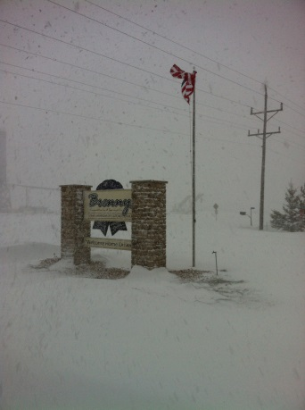
Resources Used For Weather:
www.weather.com
www.noaa.gov (national oceanic & atmospheric admin.)
T.V. & radio stations/websites
Driver check calls and personal assistance
Truckstops
Customers
CB radio
511
Experience

Slide 6
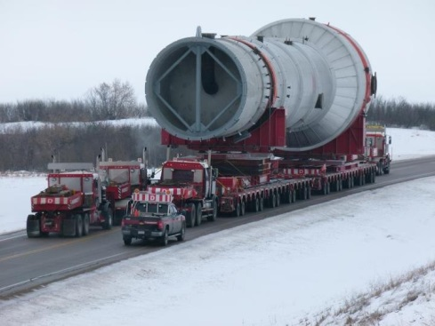
Wish list of resources:
Project underway for MN I94 Corridor truck parking notification
Live updates via routing through GPS
Voice alerts sent to drivers with input of routes
Unify all states rules for OD loads- This would keep truck traffic flowing at an even pace
Application to work with FHWA / software

Slide 7
Thank you!
www.brennytransportation.com
joyce@brennytransportation.com
sarah@brennytransportation.com

