Slide 1
Idaho 511 Truckers’ Information
Tony Ernest – Traveler Services Coordinator
Reggie Phipps – Vehicle Size and Weight Specialist
Talking Freight Seminar, July 17, 2013

Slide 2
Idaho’s Truckers’ Page
Partnership between ITD’s Commercial Vehicle Services team and 511.
Same information as in standard 511, but filtered and presented differently.
Three separate products. All offer the same basic information.
  - 5-1-1 Phone system. Separate menu item.
  - Low Bandwidth website version.
  - High Bandwidth website version.

Slide 3
System Features
Information includes: road closures, commercial vehicle restrictions, pavement spring breakup areas, truck escape ramps.
Easy to navigate to other information, such as mountain pass conditions, winter road conditions, and web cameras.
Map interface with clickable icons.
Searchable by region or highway.
High bandwidth web offers customizable routes.
Personalized user accounts to store routes.
Live e-mail and text updates.

Slide 4
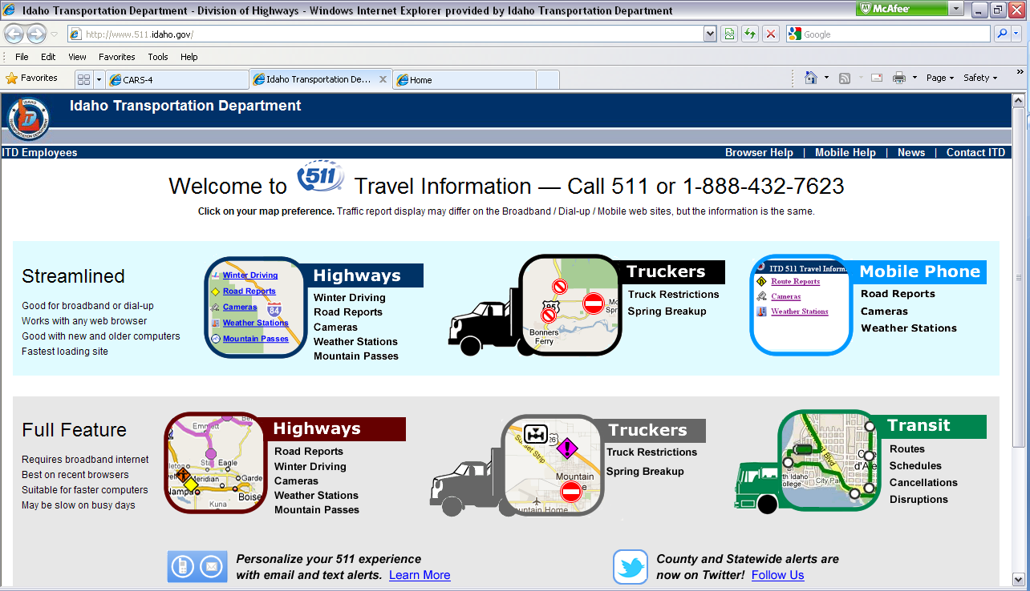
Online Website Demonstration

Slide 5
Questions?
Tony Ernest – (208) 334-8836
tony.ernest@itd.idaho.gov
Reggie Phipps – (208) 334-8418
  reggie.phipps@itd.idaho.gov

