Slide 1
Talking Freight Growth of Intermodal Terminal Facilities
Overall Economic and Transportation Perspective
Marty Lipinski / Dan Pallme
Intermodal Freight Transportation Institute
June 19, 2013
Notes:
Thank you for opportunity to participate and for allowing me to share some perspectives on inland intermodal terminal development. My objective will be to provide an overview of the topic and to set the stage for the other presenters.

Slide 2
Inland Port: Definition
“A rail or a barge terminal that is linked to a maritime terminal with regular inland transport services. ……….supports a more efficient access to the inland market both for inbound and outbound traffic. …….an array of related logistical activities linked with the terminal …distribution centers, container and chassis depot, warehouses and logistical service providers.” Rodrigue J-P. The Geography of Transport Systems. Routledge, New York, 2013
Other names: dry ports, inland terminals, inland hubs, inland logistics centers, inland freight villages
Notes:
Here is one generic definition of an inland port. There are others that are similar.

Slide 3
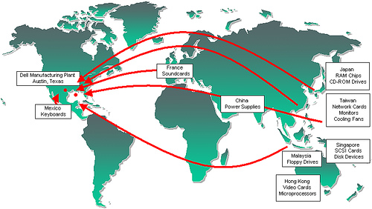
Driving Forces Why Move Inland? Global Supply Chains
Notes:
What is one of the primary factors driving the growth of inland ports – the creation of and continual shifting of global supply chains.
This is an example of the global supply chain for Dell computers. You don’t need to see the information in the little boxes – just the general flows indicated by the red arrows.

Slide 4
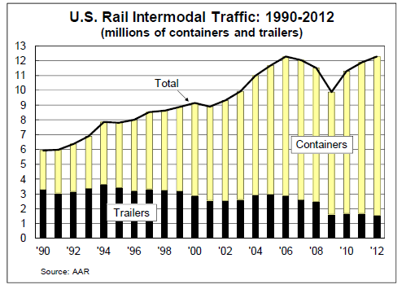
Rail Intermodal Traffic (Containerization)
Notes:
And of course all these goods are moving in containers
Here you can see the growth in rail intermodal over the past 20+ years. They hit new levels in 2013.
Note the growth in containers versus trailers
Containers are a mix of sizes – 20, 40, 53

Slide 5
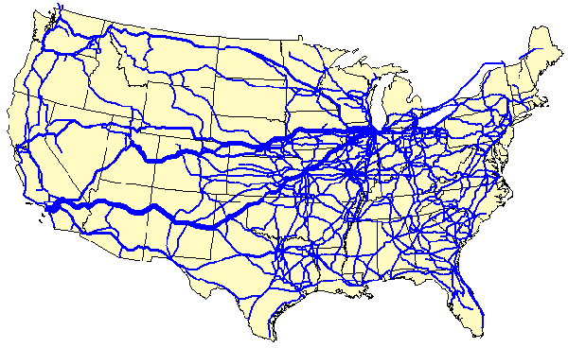
Rail Intermodal Flows
Notes:
Here you can see rail intermodal flows. Today they are primarily west to east
Note the prominence of the Chicago and the connection to the ports of LA/Long Beach.

Slide 6
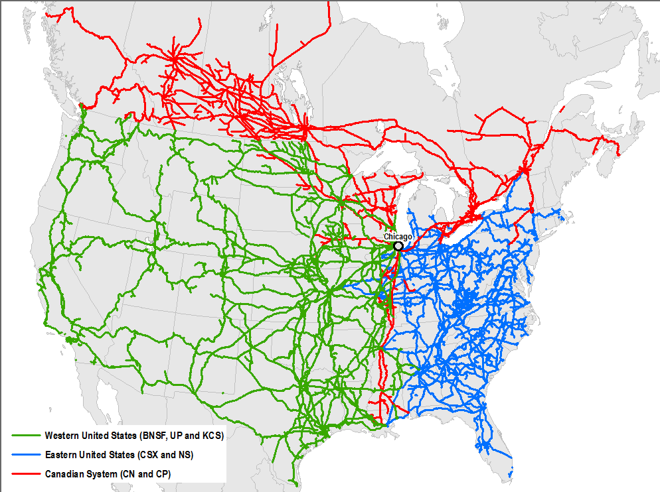
Chicago
Kansas
City
Memphis
Excerpt from: The Terminalization of Supply Chains: North American and European Perspectives, by Theo Notteboom and Jean-Paul Rodrigue
Dallas
New Orleans
Notes:
Here are shown some of the more prominent inland port locations. Note that they seem to align with the intersection of the western and eastern railroads.

Slide 7
“Rails should have edge on trucks over the next ten years.”
- Bear, Stearns
Offshore manufacturing, whereby large shipments of freight that are produced well in advance in Asia and transported by ocean to U.S. ports lend themselves to longer-haul, non-service-sensitive rail shipments within the country.
A sharper focus on reducing fuel costs and dependence on imports (we estimate that the rails are about two to three times more fuel-efficient than truckload carriers).
Worsening highway service and growing public frustration with congested highways, causing federal and state governments to increasingly encourage rail, barge, and creative tolling programs to help alleviate this problem.
Notes:
Why by rail?
Economical
Environmental advantages
Efficient – Service has improved to an extremely reliable service
Reduced Highway Congestion

Slide 8
Why Move Inland Other Driving Forces
Logistic capabilities (one location)-logistics clusters
Lower distribution cost
High land prices (and land availability) at Marine Terminals
Improve marine terminal operations
Lower land costs inland
Notes:
Here are some of the other driving forces behind the growth of inland ports
One is the ability to create logistics clusters. I will give some examples of this later
A second is economical – total distribution costs are reduced.
It is very difficult in today’s world to expand operations at the ocean marine terminals. There is stiff competition for land and other factors such as truck and rail congestion and environmental impacts have resulted in citizen opposition to port expansion.
Moving operations inland allows for the ocean port to operate more efficiently.
And, land is less expensive and more available at inland sites.

Slide 9
Basic Characteristics
Terminals
Connections
Logistics Activities
Notes:
Here are three basic elements that have fostered the development of inland ports.
In the next series of slides I will be using examples from existing inland terminals to illustrate these points

Slide 10
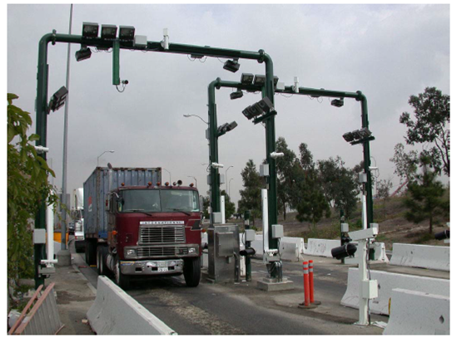
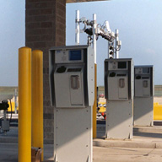
Notes:
The gate systems are completely automated. Here are a couple of examples. Information about the drayage unit and the container are captured with a series of camera. Driver information is recorded with a thumb print. The drivers are told where to proceed to along the track to have the container loaded. If a driver is incoming with an empty chassis, he is told where to go to pick up a container. GPS is used to keep track of container locations.
The same type of technology is employed at the exit gate to insure that the correct container was picked up.

Slide 11
Inland Ports…
Prince Rupert
Memphis, TN
Edmonton
Vancouver
Winnipeg
Montreal
Halifax
Chicago
Memphis
Jackson
New Orleans
Shanghai to Memphis – 18 Days
Via Prince Rupert
Notes:
This is an example of the CN movement to inland ports via the ocean ports of Price Rupert and Vancouver
An example of throughput. All containers move inland except for a low amount of containers drayed out the gate and the sheer majority of these are for customs inspections. Although this shows an overall

Slide 12
CenterPoint, Joliet, IL
Notes:
The Centerpoint development is located in Elwood, Illinois, just south of Joliet, IL, approximately 50 miles from downtown Chicago.
It covers 35 square miles with major BNSF and Union Pacific intermodal terminals.
Two interstates, I-80 and I-55 are in close proximity to the site.
There is access to a major Walmart distribution center adjacent to the BNSF facility, other distribution centers on-site and many other warehouses/DCs in the region along I-55 and I-80.
There is water access nearby which is currently underutilized.
There is a significant outbound movement of grain in containers.

Slide 13
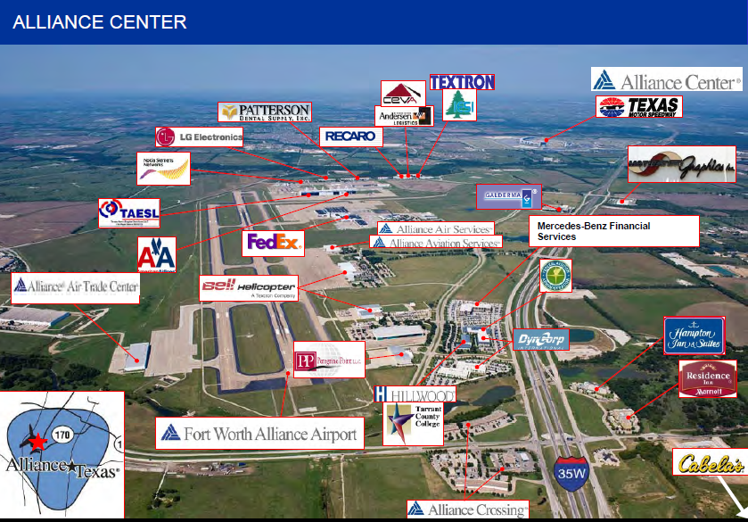
Notes:
Her is the Alliance Center in Fort Worth , Texas
Key things to note are the airport access, roadway access to I-35W, and the connection to the logistics centers in the area.

Slide 14
BNSF, Memphis
Notes:
Here is a drawing of the site. It has 6 tracks, 7000 feet long, 8 total cranes – production and stacking, and space for a total inventory of 6000 units, not including chassis storage.

Slide 15
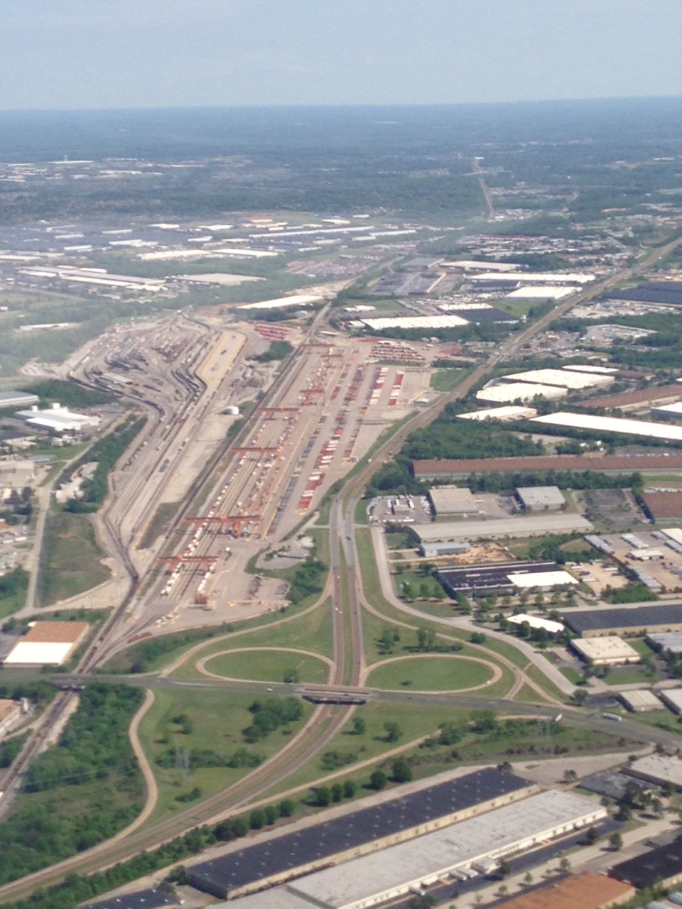
BNSF, Memphis
Notes:
This is an aerial of the BNSF intermodal facility in Memphis, TN, opened in 2009 at a cost of $200 million. It spans 185 acres and has the capacity to handle 1 million lifts per year.
When researching potential sites, BNSF looked at some ‘green filed’ locations but decided to expand operations at the site of their existing Tennessee yard primarily because of the close proximity to major customers such as Nike and Williams Sonoma.

Slide 16
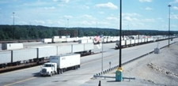
BNSF and UPS
Willow Springs, IL
Notes:
This is a good example of synergism. The UPS sort and distribution facility is located adjacent to the BNSF Yard. No travel on city streets is required.

Slide 17
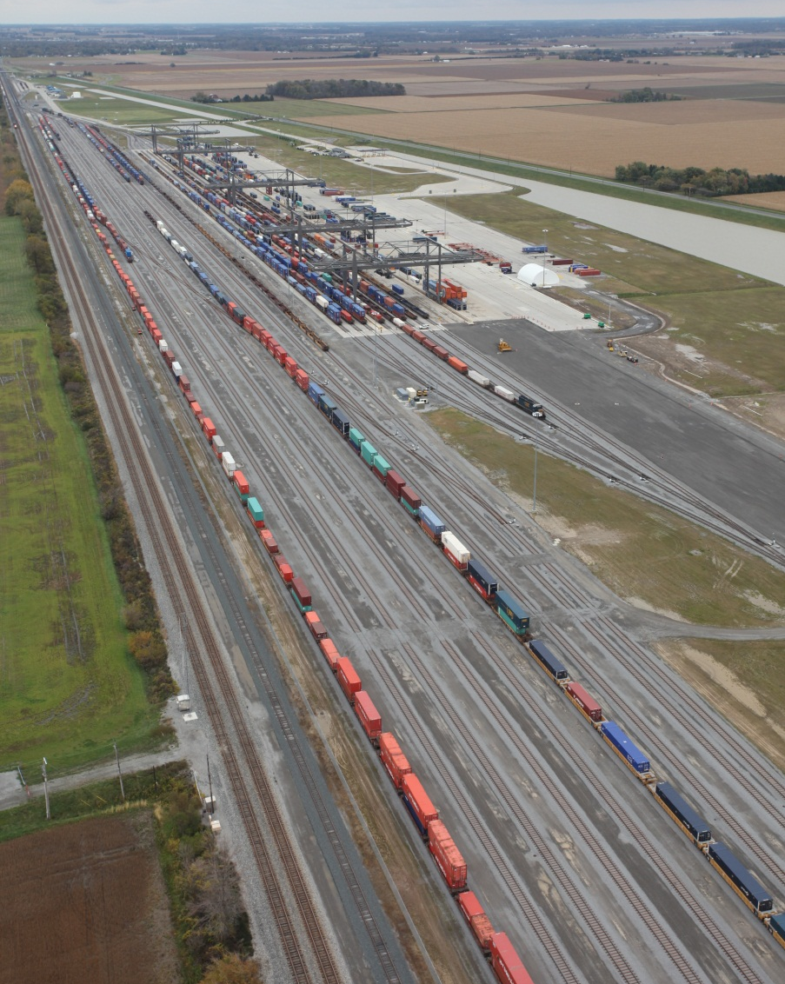
CSXT’s NW Ohio hub creates strategic connectivity
500 acre facility constructed in 2011 as a public-private partnership
Employs more than 300 full‐time employees
Technology advancements improve operational efficiencies
Cranes regenerate power, driving a reduction in pollutants by 80%
Network enables comprehensive reach to more markets
Supports highway-to-rail “H2R” growth, improved service reliability
Notes:
CSX invested $175 million in the Northwest Ohio Intermodal Terminal which is located in North Baltimore, OH
500 acre facility.
Ultra-efficient electric cranes which lower emissions – over 8 processing tracks. Re-generate electricity
Cranes as wide as a football field and weighing more than a 1,000, 000 pounds

Slide 18
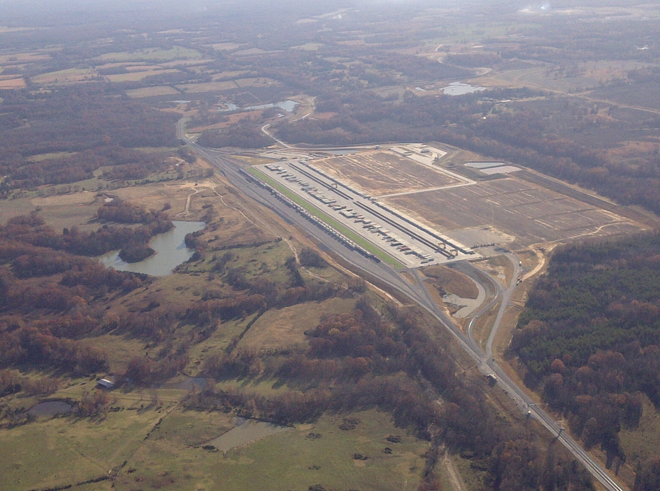
NS – Rossville, TN
Notes:
Here is the newly opened Norfolk Southern facility in Rossville, TN, located east of Memphis.
One of the most interesting facts of this operation is that the developer of the entire site surrounding the rail terminal has built, at his expense, a roadway designed to handle overweight trucks into the area connecting to potential warehouse/distribution sites. Thus one major problem of dealing with overweight trucks on public highways is eliminated.

Slide 19
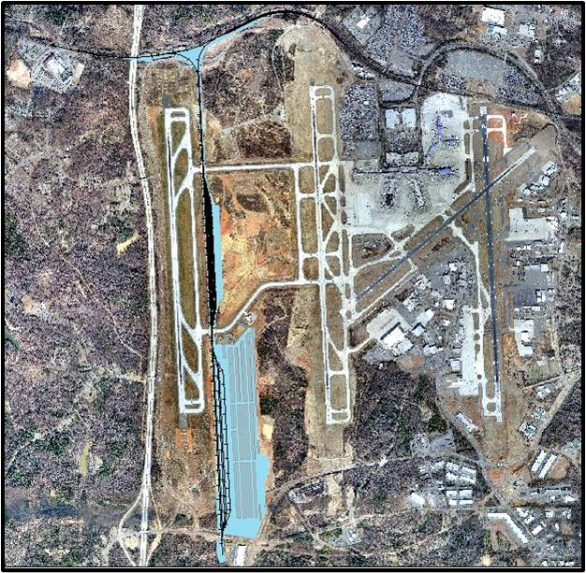
Norfolk Southern, Charlotte
Notes:
Rail to air and highway

Slide 20
Memphis area intermodal investments (example)
Over $600 million spent by the 5 class 1’s
UPRR – 1998
Build it they will come
CN / CSX – 2005
Frank C. Pidgeon Industrial Park – 3,000 acres – MS river access
Economies of scale with a shared facility
BNSF – 2010 expansion
Heart of warehousing and trucking communities
NS (Rossville) – 2012
$100 million-plus planned development
Factors encouraging growth
Notes:
The pumps, which will draw water for a San Antonio-style riverwalk, are just a tiny part of his vision for Piperton Hills, a $100 million-plus planned development with golf cart paths, a town square, charter schools, shopping centers, thousands of homes in varying price ranges and a mix of commercial and industrial facilities
Factors encouraging growth
1. Multi-regional approach (AR, MS, TN)
2. Jobs – Jobs – Jobs
3. Ready for growth – Approximately 850,000 annual lifts for the region (capacity 2x)
4. Other industries, growth, aerotropolis concept
5. Tax incentives
6. Supply chain - service

Slide 21
Other New Facilities
Columbus, Ohio
Indianapolis, IN
Birmingham, AL
Kansas City Expansion
Many More
Notes:
The railroads have been heavily investing in new facilities. Here are some examples, there are several more.
Some of the expansions in the eastern US have been a result of rail improvements such as the Norfolk Southern Crescent Corridor and the Heartland Corridor which have opened up new markets for contain flows.

Slide 22
Summary
Inland terminals have been economic engines in many communities
They have used the line haul advantages of the railroads coupled with the need for trucks to deliver the “last mile”
They have generated community concerns related to increased congestion, environmental impacts, etc
Comprehensive planning efforts involving the railroads, developers, transportation agencies, and others are required to insure that the developments are implemented in a manner to capture economic advantages while not adversely impacts community livability.
Notes:
It is about the economic drivers that drive the railroads to invest and get an acceptable return on investment. However, they are also good neighbors and trying to be a good steward and have balance between the environment and their stockholders or investors needs. Balance the green (dollars vs environment) so to speak.

Slide 23
Questions
Marty Lipinski
mlipinsk@memphis.edu or 901-678-3279
Dan Pallme
depallme@memphis.edu or 901-678-2688
Notes:
Turn it over to Jennifer

