Slide 1
Inland Intermodal Port – Auburn, Maine
Roland G. Miller -- Director of Community & Economic Development, City of Auburn, Maine
Edward J. Foley -- V.P. of Sales & Business Development (Northeast Region), Genesee & Wyoming Railroad

Slide 2
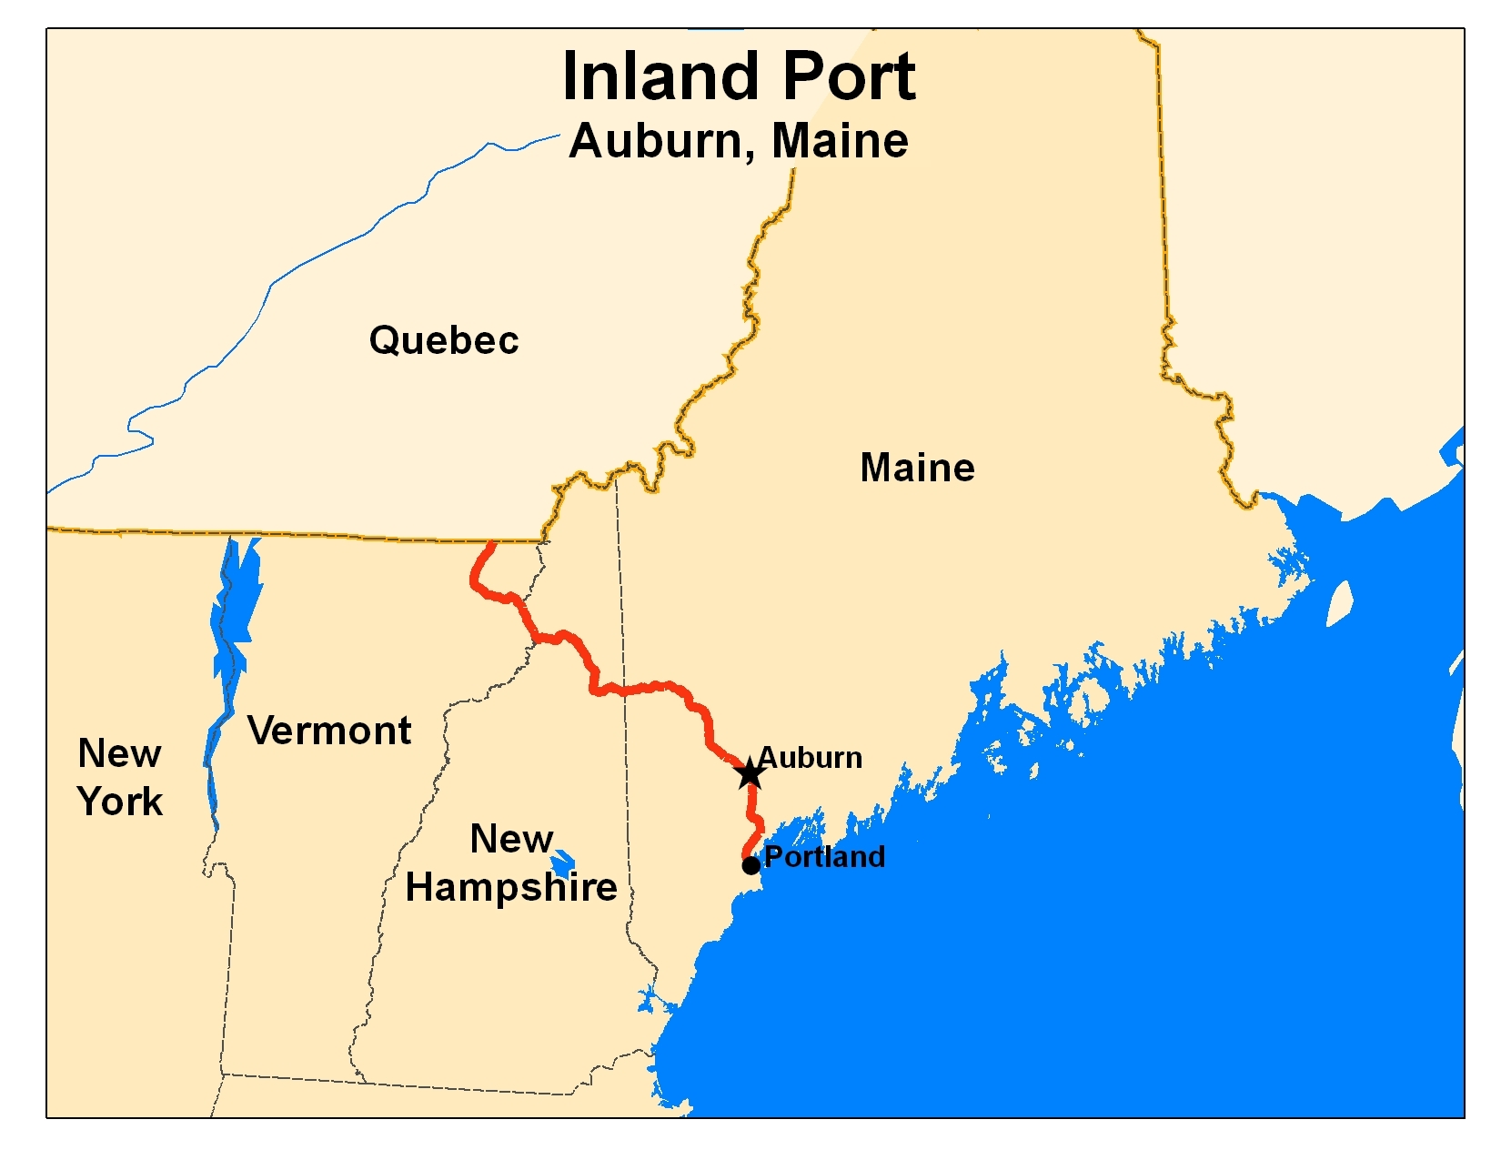

Slide 3
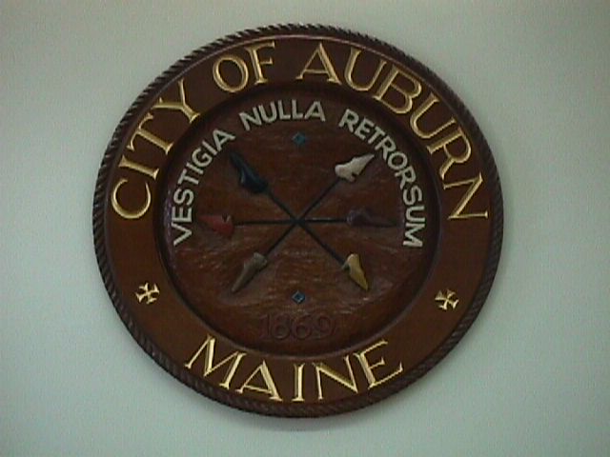
A Margaret Chase Smith Quality Award Recipient

Slide 5
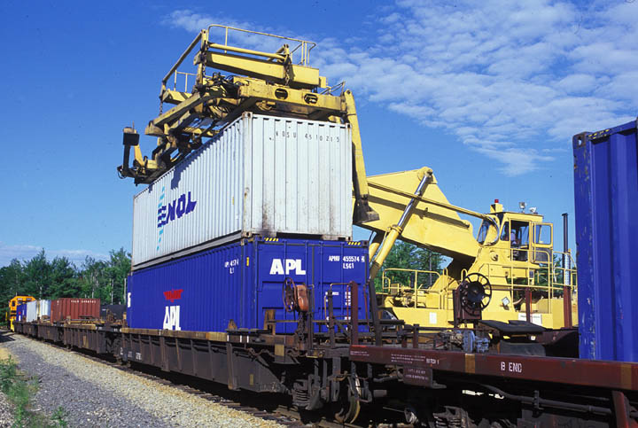

Slide 6
