Slide 1
A Case Study of Promoting Metropolitan Freight Collaboration: The Twin Cities Experience Overview Minnesota Department of Transportation Metropolitan Council U.S. Department of Transportation - Volpe Center
Federal Highway Administration
Office of Freight Management and Operations
Talking Freight Seminar Series
March 20, 2013

Slide 2
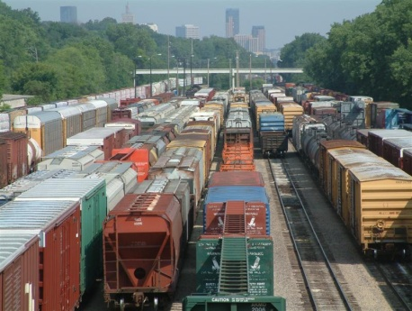
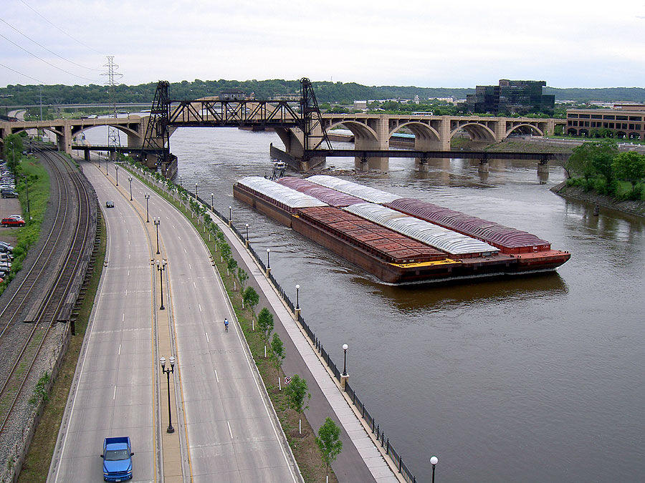
Overview
Motivation
Purpose
Context

Slide 3
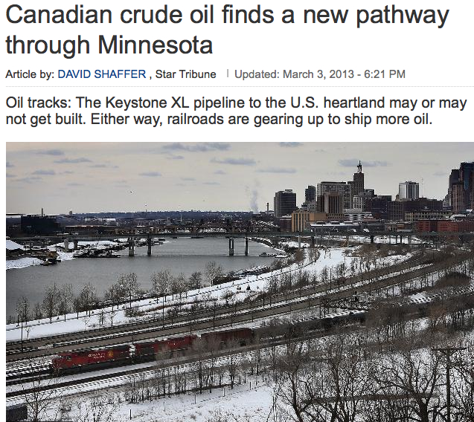
www.startribune.com

Slide 4
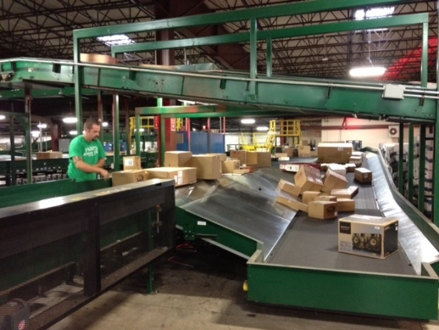
Overview continued:
Elements presented today:
-Story of Freight in the Twin Cities
-Freight in the metro transportation planning process
-Freight performance management
-The road ahead
Other elements:
-Issues and trends -Future Freight Flows Workshop
-Peer Exchange -Readiness Assessment

