Slide 1
A Case Study of Promoting Metropolitan Freight Collaboration: The Twin Cities Experience The Road Ahead Minnesota Department of Transportation Metropolitan Council U.S. Department of Transportation - Volpe Center
Federal Highway Administration
Office of Freight Management and Operations
Talking Freight Seminar Series
March 20, 2013

Slide 2
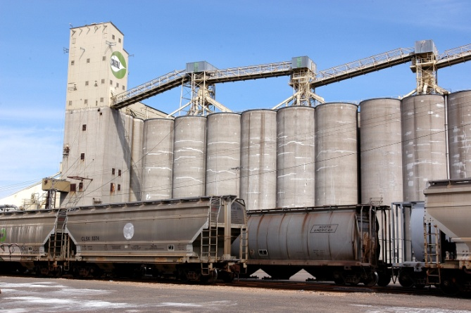
The Road Ahead
Regional Freight Priority Issues
Freight/passenger rail shared use
Regional intermodal facility capacity
Roadway access to intermodal facilities
Industrial land analysis
Traffic congestion & truck mobility
Truck safety

Slide 3
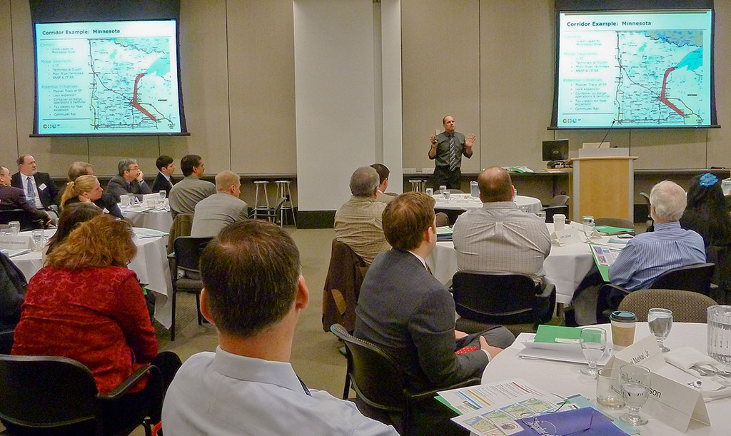
The Road Ahead
Next Steps
Jointly develop a multi-modal data collection and analysis framework
Use analysis to re-examine key issues/priorities/solutions within metro planning context
Assess regional implications of MAP-21 freight provisions including performance measures and freight network designation
Work with regional advisory committees to establish regional freight agenda with organizational commitments.
Establish a joint MnDOT-Met Council work plan to implement the regional freight agenda.

Slide 4
The Road Ahead
Lessons learned/observations
-Commitment (leadership, staff, resources)
-Informal and formal structures
-Issue ownership/role definition

Slide 5
Contact Information
Bill Gardner – William.Gardner@state.mn.us (651-366-3665)
Alisa Fine – Alisa.Fine@dot.gov (617-494-2310)
Connie Kozlak - Connie.Kozlak@metc.state.mn.us (651-602-1720)
David Damm-Luhr – David.Damm-Luhr@dot.gov (617-494-2102)
For more information on this effort and links to products, please see: www.volpe.dot.gov/noteworthy/2012/ckefm.html

