Slide 1


A Case Study of
Promoting Metropolitan Freight Collaboration:
The Twin Cities Experience
Opportunities to Strengthen Freight in Planning
Minnesota Department of Transportation
Metropolitan Council
U.S. Department of Transportation - Volpe Center
Federal Highway Administration
Office of Freight Management and Operations
Talking Freight Seminar Series
March 20, 2013

Slide 2
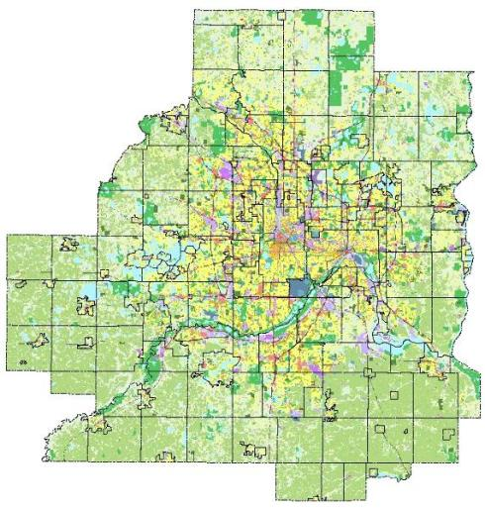
Context: Metropolitan Council
Created by the Legislature in 1967 to:
Plan for the orderly, economical growth of
seven-county area
Coordinate services that any one city or county could not effectively provide

Slide 3
Context: Metropolitan Council
Metropolitan Development Guide for the seven-county area includes:
2030 Regional Development Framework
System plans-
transportation, airports,
parks, sewers

Slide 4
Context: Metropolitan Council
Designated as the MPO
Transportation Advisory Board local official, modal input
Freight member of Technical Advisory Board (TAB)

Slide 5
Traditional Metro Freight Planning
Long Range Plan
Freight Considerations in Project Selection
Participate in MN Freight Advisory Committee
Special Freight Studies
Barge Fleeting (1970’s)
Metro Intermodal Rail Transfer Study (MIRTS-1990’s)
Air Cargo Regional Distribution Center (2000’s)

Slide 6
Why focus on planning process?
Freight buried among many factors
TIP and STIP typically consider many projects
Council has not seen freight as a big priority
Explore common interests with MnDOT
Identify opportunities to give visibility

Slide 7
Getting us on the same page
Identify relevant planning processes
Understand how each currently addresses freight and why
Explore opportunities to make freight more explicit part of processes

Slide 8
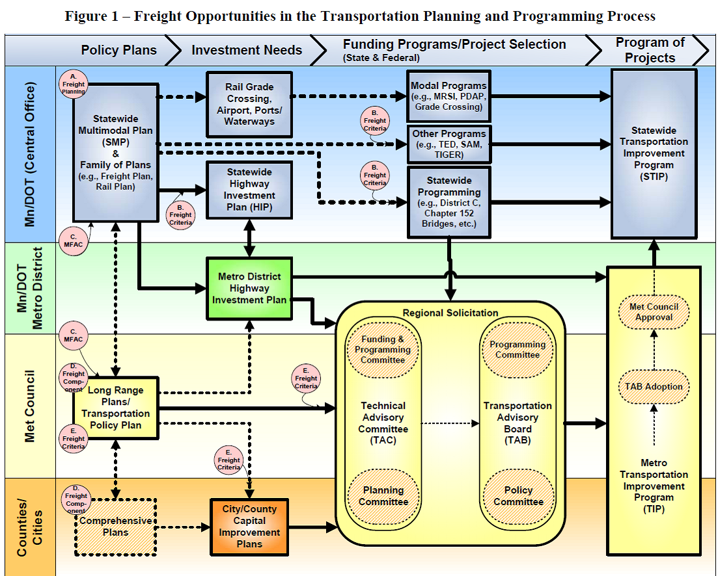

Slide 9
Opportunity Areas
Identifying needs
Articulating problems and potential solutions
Setting priorities
Selecting and programming projects
Implementing projects

Slide 10
Freight Opportunity Areas & Actions
Opportunity Areas | A. Identifying Needs | B. Clarifying problems and potential solutions | C. Setting Priorities | D. Selecting and programming projects | E. Implementing projects
Action Steps | Defining freight needs | Defining “freight” projects | Developing criteria for prioritization | Modifying project selection criteria | Improving project delivery
 | Identifying, evaluating, and sharing data sources | Conducting outreach | Assessing the efficiency of the freight system | Performing education/ outreach | Raising the profile of freight
 | Performing data collection and analysis | Collecting data and performing analysis | Cross-promoting economic development |  | Increasing funding for freight
 | Developing performance measures

Slide 11
Opportunities to
Strengthen Freight Planning
MnDOT Central Office & Metro District
Freight Planning
Freight Criteria
MFAC

Slide 12
Opportunities to
Strengthen Freight Planning
Met Council and Counties/Cities
Freight Component
Freight Criteria

