Slide 1
A Case Study of Promoting Metropolitan Freight Collaboration: The Twin Cities Experience Performance Management Framework Minnesota Department of Transportation Metropolitan Council U.S. Department of Transportation - Volpe Center
Federal Highway Administration
Office of Freight Management and Operations
Talking Freight Seminar Series
March 20, 2013

Slide 2
Performance Management: Why?
Demand > Supply
Measures & indicators point to
Place & extent of problems
Solutions grounded in root causes
Framework helps
Balance competing goals
Set priorities
Lower quality

Slide 3
Performance Management: How?
Framework for Twin Cities Freight
Used existing state & MPO policy documents
Referenced NCFRP #10
Researched 5 goals:
Safety/security
Infrastructure preservation
Mobility
Accessibility to key centers
Community & environmental sustainability

Slide 4
Framework
Summary of Metro Freight System Performance by Mode
Strategic Goals | All Modes | Highway | Rail | Air | Water
 | See Table 2 | See Table 3 | See Table 4 | See Table 5 | See Table 6
Safety/Security
Infrastructure preservation
Mobility (LOS, congestion, travel time reliability)
Accessibility to key centers (economic development)
Community and Environmental sustainability

Slide 5
Performance Management: What?
Successful=
Relevant to policy objectives
Data exist to support and can be collected
Level of detail matches action considered
Definitions
Indicators: trends affecting mode’s performance in terms of a goal + providing early warning signals
Measures: mode’s performance regarding a goal

Slide 6
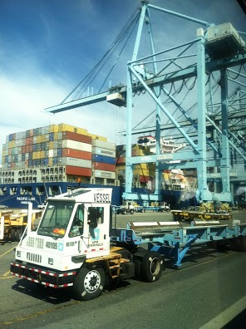
Performance Management Info
Metro Twin Cities Framework for Freight
Safety/Security
All Modes
Indicators: Trends in insurance costs Facilities with security vulnerabilities System resilience: availability of alternate routes Measures: Fatalities Serious injuries

Slide 7
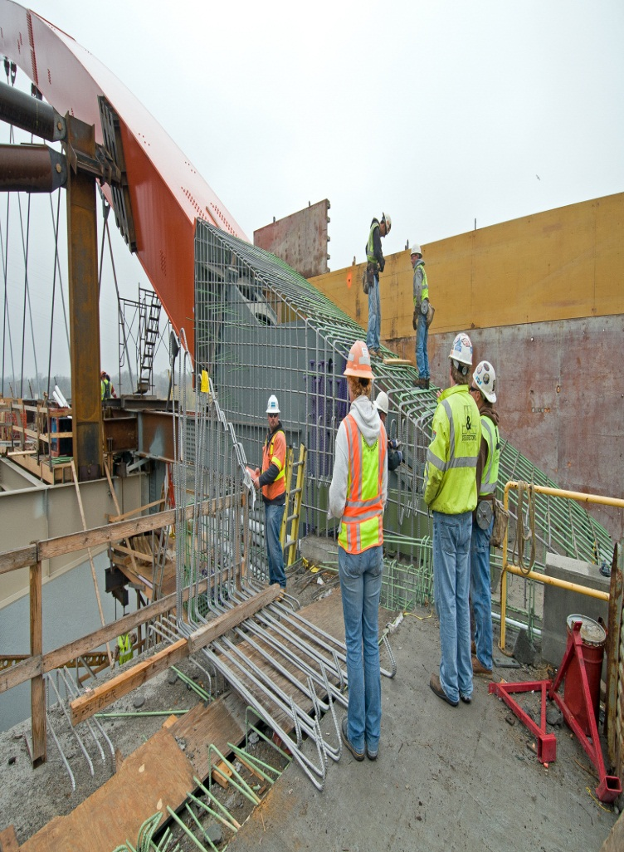
Performance Management Info
Metro Twin Cities Framework for Freight
Infrastructure Preservation
Highway
Indicators: # bridges and roads with weight restrictions # RR grade crossings on major truck routes Measures: Bridge condition on principal arterials (% poor) Pavement ride quality (% poor) by functional class (principal arterial, other arterial)

Slide 8
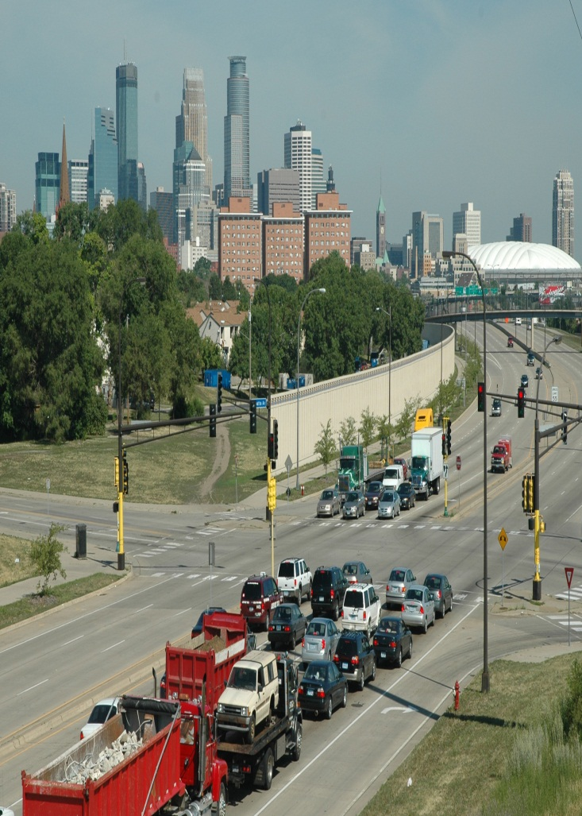
Performance Management Info
Metro Twin Cities Framework for Freight
Mobility
Highway
Indicators: Truck vehicle miles traveled Ton-miles and dollar value carried Measures: Duration and extent of congestion on freeways (peak hour spreads) Metro area delay estimates for freight Clearance time for metro-urban freeway incidents

Slide 9
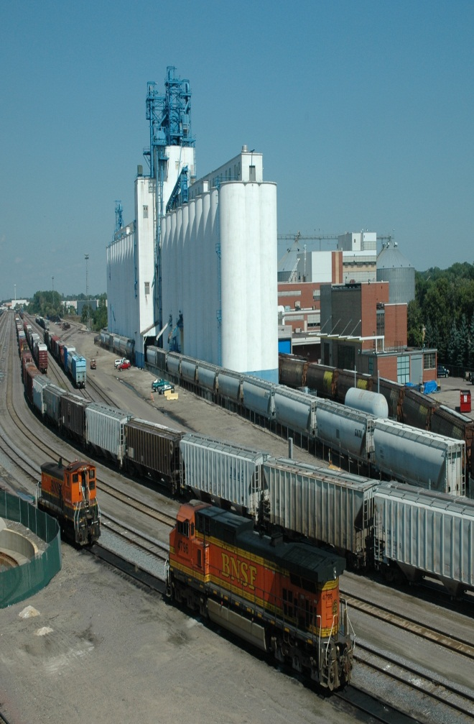
Performance Management Info
Metro Twin Cities Framework for Freight
Accessibility to Key Economic Centers
Rail
Indicators: Rail abandonments Adequacy of intermodal connector routes Measures: # key centers with adequate rail access Cost of goods movement and travel time on key rail corridors (e.g., container rail between Twin Cities and Los Angeles, Seattle and Chicago)

Slide 10
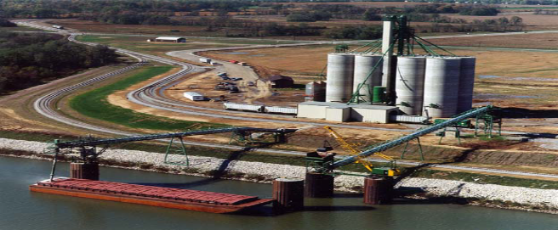
Performance Management Info
Metro Twin Cities Framework for Freight
Mobility
Water
Indicators: Tonnage and value of freight carried by barge to/from Twin Cities river ports Measures: Physical lock and river capacity (maximum number of barges in one tow) Availability of container handling or bulk transfer capability

Slide 11
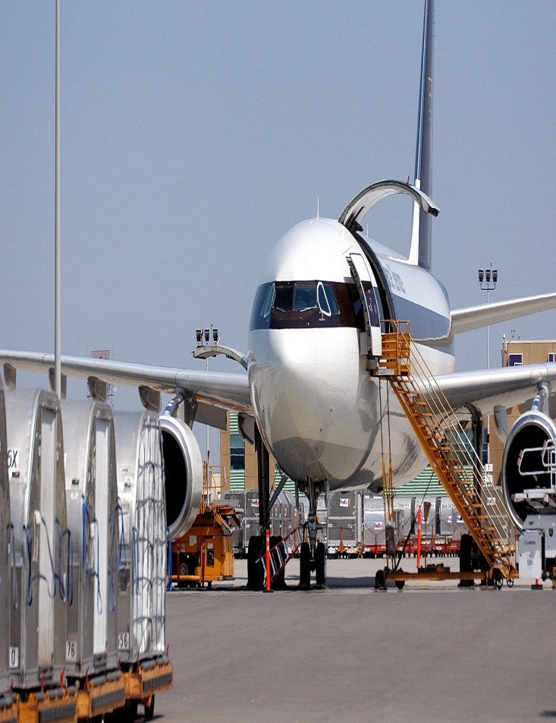
Performance Management Info
Metro Twin Cities Framework for Freight
Community/Environmental
Air
Indicators: # noise complaints/month Measures: Percent of publicly funded Minnesota airports that have Airport Safety Zoning Freight related fuel consumption Freight-related emissions

Slide 12
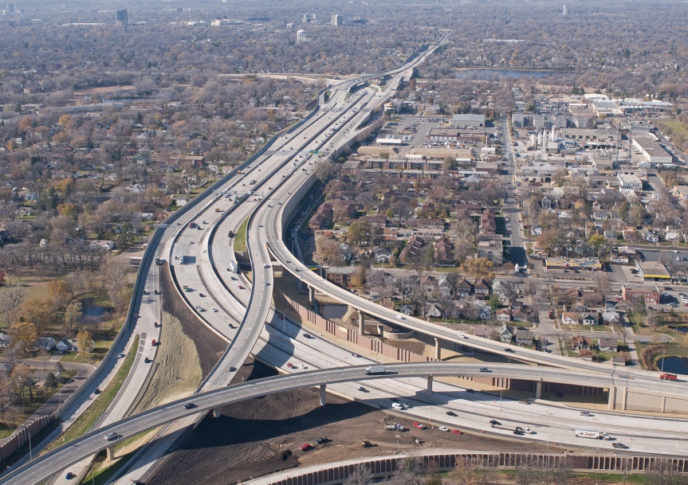
Performance Management Framework: So What?
Value to Twin Cities Region
A starting place for the Metro conversation
Opportunities that build off existing agreements
Point out where new data essential to effective use

Slide 13
Performance Management Framework: Observations
Use what you have to the fullest
Anchor in strategic goals for the region
Start where need greatest
Bring measures down to action level
Predict impact of actions wherever possible
Bake into long-range planning & priority setting

Slide 14
Twin Cities Metro Regional Freight Study: Points of Common Interest
Who’s also developed a freight framework?
How and when used?
Pros and cons of approach?
Lessons learned in DOT/MPO collaboration?
Overlapping goals?
Best ways to collaborate?

