Slide 1
Maryland’s Freight stakeholder advisory committee
Federal Highway Administration, Office of Freight Management and Operations
Talking Freight Seminar Series
May, 15, 2013
Maryland Department of Transportation
Paul Oberle and William Gayle
Office of Freight and Multimodalism
Notes:
Thank you, Jennifer. And thanks, also, to everyone listening in on the webinar today.
My colleague, Will, and I will try to relate our experiences here in Maryland in establishing and maintaining our Freight Stakeholder Advisory Committee.

Slide 2
Objectives
Provide an overview on Maryland Department of Transportation’s Freight Stakeholders Advisory Committee (FSAC)
Discuss membership and selection process
Offer early observations and lessons learned
Present an overview of how FSAC has developed and current activities
Provide a vision for FSAC in the future
Notes:
Here are our objectives for today’s presentation. I’ll begin from a more or less historical perspective starting with an overview of the Advisory Committee; then discuss a bit more about who is on the committee and how they were selected; and then offer some observations and lessons learned from our experiences.
I’ll then hand things over to Will who will talk about how the FSAC has evolved over time and also discuss a bit about what we’re looking forward to in the future.

Slide 3
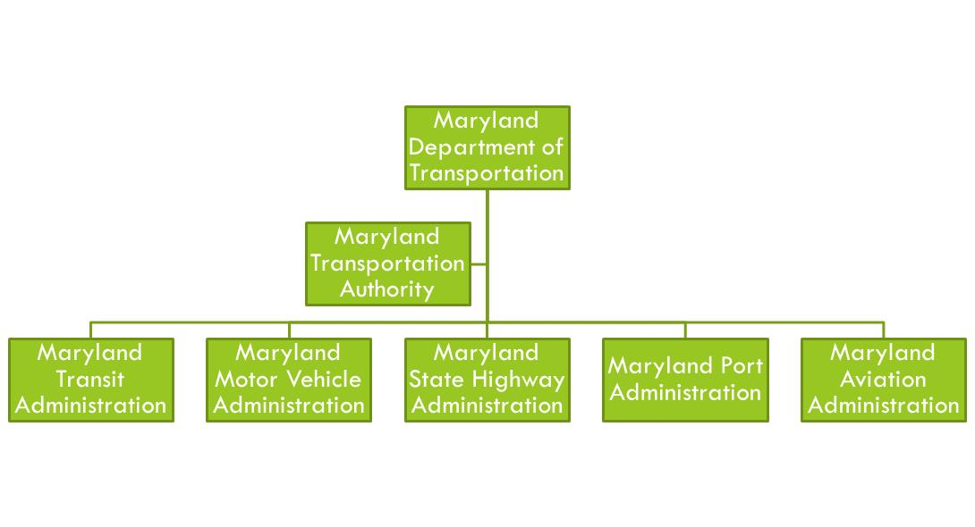
Department Organization
Notes:
First of all, I thought it might be beneficial to show you the org chart for Maryland DOT. What you see here is the overall umbrella of the Department headquarters operation (where Will and I work) over our family of modal administrations and the Maryland Transportation Authority . We’re all funded through the same pot of money save for the Authority which is our tolling agency that manages and maintains the six major toll facilities in the State.
What I wanted to impress on you with this slide is that we’re a multi-modal department. And, while each administration has its core mission to carry out, a common thread that runs through each agency is addressing freight issues. All of us deal with freight or freight related activities in some capacity. Here at the Secretary’s Office, freight is represented by our Office of Freight and Multimodalism. At the State Highway Administration, freight is addressed in their Regional Planning Division and Motor Carrier Division. The Motor Vehicle Administration handles commercial drivers’ licensing and truck registration. The Port Administration’s main job, as you can imagine, is 100% freight driven, focusing on bulk cargo, containers and roll-on roll-off cars and equipment. The Aviation Administration has three airports in the state that handle cargo. The Transportation Authority, again in charge of our toll facilities which carry a large percentage of truck traffic, also have a commercial vehicle inspection division, performing truck and safety inspections. Even our transit administration has a connection with freight in that it shares several rail transit corridors with freight railroads.
I’d like to leave this slide by offering the thought that the multimodal nature of the department allows us to collaborate on any number of study efforts. So we have had plenty of opportunities to interface with each other and with the general freight community and that includes, of course, the private sector.

Slide 4
Freight Stakeholder Advisory Committee (FSAC) Overview
High level group of freight industry leaders
Represents diverse commercial and business interests
Represents diverse geographies and local communities
Seeks ways to enhance freight mobility
Helps to determine how the state’s freight system is used and potentially improved
Increase Maryland’s global connectivity and competitiveness
Enhance safety and security
Balance freight demand with environmental preservation
Provide insight into future goods movement – patterns and needs
Notes:
This next slide, an overview of the FSAC Committee, might be better labeled the mission statement for the committee. It’s, more or less, how we view the committee and the role we’d like to see them fulfill.
First, we wanted a makeup of higher level industry leaders……these would be folks who could act as a spokesperson for that company and be able to speak to overall policy, goals and objectives.
Second, we wanted to get diversity among business and commercial interests. We wanted to include producers, shippers, receivers, railroads and steamship companies……as broad a cross section as we could get.
Thirdly, we wanted to include different geographical areas of the state to reflect what goes on in the different regions…for example, farming and poultry production on our Eastern Shore, manufacturing and port related activities in Baltimore and central Maryland, mining and truck terminal activities in Western Maryland.
More to the actual mission of the committee, the fourth bullet, seeking ways to enhance freight mobility, is just that. We want to get some real world advice from the actual users of the transportation system on issues and recommendations for improvements
The fifth bullet, helping to determine how the freight system is used and could be improved goes hand in hand. These folks are, in fact, our direct customers. They have real world experience with the transportation system and know its good points as well as its shortcomings.
Next… Increasing Maryland’s connectivity and competiveness refers to the economic growth an efficient freight system can offer. It also references Maryland’s location in the middle of the eastern seaboard and how connectivity to freight hubs via highway or rail (including CSX’s National Gateway and NS’s Crescent Corridor offering connections to the mid-west) is essential for that growth.
The next bullet, Safety and Security, is pretty self evident. We want to reduce our truck crashes, rail accidents and simply to make sure our safety efforts such as truck weigh and inspection programs are effective.
Next… environmental preservation addresses the overall issue of stewardship…..impacts to the freight system that climate change is going to bring, our need to lessen our carbon footprint and the need to pay attention to strategies like coordinating freight distribution and land use and looking at investments in rail infrastructure.
Lastly, providing insight into future goods movement, kind of comes full circle. This is where we continue to need more input from the private sector. We need to learn the real world issues that they are facing. In turn they can learn about what government can and can’t do for them. Hopefully, this committee provides a forum to have those kinds of conversations.

Slide 5
FSAC Background
Activities for Maryland Freight Plan started in 2006
Advisory committee of public and private sector recognized as essential
Freight Plan needs:
Relevance
Credibility
Acceptance
Notes:
Regarding background for the FSAC, I’ve noted on this slide that the Maryland Statewide Freight Plan began in 2006. That probably started the more earnest pursuit of establishing a private sector advisory committee. In actuality, however, we had been pursuing different freight planning activities as far back as the Year 2000. We had something internal called the Freight Movement Study, another effort was called the Maryland Freight Strategy. We also participated in the two iterations of MAROpS, the Mid-Atlantic Rail Operations Study. We had the Portside Access Study which examined land use around the Port of Baltimore. And without getting into the weeds with what these different studies tried to accomplish, I will say that they provided ample opportunities to interact with the private sector…opportunities that proved extremely valuable in getting new and different pairs of eyes to look at the issues.
At any rate, back to the Freight Plan. We had seen what the private sector had to offer in our other efforts and it was looked upon as being critical to have that participation in establishing the freight plan. So, what I have listed here…the relevance, credibility and acceptance for our new freight plan could only be achieved through buy-in from the outside… Again, these folks represent real world concerns. The successes of their businesses largely rely on what out transportation system can offer them. The goal here was to show that we, in fact, wanted to be in touch with their needs and concerns.

Slide 6
FSAC Membership
Executive level representatives
Wide array of industry and government perspectives:
Trucking Companies
Steamship Line
Shippers
Facility operators
Federal, State and MPO
Previous service on Governor’s Committee and Boards
Notes:
This next slide addresses our, more or less, qualifying issues for Committee membership.
Again, we were looking for executive level folks who could act as spokespersons for their firms. I also mentioned that we were looking for a diverse group to represent as many facets of the transport sector as we could get.
Also, it was recommended that we give consideration to folks who had previous service on state committees and boards. This was looked upon as being a plus just from the experience end of things.

Slide 7
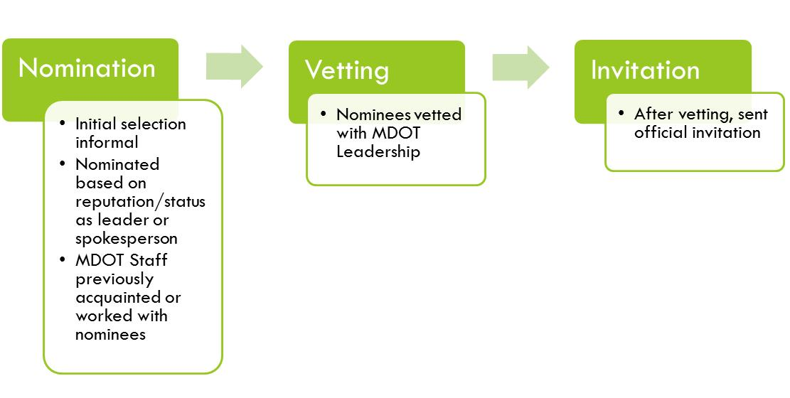
FSAC Selection Process
Notes:
This slide addresses our selection process. Please know that this was an absolutely informal process. Recommendations for nominees came from our Freight Office, our Planning Office, our Policy and Government Affairs Office. We also received input from our modal administrations, particularly our Port Administration and our Highway Administration. There definitely was a track record of being previously acquainted with or having worked with the nominees.
We developed a list of what we thought was a manageable number of candidates. If I recall correctly, we initially had about a dozen folks
The candidate list was vetted with MDOT leadership, and, when approved, invitations were sent out.

Slide 8
FSAC Meetings
Met quarterly during development of Freight Plan
Post Plan development……..1 to 2 times per year
Currently anticipating a more regular 6 month interval between meetings
Meetings generally held at MDOT….fairly central location
Agendas vary…includes regular reports from members but also address hot topics (new policy developments, State and Federal funding and legislation, new projects, etc.)
Notes:
Regarding frequency of meetings, we found ourselves a bit more purpose driven during development of our Freight Plan, getting together pretty much on a quarterly basis. Subsequent to that we slacked off to 1 or 2 times a year but are now trying to get back to a fairly consistent 3 to 4 times a year.
We hold most of our meetings here at MDOT, but are flexible to go elsewhere. We’re not that big of a state that travel times are not a major concern
Agendas vary but we certainly try to stay topical…for instance, we just had a gas tax increase here in Maryland, tolls are also going up, MAP-21 got new funding authorizations. Plenty to talk about. Agendas, obviously have to be suited to your needs.

Slide 9
Observations/Lessons Learned
Initial focus was narrow lacking broader goods movement perspectives
As Statewide Freight Plan was developed, began taking broader global view
Members of Maryland’s FSAC were eager to participate, however, time constraints were problematic for scheduling meetings
Sending “Save the Date” email well in advance of meetings helps to mitigate this as well as draft agenda a month ahead of time
Strong state/local presence on the committee
Some skepticism about government’s ability to improve problem areas
Have tried to focus the conversation and identification of issues on those that MDOT has some control over
Interest higher in brick and mortar projects; appreciate policy related issues as well
Most have stayed engaged and accessible
FSAC continues to grow
Notes:
I’ll sign off with some observations and lessons learned.
Initially, our main concern was simply the development of the freight plan. It was a narrow focus and we needed to get a bit more global to keep these folks engaged.
Secondly, and as if we didn’t know, these folks are busy people….scheduling meetings was problematic. I’d recommend planning well ahead of time with emails, reminders and early agendas.
Third, a strong state and local presence. Our membership is basically close to home although we do have reps from CSX and NS as well as Wallenius-Wilhemsen shipping line. They can offer us some national and inter-national perspectives. And that’s good. It still would be nice, in my opinion, to hear from some of the major trucking firms, the Schneiders and the J.B. Hunts who dispatch trucks from hundreds of miles away from Maryland but their decisions do affect what happens on our roadways. How do you get them interested?
Next, probably an early on sentiment that was voiced was some skepticism over what government could do. But I think these outreach efforts, like this committee, have gone far to creating a better understanding. We often do talk about what we can and can’t do.
Next, brick and mortar projects remain of high interest, but the committee also appreciates where our policy decisions take us.
Finally, our members have stayed engaged. We still have some originals from 2006. And it has been a pleasure to work with them.
With that I’ll turn it over to Will who can speak to current activities and what’s in store for the future.

Slide 10
Continued Development
“Living” Committee
Goals have broadened as time has passed
FSAC benefits from institutional commitment:
Intermodal Freight Committee – Multimodal internal freight stakeholder advisory group.
Interagency Coordinating Group – Includes enforcement and credentialing stakeholders as well as SHA and MDTA stakeholders
FSAC - 2007
Principally focused on development of Freight Plan
Freight Plan Developed
Changes in Freight Industry
MAP-21
Institutional Commitment
FSAC - Current
Ability to adapt
Focus is not confined to Freight plan but to goods movement as well
Notes:
Thank you Paul.
Now that you have heard a background of the Freight Stakeholders Advisory Committee, I would like to discuss how it has developed over the intervening years, what it is currently doing, and what some upcoming activities will be.
Although engagement with the private sector is nothing new to the Department, we have already heard that the formation of the Freight Stakeholders Advisory Committee was initially focused on the development of the Maryland Statewide Freight Plan.
After completion of the Plan, the Committee’s focus was expanded as it adapted to several external and internal developments.
These developments included changes in the freight industry, passage of a federal surface transportation bill with significant freight provisions, and a strong institutional commitment to freight.
Two corresponding internal freight advisory committees, the Intermodal Freight Committee – made up of internal modal staff - as well as the Interagency Coordinating Group – made up of enforcement and credentialing stakeholders along with staff from the Maryland State Highway Administration and Maryland Transportation Authority – are all used help keep freight issues top of mind.

Slide 11
FSAC Current Activities
Since MAP-21, focus is on expanding membership
Diversity brings strength
Selection process now:
Nomination
Initial selection informal
Invitation
After gauging interest, sent invitation to join
Nominated based on reputation/ status as leader or spokesperson
MDOT staff previously acquainted or worked with nominees
Notes:
We view the Freight Stakeholders Advisory Committee as a forum for discussing and identifying the issues affecting freight mobility within Maryland and for generating ideas to improve it.
Since the original FSAC, an effort to expand membership in order to increase participation and perspectives has occurred.
To help streamline this effort, we found that making the selection process a bit less formal helped to provide fluidity and flexibility in the membership selection process.
Since service on the Committee is not an appointment, we have reformed the membership process by not formally vetting the nominees through Maryland Department of Transportation leadership.
Rather, after identifying a prospective member, we invite them to the meeting so they can get a feel for the Committee, then if they are interested afterwards, we extend a written invitation to join.

Slide 12
FSAC Current Activities
In addition to Members, invited guests included:
Short line Railroad
Freight Forwarding/Brokerage Industry
Truck Stop Center Operator
Academia
Notes:
It is through this process that we have recently expanded participation to a number of new private and public sector participants.
As Paul had mentioned earlier, Maryland is comprised of a multimodal freight network encompassing maritime, highway, rail, and aviation modes. The pie chart shows the current multimodal composition of the Freight Stakeholders Advisory Committee as we strive toward broader participation.
To help achieve this goal, several months before our most recent Freight Stakeholders Advisory Committee meeting our Office identified sectors that we would like to have increased representation on the Committee. We identified a need to strengthen short line representation as well as participation among the freight forwarding/brokerage sector and truck stop center operators and targeted selected private sector participants within these industries to invite and join if interested.

Slide 13
FSAC Current Activities
Leveraging participation
Project/programming input
Engagement with Members
Want to provide updates but also encourage dialog.
Interesting Presentations with private sector stakeholders in mind.
Serves as forum for discussing and identifying freight issues
EXAMPLE:
Driver’s Shortage
Freight Education/Outreach
Notes:
LEVERAGING PARTICIPATION: With the freight plan completed and the passage of MAP-21 encouraging the formation of Stakeholder Advisory Committees, we have tried to make the FSAC a more proactive body. We have found that the formation of a stakeholder advisory committee provides a unique ability to communicate with the private sector and as such, we strive to make the meetings as informative and valuable as possible while also leveraging their participation to better inform our needs.
BULLET 1: As Paul discussed, originally many of the members expressed interest in specific projects or modes that most benefit their industry. This insight into desired projects provided valuable guidance during the formation of the Maryland Statewide Freight Plan and will continue.
BULLET 2: In addition to gathering feedback on specific projects or policies, we try to keep members engaged as much as possible. In structuring the discussion for the meetings, thought is given to what relevant freight topics should be provided to the Stakeholders as well as trying providing them with outcome based activities or presentations.
Sub-bullet 1: Part of engaging FSAC members includes keeping the Committee members up to date on the latest MDOT freight initiatives. Topics that are discussed are tailored to provide information that would be of interest and value to the diverse group. For example, the timing of our last meeting occurred just weeks after the completion of the Maryland General Assembly so a brief presentation was provided by Maryland State Highway Administration staff on two State sponsored bills important to truck safety. Having our Assistant Secretary for Transportation Policy and Freight on hand provided additional opportunities for dialog and a chance for members to hear directly from Maryland Department of Transportation leadership and for leadership to hear directly from the members.
Sub-bullet 2: In addition to updates on state initiatives, presentations were given on topics we thought would be of value to the other members. An overview of a short line railroad that operates in Maryland was provided as well as providing members with an opportunity to join an infrastructure security partnership program with the FBI. FBI and Department of Homeland Security agents provided an overview of the program, why FSAC members should join, and were available to answer questions.
BULLET 3: The diversity of members and industries present brings an interesting range of topics that are discussed. During the last FSAC meeting, each member was asked to briefly describe the trends in their industry and how they viewed them impacting Maryland. This was met with varying degrees of success however it did spur discussion on several important themes. For example, those in the trucking, distribution, and brokerage industries identified a number of issues that posed a challenge to them however among them the truck driver shortage was identified as an issue Maryland DOT could assist with by coordinating with other state agencies to help alleviate on the State level.
The second reoccurring theme that was identified that the Department could engage on was a perceived lack of understanding on the importance of freight movement among the general public and staff at the local level of government. As an example of the type of problem solving we are trying to foster with the Freight Stakeholders Advisory Committee, during the course of discussion of this issue, Committee members suggested the use of their facilities to assist with elected official and staff outreach.

Slide 14
FSAC Next Steps
Continue to strengthen and diversify membership
Emphasis on outcome based activities/presentations
EXAMPLES:
State and Federal Performance Measures
Identification of new state freight route designations
Scenario planning exercises
Continued involvement with Maryland Statewide Freight Planning efforts
Updates
Education/Outreach efforts
Notes:
BULLET 1: As the Freight Stakeholders Advisory Committee continues to develop to meet the evolving needs of the Maryland’s freight network, increasing the diversity of membership will make the Committee more able to lend insight into effective policy. We view this as an important step in maintaining a robust and effective committee that is able to help inform our efforts to meet the future needs of the private sector in Maryland.
BULLET 2: As I previously mentioned, providing Committee members with updates on Departmental initiatives and achievements is an important component of the meetings, however the value for us comes in hearing from the private sector. As implementation of the many freight provisions in MAP-21 continue to be rolled out, we view this as a critical time for private sector participation. For instance, engaging FSAC members on issues like freight performance measures and primary freight network, as well as by leveraging their participation in scenario planning exercises, we will be able to better target and respond to industry concerns now and in the future.
UPDATES: In addition to these activities, we feel the FSAC can play an important role in future statewide freight planning efforts. Along with the Maryland Statewide Freight Plan, MDOT has many other modal plans that have freight elements which will be increasingly useful for the FSAC to be engaged in. Some of these plans include the Eastern Shore Strategic Rail Plan, the Freight System Performance Annual Report, and the joint Maryland State Highway Administration and Maryland Transportation Authority’s Statewide Freight Implementation Plan.
EDUCATION/OUTREACH EFFORTS: In conjunction with freight planning efforts, education and outreach has been identified as an area in which MDOT could contribute its resources toward. For example, several FSAC members expressed frustration on a perceived lack of priority for freight movement during meetings with staff at the local level of government. MDOT is uniquely positioned among the modes to assist in a multimodal outreach effort to staff on the importance of freight planning to the local economy and employment.
CONCLUSION: As you can see, over the years the FSAC has played an important function and as future issues arise, it will continue to provide valuable insights and guidance in our efforts to provide a resilient and efficient multimodal freight network in Maryland.

Slide 15
Questions or additional information
For more information please feel free to contact us at:
Paul Oberle, 410-684-7067 or poberle@mdot.state.md.us
William Gayle, 410-684-7064 or wgayle1@mdot.state.md.us
Notes:
Thank you again for letting the Maryland Department of Transportation participate in this Talking Freight webinar. Both Paul and I look forward to any questions you may have at the end of presentation period.
I have included our contact information if you wish to follow-up with us off-line at a later date.

