Slide 1

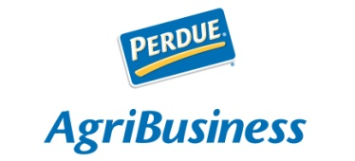
FHWA’s May 2013
Talking Freight Webinar on
State Freight Advisory Committees
May 15, 2013
Speaker: Sharon Clark
Perdue AgriBusiness LLC
Sr. VP-Transportation & Regulatory Affairs

Slide 2

About Perdue AgriBusiness
    Provides agricultural products and services to feed, food, organic fertilizer and renewable fuels markets across the U.S. and around the world.
    Is among the largest grain companies in the U.S.
    Represents approximately 40% of the Company’s annual sales.
Perdue Farms
Grain & Oilseed LLC
AgSolutions LLC
AgriRecycle LLC

Slide 3
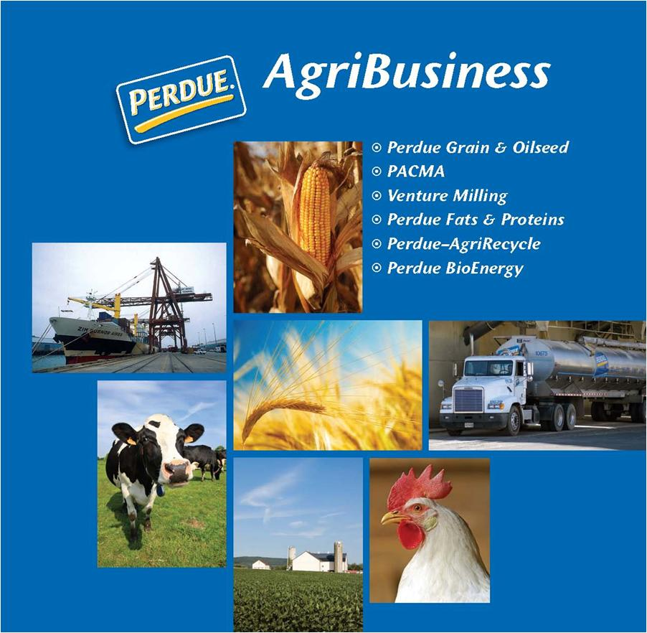
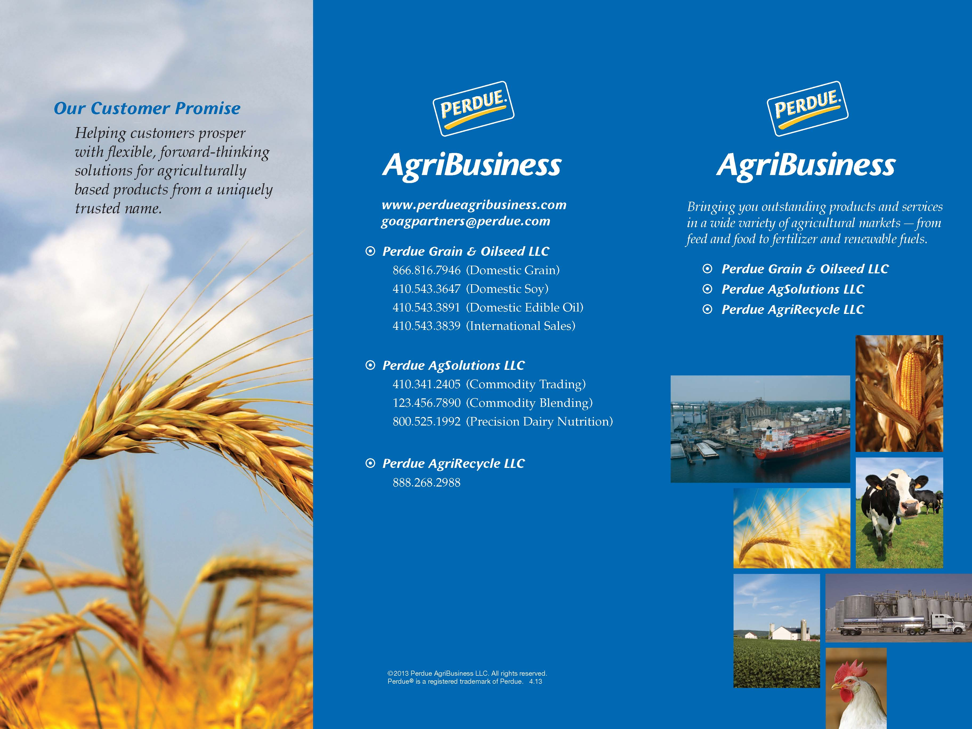

Slide 4
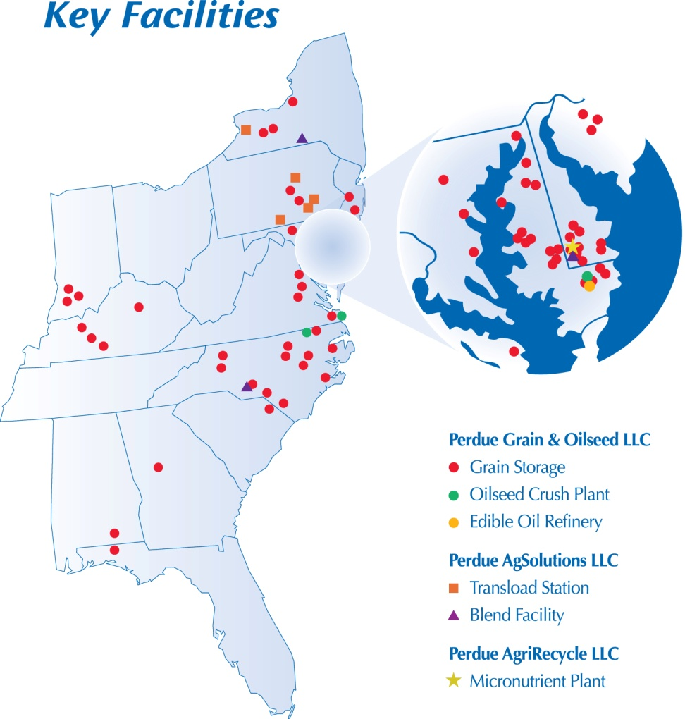
Grain & Oilseed LLC
More than 75 million bushels of grain storage space at 70 locations.
Crush of approximately 50 million bushels/year.
  Three hexane extraction oilseed crush facilities in the U.S. Mid-Atlantic with one located on deep water.
  An oilseed extruder plant at Pantego, NC.

Slide 5

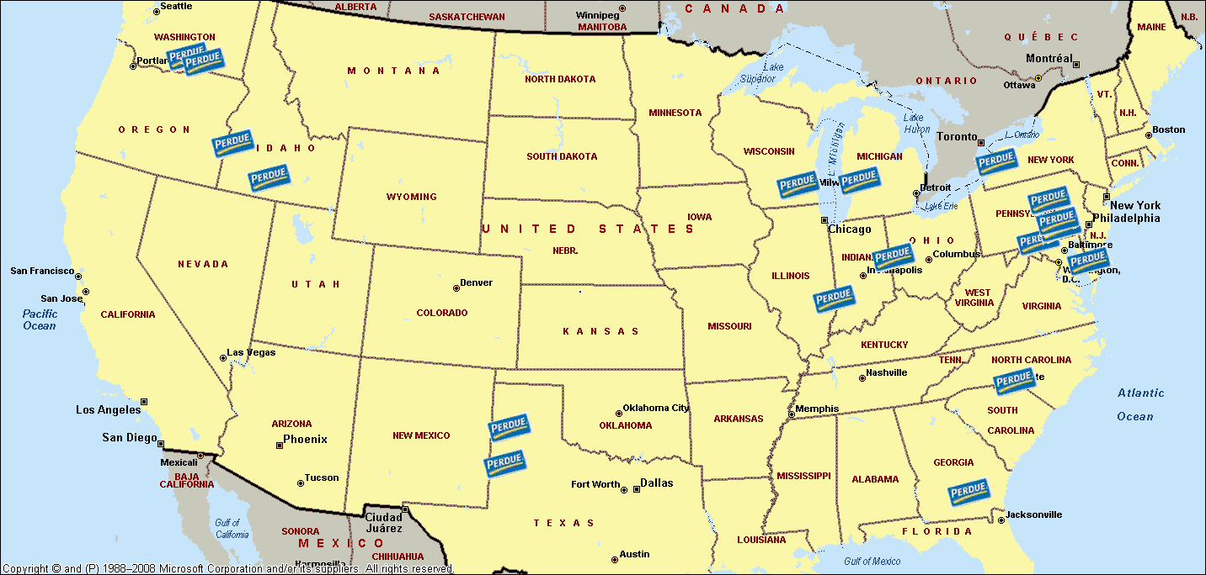
Commodities Trading merchandises a wide range of non-grain commodities for animal agriculture such as dried distillers grains with solubles (DDGS), corn gluten meal, canola meal, citrus pulp, animal by-product meals, etc.
Commodities Blending produces and sells commercial and custom protein blends for the domestic and international animal feed industries.
Perdue AgSolutions LLC Extended Network of Facilities
5

Slide 6
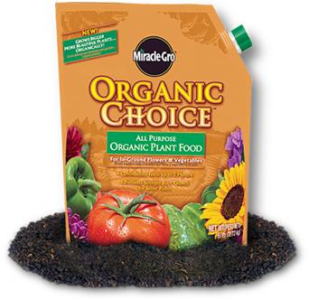

Operates the first-ever, large-scale facility for manufacturing organic fertilizer from chicken litter.
Produces and sells organic fertilizers made from chicken litter and feather meal.
Provides cleanout, loadout and transportation from farms with valid nutrient management plans to our facility.

Slide 7
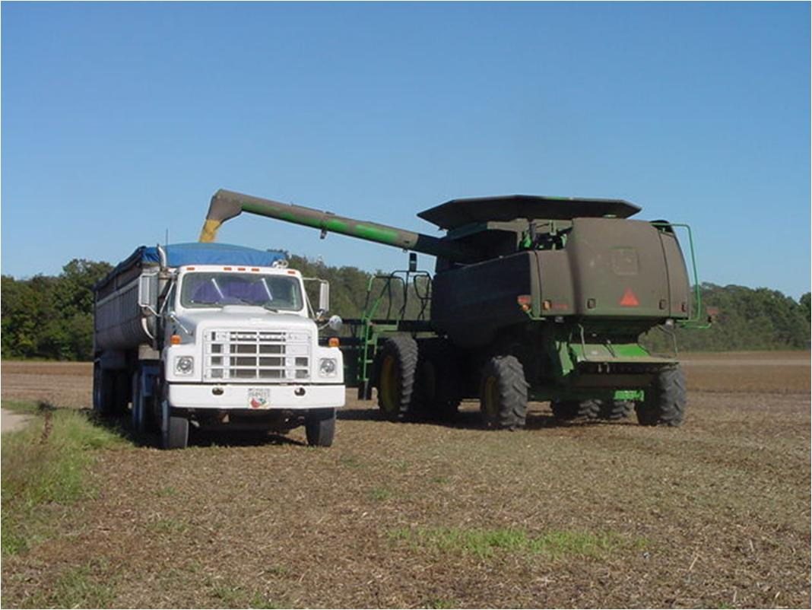

Slide 8
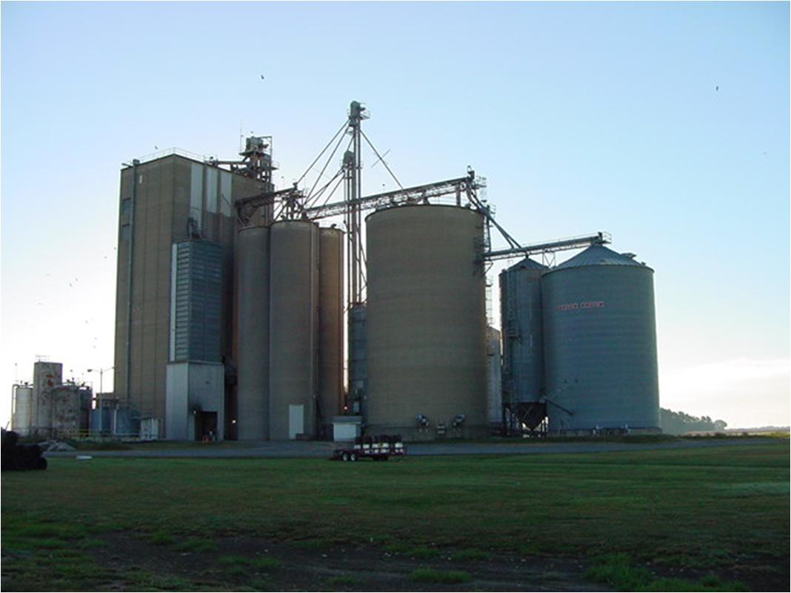

Slide 9
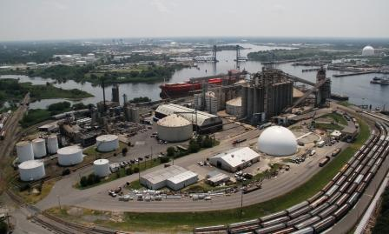
Perdue AgriBusiness
Chesapeake, VA
Chesapeake, VA Oilseed Crushing and Export Grain Terminal

Slide 10

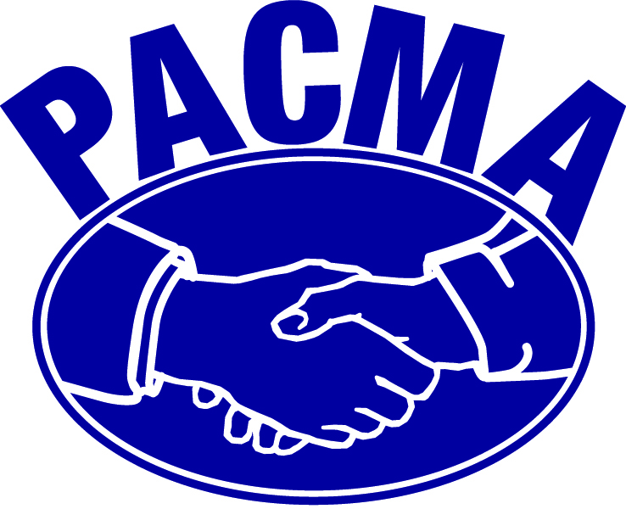

Why is Freight Important to Perdue AgriBusiness?
International imports
International exports
Domestic transactions
10

Slide 11
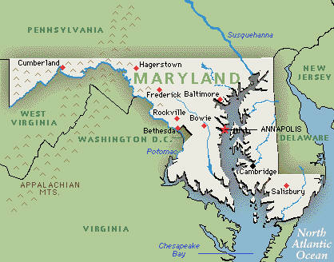
Why is Freight Important to Perdue’s Maryland operations?

Slide 12
Reasons for Involvement on the Committee
Become a part of the process
  Develop project priorities
  Develop policy ideas
  Assist in the freight planning process
Venue to discuss our Constituencies concerns
  Farmers
  Customers
  Vendors
  Associates
Share intelligence within the freight community

Slide 13
Benefits Derived from Participating on the Committee
Strategically and tactically prepare for forecasted freight trends
Learn about resources to help support our freight network
Learn what others are doing to address freight concerns

Slide 14
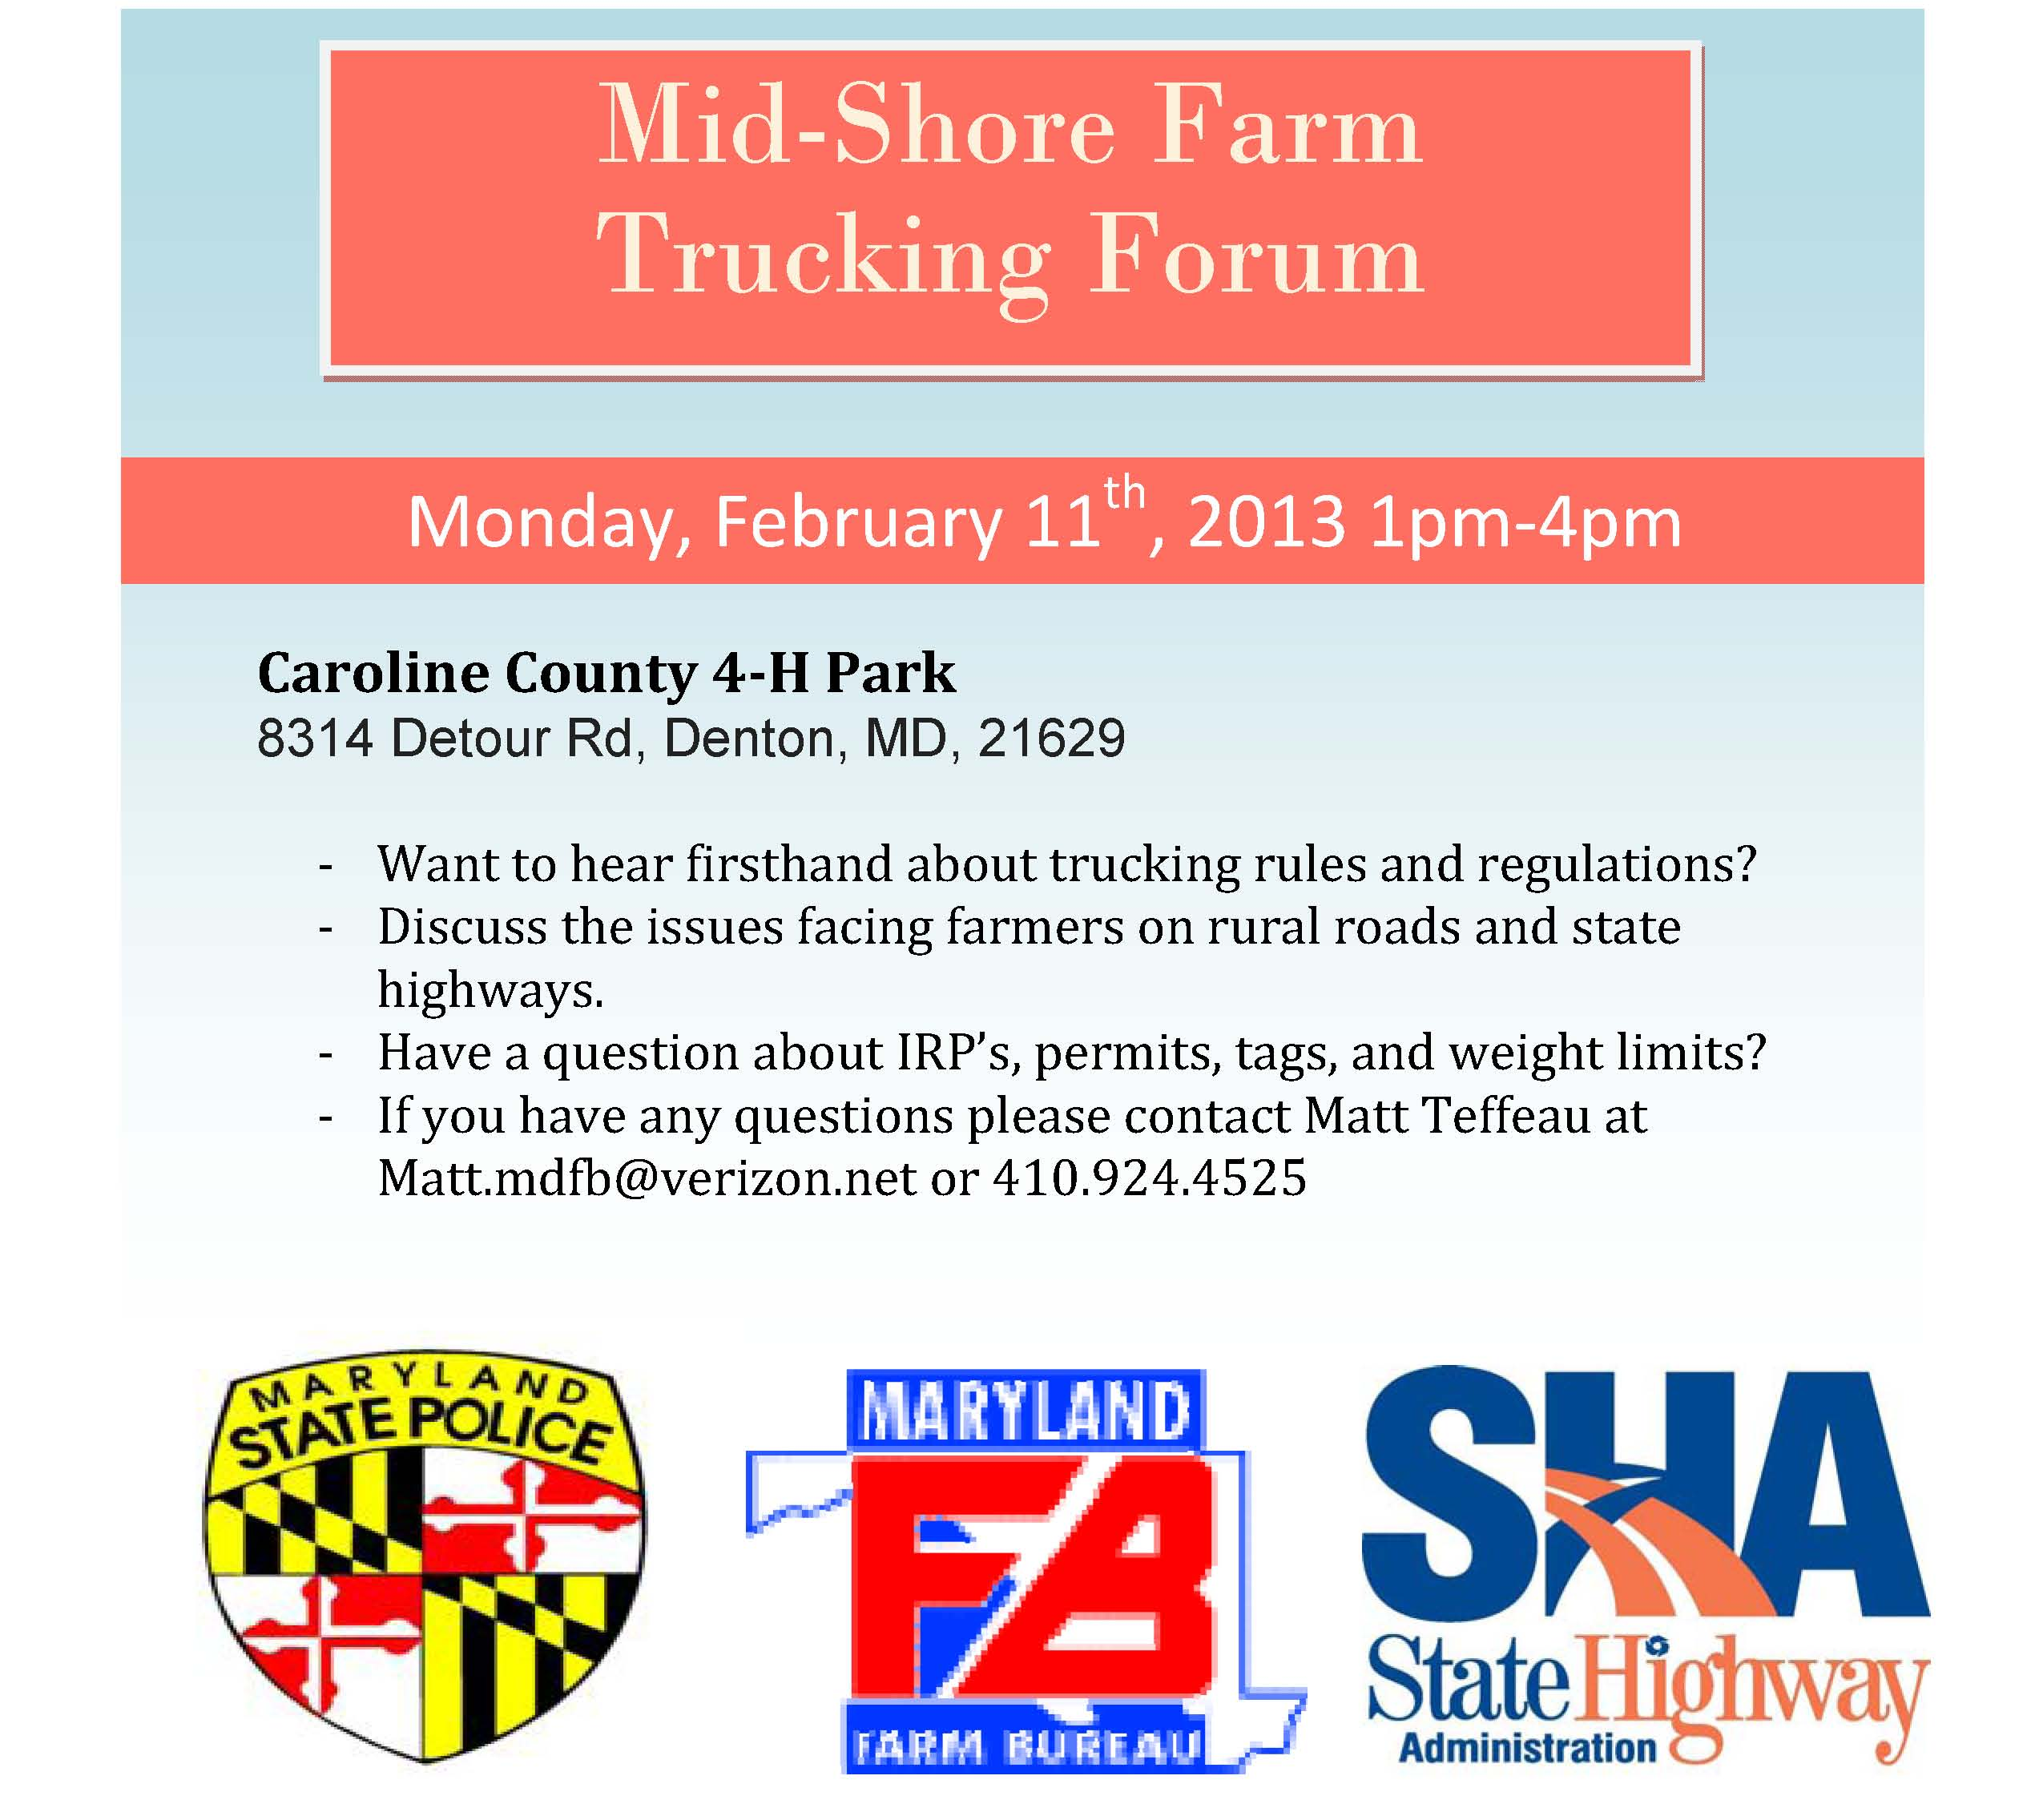

Slide 15
Insights Gained about Public Sector Freight Transportation Planning
“More is better…” there are many freight stakeholders with diverse insights to share
Maryland’s public officials have a long term commitment to the Statewide Freight Plan and Transportation Plan
Maryland’s freight plan is developed in conjunction with SmartGrowth planning and other statewide initiatives.

Slide 16
