Slide 1
Overview of the Draft Highway Primary Freight Network
November 20, 2013 1:00 – 2:30 pm ET
Coral Torres
Ed Strocko

Slide 2
MAP-21 Language for Designation of National Freight Network
In general:
The Secretary shall establish a national freight network in accordance with this section to assist States in strategically directing resources toward improved system performance for efficient movement of freight on highways, including national highway system, freight intermodal connectors and aerotropolis transportation systems.

Slide 3
National Freight Network Components
National Freight Network
Primary Freight Network
27k limit + 3k
Current Future
Importance Importance
Remainder of the Interstate System
Between 17k and 47k miles
Critical Rural Freight Corridors
Unlimited miles

Slide 4
MAP-21 Language for Designation of Primary Freight Network
NFN General language
NHS;
Aerotropolis;
Intermodal Connectors.
PFN Language:
“Based on an inventory of national freight volume conducted by FHWA…”
PFN Factors for Consideration:
Origins and destinations of freight movement in the United States;
Total freight tonnage and value of freight moved by highways;
Percentage of annual average daily truck traffic in the annual average daily traffic on principal arterials;
Annual average daily truck traffic on principal arterials;
Land and maritime ports of entry;
Access to energy exploration, development, installation, or production areas;
Population centers;
Network connectivity.

Slide 5
MAP-21 Language for Designation of Critical Rural Freight Corridors
CRFC Language:
A State may designate a road within the borders of the State as a critical rural freight corridor if the road -
Is a rural principal arterial roadway and has a minimum of 25% of the annual average daily traffic of the road measured in passenger vehicle equivalent units from trucks (FHWA vehicle class 8 to 13); or
Provides access to energy exploration, development, installation, or production areas; or
Connects the Primary Freight Network, a roadway described in paragraph (1) or (2), or Interstate System to facilities that handle more than –
50,000 20 foot equivalent units per year; or
500,000 tons per year of bulk commodities

Slide 6
National Freight Network Role
The USDOT recognizes that as a highway-only network, the NFN is an incomplete representation of the system that is required to efficiently and effectively move freight in the United States.
The lack of a stated application for the highway PFN and NFN introduces uncertainty into the designation process.
USDOT’s goal is to designate a highway PFN that will improve system performance, maximize freight efficiency, and be effectively integrated with the entire freight transportation system, including non-highway modes of freight transport.

Slide 7
Possible Applications and Future Role of PFN
What should be the focus or objective behind PFN?
National Strategic Freight Plan
North American Corridors
Intercity routes
Areas with high levels of congestion
Connectivity
Performance Measures
Funding

Slide 8
PFN Limitations
The statutory language in MAP-21 limits the designation to highways only. Therefore, this network is not multi-modal.
Multitude of factors for designation generates an infinite number of possibilities for designation.
27k mileage cap results in a network that is not representative of the most critical highway elements of national freight system that exists in the United States.

Slide 9
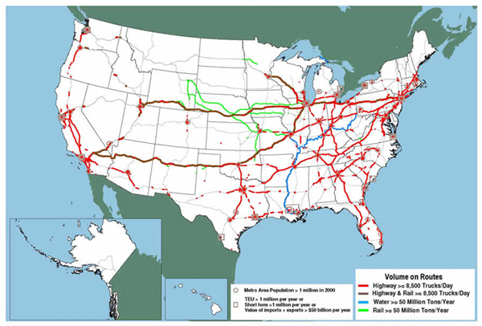
2008 Freight Story Map

Slide 10
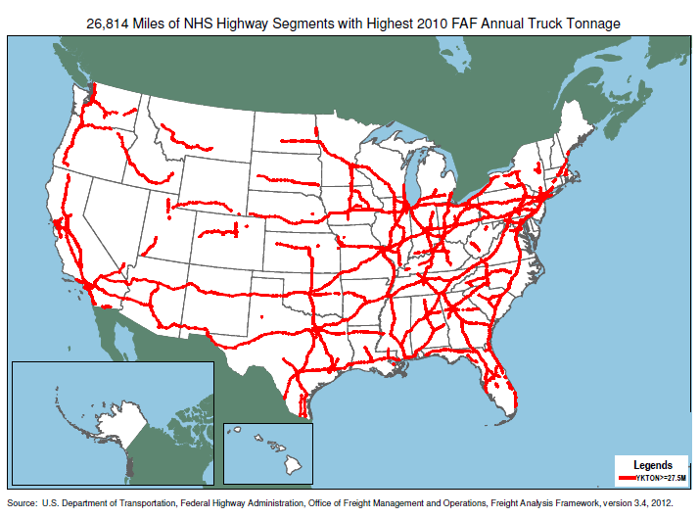

Slide 11
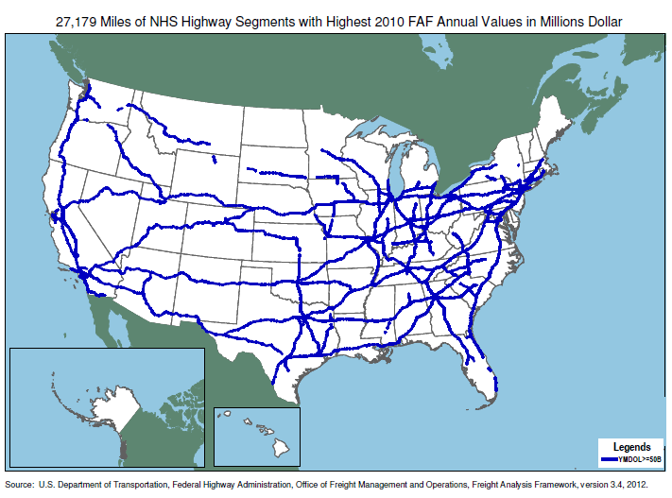

Slide 12
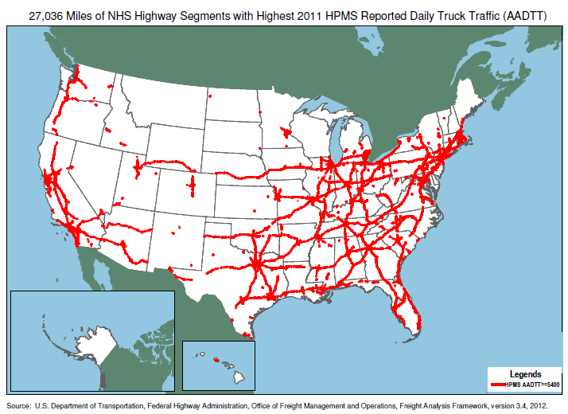

Slide 13
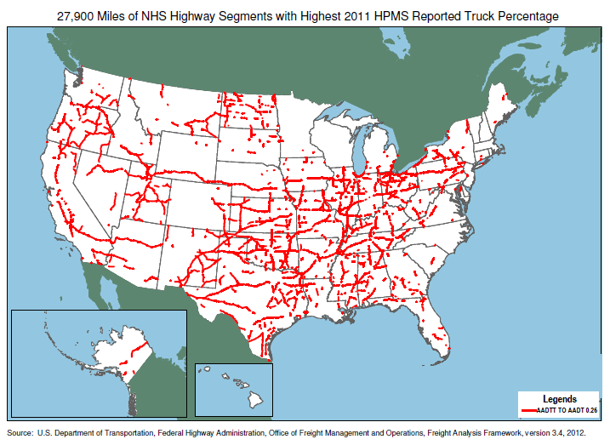

Slide 14
Centerline versus Corridor Approach
The statutory language in MAP-21 clearly directs USDOT to use centerline roadway miles for the development of the highway PFN.
This does not necessarily allow for the designation of multiple routes in a region that comprise an active and fluid highway freight system.
USDOT suggests that corridor-level analysis and investment has the potential for widespread freight benefits, and can improve the performance and efficiency of the highway PFN.

Slide 15
Limitations of National Data
Data utilized for the development of the draft initial highway PFN comprises the best information available on freight behavior at a national level.
Nevertheless, national data is not sufficient to understand fully the behavior of freight in smaller subsets of the Nation, to include goods movement in urban areas.
Issue with first and last mile connectivity.

Slide 16
Urban Freight Routes
Need to address connectivity within urban areas; first and last mile urban goods movements.
NFN language in 23 U.S.C. 167(d) lacks a parallel process to Critical Rural Freight Corridors for designating critical urban freight routes.
Lack of precision of national data at the urban level.
USDOT believes there is merit in establishing a process for local, regional, or State government entities to designate critical urban freight routes that are important for freight movement in urban areas.

Slide 17
Five Areas for Comments in the Federal Register Notice
Specific route deletions, additions, or modifications to the draft initial designation of the highway PFN contained in this notice;
The methodology for achieving a 27,000-mile final designation;
How the NFN and its components could be used by freight stakeholders in the future;
How the NFN may fit into a multimodal National Freight System; and
Suggestions for an urban-area route designation process.

Slide 18
Process for Designating the Draft Initial Highway Primary Freight Network
The draft initial highway PFN was informed by measurable and objective national data. For the development of the draft initial highway PFN, FHWA considered the following criteria and data sources:
Origins/destinations of freight movements - (FAF) 3.4
Freight tonnage and value by highways - (FAF) 3.4
Percentage of Average Annual Daily Truck Traffic (AADTT) on principal arterials - (HPMS) 2011
AADTT on principal arterials - (HPMS) 2011
Land & maritime ports of entry - U.S. Department of Transportation Maritime Administration (MARAD) Containers by U.S Customs Ports; DOT Bureau of Transportation Statistics (BTS) Transborder data; U.S. Army Corps, Navigation Data Center
Airports - Federal Aviation Administration (FAA) CT 2011 Cargo Airports by Landed Weight; FAA Aeronautical Information Services – Airport Database in the National Transportation Atlas Database (NTAD) 2013
Access to energy exploration, development, installation or production areas - United States Energy Information Administration Data; Pennwell Mapsearch data via Pipeline and Hazardous Materials Safety Administration (PHMSA)
Population centers - 2010 Census
Network connectivity - (FAF) 3.4
Intermodal Connectors - FHWA National Highway System Intermodal Connectors
Railroads - Federal Railroad Administration analysis of Rail Inc Centralized Station Master data

Slide 19
Draft Initial Highway Primary Freight Network Methodology
The methodology employed by USDOT in developing a draft initial highway PFN included the following steps:
Obtain the top 20,000 miles of road segments that qualify in two of the following four factors: value, tonnage, (AADTT), and percentage of AADTT.
Network connectivity by length of gaps and segments.
Land ports of entry with truck traffic higher than 75,000 trucks per year.
Intermodal Connectors and top 50 airports by landed weight within urban areas with a population of 200,000 or more were identified.
Road segments within urban areas with a population of 200,000 or more that have an AADTT of 8,500 trucks/day or more were identified.
The network was analyzed to determine the relationship to population centers, origins and destinations, maritime ports, airports, and rail yards and some other minor network connections were made.
Roads connecting key ports, airports and intermodal connectors to population centers in AK, HI and PR were incorporated into the draft initial highway PFN.
The network was analyzed to determine the relationship to energy exploration, development, installation, or production areas.

Slide 20
Draft Initial Highway Primary Freight Network Designation Results
This methodology resulted in a comprehensive map of 41,518 centerline miles, including 37,436 centerline miles of Interstate and 4,082 centerline miles of non-Interstate roads.
Since the statute limits the highway PFN to 27,000 centerline miles, the USDOT then identified those segments with the highest AADTT.
These road segments represented on the draft highway PFN map comprise 26,966 miles of centerline roads that reflect consideration of the criteria offered by Congress.

Slide 21
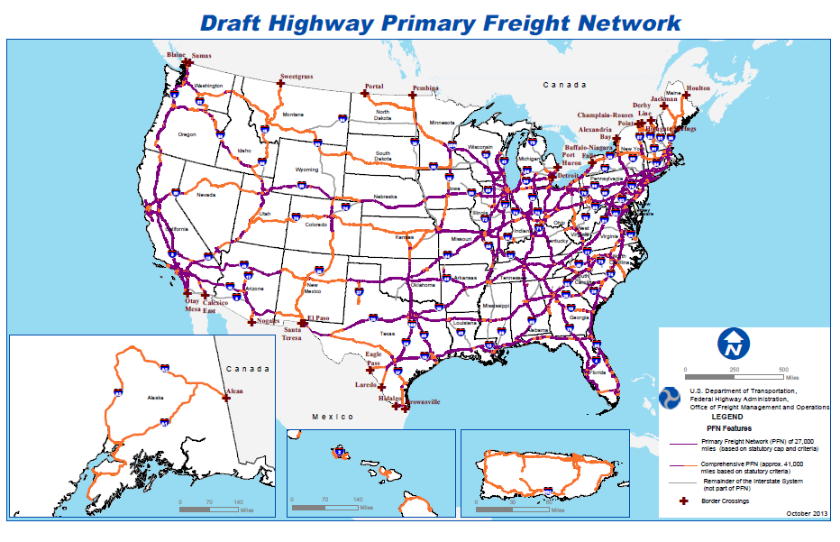

Slide 22
Additional Miles on the Highway Primary Freight Network
The Secretary of Transportation, under Section 167 of title 23, U.S.C., may increase the highway PFN by up to 3,000 centerline miles above the 27,000-mile limit, to accommodate existing or planned roads critical to future efficient movement of goods on the highway PFN.
In the draft initial designation of the highway PFN, USDOT focused on freight routes critical to the current movement of freight.
USDOT is aware of emerging freight routes that will be critical to the future efficient movement of goods and believes there is value in expanding the highway PFN in the future to reflect these routes as the Nation grows.

Slide 23
NFN website
USDOT has posted the details of the draft initial highway PFN, including the 26,966-mile draft highway PFN map, the 41,518-mile comprehensive map, State maps and lists of designated routes, tables of mileage by State, and information regarding intermodal connectors and border crossings at:
NFN website:
http://ops.fhwa.dot.gov/freight/infrastructure/nfn/index.htm
Notice website:
http://www.archives.gov/federal_register
Docket for comments:
http://www.regulations.gov

Slide 24
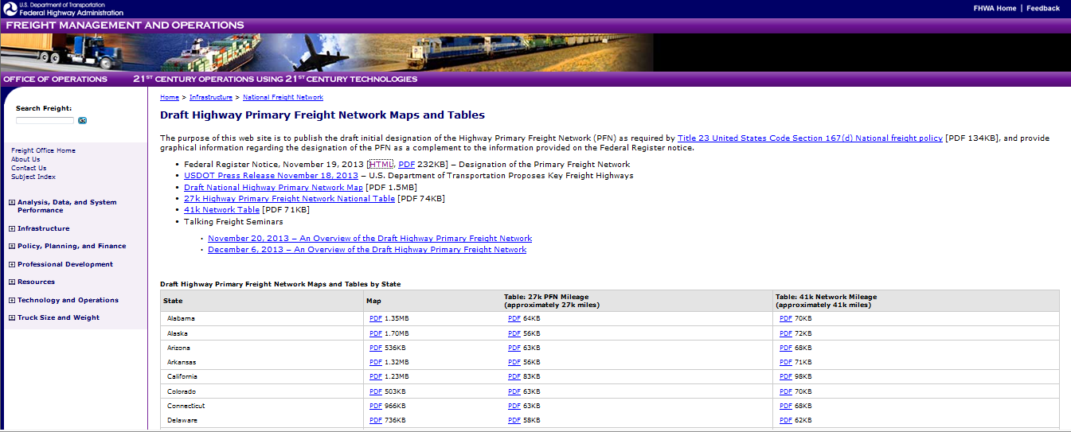
PFN website

Slide 25
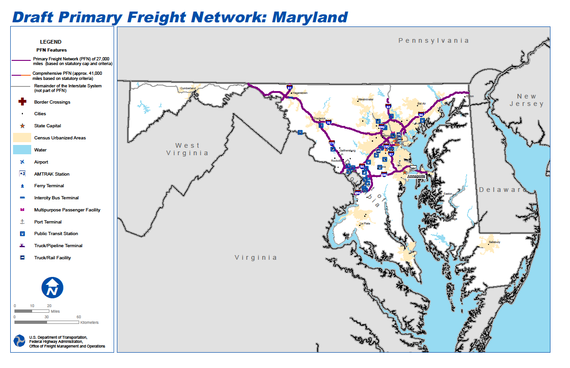

Slide 26
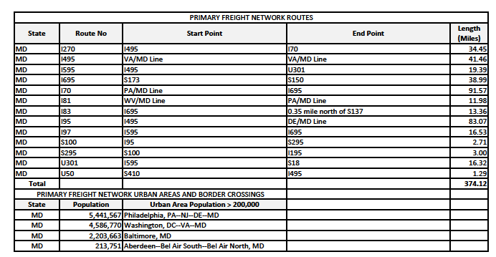

Slide 27
Next steps
The following is the approximate schedule for designation of the NFN:
Draft designation of highway PFN – Fall 2013
Comment period for highway PFN designation –fall 2013
Review and analysis of comments – early 2014
Final initial hPFN release – early 2014
Finalization of CRFC guidance- early 2014
Requests for States to designate CRFC – spring 2014
Compilation of State-designated CRFC routes – spring 2014
Release of the initial designation of the full NFN (including highway PFN, rest of the Interstate System, CRFCs) – mid 2014

Slide 28
Questions?

