Slide 1
Southeast Michigan Council of Governments

Slide 2
Freight & Economic Analysis Study
Talking Freight
November 14, 2012

Slide 3
Working Partnerships
Detroit Regional Chamber
State of Michigan
MEDC, MDOT, and MARD
Local Governments
Universities
Foundations

Slide 4
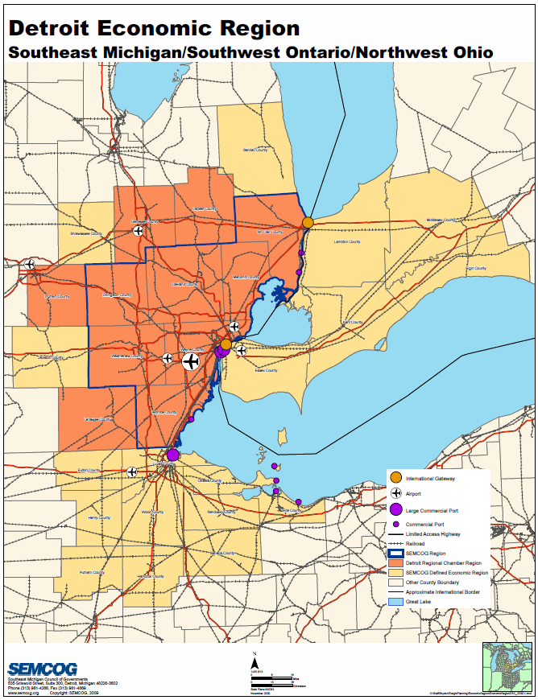

Slide 5
What We Thought We Knew
The regional freight system is
Extensive and mature
Built to serve the auto industry
Move large volumes of heavy goods
Mostly in service to local industry and population
An essential gateway to Canada

Slide 6
What We Wanted to Know More About
How well is the system serving freight businesses?
Is the freight system a barrier or an asset to economic growth?
How can we realize the greatest return on investments to the freight system?
Notes:
To assess the regional freight system’s ability to supply current and future freight-sensitive industries with efficient and reliable goods movement.
From a user perspective, how well does freight move in the region?
Are there industries that our system does not serve well?
How should we prioritize and classify freight transportation facilities?
To connect transportation decisions with economic development to make informed judgments that produce the greatest return on investment.

Slide 7
Adapting to Change
Study designed for ongoing internal update
Relationships with freight community
Description of freight flows
Industry characteristics
Economic analysis

Slide 8
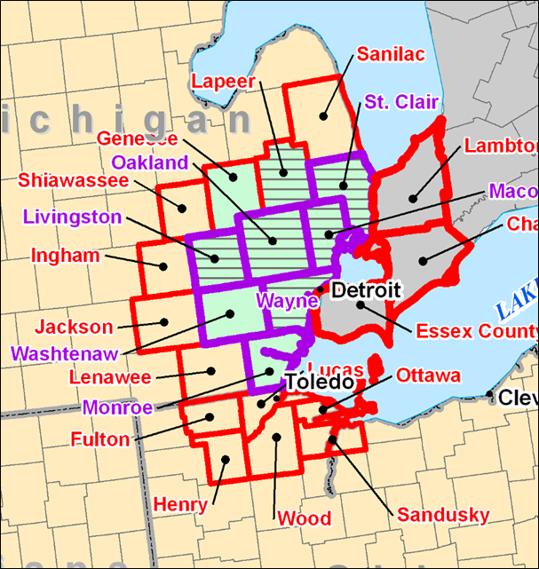
Broad Area of Interest

Slide 9
Survey
Received responses from across the freight world:
Manufacturing
Logistics
Railroads
Warehousing
Retailing

Slide 10
Survey
Core business concerns prevailed
Transportation concerns:
Manufacturing and warehousing: Incoming delivery costs
Logistics: Transition at borders and ports
Railroads: Access to business customers

Slide 11
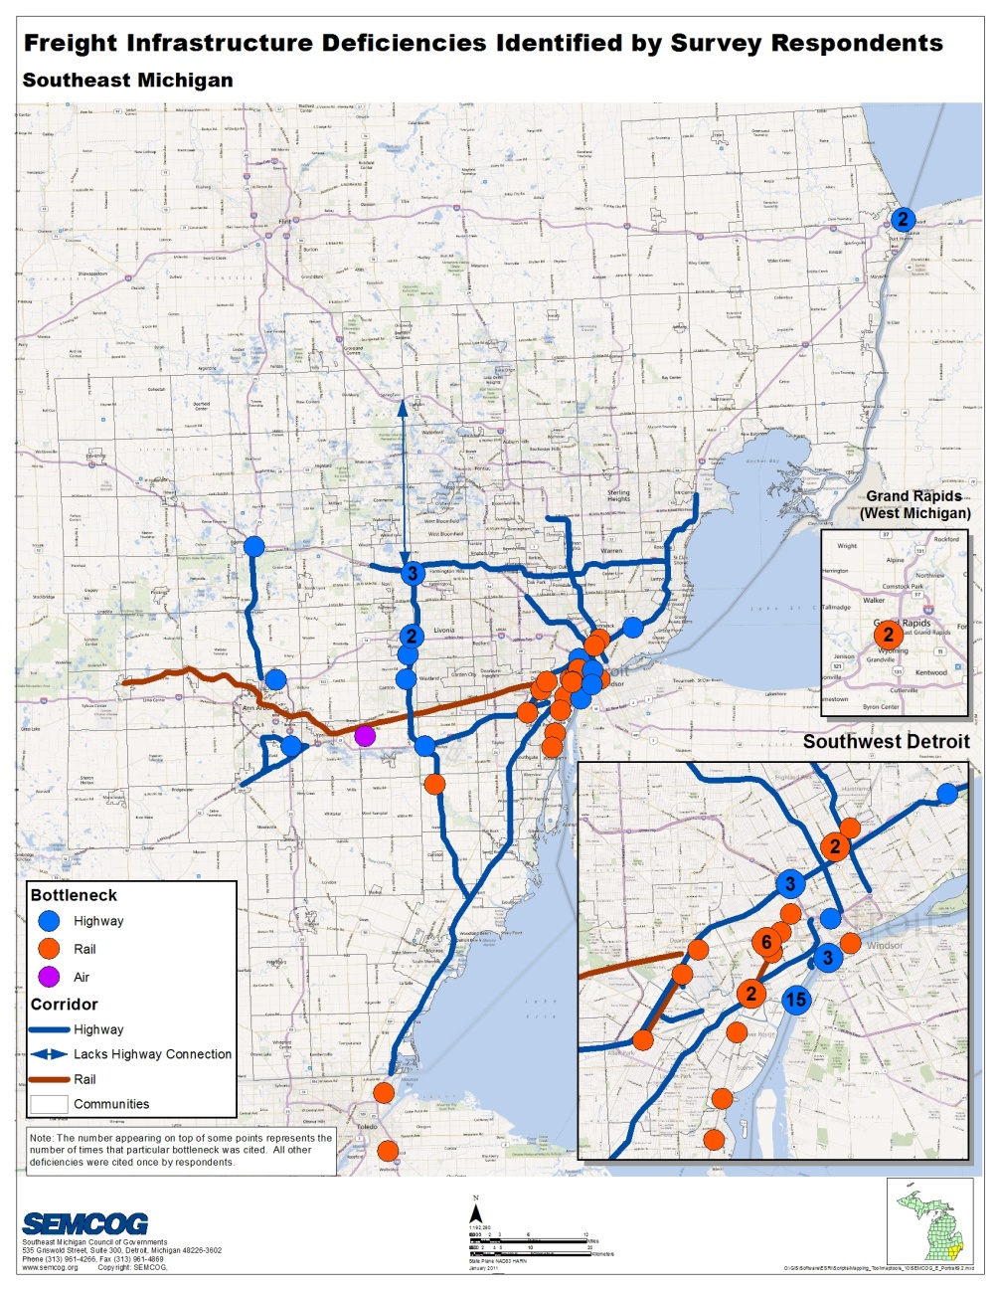
Bottlenecks
Border crossings
Rail/intermodal
Urban freeway
Local connections

Slide 12
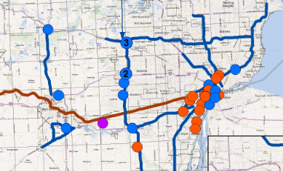

Slide 13
What This Means
Border crossings
Intermodal exchange
Freeway reliability especially at interchanges
Local connections to freeways

Slide 14
Southeast Michigan Freight Flows
Detailed look at tons and value by:
Mode of transport
Industry
Origin and destination

Slide 15
Example: Where Freight Moves
Adjacent
State
Canada
Remainder of
Michigan
Remainder of
USA
Mexico
Inbound
Outbound

Slide 16
Industry Characteristics
Different industries have different transportation needs
Profiles include
Industry-specific trends, issues, opportunities
Site selection criteria
Supply chain characteristics

Slide 17
Industry Selection
Industries with
High regional concentration
Large employment
Growing
Reliant on shipping

Slide 18
Profiled Industries
Transportation equipment manufacturing
Machinery manufacturing
Plastics and rubber parts manufacturing
Fabricated metal parts manufacturing
Wholesale trade
Healthcare
Accommodation and food services

Slide 19
Simplified Economic Analysis Tool
Spreadsheet based
Consistent with SEMCOG practices and existing tools
Leverage available resources (e.g., travel demand model, MDOT economic tools)
Consider economic impacts of freight-related and other transportation projects
Notes:
Describe economic value of transportation investments
Jobs by industry, Income, Gross Regional Product, benefit cost ratio
Evaluate scenarios for cost effectiveness
Assist in discretionary grant applications

Slide 20
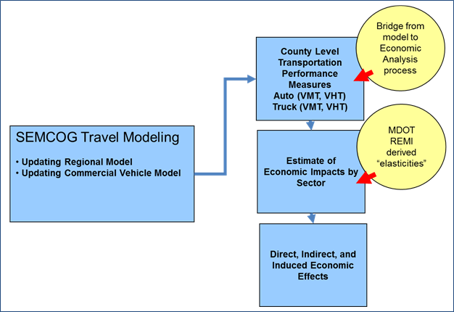
Notes:
The Simplified Economic Analysis Tool is intended to be used to assess the user benefits and economic impacts of individual projects, groups of projects, or programs of projects that can be modeled in the SEMCOG travel demand model. The tool can be used to assess the overall benefits of projects, chose among alternatives, or prioritize projects. Since the economic impacts are driven by work-related automobile travel and truck travel, the tool can help assess projects that improve freight travel.

Slide 21
What the Tool Will Estimate
Specific regional economic impacts
Gross regional product
Personal income
Employment (total and by industry group)
Cost-effectiveness measures
Benefit-cost ratio
Net present value

Slide 22
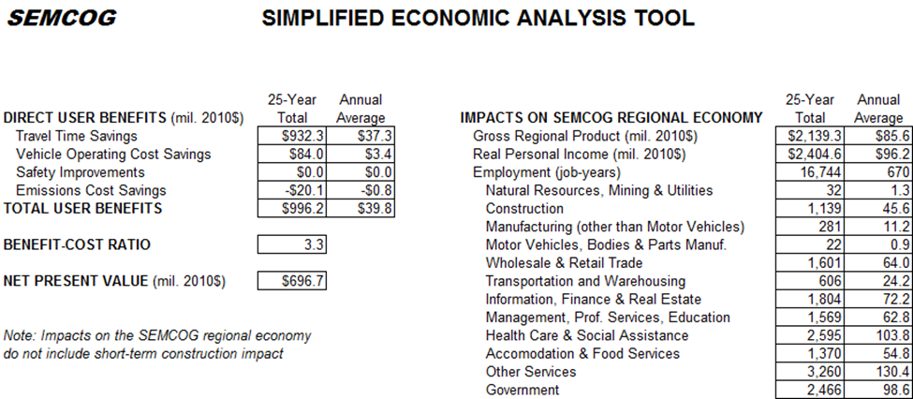
Sample Results
Note: numbers above are illustrative

Slide 23
Recommendations Projects
Improve border crossings
New International Trade Crossing
Existing crossings
Improve intermodal freight transfers
Detroit Intermodal Freight Terminal
Improve freeway performance and reliability

Slide 24
Recommendations Projects
Improve last-mile connections between major highways/rail lines to businesses
Extend the life of pavement
National ballast water standard

Slide 25
Recommendations Planning
Continued coordination with Detroit Regional Chamber and others
Ongoing industry engagement
Focus on system flexibility
Intermodal transfer
Border trade
Freeway performance

Slide 26
New International Trade Crossing
Connects the world’s largest trading partnership
Detroit crossings – over $90 billion/year
Canadian trade supports 237,000 Michigan jobs
Needed for redundancy
Canada’s top infrastructure priority

Slide 27
Detroit Intermodal Freight Terminal
Fix rail interlockers responsible for major delays
Add lift capacity
Improve business and residential conditions
50/50 public-private partnership

Slide 28
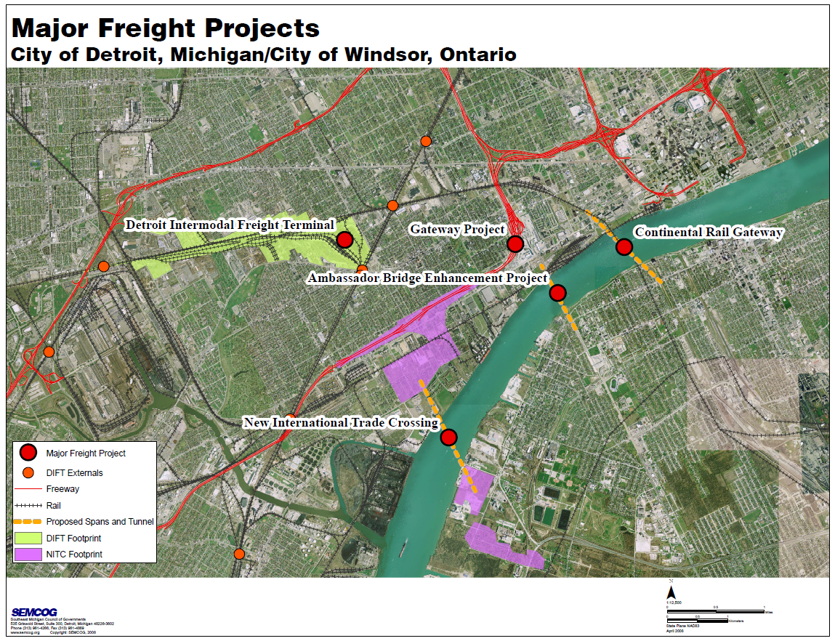

Slide 29
For More Information
SEMCOG
Freight and Economic Analysis
Detroit Regional Chamber
Translinked Study

Slide 30
Southeast Michigan Council of Governments

