Slide 1
TECHNOLOGY PLAN FOR GOODS MOVEMENT: THE NEXT 10 YEARS
BY JERRY R. WOOD
DIRECTOR OF TRANSPORTATION & ENGINEERING
GATEWAY CITIES COUNCIL OF GOVERNMENTS

Slide 2
WHAT IS GATEWAY CITIES?

Slide 3
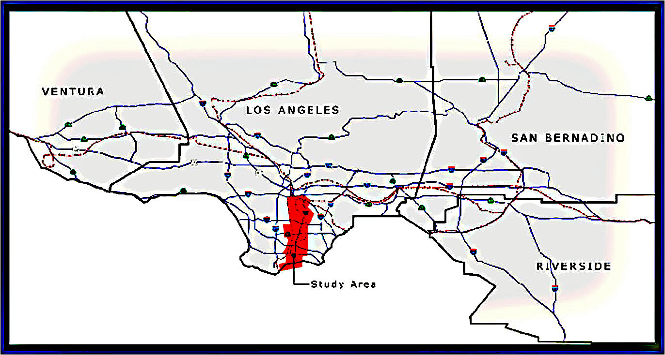
GATEWAY CITIES IN REGIONAL CONTEXT
VENTURA
LOS ANGELES
SAN BERNARDINO
SOUTHERN CALIFORNIA
RIVERSIDE
GATEWAY CITIES

Slide 4
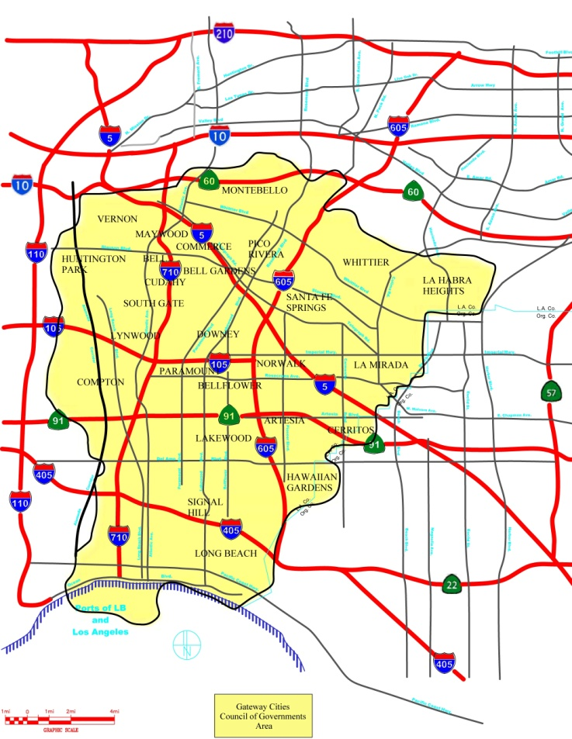
GATEWAY CITIES AT THE EPICENTER OF GOODS MOVEMENT
GATEWAY CITIES
The Gateway Cities Council of Governments (GCCOG) represents the 27 cities and unincorporated county areas of Southeast Los Angeles county (about 2.2 million residents.) Combined, Gateway Cities would be the 5th largest city in the United States. The Gateway Cities area is anchored by the Ports of Long Beach (POLB) and Los Angeles (POLA), the largest port complex in the United States.
Approximately 45% of the nation’s imports pass through these two ports, with the amount of container volumes expected to double or triple in the next few decades. The GCCOG (along with other regional public agencies) are addressing and analyzing the landside effects from this port growth, including transportation and goods movement. The I-710 is the primary truck route for goods movement to service these ports, with the highest concentration of trucks in the country.
The GCCOG, working on behalf of its communities for more than 15 years, is an active partner with Metro, OCTA, Caltrans, POLA, POLB, SCAG, CALSTART and others in joint studies and planning efforts that specifically look at transportation issues to improve air quality, mobility, congestion and public health. Research from a variety of studies indicate that major investments in infrastructure will be needed and that technology has great potential to address issues of mobility and environmental air quality.
LOS ANGELES COUNTY
GOODS MOVEMENT
ORANGE COUNTY
PARTNERSHIPS
PORTS OF
LONG BEACH & LOS ANGELES
CALIFORNIA

Slide 5
UNDERSTANDING GOODS MOVEMENT
THROUGH GATEWAY CITIES

Slide 6
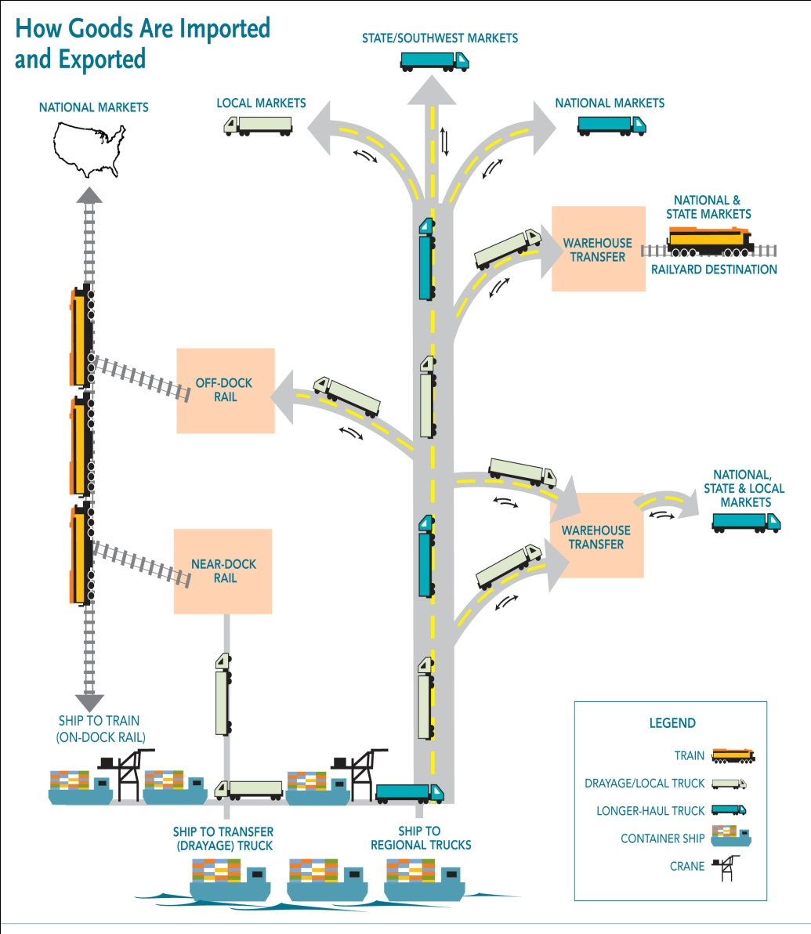
HOW GOODS ARE MOVED Summary
HOW GOODS ARE MOVED:
Movement is coordinated by cargo owner, freight forwarder, or logistics provider
Goods are moved to and from the ports in containers that travel on roads in trucks or by rail in trains
From the port terminal, vessels are unloaded or loaded; containers are placed on trucks, on trains (either on-dock rail, or via truck), or on terminal property
By TRUCK, transportation modes are: •DIRECT vessel to truck to local warehouse, distribution center or store •TRANSLOADED vessel to truck to warehouse for repacking, then to truck
By RAIL, transportation mode is: •INTERMODAL vessel to truck to rail
GOODS MOVEMENT IS
COMPLEX AND COMPLICATED
AND COULD BE MORE EFFICIENT.

Slide 7
LOGISTICS INDUSTRY/GOODS MOVEMENT SIGNIFICANT IMPACTS TO GCCOG COMMUNITIES
Goods Movement potential impacts to the GCCOG area include:
Container volumes could reach maximum number of 43 M TEU containers by 2030-2035, up from current 14 M TEU’s
Future daily truck volumes could be as high as 80,000 to 95,000, from current 25,000 per day on I-710
A projected 150 freight trains per day to and from the ports, up from 40-50 per day currently
Need for additional rail yards (on-dock, near-dock, and off-dock)
Need for a total estimated 300 M square feet of warehouses and distribution centers
The I-710, the primary truck route to service these ports, has the highest concentration of trucks and truck-related accident rates in the country
Port-related truck traffic has significant influence on the existing conditions of the freeways in GCCOG, and is expected to grow substantially in the future. This area has the highest concentration of freight trains, rail yards and warehouses and distribution centers in the country.

Slide 8
MAJOR TRANSPORTATION ROUTES FOR GOODS AND CONTAINERS TO AND FROM THE PORTS, OFF-DOCK INTERMODAL YARDS, WAREHOUSES and DISTRIBUTION CENTERS
Downtown
Los Angeles
Off-Dock
Intermodal Yards
Alameda Rail Corridor
= Gateway Cities
Council of Governments (GCCOG) Area
Near-Dock Intermodal Yards
The majority of containers to and from the ports
move by RAIL (via the Alameda Rail Corridor)
or via TRUCKS using the I-710 Freeway. As a result, this led to the preparation of a
Major Corridor Study (MCS) for I-710.
Ports of Long Beach and Los Angeles

Slide 9
THE I-710 CORRIDOR PROJECT
AND THE I-710 FREIGHT CORRIDOR

Slide 10
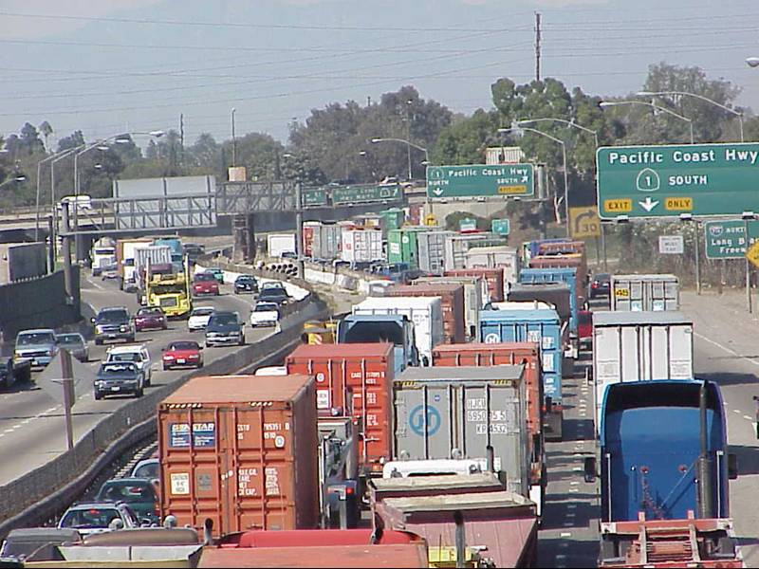
The I-710 PROBLEM

Slide 11
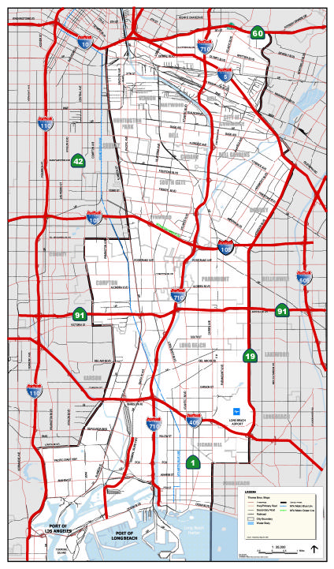
I-710 FREEWAY CORRIDOR PROJECT MAJOR CORRIDOR STUDY (MCS)
In 2005, the GCCOG, MTA, and Caltrans completed a Major Corridor Study (MCS) to improve the I-710 Freeway.
The MCS recommendation was to IMPROVE THE FREEWAY and BUILD SEPARATE TRUCK LANES on the
I-710 with community consensus and support.
Locally Preferred Strategy for I-710 includes:
• Reconstruct Freeway from 8 to 10 lanes
• BUILD 4-LANE FREIGHT CORRIDOR for entire
length
• Modernize Existing Interchanges
• Improve Arterials
The I-710 is the first major U.S. project to analyze in detail a SEPARATE FREIGHT CORRIDOR
The MCS led to the preparation of the I-710 Corridor Project EIR/EIS

Slide 12
THE I-710 CORRIDOR PROJECT
I-710 Corridor Project
PURPOSE
The full I-710 Freight Corridor project comprises a range of mainline and interchange freeway improvements, including construction of a four-lane FREIGHT CORRIDOR.
The purpose is to achieve the following by the 2035 time frame:
Improve air quality and public health
Improve traffic safety
Provide modern design for the I-710 mainline
Address projected traffic volumes
Address projected growth in population, employment, and activities related to goods movement.
The I-710 EIR/EIS will include an analysis of the impacts of complicated container movements and the capacity and ability of the freeways and rail system to transport containers & other cargo.
The EIR/EIS will environmentally analyze alternatives for improving the I-710 freeway between Ocean Blvd. in Long Beach to SR-60, encompassing 15 cities and unincorporated areas in L.A. County adjacent to the freeway corridor.
The I-710 Corridor Project EIR/EIS was started in 2008 through a cooperative agreement with GCCOG, Metro, Caltrans, POLA, POLB, SCAG, and the I-5 JPA.
Completion of a Draft EIR/EIS is anticipated for winter 2012, with completion of the final I-710 Corridor Project EIR/EIS set for winter 2013.
Objectives for the I-710 Corridor Project EIS/EIR are shaped by priorities identified by stakeholders along the I-710 corridor during and following the MCS effort. These objectives include developing transportation alternatives that will: • Improve air quality • Improve mobility, congestion and safety • Assess alternative, green goods movement technologies
GCCOG, METRO, CALSTART and others, with support from SCAQMD, are looking to develop Zero-Emission goods movement vehicles and the needed supporting infrastructure to service the I-710 Freight Corridor.

Slide 13
THE I-710 FREIGHT CORRIDOR PORTION OF THE I-710 CORRIDOR PROJECT
The Freight Corridor would include I-710 General Purpose Lane improvements next to a separated four lane freight movement facility.
The Freight Corridor would extend from the Port of Long Beach (Ocean Blvd.) to the intermodal rail yards southeast of the I-710/I-5 interchange.
The use of Zero Emission Vehicles versus conventional goods movement vehicles is being examined.
The I-710 Freight Corridor Project is aMetro Measure R highway and transit project identified as a potential Public Private Partnership (P3) candidate, to be developed with the potential for partnership with private sector funding.
THE I-710 FREIGHT CORRIDOR WILL NEED TO RELY HEAVILY ON TRANSPORTATION TECHNOLOGY TO OPERATE SUCCESSFULLY.
Communities want cars
and trucks separated,
and the Freight Corridor
will significantly improve congestion, mobility and safety (reduce accident rates) in the General Purpose Lanes.

Slide 14
GATEWAY CITIES TRANSPORTATION ISSUES/PROJECTS
ARE MULTI-FACETED AND COMPLEX

Slide 15
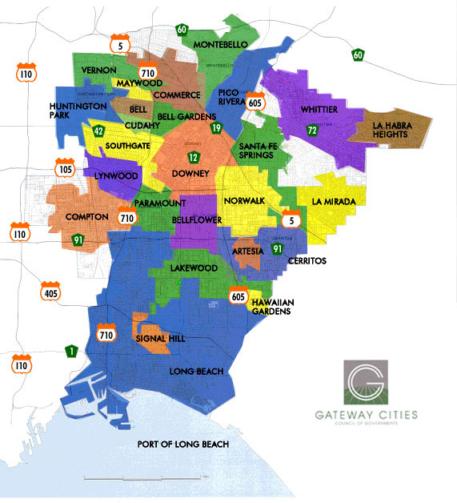
TRANSPORTATION INITIATIVES & PROJECTS INTERCONNECTING IN GATEWAY CITIES
I-710 TRANSPORTATION INITIATIVES
TRANSPORTATION TECHNOLOGY
TRANSPORTATION TECHNOLOGY
I-710 TRANSPORTATION INITIATIVES
OTHER MAJOR TRANSPORTATION INITIATIVES
Major Corridor Study (MCS) c/2005
•EIR/EIS pc/2013
•I-710 General Purpose Lanes pp
•Freight Corridor pp
•Arterial Highways pp
•I-710 Early Action Projects pp-uw
•I-710 Early Action Sound Walls pp- pc/2012
•I-710 Freight Corridor Public/Private
Partnership Study pc/2012
•I-710 Utility Relocation Studies pp-pc 2012
•Intelligent Transportation Systems
(ITS) Integration Plan for Goods
Movement c/2008
•ITS Implementation Plan pp-pc/2012
•Zero Emission Vehicle Transportation pp
•Transportation System
Management/Transportation
Demand Management Projects
(TSM/TDM) pp-pc/2012
•ITS Projects pp
AIR QUALITY INITIATIVES
GATEWAY CITIES
TRANSPORTATION STRATEGIC PLAN projected completion/2012
AIR QUALITY INITIATIVES
OTHER MAJOR TRANSPORTATION INITIATIVES
•Gateway Cities
Air Quality Action Plan pp-pc/2012
•POLB and POLA Clean Air Action
Plan (CAAP) uwo-c/2006
•Railroad Equipment Upgrades uwo
•GCCOG as Sub-Regional Sustainable
Communities Strategy SB375 (and
AB 32) Delegation c/2011
•I-710 Air Quality/Health Risk
Assessment pc/2012
•I-710 Freight Corridor with
Zero-Emission Vehicles pp-uw
•I-5 Construction (605 to County Line)
pc/2016
•I-5 EIR/EIS (605 to 710) pc/2012-13
•Arterial Highways pp
•Master Plan of Arterial Highways pp
•Truck Enforcement Facilities pp
•OC/LA Co. Inter-County Transportation
Projects pp
•Bike Lanes
•91/605 Needs Assessment c/2005
•91/605/405 Initial Corridor Studies c/2008
•91/605/405 Congestion “Hot Spot” Projects
& Feasibility Analysis pc/2012
WHAT’S STILL MISSING?
•Goods Movement Coordination with
Logistic Industry Participation uw
•State/Federal Agencies Participation uw
•Additional Funding for All Infrastructure Improvements uw
•Zero-Emission Transportation Technology Implementation / Business Plan / Demonstration Projects pp
TRANSIT & MULTI-MODAL INITIATIVES
GOODS MOVEMENT
GOODS MOVEMENT
TRANSIT AND MULTI-MODAL INITIATIVES
•Grade Separations uwo
•Main Line Track Additions uwo
•Rail Yards uwo
•SCAG Goods Movement Study
pc/2012
•I-710 Freight Corridor pp
•PierPASS c/2005
•High Speed Rail uwo
•Metrolink uwo
•Amtrak uwo
•PE/W. Santa Ana Branch Study .
pc/2012
•Orange Line Development Authority
Studies (OLDA) uw
•Eastside Extension Study pc/2012
•Local, Sub-Regional and Regional Bus
Service Improvements uw
•Light Rail and Bus Services, including
Green Line, Blue Line & Orange Line uw
WHAT’S STILL MISSING?
LEGEND
c = completed
pp = planned project
pc= projected completion
uw = underway
uwo = underway by others

Slide 16
IN GATEWAY CITIES, WHERE DOES TRANSPORTATION TECHNOLOGY FIT IN?
TRANSPORTATION TECHNOLOGY
I-710 TRANSPORTATION INITIATIVES
I-710 TRANSPORTATION INITIATIVES
•Intelligent Transportation Systems
(ITS) Integration Plan for Goods
Movement c/2008
•ITS Implementation Plan pp-pc/2012
•Zero Emission Vehicle Transportation pp
•Transportation System
Management/Transportation
Demand Management Projects
(TSM/TDM) pp-pc/2012
•ITS Projects pp
TRANSPORTATION TECHNOLOGY
Major Corridor Study (MCS) c/2005
•EIR/EIS pc/2013
•I-710 General Purpose Lanes pp
•Freight Corridor pp
•Arterial Highways pp
•I-710 Early Action Projects pp-uw
•I-710 Early Action Sound Walls pp- pc/2012
•I-710 Freight Corridor Public/Private
Partnership Study pc/2012
•I-710 Utility Relocation Studies pp-pc 2012
OTHER MAJOR TRANSPORTATION INITIATIVES
AIR QUALITY INITIATIVES
GATEWAY CITIES
TRANSPORTATION STRATEGIC PLAN projected completion/2012
OTHER MAJOR TRANSPORTATION INITIATIVES
•I-5 Construction (605 to County Line)
pc/2016
•I-5 EIR/EIS (605 to 710) pc/2012-13
•Arterial Highways pp
•Master Plan of Arterial Highways pp
•Truck Enforcement Facilities pp
•OC/LA Co. Inter-County Transportation
Projects pp
•Bike Lanes
•91/605 Needs Assessment c/2005
•91/605/405 Initial Corridor Studies c/2008
•91/605/405 Congestion “Hot Spot” Projects
& Feasibility Analysis pc/2012
AIR QUALITY INITIATIVES
•Gateway Cities
Air Quality Action Plan pp-pc/2012
•POLB and POLA Clean Air Action
Plan (CAAP) uwo-c/2006
•Railroad Equipment Upgrades uwo
•GCCOG as Sub-Regional Sustainable
Communities Strategy SB375 (and
AB 32) Delegation c/2011
•I-710 Air Quality/Health Risk
Assessment pc/2012
•I-710 Freight Corridor with
Zero-Emission Vehicles pp-uw
WHAT’S STILL MISSING?
GOODS MOVEMENT
•Goods Movement Coordination with
Logistic Industry Participation uw
•State/Federal Agencies Participation uw
•Additional Funding for All Infrastructure Improvements uw
•Zero-Emission Transportation Technology Implementation / Business Plan / Demonstration Projects pp
TRANSIT & MULTI-MODAL INITIATIVES
TRANSIT AND MULTI-MODAL INITIATIVES
WHAT’S STILL MISSING?
•High Speed Rail uwo
•Metrolink uwo
•Amtrak uwo
•PE/W. Santa Ana Branch Study .
pc/2012
•Orange Line Development Authority
Studies (OLDA) uw
•Eastside Extension Study pc/2012
•Local, Sub-Regional and Regional Bus
Service Improvements uw
•Light Rail and Bus Services, including
Green Line, Blue Line & Orange Line uw
GOODS MOVEMENT
•Grade Separations uwo
•Main Line Track Additions uwo
•Rail Yards uwo
•SCAG Goods Movement Study
pc/2012
•I-710 Freight Corridor pp
•PierPASS c/2005
PORT OF LOS ANGELES/
LEGEND
c = completed
pp = planned project
pc= projected completion
uw = underway
uwo = underway by others
THIS LED TO CREATING THE GATEWAY CITIES TECHNOLOGY PLAN FOR GOODS MOVEMENT.

Slide 17
INCEPTION OF THE
GATEWAY CITIES TECHNOLOGY PLAN
FOR GOODS MOVEMENT

Slide 18
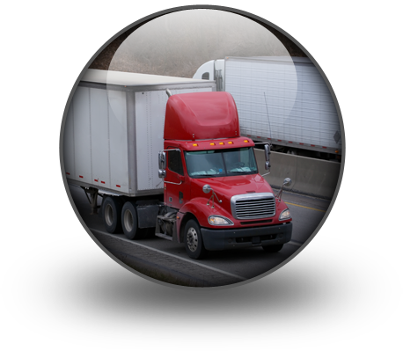
BACKGROUND FOR ITS FOR GOODS MOVEMENT
Intelligent Transportation Systems (ITS) are technology applications within the transportation system to manage congestion and goods movement efficiencies by sharing real-time traveler information to help address air quality, traffic congestion, roadway deficiencies, and pavement degradation. To evaluate their use, an ITS INTEGRATION PLAN FOR GOODS MOVEMENT was prepared for Southeast L.A. County and the two ports by the GCCOG in 2008 in partnership with Caltrans and the FHWA. The 2008 plan identified the ITS needs of the Gateway Cities and Southern California as well as several projects to improve goods movement – it represented a significant fusion of ITS and freight operations technologies. For the GCCOG area, an ITS working group of public agencies and private companies came up with local objectives for implementation. A GATEWAY CITIES TECHNOLOGY PLAN FOR GOODS MOVEMENT (ITS IMPLEMENTATION PLAN) is currently underway to determine how to implement a concept of operations for 14 different ITS projects into a solid business concept.
CalSTART recently (2011) completed a research project regarding the “state of the industry” for the development of Zero-Emission or Near-Zero Emission heavy duty trucks. They determined that this technology can be available by the time the Freight Corridor is in operation (in 10-15 years.)

Slide 19
PROJECT OVERVIEW GATEWAY CITIES TECHNOLOGY PLAN FOR GOODS MOVEMENT
ITS Projects recommended for Gateway Cities area, including but not limited to:
Truck Fleet Com
Freeway Detection
Truck Parking
CURRENT SCOPE
Update the Feasibility Studies since 2008 to:
• Accommodate recent regional developments
• Leverage recent advances in technology
˚ Traveler Information (LA 511)
˚ Mobile Applications (smart phones)
˚ Freight/Enforcement Technologies
Based on update, create technology plan that leads to
implementation (with Concept of Operations, Business, and
Implementation Plans)
Five months into an 18 month project length
The primary goal is to assist the goods movement
industry with technology to be more efficient to reduce
truck trips, improve mobility, have safer roadways and
improve air quality.
Scheduling System
Arterial Travel Times
Truck Platooning
Truck Info Integration
Queue Detection
Truck Enforcement
Performance Management
Transportation Management
Federal Programming
I-710 Opportunities
The GATEWAY CITIES TECHNOLOGY PLAN FOR GOODS MOVEMENT will include the identification and feasibility of building one or two permanently operating TRUCK ENFORCEMENT FACILITIES.

Slide 20
13 FEASIBILITY STUDIES
FEASIBILITY STUDY REPORT AREA | FEASIBILITY STUDIES
DATA COLLECTION GROUP | Freeway Information and Data (DC-1) Key Arterial Information and Data (DC-2) Terminal Queue Information and Data (DC-3)
TRANSPORTATION OPERATIONS AND MANAGEMENT GROUP | Goods Movement Transportation Management (TM-1) Truck Travel Information Integration (TM-2) Comprehensive Performance Monitoring Program (TM-3)
EMERGING GOODS MOVEMENT TECHNOLOGY APPLICATIONS GROUP | Drayage Operations ITS (ET-1) Private Sector Fleet Management Information and Dynamic Mobility Applications (ET-2) Opportunities and Integration with Emerging Federal Programs (ET-3)
I-710 FREIGHT CORRIDOR ADVANCED TECHNOLOGIES GROUP | 710 Future Technology Infrastructure (AT-1) Advanced Fleet Platooning Concepts (AT-2)
CVO OPERATIONS PLANNING GROUP | Truck Enforcement Strategies, Systems & Sites Study (CV-1) Truck Parking Coordination (CV-2)

Slide 21
WHAT ARE THE OUTCOMES EXPECTED FROM THE GATEWAY CITIES TECHNOLOGY PLAN FOR GOODS MOVEMENT?
EXPECTED OUTCOMES FROM THE GATEWAY CITIES TECHNOLOGY PLAN FOR GOODS MOVEMENT:
Detailed research on the latest trends, practices and regional priorities on ITS goods movement and other transportation technologies
Feasibility studies of more than ten different opportunity areas for new and expanded ITS technologies for Gateway Cities
Exploration of technologies supporting emerging alternatives for I-710 corridor improvements
A detailed concept of operations and implementation, and a business plan to ensure that real-world, working solutions are the outcome of the plan
The GATEWAY CITIES TECHNOLOGY PLAN FOR GOODS MOVEMENT is a program initiated by the GCCOG in partnership the MTA.
For this project, the ITS Working Group that participated with the 2008 ITS Integration Plan is reconvened. It is comprised of transportation and freight industry stakeholders from the public and private sectors.
The project is anticipated to be completed in December 2012.
ITS WILL REQUIRE:
The installation of cross-connected field infrastructure to provide real-time traveler information.
A commitment and direction from stakeholders to work on system integration for goods movement.
ITS will be an important component in the operation of a potential I-710 FREIGHT CORRIDOR.

Slide 22
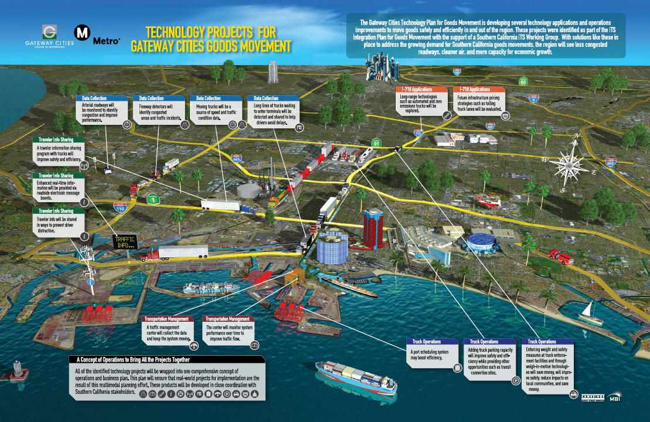

Slide 23
ITS WORKING GROUP
(PUBLIC/PRIVATE SECTOR COLLABORATION)
Build off of the success of the 2008 ITS Working Group
Engage Regional Stakeholders in new phase • Participation throughout the project • Help guide direction of outcomes • Over 30 stakeholders identified
Conducted preliminary one-on-one outreach
First meeting scheduled for November 30, 2011
Project website created to foster communication and sharing

Slide 24
TYPICAL APPLICATION EXAMPLE OF
ITS FOR FREIGHT - TECHNOLOGY POTENTIAL
FOR TRUCK ENFORCEMENT

Slide 25
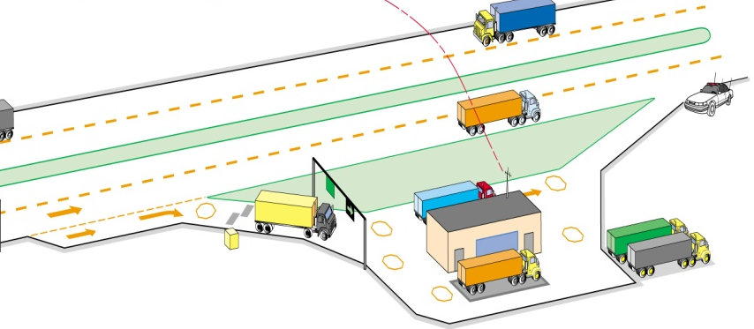
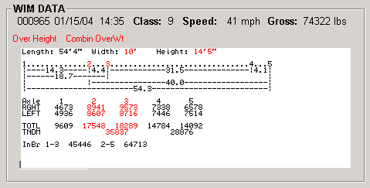
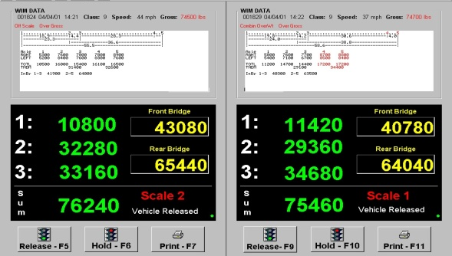
COMMERCIAL VEHICLE ENFORCEMENT NETWORK (CVEN)
TRUCK ENFORCEMENT
VIRTUAL SCREENING SITES (VSS)
COMMERCIAL VEHICLE ENFORCEMENT FACILITIES (CVEF)
MAINLINE BYPASS
FUNCTIONALITIES
Weigh in Motion
Dimension in Motion
Brake Check in Motion
Tire Pressure Check in Motion
Vehicle Identification in Motion
Load Identification in Motion
Driver Identification in Motion
FULL MINI PULL OFFS
ITS DEPENDENT FUNCTIONALITIES
Auto Calibration of WIM
Permitted Truck Sorting
Auto Truck Placement
Auto Release

Slide 26
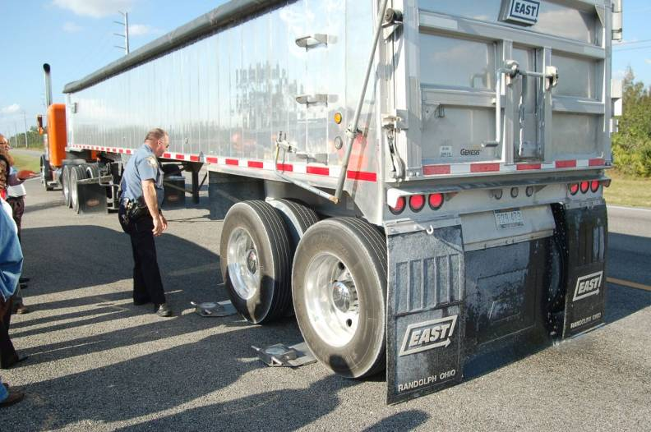
VIRTUAL SCREENING FOR MOBILE ENFORCEMENT
TRUCK ENFORCEMENT

Slide 27
COMMERCIAL VEHICLE ENFORCEMENT NETWORK MAP Concept
BENEFITS OF CVEN:
EASE OF USE | SAFER DRIVERS
ON TIME DELIVERY | LESS AIR POLLUTION
MINIMIZED EXITING/ENTERING | HOMELAND SECURITY IMPROVED
IMPROVED SAFETY | LESS WASTED TIME
LONGER PAVEMENT LIFE | LESS WASTED FUEL
LONGER BRIDGE LIFE | LESS WASTED BREAKS
LESS ACCIDENTS | IMPROVED THROUGHPUT AT: • PORTS • RAILS • TRANS-LOADING CENTERS • CROSS DOCK CENTERS
LESS CONGESTION FROM ACCIDENTS
Truck Origin/Destination Types:
• Long Haul Trucks • Local Trucks • Port Trucks

Slide 28
TYPICAL ITS APPLICATION EXAMPLE
FOR I-710 FREIGHT CORRIDOR –
TECHNOLOGY POTENTIAL /ISSUES FOR
ZERO EMISSION TRUCKS AND OPERATIONS

Slide 29
I-710 FREIGHT CORRIDOR TRANSPORTATION OPTIONS & ALTERNATIVES
The I-710 Freight Corridor will consider two transportation movement technology alternatives:
CONVENTIONAL TRUCKS •New Diesel, LNG, CNG, etc.
ZERO EMISSION TRUCKS •Battery-powered •Electrically-powered in Freight Corridor •Hybrid
A RANGE OF ALTERNATIVES for the I-710 EIR/EIS is needed to fulfill CEQA/NEPA requirements.
On the basis of the Alternative Technology Study, the following were recommended for phased implementation for the I-710 Freight Corridor: • CONVENTIONAL, LOW EMISSION TRUCKS • ZERO EMISSION TRUCKS • AUTOMATED FIXED GUIDEWAY
The design of the Freight Corridor will also assume possible future conversions, or initial construction, as feasible, of an AUTOMATED FIXED GUIDEWAY family of alternative technologies (e.g. Mag-Lev.) This may require additional environmental analysis and approval at a later date if possible.
Any Freight Corridor needs to consider Zero (or, Near-Zero) Emission container or cargo transport technologies.

Slide 30
I-710 FREIGHT CORRIDOR CONTAINER TRANSPORT TECHNOLOGIES ZERO EMISSION TRUCK SUMMARY
ELECTRIC/BATTERY/HYBRID
TRUCK TECHNOLOGY
WHAT HAVE WE LEARNED
FOR THE I-710?
PRO Fulfills zero emissions objective Compatible with existing facilities Requires significantly less terminal infrastructure Greater operational flexibility Lower cost Higher capacity Enables upgrade to more advanced technology Integrates proven, available technologies Easier to expand beyond I-710 Freight Corridor
CON Dependent on developing battery/hybrid technologies Potential limited range beyond I-710 Freight Corridor No industry “volunteers” - yet
Zero Emission container transport technologies are feasible
No such systems have yet been proven in commercial application
A holistic and multi-faceted approach is needed to evaluate any Zero Emission technology
A viable system must serve multiple origins and destinations
Zero Emission technology will be evaluated as part of the I-710 EIR/EIS
For now, Zero Emission trucks will be the subject of the environmental evaluation - this was determined from an evaluation of different types of Zero Emission technologies shown on the previous slide, and a very careful understanding of origins and destinations for containers and cargo.
The electrical requirements of Zero Emission technology will be considered, including availability and cost of power from renewable sources.
Automated operation and tolls will be needed for the
I-710 Freight Corridor.
Automated platooning of trucks would be a typical ITS application.
AUTOMATION WILL BE A KEY FACTOR
IN OPERATING THE FREIGHT CORRIDOR.

Slide 31
GATEWAY CITIES TECHNOLOGY PLAN
FOR GOODS MOVEMENT
NEXT TEN YEARS Summary

Slide 32
GATEWAY CITIES TECHNOLOGY PLAN FOR GOODS MOVMENT NEXT TEN YEARS Summary
Complete current
TECHNOLOGY PLAN FOR GOODS MOVEMENT
2012
Develop
ITS PRIORITIZATION PLAN
2012
Continue research of TRANSPORTATION TECHNOLOGIES DEVELOPMENT & IMPLEMENTATION
(ongoing)
Begin to implement
ITS GOODS MOVEMENT DEMONSTRATION PROJECTS
with partners such as:
MTA•Logistics Industry •Ports •FHWA/USDOT • Caltrans •Local Agencies
Develop
ITS BUSINESS PLAN
2012
Develop FUNDING SOURCES – both capital and operations and maintenance.

Slide 33
THANK YOU
JERRY R. WOOD, P.E.
Director of Transportation & Engineering
Gateway Cities Council of Governments
714.626.0073 Jerry@jrwoodconsultant.com
Jerry 1/Share/COG2012/PPforJRWPresentations-2012/JRWTalkingFRpp1-18-12

