Slide 1
Freight Dynamic Mobility Applications
Freight Advanced Traveler Information Systems and Cross Town Improvement Project
Randy Butler
January 18, 2012

Slide 2

DMA Freight Problem Statement: Lack of Advanced Traveler Information has negative effect on
    Efficient Movement of Freight Transportation
    Logistics Management Systems
    Environment of Neighboring Communities
    Energy Consumption
    Safety of the Traveling Public
DMA Proposed Freight Solution: Develop Freight Advanced Traveler Information (FRATIS) applications focusing on
    Freight Real-time Traveler Information
    Freight Dynamic Route Guidance
    Drayage Optimization
Notes:
The DMA freight problem….
The DMA Program proposes a solution to address the lack of freight advanced traveler information by enabling the development of freight-related (real-time) information applications, including freight-specific dynamic route guidance applications and coordinated load management (drayage optimization) to reduce empty loads using an open data/open source approach to engage researchers and the private-sector to spur innovation.
Briefly mention pilot C-TIP project results…
Commercially-available and custom developed products are on the market today for freight ATIS, route guidance and drayage optimization, and some state DOTs have limited freight-specific information on websites and provide this information to subscribers, but more freight-specific information and sharing of this information is needed.
The idea is to incorporate more freight-specific information and spur innovation to make information more broadly available to the freight industry (including smaller companies, owner-operators). What is needed? Examples include specialized freight operations information such as truck rest stops/areas, real-time truck-specific work zone and route restrictions, OS/OW restrictions, predicted travel times, and performance measure monitoring (e.g., wait times, number of bobtail trips, air quality). Information sharing is needed to optimize drayage operations so that load movements are coordinated between freight facilities, max loaded trips/min empty trips…

Slide 3
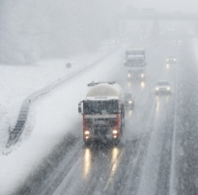


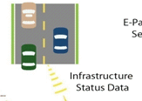

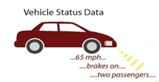
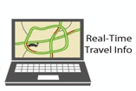


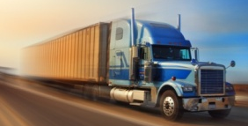




Dynamic Mobility Program
Real-time Data Capture and Management
Dynamic Mobility Applications
Reduce Speed 35 MPH
Transit Signal Priority
Weather Application
Data Environment
Fleet Management/ Dynamic Route Guidance
Truck Data
Transit Data

Slide 4

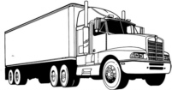

Manufacturer’s Factory
Distribution Center
⬅ Mean duration of the Deployment Test’s supply chain ➔
Time = 0
160 hours
100 %
Target
Of Opportunity
Shipment awaiting information exchanges to take place
80 %
60 %
Percent of 160
Hour Duration
Shipment awaiting physical state change, such as shipment consolidation
40 %
20 %
Shipment is in movement
0 %
Data are based on preliminary qualitative findings collected during baseline activities along the target supply chain.

Slide 5
Kansas City Cross Town Improvement Project
To develop and deploy an
Information sharing / transfer capability that Enables the coordination of moves between parties to Maximize loaded moves and Minimize unproductive moves.

Slide 6
Current Kansas City Pilot / C-TIP
Intermodal Exchange (IMEX)
Wireless Drayage Updating (WDU)
Real Time Traffic Monitoring (RTTM)
Dynamic Route Guidance (DRG)

Slide 7
Transition → C-TIP Applications to FRATIS
Scalable and Transferable
  Rail-to-rail: cross-continental moves
  Port-to-rail: where on-dock rail facilities do not exist
  Port-to-truck: port to distribution centers
  Airport-to-truck: airport to distribution centers
  Over the road freight movements

Slide 8
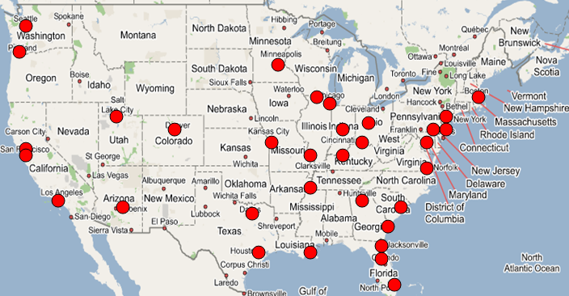
Potential Locations for the
Application of FRATIS

Slide 9
Freight Real-Time Traveler Information
Problem Addressed
  Uncertainties in traffic congestion and weather conditions pose a productivity and safety risks to freight traffic
Description
  Road Weather Information
  Truck Parking
  Truck Scales
  Permitting
  Road Construction
  Bridge Clearance
  Bridge Weight Formulas
  Travel Time Metrics

Slide 10
Freight Dynamic Route Guidance
Problem Addressed:
  Lack of awareness of the best routes along congested corridors result in increased delays and costs to freight traffic
Description
  Road Construction
  Traffic Congestion
  Predicted Travel Times
  Freight Traveler Specific
  Build on the C-TIP Real Time Traffic Monitoring (RTTM) and Dynamic Route Guidance (DRG) applications for best route between freight facilities

Slide 11
Drayage Optimization
Problem Addressed
  Reduce freight delays to ensure uninterrupted operations within the terminal/warehouse
Description
  Optimize drayage operations so that load movements are coordinated between freight facilities
  Maximize Loaded Trips and Minimize Empty Trips
  Port and Intermodal Gate Processing Information

Slide 12
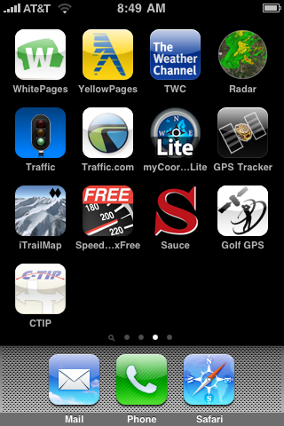
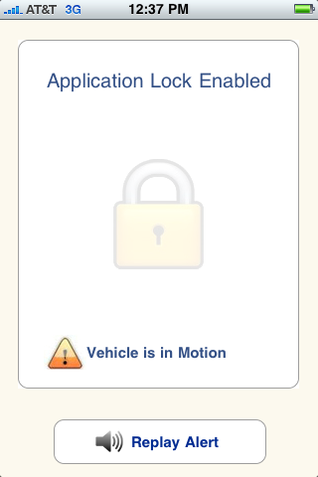
iPhone / Android Applications
Systems built to avoid DRIVER DISTRATION
Select the “FRATIS” application

Slide 13
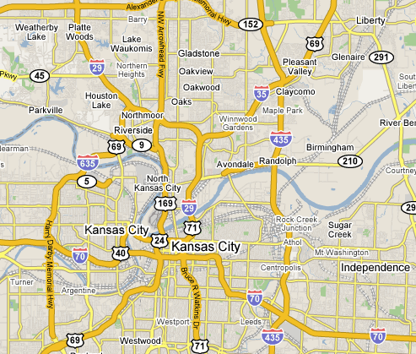
FRATIS Operating Scenario
FRATIS Components
WDU
IMEX
FRATIS
Road Weather
Truck Scales and Permit
Truck Parking
Intermodal Exchange
(IMEX)
Deliver Freight Facility
Wireless Drayage
Updating (WDU)
Real Time Traffic
Pickup
Freight Facility
Deliver
Freight Facility
Real Time Traffic
Real Time Traffic
Monitoring (RTTM)
!
Freight Identified to Move
Deliver to Industry
Pickup Industry
Dynamic Route
Guidance (DRG)
Pickup

Slide 14
Questions
Randy Butler
US DOT – FHWA
202 366 9215
randy.butler@dot.gov

