Slide 1
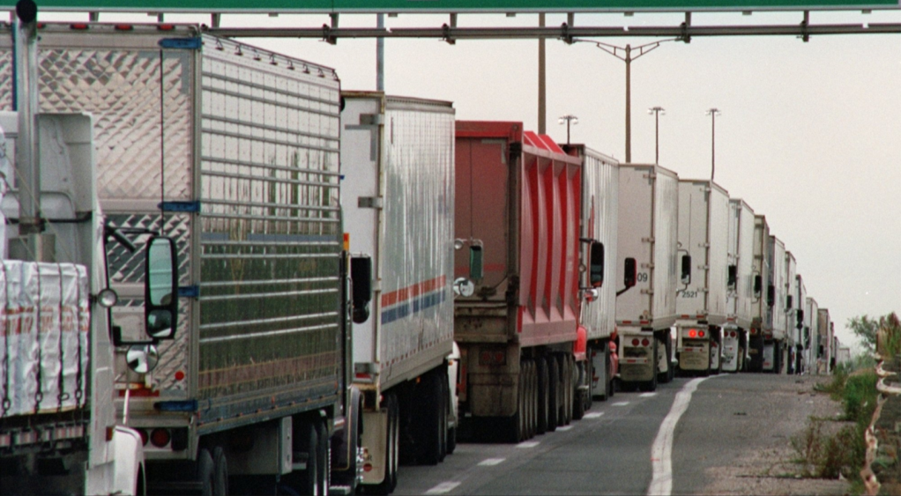


Shorepower Technologies
March 2012
(503) 892-7345

Slide 2









The Problem
Environmental
Compliance
Cost

Slide 3

Shorepower Truck Electrification Project
Replace petroleum with electricity
Alternative to idling
The new “normal” - transformation of truck transportation
50 truck stop locations nation-wide (Avg. 24 connections per site)
Select locations to maximize use by rebated vehicles

Slide 4
Shorepower Truck Electrification Project
Seed market with incentives for onboard equipment
Report viability of electricity as alternative to idling to D.O.E. in 2014
Signing up “green” first-mover fleets
Supported by energy, transportation and air quality agencies

Slide 5
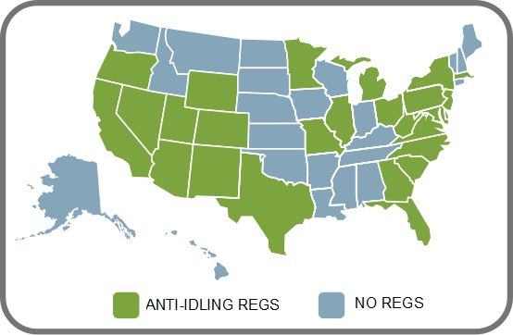

Anti-Idling Laws
Currently 29 States / 48 jurisdictions
Source: American Transportation Research Institute (as of Jan 2012)

Slide 6
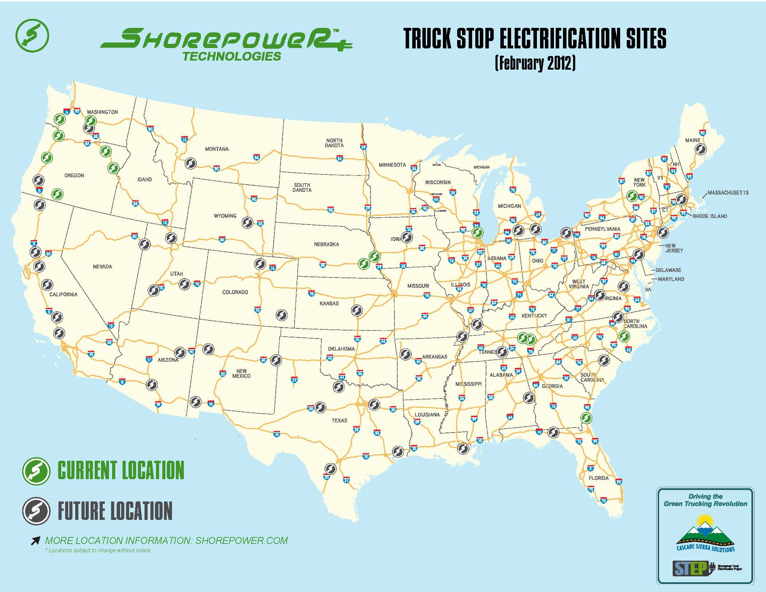
Current and Future Locations

Slide 7
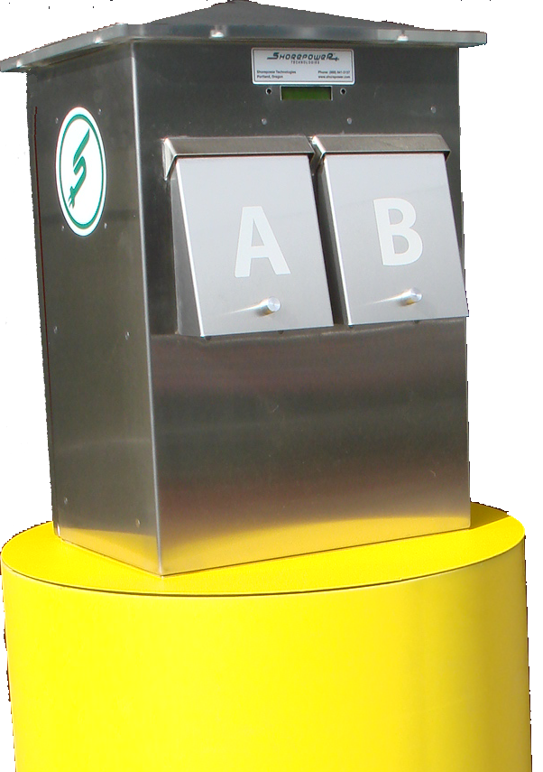
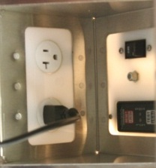
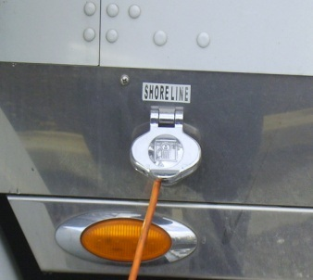

Shorepower TSE System
PRODUCT
BENEFITS
Rugged, free-standing, pedestal
Safety light
Comfort & entertainment
Significant savings
Improved air and noise quality
Compliance
Host site revenues
Power, cable TV and wireless internet
Remote payment, activation and monitoring
Renewable energy options
FUEL COST PER NIGHT
Truck shore power inlet
Shorepower
$11
Idling
$40
Notes:
Large fleets that have an average of 2000 trucks could drive $8 to $10 million or more to their bottom line if their fleet plugged into Shorepower.
Our secret sauce is contained within the pedestal – a proprietary remote payment, activation and monitoring system.
Over 60% savings in cost per night.
The equivalent of completely removing over a quarter of a million cars from the roads every year.

Slide 8




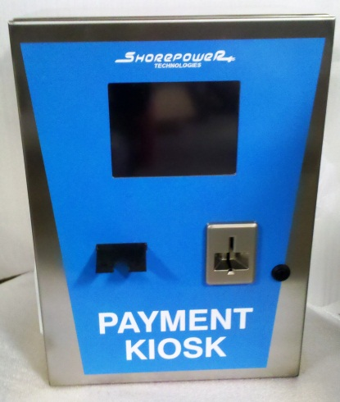


Payment Options
On-Site Kiosk
Toll-Free Operator
Web Browser
Pre-Paid Card
www.shorepowerconnect.com

Slide 9

Market Trends
Driver retention
Driver shortages
Greening of fleets
Health issues
Mobile devices, laptops etc.
Mid-size companies keenly interested
Electrifying their own terminals
Incorporating idle reduction equipment in cabs & on trailers

Slide 10
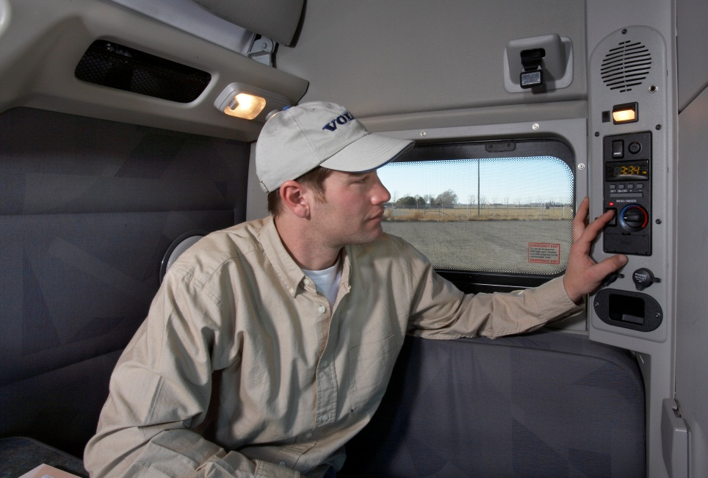
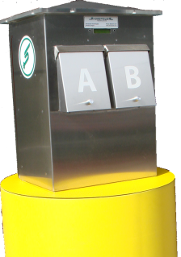
Long Term Idle Reduction Solution
No petroleum consumption
Zero local emissions
Decrease noise pollution
Safe & proven technology
Drivers have more freedom
Focused on idle-reduction
Most efficient/cost effective
Electric TRU standby power
No recycled air
Sustainable business model

Slide 11
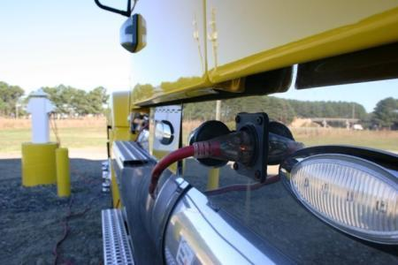
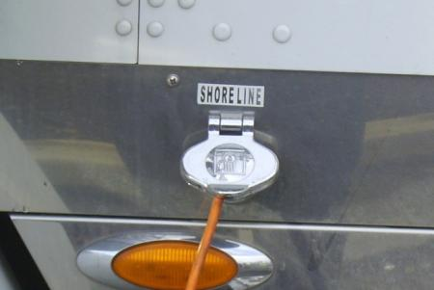
Trucking Industry is Gearing Up
100% of trucks can plug into shore power with extension cord
20-30% of trucks have shore power “convenience” prewired
All truck manufacturers and many APUs provide shore power options
Retrofit cost: $100 - $2000
Industry is providing incentives and rebates to upgrade

Slide 12

Trends in Electrification
Competition is electrifying
Easiest way to meet green supply chain requirements; (e.g. Sysco)
Reliable Technologies available (battery or plug in)
Higher electrical cab loads as shore power appears
Maintenance costs for older equipment
Higher health risks awareness by drivers (CSA)
Stricter regulation of idling nation-wide (30+ states)

Slide 13













Shorepower Capable APUs

Slide 14
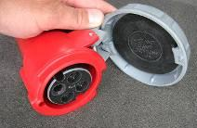
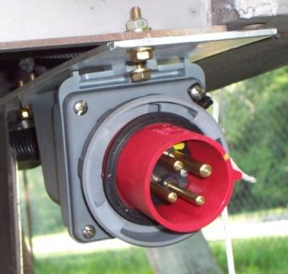
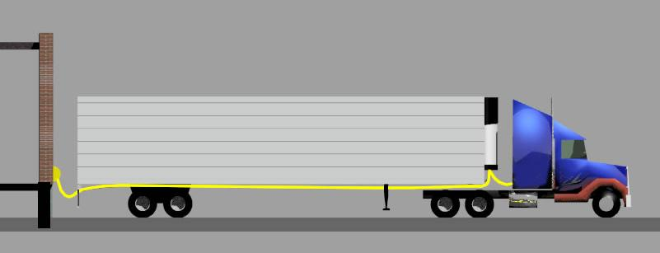
Electric Standby Transport Refrigeration Unit eTRU
Shorepower Trailer Wiring System for eTRUs
– US Patent No. 7,241,146

Slide 15

For More Information
Shorepower Technologies
2351 NW York Street
Portland, OR 97210
(503) 892-7345
www.shorepower.com

