Slide 1


U.S. EPA SmartWay
Transport Partnership
US DOT
Talking Freight
Denise Kearns
April 18, 2011

Slide 2
Today’s Discussion
Why sustainable freight?
  Environmental & economic drivers
EPA SmartWay approach and objectives
  Public-private partnership
  Save fuel, energy and the environment
EPA SmartWay tools & resources
  Carbon tracking & Performance assessment tools
  Technology Verification
  Partner Recognition
Going forward

Slide 3
Transportation is a Major Contributor to U.S. GHG Emissions
Transportation accounts for roughly 1/3 of total U.S. GHG emissions . . .
and
about 2/3 of U.S.
petroleum-based
fuel use.
2010 Data - Inventory of U.S. Greenhouse Gas Emissions and Sinks (EPA)

Slide 4
Transportation/Heavy-Duty GHG Emissions
Medium- and Heavy-Duty Trucks
2010 Data - Inventory of U.S. Greenhouse Gas Emissions and Sinks (EPA)

Slide 5

Economic Importance
Freight transportation is a cornerstone of our economy
  Communities & businesses depend on trucking & rail for production and delivery of goods purchased at local stores, online
$11 trillion value in freight shipments
  Domestic commodity shipments, domestic transport of exports, imports
Trucking generates $660 billion in revenues, employs almost 9 million people
  Essential to our nation’s competitiveness, U.S. jobs, local economies

Slide 6

EPA SmartWay Transport Partnership
Collaboration between government & business
Promote sustainable goods movement in supply chain
Reduce economic, energy and environmental costs of goods movement

Slide 7
SmartWay Approach
Recognizes that businesses freight is critical to economy, jobs, healthy business climate
Provides freight industry with tools to help businesses improve efficiency, reduce emissions and save fuel as a means to:
  save money,
  stay competitive,
  demonstrate leadership, environmental stewardship

Slide 8
SmartWay Approach
EPA provides consistent objective, market-driven tools, approaches and incentives to help businesses to benchmark, track and reduce fuel consumption from supply chain
Partners save money, cut emissions and achieve recognition
Win for business - Win for the environment

Slide 9
Program highlights, composition
Since 2004, has grown to nearly 3,000 SmartWay partners with support of the trucking industry and their freight shipping customers (large retailers)
  Top 100 U.S. truck carriers
  All Class 1 rail lines
  Fortune 500 shippers from every major business sector
  Major logistics firms

Slide 10




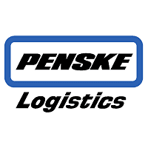



Some of SmartWay’s Partners
U.S. General Services Administration
Freight Transportation Management

Slide 11
Program Achievements
  Since 2004, SmartWay Partners have saved:
  - 16.5 million metric tons of CO2 - 235,000 tons NOx
  - 9,000 tons PM - 50 million barrels of oil
  - $6.1 billion dollars in fuel costs
  Equivalent to taking over 3 million cars off the road for 1 year

Slide 12
Key Program Elements
Partnership
Tools to assess, benchmark and track emissions
Technical support
Web-enabled performance assessments
Technology Program
Testing and verification program
SmartWay Tractor/Trailer
SmartWay-verified technologies
Outreach and Education
Partner recognition
Webinars, fact sheets, list serv workshops, events
Outreach – PSAs, media campaigns, events

Slide 13
How the Program Works
SmartWay Provides
  Partner tools and resources to assess, track and reduce emissions and energy use
  Testing and identification of lower carbon strategies and technologies
  Recognition for top-performing partners
SmartWay Partners commit to improve the environmental performance of their freight delivery operations
SmartWay Carriers commit to integrate innovative cost savings strategies into their fleet operations
SmartWay Shippers commit to ship the majority of their goods with SmartWay Carriers

Slide 14
SmartWay Tools Calculate Freight Emissions
Measure
Benchmark
Improve

Slide 15
There are 12 categories of Partners in SmartWay that report data to EPA
Trucks
9 truck categories:
Logistics
Multimodal Carriers
Shippers
Dray Flatbed LTL Dry Van Mixed Package | Refrigerated Specialized Tanker Truckload dry van

Slide 16
SmartWay Carrier Data Collection
Partners submit data annually by filling out one of the following carrier tools:
  Truck tool (TT)
  Multimodal tool (MMT) for truck companies that use truck and rail
  Logistics tool (LT) for third party providers
Data Collected
  Gallons by fuel type, total miles, revenue miles, empty miles
  Average payload, ton-miles, average volume, trailer usage and capacities, short vs. long haul
  Numbers of trucks by class and model year, duty cycle: urban/highway, average speeds, idle time, PM reduction strategies
  Fleet type, operational and equipment type, executive contact information , commodities hauled
  Sources of data: ECM, telematics, etc.

Slide 17
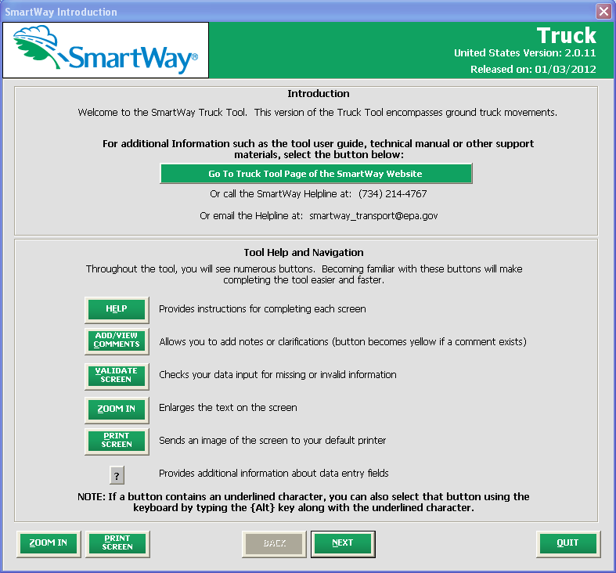
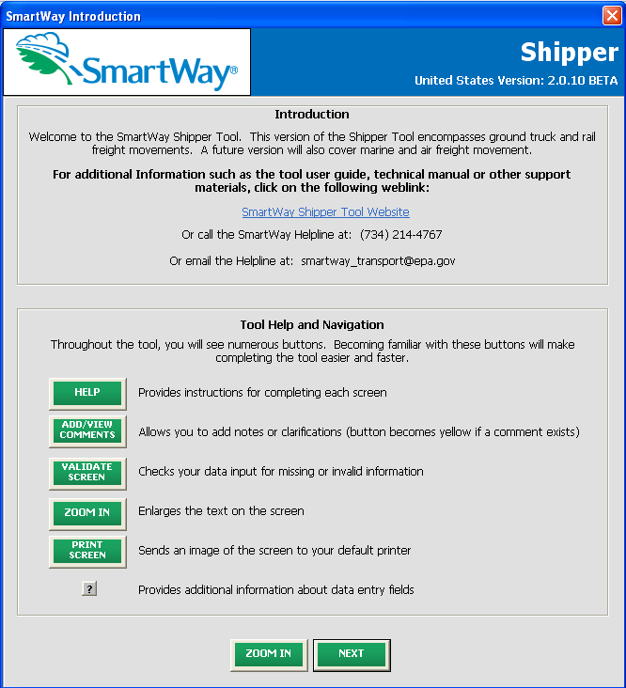
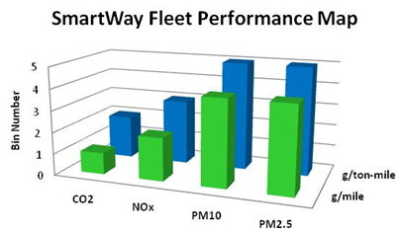
How Shippers Use Carrier Data
To make informed carrier selection via SmartWay’s carrier fleet rating approaches
Shippers submit data in shipper tool to assess and track emissions and carbon footprint
  Enables shippers to respond to customer, shareholder, and corporate needs for energy & environmental benchmarking
Carrier Tool Data
Eight Emissions &
Performance Ranking per Fleet
Shipper Tool

Slide 18
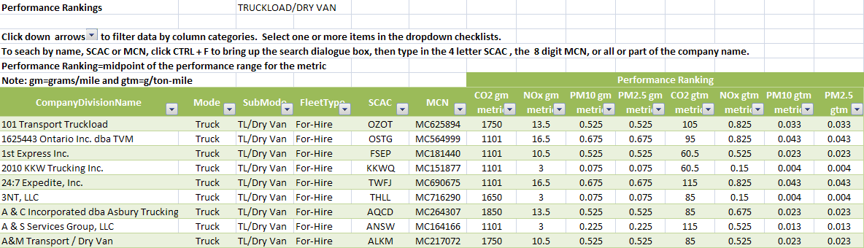
Sample of Publicly Available Report
Performance Ranking Information published weekly www.epa.gov/smartway

Slide 19
EPA Testing and Technology Programs
New Technology Assessment Center
(TAC) integrates expertise from EPA SmartWay and National Clean Diesel technology programs
Provides comprehensive approach to reducing emissions (criteria and GHG) from HD fleets.
Overseas research, test and evaluate emission and fuel-saving technologies and strategies
  Wide-range of applications including long-haul tractor-trailers, off-road equipment, marine, and rail
  Wide-range of technologies including emission controls (e.g,. diesel particulate filters, oxidation catalysts), idle reduction, low rolling resistance tires, and aerodynamics

Slide 20
EPA Testing and Technology Programs
Verifies technologies, develops testing protocols and assessment tools
Provides technical expertise
  Other federal programs,
  Academia,
  Technical groups (SAE, TMC)
  EPA’s new vehicles emissions and legacy fleet programs

Slide 21
SmartWay Recognition
Recognize SmartWay industry leaders with awards
  Highlight accomplishments of outstanding SmartWay Transport Partners
  Partners market that they are awardees
  EPA acknowledges award winners
Publicize SmartWay program results
Case Studies/Partner Profiles

Slide 22
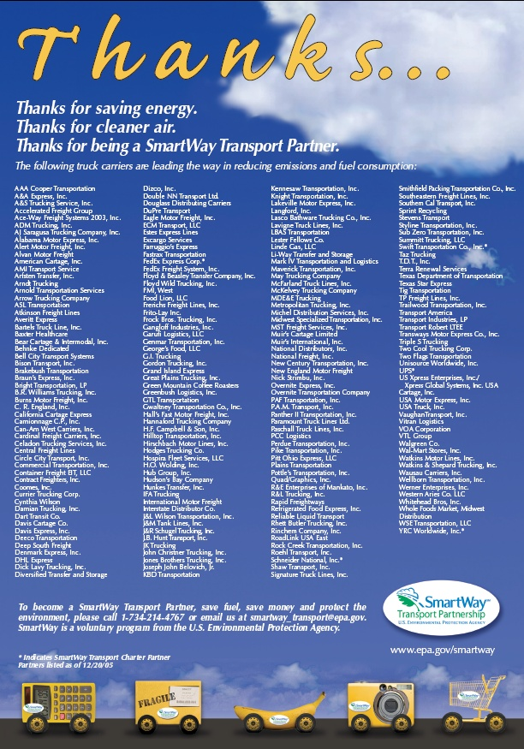
Partner Recognition

Slide 23

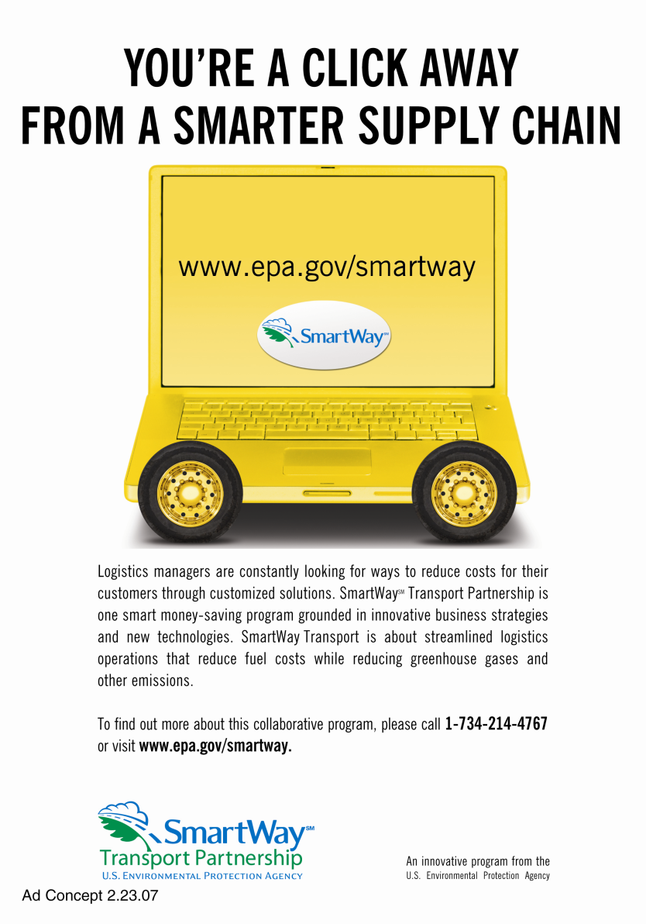

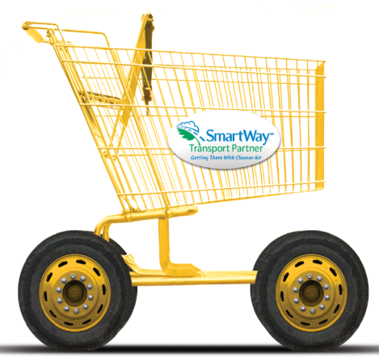
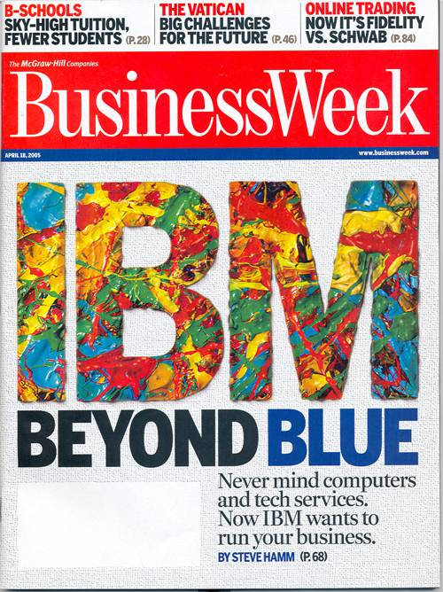
Public Service Campaign

Slide 24
Going Forward
Partnership
  - Continue to refine program tools to include more real world performance and enhance flexibility
    - New system accounts for all carrier strategies as captured in overall efficiency
    - New tools allow greater customization (TL, LTL, dry van, flat bed, etc.)
Broaden partnership to achieve more public/private benefits
  Tons of emissions reduced
  Millions of barrels of oil conserved
  Billions of dollars in operational savings
  Thousands of U.S. businesses strengthened
Notes:
24

Slide 25

Questions?
www.epa.gov/smartway
1-734-214-4767 (helpline)

