Slide 1
Developing Performance Measures for Sustainable Freight Movement
Joe Zietsman, Ph.D., P.E zietsman@tamu.edu
Texas Transportation Institute
April 18, 2012

Slide 2
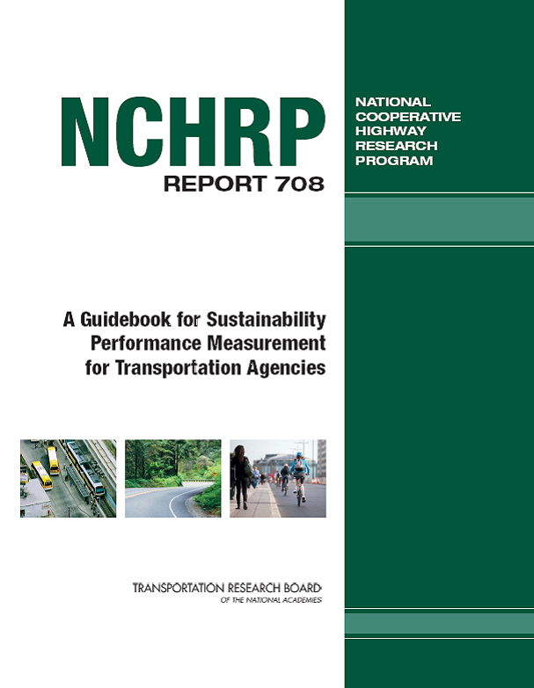

Slide 3

HUMAN NEEDS
ECONOMIC DEVELOPMENT AND PROSPERITY
ENVIRONMENTAL AND ECOLOGICAL SYSTEMS
EQUITY
EQUITY
COMMUNITY HEALTH AND VITALITY
EQUITY
EQUITY

Slide 4
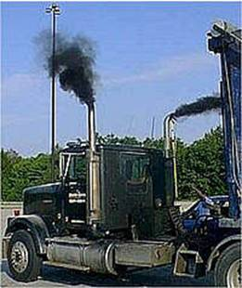
Extended Truck Idling
500,000 long haul trucks
Rest 10h for every 14h of driving
350 tons of NOx per day
2 million gallons of diesel per day

Slide 5
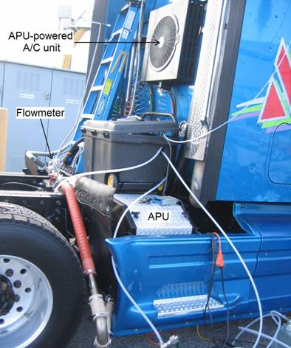
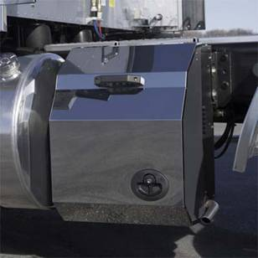
Mobile (On-Board)

Slide 6
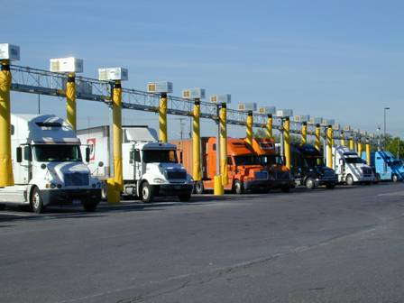
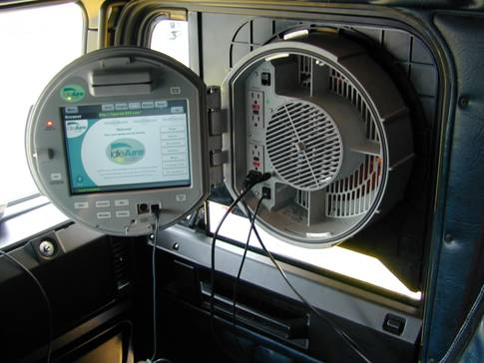
Stationary (Off-Board )

Slide 7
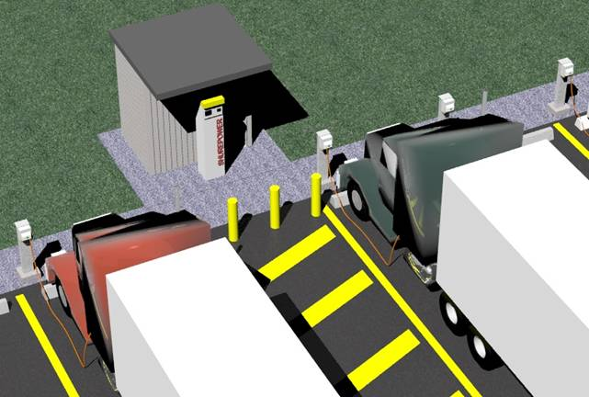
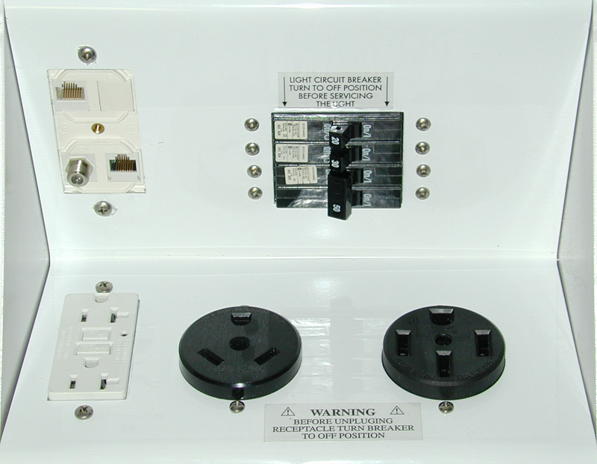
Combination (Mobile and Stationary)

Slide 8
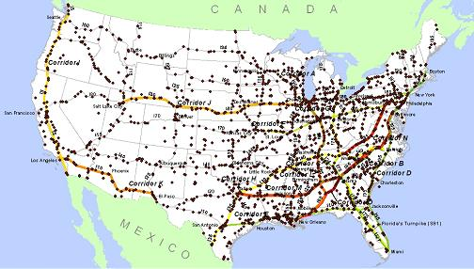
Large Truck Stops

Slide 9
National Truck Corridors

Slide 10
Evaluation Criteria

Slide 11
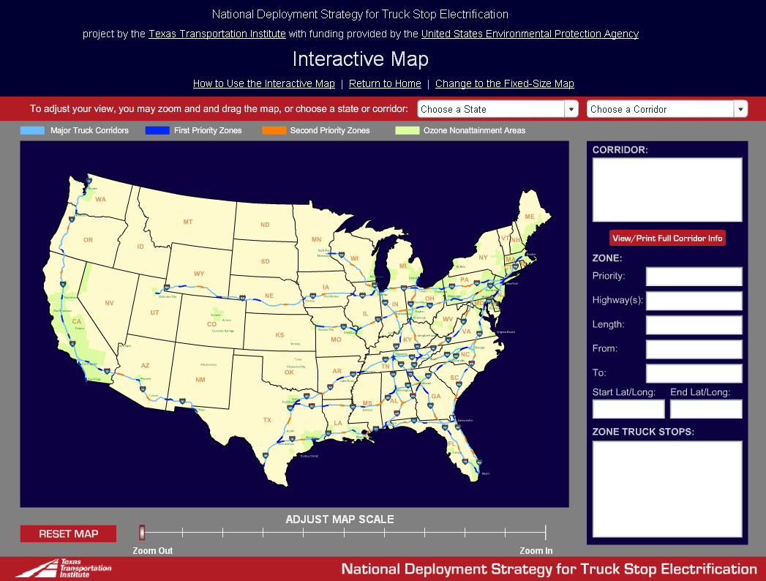

Slide 12
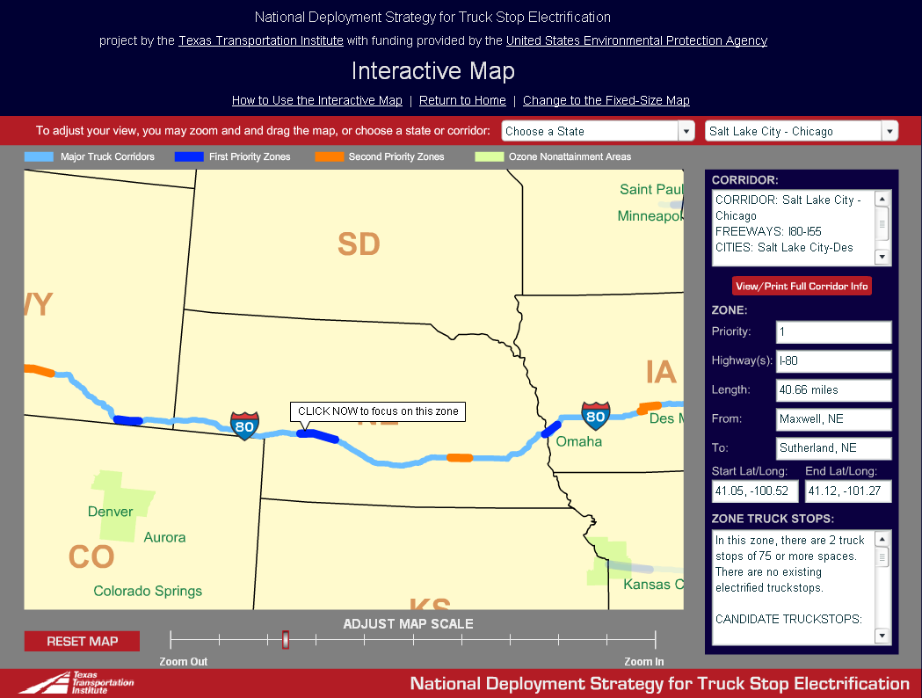

Slide 13
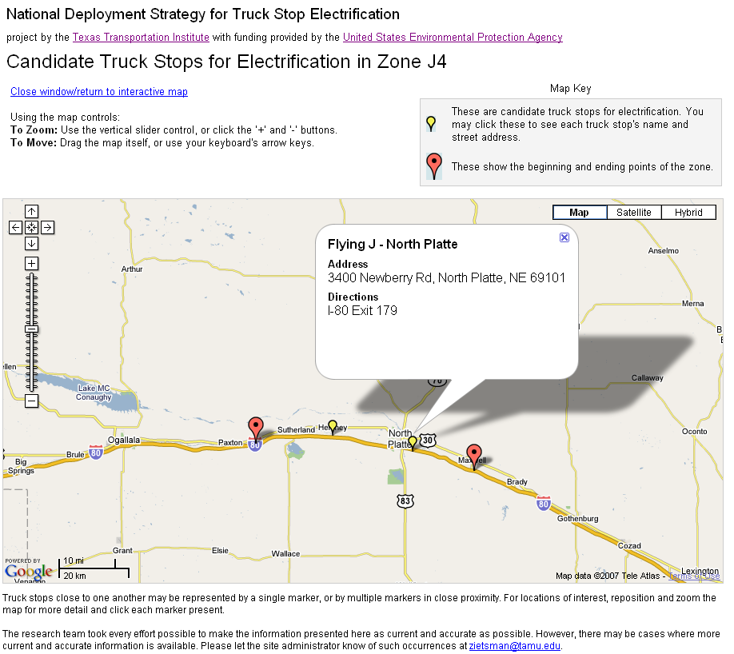

Slide 14
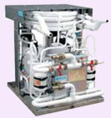
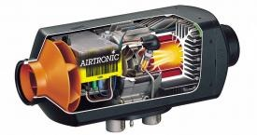
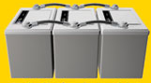
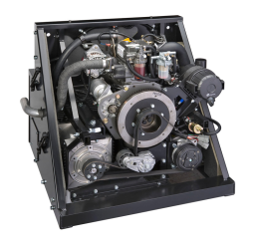

Mobile Idle Reduction Technologies
Heating
Cooling
Fuel Operated
Heaters
Thermal Storage
Cooling
APU’s
Diesel, Battery, Hybrid
Electricity

Slide 15
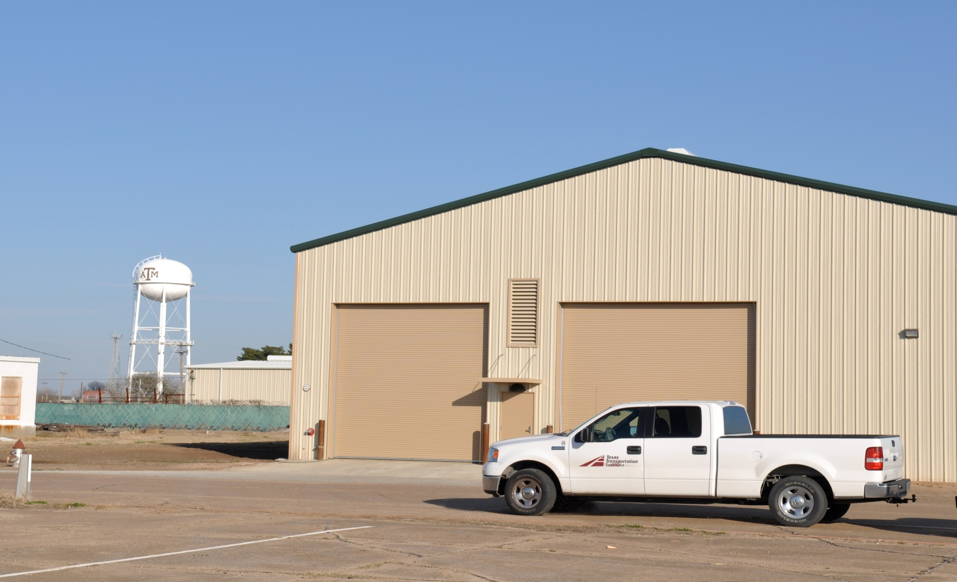
Environmental and Emissions Research Facility (EERF)

Slide 16
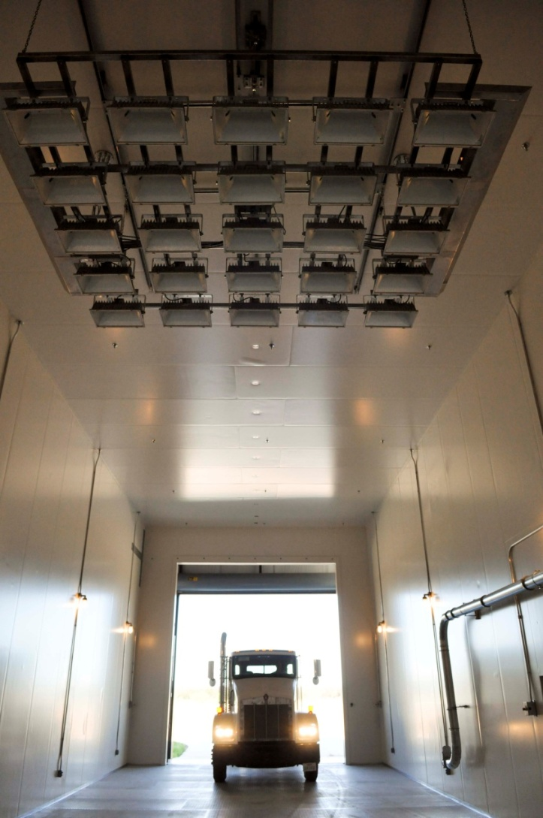
Chamber Specifications
75′ X 23′ X 22′
Temperature range
  -40 − 130 ºF
  RH up to 70% at 105 ºF
Solar load
  Up to 1100 watt/m² 14000 Lux
Wind load
  Up to 35 mph

Slide 17
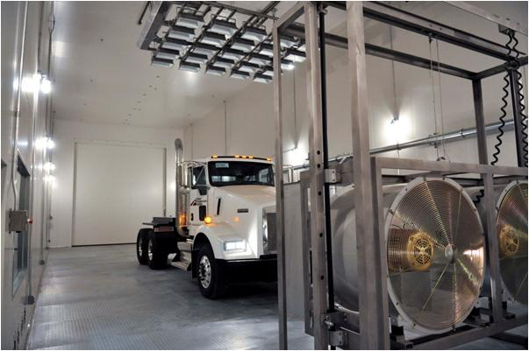

Slide 18
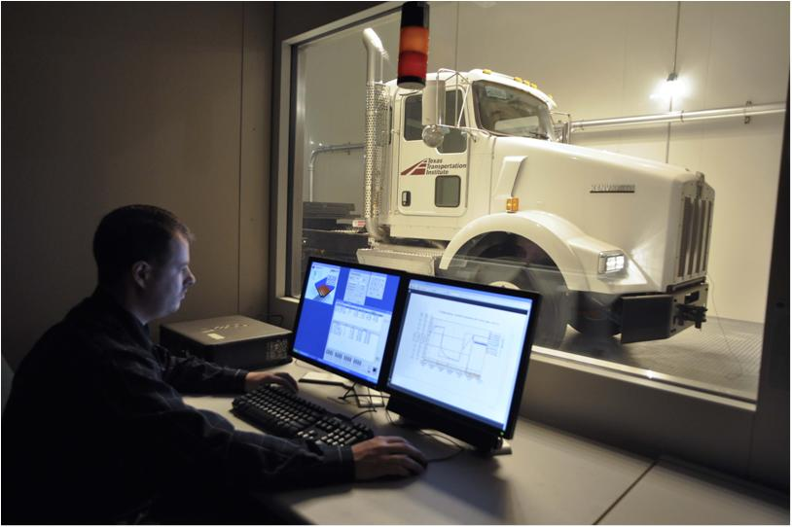

Slide 19
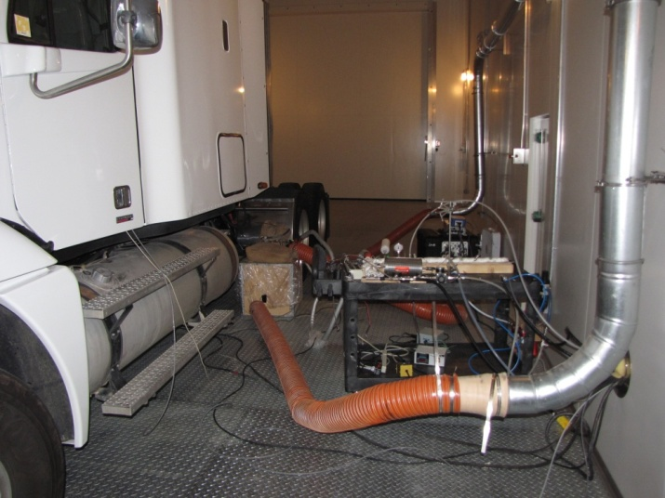
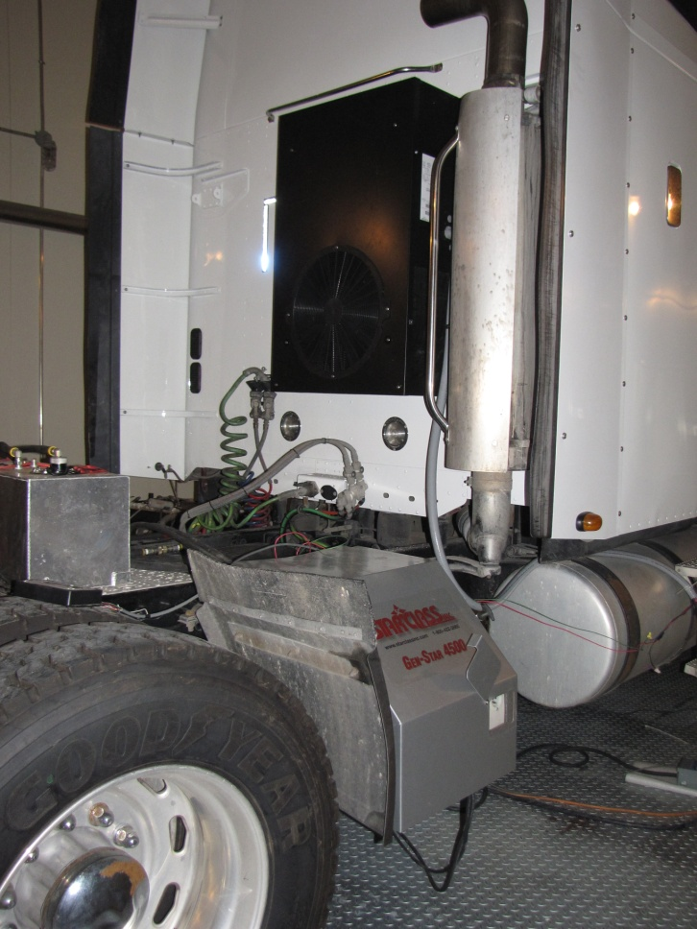
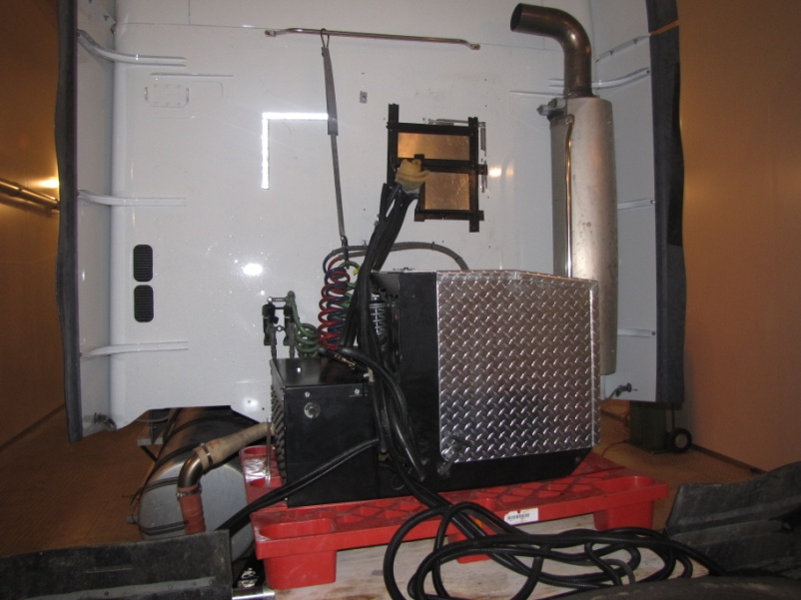
Installation Example

Slide 20
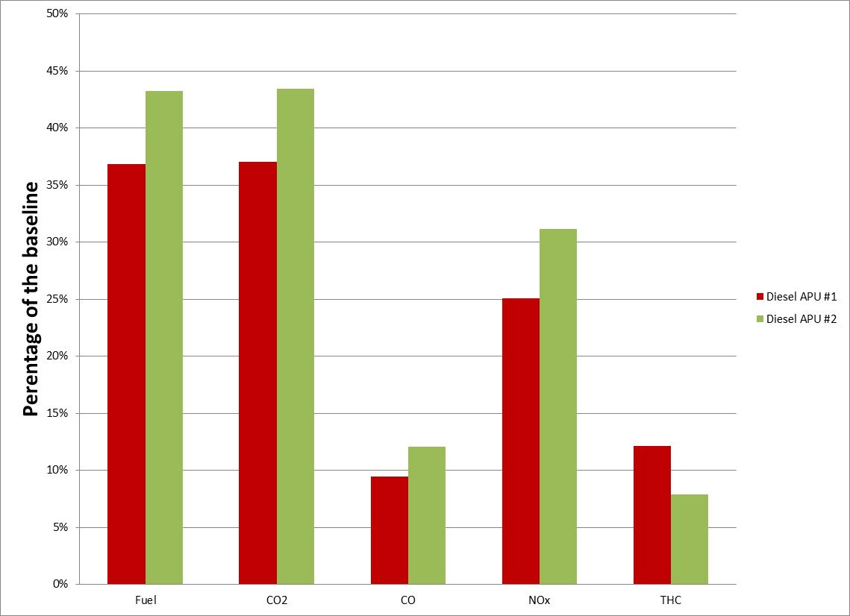
Fuel Consumption and Emissions (Hot Test)
% of Base Truck

Slide 21
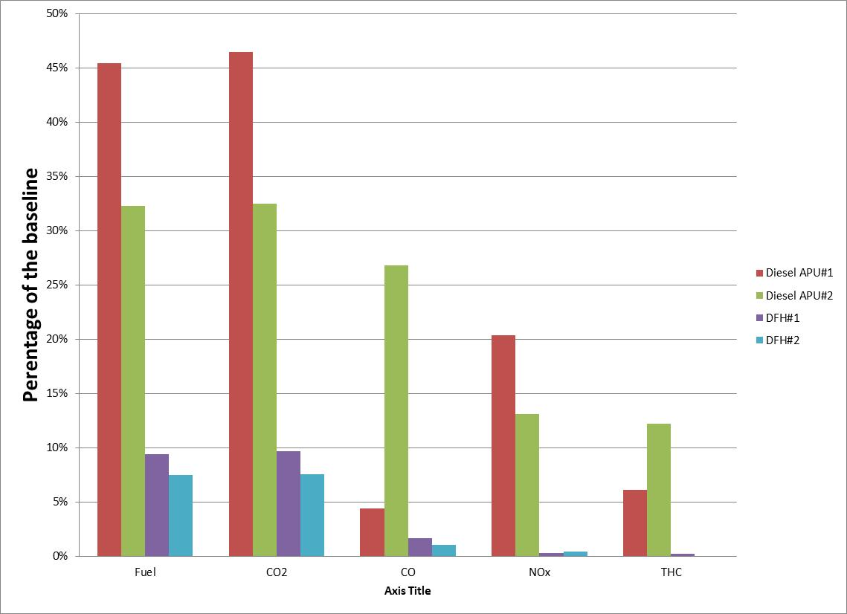
Fuel Consumption and Emissions (Cold Test)
% of Base Truck

Slide 22
Infiltration

Slide 23
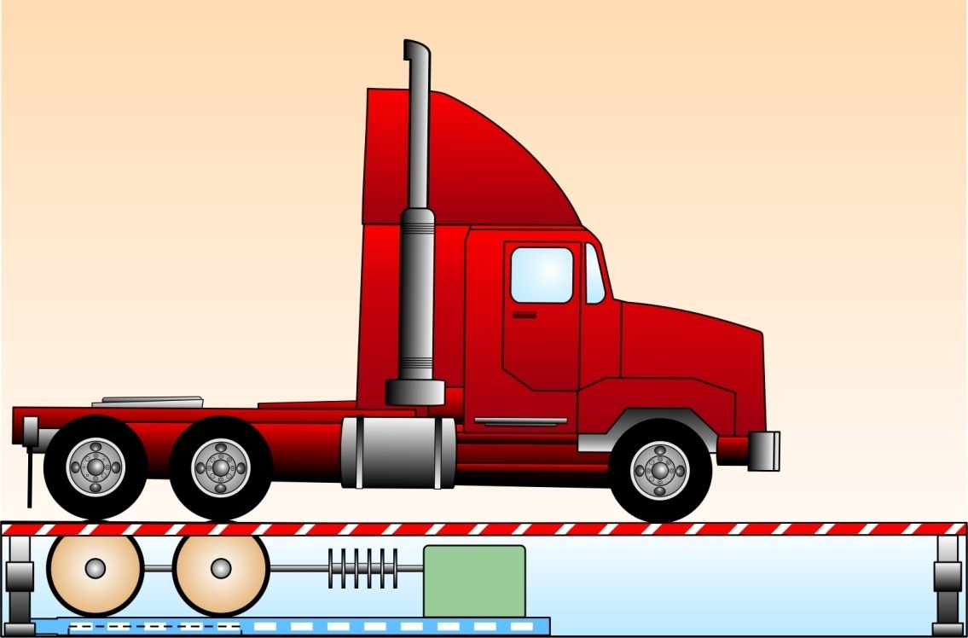
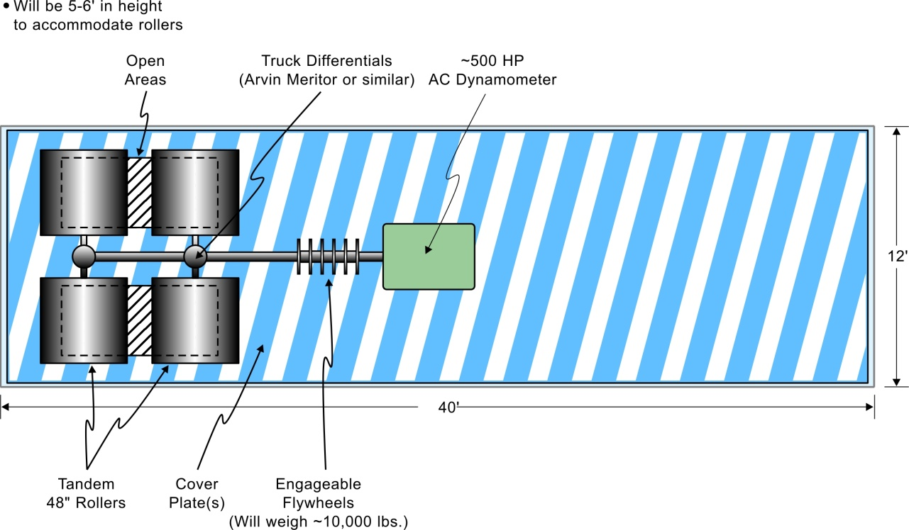
Future Vision
Mobile Chassis Dyno

Slide 24
Concluding Remarks
Sustainability is an important framework
NCHRP 708 puts it all together
Truck idling is a significant source
National deployment strategy for TSE
Protocol for APU testing
Broad range of testing
Basis for effective policies

