Slide 1
The Use of PAVEDAT for the District-wide Truck Enforcement Plan
Eulois Cleckley
Mark Berndt
June 20, 2012

Slide 2
Agenda
Introduction and background – Eulois
Study process and key data findings – Mark
PAVEDAT observations/suggestions - Mark
Conclusions and directions forward - Eulois

Slide 3
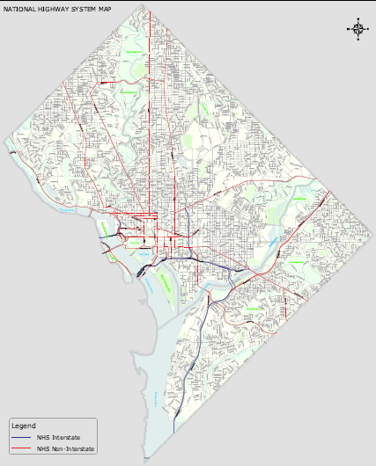
Facts about Washington, DC
Approximately 70 square miles in size
Approximately 600 thousand residents
30,000 new residents since 2000
Highest personal income per capita (2006)
19 percent of the residents are below the poverty level
Significant economic development

Slide 4
Overview of Freight Movement in District
Top Trading Partners: Indiana, Maryland, Virginia, Pennsylvania

Slide 5
Overview of Freight Movement in District
Top Trading Partners: Indiana, Maryland, Virginia, Massachusetts

Slide 6
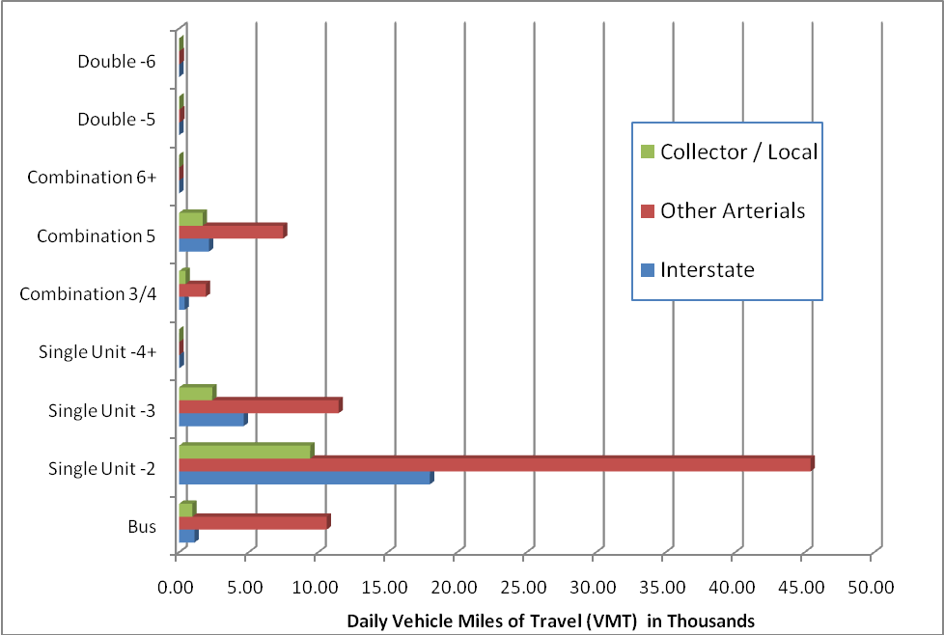
Current Commercial Vehicle Data

Slide 7
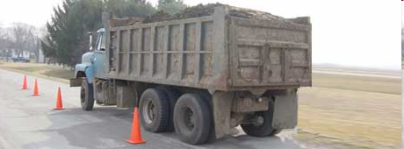
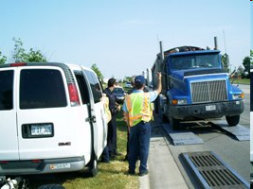
Background – DC Truck Enforcement
Disproportionate number of commercial vehicles did not comply with the city’s truck size and weight laws
Impacts of overweight commercial vehicles on roadway infrastructure not clearly understood
Enforcement efforts not resulting in acceptable level of compliance

Slide 8
Purpose
Develop a citywide truck enforcement plan:
Identify truck safety concerns
Assesses monetary impacts of overweight trucks
Provide a comprehensive approach to enforce truck operations throughout the city
Provide a safe environment that balances the needs of all road users in the district

Slide 9
Study Overview
Truck safety analysis – Evaluate safety issues related to truck operations in the District
Quantify the Effects of Overweight Vehicles − the effects and associated costs on the District’s road and bridge network
GAP Analysis − District needs assessment and future goals (short, mid, and long-term)

Slide 10
Existing Conditions
No formal integrated truck management program
Overweight truck impacts on pavement and bridges not considered
No data driven policy for permitting and enforcement
In the process of adopting an official truck route
Sporadic use of “no through trucks” and “no trucks” signs based on neighborhood complaints and physical roadway constraints

Slide 11
Infrastructure Impacts Assessment
Approached by FHWA to beta test PAVEDAT
Damage assessments limited to bridges and pavement sections on proposed DC Truck Route system
Truck count and axle weight information captured in the raw data of Weigh-in-Motion (WIM) scales from three stations (2005)
Notes:
Used PAVEDAT spreadsheet in District Study and subsequently in Wisconsin Large Truck Safety Study
Analysis Based on 136 bridges : 107 steel and 29 concrete
Federal data for 249 Bridges in the District; Screened out bridges not on the designated truck routes
Screened out National Park and pedestrian bridges, and tunnel structures
For each subject bridge:
Total Length,
Width
Number of Spans
Computed deck area

Slide 12
Infrastructure Impacts Assessment
The analysis of pavement and bridge impacts relied heavily on PAVEDAT
For the pavement analysis actual outputs from the model are used in deriving cost estimates
For the bridge analysis, the weigh-in-motion data available within the spreadsheet tool are used to develop estimates of axle loadings
Notes:
Used PAVEDAT spreadsheet in District Study and subsequently in Wisconsin Large Truck Safety Study
Analysis Based on 136 bridges : 107 steel and 29 concrete
Federal data for 249 Bridges in the District; Screened out bridges not on the designated truck routes
Screened out National Park and pedestrian bridges, and tunnel structures
For each subject bridge:
Total Length,
Width
Number of Spans
Computed deck area

Slide 13
DC WIM Data – Vehicle Counts by Class

Slide 14
Load Equivalency Factor (LEF) Summary: District of Columbia
Vehicle Class | Axles | Damage
 |  | Total LEFs | Legal | Over-weight
Bus | 760,664 | 969,163 | 464,600 | 504,563
SU2 | 2,478,515 | 305,029 | 203,818 | 101,211
SU3 | 567,954 | 1,906,480 | 1,105,452 | 801,028
SU4+ | 99,957 | 1,305,971 | 930,733 | 375,238
CS3/4 | 141,828 | 90,820 | 56,328 | 34,492
CS5 | 538,712 | 1,015,313 | 443,450 | 571,863
CS6+ | 15,004 | 82,088 | 15,653 | 66,435
DS5 | 9,576 | 6,622 | 2,725 | 3,897
DS6 | 6,067 | 4,884 | 2,314 | 2,570
DS7+ | 3,154 | 8,440 | 1,917 | 6,524
Total | 4,621,431 | 5,694,810 | 3,226,988 | 2,467,821

Slide 15
Load Equivalency Factor (LEF) Summary: Wisconsin
 | LEF |  |  | Share (All Classes)
Vehicle Class | Total | Legal | Overweight | Total | Legal | Overweight
Bus | 127,018 | 114,984 | 12,035 | 2.27% | 2.05% | 0.21%
SU2 | 32,290 | 32,290 | - | 0.58% | 0.58% | 0.00%
SU3 | 78,274 | 78,249 | 25 | 1.40% | 1.40% | 0.00%
SU4+ | 25,315 | 16,938 | 8,377 | 0.45% | 0.30% | 0.15%
CS3/4 | 383,722 | 307,339 | 76,383 | 6.85% | 5.48% | 1.36%
CS5 | 4,688,481 | 4,506,022 | 182,459 | 83.64% | 80.39% | 3.26%
CS6+ | 87,674 | 68,373 | 19,300 | 1.56% | 1.22% | 0.34%
DS5 | 142,922 | 138,881 | 4,041 | 2.55% | 2.48% | 0.07%
DS6 | 28,772 | 28,423 | 350 | 0.51% | 0.51% | 0.01%
DS7+ | 10,758 | 5,084 | 5,674 | 0.19% | 0.09% | 0.10%
Total = | 5,605,226 | 5,296,580 | 308,645 | 100.0% | 94.5% | 5.5%

Slide 16
D.C. Pavement Damage: Legal vs. Overweight Axles
Pavement Damage: Legal vs. Overweight Axles
120%
Legal Axle Damage
Overweight Axle Damage
100%
33.18%
28.73%
37.98%
80%
42.02%
52.06%
56.32%
58.85%
52.62%
60%
80.93%
77.29%
40%
71.27%
66.82%
57.98%
62.02%
20%
47.94%
43.68%
41.15%
47.38%
19.07%
22.71%
0%
Bus
SU2
SU3
SU4+
CS3/4
CS5
CS6+
DS5
DS6
DS7+
Vehicle Type

Slide 17
Mileage vs. Pavement Consumption

Slide 18
Pavement Cost Allocation by Vehicle Class

Slide 19
Bridge Cost Application by Vehicle Class
Vehicle Class | % Allocation | Annual Bridge Costs | Engr. Fees & Constr. Insp. | Total Annual Bridge Costs
Passenger Cars | 59.0 | $ 28,197,000 | $ 6,485,000 | $ 34,682,000
Legal Trucks & Buses | 23.2 | $ 11,067,000 | $ 2,545,000 | $ 13,613,000
Overweight Trucks & Buses | 17.8 | $ 8,525,000 | $ 1,961,000 | $ 10,486,000
Totals | 100.0 | $ 47,789,000 | $10,991,000 | $ 58, 781,000
Notes:
Starting assumption: based on previous research, including federal cost allocations – 41% of all bridge costs were attributed to commercial trucks and buses.
Apply the axle count for each truck classification to the corresponding LEF.
Sum all LEFs (damage) by class for each axle group (single, tandem and tridem).
Identify overweight axles based on District Regulations.
Sum sub-totals of all axle LEFs for Legal and Overweight vehicles for all 10 truck classifications

Slide 20
Bridge Conclusions
50-60 % of all bridge related costs are attributed to passenger vehicles
15-20 % of all bridge impacts (damage) are attributable to overweight axles, this is 43.5% of all truck related damage
Total annual bridge costs attributable to overweight trucks is ~$10.5 million
~10% of all sample axles weighed were overweight

Slide 21
Total Annual Infrastructure Impacts Due to Overweight Trucks
Vehicle Class | Overweight Pavement Costs | Overweight Bridge Costs | Total Overweight Infrastructure Costs
Buses | $ 1,559,152 | $ 2,473,671 | $ 4,032,823
SU2 | $ 6,112,682 | $ 496,198 | $ 6,608,880
SU3 | $ 1,964,200 | $ 355,706 | $ 2,319,906
SU4+ | $ 4,558 | $ 1,839,642 | $ 1,844,200
CS3/4 | $ 270,741 | $ 169,100 | $ 439,841
CS5 | $ 1,626,812 | $ 2,803,628 | $ 4,430,440
CS6+ | $ 4,785 | $ 323,131 | $ 327,916
DS5 | $ 17,656 | $ 19,103 | $ 36,759
DS6 | $ 8,165 | $ 12,599 | $ 20,764
DS7+ | $ 345 | $ 31,978 | $ 32,323
Total | $ 11,569,097 | $ 8,524,757 | $ 20,093,854
Total W/O Buses | $10,009,945 | $ 6,051,086 | $ 16,061,031

Slide 22
PAVEDAT Observations
Provided a low cost, ready means to analyze the cost impacts associated with truck and bus axle weights
Offers dual approaches to analysis – empirical (ESAL) and mechanistic-empirical (MEPD)
Required some manipulation of the datasets to use it for study purposes
No means of separating “illegal” from legal trucks operating under over-weight permits.

Slide 23
Data Gaps – Suggestions
WIM – data set somewhat dated, and coverage varies
Add ability to link directly to current VTRIS datasets
Develop standardized format that would allow portable WIM to be used for data collection
Cost data was non-uniform and difficult to assemble over multiple years for issues like:
Detailed bridge cost repair categories by bridge type
Detailed pavement rehabilitation costs by functional class

Slide 24
Next Steps
Educate the industry on commercial vehicle impacts
Adjust policy and regulation based on study results to offset damage
Improving enforcement techniques at flat scale operation
Expanding city-wide presence for oversize/overweight enforcement
Integrate more proactive forms of enforcement
Automatic citations
Relative evidence law
Structuring enforcement activity in properly within Department of Transportation

Slide 25
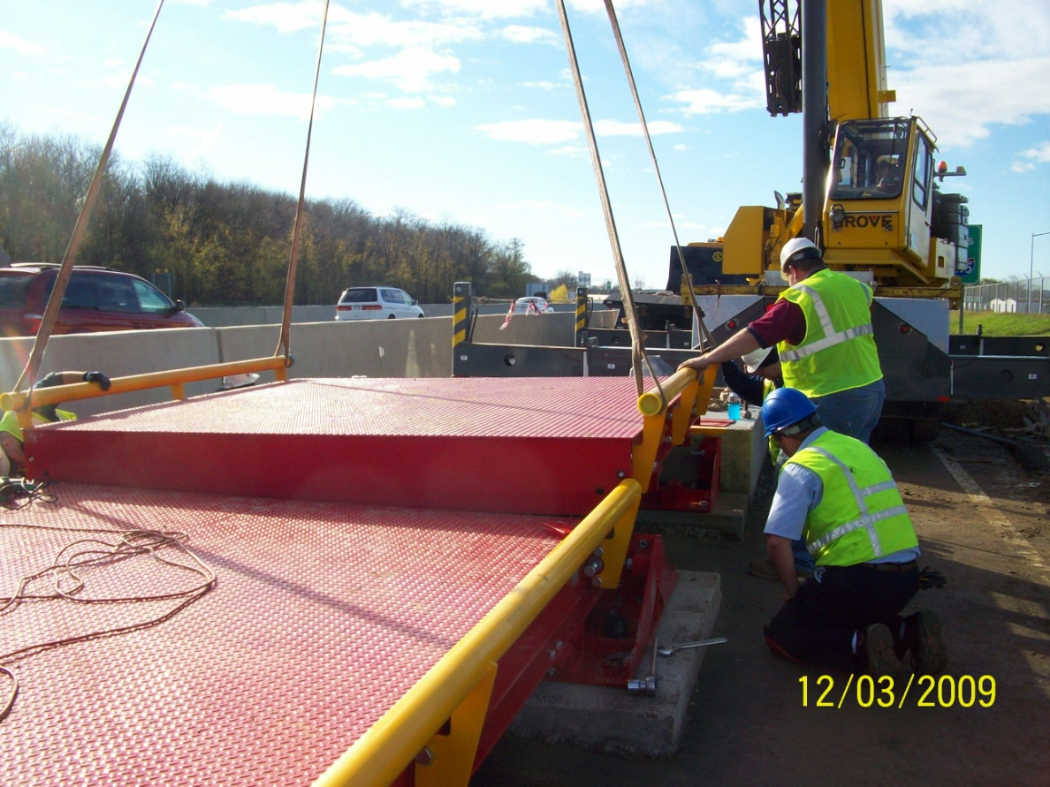
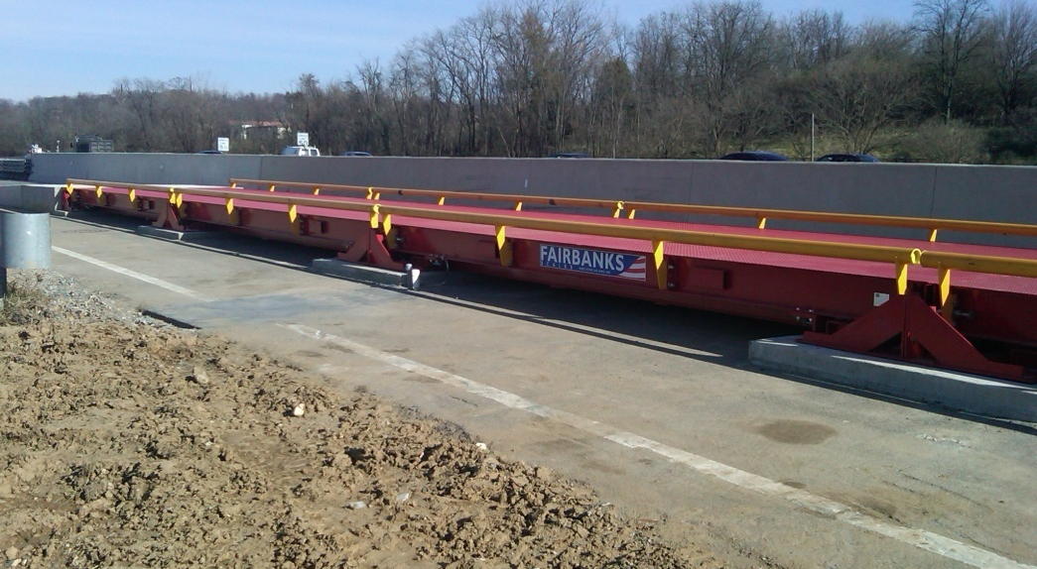
New Flat Scale Installed to Improve Static Weight Enforcement

