Slide 1

Engaging the Private Sector in Freight Planning

Slide 2
FHWA tools to help you
A Guidebook for Engaging the Private Sector in Freight Transportation Planning
One day workshop through FHWA
  Build on NHI course “Integrating Freight in the Transportation Planning Process”
  Cover why, who, how and what to expect

Slide 3

Engaging the private sector is
Public Involvement
Early and continuing process
Inform stakeholders
Allow opportunity for feedback
Notes:
Early and continuing process
Inform stakeholders
Allow opportunity for feedback

Slide 4

Why Engage Private Sector in Your Planning Process?
Links to
  Economic development
  Jobs
  QOL
Congestion/capacity
They are our customers too – they have unique needs

Slide 5
What can the private sector offer?
Understanding of their perspective / priorities
  Predictability /reliability
  Access / parking issues
  Geometric problems
  Intermodal connections
  Operational problems
Access to data, plans

Slide 6
Fulfills Planning Regulations
§ 23 CFR 450
Statewide and MPO Long Range Plans

Slide 7
Getting Started – internal actions
Set goals and objectives
Get agency leadership support
Define your product / process
Identify stakeholder targets
Specify techniques

Slide 8

Who are Freight Stakeholders?
Shippers and receivers
3PL service providers
Terminal facility operators
Business and industry of all size

Slide 9

When to engage the private sector
Planning
Environmental Analysis
Design
Construction
Operations and Maintenance
Asset Management
Project Development Process

Slide 10

How to Engage the Private Sector
Informal interactions
Networking (conferences, luncheons)
Educational seminars
Regional business coalitions

Slide 11







Private Sector Professional Associations
Association of
American Railroads
Inland Rivers Port
And Terminal Assoc.
National Industrial
Transportation League

Slide 12

How to Engage the Private Sector
Surveys
Interviews
Site visits

Slide 13

Interview / Survey Techniques
Develop an interview/discussion guide
Identify the right contact
Ensure anonymity
Avoid Mondays and Fridays
When calling to schedule in-person interviews; be prepared to conduct a phone interview
Notes:
The discussion guide should start by stating clearly up front what the purpose and goals of the survey instrument. Doing surveys is also a good way to identify who in your freight community is willing to be more engaged.
Also include a statement of confidentiality regarding the release of individual respondent or firm data

Slide 14
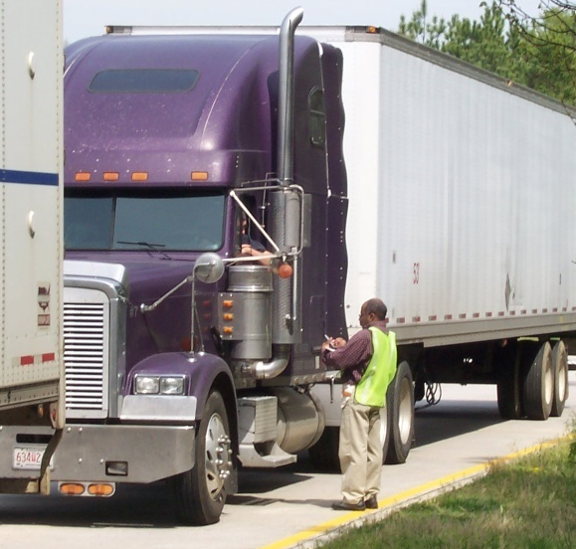

How to Engage the Private Sector
Intercept surveys
Origin / destination surveys
GPS tracking
Truck tailing

Slide 15
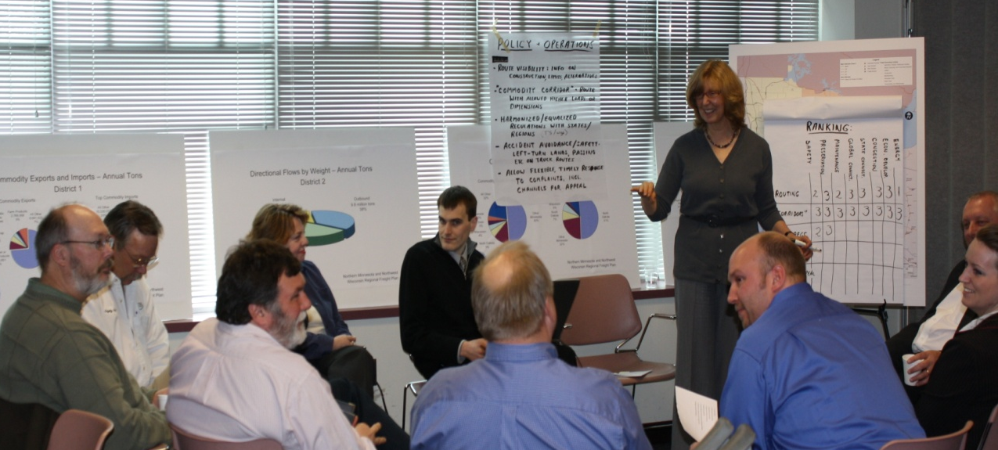
How to Engage the Private Sector
Focus groups
Freight forums
Round tables
Freight advisory committees

Slide 16


How to Engage the Private Sector
Establish a freight working group:
  Advisory groups (state, multi-state, MPO regional)
Research conferences
Luncheons / Roundtables / Forums
Standing working group
Economic development groups
Market research activities

Slide 17
Results
Plans and projects that address the needs of your businesses and industries
Improved economic competiveness in your region
Sustainable long term relationships – to address future problems and issues

Slide 18
Training / Guidebook:
http://ops.fhwa.dot.gov/freight/FPD/training/index.htm.
http://www.fhwa.dot.gov/planning/freight_planning/guidebook/guidebookps00.cfm
To schedule a workshop:
Jocelyn Jones
410-962-2486
Jocelyn.Jones@fhwa.dot.gov
Carol Keenan
202-366-6993
Carol.Keenan@fhwa.dot.gov

Slide 19

Suzann Rhodes, AICP
614 - 888-9440 ext. 1242
srhodes@wilbursmith.com

