Slide 1
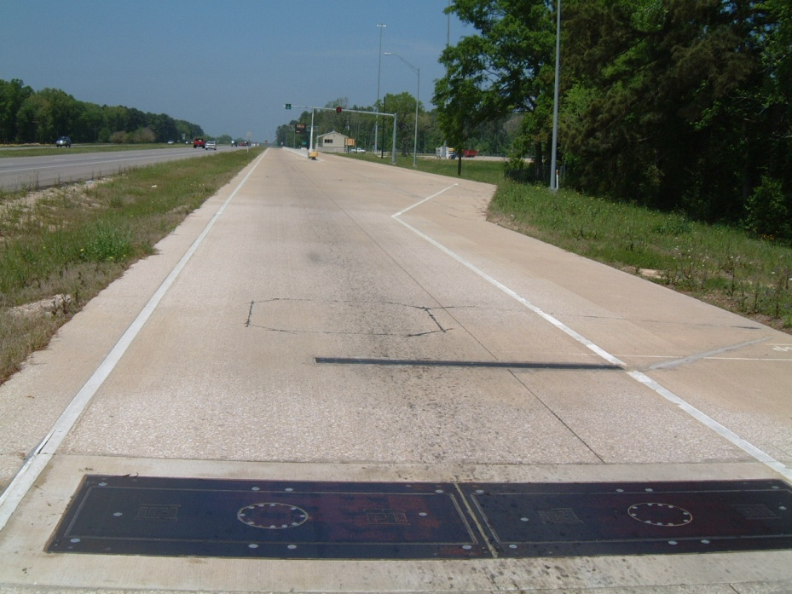
INTEGRATION OF WEIGH-IN-MOTION TECHNOLOGY INTO NIST’S HANDBOOK 44
Webinar: Talking Freight
September 21, 2011
Dan Middleton
Texas Transportation Institute

Slide 2
PROJECT OVERVIEW
Motivation
Objectives
Technical Approach
Working Group
Existing WIM Standards
Next Steps
Notes:
2

Slide 3
MOTIVATION
U.S. CMV weight enforcement characteristics:
  Limited enforcement resources
    significant effort expended on compliant carriers
  Infrequent and inconsistent technology use
  A lack of coordination, shared technologies, and data exchange
  Ineffective penalty and prosecution procedures
    encourage overloading as a routine business practice
  Activity not outcome based performance measures
    Citations issued vs. reductions in overloading
Notes:
3

Slide 4
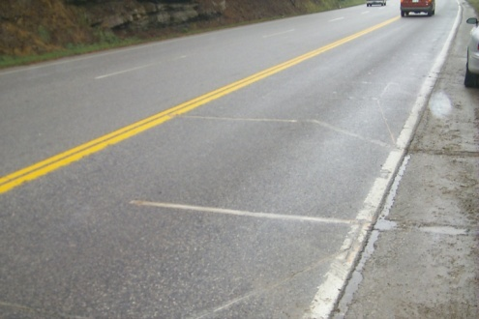
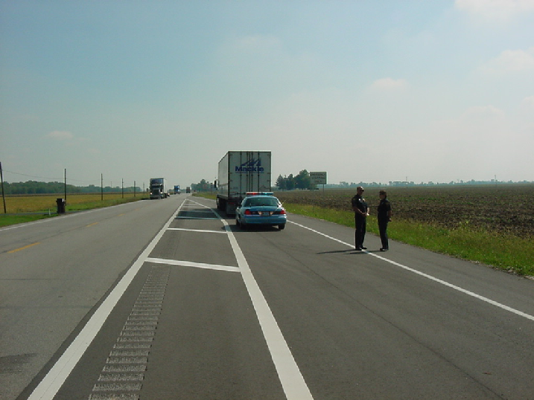
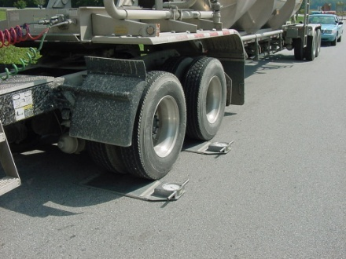
MOTIVATION
Growing consensus that increased technology use, including WIM systems, can significantly improve CMV weight enforcement effectiveness and efficiency
  Lack of uniformity in design, testing, installation, performance of WIM technology
  Lack of prosecution agency acceptance regarding validity of WIM technology for weight enforcement
Notes:
4

Slide 5
OBJECTIVES
To develop a proposed amendment to
NIST Handbook 44 related to WIM technology
“NIST Handbook 44 contains the specifications, tolerances and other technical requirements for weighing and measuring devices.
It describes how devices will be designed, tested, installed and how they will perform.
It includes scales, meters, grain analyzers, measure containers, taxi meters, timing devices, and more.
Every state adopts NIST Handbook 44 in some form.”
−The National Conference on Weights and Measures
Notes:
5

Slide 6
TECHNICAL APPROACH
PREPARATORY | Task 1: Develop Project Work Plan
 | Task 2: Establish Working Group
 | Task 3: Solicit Stakeholder Input
DEVELOPMENT | Task 4: Draft Proposed “WIM Scale Code”
CLOSEOUT | Task 5: Submit Supporting Documentation
Notes:
6

Slide 7
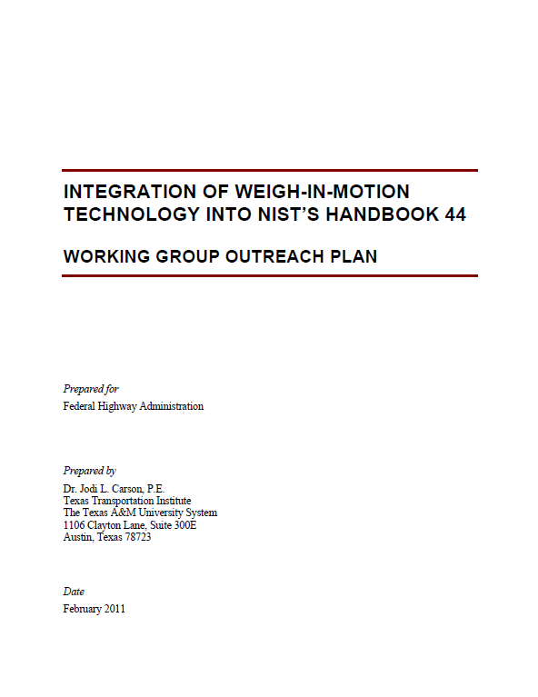
TECHNICAL APPROACH
Preparatory Tasks (Substantially Complete)
  Task 1: Develop Project Work Plan
  Task 2: Establish Working Group
  Task 3: Solicit Stakeholder Input
    Working Group
    Outreach Plan
    Kickoff meeting
Notes:
7

Slide 8
TECHNICAL APPROACH
Development Tasks (Forthcoming)
  Task 4: Draft Proposed “WIM Scale Code”
    Content
      Definition
      Applications
      General provisions
      Specifications
      Notes
      Tolerances
      User requirements
The technology’s intended function must be matched with associated acceptable levels of performance
Notes:
8

Slide 9

TECHNICAL APPROACH
  Task 4: Draft Proposed “WIM Scale Code” (Continued)
    Information sources
      Working group user requirements workshop (Date and location TBD)
      Stakeholder input
      State-of-the-practice review
      Existing standards/
      specifications
      Expert guidance by
      NIST staff
  Task 5: Submit Supporting
  Documentation to FHWA
Notes:
9

Slide 10
WORKING GROUP CHARTER
Representation
Member roles and responsibilities
Voting eligibility and procedures
General rules of order
Communication and information exchange
Working group members will provide input on:
  Focused or comprehensive draft specification language
  Methods or approaches for advancing the draft WIM Scale Code.
Notes:
10

Slide 11
WORKING GROUP REPRESENTATION
State departments of transportation
State law enforcement agencies
Prosecution agencies
Equipment manufacturers/vendors
Private consultants
Academic researchers
Weights and measures regulatory officials
Federal agencies and organizations
International counterparts
Notes:
11

Slide 12
EXISTING WIM STANDARDS
ASTM E1318-09 Standard Specification for Highway Weigh-In-Motion (WIM) Systems with User Requirements and Test Methods
LTPP Protocol for Calibrating Traffic Data Collection Equipment
COST 323 European WIM specification
Czech Metrology Institute Measure of a General Nature No. 0111-OOP-C010-10
OIML Automatic Instruments for Weighing Road Vehicles in Motion and Measuring Axle Loads
Notes:
12

Slide 13
NEXT STEPS
Document proceedings from kickoff meeting
Begin drafting proposed “WIM Scale Code”
  Build from existing standards and specifications
  Solicit input from working group members
Plan and conduct next working group meeting
  Intended to identify WIM system user requirements
Notes:
13

Slide 14
Contact Information
Dan Middleton, Ph.D., P.E.
Texas Transportation Institute
Texas A&M University
College Station, TX 77843-3135
Phone: (979) 845-7196
Email: d-middleton@tamu.edu

