Slide 1
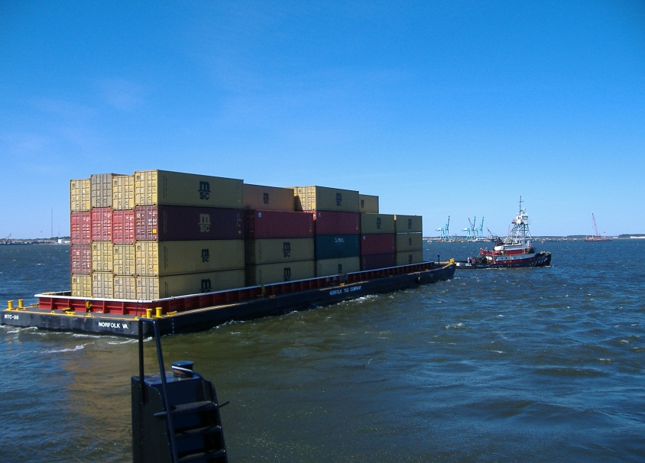
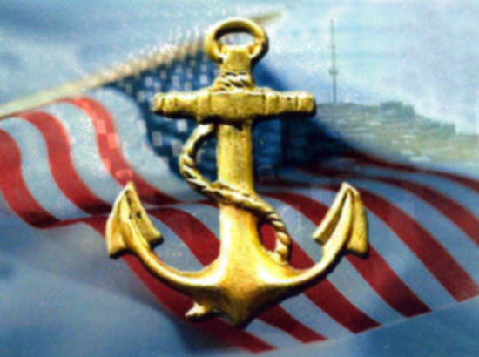
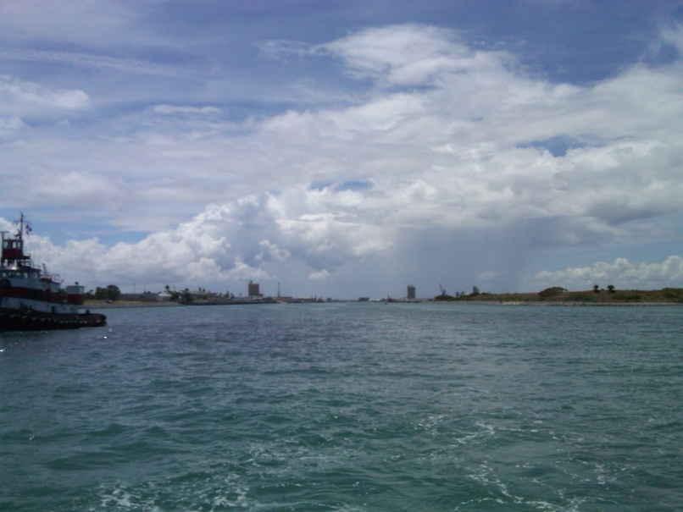
FHWA’s Talking Freight Series:
America’s Marine Highways
October 17, 2012
012
Lauren Brand, PPM
Director, Office of Marine Highways and Passenger Vessel Services
U.S. Department of Transportation – Maritime Administration

Slide 2
Maritime Administration Mission:
To improve and strengthen the U.S. marine transportation system - including infrastructure, industry and labor - to meet the economic and security needs of the Nation.

Slide 3
Shifting Trade Patterns
Vessels continue to get bigger
From 1950 (56 TEU) to 2012 (15,000 TEU)
Panama Canal expansion
Additional capacity needed on U.S. transportation system
Manufacturing and distribution shifts
From highway centric to intermodal hubs

Slide 4
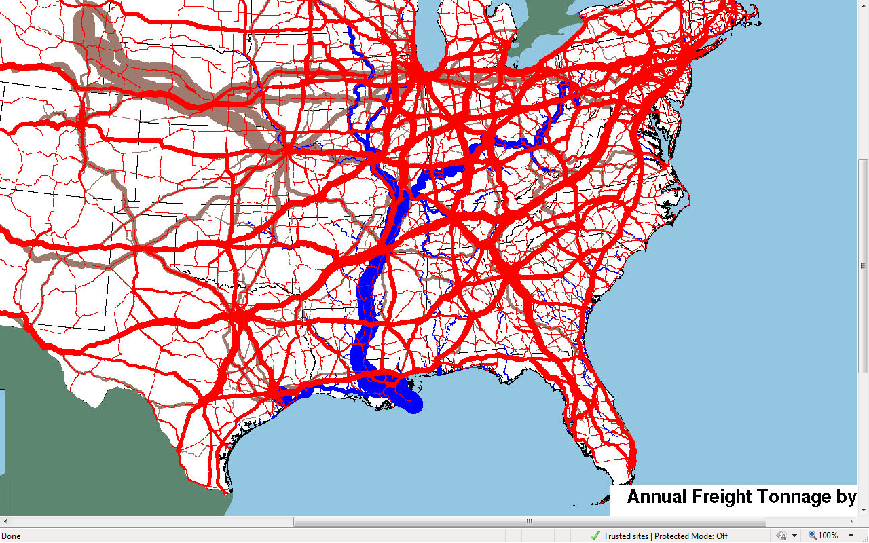
Freight Volumes
Notes:
This map shows regional flow of all commodities reported to FHWA and how the Ohio River Valley and Mississippi River parallel some of the most congested routes in the country.
(Additional regional maps can be created from FAF3 modeling and/or can be requested from Melissa Whitener)

Slide 5
Top 1000 “Blue Chip” Multinational Shipper Priorities
With Permission from

Slide 6
Map - 21
New legislation – passed July 2012
27 month program that will lay the baseline for future of transportation system in the U.S. / freight and passengers
Will identify National Freight Network
Will establish State Freight Advisory Committees

Slide 7
America’s Marine Highway – a Congressionally Legislated Program
2007 Energy Independence & Security Act authorized program
2010 National Defense Authorization Act authorized grants
2010 Consolidated Appropriations Act funded $7 million
Stated Priority of the Secretary of Transportation and the Maritime Administrator
First time navigable water legislated as extension
of the surface transportation system.

Slide 8
Purpose: Mitigate landside congestion
Program encourages use of short sea transportation through development and expansion of:
Designated Corridors
Documented vessels
Shipper utilization
Port and landside infrastructure and
Marine transportation strategies by State and local governments

Slide 9
M-5 (AK)
America’s Marine Highways
Designated August 2010
M-5
M-84
M-90
M-90
M-87
M-71/77
M-90
M-75
M-580
M-95
M-55
M-70
M-70
M-64
M-40
M-5
M-65
M-49
M-55
M-95
LEGEND
MH Corridor
MH Connector
MH Crossing
U.S. Interstate
M-10
M-A1
M-2
M-5 (AK)

Slide 10
Objectives
Marine routes are designated as extensions of the surface transportation system
Marine Highways are incorporated into State/Regional transportation planning
Landside facilities and infrastructure are developed to support short sea services
Performance measures are developed addressing short sea transportation

Slide 11
Project Designation Eligibility
On designated MH Corridor
Public sponsorship
Create new, expand or enhance existing service
Business plan, market plan & financial plan
Indications of market support
Documented vessels
Containerized/trailerized freight; passengers

Slide 12
Critical to Developing Marine Highway services
Need communication among multiple partners (including public and private)
Promotion efforts must be coordinated between all partners
Need business, market and finance plans
Need adequate capital for start-up operations, with contingency fund
Need to be located on a designated Marine Highway Corridor, Connector or Crossing.

Slide 13
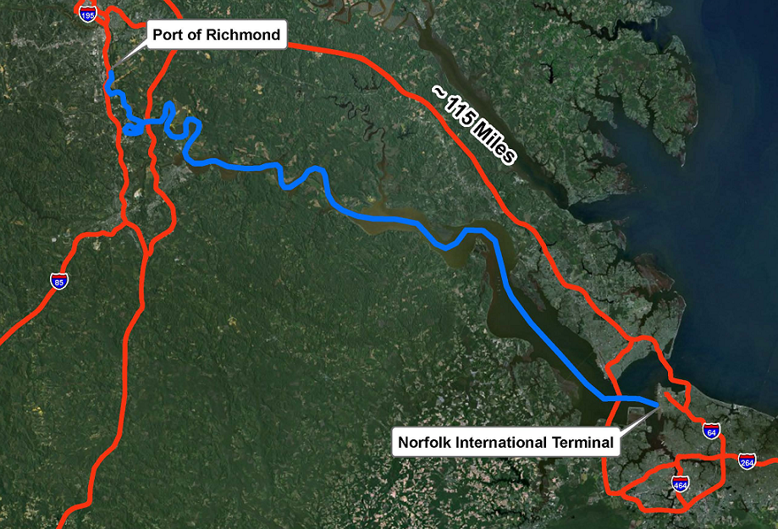
64 Express Marine Highway Service
MARAD Marine Highway Grant Funds provided for purchase of barges
Service started in 2008
Moves approx. 450 TEUs per month
Provides relief of congested I-64 corridor
13
Notes:
The 64 Express is an example of one of those investments using Marine Highway grant funds to help capitalize a marine highway service that has been growing in popularity and whose volumes have grown by over 400% since its inception in 2008.
Additionally, this service provides heavy weight shipping alternatives to manufacturers in the Richmond area and significantly reduces congestion, road maintenance costs, and air emissions in the Norfolk area.

Slide 14
M-5 (AK)
$179.26M Marine Highway &
TIGER Grants 2009 to 2012
M-5
Maine Ports, ME
$14,000,000
M-84
M-90
M-90
Detroit/Windsor Ferry
$2,200,000
M-87
Lewiston, ID
$1,300,000
M-71/77
M-90
M-75
Bayonne, NJ
$11,400,000
M-580
Davisville, RI
$22,300,000
M-95
Green Trade Corridor, CA
$30,000,000
M-55
M-70
M-70
James River
$1,100,000
Tri-City Port, IL
$14,500,000
M-64
Oakland, CA
$15,000,000
Cates Landing, TN
$13,000,000
M-40
Catoosa, OK
$6,425,000
M-5
M-65
Corpus Christi, TX
$10,000,000
Tenn-Tom W/W
$1,700,000
M-49
M-55
M-95
Cross Gulf
$3,340,000
Mobile, AL
$12,000,000
LEGEND
MH Corridor
MH Connector
MH Crossing
U.S. Interstate
Brownsville, TX
$12,000,000
M-10
Port Manatee, FL
$9,000,000
M-A1
M-2
M-5 (AK)

Slide 15
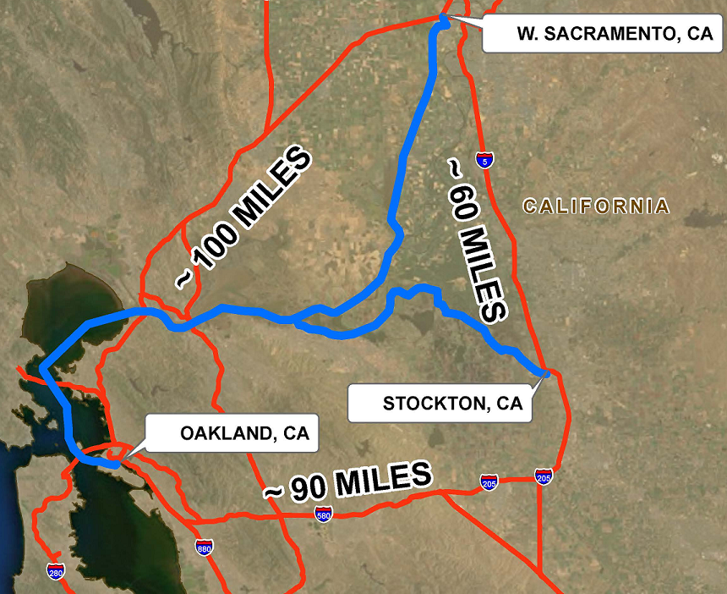
California Green Trade Corridor
Tiger Grant
DOT Tiger Grant Funds provided for landside improvements and two barges
Service between Stockton and Oakland to begin October 2012
TEUs already booked, majority heavy weight freight
Major relief of congested I-580 corridor

Slide 16
Focus on States
Seeking Maritime Coordinators within each State DOT having Marine Highways within their area of responsibility
36 State DOTs influence America’s Marine Highways
Which State DOT department will plan to use it?
6 = maritime, ports, waterways or marine
8 = planning
6 = intermodal
5 = freight
3 = rail & marine/railroads & harbors
1 = aviation & ports
1 = trade development
6= have no department that addresses maritime

Slide 17
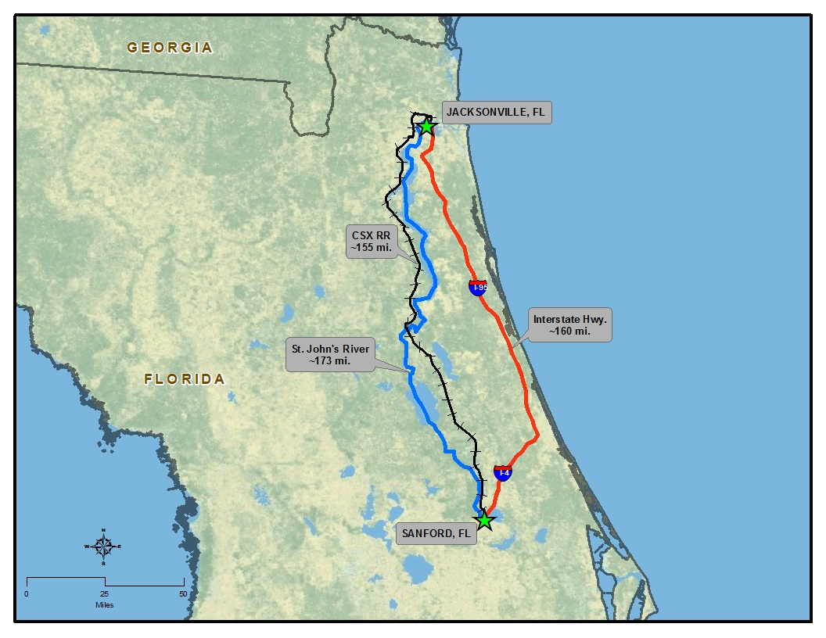
St. John’s River, FL
Notes:
The community in northern FL has done an analysis of the regional transportation system and this diagram shows how the inland river can supplement capacity along the I-95 Corridor.
The Maritime Administration recently held a roundtable meeting at the request of the Jax Chamber of Commerce bringing together public and private entities to explore the development of a marine highway connector linking the interior of central FL along the St. Johns River with the M-95 through JAXPort.

Slide 18
HazMat on MH
All restricted, designated, and preferred road and highway routes for transporting radioactive (RAM) and non-radioactive hazardous materials (NRHM) are reported to the FMCSA by State and Indian Tribe routing agencies (Sept ’09)
49 USC § 5112 - Highway routing of hazardous material
Many States designate routes that include road, rail and pipeline.
Rail carriers are responsible for annually reviewing and selecting the commercially viable route with the least safety and security risk based on commodity data collection and analysis by route and the rail route analysis risk factors included in the legislation.
Rail carriers are also responsible to minimize time in transit and increase security in storage of hazmat. Analyses or route decisions are not required to be submitted but must be available for inspection.
Exploring pros and cons of routing HazMat on Marine Highways

Slide 19
Our Vision: America’s Marine Highway
Reliable, regularly scheduled, competitive and sustainable services employing U.S. ships and tugs are a routine choice to transport freight and passengers.

Slide 20
Demand
Supply
Shipper Incentives
Start up funding risk
Carbon Trading
Right sized vessels
Policy Changes
Maritime as part of the surface transportation system
Fuel Costs
Notes:
It’s a complex puzzle with multiple elements which all must align at the same time for marine highways to work but it is achievable.

Slide 21
Update Oct 1, 2012
In FY 2013 we are focusing on three areas:
Incorporating Marine Highways Corridors, Connectors and Crossings into State freight system plans, to improve infrastructure and efficiencies for exports, heavy weight freight and hazardous materials,
Encouraging development of Marine Highway Projects that will expand the use of waterways for freight and passenger movement, and
Working with new and existing Marine Highway services towards long term sustainability and reliability to provide resiliency and redundancy to our road and rail systems.

Slide 22
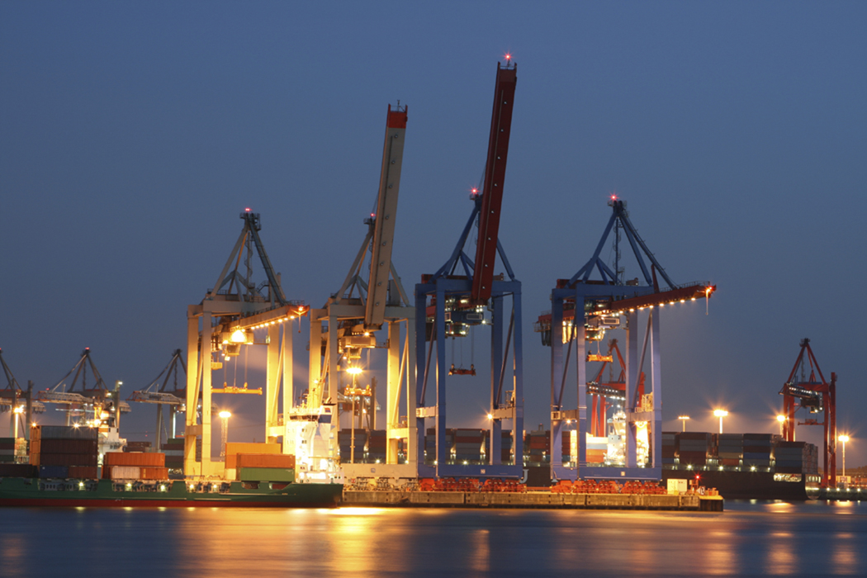
Thank you
Lauren Brand, PPM
202-366-0757
Lauren.Brand@dot.gov

