Slide 1
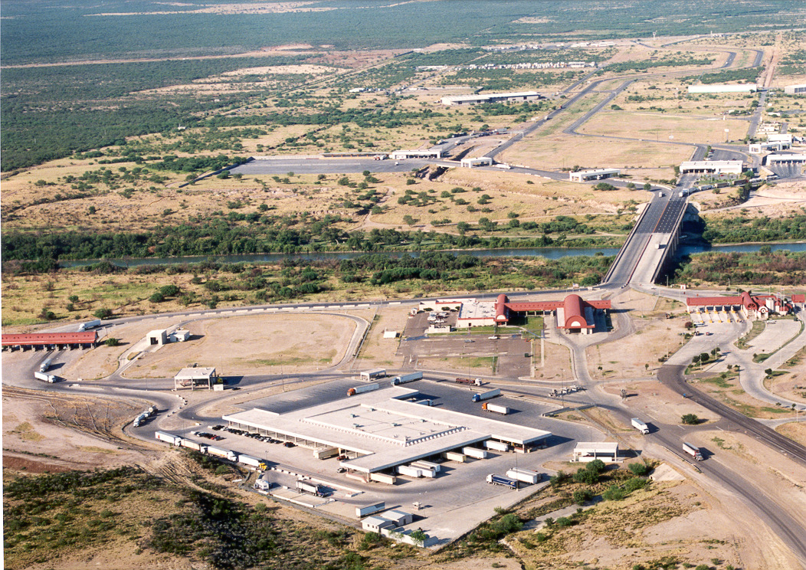


Talking Freight Seminar on Measuring Freight Performance
Commercial Border Crossing Time Measurement along the Texas/Mexico Border
November 16, 2011
Notes:
1
ECH
Good morning/afternoon. I am Esther Hitzfelder from the International Relations section of the Texas Department of Transportation. Juan Carlos Villa from the Texas Transportation Institute and I will be giving this presentation together. Juan Carlos has been the principal researcher on all of the studies that we will be talking about, and I am the project manager for TxDOT.

Slide 2
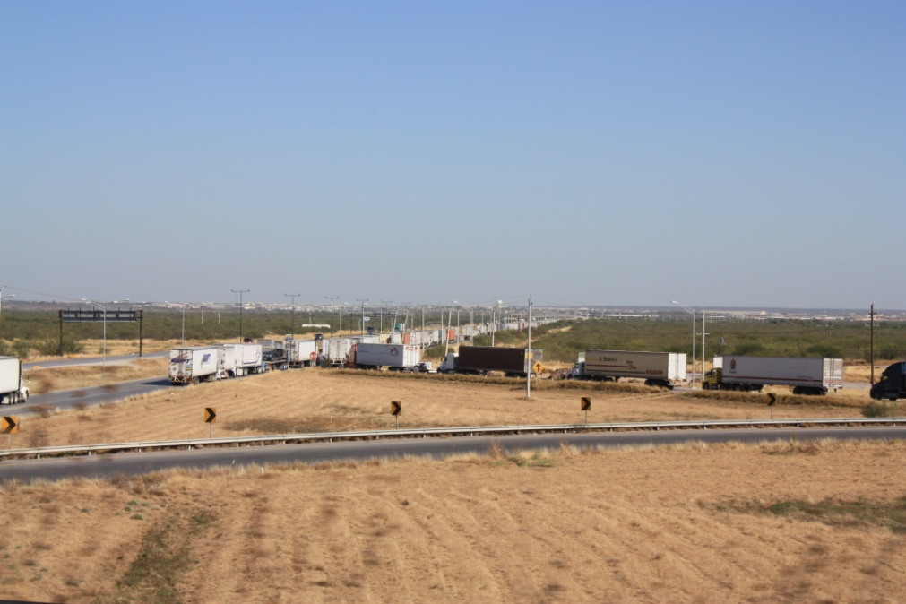
Agenda
Introduction
Testing of different technologies at BOTA and choice of RFID
Different locations with studies, and how the systems function and data collected
Web prototype and reports
Data collected at different study crossings
Next steps, Zaragoza and Data Dissemination
2
Notes:
2
ECH
We will be introducing the Wait Time/crossing time studies that we have been working on in Texas.
Juan Carlos will discuss the different technologies that were tested to see which would work best in our environments.
I will show you some of the different study locations and data that we have collected
Juan carlos will discuss the web prototype and reports which have been funded by FHWA
And I will go over the next steps with you.

Slide 3
Introduction
Background and Objectives
Delay time for commercial motor vehicles entering and leaving the U.S. at ports-of-entry with Mexico is a key indicator of transportation and international supply-chain performance.
TXDOT and FHWA are interested in measuring travel times for commercial trucks crossing from Mexico to the US
This information will be the basis for a border performance measurement system
Data collected in the system will be used to analyze different improvements in the border crossing process
3
3
Notes:
3
3
ECH
On the background and objectives,
Delay for commercial vehicles entering and leaving the us at Ports of entry with Mexico is a key indicator of transportation and supply-chain performance. And with over $1 billion of trade with Mexico on a daily basis, minutes of delay can cause large dollar impacts in the economy.
TxDOT, along with the US-Mx Joint Working Committee is interested in measuring travel times for commercial trucks crossing from Mexico to the US
We use RFID technology and data will be disseminated through the Internet and other systems as Juan Carlos will discuss with you
The data will be useful to make informed decisions on reducing delays caused by traffic congestion, better accommodating trade and travel demand, and increasing economic growth and job opportunities on both sides of the border without sacrificing border safety and security.

Slide 4
Technology Assessment
Six Technologies were Originally Analyzed
  Automatic Vehicle Identification (AVI)
    AVI using Laser Frequency
    AVI using Radio Frequency (RFID)
    AVI using Infrared Frequency
  Automatic License Plate Recognition (ALPR)
  Vehicle Matching
  Automatic Vehicle Location (AVL)
    GPS
  Mobile Phone Location
  Inductive Loop Detectors
Two Technologies Emerged as Best Candidates
  GPS
  RFID
4
Notes:
4
JCV

Slide 5
Technology Assessment (con’t)
RFID
Benefits
  RFID technology already in use by CBP for FAST program, and is being implemented by DPS at State Inspection Facilities
  No in-truck equipment installation required
  Continuing costs of operation is relatively low
Concerns
  Data collected is not as precise as GPS
  Agreements must be made with US / Mexican agencies to install RFID readers Information system more complicated than GPS
5
Notes:
5
JCV

Slide 6
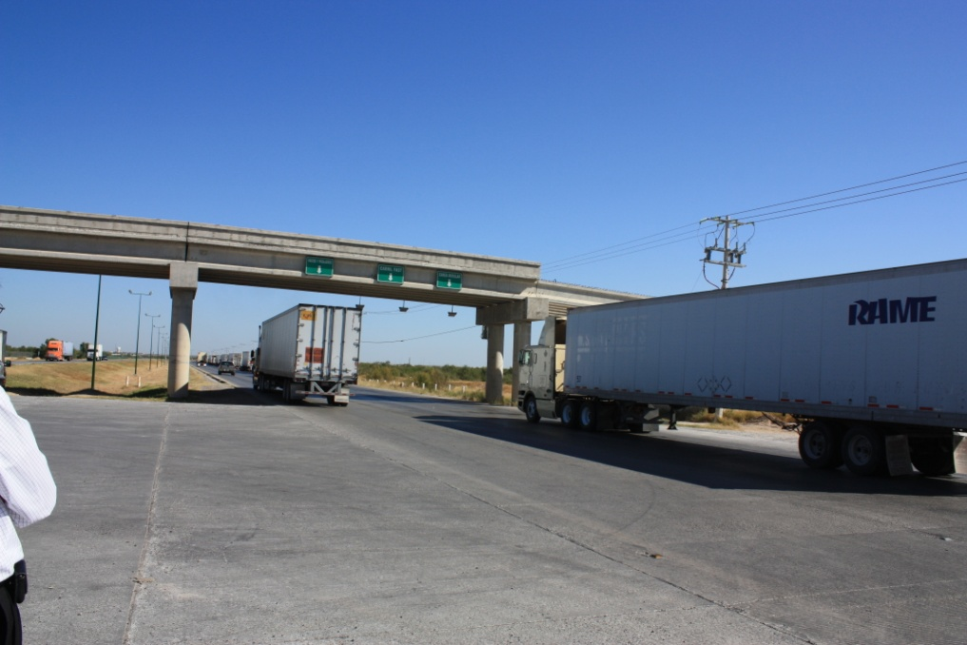
Project Background
Crossing times are being collected by using Radio Frequency Identification (RFID) technology at the following locations in Texas
  Pharr - Pharr/Reynosa International Bridge
  Laredo - World Trade Bridge
  Laredo - Colombia-Solidarity Bridge
  El Paso - Bridge of the Americas – BOTA
  Brownsville – Veterans Bridge
Notes:
ECH
Currently we are collecting wait times and travel or crossing times in 5 different locations in Texas. I want to thank the FHWA, especially the Freight Operations office for all of their assistance with these projects.
Not all has been smooth sailing. We have had some major and many minor glitches, some due to weather, some due to dealing with an international border.
Difference between crossing time and wait time.

Slide 7
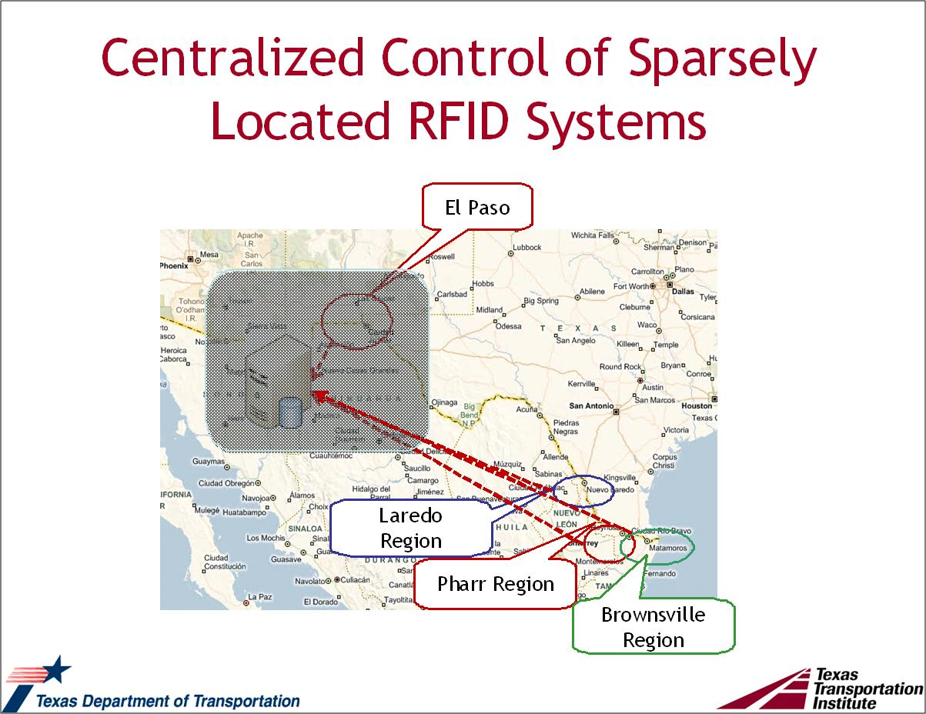
Notes:
ECH
The border between Texas and Mexico is over 1250 miles long, and we have systems at both ends. So, information is sent by Internet to a server at TTI in El Paso where it is processed for useful information for stakeholders. Juan Carlos will describe that process to you in a few minutes.

Slide 8
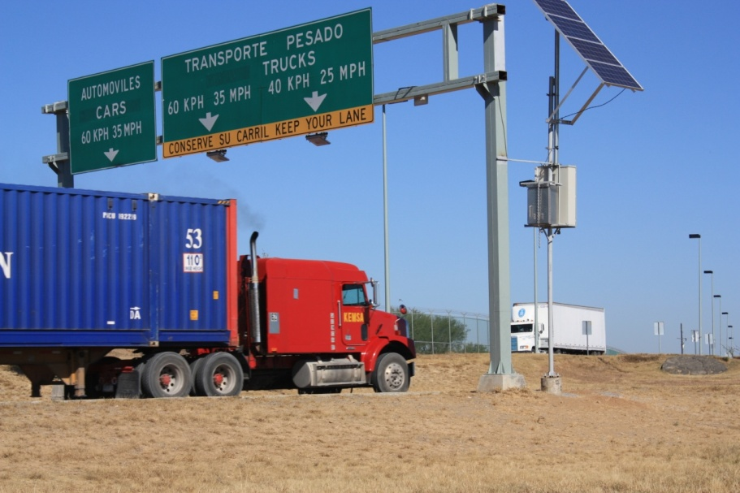
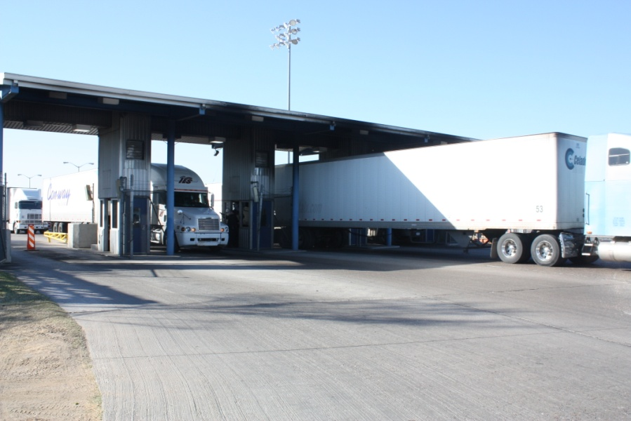
How the System Works
Installation of at least 3 measuring locations at the bridge
  1 before queue on Mexican side
  1 at the CBP primary inspection booth
  1 at exit of State Inspection Facility
Trucks equipped with RFID tags will pass under each measuring site, which record:
  the unique tag #
  time stamp
The time stamps are compared, enabling the overall Northbound border crossing time for a truck to be calculated
RFID tags are anonymous in the system
8
Notes:
ECH
In a nutshell, this is how the system works.
8

Slide 9
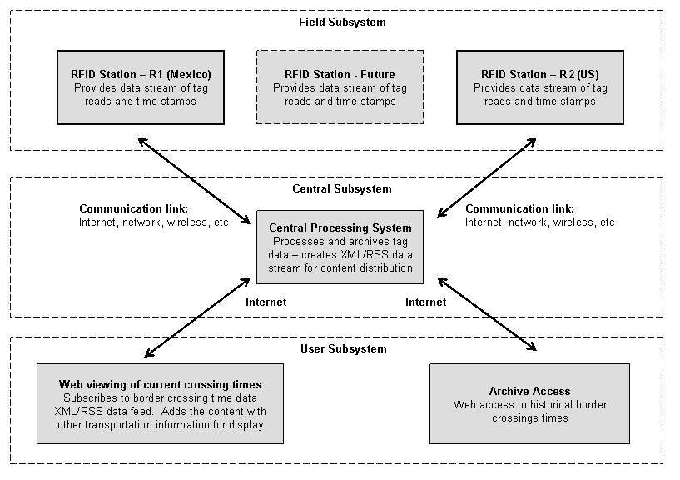
System Design
9
Notes:
JCV
9

Slide 10
Objectives of the Border Crossing Information System
1
Provide Border Crossings Related
Pre-Trip Traveler Information
  Provide a single window of information.
  Provide mechanisms to “push” and “pull” information.
2
  Develop a Centralized Repository of Border Crossing Data
  Archived data source for planners, researchers and decision makers.
  Estimate economic impact of border crossing delay.
  Calibrate cross-border traffic assignment models.
  Long –range transportation planning of border infrastructure
10
Notes:
10
10
JCV

Slide 11
Border Crossing Performance Measures
Border Crossing Times
Homeland Security Threat Level
Inspection Lanes Open
Border Crossing Volume
Processes to Estimate Performance of Border Crossings
Total Delay
Delay Per Vehicle
Border Crossing Index
Border Planning Index
Buffer Index
11
Notes:
11
JCV
Total delay: Total delay in a system is calculated as the sum of individual segment delays, and this could include any of the several links in the border crossing chain of events.
Delay per vehicle: It can normalize the total delay value, and still provide information to improvement analyses. It can show the impact of projects that handle much higher demand using newly constructed facilities as well as operational improvements.
Border crossing index: A ratio of the travel time in the peak period to travel time during low volume conditions. For example, a BCI of 1.20 would indicate that a trip that takes 20 minutes in the off-peak period will take 24 minutes in the peak period (20 percent longer).
Border planning index: The total travel time that should be planned for a border crossing (near-worst case travel time) to a travel time in light traffic conditions. A Border Planning Index of 1.60 means that a driver should plan for 32 minutes to make a trip that requires 20 minutes in light traffic (20 minutes × 1.60 = 32 minutes).
Buffer index: A measure of trip reliability that expresses the amount of extra “buffer” time needed to be “on time” for 95 percent of the trips (e.g., a late shipment on one day per month).
11

Slide 12
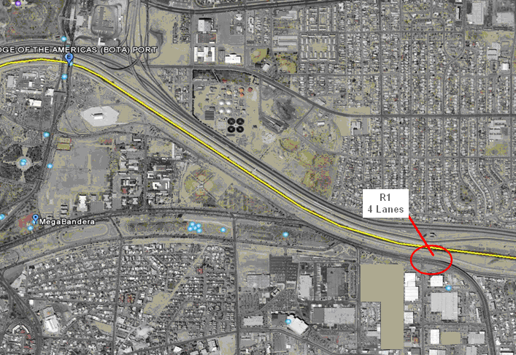
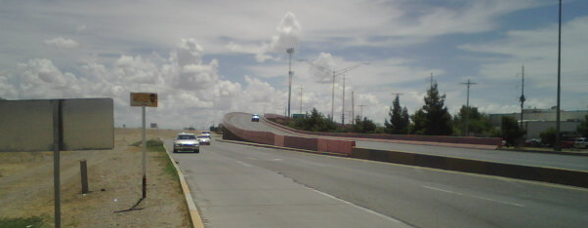
Implementation at the BOTA
Mexican Side of the Border
12
Notes:
JCV
12

Slide 13
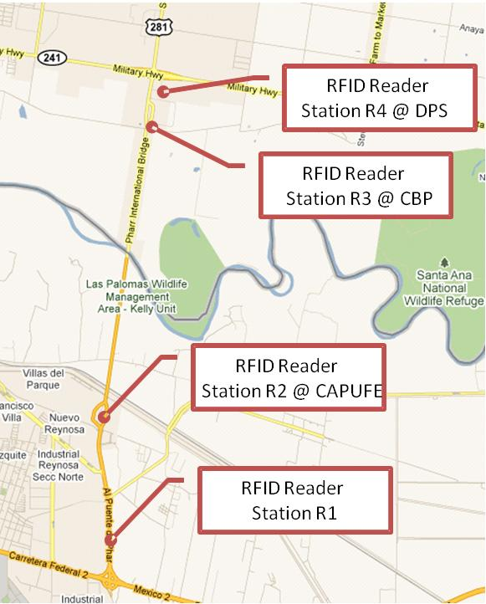
Pharr - Reynosa
Pharr-Reynosa International Bridge
Due to bridge length and POE configuration Pharr has 4 reading stations 2 in Mexico and 2 in the US allowing to segment trip in 3 parts.
GPS data from local truckers were obtained to compare vs. RFID calculation
Notes:
ECH
This is a map of the Pharr – Reynosa crossing. The R! is at the location in Mexico where trucks tend to queue up. Since the bridge is 3 miles long, an unusual set-up, at this location, we also installed readers at CAPUFE, right before the beginning of the bridge to be able to track how long the actual bridge crossing takes. R3 is at CBP Primary inspection and R4 is at the exit of the state Safety Inspection facility. With these readers, we can measure CBP’s definition of wait time, the time from the end of the queue to CBP primary, as well as crossing time or travel time, the time from the end of the queue to end of the final inspection when the truck is released from all border crossing inspections.

Slide 14
Hourly Average Crossing Time in a Week at Pharr - Reynosa
Mon
Tue
Wed
Thu
Fri
Hourly variation of average crossing time over a weekday period
Notes:
ECH
This graph shows crossing times over the course of a week. You can see the peaks and valleys over the course of the days in crossing times. This is the time it takes the truck from the beginning of the queue to the exit of the safety inspection facility.

Slide 15
Average Wait Time at Colombia Solidaridad Bridge
  Average Wait Time During a Day (October 20, 2011)
Notes:
ECH
This curve shows the average wait time on a particular day. Again, wait time is the time it takes trucks from the end of the queue to CBP primary inspection lanes.

Slide 16
Crossing Times at Colombia Solidarity
  Average Crossing Time During a Day (October 20, 2011)
Notes:
ECH
Crossing times show the entire process from the end of the queue to the exit of the state inspection facility. The curves are similar with peaks and valleys, altho inspection times seem to take longer later in the day. This may be due to a variety of issues including trucks with safety problems, inspection systems not working properly, fewer lanes open, or a host of other issues.

Slide 17
Processing Time of Trucks in a Day at Colombia Solidarity
Oct 20, 2011 /~ 1050 truck sample
Processing time includes time spent by CVs at both federal and state facilities in US.
Notes:
ECH
Over the course of the day, the 1050 truck sample (those with readers) 59% cleared all inspections in less than 10 minutes, and 66% cleared in less than 20 minutes.

Slide 18
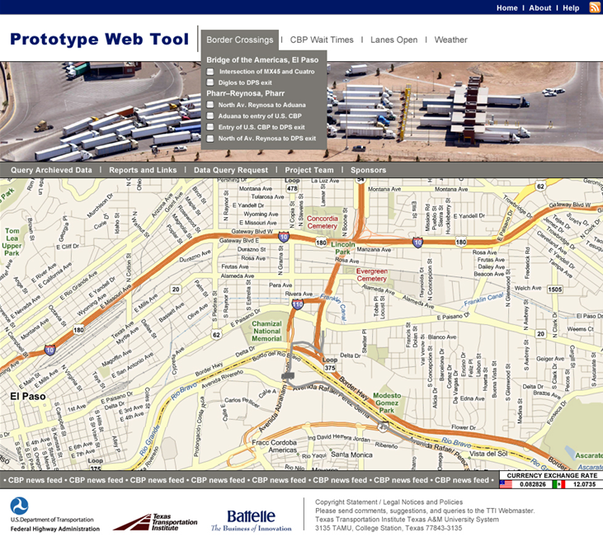
User Interface to Query Archived Data
Entry Link to Query Archived Data (password protected
Reports, Journal Papers, Presentations
Send Requests for Data Query to Admin
18
Notes:
JCV
18

Slide 19
User Interface to View Traveler Information (cont’d)
Select POE or Segment travel time from RFID
Wait time data from CBP.
Number of lanes open from CBP.
Color coded and icon to show wait time and crossing times at the POE.
Currency exchange rate.
News feed from CBP.
19
Notes:
JCV
19

Slide 20
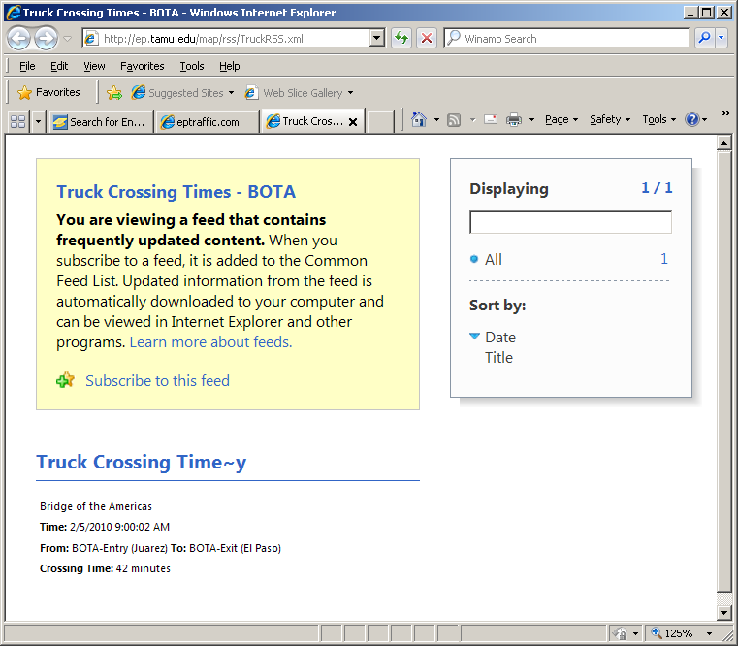
User Interface to View Traveler Information (cont’d)
20
Notes:
JCV
20

Slide 21
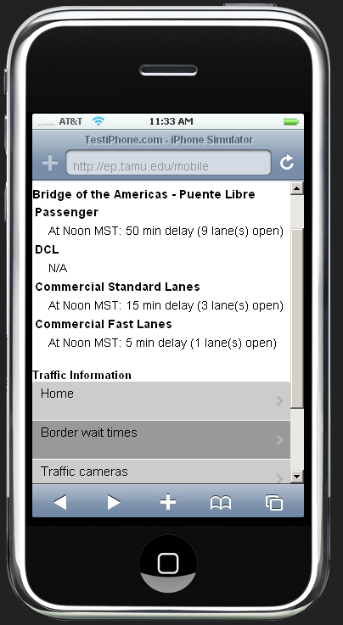
User Interface to View Traveler Information (cont’d)
Text version of the web page to show current wait time and crossing time.
21
Notes:
JCV
21

Slide 22
User Interface to Query Archived Data (cont’d)
Dashboard for each POE
  Will consist of a graph showing monthly trends of northbound trucks
22
Notes:
JCV
22

Slide 23
User Interface to Query Archived Data (cont’d)
Operational Improvement/Changes
Before
After
23
Trends showing increased or decreased number of congested trips are excellent indicators for monitoring congestion and system performance, before-after effect, etc.
Notes:
JCV
23

Slide 24
Next Steps
  Working with Texas DPS to collect truck volumes at land POEs on a close to real time basis
  Start Wait Time study at Zaragoza Bridge in El Paso
    Commercial vehicles northbound
    POVs northbound and southbound
  Pick up Dissemination project from the Web Prototype FHWA study and begin disseminating data to stakeholders via the Internet, mobile phone, and reports.
  Analyze the data and make recommendations on improvements in the border crossing processes.
  Currently working on contract to start theses projects thanks to a grant from the FHWA.
Notes:
ECH
Our next steps include beginning a Wait Time study at the Zaragoza Bridge in El Paso, the other bridge besides BOTA in El Paso with significant commercial traffic. In this study we will look not only at commercial vehicles, but also northbound and southbound POVs. In addition, we will begin dissemination of the data in real time and through historical reports using information from the FHWA Web Prototype study. We will also be making recommendations on improvements after analyzing the data to reduce delays, increase economic growth and job opportunities without sacrificing border safety and security. We are able to start on this study thanks to a grant from FHWA, and are currently in the contracting process.

Slide 25
Questions / Comments
  Esther Hitzfelder
  Texas Department of Transportation
  International Relations Office
  Ph: (512) 416-2030
  Fax: (512) 416-2040
  Esther.Hitzfelder@txdot.gov
  Juan Carlos Villa
  Texas Transportation Institute
  Ph: (979) 862-3382
  J-villa@tamu.edu
Notes:
ECH
We will be happy to answer any questions during the Q and A session.

