Slide 1
Talking Freight 2/16/11 Ken Braunbach Senior Director-Transportation

Slide 2
Wal-Mart Distribution Network

Slide 3
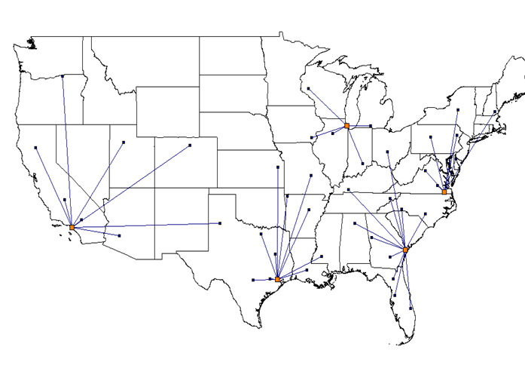
Import DC Alignment

Slide 4
Walmart International Distribution Center Count
Canada
10 DC’s
UK
34 DC’s
Japan
36 DC
Puerto Rico
3 DC’s
China
9 DC’s
Mexico
15 DC’s
Central America
11 DC’s
India
1 DC
Brazil
16 DC’s
Chile
5 DC’s
As of…May 31, 2009
Total DC’s | 141
Argentina
1 DC

Slide 5
Walmart International Stores Count
Canada
312 Units
UK
360 Units
Japan
371 Units
Puerto Rico
56 Units
China
103 TM Units
149 WMT Units
Mexico
1,232 Units
Central America
509 Units
India*
26 Units
Brazil
347 Units
Chile
216 Units
As of…May 31, 2009
Units | 3,685
International Associates | 680,000 +
Argentina
29 Units
* Franchise Units

Slide 6
Walmart International Facts
15 countries
7,900+ stores and clubs
200 million customers per week
228 DC’s
Global Presence
Multi-format Operation
10 different formats
53 banners
Multiple Businesses
Retail, wholesale, restaurants, real estate development, bakeries, meat plants, food sourcing and processing, bank
Multiple Equity Structures
Mexico – Majority holder in a public company
Central America – Majority holder in a JV
India – 50/50 JV in a holding company & Franchisor

Slide 7









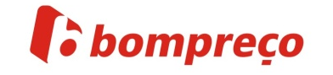








































MAGAZINE
L I V I N
ASDA
WALMART
supercenter
ASDA
LIVING
Express

Slide 8
Walmart International Facts International – High growth platform for Walmart
$98 billion in annual sales
Annual Sales (Millions USD) at Reported Rates

Slide 9
Examples of Supply Chain Market Maturity
“Emerging”
“High-Growth”
“Asset-Utilization”
“Redefinition”
India
Brazil
United States
Japan

Slide 10
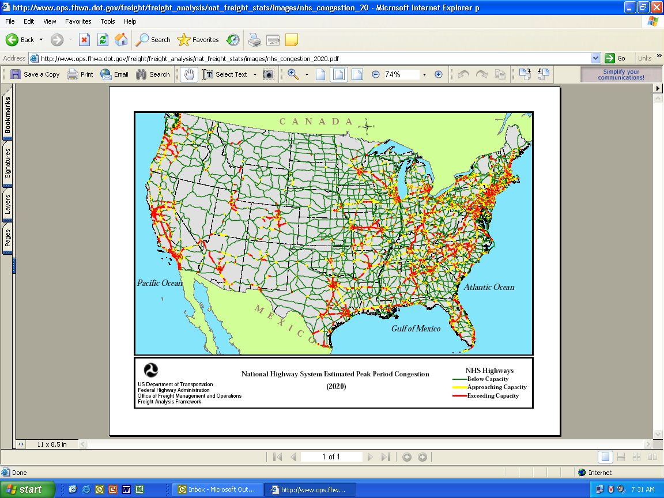
Industry
Climate Change
Driver Shortage
Fuel/Commodity Cost
Highway Congestion
Regulatory Change
Notes:
10
We knew that we could not solve the challenges of tomorrow within, or external to the company, without an aggressive ES strategy.
And it became obvious early on that:
1) We were already involved in ES
Supply Chain efficiency
Productivity Improvements
Energy Saving Initiatives
2) We needed to move from the incremental to the transformational…..

Slide 11
Inbound Expense by Mode
Sm Pkg
7%
Ocean
2%
Consolidators
1%
LTL
20%
Overnight
1%
Truckload
69%

Slide 12
Load Count 2010 vs. 2009
Freight Type | TY | LY | % Change
Construction | 8,333 | 9,983 | -17%
Fixtures | 80,619 | 37,820 | 113%
GMT | 970,472 | 770,149 | 26%
Grocery | 556,606 | 538,275 | 3%
PAD | 139,131 | 152,134 | -9%
Sams | 45,374 | 43,748 | 4%
TAB | 23,759 | 41,117 | -42%
Remix | 111,501 | 84,777 | 32%
LTL | 460,528 | 508,747 | -9%
Grand Total | 1,935,795 | 1,678,003 | 15%

Slide 13
Current Impacts
Beyond the recession….
Government regulations
Comprehensive Safety Analysis (CSA)
Hours of Service
EOBR
CARB
Financial
Higher fuel costs
Limited access to credit
Residual values- Book to actual value gap
……………Decreased Capacity

Slide 14
Less Discussed Issues
Weather
CSA
Tort reform-Negligent retention, hiring, and awarding
Selection criteria
Security
Mexico-Shift in manufacturing
Food supply chain safety
Steamship chassis management
Currency stability-Inflation
Multinational corporations profitability
Canadian manufacturing demand
India inflation

Slide 15
2011 Transportation Initiatives
Transportation Collaboration
Eliminate empty miles from our networks
Allow the carriers to engineer sectors of our network
Mutual long-term network, financial and service stability
Cost and inflationary indices used for rate escalators
Expand E-Commerce and Multichannel Logistics
Conversion-Convergence
Environmental Sustainability
Local Food Initiatives

Slide 16
More People – More Freight
Americans require a freight system that moves 40 tons of freight per person annually. With current population growth projections, we are looking at moving 4 Billion more tons of freight in the next 40 years.
Source: U.S. Census Bureau; FRA’s National Rail Plan

Slide 17
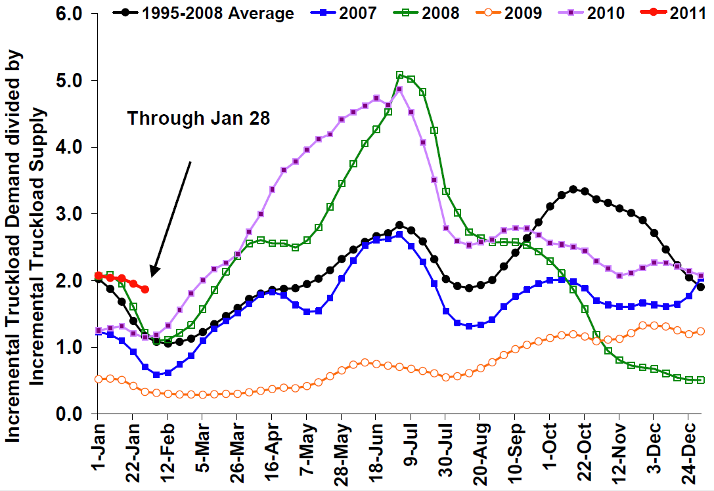
Truckload Freight Index
Truckload demand relative to capacity continued to outpace last year and is the highest it has been in the past five years.
Dry-Van Only
Source: Morgan Stanley

Slide 18
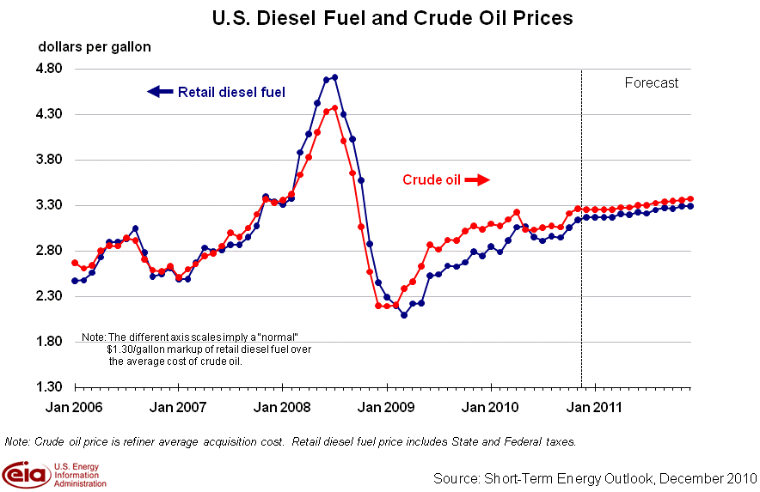
Purpose

Slide 19
Intermodal Opportunities

Slide 20
Marketplace Update
Demand continues to increase
Highway capacity continues to decrease
Year-over-year | December | 2010 Full Year
Domestic Intermodal | 9.5% | 10.6%
International Intermodal | 15.0% | 18.5%
For-Hire Truck Tonnage | 4.2% | 5.7%
Sources: IANA, ATA and Baird

Slide 21
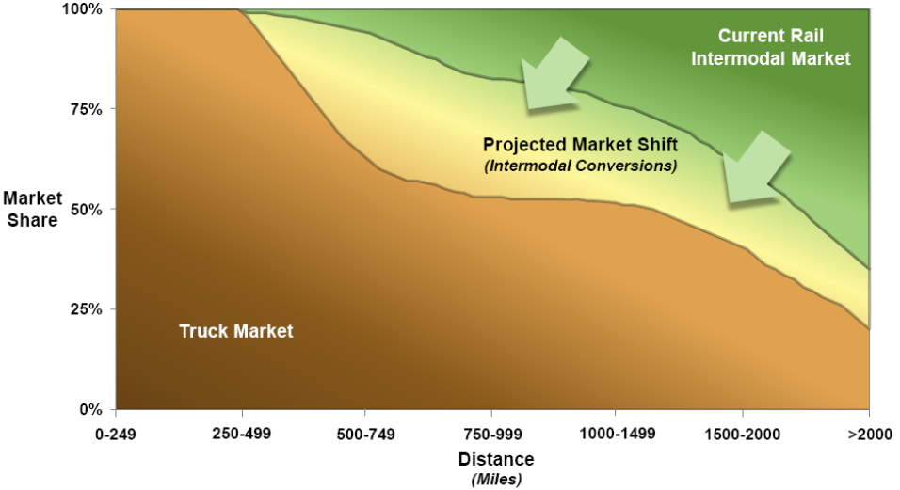
Modal Shift Opportunity
With improvements in service and facilities, Intermodal is becoming more competitive in shorter distances, absorbing more of the projected growth in freight.
% truck % intermodal conversion %rail
Source: FRA’s National Rail Plan

Slide 22
Domestic Intermodal Volume
Domestic Intermodal demand showed continued growth, with volume up over 8% for the fourth quarter and up over 9% in December.
Source: Intermodal Association of North America

Slide 23
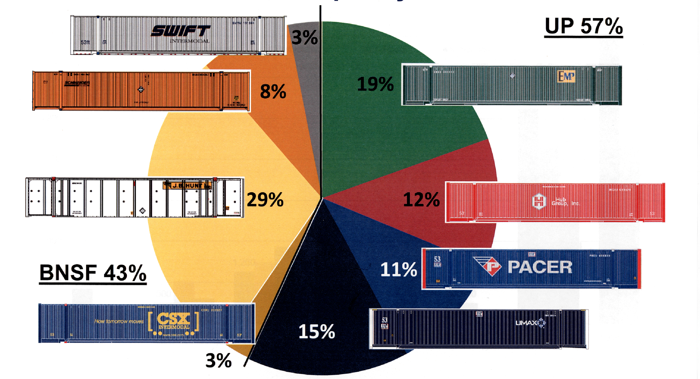
Western Intermodal Current State (2010)
Western Railroad Container (COFC) Breakdown

Slide 24
Environmental Initiatives

Slide 25
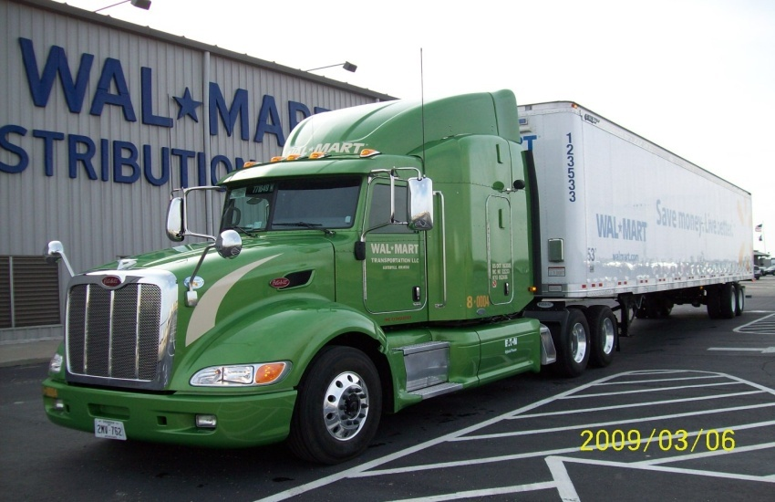
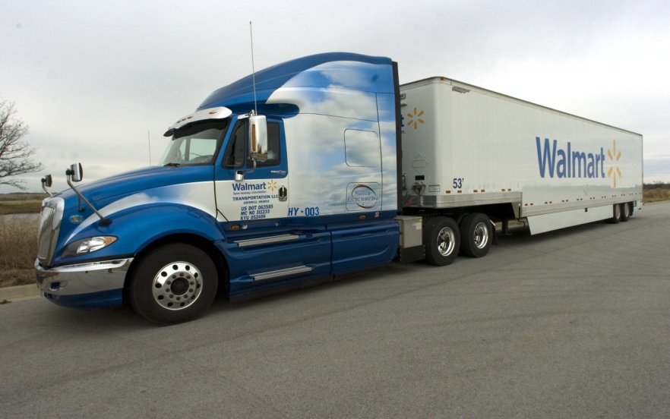
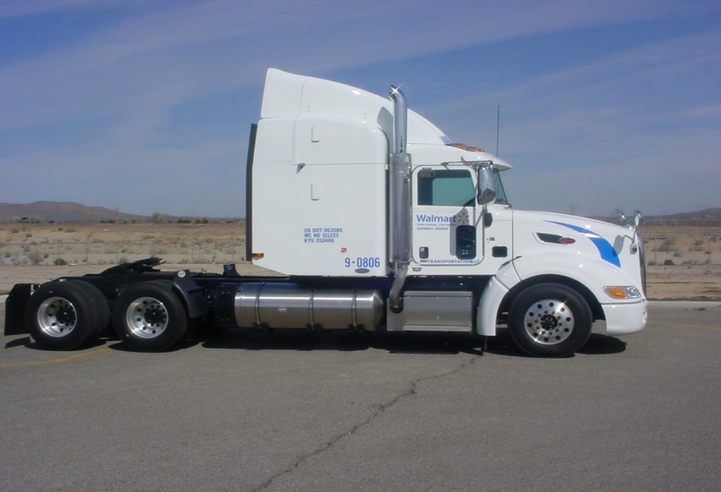
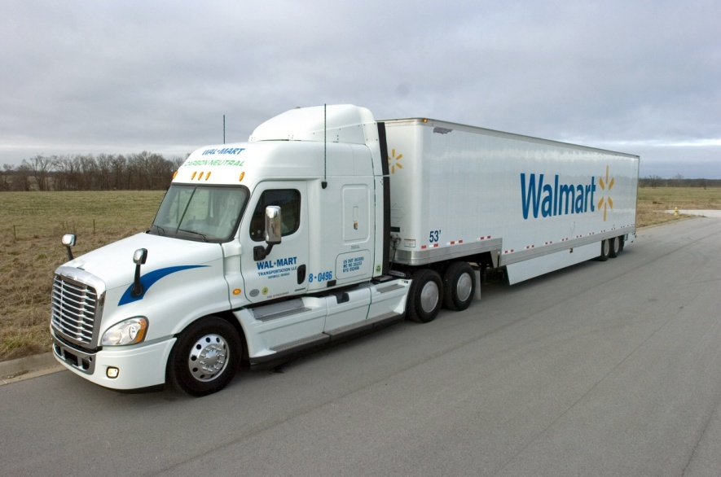
Alternatively Fueled Trucks
Hybrid Assist
Full Propulsion Hybrid
Liquid Natural Gas (LNG)
Reclaimed Grease Fuel (RGF)

Slide 26

FYE 2010 Operational Results
We delivered 161.2M more cases while reducing mileage by 97.1M…
3.0% more cases and 6.9% less miles
14.2% increase in GDC trailer cube
5.0% reduction in empty mileage
12.7% reduction in load dist ~ 34 Miles
“If nothing was done we would have passed on an additional 12bp of expenses, or $178.1M to our Stores and Clubs”

Slide 27
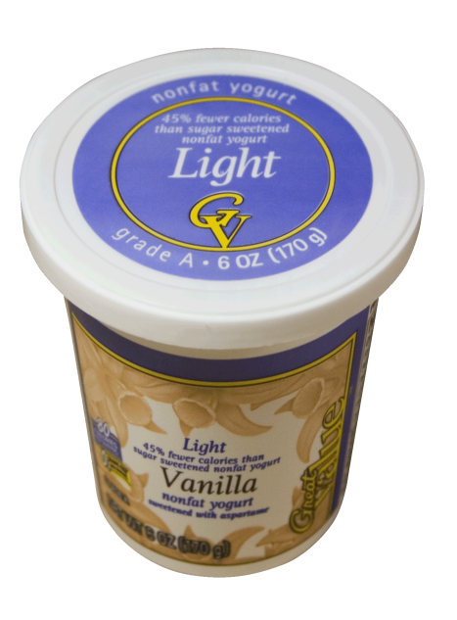
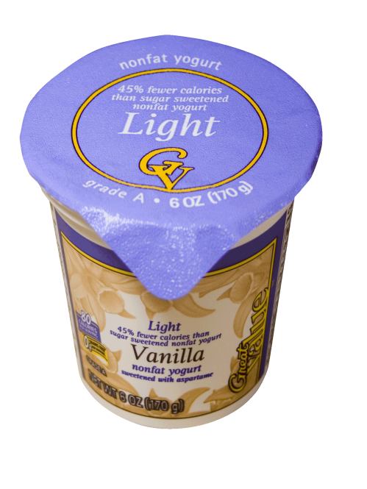
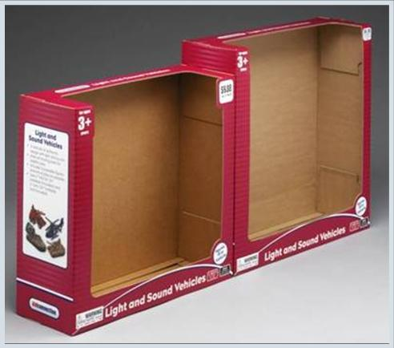
Zero Waste – Before & After
Yogurt Lids
Packaging for Kid Connection Toys
Notes:
Packaging and Waste Examples
Our packaging Network worked to reduce excessive packaging on some of our private-label toy products. By making the packaging just a little bit smaller to fit the items a little better…we found that we could supply the product with 727 fewer shipping containers than what was needed with the previous packaging design. Which saved $3.5 million in transportation costs alone. We estimate that we saved 5,190 trees and 1358 barrels of oil that would have been used to produce the packaging.
We have also worked with a vendor to create something call a sandwich bale, that allows us to recycle plastic that we haven’t recycled in the past…like apparel film, plastic bags and shrink wrap. We pay to haul if off and dump it…we getting nothing back from it. Well, this plastic can be recycled into all kinds of products. But to this point, it’s been very hard to get this loose plastic into a form that’s easy to transport. The sandwich bale solves that problem – by compressing the plastic between cardboard layers. Then baled, and hauled off. We just began implementing this program and this program could add US$28 million to the bottom line in 2006.

Slide 28
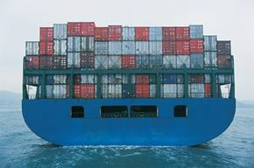

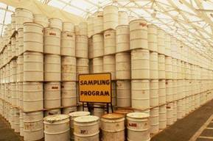
Used 727 less shipping containers.
Saved $3.5 million on transportation costs.
$3.5 million
+
Saved 5,100 trees.
5,100
+
Prevented 1,300 barrels of oil from being used.
1,300
=
Just 277 SKU’s. Imagine the possibilities…

Slide 29
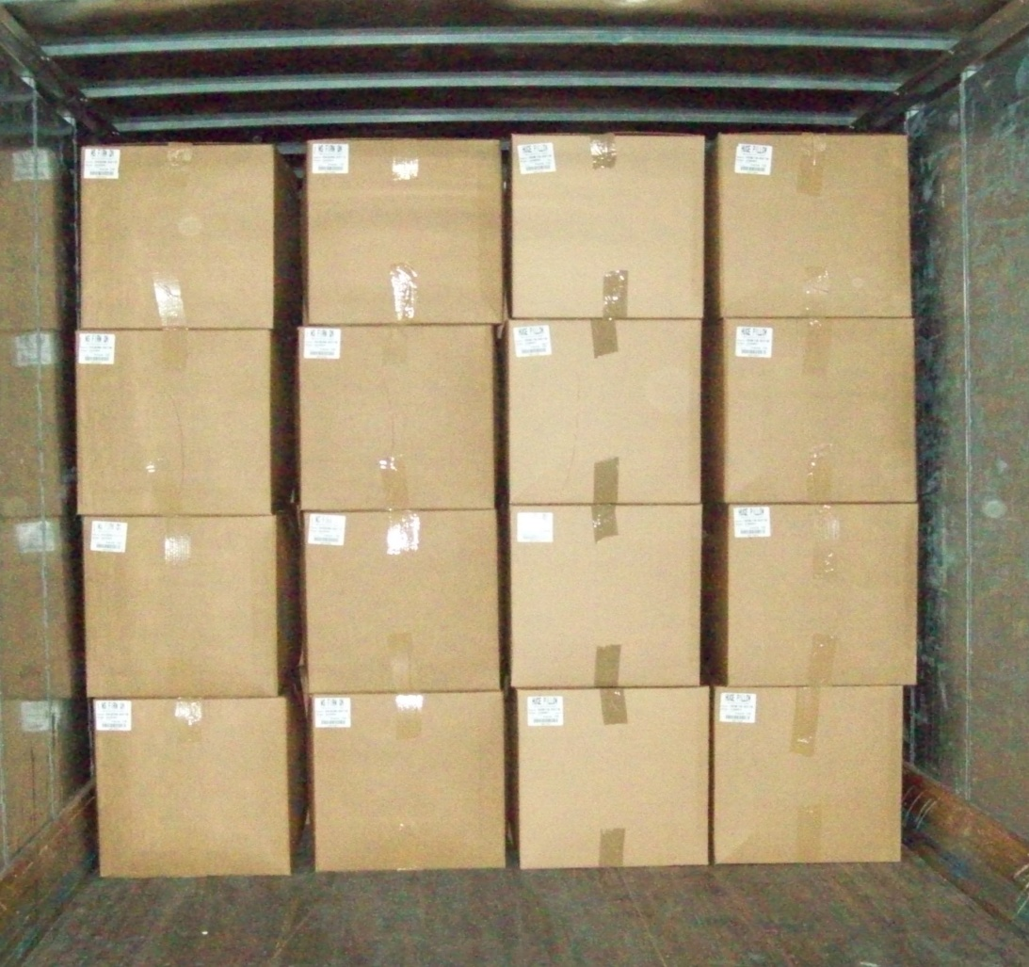
Existing Load Configuration Large Pillows
16 cases per row
20 rows per load
320 cases per load
10 units per cases
= 3,200 pillows/load

Slide 30
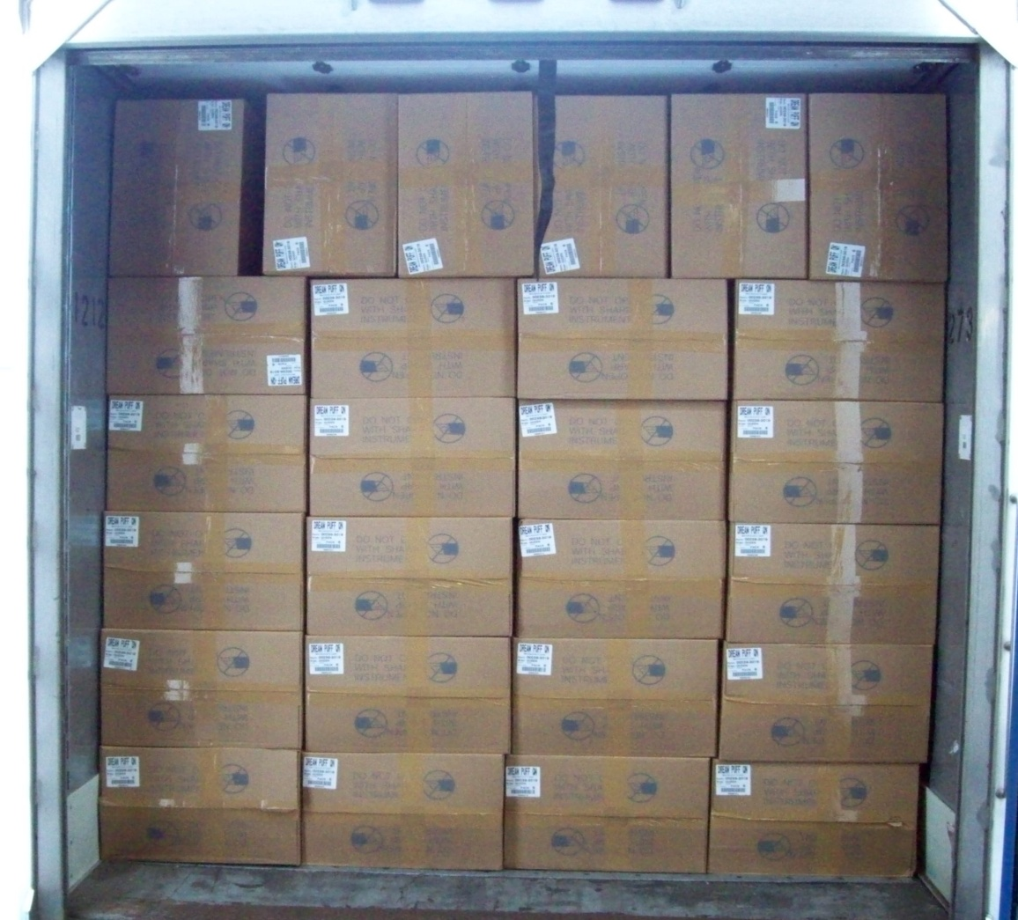
Proposed Load Configuration Large Pillows
26 cases / row
17 rows / load
442 cartons per load
12 units per carton
= 5,304 pillows/load

Slide 31
New Carton Design Annual Reduction
17 items impacted totaling 21.9M units / yr
14 million less square feet of corrugate
1.6 million less lbs of corrugate
1,800 less truckloads
Estimated savings of $2.1M

Slide 32
The Customer
The Walmart Customer
140 M customers per week shop at Walmart or Sam’s Clubs.
What Has Changed?
Price Point Decisions
Payday Patterns
Purchase Priorities
Size Selection
Staycations
Tax Return Delays
Credit Crunch

Slide 33
Goldman Sachs January Comparable-Store Sales for Major Retailers (a)
 | January 2011 |  |  |  | January |  | February |  |  |  | January 2011 |  |  |  | January |  | February
 | Actual |  | Estimate* |  | 2010 |  | 2010 |  |  |  | Actual |  | Estimate |  | 2010 |  | 2010
DEPARTMENT STORES |  |  |  |  |  |  |  |  |  | DISCOUNT STORES
Dillards | 6.0 | % | 1.0 | % | (5.0) | % | 2.0 | % |  | Target | 1.7 | % | 3.0 | % | 0.5 | % | 2.4 | %
Macy's | 2.6 |  | 1.0 |  | 3.4 |  | 3.7
J.C. Penney Stores (b) | (1.2) |  | (3.0) |  | (4.6) |  | 1.2
Kohl's | 1.4 |  | 1.0 |  | 6.5 |  | 3.7
Nordstrom | 4.8 |  | 3.0 |  | 14.0 |  | 10.3 |  |  | WAREHOUSE CLUBS
Saks | 4.4 |  | 4.0 |  | 7.0 |  | 2.0 |  |  | Costco (incl fuel) | 9.0 | % | 6.0 | % | 8.0 | % | 9.0 | %
Neiman Marcus | 9.8 |  | 4.0 |  | 6.8 |  | 6.2 |  |  | BJ's (incl fuel) | 2.7 |  | 3.0 |  | 8.4 |  | 7.5
SPECIALTY APPAREL
Abercrombie & Fitch | (4.0) | % | (3.0) | % | 8.0 | % | 5.0 | %
American Eagle Outfitters | (6.0) |  | (13.0) |  | 10.0 |  | 6.0
Aeropostale | 1.0 |  | (7.0) |  | 6.0 |  | 7.0
The Buckle | 4.3 |  | 3.0 |  | (1.2) |  | 5.1
Gap, Inc. | 1.0 |  | (4.0) |  | 5.0 |  | 3.0
Gap N. America | 0.0 |  | (6.0) |  | 2.0 |  | 0.0
International | 8.0 |  | 3.0 |  | 3.0 |  | 0.0
Banana Republic N. America | 4.0 |  | (2.0) |  | 4.0 |  | 6.0
Old Navy N. America | (3.0) |  | (4.0) |  | 10.0 |  | 5.0
Hot Topic (c) | (3.3) |  | (1.6) |  | (13.1) |  | (7.0)
Limited Brands (c) | 24.0 |  | 7.0 |  | 6.0 |  | 10.0
Victoria's Secret | 35.0 |  | 12.0 |  | 17.0 |  | 10.0
Bath & Body Works | 9.0 |  | 0.0 |  | (8.0) |  | 11.0 |  |  |  | January 2011 |  |  |  | January |  | February
 |  |  |  |  |  |  |  |  |  |  | Actual |  | Estimate |  | 2010 |  | 2010
 |  |  |  |  |  |  |  |  |  | RETAIL COMPOSITE INDEX | 4.3 |  | 2.3 | % | 4.9 | % | 5.7 | %
OFF-PRICE |  |  |  |  |  |  |  |  |  | Department Stores | 2.4 |  | 0.6 |  | 3.0 | % | 3.8
Ross Stores | 3.0 | % | 2.0 | % | 8.0 | % | 11.0 | % |  | Specialty Apparel/Off Price | 6.0 |  | (1.8) |  | 5.8 | % | 5.4
TJX Co. (d) | 2.0 |  | 0.0 |  | 12.0 | % | 10.0 | % |  | Discount Stores | 4.8 |  | 3.8 |  | 5.6 | % | 6.6
*Estimates are Goldman Sachs estimates and do not reflect consensus analyst expectations

Slide 34
To Be the Best in Market Supply Chain …
Think Like a Customer
Be Compliant
Set High Expectations for Low Cost
Be Sustainable

