Slide 1
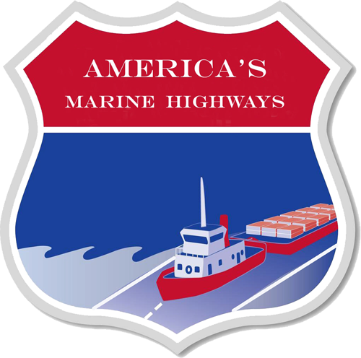
America’s Marine Highway Program Update:
March 16th 2011
Lauren Brand
Office of Marine Highways & Passenger Services
Maritime Administration
US Department of Transportation

Slide 2
Legislative - Regulatory Process
Energy Independence and Security Act of 2007 (December 2007)
  Authorized America’s MH Program
Interim Final Rule
(October 2008)
  Defined America’s MH Program
  Requested comments
National Defense Authorization
Act for FY2010 (June 2009)
  Authorized America’s MH Grant Program
* Consolidated Appropriations Act of 2010 (December 2009)
  Funded America’s MH Grant Program
Final Rule (April 2010)
  Addressed comments
  Refined America’s MH Program, including MH Projects
Call for Projects (April 2010)
  Requested MH Project applications
WWW.Grants.Gov Notice (September 2010)
  Requested grant applications for designated MH Projects
Notes:
This slide exemplifies the legislative process. Peggy Tadej of the NVRC asked me to cover the overall programmatic process. It takes a lot to create and maintain a program. This should be explained to meeting attendees.
Great slide! Just reorder the bullets so they flow in date order. Right now the dates seem to jump around. Once fixed, I will add this one to my ‘arsenal’ of slides.

Slide 3
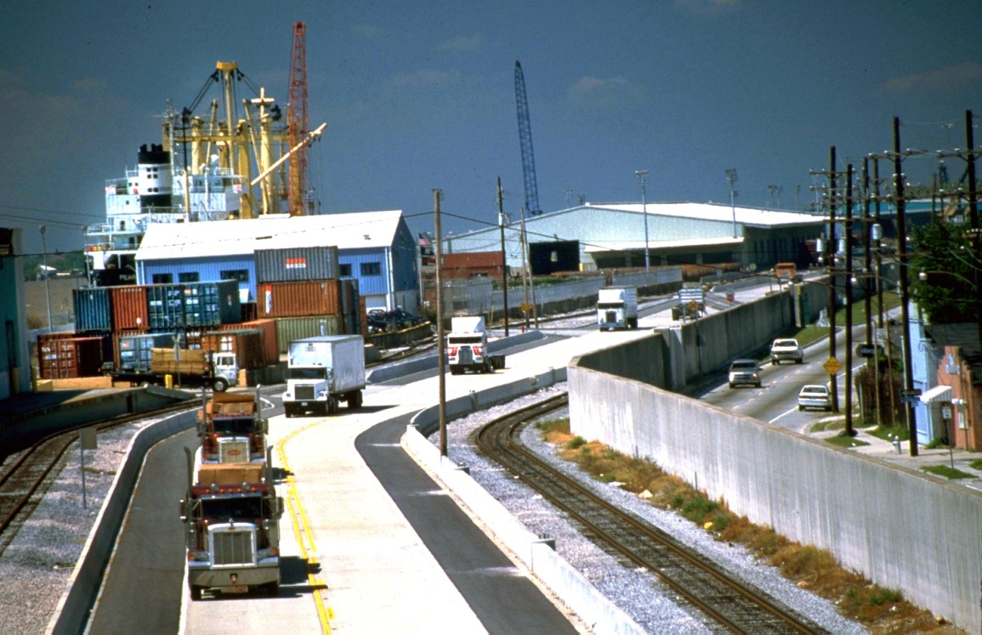
What are we talking about?
In 2007, Congress passed legislation making our nation’s waterways part of the surface transportation system.
Now we have a third intermodal option to work with.

Slide 4
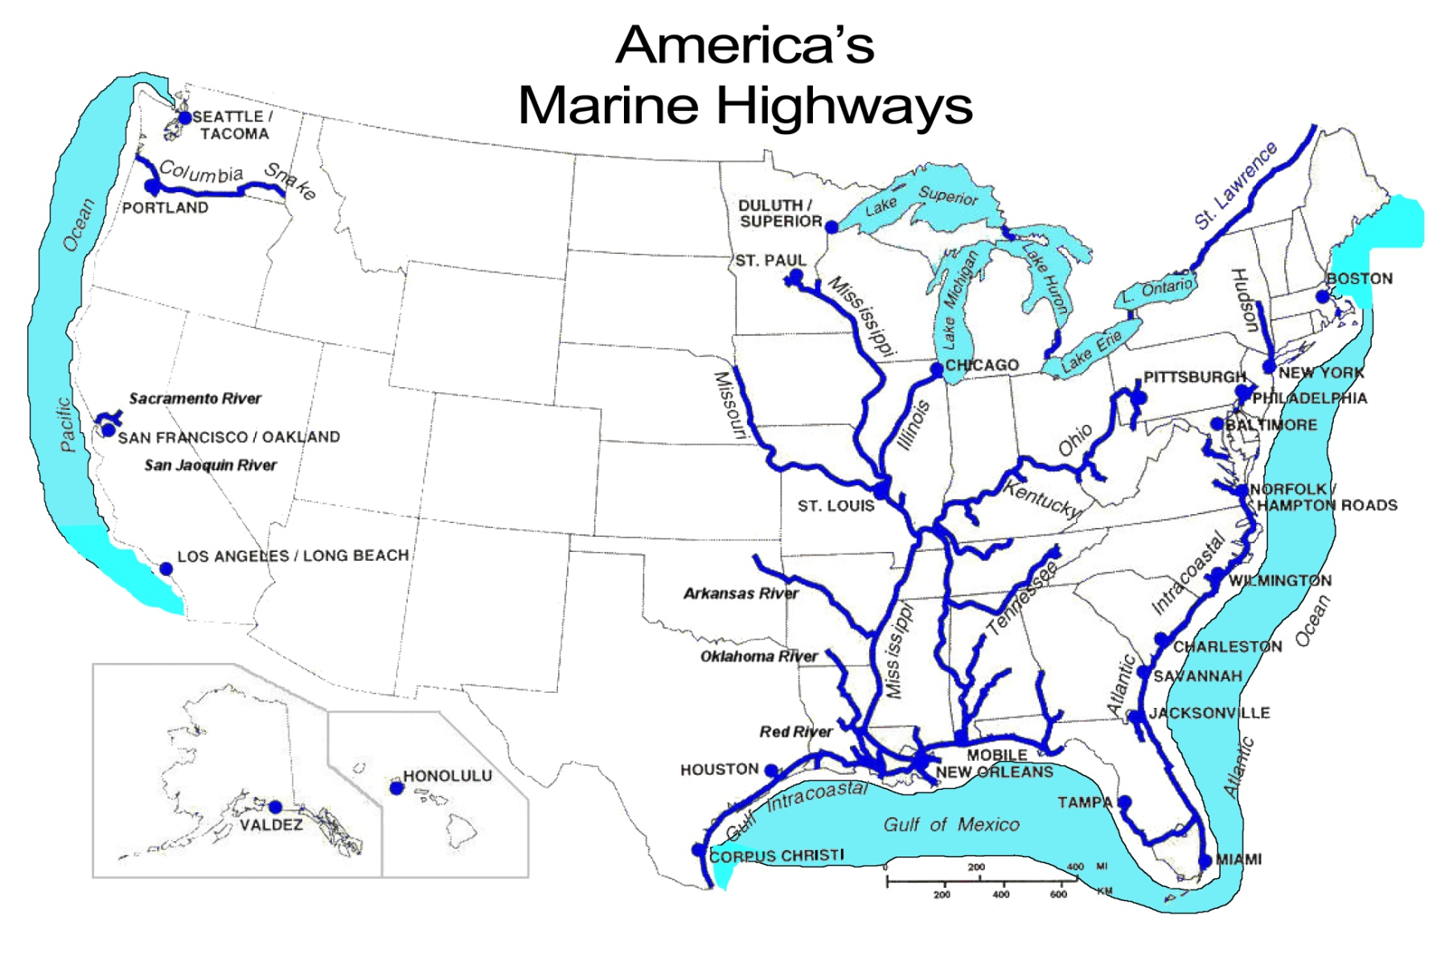
Marine Highways - July 2010

Slide 5
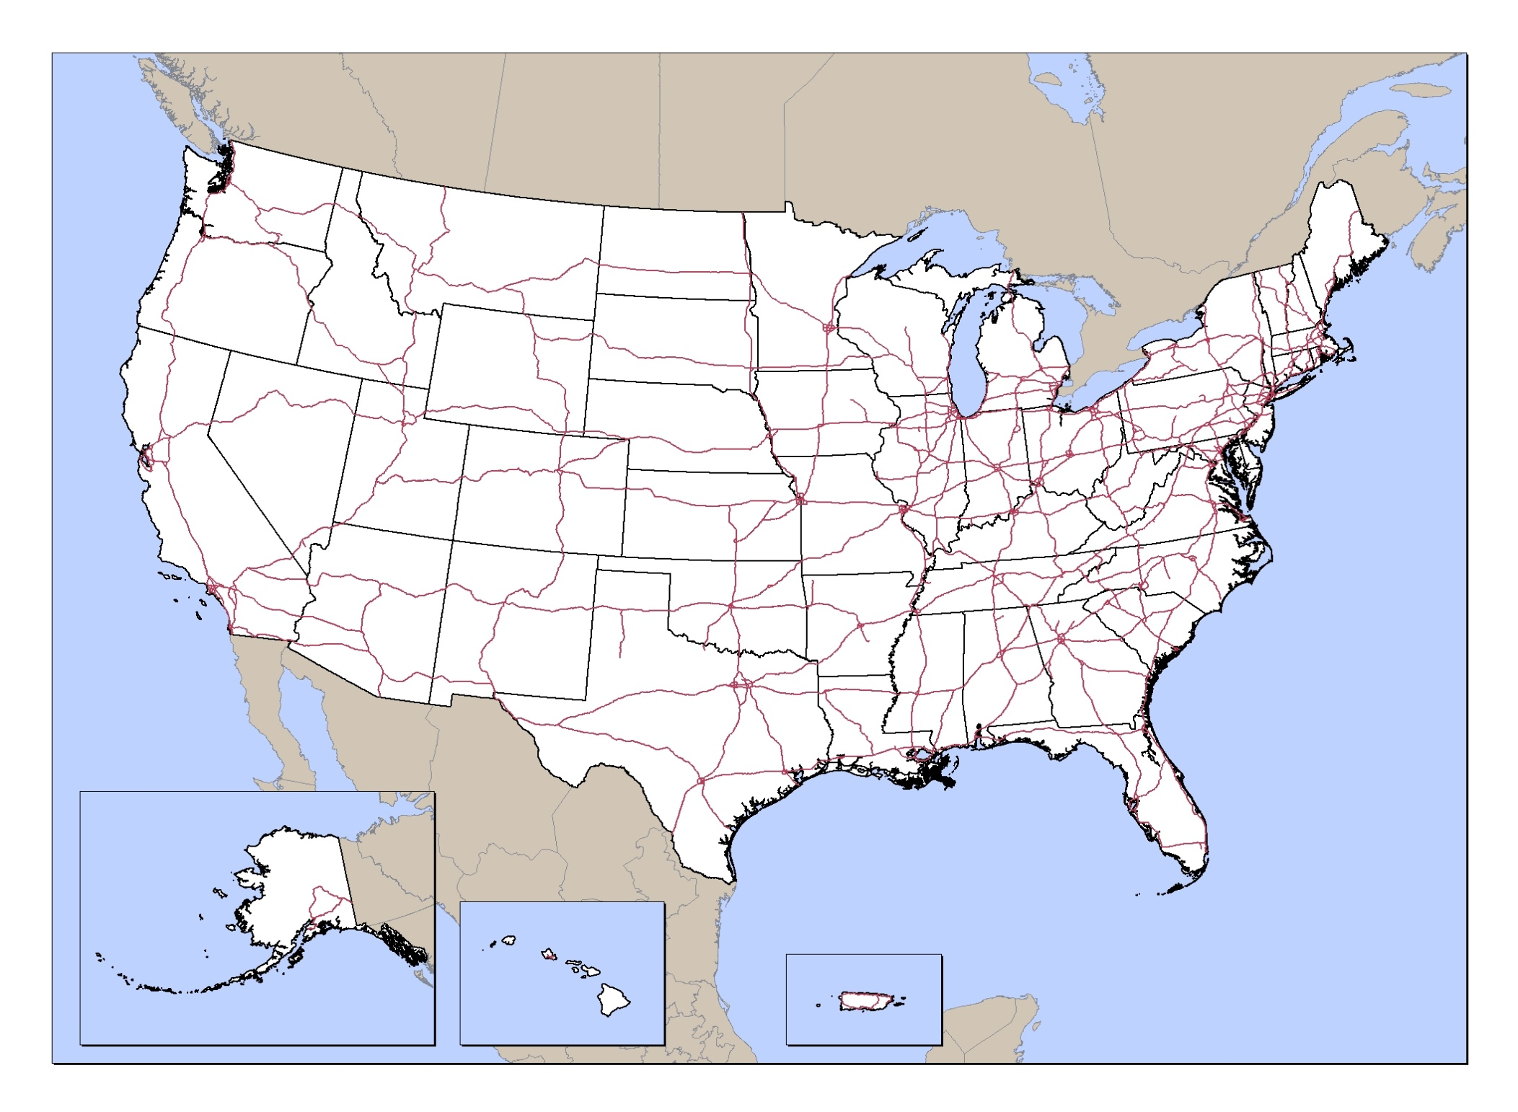
M-5 (AK)
America’s Marine Highway Corridors Designated Aug 2010
M-5
M-84
M-90
M-90
M-87
M-71/77
M-90
M-75
M-580
M-95
M-55
M-70
M-70
M-64
M-40
M-5
M-65
M-49
M-55
M-95
LEGEND
MH Corridor
MH Connector
MH Crossing
U.S. Interstate
M-10
M-A1
M-2
M-5 (AK)

Slide 6

M-5 (AK)
Marine Highway Projects & Grants - September 2010
M-5
P
M-84
M-90
M-90
P
M-71/77
M-87
M-90
P
P
M-75
P
M-580
M-95
M-55
M-70
P
M-70
M-64
M-40
P
M-5
M-65
M-49
M-55
M-95
P
LEGEND
MH Corridor
MH Connector
MH Crossing
U.S. Interstate
P
M-10
M-A1
M-2
M-5 (AK)

Slide 7
M-5 (AK)
Marine Highway Cooperative Agreements- Sept. 2010
M-5
M-84
M-90
M-90
M-87
M-71/77
M-90
M-75
M-580
M-95
M-55
M-70
M-70
M-64
M-40
M-5
M-65
M-49
M-55
M-95
LEGEND
MH Corridor
MH Connector
MH Crossing
U.S. Interstate
M-10
M-A1
M-2
M-5 (AK)

Slide 8
M-5 (AK)
Marine Highway
Freight Services – Nov. 2010
M-5
M-84
M-90
M-90
M-87
M-71/77
M-90
M-75
M-580
M-95
M-55
M-70
M-70
M-64
M-40
M-5
M-65
M-49
M-55
M-95
M-10
LEGEND
MH Corridor
MH Connector
MH Crossing
U.S. Interstate
M-A1
M-2
M-5 (AK)

Slide 9
M-5 (AK)
Potential Marine Highway Services
M-5
M-84
M-90
M-90
M-87
M-71/77
M-90
M-75
M-580
M-95
M-55
M-70
M-70
M-64
M-40
M-5
M-65
M-49
M-55
M-95
LEGEND
MH Corridor
MH Connector
MH Crossing
U.S. Interstate
M-10
M-A1
M-2
M-5 (AK)

Slide 10
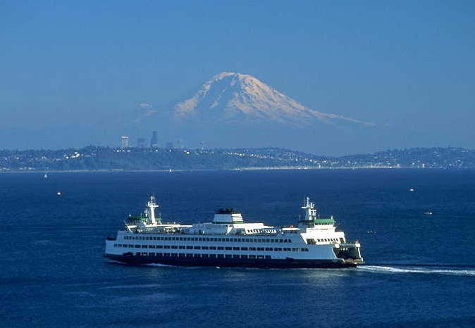
U.S. Department of Transportation
Funding & Other Resources
  Maritime Administration
    America’s Marine Highway Program
    America’s Marine Highway Program Grant Program
    Dual-Use Vessel Design
  Federal Highway Administration
    Ferry Discretionary Grant Program
      Detroit-Windsor Marine Highway Project
      Washington State Counties (Puget Sound Ferries)
    Congestion Mitigation and Air Quality (CMAQ) Grant Program
      64-Express Marine Highway Project
  Multimodal
    TIGER Grant Programs
      Cross Gulf Marine Highway Project
      Various Multimodal Transportation Center Projects
Notes:
This slide covers more details for “FY2011” stemming from the prior slide. It discusses funded and unfunded DOT resources including TIGER Grants.
The picture is a Puget Sound Ferry Service.
For TIGER – add
California Green Trade Corridor
Quonset Wind Energy/Surface Transportation
Beautiful picture.
Formatting for this slide and the next are different. Title of agencies are in white on this slide and bold red on the next.

Slide 11
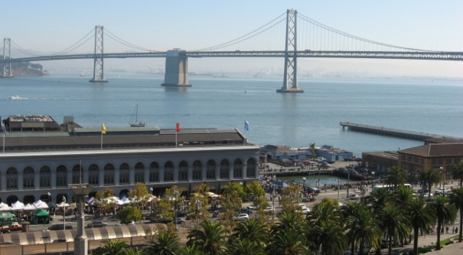
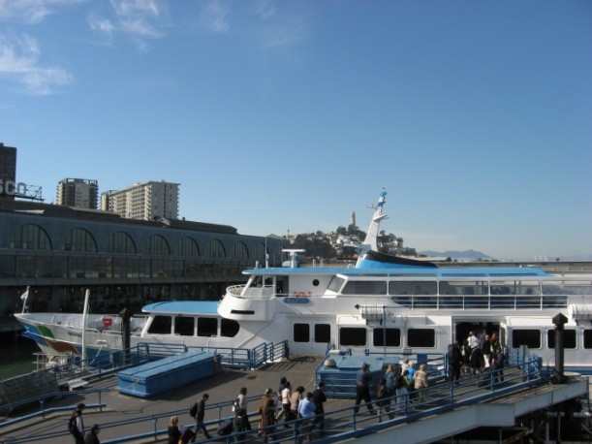
Other Considerations
Department of Transportation (Cont.)
  DOT/HUD/EPA Planning Grants
    To move goods and people in the most efficient and environmentally friendly means; e.g., intermodal connectivity
Department of Defense
  Emergency Response Grants
  Navy & Army Security Requirements
Department of Homeland Security
  Federal Emergency Management Agency
    Hazard Mitigation Program
    Public Assistance Program
    Port Security Grants
Notes:
This slide continues the forethought of available DOT resources but continues with DOD, DHS, and even Commonwealth resources.
The pictures provide an example of San Francisco-Oakland Bay Ferry Services and intermodal passenger activity. These services were key in the Prieta Loma Earthquake.
Would EPA’s clean engine program apply to this list? What about Capital Construction funds?

Slide 12
Does this work?

Slide 13
What Else is Happening?

Slide 14
Dual Use Vessel Study
Joint Study:
  Maritime Administration
  U.S. Navy
Scope/Purpose:
  To address both commercial & military cargo requirements
  Commercial survey
    Industry requirements
  Vessel design
    Including potentially both LO/LO & RO/RO
Notes:
14

Slide 15
Missouri River Study
Interagency Cooperative Effort
  Maritime Administration – LEAD AGENCY
  Department of Energy
  Department of Commerce
  US Department of Agriculture
Scope/Purpose:
  Develop recommendations on how to minimize impediments to growth and maximize benefits related to energy production and efficiency, congestion relief, trade and transport efficiency and air quality.
Notes:
15

Slide 16
TIGER* Grants for Related Infrastructure Dev.
TIGER I:
  California Green Trade Corridor
  Quonset Wind Energy/Surface Transportation
TIGER II:
  Port Manatee Marine Highway
  * Transportation Investment Generating Economic Recovery
Notes:
16

Slide 17
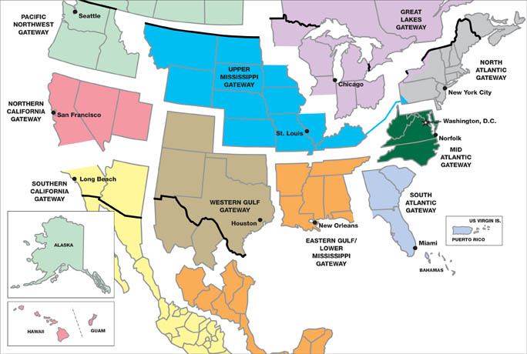
Regional Support:
Maritime Administration Gateway Offices

Slide 18
Marine Highway Cooperative
Developing an online Benefits Calculator
  User friendly planning tool
  Calculates the public benefits of new or expanded marine highway services
  Expected April 2011 & will be available at no charge to the public
Notes:
18

Slide 19
Marine Highway
Advisory Board
MTSNAC Subcommittee
  Authorized by the Energy Independence & Security Act of 2007
Purpose:
  Identify and seek solutions to impediments hindering effective use of short sea transportation.
FACA Committee
Status:
  Currently being established
Notes:
19

Slide 20
North American Short Sea Shipping Steering Committee
Established 2003; Members:
  US Maritime Administration
  Transport Canada
  Mexico’s Secretary of Communications & Transport
Purpose:
  Identify impediments to short sea transportation between nations and collaborate to resolve issues
  Understand and support efforts to develop Short Sea Services between and within each nation
Five Year Plan:
  Work together to develop Short Sea services that will provide resiliency and relief to congested border crossings and to overcome impediments that inhibit such developments.
Notes:
20

Slide 21
What’s Next?
Fiscal Year 2011
Advancing designated Projects
Supporting designated Initiatives
Accepting Corridor Applications
New Call for Projects – This Summer
Dual Use Vessel Report to be Issued
Fiscal Year 2012
Designation of New Projects
Supplemental Missouri River Study Due
Grant funds not currently authorized

Slide 22
Upcoming Meetings
Three Corridor Workshops being scheduled
  East Coast / West Coast/ Inland Waterway
JOC Marine Highways Conference
  April 5-6, 2011, Linthicum, MD
American Planning Assn (APA) National Conference
  April 9-13, 2011, Boston
AAPA’s Communicating the Importance of Infrastructure Investment
  June 21-23, Savannah
Delaware Valley Regional Planning Commission’s Freight Advisory Committee
  July 13th, Philadelphia
IANA/NITL eague Annual Conference
  November 11-16, Atlanta
Notes:
22

Slide 23
What can you do to develop routine maritime freight movements?
  We’re reaching out to State Departments of Transportation, Metropolitan Planning Organizations, Inland and Coastal Seaports, Logistics Providers, Shippers, Labor, Terminal Operators, Truck Lines, Railroads, Economic Development Agencies, Federal Highway Administration, Federal Rail Administration, US Department of Agriculture, Department of State, Department of Defense, Department of Commerce, Department of Energy, Environmental Protection Agency, Pipeline and Hazardous Materials Safety Administration, Illinois Soybean Association and…

Slide 24
We Invite you to Partner With Us
America’s Marine Highways Program
  http://www.marad.dot.gov
    Existing MH Corridors Map
    Existing MH Corridor, Project and Initiative descriptions
    References (Studies)
Lauren Brand
  Director, Office of Marine Highways & Passenger Services
  U.S. Maritime Administration
  202-366-7057 Lauren.Brand@dot.gov

