Slide 1
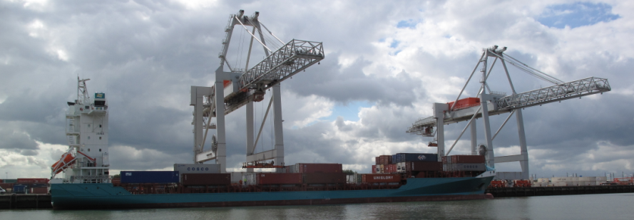
The International Technology Scanning Program
Freight Corridor Programs in the
European Union
Talking Freight, April 20, 2011
Renee Sigel – FHWA
Eric Madden – Pennsylvania DOT
Ernie Perry – Missouri DOT

Slide 2
Objectives
Identify:
The institutional, organizational and administrative structure of freight corridor programs
How freight corridors selected and prioritize
How improvements and operations are financed and managed
How performance standards are developed
International collaboration on freight corridor issues
Role of private sector stakeholders in the definition, development and implementation of freight corridors.

Slide 3
Participants
Anthony T. Furst - Federal Highway Administration
Eric G. Madden - Pennsylvania Department of Transportation
Eduardo Asperó - Mexico Intermodal Transportation Association
Monica M. Blaney - Transport Canada
David F. Long - U.S. Department of Commerce
Bernardo J. Ortiz - Mexico Ministry of Communications and Transport
Robert L. Penne - AASHTO
Ernie B. Perry - Missouri Department of Transportation
George E. Schoener - I-95 Corridor Coalition
B. Renee Sigel - Federal Highway Administration
Spencer L. Stevens - Federal Highway Administration
Kenneth L. Sweeney - Maine Department of Transportation
Juan C. Villa - Texas Transportation Institute

Slide 4
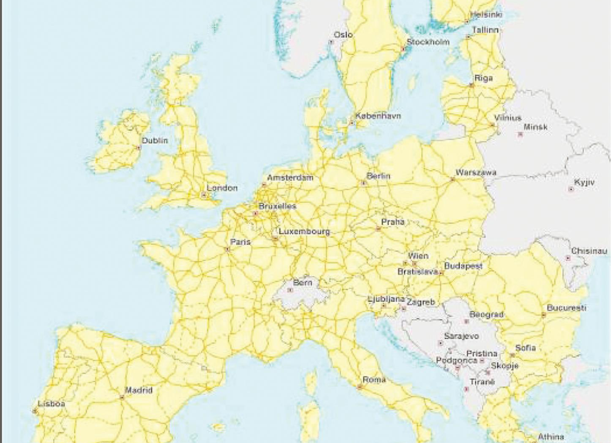
Scan Tour Countries
European Union
Brussels, Belgium
New Member Countries
Budapest, Hungary
Warsaw, Poland
Older Member Countries
Berlin, Germany
Rotterdam, The Netherlands
Vienna, Austria

Slide 5
Comparison
 | US | EU | China
Area (sq km) | 9.9 million | 4.3 million | 9.6 million
Population | 300 million | 492 million | 1,330 billion
Pop. Growth Rate | 0.97% | 0.098 % | 0.494%
GDP | $14.1 Trillion | $14.4 Trillion | $4.985 trillion
GDP growth rate | -2.6% | -4% | 9.1%
GDP/Per Person | $46,000 | $31,900 | $6,700

Slide 6
Percent Modal Share for Freight
Mode | US | EU
Rail | 34% | 10%
Road | 37% | 44%
Pipelines | 17% | 3%
Waterways
Inland | 7% | 3%
Sea | 5% | 39%
Other | 1% | 1%
EU – based on tonne-kilometre
US – based on Ton/miles

Slide 7
Key Findings -- Categories
Policies: Policy issues as they relate to freight corridor programs.
Planning Process: EU Corridor selection & prioritization, and its integration into national programs.
Sustainability: The role environmental issues play in freight corridor development and implementation.
Implementation: The national / EU alignment and funding issues impacting corridor implementation.
Operations: Freight corridor operation issues.

Slide 8
Key Findings - Policy
The EU has a unifying vision:
Connectivity/Access - Corridors/Axes
Economic Development/Commerce
Connected to societal goals
Member states fully support
Provides stable policy and funding
Stable vision / objective attracts private financing

Slide 9
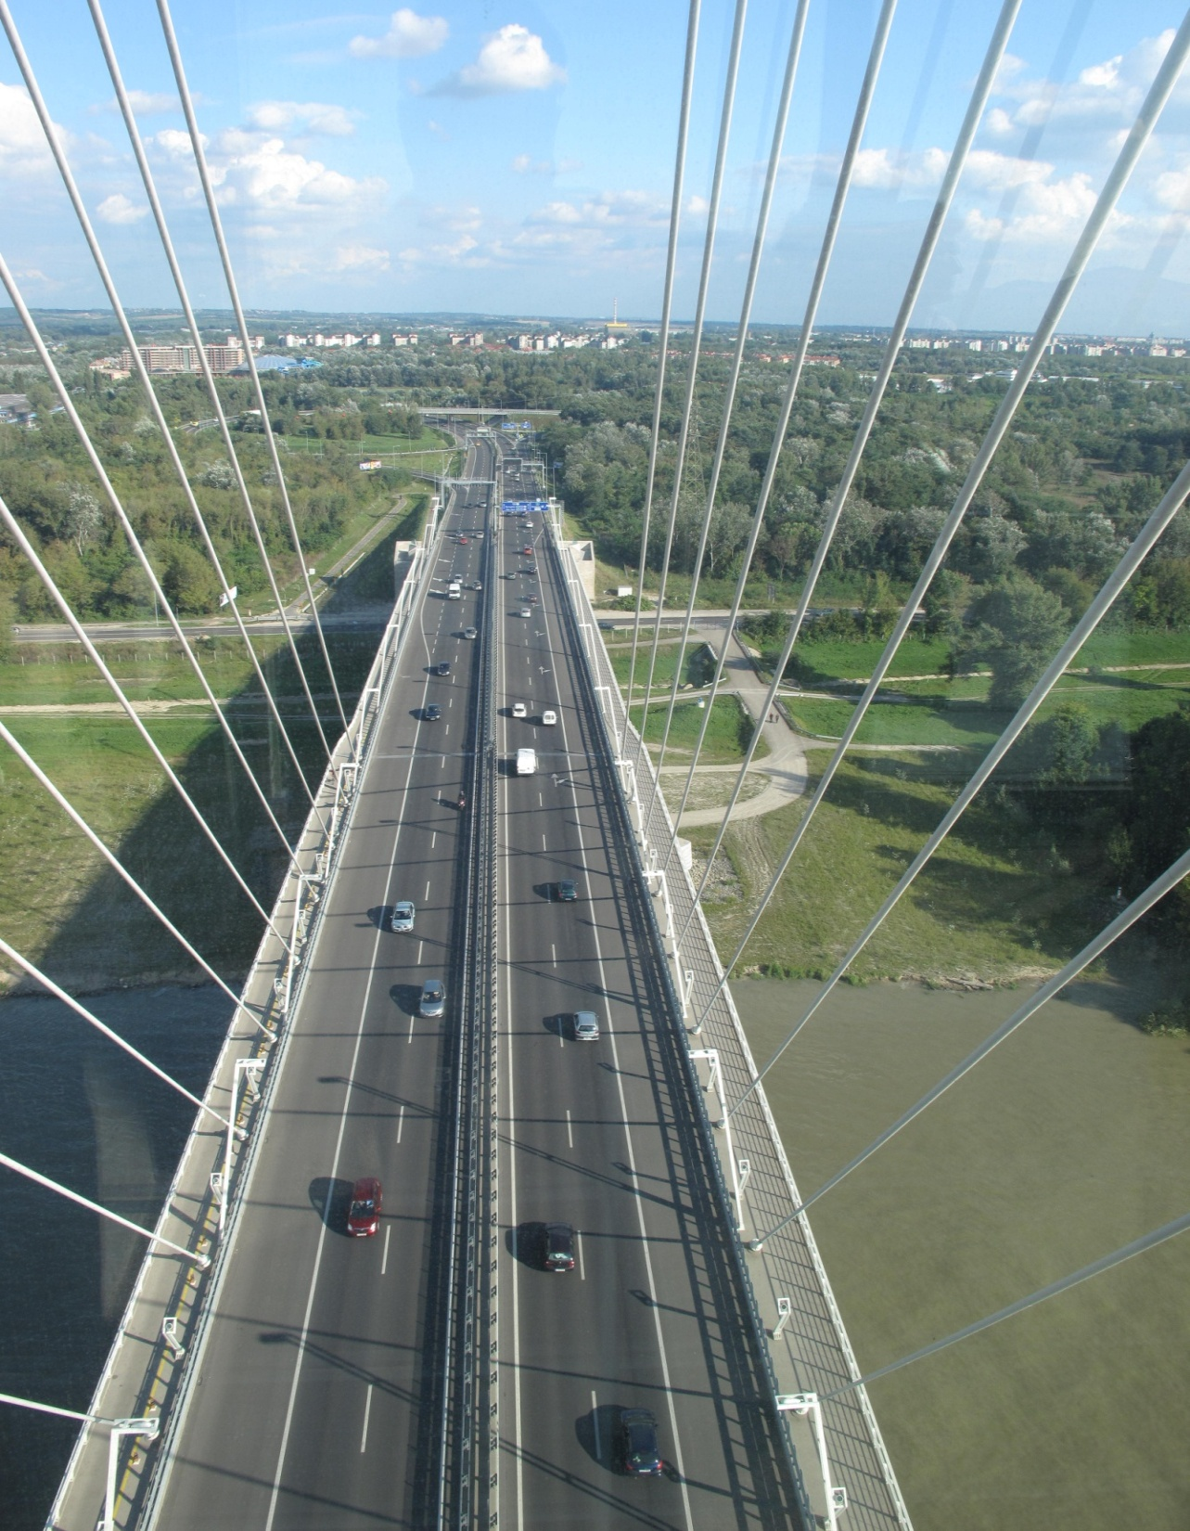
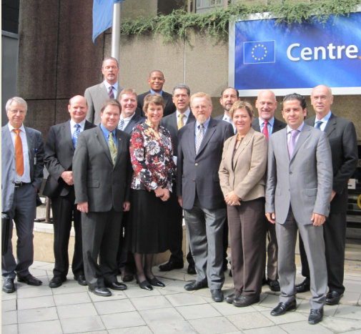
Vision
Single market
De – carbonization
Multimodal
Passenger and Freight

Slide 10
Key Findings - Policy
Policy coherence impacts implementation
Waterways
Boats that carry tourists given priority over freight
Higher priorities for water - population, agriculture, flood control, recreation, transportation
Rail
Passenger traffic is prioritized
Harmonization - gauge, electrification, signalization, credentialing
Roads
Mainlines tolled (in the case of Germany, heavy trucks are tolled while passenger vehicles move without tolls)
Railroads subsidized

Slide 11
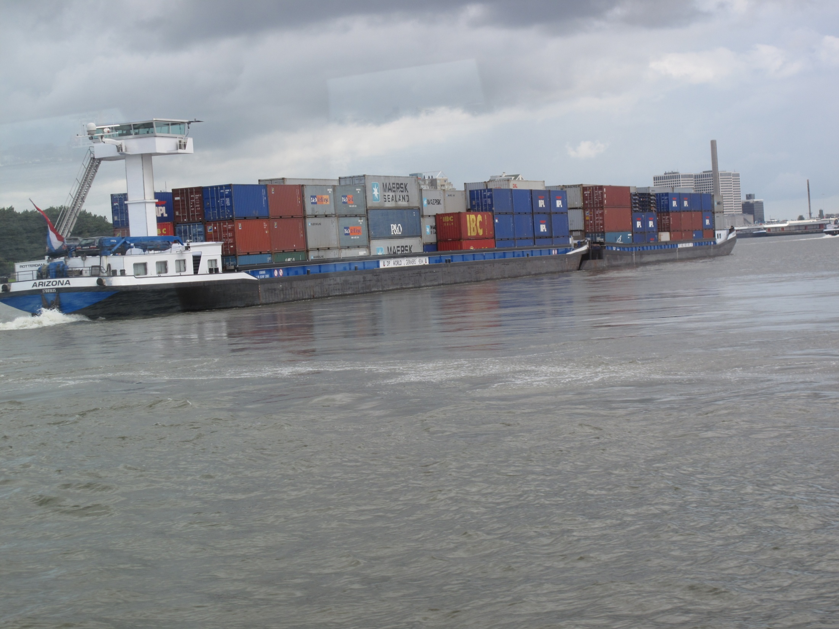
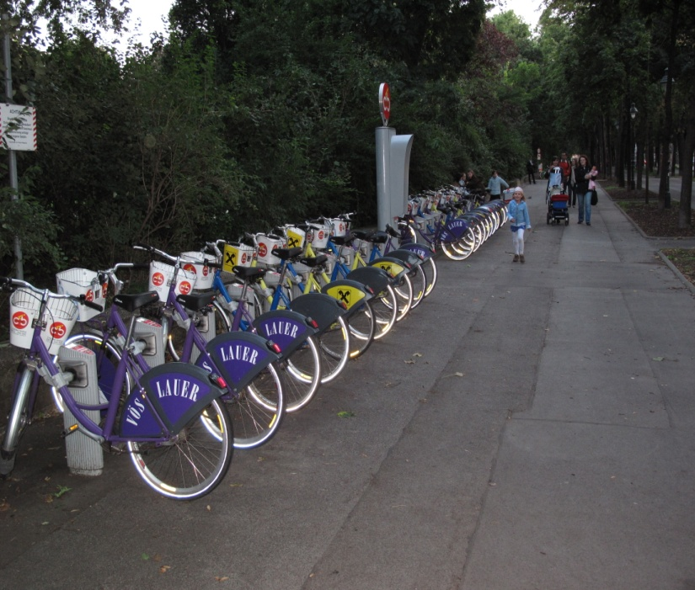
Policy Integration
Environment
Mode share and shift
Passengers and Freight

Slide 12
Key Findings – Planning Process
Original Network
Original network was not defined on the basis of data
Core Network
“Top-down” analytic approach determined at the EU.
Will use nodes and links that allow implementation flexibility
Conceptual corridors without specific modal infrastructure
Comprehensive Network
“bottom-up” approach that serves both member State and regional interests.
Member States submit what they believe should be on the Comprehensive Network

Slide 13
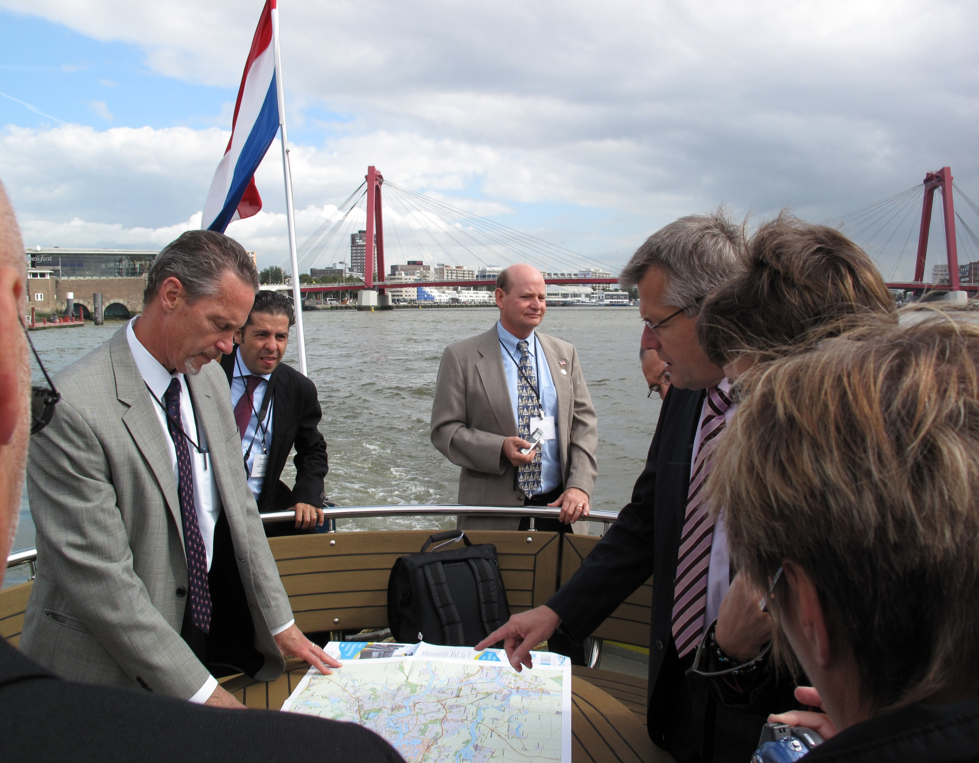
Planning Process –
From B/C to MCA
EIB as a “Policy” bank
EIB staffed to provide/verify traffic, costs, and other inputs

Slide 14
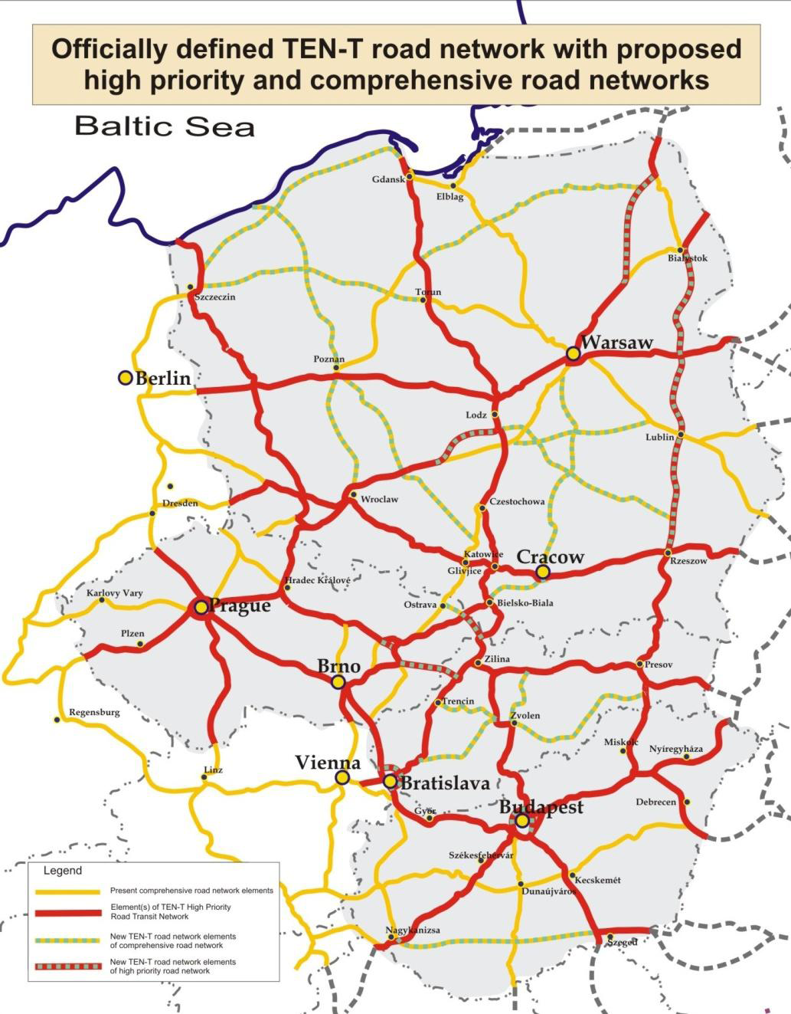
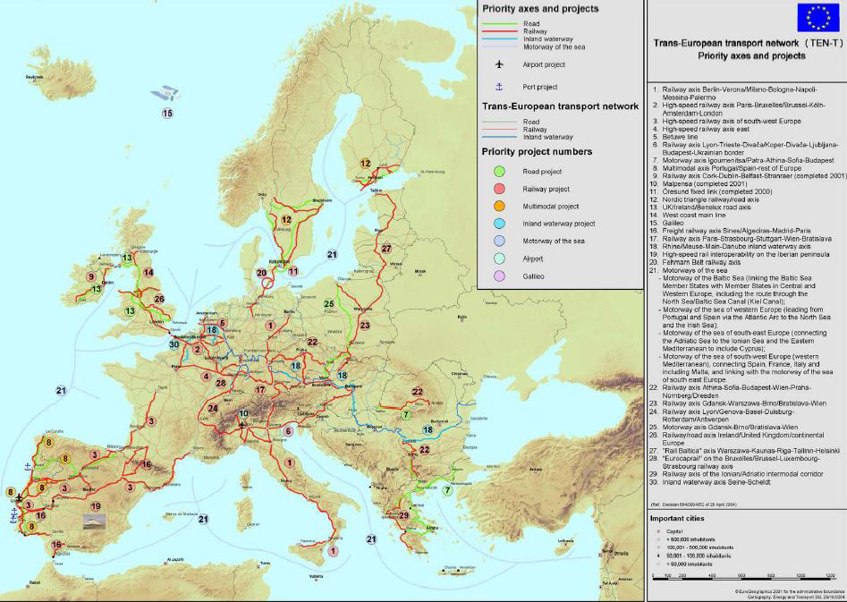
TEN-T Potential Core & Comprehensive

Slide 15
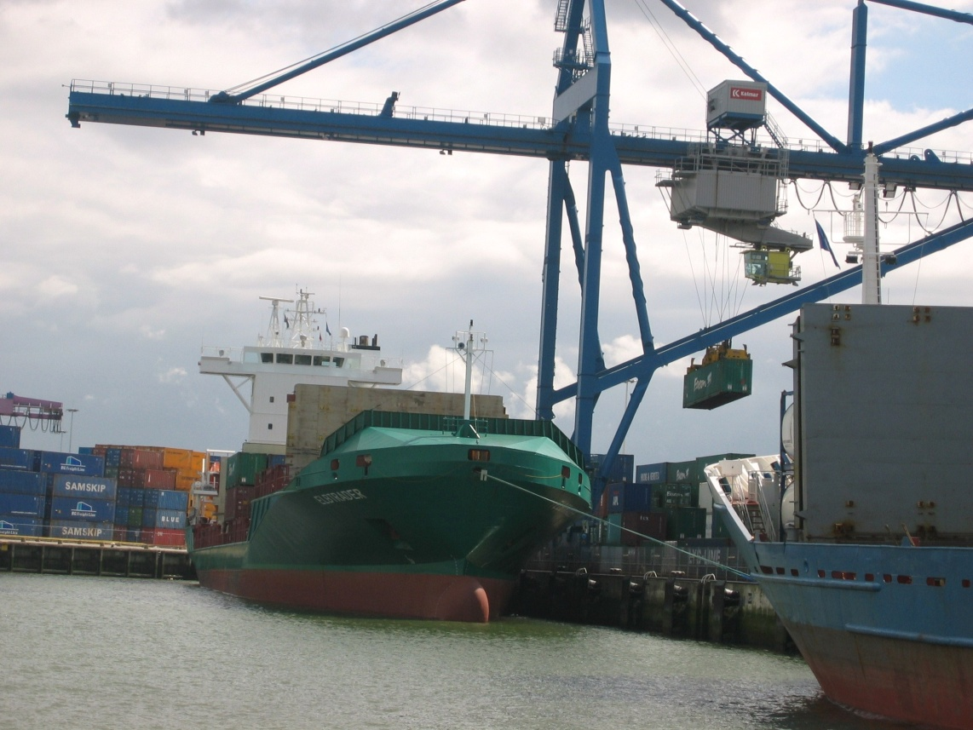
Key Findings -- Sustainability
Strong linkage of transportation policy to environmental, social, and sustainability aspects:
The freight system vision has as one of its underlying tenets “environmental sustainability”
Take global warming as a serious threat to their economic well being.
Taking concrete steps such as forcing through tolling and taxes cleaner trucks on their motorways “decarbonization”

Slide 16
Key Findings -- Sustainability
However, practice differs from the theory:
Reinforcing alignment:
Germany Toll Collect – linkage of toll amounts to emissions drove fleet overhaul to cleaner engines
Rotterdam – new terminal leases require mode split of 35% truck, 45% barge, and 20% rail
Misalignment:
Desire to shift freight to rail, but priority on the rail system is passenger movement
River cruise boats tourists given priority over freight barges
Toll Collect in Germany applies to heavy trucks only

Slide 17
Key Findings -- Implementation
Funding
Member states still provide bulk of project funding
Original and new member states have different funding opportunities
Multi-year funding helps immensely
The European Investment Bank (EIB) provides multiple options for large projects
Alignment
Original and new member states have different objectives
There is no harmonized tolling policy
EU project coordinators

Slide 18
Key Findings -- Implementation

Slide 19
Key Findings -- Operations
Need for greater harmonization of technology and operations to ensure success of a EU vision
Roadway
Alignment of tolling levels / application (trucks - cars)
Harmonization of tolling technology
Rail
Harmonization of signalization and electrification
One-stop shopping for freight rail movement

Slide 20
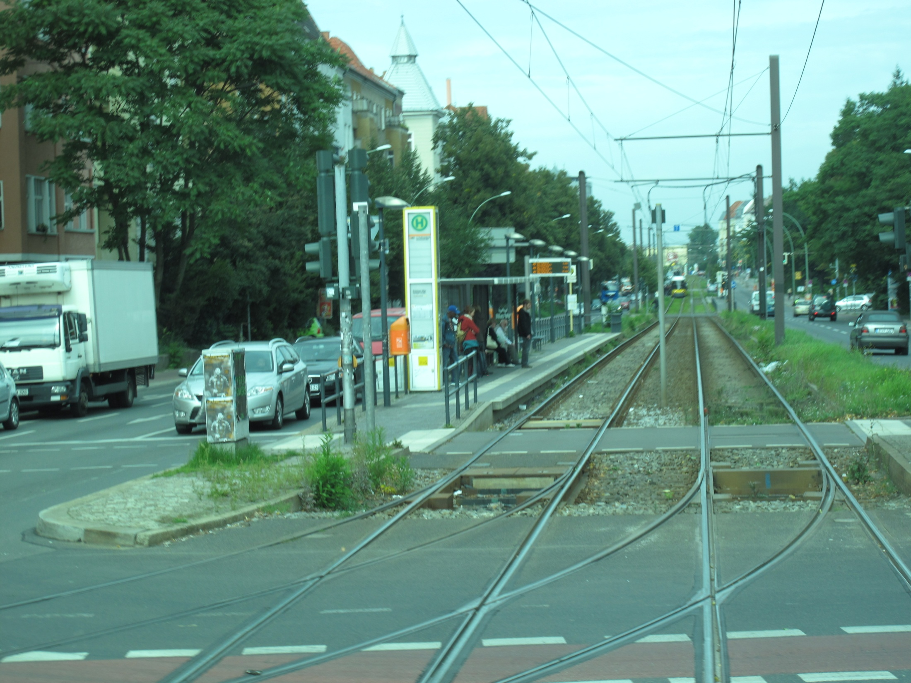
Equipment and Operations – ICE/PTC, electrified rail, Self-propelled barges, tolling, not very many pickups!

Slide 21
Conclusions
Importance of a constant unifying vision linking transportation and the economy
Evolution from exclusively national / local to multi-jurisdictional / international understanding
Policy alignment is critical - all pulling in same direction
Aligning National and EU interests / priorities and balancing the funding accordingly
Challenges of harmonizing transportation across borders
Value of fact-based analysis of transportation network
Reinforced the value of multiyear, stable funding
Recognize the value of what the US has accomplished

Slide 22
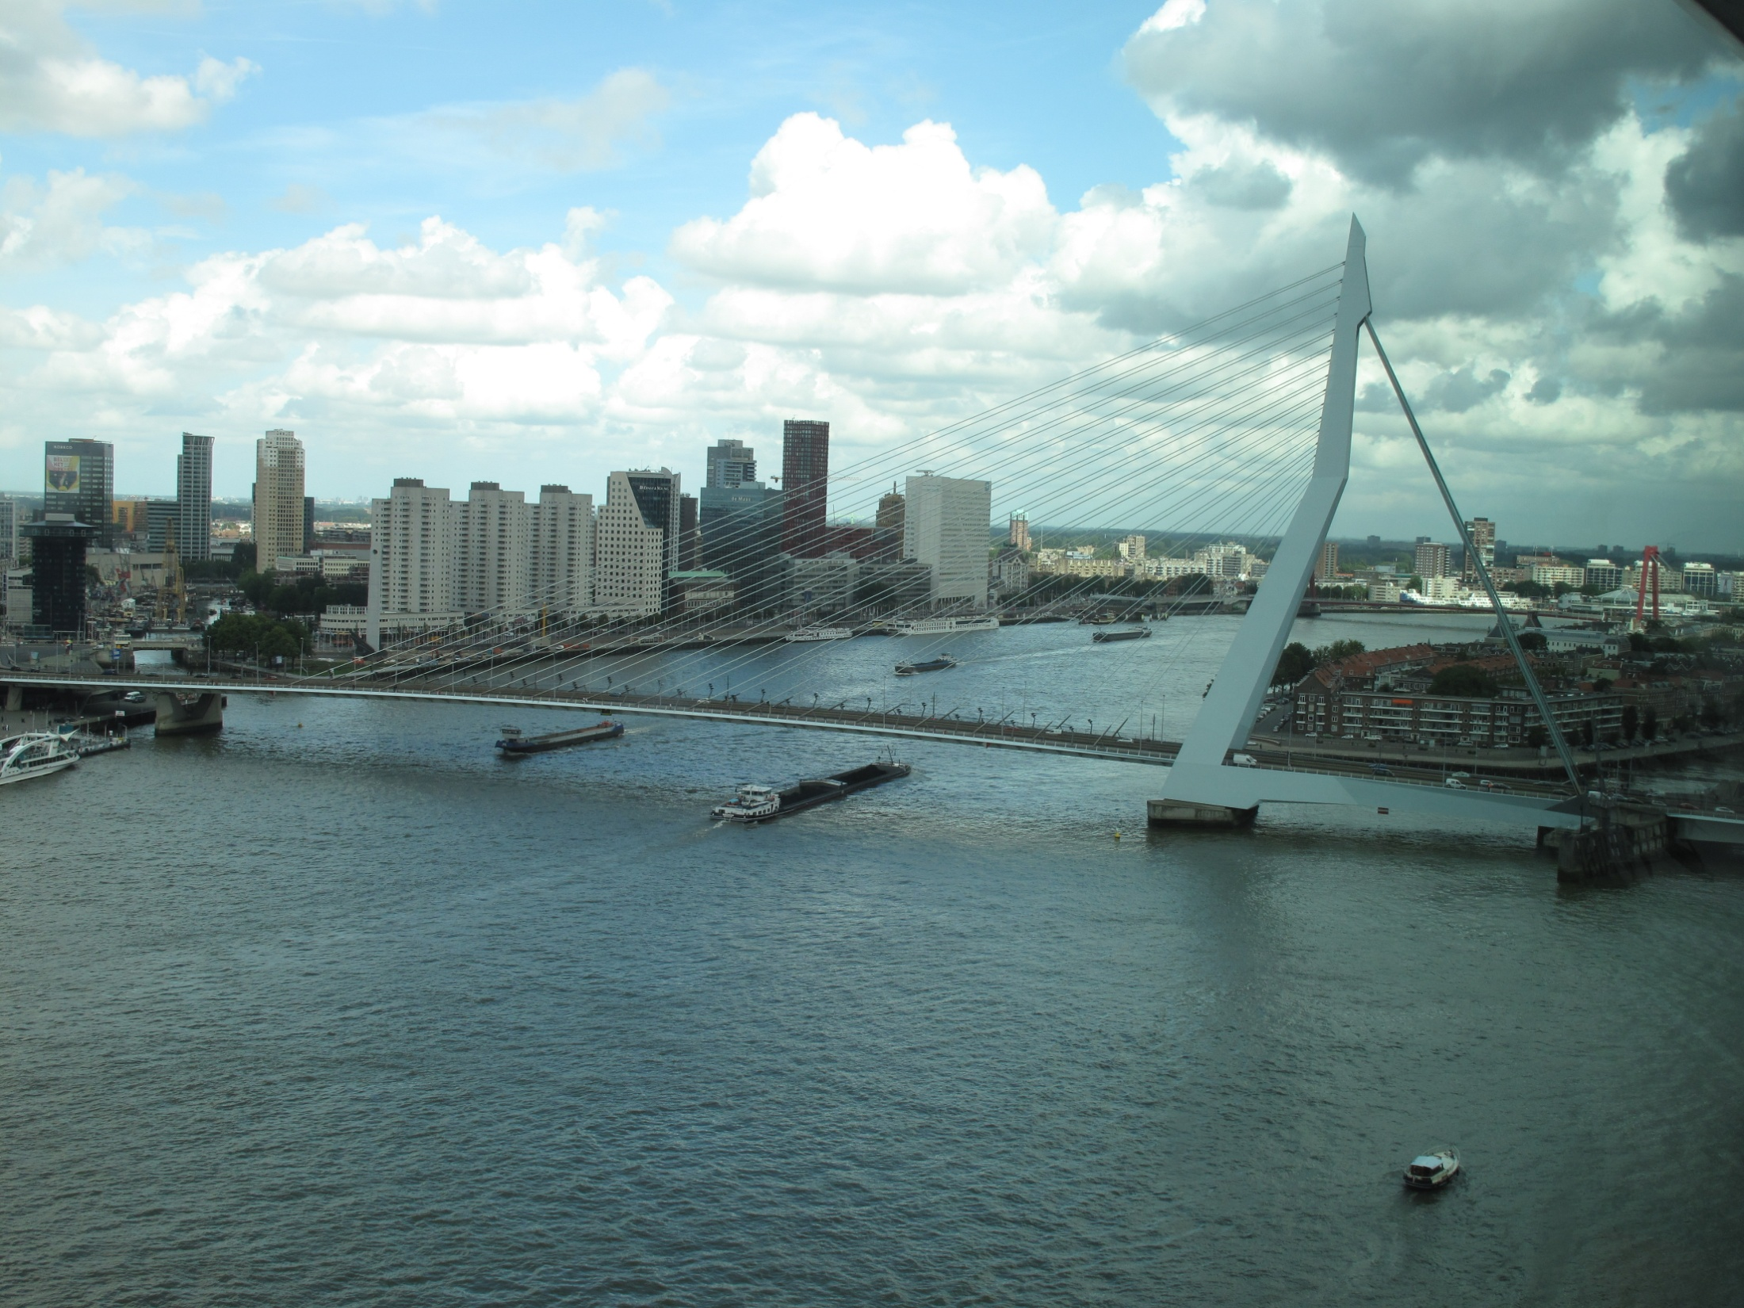
International Freight Scan: Aug 27-Sept 11, 2010
Questions?
Renee Sigel – FHWA
Eric Madden – Pennsylvania DOT
Ernie Perry – Missouri DOT

