Slide 1
Presentation to the
Talking Freight Webinar Series
May 18, 2011

Slide 2
Who is CRT?
Formed in 2007, CRT is a national coalition of leading cargo owners, trucking companies, ocean carriers, manufacturers and ports
Dedicated to partnering with ports across the country to implement clean truck programs
Demonstrate the environmental responsibility of the shipping industry by implementing voluntary emission reduction initiatives

Slide 3
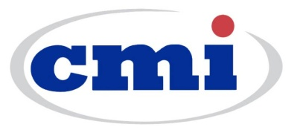

Slide 4
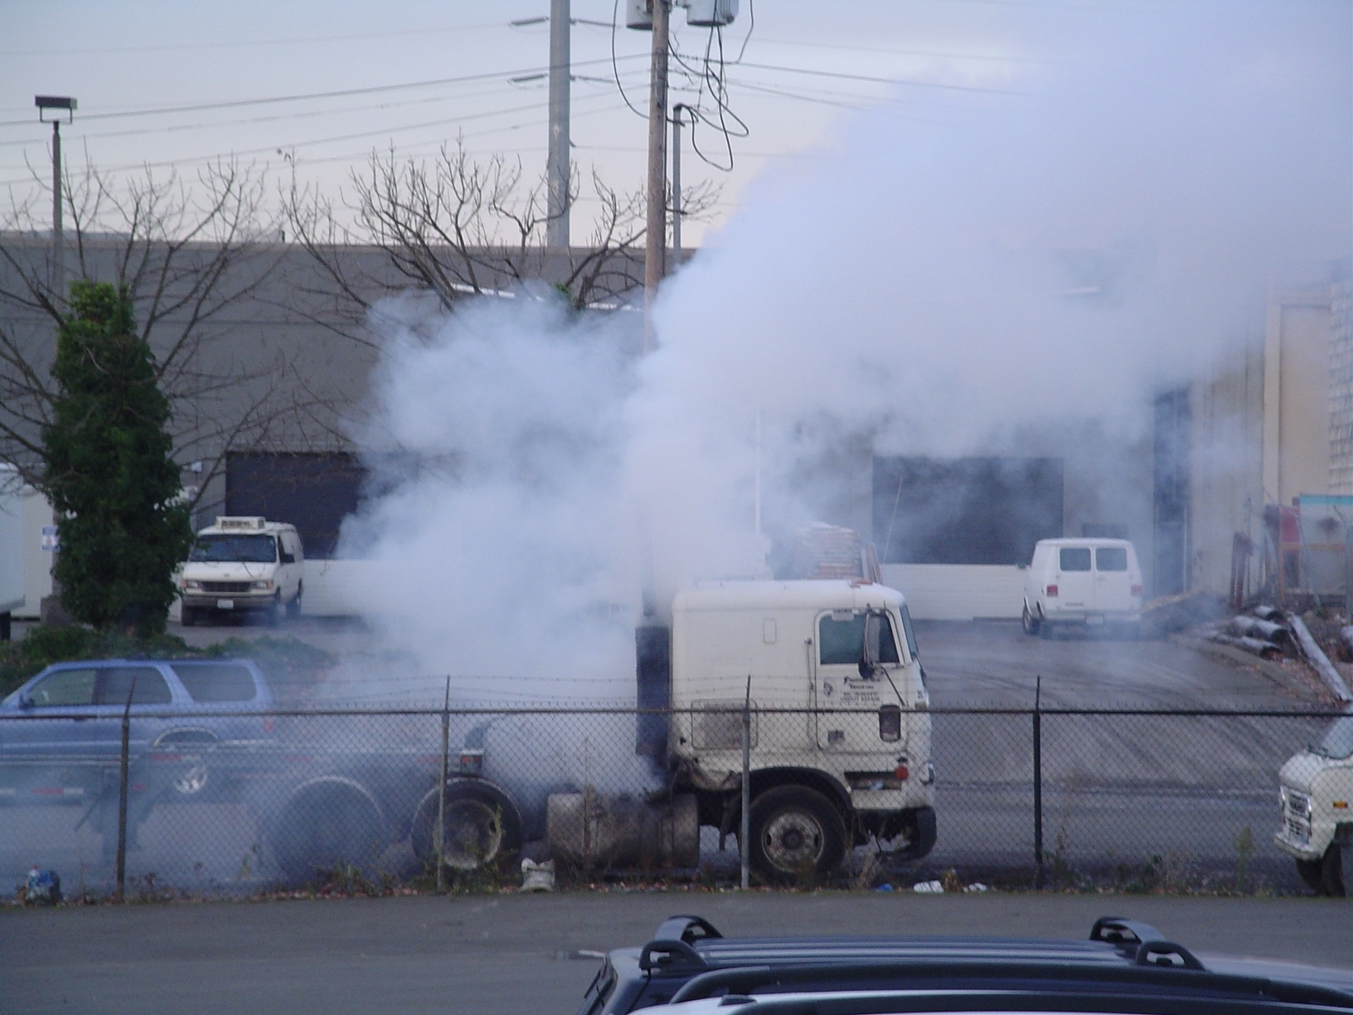
Ports: “Where Old Trucks Go to Die”

Slide 5
Truck Age Impact on Pollution
All options meet 2007/10 PM standards, and
meet or exceed 2004 NOx standards.
Clean Pre-owned Trucks

Slide 7
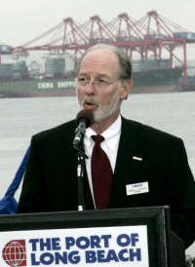
“CRT’s efforts are right on point, and CRT’s members are committed to environmental programs.”
Port of Long Beach Harbor Commission President Jim Hankla

Slide 8
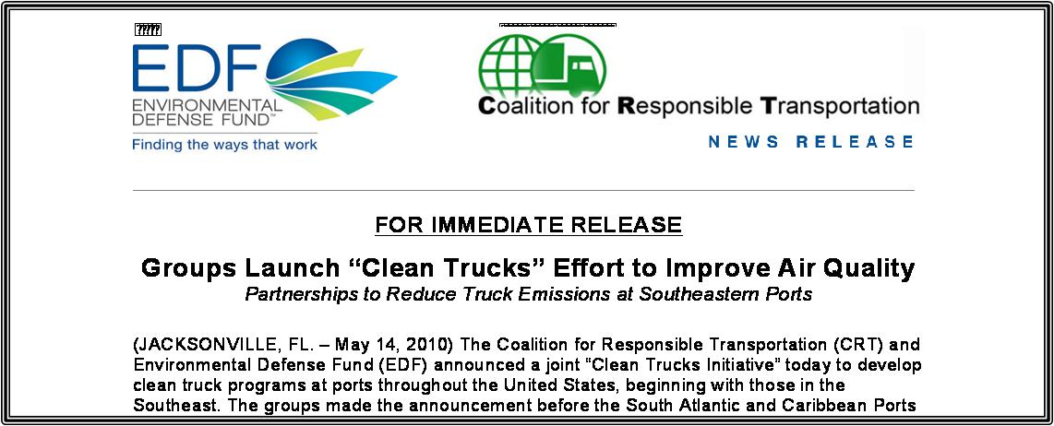
CRT/EDF Partnership
In 2010, CRT launched a national Clean Trucks Initiative with the Environmental Defense Fund, one of the most highly respected environmental advocacy groups in the nation
Unprecedented industry-environmentalist partnership to solve port-related air quality challenges

Slide 9
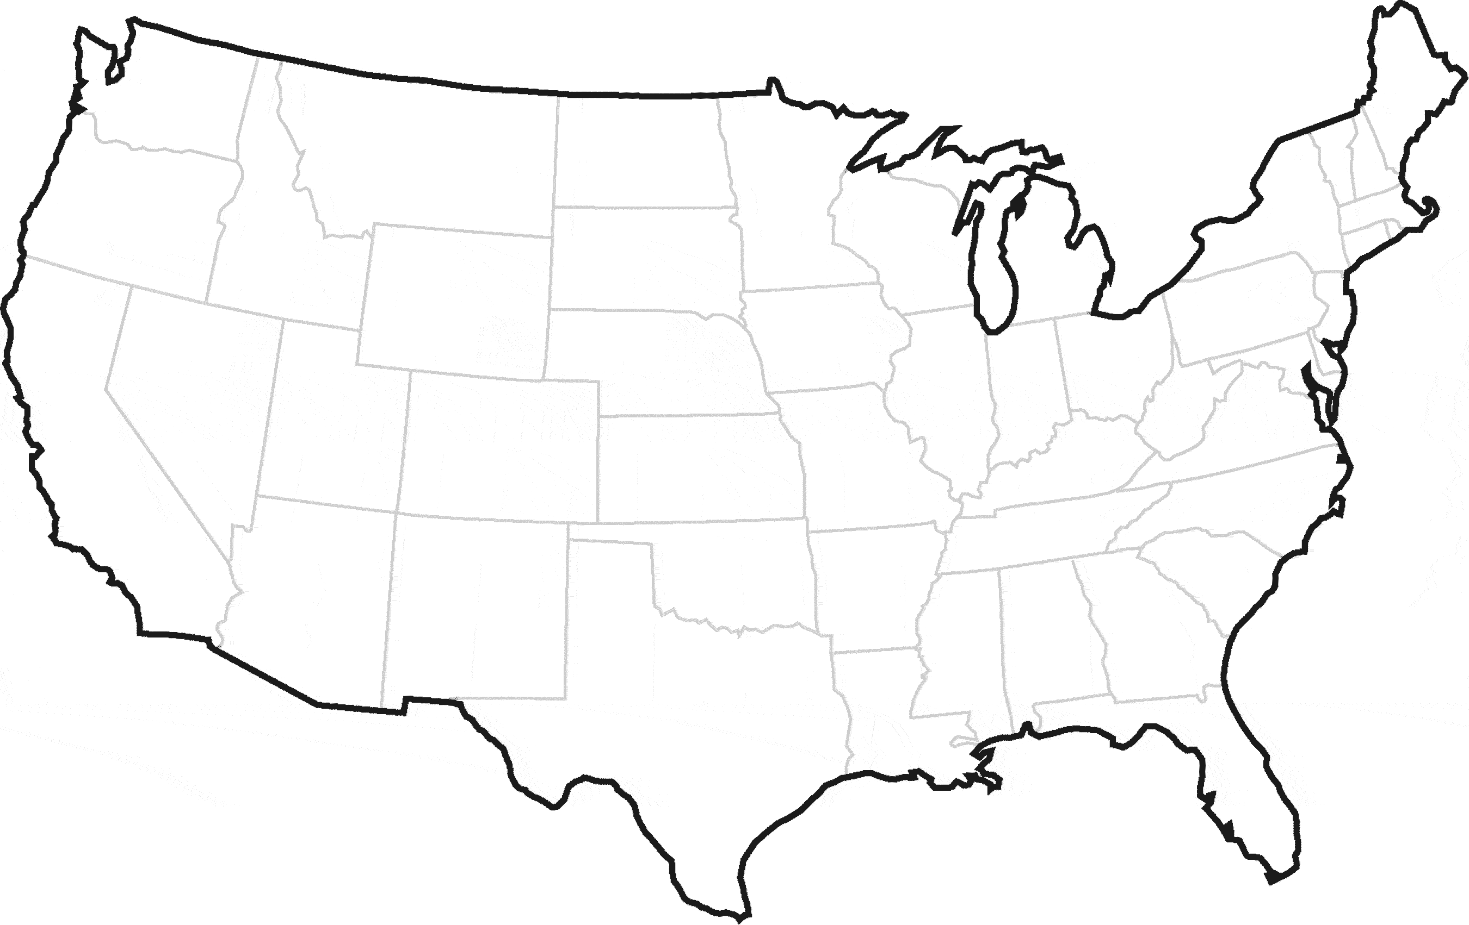
CRT/EDF Clean Truck Partnerships
Seattle
Tacoma
NY/NJ
Oakland
Norfolk
Los Angeles
Wilmington
Long Beach
Charleston
Savannah
Houston

Slide 10
Clean Truck Initiative Objectives
Develop industry supported clean truck programs in ports across the country
Collaborate with port authorities to develop programs that reflect local air quality needs
Develop partnerships with environmental organizations to promote industry sustainability efforts
Partner with govt. agencies to provide financial support and recognition for industry
Work with carriers and drivers to ensure they have financial support to transition to clean equipment

Slide 11
Clean Truck Initiative Benefits
Community Benefit
Economic
Benefit
Infrastructure
Benefit
Future
Benefit
Demonstrate our positive commitment to air quality in the communities we serve
Develop community partnerships in port regions
Improve the profile of the shipping community
It’s the right thing to do
Drayage regulations commanding attention at federal, state and local levels
Mitigates costs to shipping community from regulations, fees and mandates
Ports don’t have to chose between clean air and cargo
Air quality improvements support sustainable growth in port infrastructure and congestion reduction
Minimizes the potential for air quality (or future GHG) requirements to restrict future port growth
New federal PM 2.5 and Ozone air quality standards will require greater emission reductions in port communities
Shippers and carriers will be better prepared for upcoming federal requirements by taking action now

Slide 12
How Can You Get Involved?
By Partnering with the CRT and EDF Clean Truck Initiative you will:
Demonstrate your commitment to sustainability
Improve the environmental quality of our port communities
Preserve the competitive business environment at our nation’s ports

Slide 13
For information on how to join CRT,
please contact us at:
info@responsibletrans.org or (916) 880-3008

