Slide 1
Freight and Livability
Chip Millard
FHWA Office of Freight Management and Operations
June 15, 2011

Slide 2
Importance of Freight, Livability at USDOT
Freight transportation is a U.S. DOT priority
Over 20 billion tons of domestic and international freight was transported in the U.S. in 2008
Freight transportation is integral to meeting President Obama’s objective to double U.S. exports between 2010 and 2015
Livability is a U.S. DOT priority
DOT has taken leadership with HUD, EPA in creating the Sustainable Communities Partnership focused on enhancing livability in the U.S.
Livability was one the primary evaluation criteria in the TIGER Grant Programs
Notes:
Freight and livability are two quite different concepts that have different goals, but both are important considerations locally, regionally, and nationally, and both needs/concepts are highly valued.
Freight sector key component of U.S. economy and U.S. trade
Livability tied to increasing quality of life

Slide 3
Freight Transportation Considerations
Higher . . . . . . . . . . . . . . . . . . . . . . Service Cost Continuum. . . . . . . . . . . . . . . . . . . . . .Lower
Air
Truck
Rail
Water
Pipeline
$10,000 - $1/lb. 10¢-3¢/lb. 1¢-1/2¢/lb.
Fastest, most visible
Lowest weight, highest value/weight ratio, most time-sensitive cargo
Generally higher emissions per ton
Moderate speed and visibility
Range of weight and value
Generally moderate emissions per ton
Slower, less visible
Highest weight, lowest value/weight ratio, least time-sensitive cargo
Generally lower emissions per ton
Notes:
Summary:
How and when freight is moved depends largely on retailer/customer needs (pull logistics) and infrastructure availability, and diverting freight to other modes may not be easy to do in many cases.
Freight service spectrum. This slide is designed to highlight the difference in levels of service (and pricing) for each mode of transportation. Though the speed, reliability, and prices may vary, each mode is a critical piece of the overall structure of the freight industry.
Goods that are time sensitive and/or have high value/low weight usually are transported via faster but more expensive modes, shown on the left side of the continuum.
Goods that are not time sensitive but are cost sensitive and/or have low value/high weight are usually transported via slower but less expensive modes, shown on the right side of the continuum.
The continuum shown above is generally true but may not be accurate in some situations; for example, rail or water might be more efficient than truck or air in some cases. The information displayed above does not represent absolute differences between the modes, just relative ones, i.e. air is generally faster and reliable than truck, rail, or water movements; water movements are less costly, in general, than truck movements.
In addition to understanding how and why different freight modes are used to transport products, it also important to remember that trucks are almost always used for the “last mile” of shipments, due to a lack of railroad, water port, or airport infrastructure at most businesses.

Slide 4

Livability & Transportation Basics
Livability is about tying the quality and
location of transportation facilities to
broader opportunities such as access
to good jobs, affordable housing,
quality schools, and safe streets.
Livability is, “investing in a way that recognizes the unique character of each community.”
U.S. DOT Secretary Ray LaHood
Notes:
Livability is about tying the quality and location of transportation facilities to broader opportunities such as access to good jobs, affordable housing, quality schools, and safe streets. This includes addressing safety and capacity issues on all roads through appropriate planning, infrastructure design, and traffic management tools such as ITS technologies and Travel Demand Management approaches.
US DOT Secretary Ray LaHood defined livability as “investing in a way that recognizes the unique character of each community. The era of one-size-fits-all transportation projects must give way to one where preserving and enhancing unique community characteristics, be they rural or urban, is a primary mission of our work rather than an afterthought.”

Slide 5
Sustainable Communities Partnership’s Livability Principles
Promote Equitable, Affordable Housing
Enhance Economic Competitiveness
Support Existing Communities
Value Communities and Neighborhoods
Coordinate Policies and Leverage Investment
Provide More Transportation Choices
Notes:
In order to promote livability, the DOT-HUD-EPA Sustainable Communities Partnership has developed six guiding livability principles:
Enhance economic competitiveness. Improve economic competitiveness through reliable and timely access to employment centers, educational opportunities, services and other basic needs by workers as well as expanded business access to markets.
Value communities and neighborhoods. Enhance the unique characteristics of all communities by investing in healthy, safe and walkable neighborhoods – rural, urban or suburban.
Support existing communities. Target federal funding toward existing communities – through such strategies as transit oriented, mixed-use development and land recycling – to increase community revitalization, improve the efficiency of public works investments, and safeguard rural landscapes.
4. Coordinate policies and leverage investment. Align federal policies and funding to remove barriers to collaboration, leverage funding and increase the accountability and effectiveness of all levels of government to plan for future growth, including making smart energy choices such as locally generated renewable energy.
5. Provide more transportation choices. Develop safe, reliable and economical transportation choices to decrease household transportation costs, reduce our nations’ dependence on foreign oil, improve air quality, reduce greenhouse gas emissions and promote public health.
6. Promote equitable, affordable housing. Expand location- and energy-efficient housing choices for people of all ages, incomes, races and ethnicities to increase mobility and lower the combined cost of housing and transportation.

Slide 6
HUD-DOT-EPA Livability Core Principles
Enhance Economic Competitiveness
Value Communities and Neighborhoods
Support Existing Communities
Coordinate Policies and Leverage Investment
Provide More Transportation Choices
Promote Equitable, Affordable Housing
Freight directly supports or is consistent with most of the Livability core principles
Notes:
Freight transportation has ties to most of the HUD-DOT-EPA core Livability principles, either in terms of directly supporting those principles or having consistency with those principles. The principles shown in bold have ties to livability. In particular, freight and livability are closely tied in enhancing economic competitiveness, in terms of creating jobs for communities and for supporting a community’s businesses. Freight is also closely tied to the value communities and neighborhoods principle; freight transportation can either enhance livability or undermine livability, depending on how freight is accommodated within the community.

Slide 7
Enhance Economic Competitiveness
HUD-DOT-EPA Partnership Definition:
Improve economic competitiveness through reliable and timely access to employment centers, educational opportunities, services and other basic needs by workers as well as expanded business access to markets.

Slide 8
Enhance Economic Competitiveness
Freight transportation supplies the products that are needed to sustain communities and businesses.
Freight industry provides goods and supports jobs in communities – viable, livable communities need jobs
Major freight facilities are key economic generators in particular communities
Example: Ports and Rail Yards – provide jobs and tax base
Land use and zoning often the key connection point
Notes:
The “Enhance Economic Competitiveness” core livability principle has the closest tie to freight transportation among the livability principles. Freight transportation is essential for picking up and delivering the goods that are produced and/or consumed in livable communities. If goods cannot be easily picked up and delivered within communities, the restaurants, stores, and other commercial amenities within the community cannot receive their goods, and the community’s livability is reduced. In addition to goods pick-ups and deliveries, freight transportation is also critical for supporting many jobs, including many well-paying jobs, within communities.

Slide 9
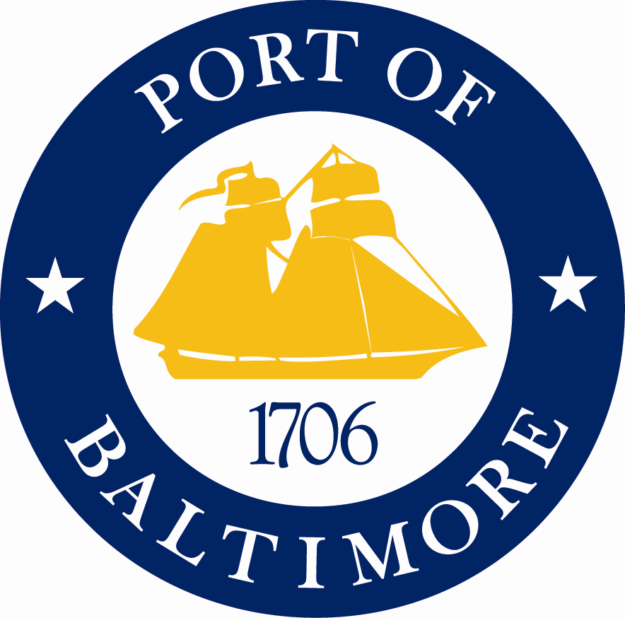
Enhance Economic Competitiveness Example: Port of Baltimore
Economic Impact of the Port
50,200 jobs in Maryland are dependent upon cargo and vessel activity at the port
16,500 direct jobs
33,200 induced and indirect jobs
$388 million in state and local taxes per year
Port enhances business access to markets
Potential Threats to the Port’s Economic Viability
Neighboring ports are very competitive for business, jobs
Developers are competitive for waterfront land
Port job and tax information courtesy of James Dwyer, Maryland Port Administration
Notes:
Major freight-generating, industrial facilities such as ports are large economic engines and job creators for their regions. However, many industrial facilities, particularly facilities that handle significant discretionary (non-local) freight movements, face strong competition from other, similar facilities. Additionally, the location attractiveness of some industrial facilities, particularly ports that are located on desirable waterfront land, also makes them susceptible to non-freight development pressures and non-facility related traffic issues. Less efficient freight facilities become less economically viable, often costing jobs to their region.

Slide 10
Baltimore’s Waterfront – Success
Inner Harbor
Pedestrian
Promenade
Commercial retail
Restaurants
Offices
Photos on next 2 slides courtesy of James Dwyer, Maryland Port Administration
11
Notes:
Baltimore’s Inner Harbor near the Port of Baltimore has provided many social and economic benefits, including livability benefits, to the city of Baltimore and the greater Baltimore area.

Slide 11
Baltimore’s Waterfront – Challenges
Proposed Condominiums?
Notes:
However, the very success of Baltimore’s Inner Harbor also has created development pressures from non-freight development elsewhere on the port’s waterfront that could threaten the port’s viability.

Slide 12
Enhance Economic Competitiveness Port of Baltimore – Zoning Connections
Freight and Livability Connections: New Industrial District in Baltimore (2004)
Designed to reduce increasing conflicts between mixed-use development and maritime shipping by demarcating deep water areas in industrial precincts and reserving them for industrial use
Zoning near port is “Heavy Industrial”
Limited residential and other commercial uses through 2014
10-year extension is now being considered
Notes:
The city of Baltimore created a new industrial district to help preserve existing port and port-related uses. Proactive zoning or other land development controls or protections can help preserve pre-existing, economically viable industrial development, helping to protect job generators within their regions.

Slide 13
Value Communities and Neighborhoods
HUD-DOT-EPA Partnership Definition:
Enhance the unique characteristics of all communities by investing in healthy, safe, and walkable neighborhoods – rural, urban, or suburban.

Slide 14
Value Communities and Neighborhoods
Effective Freight and Land Use Practices
Recognize that all levels of government (federal, state, regional, local) have a role (economic development, transportation, zoning, etc.)
Open lines of communication between all levels of government and also with the public
Create buffer zones between industrial areas and more sensitive uses (residential, environmental)
Ensure new developments provide for sufficient on-site loading through zoning requirements and site plan review
Ensure that street network can accommodate freight
Notes:
The “Value Communities and Neighborhoods” core livability principle can either be supported or be undermined by freight transportation; whether it is supported or undermined depends largely on whether or not freight transportation needs are appropriately considered in community planning efforts and community development implementation.

Slide 15
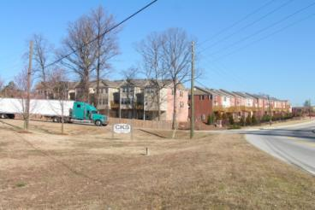
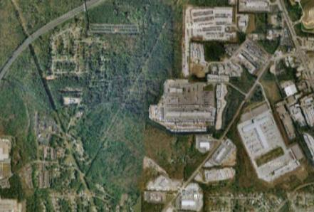
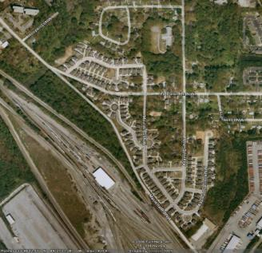
Questionable Residential Land Use Decisions near Existing Freight Facilities
New Subdivision
Townhomes Backing to Commercial Facility with Significant Truck Movements
New subdivision built next to the freight intensive uses
New Housing Adjacent to Active Rail Facilities
Photos courtesy of Atlanta Regional Commission
Notes:
15
Communities need to be aware of existing freight facilities and freight traffic flows when planning new residential development or development that is incompatible with intensive freight transportation movements. A failure to do so can undermine both community attractiveness and freight transportation efficiency.

Slide 16
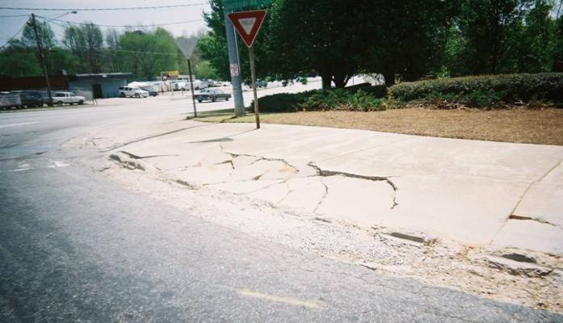
Questionable Roadway/Sidewalk Design
near Existing Freight Facilities
New Subdivision
Inadequate Turning Radius Damages Pedestrian Infrastructure
Notes:
16
Roadways and intersections that handle moderate to high volumes of trucks due to the development along or near the roadways/intersections need to be properly designed to accommodate trucks. It is important to remember that freight movements usually occur because there is demand to pick up or deliver products from a given location or locations.
On the picture on this slide, notice not only the cracked sidewalk but also the placement of the yield sign.

Slide 17
Appropriate Street Design for Freight Vehicles Serving the Community
Accommodation of Curbside Truck Deliveries
Photo courtesy of Arun Chatterjee, University of Tennessee
Notes:
In contrast to the previous two slides, when a community’s freight needs are properly considered, not only can freight transportation operate more efficiently, but the community’s assets, such as grocery stores and other commercial retail outlets, are enhanced. Curbside truck parking not only benefits freight deliveries by making it easier for trucks to deliver the businesses they are serving, but they also help reduce traffic congestion and improve safety for bicyclists and pedestrians by reducing the amount of double-parking that takes place.

Slide 18
Value Communities and Neighborhoods
Logistics needs are often an afterthought in planning & site development review processes
Designing for goods movement improves overall mobility and access while minimizing negative community impacts
Finding the proper balance between promoting livability and accommodating freight movements within communities is the key
Notes:
18
It is important to properly consider freight transportation needs within communities. Underemphasizing freight needs within livable communities can restrict freight transportation efficiency and negatively impact the community’s economic vitality. Overemphasizing freight needs within livable communities, such as designing all roads to accommodate large trucks, even those that never or very rarely handle those trucks, can make walking, biking, and public transit use less attractive and convenient. Finding the proper balance between non-freight livability needs and freight transportation needs will make it more likely the community can be attractive both aesthetically and economically.

Slide 19
Support Existing Communities
HUD-DOT-EPA Partnership Definition:
Target federal funding toward existing communities – through strategies such as transit-oriented, mixed use development and land recycling – to increase community revitalization, improve the efficiency of public works investments, and safeguard rural landscapes.

Slide 20
Support Existing Communities
Opportunities exist for consolidating freight functions
Freight hubs/villages locate many complementary or similar types of freight facilities at one site or a small number of sites
These hubs/villages can enhance economic efficiency for the freight facilities and function as job centers
By consolidating freight functions at a small number of locations the overall community impact is reduced
Intermodal freight movements can be supported if freight hubs are located where necessary infrastructure (highways, railroads, water ports, and/or airports) is in place
Notes:
The “Support Existing Communities” core livability principle is consistent with freight transportation goals, both in terms of preserving or protecting existing, active freight-oriented development that already has infrastructure in place and in terms of ensuring freight development is neither negatively impacted by nor negatively impacts valued community development. Consolidating freight uses into an appropriate number of hub locations where extensive transportation and public utility infrastructure is already in place can reduce freight’s impact on communities while also enhancing freight transportation efficiency and providing jobs to the community.

Slide 21
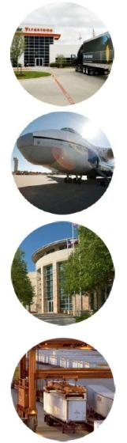
Support Existing Communities
Example: Alliance, TX Freight Village
Site Size: 17,000 acres
140 Tenants
Freight Activities:
BNSF Railway’s Alliance Intermodal Facility: 587,274 lifts in 2006
BNSF and UP Class I rail lines and rail-served facilities
Fort Worth Alliance Airport – 100% industrial airport
10-to-15 minute access to Dallas Fort Worth Airport
Interstate 35W, State Highway 170 and State Highway 114
FedEx Southwest Regional Sort Hub; FedEx Service Center
Foreign Trade Zone & Freeport Tax Exemption
Other Land Uses: Office, Residential, Recreational
Information and image on next slide courtesy of Anne Strauss-Wieder, AS-W Inc.
Notes:
Freight hubs/villages are typically multimodal and are usually located in locations with 1) strong existing transportation infrastructure connectivity between and/or within modes and 2) strong regional demand for freight goods and services (i.e. medium to large-sized metropolitan areas).
Not all freight hubs/villages have residential or recreational land uses, but those that do try to maximize the benefits of having freight-related jobs nearby while minimizing the negative impact of freight-oriented development on the community.

Slide 22
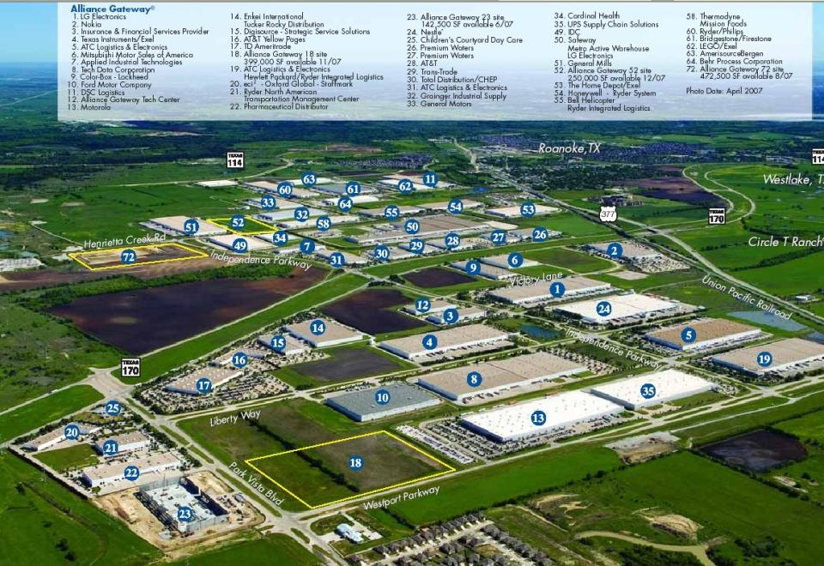
Notes:
By consolidating industrial and other freight-oriented land uses at one large location that has excellent transportation network access, the impact freight hubs have on their communities is reduced.
Note that this development has direct access to various roadways as well as at least one Class I railroad (Union Pacific, shown on the right side of the slide)

Slide 23
Coordinate Policies and Leverage Investment
HUD-DOT-EPA Partnership Definition:
Align federal policies and funding to remove barriers to collaboration, leverage funding, and increase the accountability and effectiveness of all levels of government to plan for future growth, including making smart energy choices such as locally-generated renewable energy.

Slide 24
Coordinate Policies and Leverage Investment
Transportation funding issues continue to be a significant challenge for public sector transportation agencies and are a growing concern for private sector transportation providers and users
Leveraging funds and innovative financing provide future opportunities
Includes integrating range of local, state and federal funds
Includes leveraging of private funds and in-kind services
Reveals importance of connecting with private freight stakeholders
Notes:
The “Coordinate Policies and Leverage Investment” core livability principle is consistent with freight transportation needs; an increasing number of freight-focused projects are utilizing public-private partnerships to obtain the funding necessary to implement projects that will benefit freight transportation. Some of these freight-oriented projects also provide ancillary livability benefits.

Slide 25
Coordinate Policies and Leverage Investment Example: Chicago CREATE Program
Provides both passenger and freight transportation benefits through removing transportation conflicts, improves passenger and freight transportation system efficiency
Involves many public and private sector partners
Leverages both public and private sector funding
Total Program $2.6 Billion+
U.S. DOT $333 Million SAFETEA-LU, ARRA (TIGER, HSR)
Railroads $212 Million Private sources
Illinois DOT $320 Million Bonding/Capital Program
Chicago DOT $ 30 Million Existing Sources
METRA $ 20 Million Existing Sources/FTA programs
Notes:
The Chicago area CREATE (Chicago Region Environmental and Transportation Efficiency Program) project involves many partners, including federal, state, and local governments, private freight railroads, and publicly-funded passenger railroads (Amtrak and Metra), who are providing financial contributions to fund projects that will improve the freight and passenger rail system in the Chicago area and will provide both public sector and private sector benefits.

Slide 26
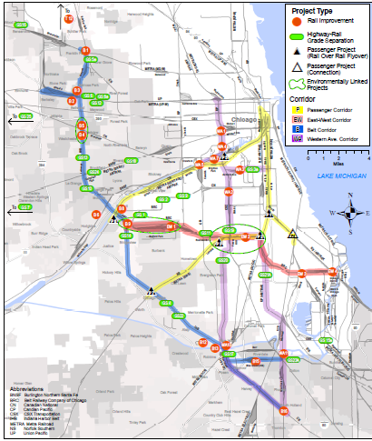
CREATE Program – Improvements
1 Passenger and 3 Freight Corridors
6 Passenger – Freight Grade Separations
25 Highway-Rail Grade Separations
Grade Crossing Safety Enhancements
Extensive track, signal and switch replacement
50 Miles of New Track
Notes:
The scope of the CREATE improvements (highway-rail grade separations, rail-rail grade separations, grade crossing safety enhancements, etc.) necessitated the public-private, multi-source program approach.

Slide 27
Provide More Transportation Choices
HUD-DOT-EPA Partnership Definition:
Develop safe, reliable, and economical transportation choices to decrease household transportation costs, reduce our nation’s dependence on foreign oil, improve air quality, reduce greenhouse gas emissions, and promote public health.

Slide 28
Provide More Transportation Choices
Transportation choices apply to both passenger and freight movements
Robust multimodal transportation system is critical for efficient freight movement
Longer haul shipments will likely use a mix of modes
Commodity mix will help determine mode(s) used
Freight shippers increasingly focused on reducing fuel costs and in turn reducing carbon emissions
However, trucks will continue to play key role – especially for short haul and urban freight movements
Notes:
The “Provide More Transportation Choices” core livability principle is consistent with freight transportation goals. It is U.S. DOT’s objective to support freight movement on the most energy efficient, environmentally sustainable mode for as long as possible. Additionally, freight movements by their very nature often require or are best served by intermodal solutions, though almost all freight will be shipped by truck for at least the “last mile” of the shipment.
There can be opportunities where providing more transportation choices can provide mutual benefits for both freight and passenger transportation, enhancing both freight movements and livability.

Slide 29
Provide More Transportation Choices Example: Chicago CREATE – Englewood Flyover
Provides rail to rail separation (freight from passenger)
Norfolk Southern METRA Rock Island line (commuter rail) over the Norfolk Southern East-West Line (freight rail, intercity passenger rail)
Project enhances both passenger and freight mobility, reduces congestion, helps reduce emissions and improve air quality
Notes:
The Englewood Flyover project in Chicago will dramatically improve both freight rail and passenger rail operations by removing an at-grade crossing between two tracks that serve extensive freight and passenger rail operations.
78 METRA trains/day
14 Amtrak trains/day
46 Norfolk Southern trains/day

Slide 30
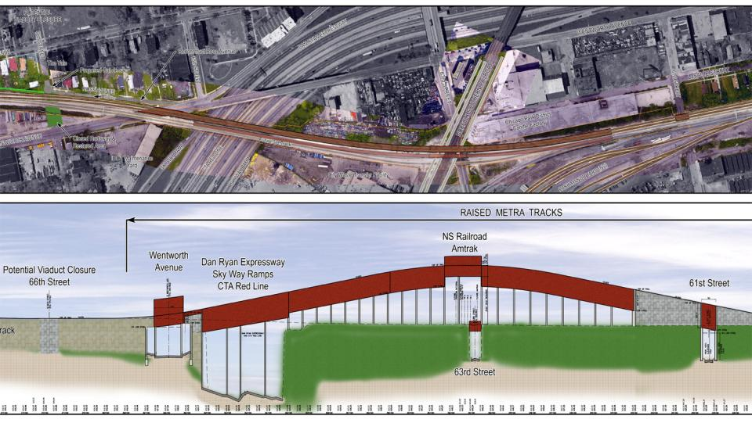
CREATE – Englewood Flyover Final Design

Slide 31
Thank You
Chip Millard
FHWA Office of Freight Management and Operations
chip.millard@dot.gov
FHWA Freight Office website:
http://www.ops.fhwa.dot.gov/freight/

