Slide 1
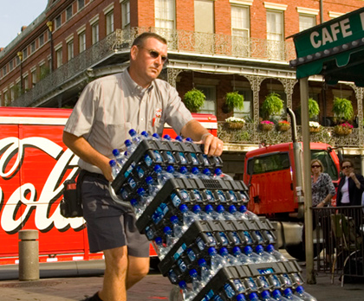
Customer Delivery Process
Dwayne Fitzgerald
Coca-Cola Refreshments USA
Southeast Region – Product Supply System 6/15/2011

Slide 2
Who we are
We are the worlds largest producer and distributor of non alcoholic beverages
Sold in 200+ countries
1.7 Billion servings per day

Slide 3
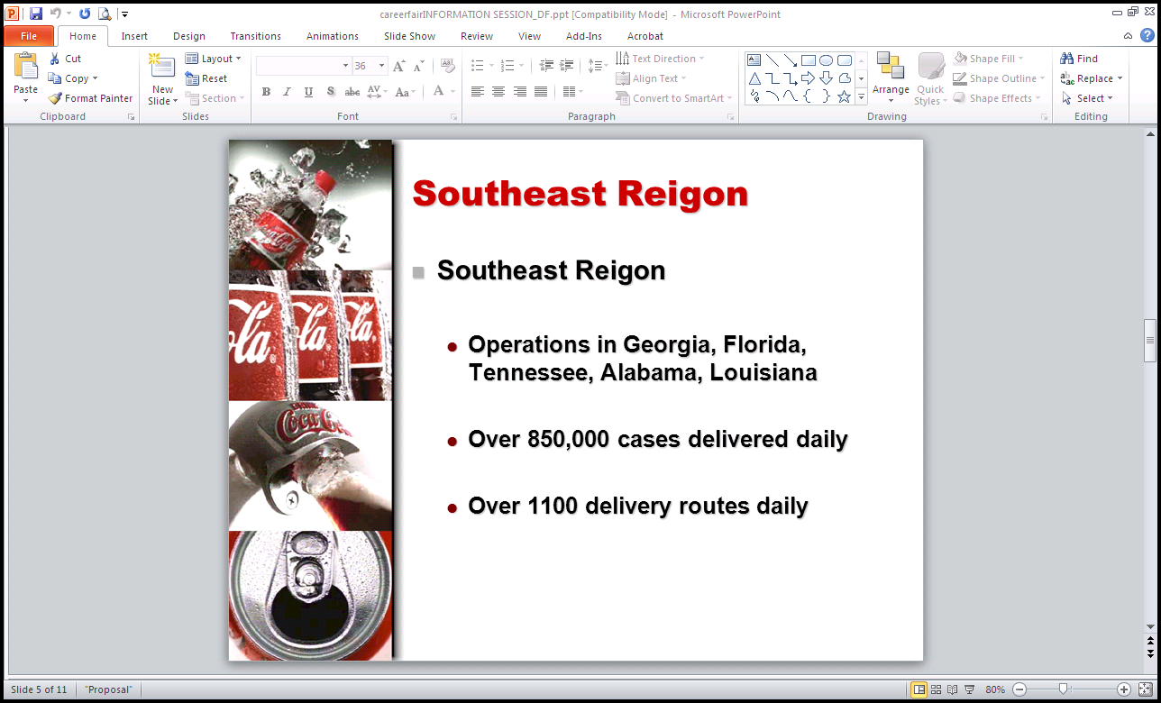

Slide 4
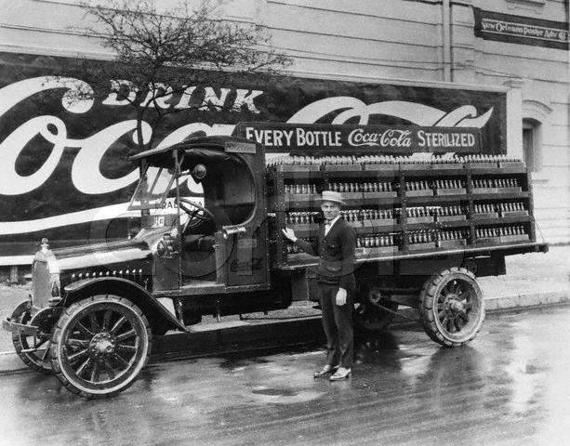
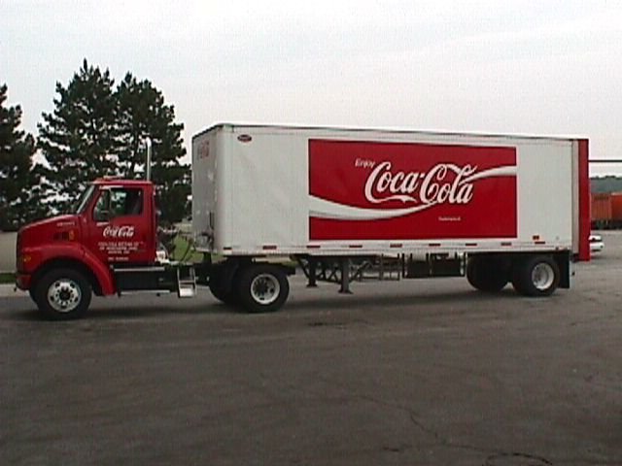
Our vehicles have improved……..
.

Slide 5
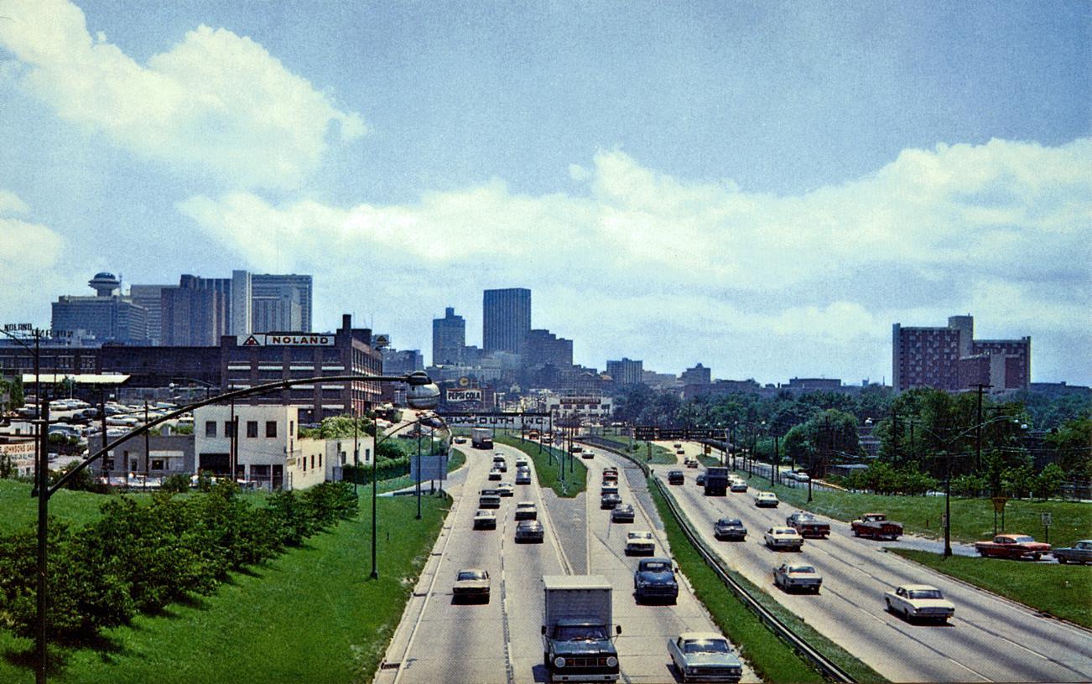
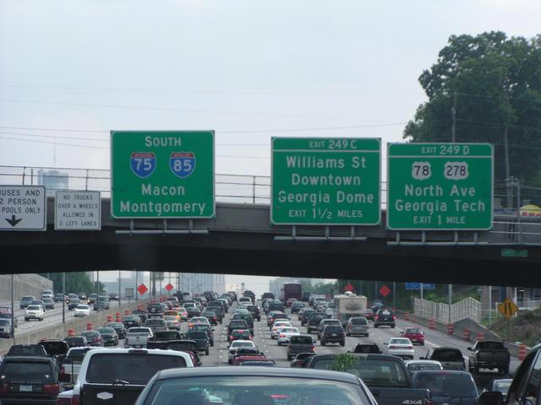
But traffic continues to worsen.
.
1967
2011

Slide 6
What is the process?
Customers place orders through a salesperson or by phone.
Orders transmitted electronically to a Central Dispatch location
Dispatchers view orders for a particular Distribution Center and determine best method for delivery.
Orders are optimized via software basing decisions on customer delivery time windows, geography, and workload for the driver
Completed routes sent to Distribution Center for truck loading.
Driver delivers tomorrow what we dispatch today.

Slide 7
Challenges faced by driver
Customer time windows – We can only deliver to our customers during the times they specify.
Traffic congestion – Any number of traffic concerns can happen, taking the driver off course and in danger of missing delivery times.
Accessibility – There are areas that do not allow deliveries within specific time ranges. Example; No delivery in some neighborhoods till after 8AM
Pedestrian friendly areas – we have areas that are within pedestrian friendly zones, making delivery very difficult.

Slide 8
What action have we taken to help?
Alternative deliveries – We implemented night delivery where possible in non-peak traffic hours
Geographic optimization – Aligned delivery days to deliver accounts in high traffic areas on the same day.
Sales route optimization – Aligned sales routes by geography also.
Delivery vehicle optimization – We have replaced older and less efficient vehicles, with rear unload trailers resulting in fewer deliveries on the road. While these older units life cycle out, they are being replaced with hybrid clean fuel vehicles.
GPS devices – We are utilizing a GPS device to track data of speed and travel time. This will help us better understand traffic patterns and assist in planning a route of delivery.

Slide 9
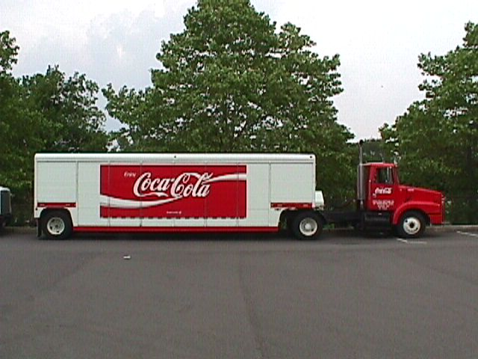
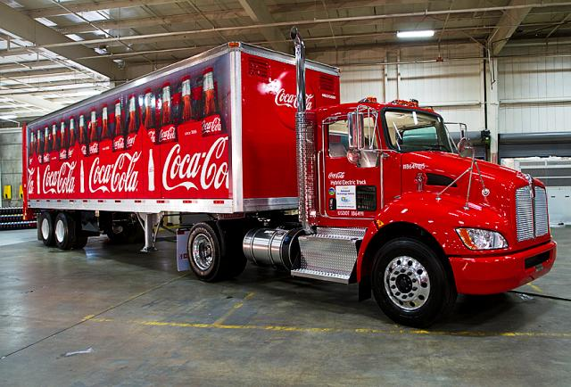
.

Slide 10
Thank You!

