Slide 1
Truck Routing and Environmental Justice
Talking Freight: Freight and Livability
June 15, 1022
Michael Kray, Atlanta Regional Commission

Slide 2
Agenda
Base Transportation Network
Land Use
Environmental Justice Groups
Methodology

Slide 3
Roadway Network Analyzed
N

Slide 4
Land Use by Color

Slide 5
Regional Land Use

Slide 6
Industrial Uses

Slide 7
Land Use and Freight
Land Use | Freight Intensive
Commercial | Yes
Industrial | Yes
Transportation, Communications, Utilities (TCU) | Yes
Industrial, Commercial Complexes | Yes
Urban – other | No
Agriculture | Yes
Forest – Mixed | Yes
Rivers | No
Reservoirs | No
Wetlands | No
Exposed Rock | No
Quarries/Pits/Mines | Yes
Transitional | Yes
Residential – Low Density | No
Residential – Medium Density | No
Residential – High Density | No
Residential – Multi-family | No
Institutional – Intensive | Yes
Limited Access Highways | No
Golf Courses | No
Cemeteries | No
Parks | No

Slide 8
All Freight Intensive Uses

Slide 9
Environmental Justice Census Block Groups
Poverty
More than 9.1% of block group in poverty
Race
More than 30.4% African American
More than 3.6% Asian
More than 7% Hispanic
Age
More than 9.6% over 65 living in poverty
More than 18.1% under 11 living in poverty

Slide 10
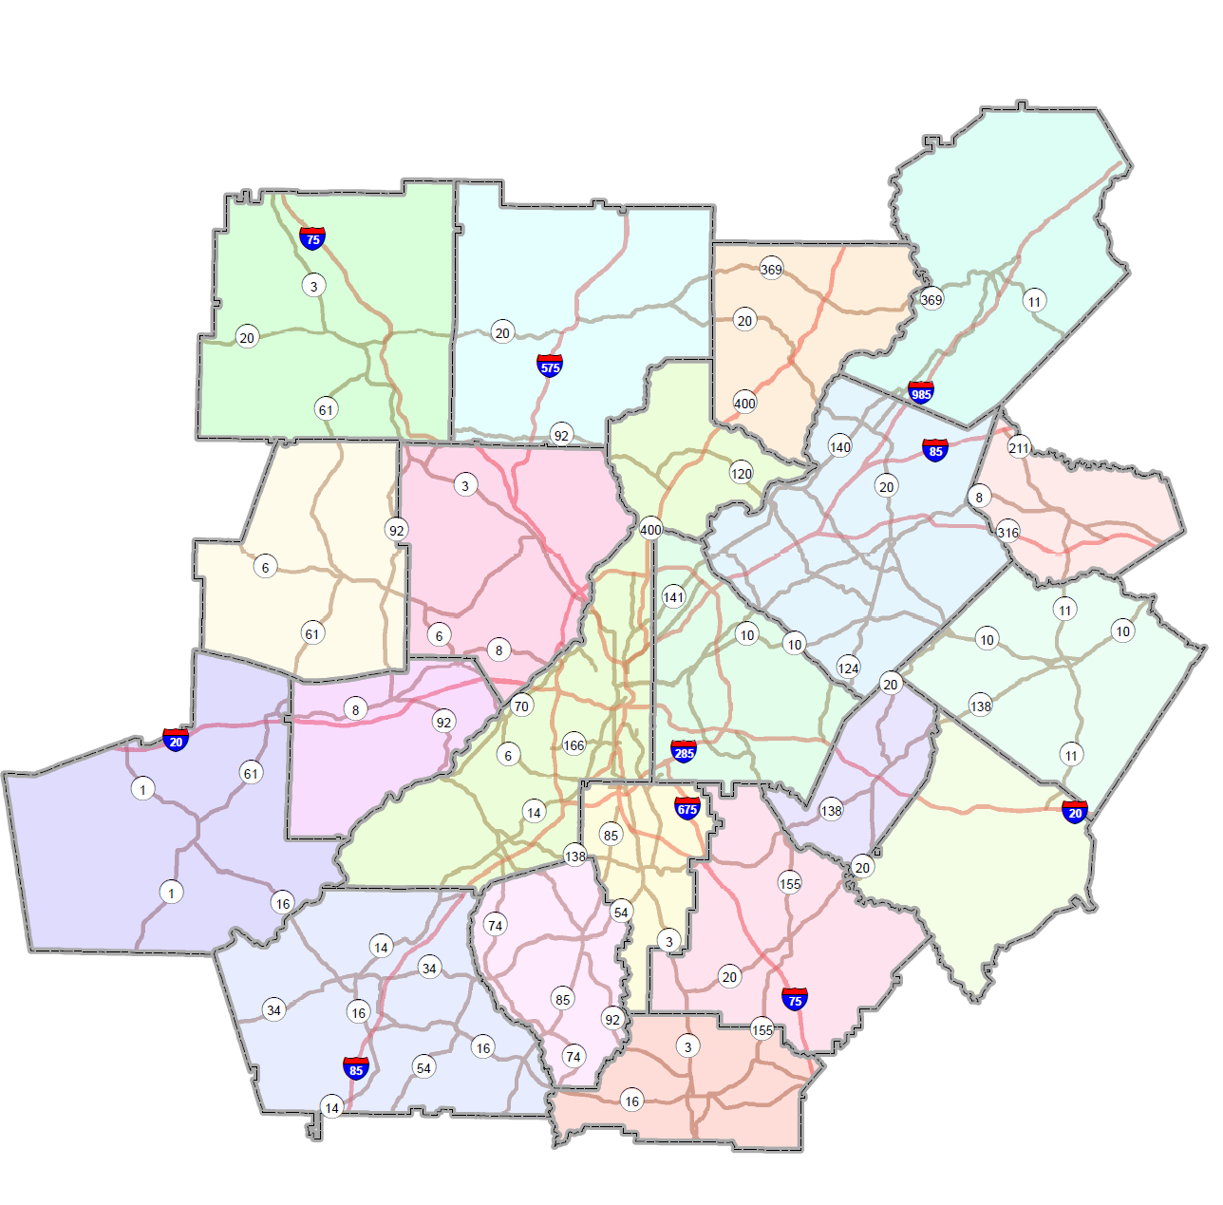
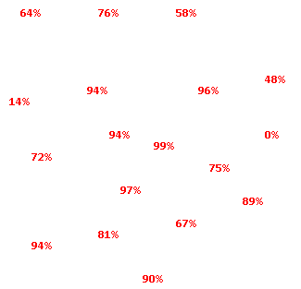
Percentage of Block Groups with EJ presence within ½ mile of RPFHN

Slide 11
Methodology
Half mile buffer around RPFHN
Analyzed Land Use and Demographic Data
EJ
Presence
Balanced EJ | Imbalanced EJ
Balanced Non-EJ | Imbalanced Non-EJ
Freight Intensity

Slide 12
Methodology
Half mile buffer around RPFHN
Analyzed Land Use and Demographic Data
EJ
Presence
Balanced EJ | Imbalanced EJ
Balanced Non-EJ | Imbalanced Non-EJ
Freight Intensity
Notes:
In an ideal world all the truck routes would fall in this category.

Slide 13
Methodology
Half mile buffer around RPFHN
Analyzed Land Use and Demographic Data
EJ
Presence
Balanced EJ | Imbalanced EJ
Balanced Non-EJ | Imbalanced Non-EJ
Freight Intensity
Notes:
Unless other compelling reasons exist, routes through areas under the “balanced” categories would be the easiest to remove from the network.

Slide 14
Methodology
Half mile buffer around RPFHN
Analyzed Land Use and Demographic Data
EJ
Presence
Balanced EJ | Imbalanced EJ
Balanced Non-EJ | Imbalanced Non-EJ
Freight Intensity
Notes:
This is the category with the most EJ conflicts and presents the most challenges.

Slide 15
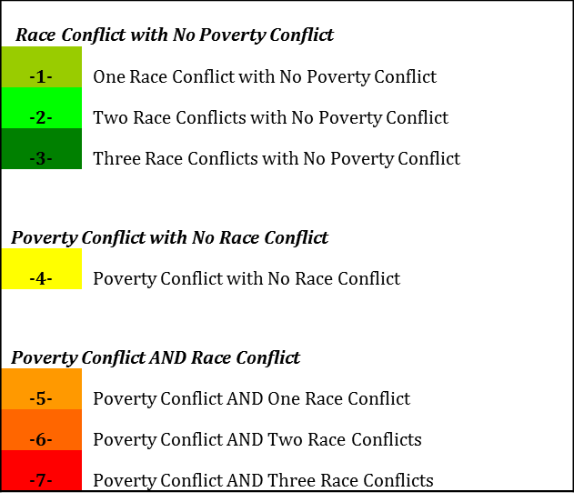
Block Group EJ Characteristics

Slide 16
Barrow County Example
State and County FIPS | Census Tract | Census Block Group | Census Block Group FIPS | Total Population | Environmental Justice (EJ) Communities < Against ARC Criteria > |  |  |  | EJ Rank/Order (map label) | Health Impact Vulnerable Communities < Against Regional Mean >
 |  |  |  |  | African American > 30.4% | Asian > 3.6% | Hispanic Origin > 7.0 % | Income Below Poverty > 9.1% |  | Children ( 11 and under ) in Poverty > 18.1% | Elderly ( 65 and over ) in Poverty > 9.6%
Barrow County
13013 | 180101 | 1 | 130131801011 | 7901 | 2.8 | 4.0 | 3.8 | 5.6 | 1 | 6.5 | 7.0
13013 | 180101 | 2 | 130131801012 | 2229 | 1.7 | 1.1 | 1.7 | 7.2 |  | 9.6 | 10.9
13013 | 180102 | 1 | 130131801021 | 4970 | 3.6 | 2.5 | 2.6 | 6.5 |  | 6.5 | 20.4
13013 | 180201 | 3 | 130131802013 | 1952 | 11.7 | 2.9 | 3.2 | 4.0 |  | 3.8 | 14.7
13013 | 180201 | 4 | 130131802014 | 1687 | 29.8 | 0.3 | 4.1 | 15.5 | 4 | 5.9 | 26.4
13013 | 180201 | 5 | 130131802015 | 2459 | 3.6 | 1.3 | 1.9 | 13.9 | 4 | 14.4 | 14.3
13013 | 180202 | 1 | 130131802021 | 3005 | 34.4 | 1.5 | 1.2 | 11.3 | 5 | 13.8 | 6.5
13013 | 180202 | 2 | 130131802022 | 1636 | 21.3 | 0.8 | 3.1 | 16.9 | 4 | 16.9 | 21.9
13013 | 180300 | 2 | 130131803002 | 2926 | 3.1 | 0.8 | 6.2 | 5.5 |  | 4.5 | 17.5
13013 | 180400 | 1 | 130131804001 | 3602 | 14.4 | 1.1 | 1.8 | 7.1 |  | 5.2 | 16.7
13013 | 180400 | 2 | 130131804002 | 1568 | 21.9 | 0.5 | 1.3 | 20.2 | 4 | 30.6 | 15.2
13013 | 180400 | 3 | 130131804003 | 462 | 1.9 | 0.0 | 0.4 | 10.8 | 4 | 0.0 | 38.9
13013 | 180500 | 1 | 130131805001 | 2469 | 9.3 | 3.6 | 3.0 | 3.5 |  | 0.0 | 21.4
13013 | 180500 | 2 | 130131805002 | 3265 | 13.4 | 3.1 | 7.0 | 7.6 |  | 9.9 | 9.7

Slide 17
Routes in Barrow
 | Northern/Western | Central | Southern/Eastern
GA-8 | Imbalanced EJ | Imbalanced EJ | Imbalanced EJ
GA-11 | Imbalanced EJ | Imbalanced EJ | Imbalanced EJ
GA-53 | Imbalanced EJ | Imbalanced EJ | Imbalanced EJ
GA-211 | Imbalanced EJ | Imbalanced EJ | Imbalanced EJ

Slide 18
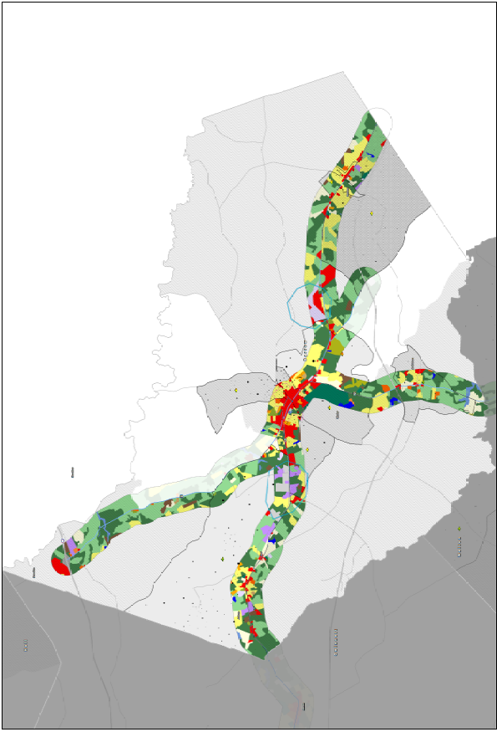
Spatial Representation

Slide 19
Elementary Schools in MPO Boundary (519 Total)

Slide 20
Elementary Schools within ¼ mile of freight intensive land use (306 of 519 or 59%)

Slide 21
Elementary Schools Within ½ Mile of Final Truck Network (176 of 519or 34%)

Slide 22
Final ASTRoMaP Network

