Slide 1
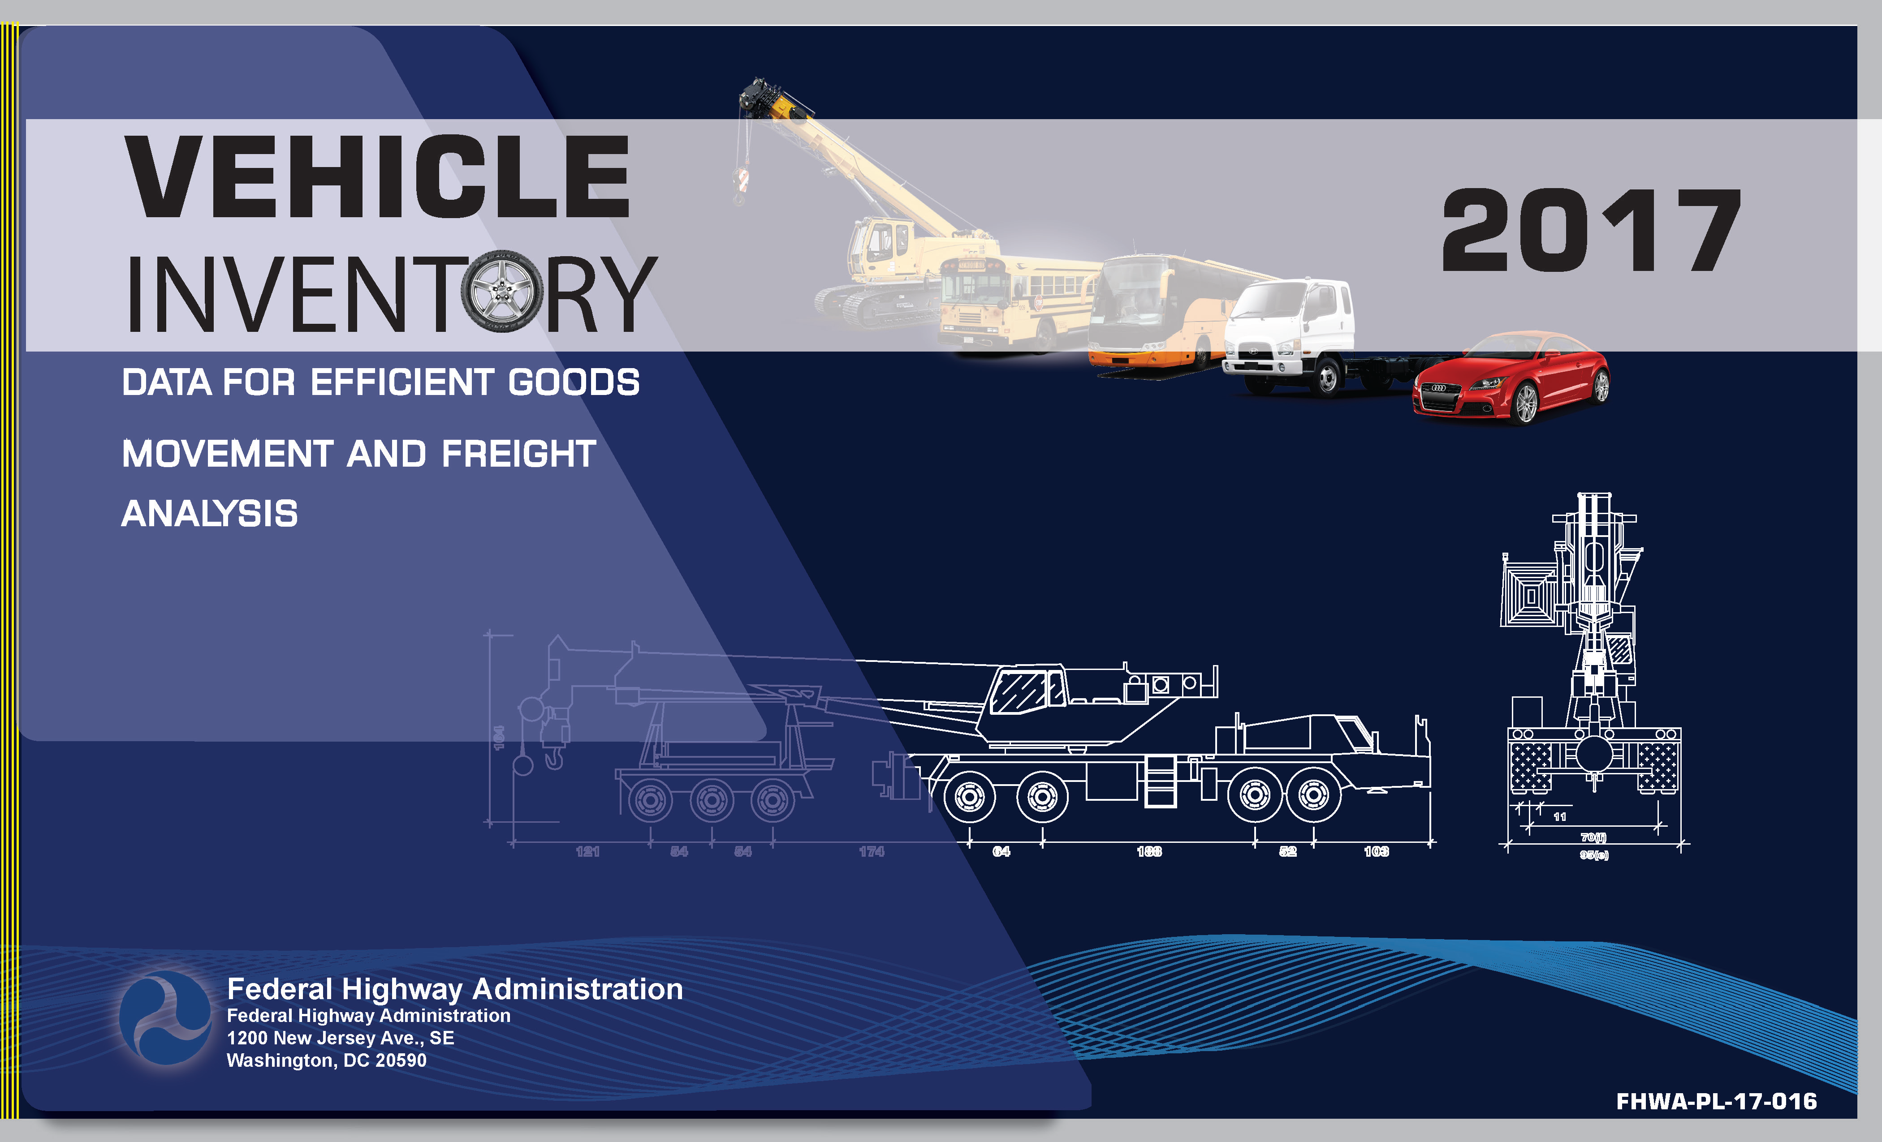

Slide 2
Talking Traffic Webinar – July 11, 2017
FHWA Research on the US Vehicle Inventory
Office of Highway Policy Information – Travel Monitoring and Surveys Section
Daniel Jenkins – daniel.Jenkins@dot.gov

Slide 3
GOALS:
Find Different Vehicles Associated with Each of the 13 Vehicle Classes
Obtain as Many Pictures as Possible
Develop a Method to Obtain as Many Dimensions as Possible
Learn Where These Vehicles Travel in the United States

Slide 4
Catalog Different Vehicles Associated with the 13 Vehicle Classes
VIUS database
Road Trips
Google Street View

Slide 5
Obtain as Many Pictures as Possible:
Internet (When We Could Prove Vehicle Was Inside USA)
Manufacturer Web Sites
Google Street View
Road Trips

Slide 7
Develop a Method to Obtain as Many Dimensions as Possible:
Steel Tape Measurements
Extrapolation:
- Tire Size / Rim Size
- Known Dimensions
- Skew Formula

Slide 8
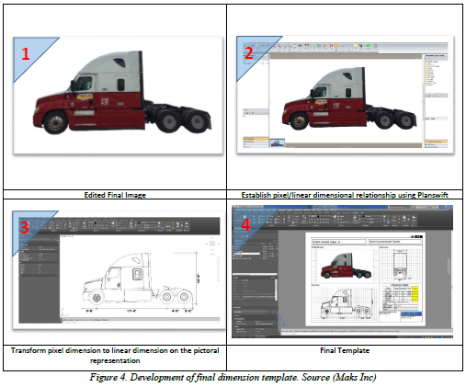

Slide 9
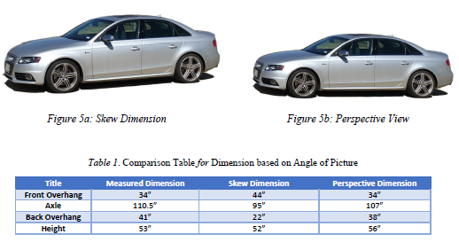

Slide 10
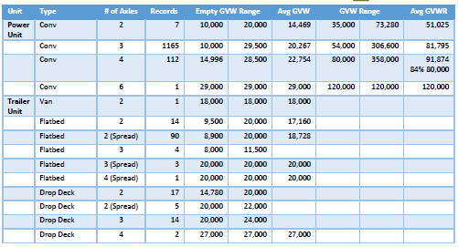

Slide 11
Learn Where These Vehicles Travel in the United States:
Google Street View
Road Trips
LCV Highways

Slide 13
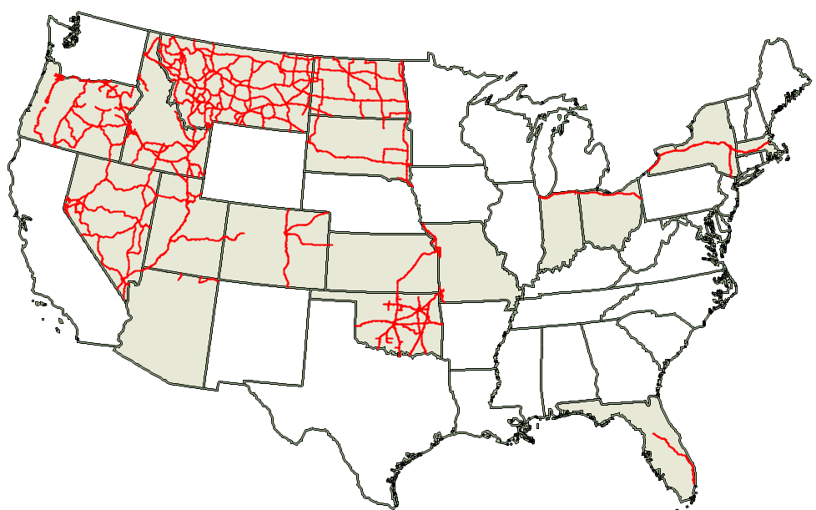
LCV Highways

Slide 14
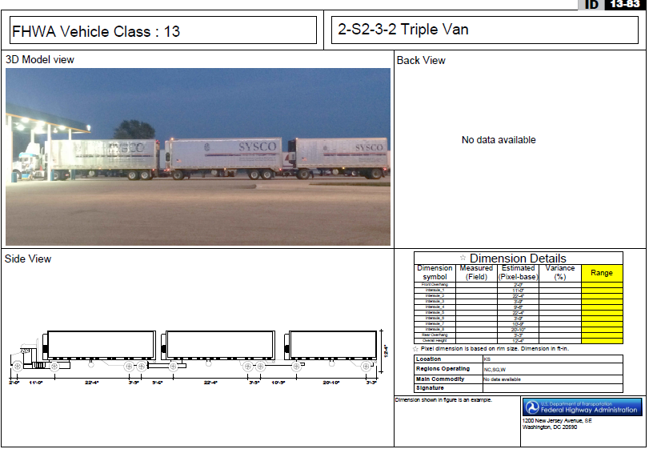

Slide 15
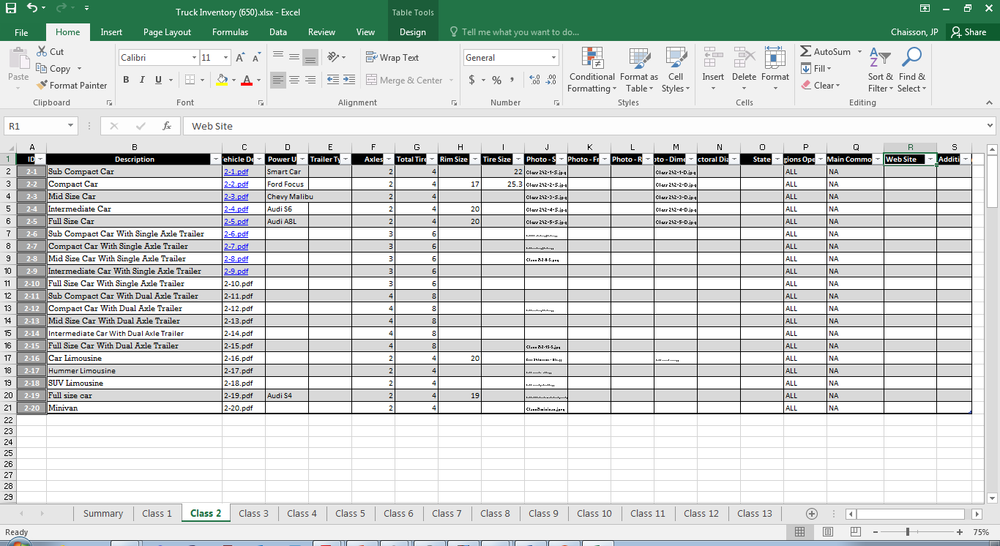

Slide 16
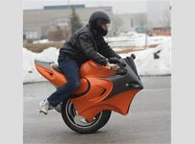
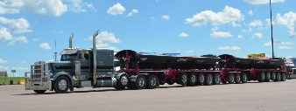

Slide 17
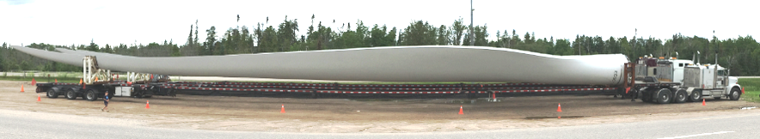

Slide 18
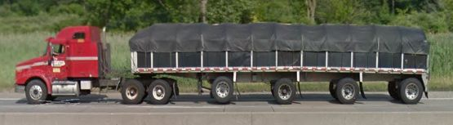
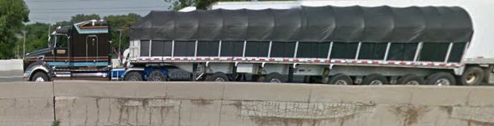
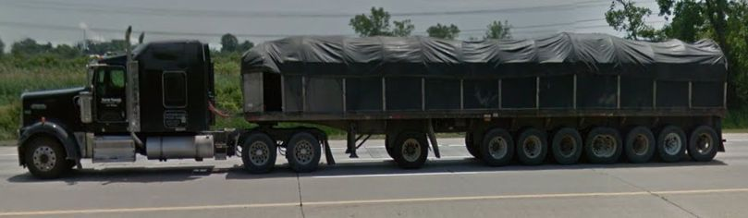
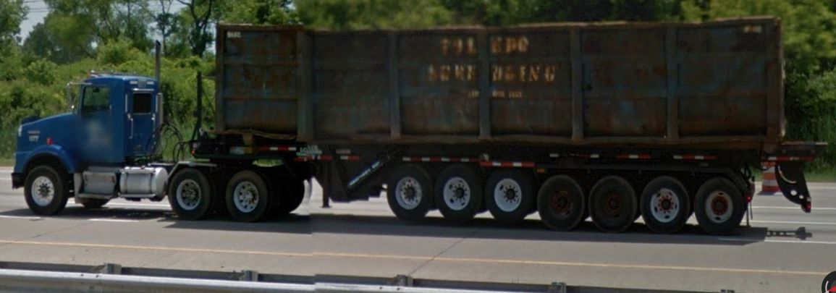

Slide 19
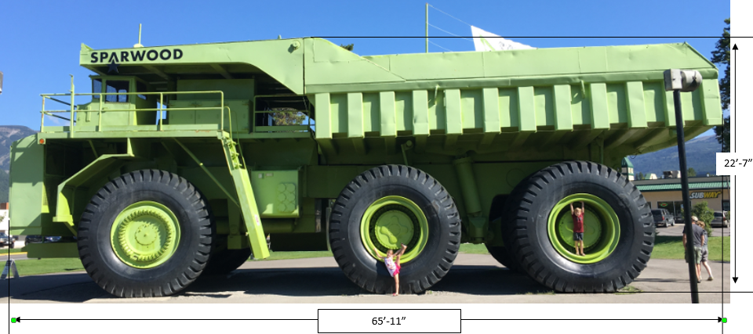

Slide 20
Examples:
2+3 = 2 Axle Power Unit (No 5th Wheel) Pulling 3 Axle Towed Unit via Standard Hitch
2-S3 = 2 Axle Power Unit (5th Wheel) Pulling 3 Axle Towed Unit via 5th Wheel Connector
4-S3-2 = 4-S3-2 = 4 Axle Power Unit: Pulling 3 Axle Towed Unit via 5th Wheel Connector: Pulling 2 Axle Towed Unit via 1 Axle Standard Hitch Dolly
3-S1-2-2 = 3 Axle Power Unit: Pulling 1 Axle Towed Unit via 5th Wheel Connector: Pulling 2 Axle Towed Unit via 1 Axle Standard Hitch Dolly: Pulling 2 Axle Towed Unit via 1 Axle Standard Hitch Dolly.

