Slide 1
Slide in Bridge Construction
Construction Contractors
Name of Presenter
Title
Meeting Name
Location Date
Notes:
Thank you for attending today’s session on Slide in Bridge Construction.
This presentation is aimed towards contractors and developed for the FHWA as an extended effort of the Every Day Counts Initiative.
Slide-in bridge construction (SIBC) is a particular method and refinement of construction contained under the broader topic of Accelerated Bridge Construction (ABC) with the specific goal of extremely rapid bridge installation under very short term road closure.

Slide 2
Introduction
U.S. bridges
In need of rehabilitation, repair, or replacement
Notes:
Nearly 25% of the Nation’s 600,000 bridges are in need of rehabilitation, repair, or total replacement. Given this vast number, the need for bridge reconstruction methods that reduce the impacts to mobility and safety is needed. This need was one reason the Every Day Counts Initiative was launched.

Slide 3
Background
Deploy underutilized innovations to
Shorten delivery of highway projects
Enhance roadway safety
Reduce congestion
Improve environmental sustainability
Notes:
Every Day Counts was first established in 2010 as a state-based initiative meant to identify and deploy innovation; specifically, to shorten project delivery, enhance safety, reduce mobility impacts, and protect the environment. The term “get in, get out, and stay out” was popularized under this program.

Slide 4
EDC-2 Initiative
PBES
EDC-2 Launched in 2012 to shorten delivery time using new technologies
Accelerated Bridge Construction
GRS-IBS
SIBC
Notes:
As a result of these efforts, EDC-2 was launched in 2012 with the specific focus of shortening the time needed to complete highway projects through the use of new technologies and ground-breaking processes. Within that directive, accelerated bridge construction became an area of concentration.
Three particular ABC technologies being promoted under EDC-2 are prefabricated bridge elements and systems, geosynthetic reinforced soil-integrated bridge systems, and slide-in bridge construction.

Slide 5
EDC-2 Initiative
PBES
Accelerated Bridge Construction
SIBC
GRS-IBS
Notes:
It comes as no news to anybody that our focus today will be on slide-in bridge construction.

Slide 6
Agenda
Definition and benefits of SIBC
Decision making and delivery methods
Planning and designing for SIBC
Submittals and temporary works
Case study
Overview for contractors
Notes:
Several slide-in bridge construction topics will be covered as the day progresses. Collectively, the topics aim to provide an overview for contractors; thereby better equipping the group to pursue slide-in bridge construction or SIBC as it is now more commonly referred to.
SIBC will be defined and its benefits will be discussed.
Several ABC and SIBC decision making tools are presented along with the various delivery methods that can be employed.
Planning and designing for SIBC, planned contract submittals, and temporary works will be covered.
Given that SIBC is a relatively new and innovative method of bridge construction, it is not uncommon for the media and public to have a more involved roll, even as spectators. As such, relations with the media and public will be addressed.
Lastly, a case of a previous SIBC project will be presented.

Slide 7
What is SIBC?
ABC method also known as known as lateral sliding or skidding
New bridge (normally) built parallel to existing bridge on temporary supports
New bridge slid into place after
New substructure constructed
Old bridge demolished
Moved laterally using hydraulics or a winch. Some minor vertical jacking is typically needed.
Notes:
So, what is slide-in bridge construction?
It is a method of ABC that has also been known as lateral sliding or skidding, and the variations of these techniques.
In SIBC, a new bridge is typically constructed adjacent to and parallel to the existing bridge on temporary supports.
Once complete, the old structure is demolished and the new substructure is constructed, followed by the sliding of the new superstructure on to the new substructure already in place. There have been some cases where the old substructure was reused.
The new bridge is moved laterally most commonly with hydraulic jacks, though other methods have been employed, such as a winch. Some minor vertical jacking is typically needed.
SIBC, and ABC in general, is primarily used for bridge replacement projects where the impacts to mobility are significant.

Slide 8
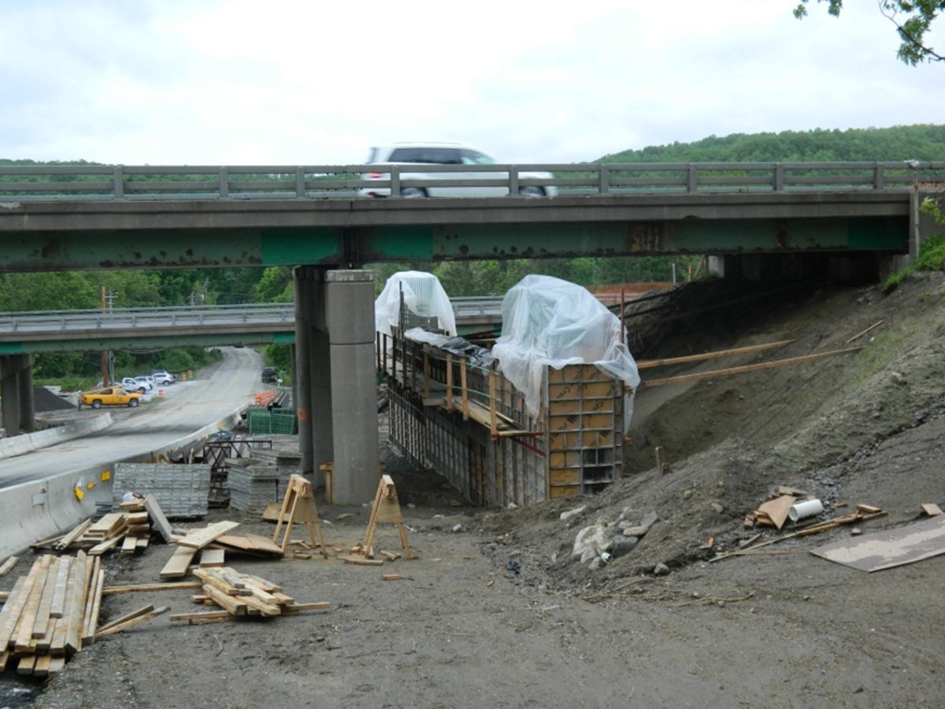
What is SIBC?
Reduced disruption if substructure can be constructed below the existing bridge
Minimal disruption likely requires innovative foundation systems
Drilled shafts outside footprint of existing bridge
Micro or mini piles
Integrating cap beams
Spread footings
Prefabricated substructure units
Notes:
There have been many cases where the new substructure was constructed beneath the existing bridge prior to demolition. As you can predict, this expedites the process from demolition to bridge slide.
It should be pointed out, however, that constructing traditional foundation systems might not be feasible. Rather, an innovative foundation system might be required when using this method.
It is possible that prefabricated elements could play a key role in constructing the new substructure.

Slide 9
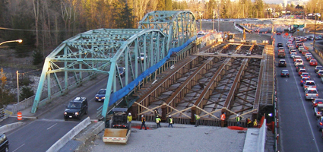
What is SIBC?
Can be used for temporary bypass bridges
Temporary substructure must be designed for live and other transient loads
Notes:
One might believe that bridge slides are only used for sliding a new bridge into the position of the existing. This is most commonly the case, but SIBC is not limited to only sliding new structures.
Existing structures can be slid to a new alignment to serve as a bypass bridge while a new bridge is constructed using more traditional methods. Keep in mind that in this case, the temporary substructure system will be subjected to live and other transient loads in addition to the bridge itself, typically resulting in a more robust, and hence higher cost, to such an installation.

Slide 10
Benefits
What is driving the use of SIBC?
Increased traffic demands
Increasing congestion
Public demand for rapid delivery of projects
Safety
Societal costs
Mobility
Environmental impact
Lower cost and less risk when compared to other structure placement methods (e.g., SPMT)
Notes:
So, what benefits can be gained by using slide-in bridge construction? Maybe the better question is ‘What is driving the use of SIBC and how is it that SIBC addresses those needs?’
Traffic demands are increasing, congestion is increasing – both create an unnecessary nuisance in the lives of the traveling public. As such, the public demand for rapid delivery is increasing.
One can see in this chart the overwhelming preference for accelerated bridge construction when polled in Massachusetts prior to the MassDOT Fast 14 project.
Even more, the safety of the traveling public and bridge builders is compromised when bridge projects are long in duration. SIBC alleviates some of this risk by significantly reducing the time main-line traffic is interrupted.
Societal costs, though often difficult to fully quantify, are significantly reduced as well.
Environmental impacts can be softened.
And lastly, the costs can be lower and at less risk when compared to other rapid structure placement methods, such as self-propelled modular transporters, float in delivery, or a heavy crane pick, for example.

Slide 11
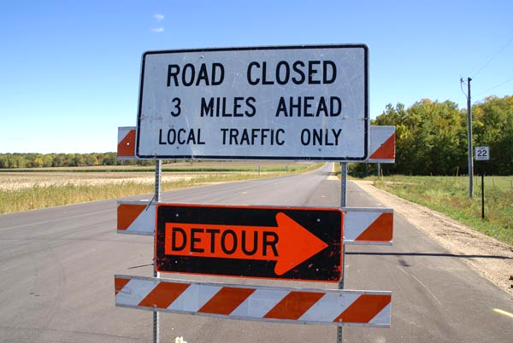
Benefits
Offers non-traditional site options
Eliminates crossovers, shoo-flies, staged construction, and long term detours
Can result in lower construction costs/bid price
Reduces mobility impacts
Notes:
To continue with the benefits of using SIBC: non-traditional site options can be offered, cross-overs or shoo-flies are eliminated along with staged construction and long term detours. These things can result in lower construction costs.
When compared to other ABC methods, SIBC often receives better contractor “buy-in”, presumably because of the reduced risk that was previously mentioned.
Mobility and environmental impacts can also be reduced and safety is nearly always enhanced for the worker and road user.

Slide 12
Benefits
Promotes user and worker safety
Better contractor “buy-in” when compared to other ABC methods
Could reduce environmental impact
Notes:
Potentially of greatest significance is that SIBC promotes user and worker safety. Safety is nearly always enhanced for the worker and road user; this can not be understated.
When compared to other ABC methods, SIBC often receives better contractor “buy-in”, presumably because of the reduced risk that was previously mentioned.
Environmental impacts can also be reduced.

Slide 13
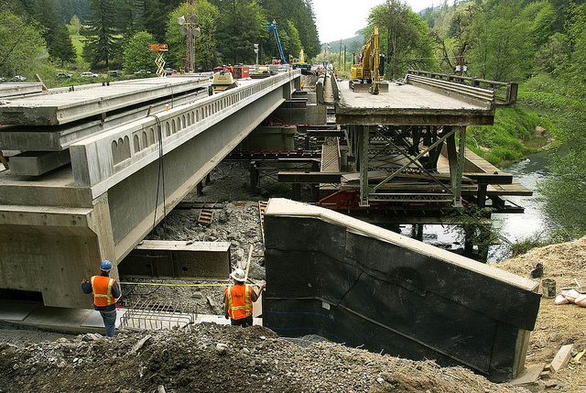
Benefits
Removes bridge construction from critical path
May lead to better quality end product
Involves public in reducing societal costs
Results in greater “buy-in” in the overall project
Road closures better managed
Dates and duration are more predictable
Notes:
Lastly, SIBC removes the bridge construction from the critical path which may lead to a better quality end product, it involves the public by reducing societal costs, thereby creating better “buy-in”, and road closures can be better managed.

Slide 14
Project Highlight
I-84 at Dingle Ridge Road – New York
Cost savings
Over $1.2 M in user delay cost savings by using ABC (Source: NYSDOT)
$2 M cost savings from elimination of cross-overs, temporary bridge (Source: NYSDOT)
Savings in work-zone accidents costs
Notes:
Along the way, we’ll take a minute to quickly highlight a project to emphasize a couple of points. The first project highlighted is I-84 at Dingle Ridge Road in New York.
A considerable amount of cost savings was realized by constructing the bridge using ABC methods rather than traditional methods.
According to the New York State DOT, over $1.2 million was saved in user delay costs. An additional $2 million was saved by eliminating the cross-overs and temporary bridge. Furthermore, an unquantified savings in work-zone accident costs was realized.

Slide 15
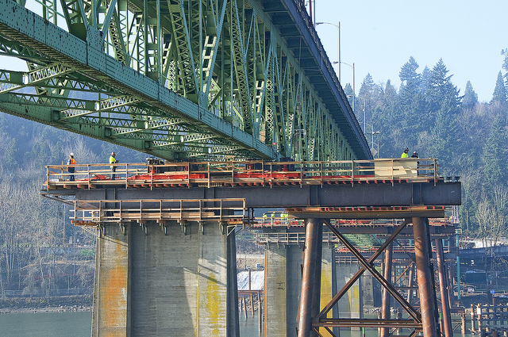
Potential Challenges
Internal resistance in the DOT
Finding experienced contractors or heavy lift engineer
Mitigated through education
Becoming less of a challenge as more projects are bid nationwide
Public interest
Spectators on the job site
Notes:
Though the benefits are great, one must be aware that some potential challenges exist.
While some personnel within the DOTs embrace innovative methods, others are more resistant and tend to lean on traditional construction methods. This resistance can stall a potential SIBC project.
Finding experienced contractors and/or heavy lift engineers can be a challenge, though that challenge is being lessened as more and more SIBC projects are being completed and contractors become more familiar with the process.
And given that many SIBC projects are high profile, public interest is high which draws spectators to the job site creating a potential crowd control issue not familiar to typical construction. The method will require some short term full road closure with a public commitment to meet those dates well in advance, leading to schedule pressure on construction.

Slide 16
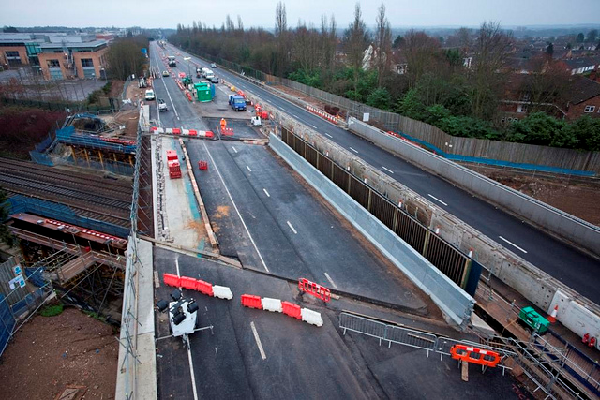
Potential Challenges
Curved bridges; High skews
Vertical profile changes
Lack of space adjacent to bridge
Traffic management plans
A need to be fluid and/or a have a contingency plan in place
Notes:
In traditional construction projects it is common that unique bridge geometry, difficult foundations, or lack of space can present a challenge. These aspects are only magnified by the nature of SIBC.
A sound traffic management plan with contingency plan included is a must.

Slide 17
Potential Challenges
Possible contractor limitations
Forethought, significant temporary shoring, and unconventional schedules are required
Time commitment
Requires 24 hour commitment of the contractor/design/owner team during slide operations
Worker fatigue
Extended time for contractor, owner, and designer
Notes:
This method of bridge construction is relatively new, and as a result, there may be some contractor limitations.
For example, significant temporary shoring and unconventional schedules are often required.
During slide operations, a 24 hour commitment from the contractor, designer, and owner is necessary.
There are periods during the overall SIBC process that require extended time for the contractor, owner, and designer and, as a result, worker fatigue be an issue if not properly managed. Multiple crews can help alleviate this potential problem.

Slide 18
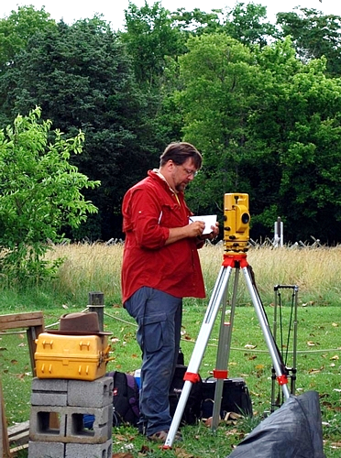
Potential Challenges
Difficult foundations/substructures
Equipment breakdowns
Speed of approach work completion
Surveying mistakes
Public spectators
Notes:
Even more, difficult foundations, equipment breakdowns, and the speed required to complete approach work can present a challenge.
Also, significant, critical time can be lost to surveying mistakes.
And given that many SIBC projects are high profile, public interest is high which draws spectators to the job site creating a potential crowd control issue not familiar to typical construction. The method will require some short term full road closure with a public commitment to meet those dates well in advance, leading to schedule pressure on construction.

Slide 19
Project Highlight
Elk Creek – Oregon
Site concerns
Mountainous terrain surrounding bridge construction site
Slides can be effective even in very confined locations
Notes:
To highlight another project, the Elk Creek project in Oregon was faced with numerous challenges that could be considered somewhat unique to this project. For example, the site, located in the mountains of western Oregon, did not afford ample space or flat terrain from which a new bridge could be easily constructed and slid into place. Nonetheless, the successful completion of this project using slide in construction proved that slides can be effective even in very confined locations.

Slide 20
Factors of Interest
ADT/ADTT
Facility crossed
Railroad/roadway
Navigable waterway
Evacuation route
Detour length
Duration and viability
Environmental
Limits on when
Limits on how
Notes:
Some factors of interest to consider when making an initial decision for or against SIBC include: average daily traffic, the facility that is being crossed (railroad, roadway, other?), the detour length (duration and viability), and environmental effects (limits on when and how).

Slide 21
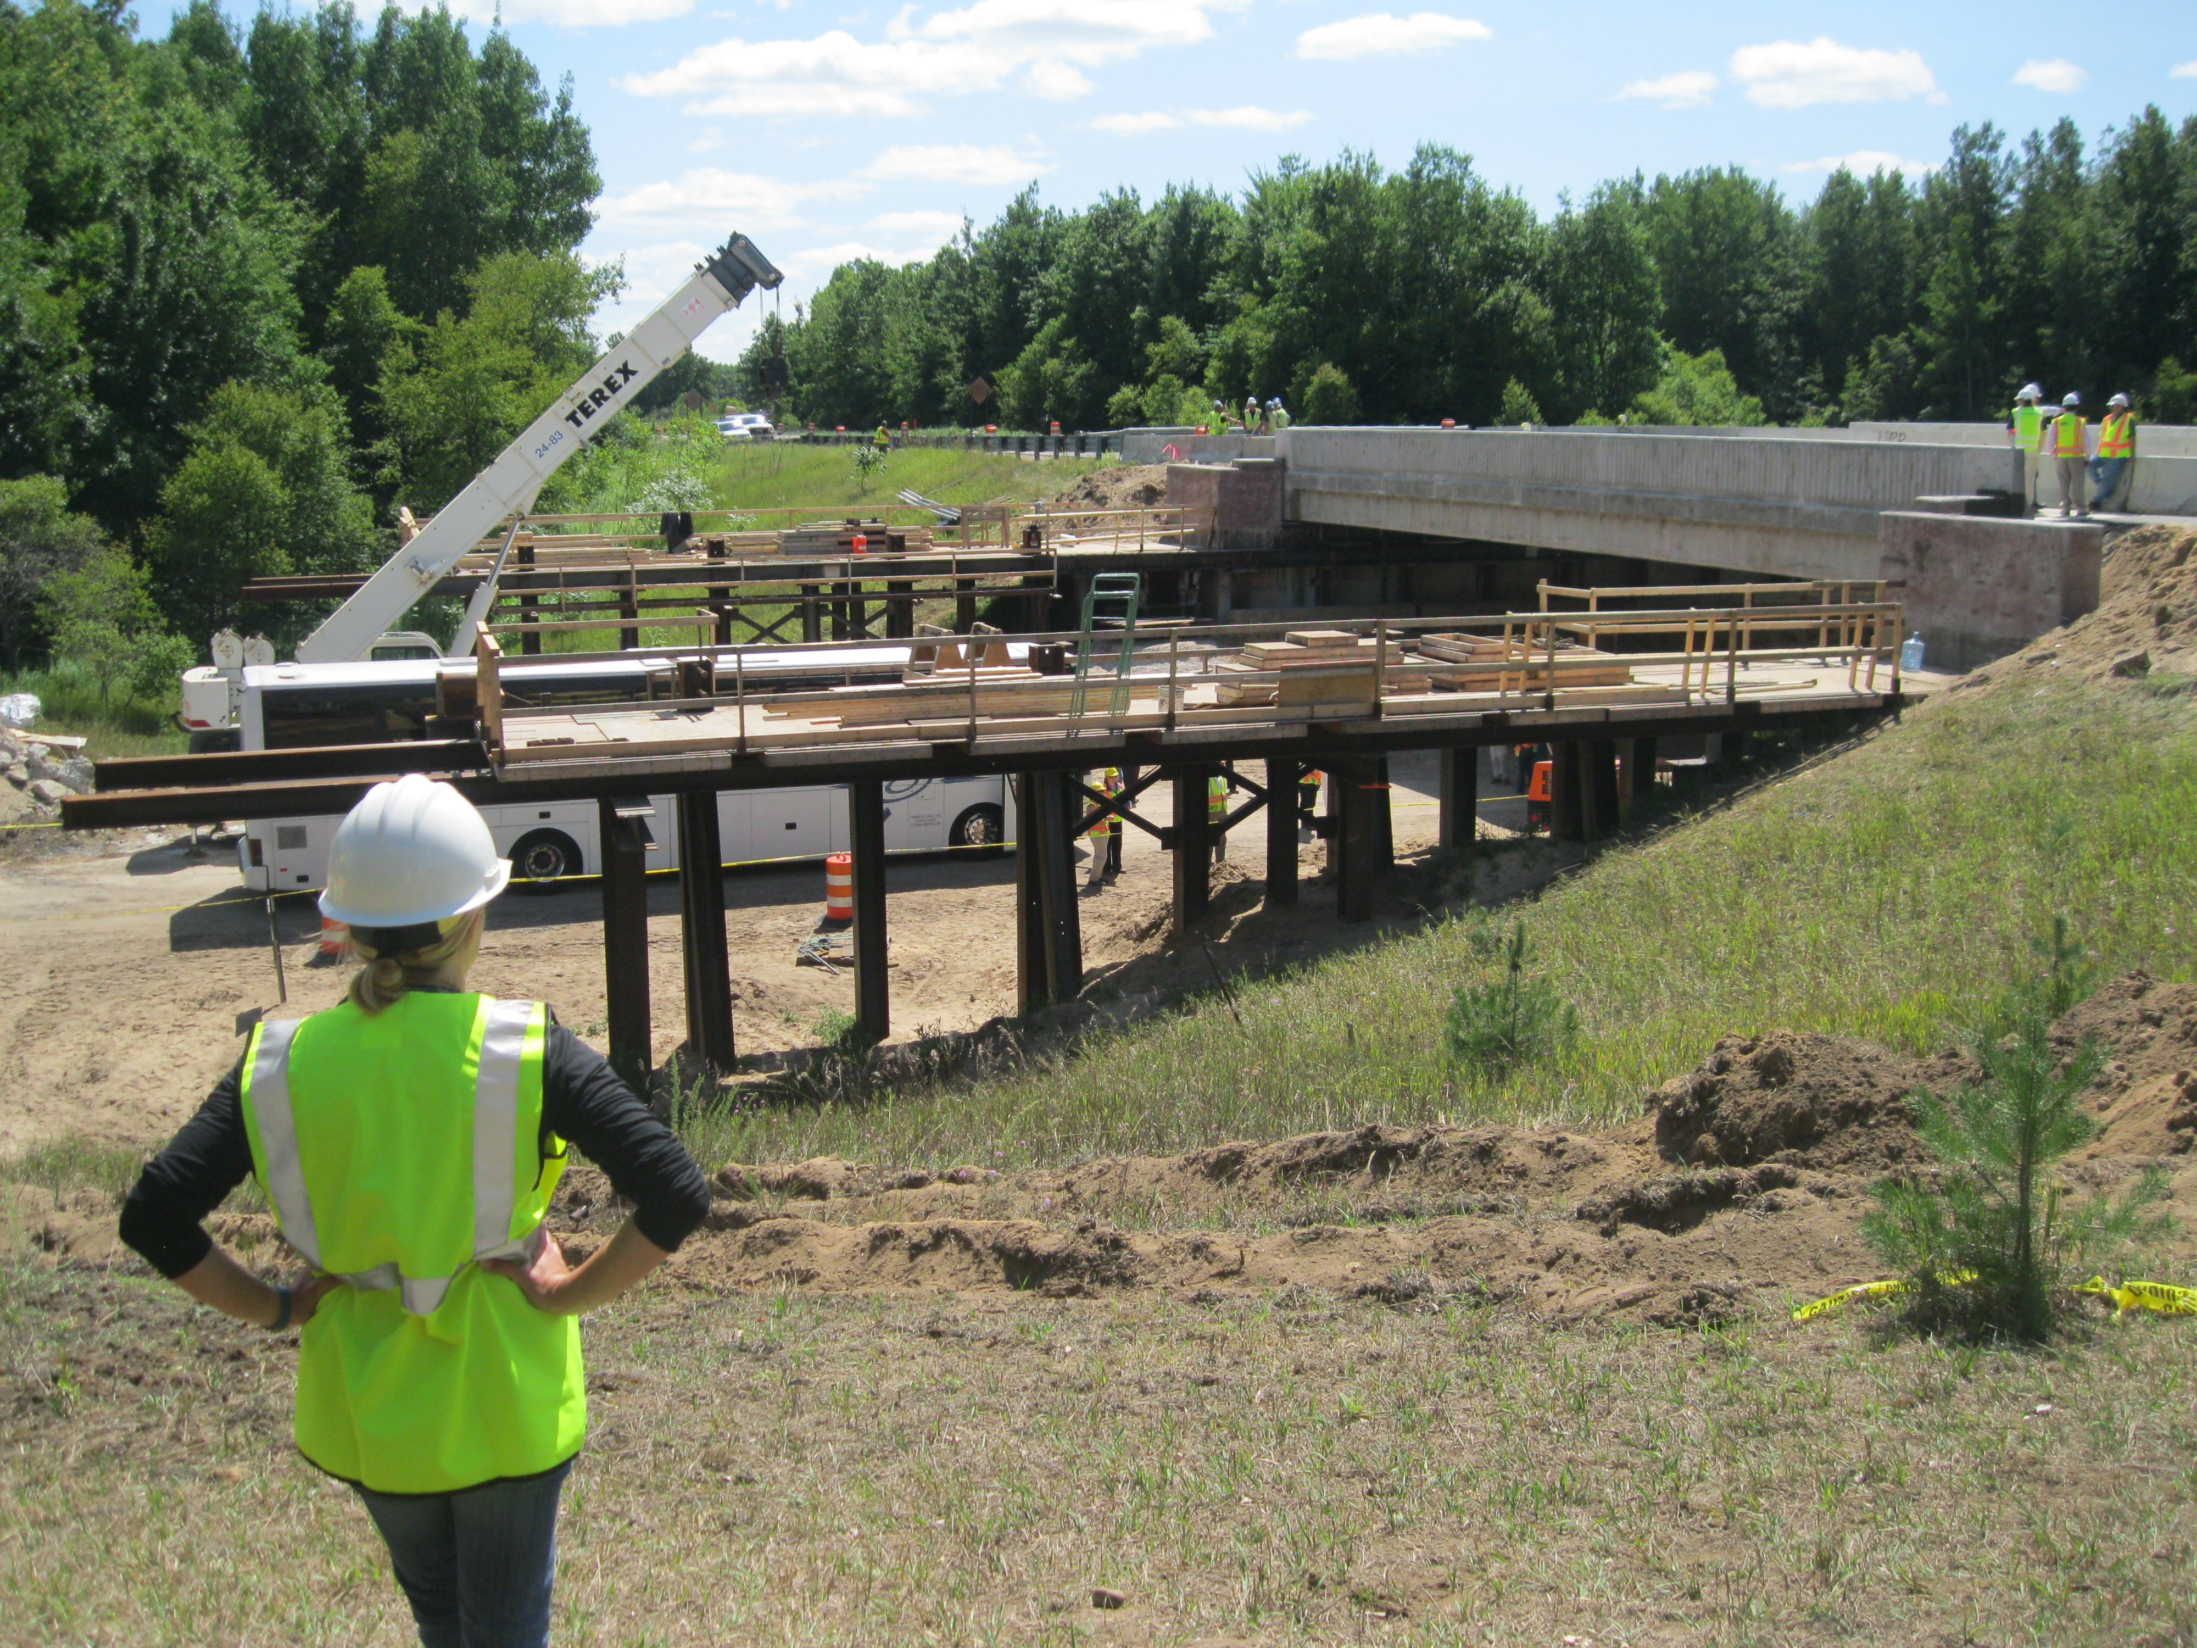
Factors of Interest
On critical path of entire project
Available right of way for bridge construction
Traffic analysis
Contractor’s work area and ingress/egress ability
Notes:
Is the bridge on the critical path of the entire project?, is there available right-of-way?, should traffic analysts be engaged?, where will the contractor’s workspace, entrances, and exits be located?.

Slide 22
Costs
Direct vs. indirect
Account for agency and other indirect cost savings during decision making (CEI labor, flagging, field office, etc.)
Avoided costs (detours)
Reduced inflation costs (i.e., decreased construction time)
Notes:
If comparing only the costs of building a bridge using traditional methods and slide-in bridge construction, it is possible, and maybe even likely with the first projects, that SIBC costs will be higher.
It has been found, however, that the costs become more aligned when including other project related costs such as direct versus indirect costs and detour costs. These costs are often not included in the bid; therefore it is not appropriate to compare conventional construction costs with ABC costs.
Project planners should evaluate the total construction cost when making decisions.
Even more, due to the decreased construction time, overall inflation costs can be reduced, specifically the risk of price escalation of steel and fuel can be minimized.

Slide 23
Project Highlight
Mesquite Interchange - Nevada
Project costs
Total interchange reconstruction = $15 million
Original estimate without ABC = $25 million
Notes:
The next project highlighted is the Mesquite Interchange in the state of Nevada. The total interchange reconstruction cost was $15 million, $10 million less than the original $25 million estimate. A significant amount of the cost savings stemmed from the decision to slide each of the two bridges being replaced. Traditional construction would have required a complete realignment of the mainline pavement and interchange reconfiguration. Instead, the interchange was left in its original configuration and the bridges constructed adjunct to the existing.

Slide 24
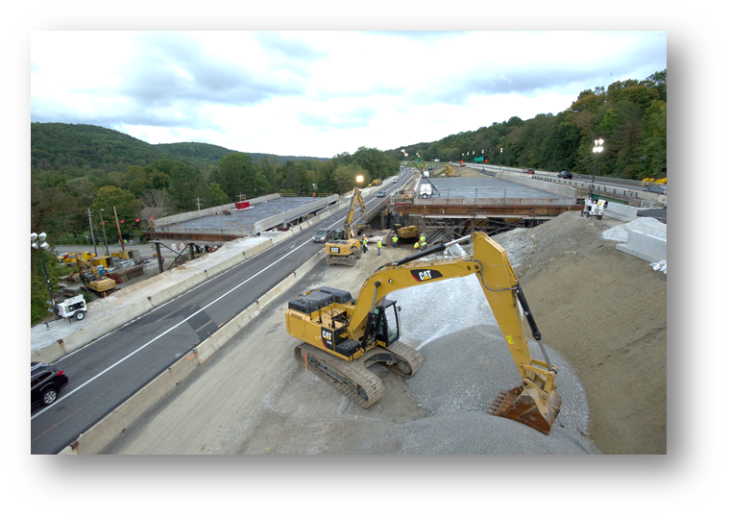
Knowledge Check
In SIBC, the new bridge is constructed parallel to the existing bridge on temporary supports.
In SIBC, the new bridge is constructed ______ to the existing bridge on ________ supports
Notes:
To this point, SIBC has been defined, some benefits and challenges have been listed, and factors of interest shown. You’ll now get an opportunity to check a bit of your knowledge.
In SIBC, the new bridge is constructed “blank” to the existing bridge on “blank” supports.
In SIBC, the new bridge is constructed “parallel” to the existing bridge on “temporary” supports.

Slide 25
Knowledge Check
Drilled shafts outside footprint of existing bridge
Micro or mini piles
Integrating cap beams
Spread footings
All of the above
What types of innovative foundations systems are commonly used to minimize disruption?
Drilled shafts outside footprint of existing bridge
Micro or mini piles
Integrating cap beams
Spread footings
All of the above
Notes:
What types of innovative foundations systems are commonly used to minimize disruption?
Drilled shafts outside footprint of existing bridge?
Micro or mini piles?
Integrating cap beams?
Spread footings?
Or
All of the above?
The answer: All of the above. Each of the options are commonly used to minimize disruption.

Slide 26
Knowledge Check
True or false: SIBC can eliminate crossovers, shoo-flies, staged construction, and long term detours resulting in lower construction costs/bid price?
TRUE
Notes:
True or false: SIBC can eliminate crossovers, shoo-flies, staged construction, and long term detours resulting in lower construction costs/bid price?
True

Slide 27
When to Use SIBC
Ideal conditions for SIBC
Wide, flat area(s) adjacent to original structure
Factors to be considered
Limited ROW
Terrain around existing bridge is rugged
Geotechnical conditions cannot adequately support temporary works
Alignment restrictions
Utilities
Notes:
So, you might be asking yourself, ‘When should I consider using slide-in bridge construction’?
Ideally, sites with wide flat areas adjacent to the existing structure would be found at all bridge locations. But since this is rarely the case, one has to look beyond the ideal locations and consider other factors.
Factors such as, right-of-way, terrain, geotechnical conditions, and alignment restrictions. If right-of-way is limited, can temporary right-of-way be made available?
Rugged terrain doesn’t necessarily prohibit the use of SIBC, but does introduce another challenge.
Since temporary works will be significant and require supporting the entire superstructure, the adequacy of geotechnical conditions is key.
One should also consider alignment restrictions and utility locations.

Slide 28
SIBC Flowchart Method
Notes:
As an example, let’s step through the flowchart method for SIBC and see out that plays out looking at different site conditions. We will be using one of the sites that will be discussed later in the case studies.

Slide 29
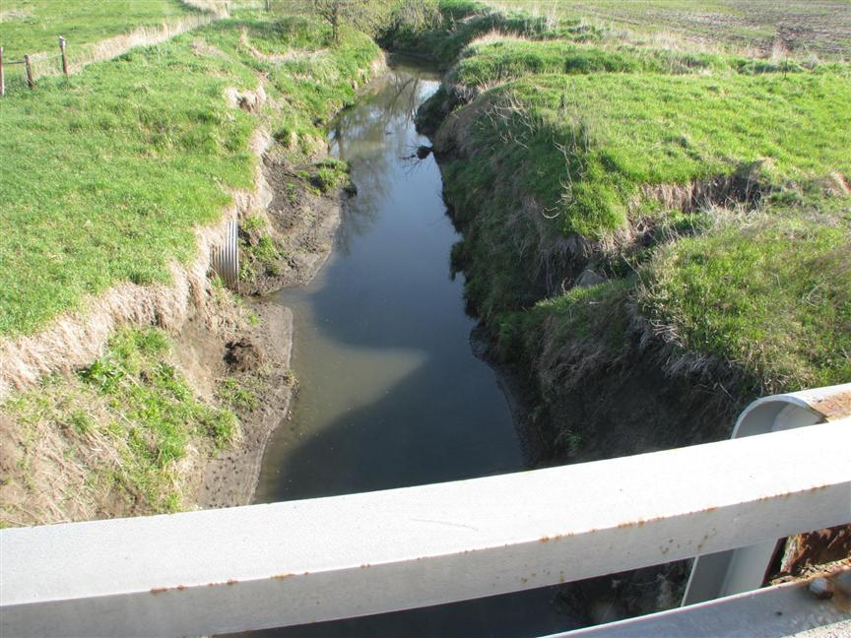
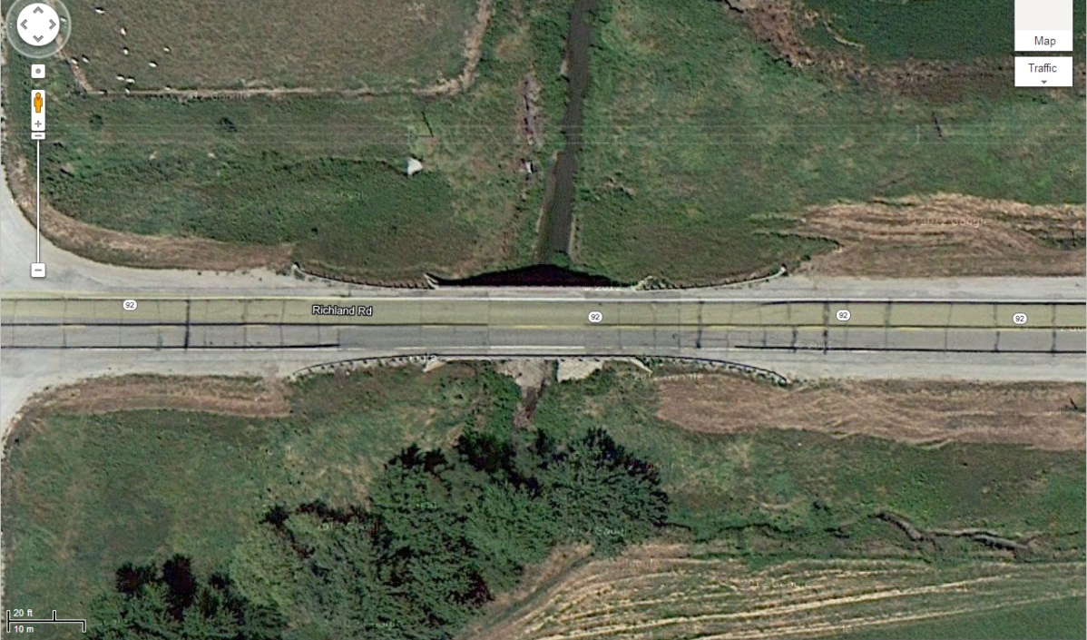
Sites Suitable for SIBC
Notes:
Two photos of the site are shown. As you can see, the bridge is in a rural location and it carries two lanes of traffic over a small stream. The decision has been made to use ABC.
Is there room adjacent to the bridge for construction of the new superstructure? There are no structures or facilities adjacent to the bridge, so the answer is yes.
Is there available right of way? After checking the right-of-way mapping, the design team determined the answer to be yes.

Slide 30
Sites Suitable for SIBC
Notes:
Is the bridge over a transportation facility? No.
Is the bridge over a wetland? Yes.
Can permits be obtained for temporary shoring? After a review with regulatory agencies, the design team determined that the answer to this question is yes.

Slide 31
Sites Suitable for SIBC
Notes:
Is a short-term detour feasible? After conferring with traffic engineering personnel, the answer to this question was determined to be yes. Therefore, SIBC is appropriate. This is just one example of when SIBC might be appropriate.

Slide 32
Delivery Methods/Contracting
Not all options are available in all locations – some governments prohibit certain contracting methods
Design-bid-build
Design-build
Construction manager/general contractor (CM/GC)
A+B contracting
And value engineering should always be an option
Notes:
It should be noted that not all options are available in all locations as some methods are prevented by existing state government laws or policies, but numerous delivery and contracting methods exist nationwide.
These include Design-Bid-Build, Design-Build, Construction Manager General Contractor, A+B contracting, and value engineering.

Slide 33
Design-Bid-Build
Separate contracts for design and build
Selection based on lowest total construction cost
A complete design must be developed prior to bid
Temporary shoring design is still undertaken by the contractor
Notes:
Design-bid-build has been the traditional method of contracting. Separate contracts are extended from the owner to the designer and builder, and the selection is based on the lowest-bid total construction cost.
For this method, a complete design must be developed prior to the bid process taking place.
It should be noted that the designer is not responsible for the design of the temporary shoring system or the equipment used to move the bridge. The designer needs to show schematic drawings of the systems, and allow the contractor to develop the details of the move.

Slide 34
Design-Bid-Build
Advantages
Widely applicable and well understood
Clearly defined roles for parties involved
Competitive bidding process
Disadvantages
Lack of input from contractor
Delay claims and disputes are common
Change orders are common
SIBC is new to most designers
Notes:
For SIBC, some advantages of design-bid-build are its wide applicability and well understanding, the rolls are clearly defined for all parties involved, and the bidding process is competitive. However, the method is disadvantaged for SIBC in other ways.
There is a lack of input from the contractor; delay claims, disputes, and change orders are all common.
Additionally, SIBC is new to most designers and blurs the line of means and methods of construction, typically the contractor’s stock in trade.

Slide 35
Design-Build
Brings the design and construction under one contract for one team
Owner gives up much of the control over the design and construction processes. Owner must communicate expectations very clearly
Owner typically does some up-front design work prior to bidding
Owner must then define fundamentals of what is expected in terms of performance, etc.
Notes:
Unlike the design-bid-build process, the design-build process brings the design and construction under one contract from the owner. In doing so, the owner gives up some control over the design and construction process and therefore must make expectations very clear.
It is not uncommon for the owner to do some preliminary design work prior to the design-build teams bidding on the project; through this exercise the owner must define performance expectations.

Slide 36
Design-Build
Advantages
Faster project delivery in many cases
Design can be tailored to contractors experience
May promote innovative design thinking
Can benefit from contractor SIBC experience
Change orders are minimized
Disadvantages
Outcomes must be clearly communicated
Owner relinquishes control; designer is working for the contractor and not the owner. DB team takes on more risk
Team must complete some design “at their expense” in order to bid
Cost savings, if any, can vary
Notes:
An inherent advantage to the design-build method is that a project can often be delivered more quickly than would otherwise be possible. The design can be tailored to the contractor’s experience, tools, and equipment. Also, it may promote innovative design thinking.
As with design-bid-build, some disadvantages exist. Outcomes must be clearly communicated by the owner or else risk the project scope transforming to something unintended.
The owner is relinquishing control as the designer is working for the contractor not the owner with the potential that the final design will be influenced heavily by the required means and methods of installation. Prior to bidding, the design team must complete some design at their expense.
Lastly, cost savings, if any, can vary from project to project.

Slide 37
CM/GC
Similar to design-build in that the contractor and designer work together
However, each has their own contract with owner; and, the owner is an integral part of the team
Both designer and contractor are independently selected by the owner
Risks are identified and managed
Notes:
CM/GC, or Construction Manager/General Contractor, is not as commonly used as the previous methods of delivery but is gaining popularity with the bridge building industry.
CM/GC is similar to design-build in that the contractor and designer work together. It differs, however, in that each has their own contract with the owner and the owner remains an integral part of the overall team. The designer and contractor are both independently selected by the owner.
As a construction manager, the contractor has the ability to provide significant input during the design process. In this way the designer can better accommodate the means and methods a contractor may use to erect the bridge and changes are minimized to the contract documents that could otherwise be necessary. As such, risks are better identified and managed. The transition from construction manager to general contractor is generally smoother on account of the aforementioned role of construction manager.

Slide 38
CM/GC
Advantages
Fast project delivery
No significant up-front design needed
Design can be tailored to contractor capabilities
Lower construction costs possible
Change orders are minimized
Disadvantages
Question as to how to select contractor without a design
Must be a checks-and-balances system to verify bid costs
Cost negotiations
Notes:
Some advantages to CM/GC include: fast project delivery, no significant up-front design needed, the design can be tailored to the contractor’s abilities, construction costs may be lower, and change orders are minimized.
Some disadvantages include how an owner selects a contractor without a design and that a checks-and-balance system is needed to verify bid costs.

Slide 39
A+B
Combines base bid price and a value to a time component.
Winning bid is the combination considered to be of best overall value
A = dollar bid for the contract work items
B = usually road user costs associated with user delays
Contractor is only paid the A component
Notes:
A + B bidding is most commonly a variation of design-bid-build.
Rather than low bid construction costs being the method by which a contractor is selected, two components, contract work items and road user costs, are quantified and summed to compose a bid price. The contractor with the low bid of the summed total is awarded the contract.
In the actual contract, the contractor will only be reimbursed for unit items – A – and the time allowed to complete the project is set at the bidders time component – B.
Here an emphasis is placed on how the project affects the public, not just the lowest construction cost.

Slide 40
A+B
Advantages
Contractor’s schedule must minimize construction time and delays
Disadvantages
Contract changes are magnified
More resources may be required for contract administration
Notes:
An advantage to A + B bidding is the contractor’s schedule must minimize construction time and delays. Unfortunately some disadvantages are contract changes are magnified and more resources may be required for contract administration.

Slide 41
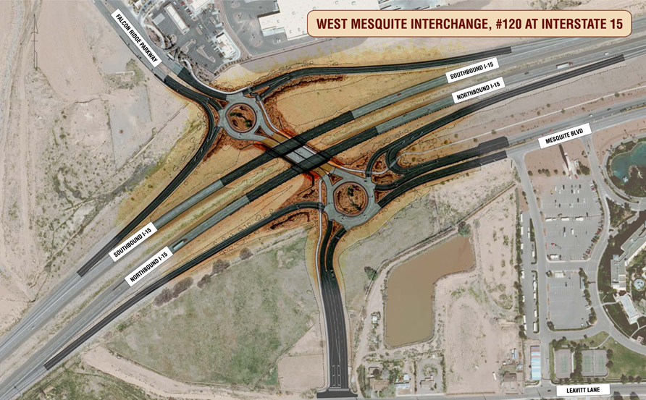
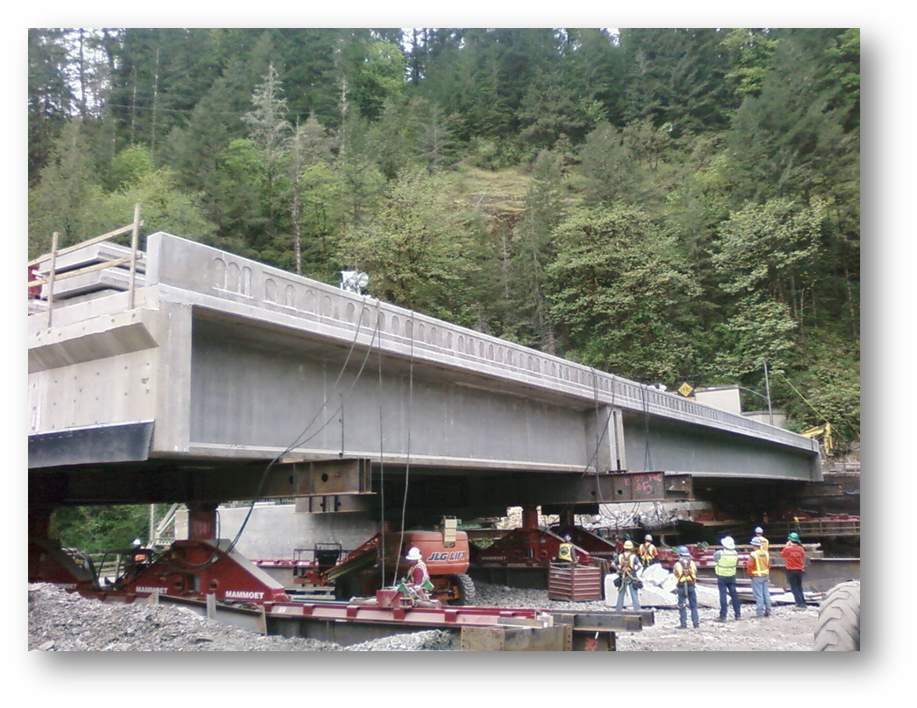
Project Highlight
Design-Build
Mesquite Interchange
Team proposed slide
Saved 6 mo. and $10 M
Elk Creek
Team proposed slide
Saved 22 mo. and $3M
Notes:
Two projects successfully completed using design-build contracting methods are the Elk Creek project in Oregon and the Mesquite Interchange project in Nevada.
The Mesquite Interchange team proposed slide in methods and were able to save 6 months and $10 million.
The Elk Creek design-build team was first to propose slide in methods and, in doing so, saved 22 months and $3 million.

Slide 42
Knowledge Check
Can any delivery method option be used in all locations?
No
Some governments prohibit certain contracting methods.
Notes:
The next knowledge check looks at delivery methods.
Can any delivery method option be used in all locations?
Answer: No, some governments prohibit certain contracting methods.

Slide 43
Planning for SIBC
The owner must ensure that there is sufficient right-of-way at the site for likely SIBC equipment
Great care must be given to determining acceptable length of closures
Incentives and disincentives must be appropriately defined. Too high or too low can have undesired consequences
Expectations with respect to “traffic impact” must be defined
On bridge
Below bridge
The owner and contractor should involve the public from very early on
Naming or branding the project or program (i.e., “Accelerated Bridge Program”) early on should be considered because it is likely to be named by the media or public regardless
Notes:
Planning for slide-in bridge construction generally follows that of traditional construction, yet there are some other unique items one must also plan for.
For example, the owner must ensure that there is sufficient right-of-way at the site for likely SIBC equipment and cranes for erection of beams, and it might be more space than anticipated.
A comprehensive study of an acceptable length of closure must be completed to appropriately assign incentives or disincentives. The owner must define the expectations to traffic impact, whether that be on the bridge or below the bridge.
The owner and/or contractor should involve the public from very early on to communicate the intent and expectation for using SIBC. Given that SIBC is an innovative method for bridge construction, it is likely to draw the attention from the public and media. For this reason, naming or branding the project or program should be considered since it will undoubtedly be named by someone.

Slide 44
Planning for SIBC
The programming of costs should recognize that higher costs may be realized
Owner must define needed submittals and provide project specifications that define the desired design criteria
It is likely that a great level of attention to creating and reviewing specifications will be required of the owner especially on the first project. The same is also true for contractor submittals
The owner needs to devise a reasonable project timeline where the SIBC period is conducive to submission, review, weather, and closure timing
Notes:
Higher overall costs, especially for initial SIBC projects, may be realized and should be addressed when programming.
Additionally, the owner must define any needed submittals and provide project specifications that define the desired design criteria.
It should come as no surprise that creating and reviewing specifications and submittals will require more attention, especially on the first project. Accordingly, the owner should devise a reasonable timeline to accommodate the added attention and so that weather and closure times can be best mitigated.

Slide 45
Planning for SIBC
Once construction begins the owner must be willing to dedicate additional resources to construction inspection
Inspectors must have a clear understanding of what is desired, what is acceptable and what isn’t
Must be prepared for inspectors to work long hours
The contractor must be willing and able to commit more resources than normal during the slide or other critical operations
The contractor should be required to effectively communicate means and methods with an assembly plan so that the owner, designer, and others understand and can verify
The contractor must have a fluid and efficient communication plan both before and during construction
Notes:
It should be expected that once construction begins, additional owner resources will be required in the form of construction inspectors.
Ensuring inspectors have a clear understanding of what is acceptable will take additional time. Even more, inspectors may have to work longer hours. Given the time-sensitive nature of SIBC during slide operations, a contractor must be willing and able to commit more resources than normal.
Also, an assembly plan is critical so that the contractor can clearly communicate his means and methods. His overall ability to efficiently communicate both before and during construction will be key to success.

Slide 46
Planning for SIBC
The contractor must have a contingency plan
Emergency response
Equipment failure
Extended detour time
Accident on detour
Severe weather
Notes:
Lastly, the contractor must have a contingency plan that addresses these questions and others. What should happen during an emergency response, or equipment failure? What if an extended detour time is required and what if there is an accident on the detour? What happens if severe weather approaches?
Project specifications should include the minimum contingency scenarios. The specifications should also encourage the contractor to determine and plan for other contingency plans.

Slide 47
Design and Detailing
In general, loads from sliding operations are similar to normal service life loads though jacking force loads should be addressed in design
Special attention is required for the design and detailing of the push and jacking locations
The use of concrete integral diaphragms are useful in dealing with this issue
Typically a bridge designer can relate slide operations to other maintenance operations
Lifting from slide bearings to final position is similar to replacing a bearing
Notes:
The design and detailing of a bridge slated for slide-in bridge construction is more similar than different from that of a traditionally constructed bridge. In general the loads during sliding operations are minimal and likely will not exceed loads typically seen during normal service life.
It is at the jacking locations that additional loads should be addressed. The use of concrete integral diaphragms are quite useful in dealing with this issue, an example of which is shown along with a slide plate in this detail. Forces can best be related to those seen in maintenance operations. For example, replacing a bearing.

Slide 48
Design and Detailing
Details are dependent on the slide system used
Detailing of slide shoes and bearings required
Jacking locations needed for bearing change-out
Notes:
Special attention should be paid to the detailing of slide shoes, bearings, and jacking locations if bearing change out is required.

Slide 49
Design and Detailing
Owner should be open to contractor suggestions for modifications of the design to accommodate specific construction processes
Include notes in contract to allow for contractor submitted alternate slide shoes and jacking locations
Semi-integral abutments can be used to facilitate detail; substructure needs to be designed appropriately
Notes:
Even more, the owner should be willing to entertain a contractor’s suggestions for design modifications that would enable a specific construction process to be completed with other equipment or in a different manner.
A semi-integral abutment with properly designed substructure can be used to facilitate slide details and modifications. In general, the slide surface should be level. This means that the depth of the semi-integral diaphragm will vary with roadway cross slope.

Slide 50
Design and Detailing
Detail adjustability on the bearings to provide uniform loading on all bearings
Need for slide displacement monitoring and controls
Temporary works structure should be attached to substructure
Notes:
Adjustability should be provided on the bearing to ensure uniform loading on all bearings.
A system for monitoring displacement during the slides should be in place.
Lastly, it is greatly beneficial to the overall substructure design, both permanent and temporary, to attach the temporary works to the permanent substructure. The reason for this will be demonstrated in the following slides.
Generally the temptation is to treat the bridge as very fragile when being moved and placed, while this is appropriate, this should also be tempered with the perspective that bridges are, in fact, quite strong and durable structures.

Slide 51
Force Diagram
Unattached temporary works
Jack
Superstructure
Substructure
Temporary Works
Notes:
Seen in this schematic are the two substructures for the permanent and temporary works in an ‘unattached’ state. When pulling or pushing the new superstructure from one substructure to the other, significant forces are introduced to the substructures as seen in free-body-diagram on the following slide…

Slide 52
Force Diagram
Jack
Superstructure
Friction Force
Substructure
Temporary Works
Unattached temporary works results in an overturning moment at temporary bent
Notes:
The resulting overturning moments must be accounted for in the design of the substructures, especially that of the temporary works.

Slide 53
Force Diagram
Attached temporary works
Jack
Superstructure
Substructure
Temporary Works
Notes:
Conversely, if a point of attachment is provided between the two substructures as seen in this schematic diagram, then…

Slide 54
Force Diagram
Connection transfers friction forces between the structures
Jack
Superstructure
Friction Force
Substructure
Attached temporary works ensures no overturning moment induced in temporary bent
Temporary Works
Notes:
… the overturning moments are eliminated, thereby greatly simplifying the design of the substructure and the temporary works.

Slide 55
Knowledge Check
Which is a better method for constructing temporary works?
Unattached temporary works
Attached temporary works
Jack
Jack
Superstructure
Superstructure
Substructure
Temporary Works
Temporary Works
Substructure
Notes:
Which method is better for constructing temporary works?
Leaving the temporary works unattached from the permanent substructure?
or
Attaching the temporary works to the permanent substructure?
Answer: Attaching the temporary works to the permanent substructure. This simplifies the demand and design of the temporary works and substructure.

Slide 56
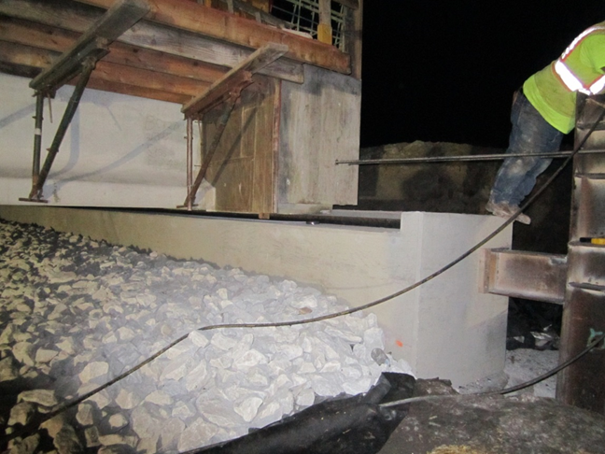
Project Highlight
Massena – Iowa
Semi-integral abutment acts as jacking location
Temporary works attached to permanent substructure
Notes:
As part of the Massena, Iowa bridge slide, semi-integral abutments act as the jacking locations and the temporary works were attached to the substructure. Together these details proved to be an effective means for sliding the superstructure.

Slide 57
Approach Slab
Attention to approach slab design and construction should be a priority and not an afterthought
Notes:
Not to be lost with the significant focus on the constructability and slide of a new superstructure are the approach slabs. Attention to approach slab design and construction should be priority, rather than an afterthought.
Several methods have been used including the ‘Utah Method’ which involves sliding the approach slabs with the bridge, precast approach slabs placed after the slide, cast-in-place approach slabs, or even buried approach slabs commonly referred to as the ‘European Method’.
A site-specific evaluation should be completed to assess which method is best. Most DOT’s have standards for this item that are not compatible with SIBC; again perspective is key. Age-old standard details can often be placed on a pedestal resulting in resistance to otherwise reasonable alternatives.

Slide 58
Design of Temporary Works
Temporary works usually lies within the contractor’s responsibilities, including foundation design. Possibly different if live load on temporary works is intended
Must be completed by a competent, registered professional engineer
Geotechnical investigation should be the responsibility of the engineer of record
Reports should consider both deep and shallow foundations
Design parameters should be included in the contract documents
Notes:
In most cases, the design of temporary works lies within the contractor’s responsibilities. Though if the traveling public will at least minimally travel over the temporary works, the responsibility may lie elsewhere.
The design must be completed by a competent, registered professional engineer. The engineer of record should be responsible for the geotechnical investigation around the site including the area proposed for temporary works.
Both deep and shallow foundations should be considered and all design parameters included in the contract documents.

Slide 59
Design of Temporary Works
Additional geotechnical borings at falsework locations may be required to ensure that the temporary foundation system operates as desired/needed
The contractor should be required to hire a geotechnical engineer if the proposed foundations are different than what is described in the geotechnical report
Codified resources
Guide Design Specifications for Bridge Temporary Works
Temporary substructure according to AASHTO for temporary bridges
Design for full seismic, wind or other probability based design loads may not be needed
Engineer of record for the temporary works will be responsible for the acceptance of that portion of the project
Notes:
If temporary works foundations different than those considered are proposed by the contractor, it is required of the contractor to hire a geotechnical engineer. Several codified resources exist to guide the temporary works design including those listed here.
In the end, acceptance of the temporary works will be up to the engineer of record for the installation.

Slide 60
Design of Temporary Works
Engineer of record should have ways of verifying certification of materials used for temporary works
It is recommended to hold a pre-bid meeting
Sample temporary works drawings should be provided to contractors new to SIBC
The construction of the superstructure on the falsework is nearly identical to that of conventional construction
Notes:
Further, the engineer of record should have the ability to verify materials certification.
A pre-bid meeting is recommended where sample temporary works drawings can be viewed for those unfamiliar with slide-in construction.
For SIBC, the actual construction of the new superstructure upon the temporary works is very close to that of conventional construction; very few methodical changes are needed.

Slide 61
Design of Temporary Works
Accurate estimation of jacking forces is critical.
Where the jacking forces will be applied is equally critical. Design engineer must consider localized effects during design.
Engineer must recognized that lateral slides rarely go perfectly lateral Racking or binding increases concentrated loads at the jacking points. Connections must be appropriately designed
Temporary works frame needs to be attached to permanent substructure
Provide jacking locations for vertical adjustment of superstructure
Notes:
The expected jacking forces and jacking locations are key to the design of temporary works. It should be noted that possible misalignments or hang-ups during slide operations can considerably increase the jacking forces. Accordingly, connections should be appropriately designed.
For reasons discussed earlier, the temporary works should be attached to the permanent substructure. Lastly, jacking locations for vertical adjustment of the superstructure should be incorporated into the design.

Slide 62
Design of Temporary Works
Minimize differential settlements
All loads are transient and changing. Therefore analysis must be completed at each state and stage
Differential displacement must be minimized to the extent possible
P-delta forces might need to be considered. When critical, additional bracing should be provided
Some critical loading cases will be for horizontally and vertically applied jacking loads
Notes:
Attempts to minimize the differential settlements between permanent and temporary works should be made. Note that all loads are transient and changing; therefore an analysis should be completed for stages throughout the process. Special attention should be paid to differential displacements, p-delta forces, and jacking loads.

Slide 63
Design of Temporary Works
The engineer must make a very good estimation of the coefficient of friction (static and kinetic) expected during the slide. Verify during rehearsal slide
Slide Mechanism | Estimated Lateral Force Required*
PTFE coated neoprene bearing pads | 10% of vertical load
Heavy duty rollers | 5% of vertical load**
* Recommended 5% minimum design load in any case
** Possibility of roller binding occurring increasing lateral force required
Notes:
To ensure the proper jacks will be supplied to the project, the engineer must make a good estimation of the friction forces during the slide. These forces should be verified during the rehearsal slide.
Two commonly used slide mechanisms include PTFE coated neoprene bearing pads and heavy duty rollers. The estimated lateral force required is 10% and 5% of the vertical load, respectively. Note that, in addition to the higher forces required during possible binding, a slightly higher force may be required when pushing the superstructure from a static to kinetic state.
Since the engineer of record does not know the make-up of the actual slide system, a recommended value of 10% should be used for preliminary engineering. The plans should show the recommended jacking location on the bridge and the engineer of record should verify that the structure can accommodate this force.

Slide 64
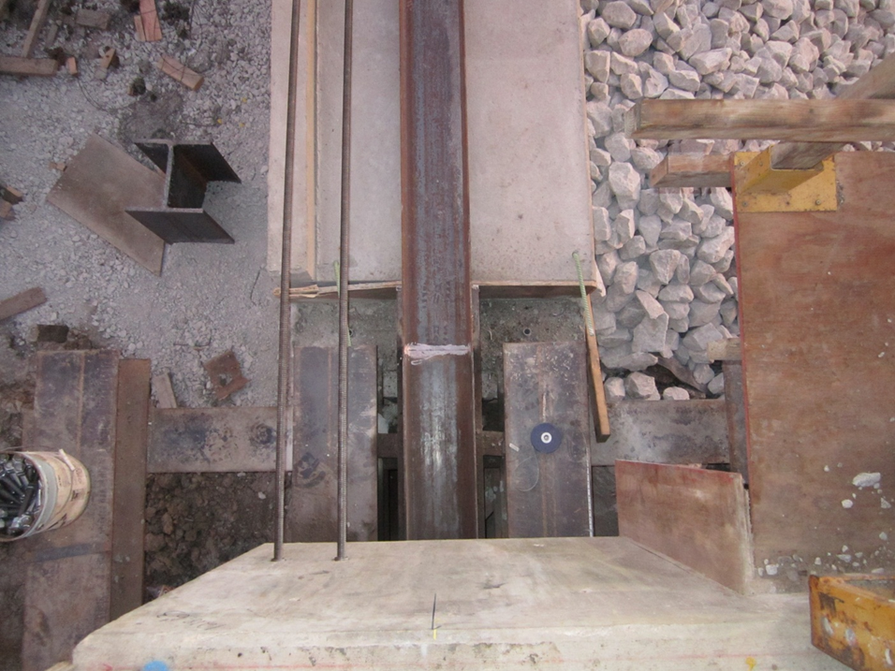
Design of Temporary Works
Transition from temporary support to permanent structure must be designed to accommodate the transient load and possible differential deflection
Notes:
It is key that the transition from temporary supports to the permanent structure be designed to accommodate the transient load and possible differential deflection. The superstructure should experience little effect due to the changing support condition.

Slide 65
Knowledge Check
Who is typically responsible for the design of temporary works for slide in bridge construction?
Contractor
Notes:
Who is typically responsible for the design of temporary works for slide in bridge construction?
Answer: The contractor.
Temporary works usually lies within the contractor’s responsibilities, including foundation design, though this could change if live load on temporary works is intended.

Slide 66
Knowledge Check
What percentage of vertical load can be considered a good estimate for the forces required to slide a bridge superstructure on PTFE coated neoprene bearing pads?
5%
10%
15%
20%
25%
5%
10%
15%
20%
25%
Notes:
What percentage of vertical load can be considered a good estimate for the forces required to slide a bridge superstructure on PTFE coated neoprene bearing pads?
5%?
10%?
15%?
20%?
Or
25%?
The answer: A good estimate on PTFE bearing pads is 10%. When using heavy duty rollers the force required is generally less, though in both circumstances the loads can increase if binding occurs or an obstruction isn’t removed.

Slide 67
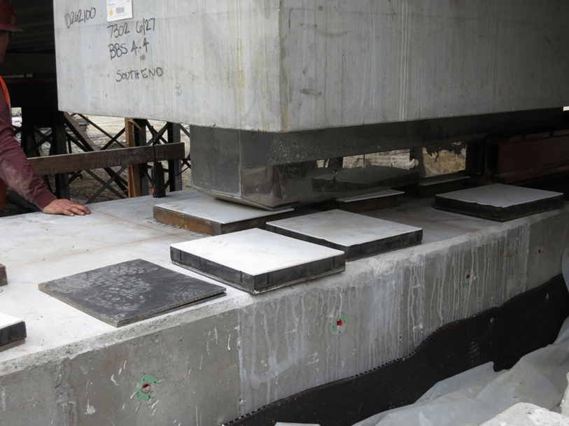
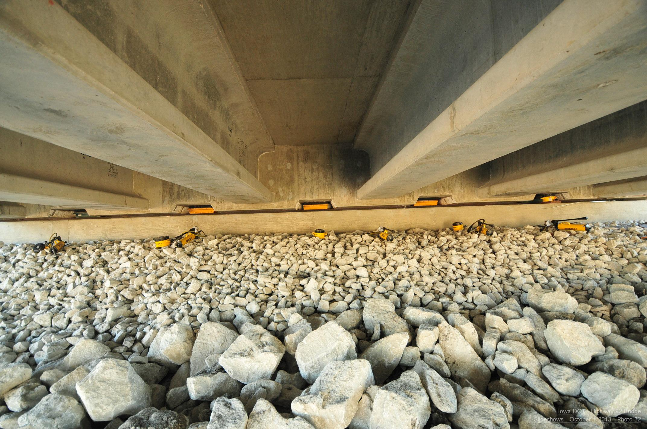
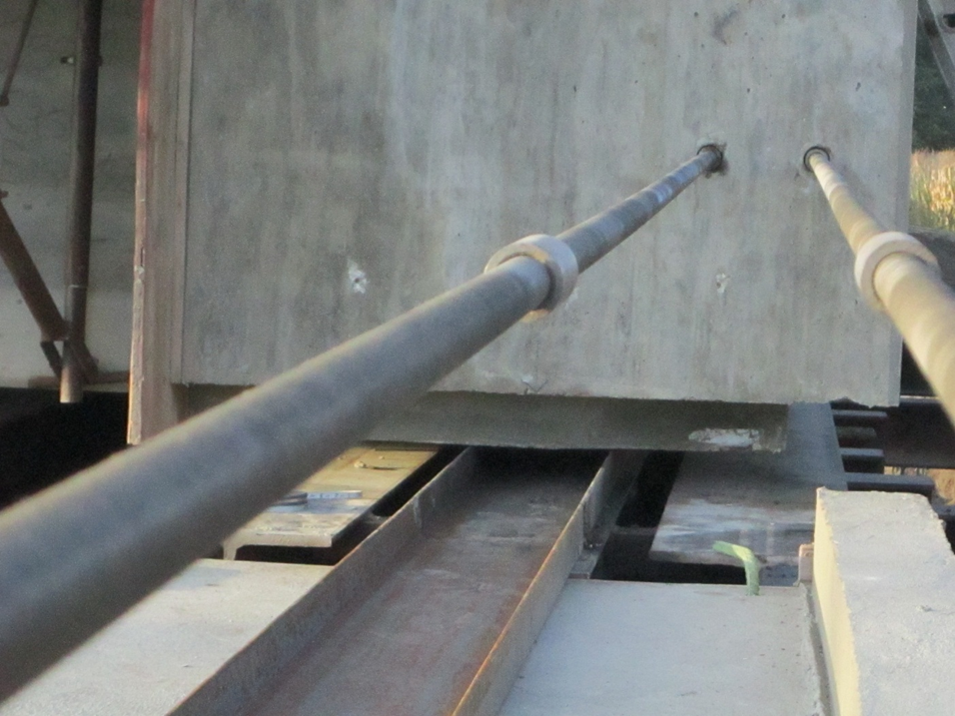
SIBC Slide Methods
Notes:
Provided in this slide are a few examples of various slide details. Shown in the two pictures to the left are PTFE coated bearing pads along with stainless steel slide shoes. Each pad is coated with dishwashing soap to further decrease the frictional forces; it is available, cheap and effective.
The top picture to the right shows jacking pockets incorporated into the semi-integral abutment used for vertical adjustment and bearing pad change-out.
The bottom picture shows the guide channel used with heavy duty rollers and also threaded rods which are connected to the jack. The slide shoe option works in conjunction with a semi-integral backwall diaphragm. The slide shoe can be just used for the move, or it can be used for the permanent bearing support. By using this method of detailing, the number of permanent bearings can be reduced by more than half. The Utah DOT has designed bridges with only 2 or 3 bearings at each support line.

Slide 68
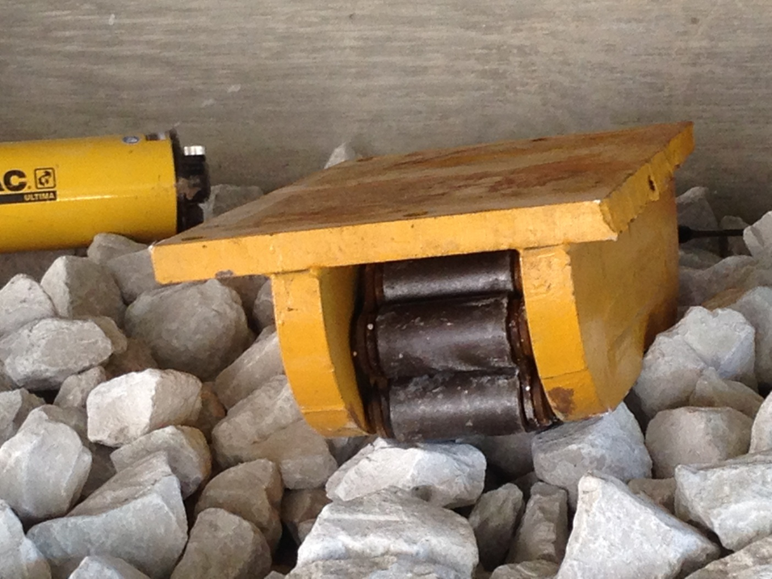
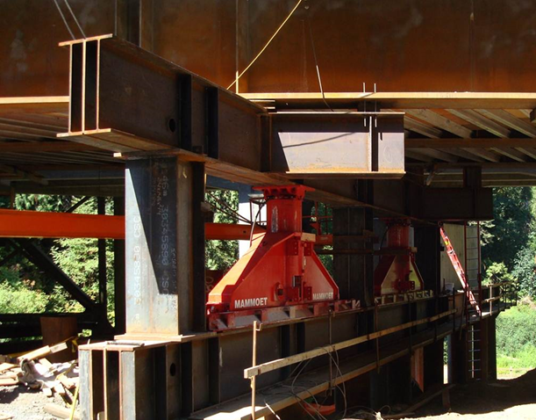
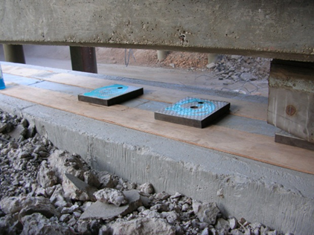
SIBC Hardware
Rollers
Skids
PTFE pads
Hydraulic rams
Hydraulic threaded bars
Vertical jacking hardware
Notes:
Additional pictures of hardware commonly used in slide-in applications are shown here. These include rollers, skids, PTFE pads, hydraulic rams, threaded bars, and vertical jacking hardware.

Slide 69
Power Systems
Hydraulic jack
Hydraulic push/pull jack
Winches
Cranes
Other Equipment
Notes:
Several power systems can be employed to move the bridge superstructure. These include hydraulic jacks, push/pull jacks, winches, cranes, and even other equipment.
It is recommended that hydraulic equipment be required to be proof tested prior to being put into service, even new jacks can blow out seals and fail.

Slide 70
Submittals
Slide system
Slide plan
Hour by hour schedule
Communication plan
Contingency plan
Contractor’s ingress/egress plan
Temporary works
Separate temporary supports and actual slide
Notes:
Submittals were briefly mentioned during the slides addressing the specifications. To further elaborate, some of the submittals that should be required include slide system plans; slide plans including an hour-by-hour schedule, communication plan, and contingency plan; the contractor’s ingress and egress plan; and temporary works, which should be separated from the actual slide due to the timeline in which each is required during the project.

Slide 71
Case Study: Elk Creek
Oregon Department of Transportation
Notes:
The Oregon Department of Transportation completed a project requiring several bridge replacements on State Highway 38 between the towns of Elk Creek and Hardscrabble, two of which were replaced using slide-in bridge construction methods. Here forward, the bridges will be referred to as Crossing 3 and Crossing 4.

Slide 72
Location
Notes:
The project is an hour south of Eugene in the mountains of western Oregon. The terrain alone would have been enough to make any bridge replacement project more difficult. Couple that with the desire to maintain traffic through the corridor during construction and the difficulty is only increased.

Slide 73
Project Overview
Design Build, Best Value Selection
Winning team proposed 2 slide-ins to eliminate expensive detours and flagging
Winning bid: approximately $50,000,000
Engineers estimate: approximately $53,000,000
Actual project duration: 32 months
Estimated project duration: 54 months
Notes:
The method of delivery was design-build with best value selection and the winning team proposed slide-in bridge construction for two bridges to eliminate expensive detours and flagging.
The project was in a very difficult location. Both of the existing bridges featured deck truss main spans which essentially eliminated the possibility of phased removal and construction.
Both bridges were on opposite ends of the same tunnel, with one of the bridges starting almost immediately after exiting the tunnel. This made traffic shifts and alternative alignments extremely difficult to complete.
The lateral slides which were completed in a 48 hour closure window for each bridge eliminated costly realignments, costly temporary bridges, and eliminated most of the single lane restrictions.
The winning bid was approximately $50 million, slightly under the engineer’s estimate of $53 million, and the total project duration was 32 months, almost two fewer years than the original estimated project duration.

Slide 74
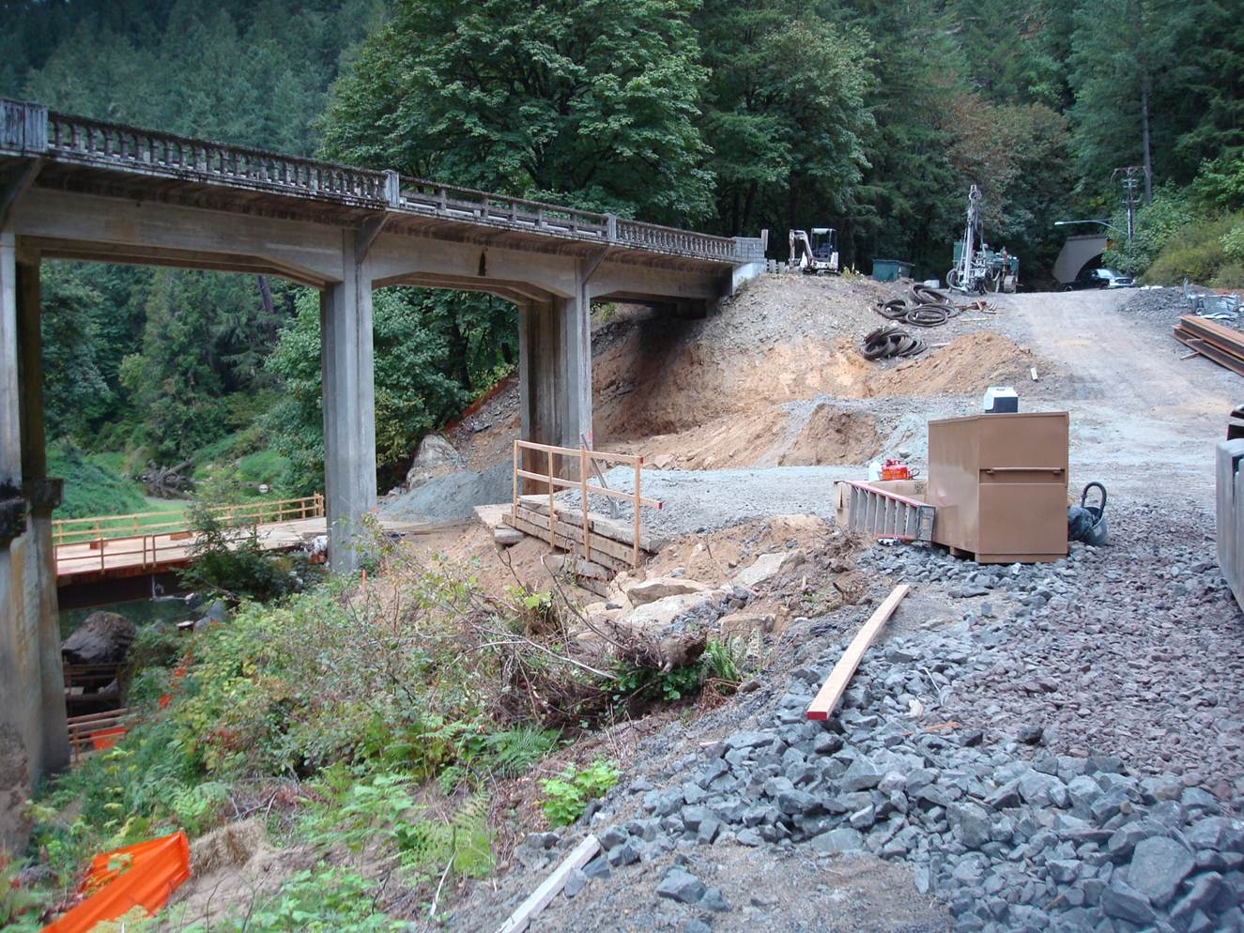
Why SIBC?
Crossing No. 3
2-lane detour very expensive and high risk
Long detour bridge with high bents or shorter detour with potentially unstable rock cut presenting high risk of unknown resultant solution
High risk due to temporary bents within narrow stream channel
Very little working room left on East end
Rapid replacement would score higher and guaranteed full incentive
Reduced risk of unknowns by avoiding cut slopes and potential geologic instabilities
Notes:
It’s useful to look at the reasons Slayden chose the lateral slides.
For Crossing 3, a temporary bridge could have been constructed but the local geometry made the temporary bridge almost three times the length of the permanent bridge.
Furthermore, there would have been considerable risk due to temporary bents within the narrow stream channel and very little working room would have been left on the east end which would have required a substantial hillside cut to reconnect at the west end.
Another reason, given that the project was design-build with best value selection, was that rapid replacement would score higher and guarantee full incentive.
The terrain also imposed several unique challenges. By avoiding cut slopes and potential geologic instabilities, the risk of unknowns was reduced.

Slide 75
Why SIBC?
Crossing No. 4
Single-lane detour problematic
A two-lane detour was impossible
Staging at tunnel portal would have required temporary signal or constant flagging
Analysis demonstrated temporary traffic signal would back traffic up across Crossing No. 3 – negative in proposal
180 calendar days to complete new bridge
Rapid replacement, which was not envisioned in the procurement documents for these sites, would score higher and guaranteed full incentive
Notes:
For Crossing 4, the proximity of the tunnel to the bridge, only about 50 feet from the tunnel portal to Crossing 3 from the bridge joint, made staging the new bridge very difficult. A temporary signal or constant flagging would have been required and in this case it was discovered that traffic would have backed up through the tunnel and across Crossing 3.
Additionally, if a single lane detour was used, the contractor would have been limited to 180 calendar days to complete the new bridge.
Rapid replacement was not originally envisioned in the procurement documents for these sites. However, its use did score higher and guarantee full incentive.

Slide 76
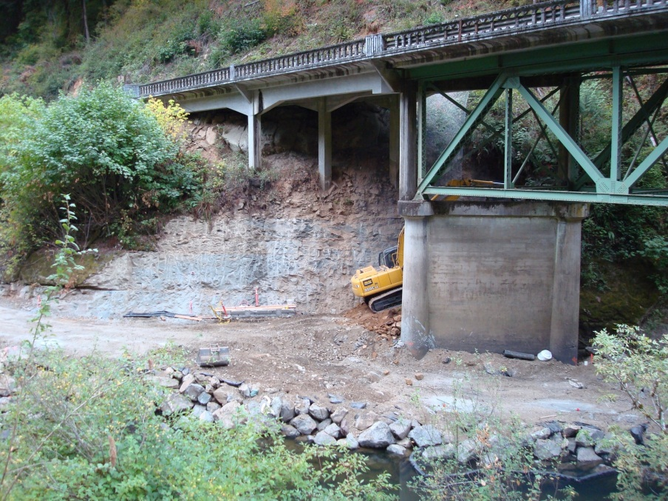
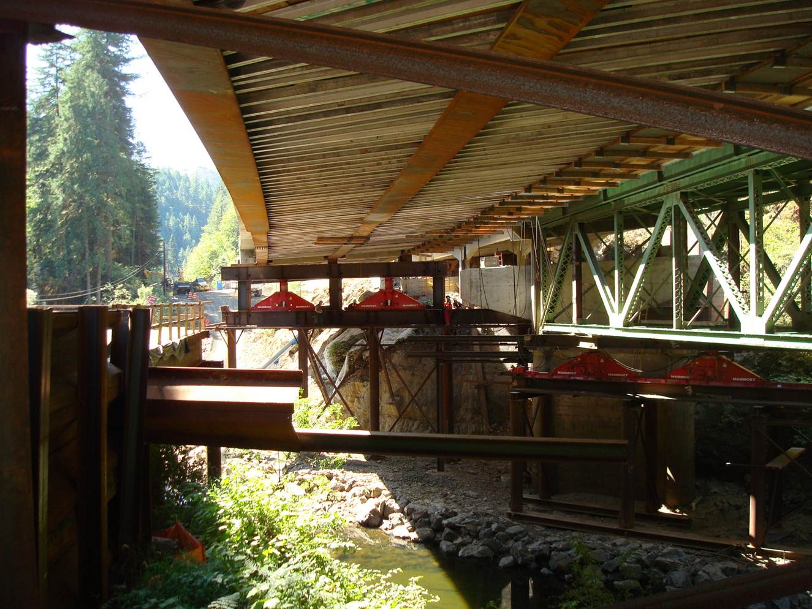
Crossing 3
Three-span continuous steel plate girder
Translation accomplished by support at two interior points with end spans cantilevered
Notes:
These pictures show the difficult construction conditions and site constraints.
The primary structure of the original bridge, shown on the left, was a deck truss.
The overall structure was also composed of several shorter concrete girder spans approaching the truss structure.
On the right, the new structure is shown adjacent to the old structure, and is a three-span continuous steel plate girder bridge.
The red pieces are the vertical jack and slide shoes. Translation was accomplished by supporting and sliding at two interior points with the end spans cantilevered.

Slide 77
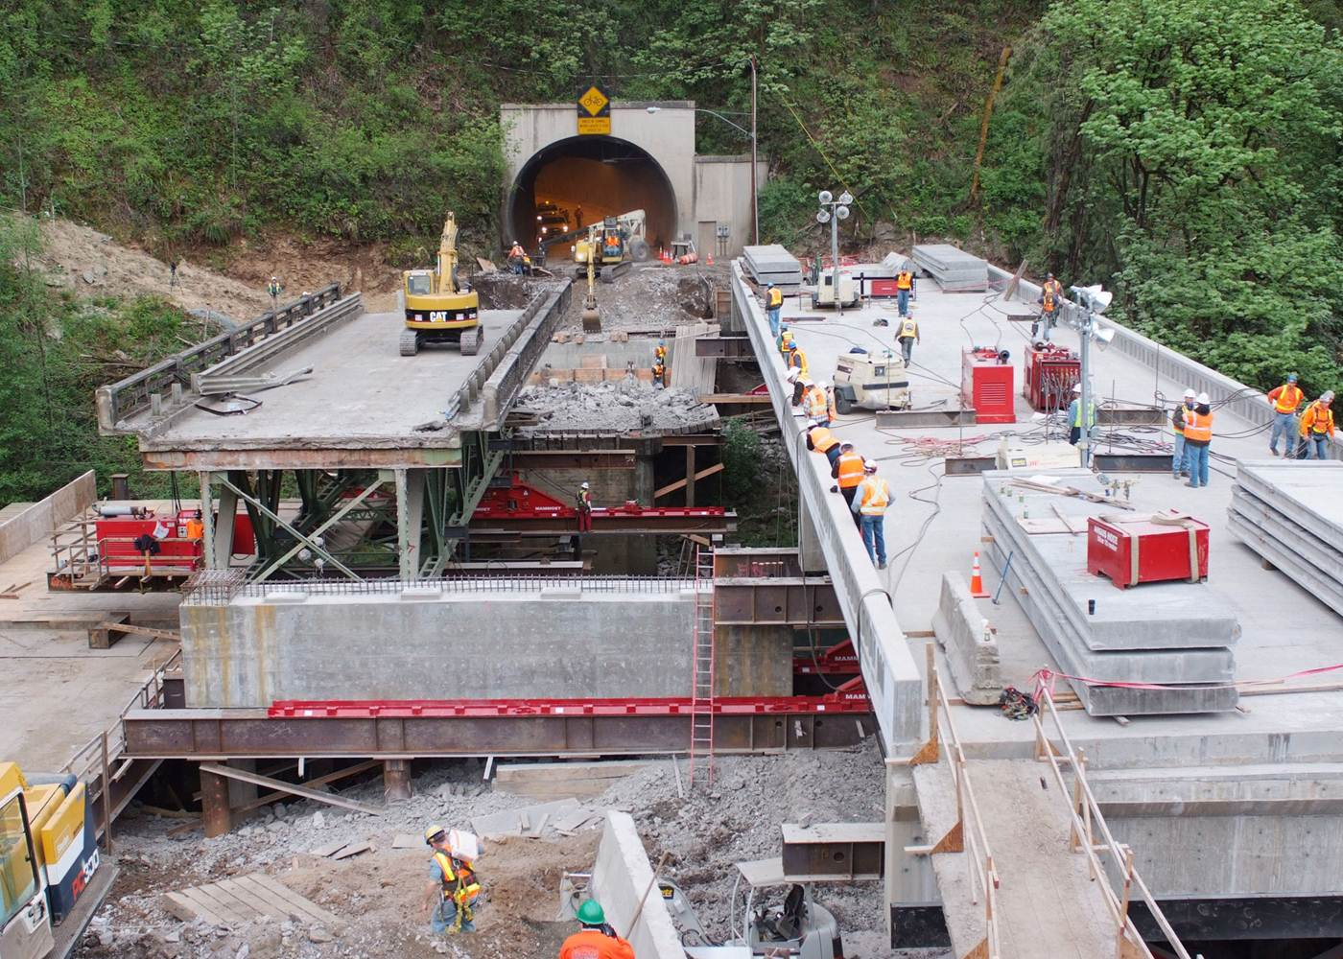
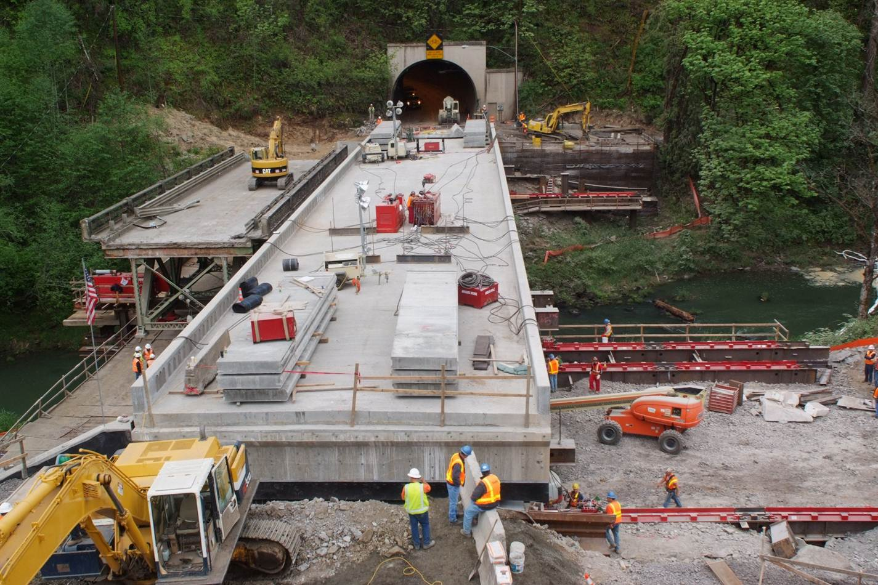
Crossing 4
Two-span prestressed concrete deck girder bridge
Translation supported at four points
Notes:
These pictures of Crossing 4, give you an idea of how difficult phased construction would have been due to the proximity of the bridge and tunnel. Like Crossing 3, the existing structure was a truss.
The new structure is a two-span, prestressed, concrete deck girder bridge. Translation was accomplished by supporting the structure along four lines.

Slide 78
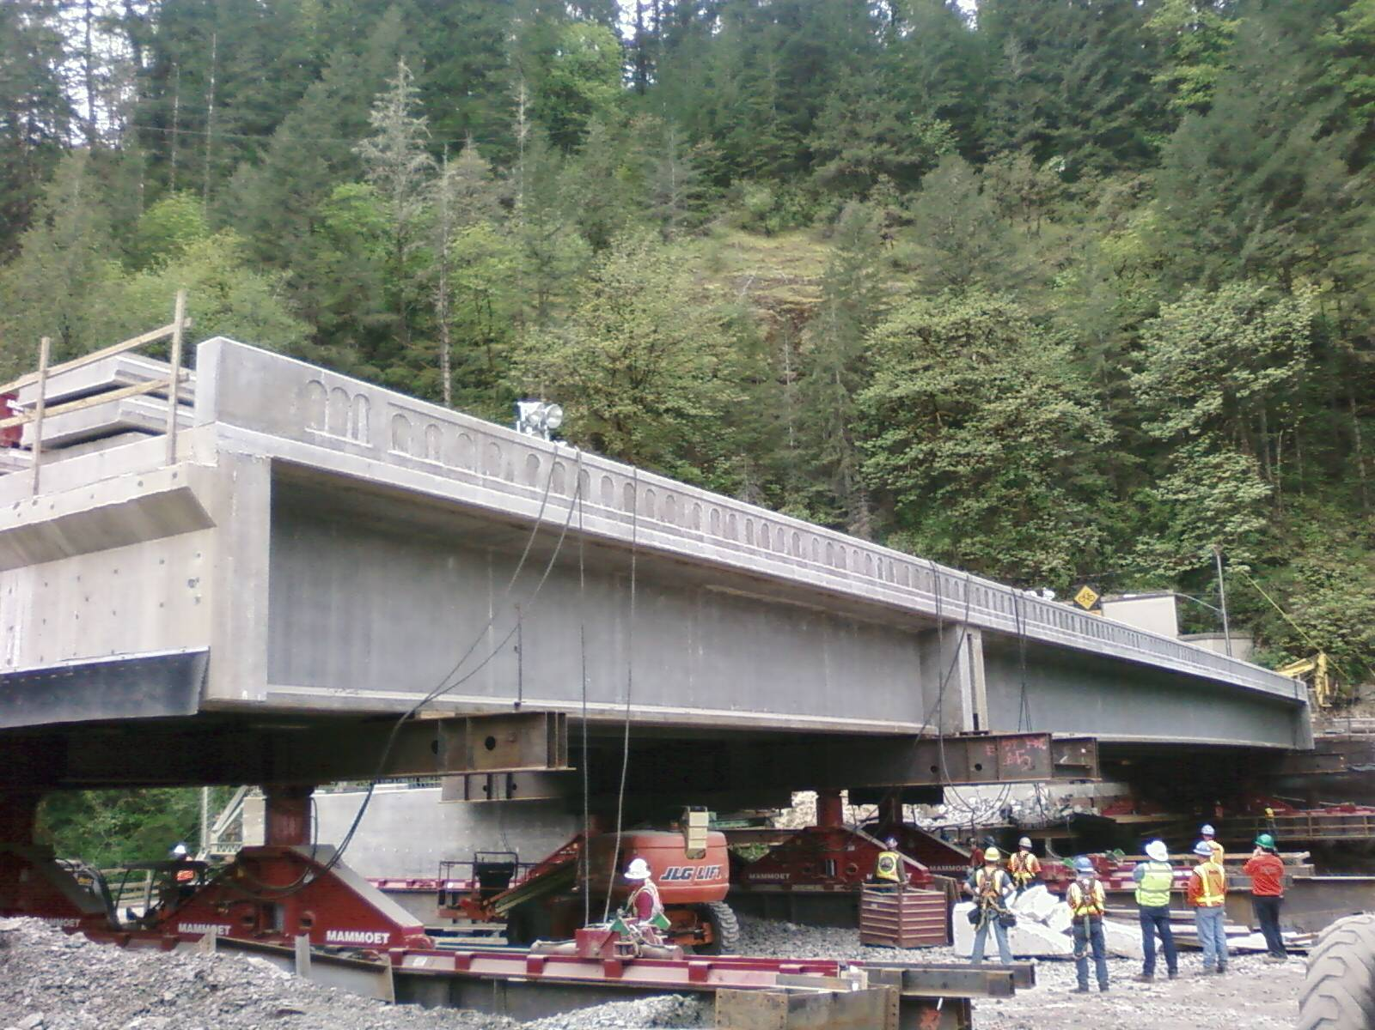
Crossing 4
Notes:
Here, another picture of Crossing 4 is shown and the points at which the structure was supported during translation are better seen.
A greater appreciation is also gained for the surrounding terrain and the magnitude of a bridge slide operation.
For both crossings, the slide operation was subcontracted to Mammoet who used a similar technology found in Self Propelled Modular Transporters.

Slide 79
Keys to success
Reduction in construction time offsetting additional SIBC costs
Reduction In MOT time resulting in schedule savings and good public relations
Elimination of flagging, 180 days one way traffic and traffic shifts – cost savings
Elimination of a significant temporary bridge carrying public traffic – risk reduction
Coordination and cooperation with the owner and local communities
Notes:
After all was completed, several keys to success were identified.
First, the reduction in construction time offset the additional costs due to slide-in bridge construction. Also, a significant reduction in maintenance of traffic resulted in schedule savings and good public relations, and the elimination of flagging for what would likely have been 180 days resulted in cost savings.
Furthermore, risk was greatly reduced by not using a temporary bridge to carry public traffic. And, maybe most importantly, the contractor made it known that coordination, communication and cooperation between the owner, community, and contractor was the real key to success.

Slide 80
Keys to success
Performance based procurement specifications allowing for innovation and an engineered solution
Maintained traffic on alignment throughout, greatly enhancing traveler safety and reducing risk
Notes:
Some additional keys to success include the performance based procurement specifications which allowed for innovation and an engineered solution.
Lastly, traveler safety and reduced risk were achieved by maintaining traffic on alignment throughout the duration of the project.

Slide 81
Community Outreach
Instrumental in providing information to traveling public
Initiative with local schools
Student pylon designs
$500 scholarship
Time capsule
Picture Courtesy of Structural Engineer Magazine
Notes:
As part of the project, the contractor implemented a community outreach program which was instrumental in providing information to the traveling public.
The initiative began with the local schools. On several occasions the contractor visited the schools to convey necessary information whether it be through the students or directly to parents.
A student competition was established to design the pylons at the corners of one of the bridges and the winning student was awarded with a $500 scholarship.
Lastly, a time capsule on one of the bridges was created for students and other community members to contribute to. For this project the location allowed for closing off the site to any public viewing eliminating that potential security and safety issue.

Slide 82
Contractor Obstacles on DBB
Contract issues
Design modifications to complete the slide (Will the owner accept the changes?)
Contract documents may preclude a complete closure. Will an owner accept a complete overnight closure in place of months of lane restrictions?
Are additional environmental clearances or permits required?
ATC process provides a viable method to bid
Site concerns
Reduction in quality
Design concerns
Cost concerns
Increase in risk
Contract issues
Notes:
Given all the benefits you may wonder why slides aren’t used more often. It’s likely we would see a lot more slides on traditional projects if the contractor knew they could get past a few obstacles. If a slide wasn’t part of the bid package and a slide requires modifications, the contractor can’t bid the slide in case the owner doesn’t accept the revisions. Once the project is won the contractor has little incentive to go down the value engineering change path. Sometimes value engineering changes can lead to a loss of positive partnering attitudes.
Site concerns – There are places where it is not feasible to construct a new bridge adjacent to the existing structure but the Oregon project shows that slides can be effective even in very confined locations.
Reduction in quality – There is no evidence in reduction in quality in bridge lateral slide projects. When compared to phased construction it might even be an improvement. The Utah DOT has performed special inspections of all lateral slide bridges and no adverse effects have been found with the bridges. In fact, the condition in most cases is better than bridges built with SPMT installations.
Design is fairly simple and there are a variety of solutions or methods used that demonstrate this. Difficult problems usually have few viable solutions.
Cost is difficult to quantify. It is more costly to slide a bridge into place than to close the road and build it in place. Once you start phasing the construction or requiring a temporary structure the slide becomes cost effective without even considering user cost and construction oversight costs.
Increase in risk – any new construction method for any contractor or owner represents a risk but in general it is believed to be low. Construction risk is similar to a cast-in-place bridge. The move risk is really a function of the time provided for the move and the associated penalties for not opening. A tight timeframe increases the risk the project won’t be completed in the allotted time. Low damages increases the risk that the contractor will not be prepared for problems. For example, having an additional jack onsite is cheap insurance against high penalties for not opening on time.
Contract issues – As a policy, owners should start structuring all projects to allow a lateral slide option. In addition to the normal contract and maintenance of traffic requirements it is relatively easy to add maintenance of traffic language to allow a limited complete closure with penalties or incentives in lieu of a defined time of reduced lanes or on site construction time. Also a special provision defining the requirements of any redesign and any other special requirements would allow the contractor to bid the job assuming a slide. As long as they know the requirements they need to meet they can confidently bid the job.

Slide 83
Time Lapse Video
Notes:
Here is a time lapse video of the slide period on Crossing 3.

Slide 84
“FHWA Slide” www.fhwa.dot.gov/construction/sibc/
Notes:
A technical support solutions center has been established and is available for all to use to assist in slide-in bridge construction projects. Here the most up-to-date information about SIBC resources and training can be accessed. The center is most easily found by searching “FHWA Slide” online, or by simply going to directly to the web address shown here.

Slide 85
Thank you!

