Slide 1
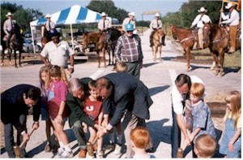
Designing Recreational Trails
Where Engineering and Art Meet
Christopher Douwes, Community Planner
Federal Highway Administration
Notes:
Photo from the National Transportation Enhancements Clearinghouse: www.enhancements.org/examples.asp. Mineral Wells to Weatherford Rail-Trail , Mineral Wells, TX. Opening day and dedication of the Mineral Wells to Weatherford Rail Trail. (Photo: Texas DOT).

Slide 2
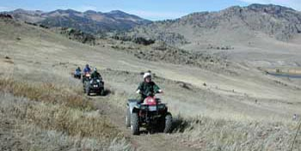
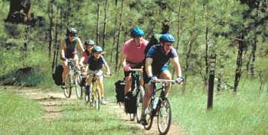
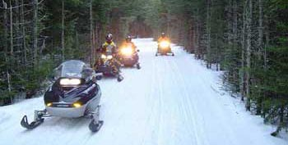
Recreational Trails
Why does FHWA care?
Eligible for Recreational Trails Program funds.
May be eligible for Federal Lands Highway funds.
Notes:
Photos from the Recreational Trails Program website: www.fhwa.dot.gov/environment/rectrails/
Left: Mountain bike trails at Butte State Park, Montana.
Top right: ATV trail on the Bull Run Guest Ranch near Cascade, Montana.
Bottom right: Snowmobiles at Eagle River, Wisconsin.

Slide 3
Recreational Trails
What is a recreational trail? A thoroughfare or track across land or snow, used for recreational purposes:
Pedestrian activities, including wheelchair use;
Skating or skateboarding;
Equestrian activities, including carriage driving;
Nonmotorized snow trail activities, including skiing;
Bicycling or use of other human powered vehicles;
Aquatic or water activities; and
Motorized vehicular activities, including all terrain vehicle riding, motorcycling, snowmobiling, use of off-road light trucks, or use of other off road motorized vehicles.

Slide 4
Shared Use Path or Trail?
What is the difference between a shared use path and a trail?
A shared use path is a trail that is readily usable for transportation.
A recreational trail is primarily for recreation, but may provide a transportation link.
Historic and cultural trails: National Historic Trails, Civil War Trails, Underground Railroad.
Tourism trails: birding trails, scenic routes.

Slide 5
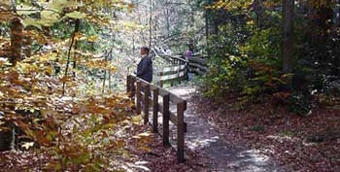
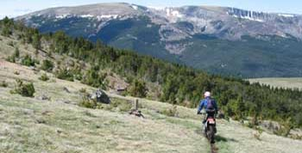
Recreational Trails
Recreational trail purpose:
A primary purpose is the user experience.
Less concern about getting from Point A to B.
Less concern about engineered designs.
These are not narrow highways!!!
Notes:
Photos from the Recreational Trails Program website: www.fhwa.dot.gov/environment/rectrails/
Left: Visitors enjoy a fenced trail near the Cycling the Pass stop on McKenzie Pass - Santiam Pass Scenic Byway, Oregon.
Right: Two-wheeling in the Lewis and Clark National Forest near Neihart, Montana.

Slide 6
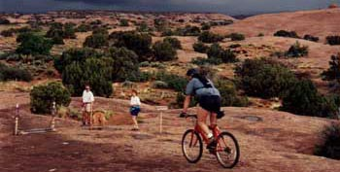
Provisions
If you build a recreational trail….
Make sure it works for all legal users.
  Accommodate pre-existing legal users, including equestrians, motorized, etc.
Ensure Accessibility, but there are exceptions.
What do users want to
experience and see?
These aren’t AASHTO
Guide facilities….
Notes:
See Equestrian and Other Nonmotorized Use on Bicycle and Pedestrian Facilities at www.fhwa.dot.gov/environment/bikeped/allow_uses_eqnm.htm.
Photo from the Recreational Trails Program website: www.fhwa.dot.gov/environment/rectrails/
Hikers and bikers both enjoy the Slickrock Trail in Moab, Utah, despite threatening storm clouds from the north. ©2000. A. Crane.

Slide 7
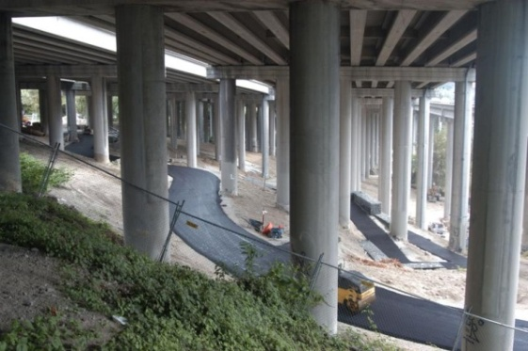
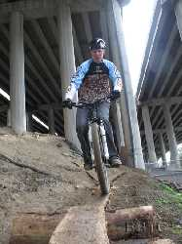
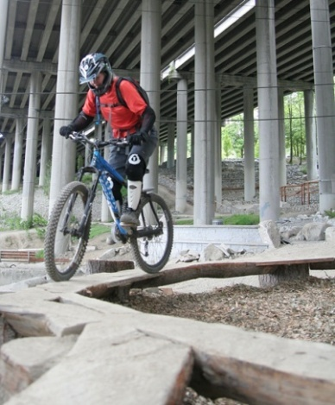
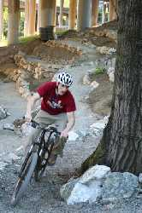
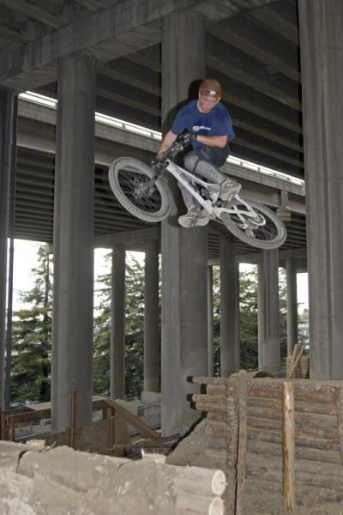
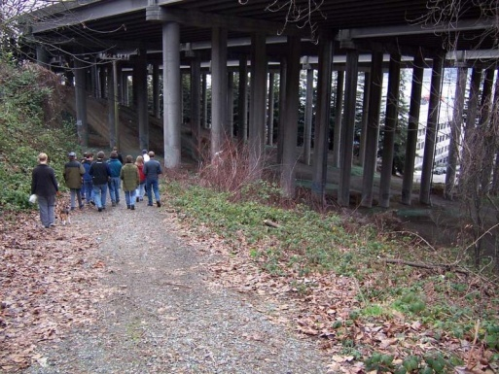
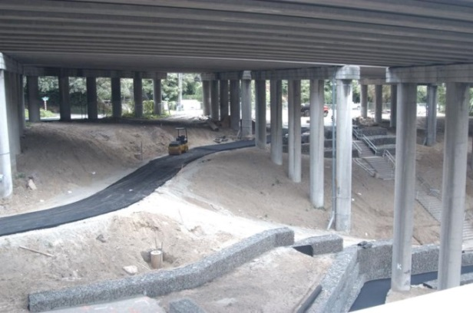
Recreational Trails:
What is the trail purpose?
What are the skill levels?
Beginners?
Family outings?
Technical skills?
  Challenge course?
  Freeriding? Speed?
  I-5 Colonnade, Seattle
Photos from Evergreen Mountain Bike Alliance: http://evergreenmtb.org/colonnade/
Notes:
Photos from Evergreen Mountain Bike Alliance: http://evergreenmtb.org/colonnade/ .
From: Maarten van Dantzich [mailto:maarten@evergreenmtb.org]
Sent: Wednesday, June 02, 2010 3:49 PM
To: Douwes, Christopher (FHWA); Glenn Glover
Subject: Re: Seeking Permission to Use Photos on a Federal Highway Administration Website
Hi Christopher--The photos were taken by a number of different members of our organization. As long as the use is low-resolution and in the context you described, I'm sure all the individuals are OK with the usage. If this makes you nervous and you want me to get in touch with each of them, I'm willing to, but most are active members who are interested in promoting good use of public spaces and in my opinion would be happy to have their photos used in this way.
Maarten. Evergreen website volunteer.

Slide 8
Recreational Trails:
What do you design for?
Accessibility: See www.access-board.gov/outdoor/.
Federal agencies and Federal lands: see Final Guidelines for Outdoor Developed Areas.
Forest Service: Use Forest Service Trails Accessibility Guidelines (FSTAG) and Accessibility Guidebook on Outdoor Recreation and Trails.
State, local, and private, including Federal-aid: no officially proposed guidelines. The Final Guidelines for Outdoor Developed Areas, FSTAG, and Accessibility Guidebook on Outdoor Recreation and Trails are best practices to use.
Access Board is still considering ADA guidelines.
In general: An accessible trail is a sustainable trail.
Notes:
Outdoor Developed Areas: The U.S. Access Board developed standards for Outdoor Developed Areas, see www.access-board.gov/guidelines-and-standards/recreation-facilities/outdoor-developed-areas. These guidelines are for recreational trails (trails not intended for a transportation purpose), outdoor recreation access routes, picnic and camping facilities, and beach access routes.
Federal Lands and Federal Agencies (except Forest Service): Use the Access Board’s Final Guidelines for Outdoor Developed Areas, published on September 26, 2013, under the Architectural Barriers Act (ABA) of 1968. These guidelines apply to projects on Federal lands or constructed by a Federal agency.
Forest Service: Use the Forest Service Trails Accessibility Guidelines (FSTAG) and Accessibility Guidebook on Outdoor Recreation and Trails. These guidelines comply with the Final Guidelines for Outdoor Developed Areas. The Forest Service guidelines are legally enforceable on National Forest System lands. Although the guidelines are official policy only for the Forest Service, they contain useful concepts to help other agencies and organizations maximize accessibility without changing the setting in outdoor recreation areas and on trails. The Accessibility Guidebook on Outdoor Recreation and Trails provides “how-to” information to integrate accessibility into outdoor recreation site and trail projects.
Projects constructed with or without Federal-aid funding by a State or local government, or a private entity, and not located on Federal lands: There are no officially proposed guidelines for outdoor developed areas under the ADA. However, in the absence of a standard, accessibility must still be provided under the ADA. The Access Board’s Final Guidelines for Outdoor Developed Areas and the Forest Service Trails Accessibility Guidelines (FSTAG) and Accessibility Guidebook on Outdoor Recreation and Trails are best practices that State and local governments and private entities may use.
The Outdoor Developed Areas guidelines are not appropriate for trails intended for transportation purposes: use the proposed PROWAG / Shared Use Paths guidelines.
Recreation facilities (other than trails): Use the Access Board’s Requirements for Recreation Facilities at www.access-board.gov/guidelines-and-standards/recreation-facilities/about-recreation-facilities. It would be relatively rare for FHWA to be involved with these projects, because most of these facilities are not eligible under Federal-aid highway programs unless required as environmental mitigation.

Slide 9
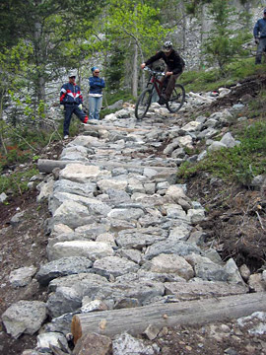
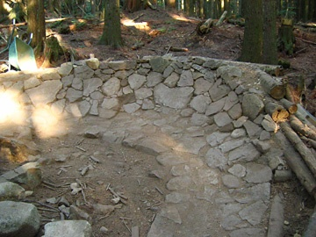
Recreational Trails: Surface
Surface: Firm and stable for accessibility.
Must accommodate wheelchairs to be accessible.
But not all recreational trails will be accessible.
Mountain bike trails: www.imba.com.
Equestrian trails
Motorized trails
Remote hiking
Trailside and trailhead facilities must be accessible.
Notes:
Photos: From International Mountain Bicycling Association: www.imba.com/resources/trail_building/index.html
Publication developed with funding in part through FHWA’s Recreational Trails Program.

Slide 10
Recreational Trails: Surface
Surface: Likely not paved.
Consider accessibility guidelines for trails.
Engineered or natural surface?
Tread Obstacles may exist:
Roots, rocks, ruts, bumps, etc. Keep <2 inches.
Drainage features. May affect cross slope.
Gaps: Usually in bridges and boardwalks. Keep <0.5 inches, or <0.75 inches by exception.

Slide 11
Recreational Trails: Width
What will be the user experience?
Design for minimum impact.
Accessible trails: generally 36 inch minimum, with exceptions if necessary.
Mountain bikes: narrow preferred: 12-24 inches.
Motorcycles: narrow preferred: 18-24 inches.
Equestrians: consider equestrian widths.
ATVs: wide enough for an ATV, not more.
ROVs/UTVs: wider than ATVs.
Notes:
ATVs: All-terrain vehicles
ROV: Recreational Off-road Vehicle
UTV: Utility Vehicle

Slide 12
Recreational Trails: Control water!
Avoid the Fall Line.
  Don’t let water run down the trail!
An accessible trail usually is a sustainable trail.
General: <5% to the extent feasible, but…
Consider the “half rule”:
  Keep trail slope less than half of the terrain slope.
  Keep the running slope under 10% if feasible.
Rest intervals needed for accessible trails.
Notes:
The “half rule” is not a “rule”. It is a consideration, and might not work depending on soils, surrounding terrain, rainfall, expected use, etc.

Slide 13
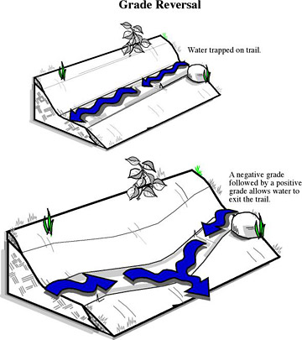
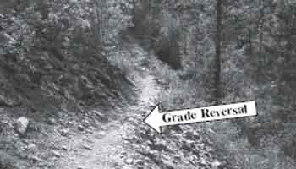
Trail Slope: Grade Reversals
Grade reversals stop water flowing down the trail.
Drawing: www.imba.com/resources/trail_building/downhill_tips.html
Photo: Trail Construction & Maintenance Notebook
(US Forest Service)
www.fhwa.dot.gov/environment/fspubs/07232806/page06.htm#grad
Notes:
Photo: USDA Forest Service, Trail Construction and Maintenance Notebook. www.fhwa.dot.gov/environment/fspubs/07232806/page06.htm#grad
Drawing: International Mountain Bicycling Association: www.imba.com/resources/trail_building/downhill_tips.html

Slide 14
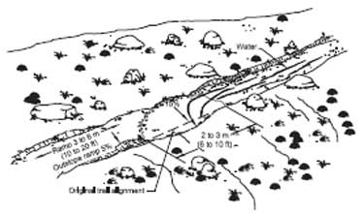
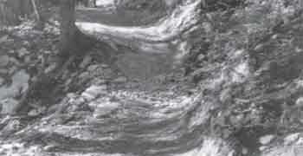
Trail Slope: Rolling Grade Dips
Easy way to get water off an existing trail.
Place frequently enough to prevent water from building up enough volume and velocity to carry your tread's surface away.
www.fhwa.dot.gov/environment/fspubs/07232806/page06a.htm#roll
Notes:
Photo and Drawing from USDA Forest Service, Trail Construction and Maintenance Notebook. www.fhwa.dot.gov/environment/fspubs/07232806/page06a.htm#roll

Slide 15
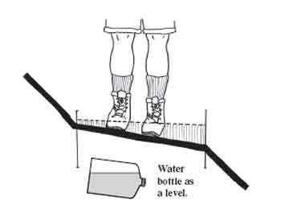
Recreational Trails: Cross Slope
Cross Slope: Control Water!
Maintain sheet flow across the trail.
  PROW ORAR Trail
General: 2% 3% 5%, 3% preferred
Exception: 5%* 5%** 10%**
* At street crossings without stop control or at midblock.
** If needed for drainage on an unpaved surface.
If your ankles start to roll, tread has too much outslope. www.fhwa.dot.gov/environment/fspubs/07232806/page08.htm.
Notes:
Drawing from USDA Forest Service, Trail Construction and Maintenance Notebook. www.fhwa.dot.gov/environment/fspubs/07232806/page08.htm.

Slide 16
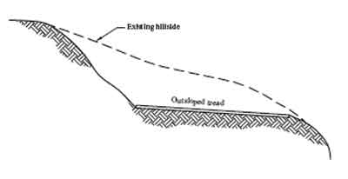
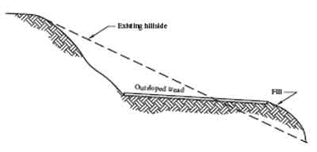
Recreational Trails: Cross Slope
Prefer a “full bench cut” over a “half bench” cut.
Full bench
  Holds its shape.
Half bench
  Easier to construct.
  But it slumps over time.
Notes:
Drawings from USDA Forest Service, Trail Construction and Maintenance Notebook. www.fhwa.dot.gov/environment/fspubs/07232806/page08.htm.

Slide 17
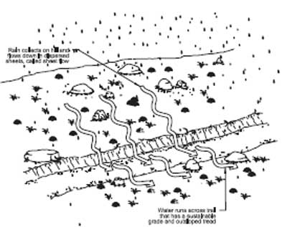
Trail Cross Slope: Sheet Flow
Sheet Flow Example
www.fhwa.dot.gov/environment/fspubs/07232806/page06.htm#shee
Notes:
Drawing from USDA Forest Service, Trail Construction and Maintenance Notebook.
www.fhwa.dot.gov/environment/fspubs/07232806/page06.htm#shee

Slide 18
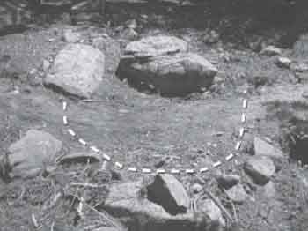
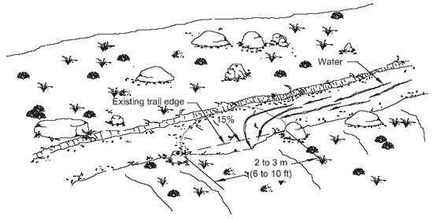
Trail Cross Slope: Sheet Flow
Knicks constructed into existing trails will drain puddles from flat areas.
A semicircle cut into the tread, about 3 m (10 feet) long and outsloped the center.
Notes:
Photo and Drawing from USDA Forest Service, Trail Construction and Maintenance Notebook.
www.fhwa.dot.gov/environment/fspubs/07232806/page06.htm#knic

Slide 19
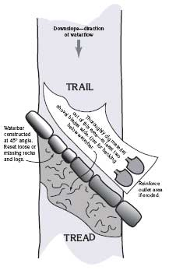
Please Avoid!
Don’t add barriers to trails.
Waterbars: To get water off the trail.
  Very popular. Not very effective.
  Not accessible. Possibly dangerous.
  Need ongoing maintenance.
  If you think you need a waterbar, the trail is in the wrong location.
  Grade reversals, rolling dips, and knicks function much better.
Avoid bollards (see Shared Use Path discussion).
Notes:
Drawing from USDA Forest Service, Trail Construction and Maintenance Notebook. www.fhwa.dot.gov/environment/fspubs/07232806/page06a.htm#main

Slide 20
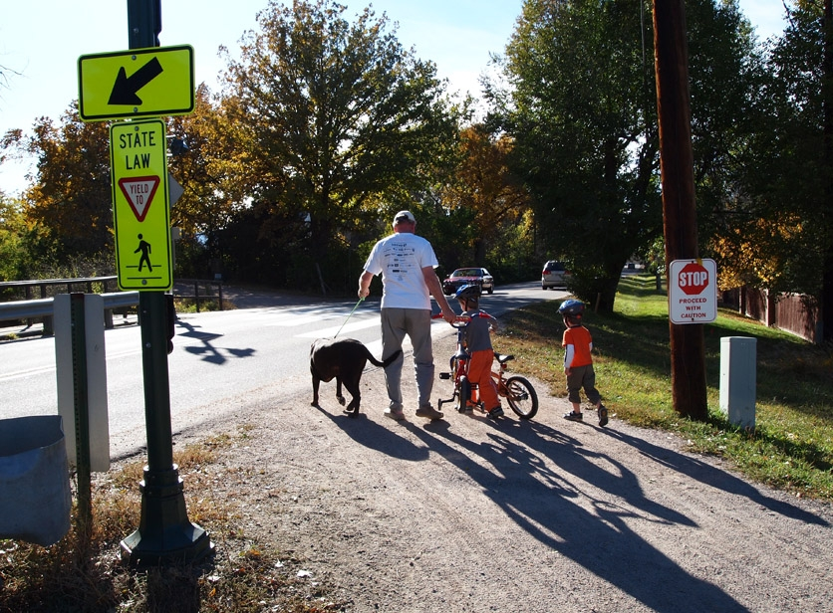
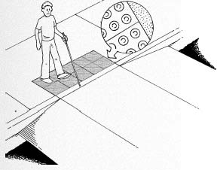
Recreational Trails: Crossings
You are in the public right-of-way.
See Shared Use Path discussion.
Notes:
Drawing: From FHWA’s Designing Sidewalks and Trails for Access: Best Practices Design Guide
Chapter 6. www.fhwa.dot.gov/environment/sidewalk2/sidewalks206.htm#rec
Photo: High Line Canal Trail, Cherry Hills Village, CO. Photo by Stuart Macdonald, American Trails.

Slide 21
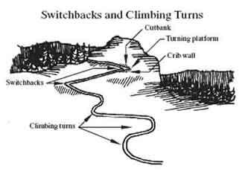
Please Avoid!
Don’t rip up the environment just to make a trail accessible.
  Avoid zigzagging switchbacks: Use climbing turns.
Notes:
Drawing from USDA Forest Service, Trail Construction and Maintenance Notebook. www.fhwa.dot.gov/environment/fspubs/07232806/page12.htm

Slide 22
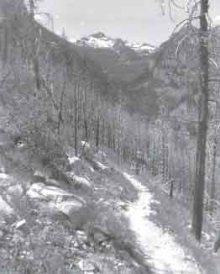
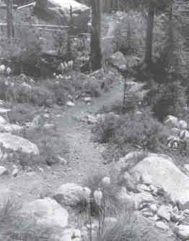
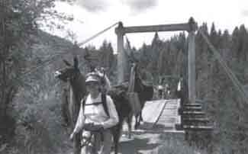
Scenery
Use Context Sensitive Solutions thinking.
A finished trail should look like it belongs there: it should blend into the scenery.
A trail should offer scenic views.
Build only the width you need.
Use natural features.
Notes:
Photos from USDA Forest Service, Trail Construction and Maintenance Notebook.
Left: www.fhwa.dot.gov/environment/fspubs/07232806/page11.htm#brid
Middle: www.fhwa.dot.gov/environment/fspubs/07232806/page04.htm#ligh
Right: www.fhwa.dot.gov/environment/fspubs/07232806/page04.htm#trai

Slide 23
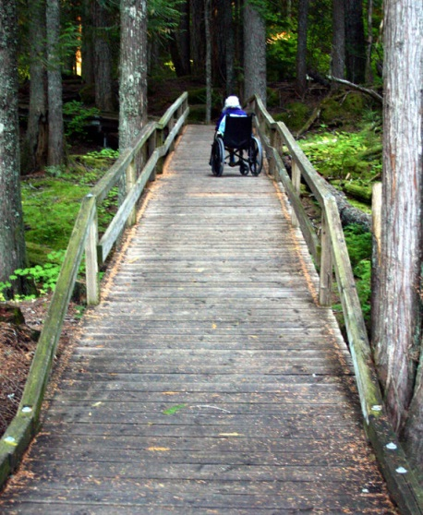
Drainage, Wetlands
Keep drainage as natural as possible.
Avoid wetlands to the extent feasible.
From Trail Construction and Maintenance Notebook:
Trails in Wet Areas
Geosynthetics, Rock Underdrains,
Turnpikes, Turnpikes Without Ditches,
Crossing Streams and Rivers
Shallow Stream Fords
Culverts, Bridges
See also Wetland Trail Design and Construction.
Notes:
Photo: Happy Creek Nature Trail, North Cascades, WA
Photo by Stuart Macdonald, September 24, 2006. www.americantrails.org/galleries/5index.htm

Slide 24
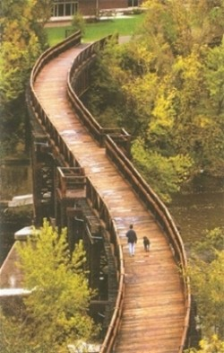
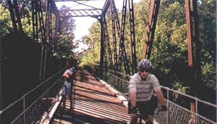
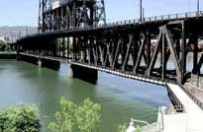
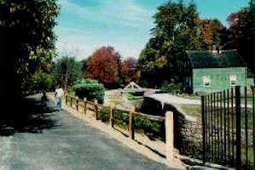
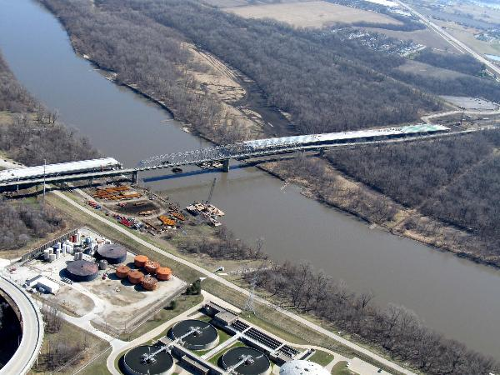
Bridges
Bridges: What are we building?
Notes:
4 photos from the National Transportation Enhancements Clearinghouse: www.enhancements.org/examples.asp.
Top right: Osage Prairie Trail, Tulsa OK
Top middle: Steel Bridge, Portland OR
Bottom left: Farmington Canal, Cheshire CT
Right side: Soo Line “S” Bridge, Eau Claire WI
Bottom middle: Rich Zelensky, Nebraska Department of Roads, through the River Valley Trail Riders, Council Bluffs IA. www.rivervalleytrailriders.com/PhotoGallery/tabid/68/AlbumID/473-1/Default.aspx

Slide 25
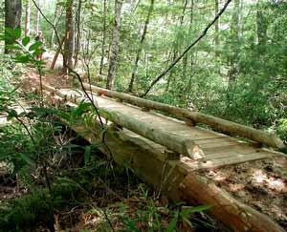
Bridges
You don’t need truck standards for most trail bridges.
Choosing the Right Bridge:
www.americantrails.org/resources/structures/ChooseBridgeBuild.html
Forest Service Trail Bridge Catalog:
www.fs.fed.us/eng/bridges/
Notes:
Photo: A rustic bridge on the Palmetto Trail. www.americantrails.org/resources/structures/CreativeCrossings.html
Photo source: Stuart Macdonald, American Trails: www.americantrails.org

Slide 26
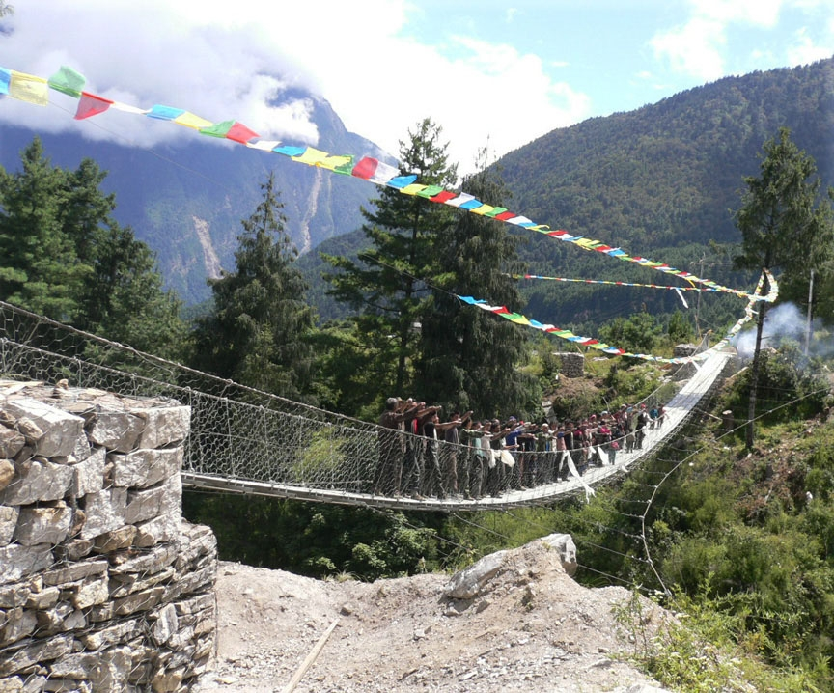
Bridges
Some Americans might not feel comfortable with swinging suspension bridges!
Notes:
TIBET: a bridge for the Happy Valley. www.americantrails.org/resources/info/Bridge-Tibet-Happy-Valley.html
Photo source: Stuart Macdonald, American Trails: www.americantrails.org

Slide 27
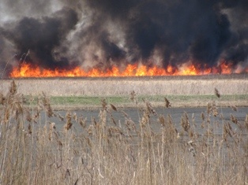
Wildlife Impact
Trails can impact wildlife.
Use caution when locating trails: Avoid sensitive areas.
Wildfire at Montezuma National Wildlife Refuge, along New York State Thruway, I-90 near Seneca Falls NY: April 4, 2010.
Courtesy of Joan Martin, Cortland NY
Notes:
Wildfire at Montezuma National Wildlife Refuge, along New York State Thruway, I-90 near Seneca Falls NY: April 4, 2010.
Photo Courtesy of Joan Martin, Cortland NY
Disclosure: Sister of the Presenter.

Slide 28
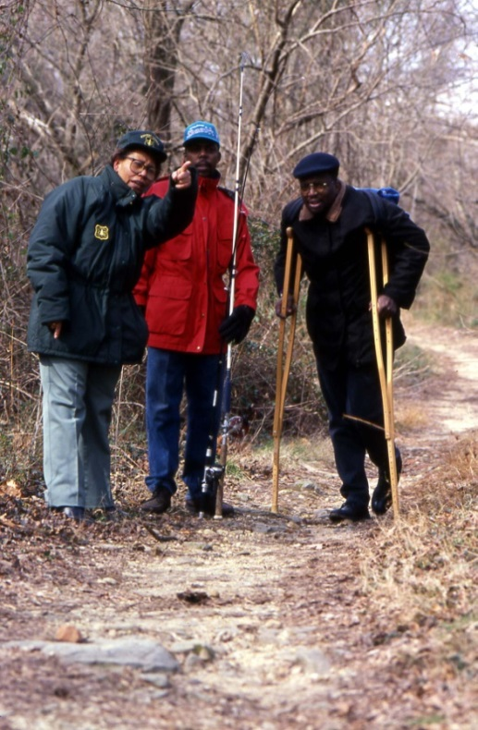
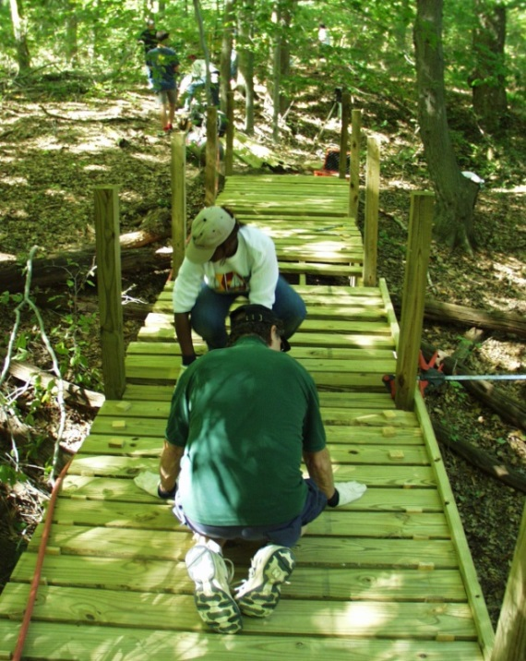
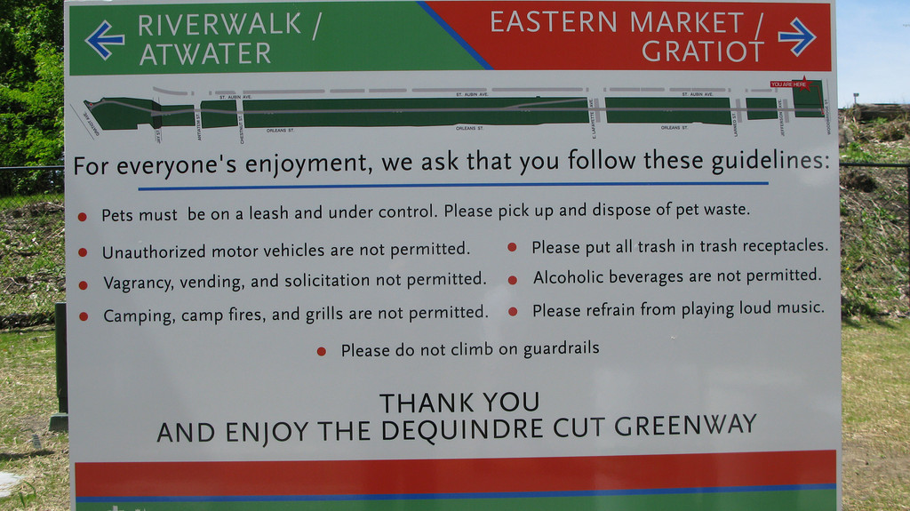
Maintenance and Operations
Maintenance prevents worse problems!
States may use Recreational Trails Program funds for maintenance.
Inform the public.
Notes:
Photos:
Left: National Transportation Enhancements Clearinghouse: http://images.enhancements.org/8-Rail-Trails/Dequindre-CutDetroit-MI/10111527_mXQTA#694612364_aSvtN
Middle: State Trail Administrators building a boardwalk/bridge at White Clay Creek State Park, Delaware, September 21, 2005. www.fhwa.dot.gov/environment/rectrails/stam2005/notes.htm#wed
Right: USDA Forest Service

Slide 29
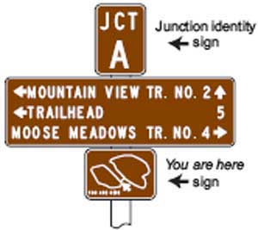
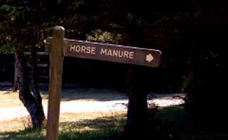
Signs
See MUTCD Chapter 9: http://mutcd.fhwa.dot.gov/.
Use it carefully. These trails aren’t highways.
Some sign sizes are excessive.
Notes:
Drawing and photo: USDA Forest Service: Equestrian Design Guidebook for Trails, Trailheads, and Campgrounds.
Drawing: www.fhwa.dot.gov/environment/fspubs/07232816/page19.htm#trai
Photo: www.fhwa.dot.gov/environment/fspubs/07232816/page13a.htm

Slide 30
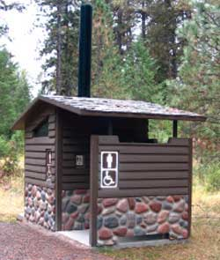
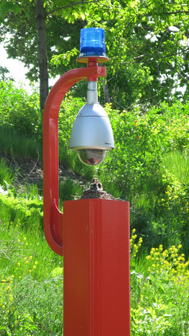
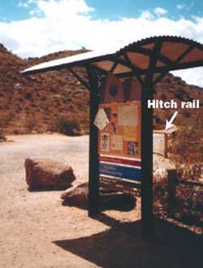


Support Facilities
Eligible:
Trailside and trailhead facilities.
Information kiosks, call boxes.
Benches, hitching posts.
Equestrian mounting ramps.
Rest rooms, water.
Bike racks.
Notes:
Top left: National Transportation Enhancements Clearinghouse: http://images.enhancements.org/8-Rail-Trails/Dequindre-CutDetroit-MI/10111527_mXQTA#694612364_aSvtN
Top right: USDA Forest Service: Equestrian Design Guidebook for Trails, Trailheads, and Campgrounds. www.fhwa.dot.gov/environment/fspubs/07232816/page13.htm#toil
Bottom left: Pedestrian and Bicycle Information Center: www.pedbikeimages.org/. Boulder, Colorado, Taken in 2004 by Austin Brown
Bottom center: USDA Forest Service: Equestrian Design Guidebook for Trails, Trailheads, and Campgrounds. www.fhwa.dot.gov/environment/fspubs/07232816/page13a.htm#ramp
Bottom right: USDA Forest Service: Equestrian Design Guidebook for Trails, Trailheads, and Campgrounds. www.fhwa.dot.gov/environment/fspubs/07232816/page13.htm#shel

Slide 31






Support Facilities
Facilities must meet accessibility guidelines for buildings and sites.
Notes:
Top left: National Transportation Enhancements Clearinghouse: http://images.enhancements.org/1-Ped-Bike-Facilities/James-D-Pfluger-FAIA-Bridge/9062921_82w5v#603389316_c9M2q
Top middle: MKT Trailhead Project, Columbia MO. www.americantrails.org/awards/CRT05awards/mkttrailhead.html
Top right: USDA Forest Service: Equestrian Design Guidebook for Trails, Trailheads, and Campgrounds. www.fhwa.dot.gov/environment/fspubs/07232816/page13.htm
Bottom left: Sheyenne River Valley National Scenic Byway, North Dakota's National Transportation Enhancements Clearinghouse: http://images.enhancements.org/4-Scenic-Hist-Hwy-Programs/North-Dakotas-Scenic/9796777_Ln5wi#664951991_hjFWU
Bottom middle: Bedford Depot, Minuteman Bikeway, Massachusetts. National Transportation Enhancements Clearinghouse: http://images.enhancements.org/8-Rail-Trails/Minuteman-BikewayMassachusetts/10223957_WdY3L#704910946_du6yu
Bottom right: USDA Forest Service: Equestrian Design Guidebook for Trails, Trailheads, and Campgrounds. www.fhwa.dot.gov/environment/fspubs/07232816/page13a.htm#ramp

Slide 32


Support Facilities
Not eligible
Park amenities: visitor centers*, whole park restrooms, picnic pavilions, campgrounds, ball fields, etc.
Play areas, spray areas, swimming pools, marinas, etc.
School facilities: running tracks, sports fields, bleachers, parking areas, field lighting, etc.
Notes:
Visitor centers are not eligible for Recreational Trails Program funds. Visitor centers that relate to scenic or historic highway programs were eligible for Transportation Enhancement funds or for National Scenic Byways Program funds, and may be eligible for Federal Lands Highway Program funds. Visitor centers are not eligible under the Transportation Alternatives Program.
Photos:
Left: USDA Forest Service: Equestrian Design Guidebook for Trails, Trailheads, and Campgrounds. www.fhwa.dot.gov/environment/fspubs/07232816/page13.htm#toil
Right: Picnic pavilion at Silver River State Park, Ocala FL. Photo by Charles Hughes. www.floridastateparks.org/silverriver/photogallery.cfm?pagenum=5&viewphoto=40

Slide 33

Support Facilities
Not eligible: Play areas, spray areas, swimming pools.
Seneca Lake State Park, near Seneca Falls NY, April 4, 2010
Photo Courtesy of Joan Martin, Cortland NY
Notes:
Photo: Seneca Lake State Park, near Seneca Falls NY, April 4, 2010
Photo Courtesy of Joan Martin, Cortland NY
Disclosure: Sister of the Presenter.

Slide 34

Questions, Comments, etc.
Happy Trails!
Christopher B Douwes
Community Planner
Transportation Alternatives Program
Recreational Trails Program
Federal Highway Administration
FHWA HEPH-10 Rm E74-474
1200 New Jersey Ave SE
Washington DC 20590-0001
Phone: 202-366-5013; Fax: 202-366-3409
www.fhwa.dot.gov/environment/transportation_alternatives/
www.fhwa.dot.gov/environment/recreational_trails/
Notes:
Photo of Christopher Douwes (Session Presenter), Trails and Enhancements Program Manager, Federal Highway Administration, at the Southeastern Equestrian Trails Conference, July 10, 2009: www.southeasternequestriantrails.com/2009FL.html

