Slide 1
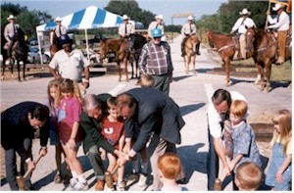
Trail Resources
Training, Publications, Websites
Christopher Douwes, Community Planner, Federal Highway Administration
Notes:
Photo from the National Transportation Enhancements Clearinghouse: www.enhancements.org/examples.asp. Mineral Wells to Weatherford Rail-Trail , Mineral Wells, TX. Opening day and dedication of the Mineral Wells to Weatherford Rail Trail. (Photo: Texas DOT).

Slide 2
Resources: Training
NHI Courses: www.nhi.fhwa.dot.gov/
  Bicycle Facility Design: 1.5 day course.
  Pedestrian Facility Design: 1.5 day course
FHWA University Course on Bicycle and Pedestrian Transportation: www.walkinginfo.org/training/university-courses/fhwa.cfm
PBIC Bicycle and Pedestrian Planning Course for Graduate Students: www.walkinginfo.org/training/university-courses/masters-course.cfm

Slide 3




Resources: Training
Pedestrian and Bicycle Information Center: www.pedbikeinfo.org
National Center for Safe Routes to School: www.saferoutesinfo.org
Association of Pedestrian and Bicycle Professionals: www.apbp.org
National Trails Training Partnership: www.NTTP.net
Tread Lightly, Inc.: www.treadlightly.org

Slide 4
Resources: Publications
Accessibility
Designing Sidewalks and Trails for Access: www.fhwa.dot.gov/environment/sidewalk2/index.htm
Accessible Public Rights-of-Way Planning and Design for Alterations: www.access-board.gov/guidelines-and-standards/streets-sidewalks/public-rights-of-way/guidance-and-research/accessible-public-rights-of-way-planning-and-design-for-alterations
Accessibility Guidelines for Outdoor Developed Areas (Federal areas) and Regulatory Negotiation Committee on Accessibility Guidelines for Outdoor Developed Areas: www.access-board.gov/guidelines-and-standards/recreation-facilities/outdoor-developed-areas
Forest Service Trail Accessibility Guidelines: www.fs.fed.us/recreation/programs/accessibility/

Slide 5
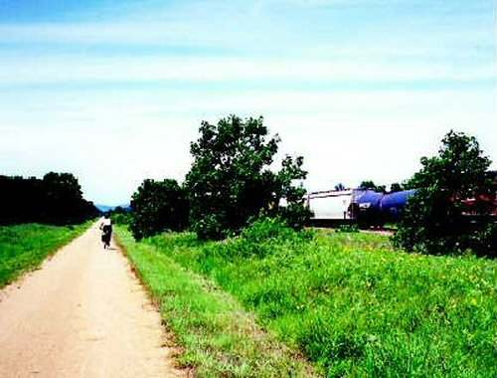
Resources: Publications
Guide to Promoting Bicycling on Federal Lands: www.cflhd.gov/techDevelopment/completed_projects/bikes/index.cfm
A Guide to Transportation Decisionmaking: www.fhwa.dot.gov/planning/decisionmaking/index.htm
A Resident's Guide for Creating Safe and Walkable Communities: http://safety.fhwa.dot.gov/ped_bike/ped_cmnity/ped_walkguide/index.cfm
Rails-with-Trails: Lessons Learned: www.fhwa.dot.gov/environment/recreational_trails/publications/rwt/index.cfm
Notes:
Photo from FHWA Report: Rails-with-Trails: Lessons Learned: www.fhwa.dot.gov/environment/rectrails/rwt/

Slide 6

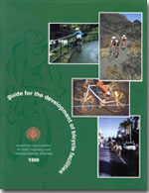

Resources: Publications
American Association of State Highway and Transportation Officials (AASHTO)
Guide for the Development of Bicycle Facilities: 2012. https://bookstore.transportation.org/.
Guide for the Planning, Design, and Operation of Pedestrian Facilities: 2004. https://bookstore.transportation.org/

Slide 7

Resources: Trail Publications
Recreational Trails Program: www.fhwa.dot.gov/environment/recreational_trails/publications/index.cfm
Trail Publications: USDA Forest Service: www.fhwa.dot.gov/environment/recreational_trails/publications/fs_publications/
US Forest Service National Trail Drawings and Specifications: www.fs.fed.us/.ftproot/pub/acad/dev/trails/trails.htm

Slide 8



Resources: Trail Publications
USDA Forest Service: www.fhwa.dot.gov/environment/fspubs/index.htm
Equestrian Design Guidebook for Trails,
Trailheads, and Campgrounds
Trail Construction and Maintenance Notebook
Wetland Trail Design and Construction
Trail Bridge Catalog
Additional FS Trail Bridge Resources

Slide 9
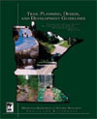
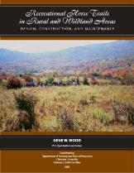
Resources: Trail Publications
States and Universities
Trail Planning, Design, and Development Guidelines: Minnesota Department of Natural Resources: www.dnr.state.mn.us/publications/trails_waterways/index.html
Recreational Horse Trails in Rural and Wildland Areas: Design, Construction and Maintenance - Gene Wood, Clemson University: www.clemson.edu/cafls/departments/forestry/fnr_store.html

Slide 10
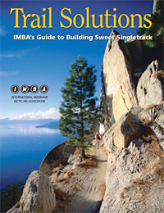

Resources: Trail Publications
Nonprofit Trail Organizations
International Mountain Bicycling Association: www.imba.com

Slide 11

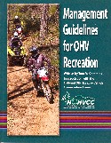
Resources: Trail Publications
Nonprofit Trail Organizations
National Off Highway Vehicle Conservation Council: www.nohvcc.org.
Park Guidelines; Management Guidelines

Slide 12


Resources: Trail Publications
Nonprofit Trail Organizations
American Council of Snowmobile Associations: www.snowmobilers.org
  Access Guide for Private and Public Lands
  Trail Grooming
  Safety Awareness Program
International Association of Snowmobile Administrators: www.snowiasa.org.
  Sign Guide
  Trail Evaluations

Slide 13
Resources: Websites
FHWA Accessibility Resource Library: www.fhwa.dot.gov/accessibility/
FHWA: Manuals and Guides for Trail Design, Construction, Maintenance, and Operation, and Signs: www.fhwa.dot.gov/environment/recreational_trails/guidance/manuals.cfm.
Manual on Uniform Traffic Control Devices: http://mutcd.fhwa.dot.gov/

Slide 14
Resources: Websites
Recreational Trail Websites
American Trails Resources: www.americantrails.org/resources/trans/index.html
American Trails: Cool Trail Solutions: www.americantrails.org/resources/cool/index.html
  Trail construction, Consultants & services, Tools, Accessible trails and ADA, Bicycle/pedestrian facilities, Bridges and boardwalks, Structures, tunnels, overpasses
Recreational Trails Program links: www.fhwa.dot.gov/environment/recreational_trails/resources/index.cfm

Slide 15
Resources: Websites with Examples
Pedestrian and Bicycle Information Center: www.pedbikeimages.org.
Transportation Alternatives Data Exchange Examples: http://trade.railstotrails.org/project_examples
American Trails Resource Library: www.americantrails.org/resources/index.html

Slide 16
Photo and Picture Sources
US Access Board. Accessible Public Rights-of-Way Planning and Design for Alterations: www.access-board.gov/guidelines-and-standards/streets-sidewalks/public-rights-of-way/guidance-and-research/accessible-public-rights-of-way-planning-and-design-for-alterations
Alta Planning + Design: www.altaplanning.com, from FHWA’s, Rails-with-Trails: Lessons Learned: www.fhwa.dot.gov/environment/rectrails/rwt/index.htm
American Trails: www.americantrails.org
Association of Pedestrian and Bicycle Professionals: www.apbp.org
Evergreen Mountain Bike Alliance: http://evergreenmtb.org/colonnade/
Federal Highway Administration:
  A Resident's Guide for Creating Safe and Walkable Communities, Resource Sheet 7: http://safety.fhwa.dot.gov/ped_bike/ped_cmnity/ped_walkguide/resource7.cfm
  Designing Sidewalks and Trails for Access, Best Practices Design Guide: www.fhwa.dot.gov/environment/sidewalk2/index.htm
  University Course on Bicycle and Pedestrian Transportation, Publication No. FHWA-HRT-05-133, http://www.tfhrc.gov/safety/pedbike/pubs/05085/chapt15.htm#fig154

Slide 17
Photo and Picture Sources
International Mountain Bicycling Association: www.imba.com
National Complete Streets Coalition: www.completestreets.org
National Transportation Enhancements Clearinghouse: www.enhancements.org
Nebraska Department of Roads, thru www.rivervalleytrailriders.com/
Pedestrian and Bicycle Information Center: www.pedbikeimages.org
US Department of Agriculture, Forest Service: Various publications: www.fhwa.dot.gov/environment/fspubs/index.htm
Virginia Secondary Street Acceptance Requirements: www.virginiadot.org/projects/ssar/default.asp
Walkable Communities, Inc.: www.walkable.org (Dan Burden). Dan also is the source for many Complete Streets and PBIC photos.
If source attribution is missing or incorrect, please contact christopher.douwes@dot.gov for proper attribution.

Slide 18
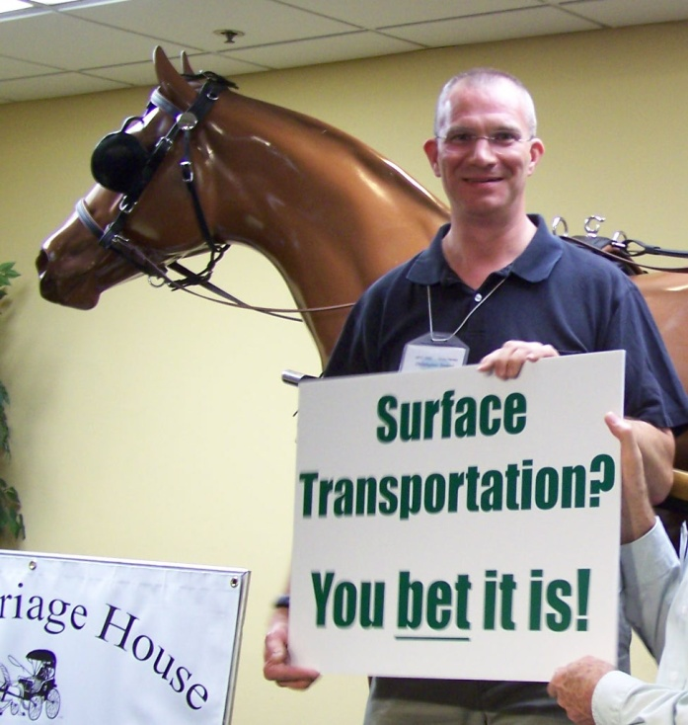
Questions, Comments, etc.
Christopher B Douwes
Community Planner
Transportation Alternatives Program
Recreational Trails Program
Federal Highway Administration
FHWA HEPH-10 Rm E74-474
1200 New Jersey Ave SE
Washington DC 20590-0001
Phone: 202-366-5013; Fax: 202-366-3409
www.fhwa.dot.gov/environment/transportation_alternatives/
www.fhwa.dot.gov/environment/recreational_trails/
Notes:
Photo of Christopher Douwes (Session Presenter), Trails and Enhancements Program Manager, Federal Highway Administration, at the Southeastern Equestrian Trails Conference, July 10, 2009: www.southeasternequestriantrails.com/2009FL.html

