Slide 1
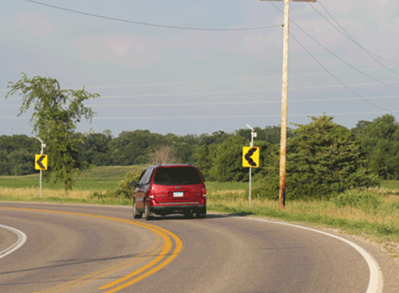
Sequential Dynamic Curve Warning System

Slide 2
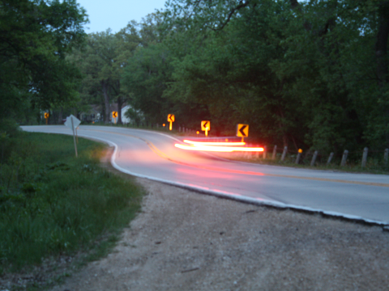
Project Partners
Technology Provider:
Traffic and Parking Control Co., (TAPCO)
Evaluation Team:
CTRE (Iowa State University)
TTI
SAIC

Slide 3
Project Partners
Participating State DOT’s:
Colorado (Existing Sites)
Missouri
Texas
Washington
Wisconsin

Slide 4
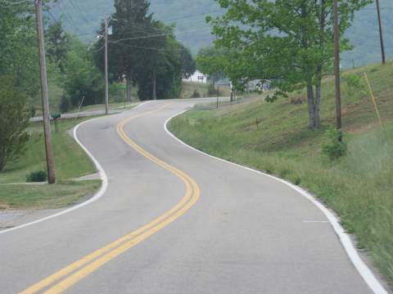
Current Safety Challenge
Horizontal curves make up a small percentage of total road miles, yet account for one-quarter of all highway fatalities.
Curves can have roughly 3 times the crash rate of tangent sections.
Majority of curve related crashes are attributed to speeding and driver error.
Majority of crashes on curves involve lane departures.

Slide 5
How it Works
The System consists of a series of solar-powered, LED-enhanced BlinkerSigns (a Curve Warning BlinkerSign and an array of Chevron BlinkerSigns) that are installed throughout a curve.

Slide 6
How it Works
Approaching vehicles, sensed by radar or other ITS device, trigger the controller that wirelessly activates the LED signs to flash sequentially through the curves to warn speeding drivers to slow down.
The flash pattern and timing is easily programmed.

Slide 7
Benefits of the System
Reduces the frequency of lane departures by providing dynamic feedback and guidance to drivers.
System is solar and can be installed anywhere
Economical – no electrical power costs
Quick and simple installation

Slide 8
Project Tasks
Task 1 – Site Identification
Identify 12 new treatment sites and 24 control sites in 4 geographically diverse states (MO, TX, WA, and WI).
The SDCWS are expected to be installed by October/November 2011.

Slide 9
Project Tasks
Site Criteria
Two-lane rural paved roads
Posted speed limit of 50 mph or above
Existing chevrons
No unusual conditions within the curve
High crash location
No major changes in the last 3 years
No major changes for the next 2 years

Slide 10
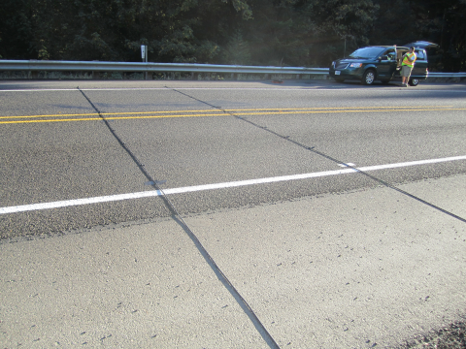
Project Tasks
Task 2 – Data Collection
Crash data: 3 to 5 years before and 1.5 years after
Speed data:
before install (Fall 2011)
after install (Winter 2011)
12 months after install (Winter 2012)
18 months after install (Summer 2013)
Base-line data: roadway, geometry, signage, etc..

Slide 11
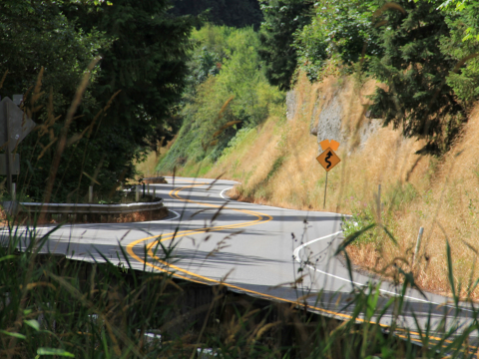
Project Tasks
Task 3 – First Year Evaluation Report
Completed 12 months “after” data collection
Estimated due date: January 2013

Slide 12
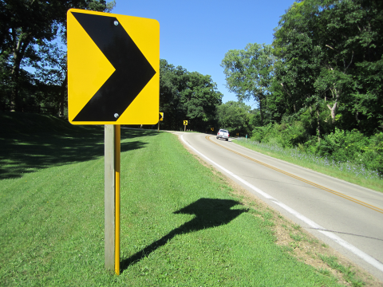
Project Tasks
Task 4 – Final Report
Full speed analysis through the 18-month analysis period
Guidelines and recommendations for implementing speed activated displays for curves based on lessons learned over the study period.
Estimated due date: December 2013

