Slide 1
The Alabama Pilot Program
Past, Present, and Future

Slide 2
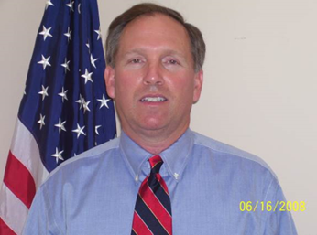
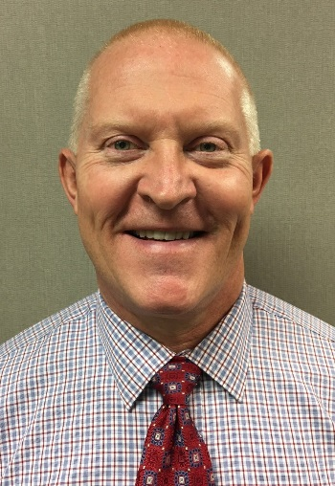
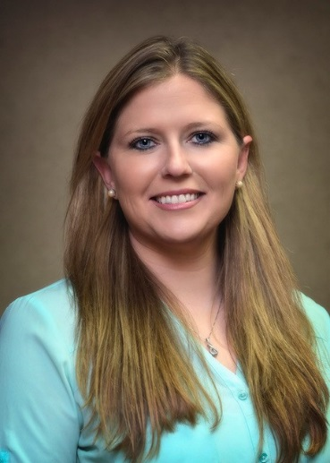
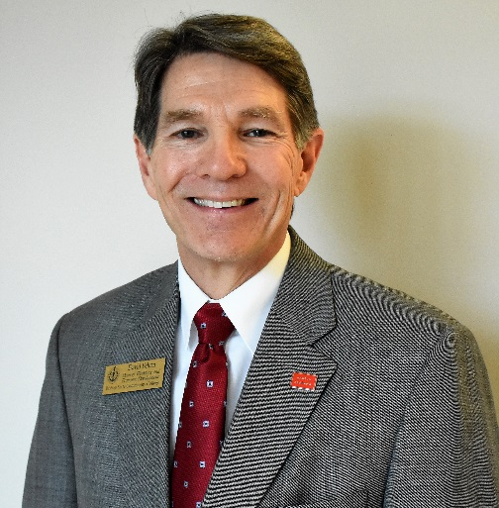
Alabama HCWP
 | Jeff Shelley Alabama Assistant Division Administrator Federal Highway Administration
 | Stephanie James Civil Rights Specialist Alabama Division Federal Highway Administration
 | Gary Weaver Regional Workforce Director Alabama Community College System
 | Courtney Taylor Region Director Workforce & Economic Development Alabama Community College System
 | David Felton Dean of Workforce Development Bishop State Community College

Slide 3
Pilot Program: Past and Present
PAST:
HCWP Pilot
Positive Results
Relationships were built that remain today: “The Team”
AGC, Alabama Chapter
Alabama Community College System (ACCS)
ALDOT
Industry Leaders
ARBA, Alabama Chapter
FHWA
Present:
The same Team decided to run this into an off-shoot pilot Program
The Team set-up the following objectives:
Outreach-ACCS, ARBA, and AGC
Curriculum/Certifications-ACCS
Administration of Program-Bishop State (2 Community Colleges total)
Document Development-MOU and SOW
End Result-Sustainable Program that continues; Roll the Pilot into AL Apprenticeship Program; Nationally Recognized Certification

Slide 4
Power Point Slides for Industry
Illustration of Partnerships in Place for the Pilot program

Slide 5
Power Point Slides for Industry
Mobile Area presented to 9 Companies and 6 signed on support the Pilot Program

Slide 6
Pilot Program: Future
Running the Pilot Program as a dynamic and ever changing model, pursuant to changing construction needs and development of newer technology in the industry. (Living, Breathing Program)
Allows for adjustments to be made as needed during the Pilot, while still following contracting methods and policies
Sustainable program that will be supported by the on-going partnerships in place now.
Roll this program into the Alabama Apprenticeship Program proposed by Alabama Governor Ivey.
Provision of National Certification recognized throughout the US

Slide 7
Participating in the Webinar Today
Alabama Community College System (ACCS):
Gary Weaver, Regional Workforce Director, ACCS
Courtney Taylor, Regional Director of Workforce and Economic Development, ACCS
David Felton, Dean of Workforce Development, Bishop State Community College
ALDOT: Clarence Hampton, Compliance Bureau Chief
FHWA: Stephanie James, AL Division Office, Civil Rights Specialist

