Slide 1





ALDOT HEAVY HIGHWAY CONSTRUCTION
OJT training pilot project
WORKFORCE DEVELOPMENT

Slide 2
HEAVY HIGHWAY CONSTRUCTION
On-the-Job training Pilot project
Increase numbers
of trained workers for the Heavy Highway Construction Industry
Apprenticeship
Style Program
(OJT)
Incorporate Industry Recognized Credentials: ATSSA Flagger, OHSA, NCEER,
& CDL
Ensure Sustaining Program Activities after Grant Period
Curriculum and Program Development
Industry Driven
Oversight by Industry
Up to 15 Students/College
For this Pilot Project
Grant funding of Tuition by College
Paid OJT Work by Employer
DOT HEAVY HIGHWAY CONSTRUCTION APPRENTICESHIP

Slide 3
Pilot project Partnerships
HEAVY HIGHWAY CONSTRUCTION
OJT TRAINIG
PILOT PROJECT
ALDOT &
Federal Highway Administration (FHWA)
Alabama Road Builders Association (ARBA),
Alabama General Contractors (AGC) - Mobile Section
Career Centers
SWAPTE
Alabama Community College System
(ACCS)
Bishop State
Trenholm State
Bishop State is the
Lead College
DOT HEAVY HIGHWAY CONSTRUCTION APPRENTICESHIP

Slide 4
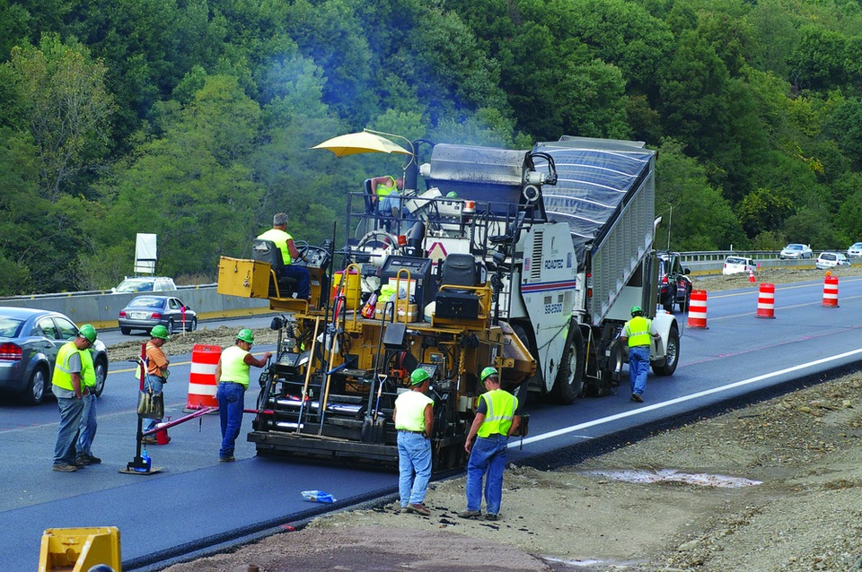
EARN WHILE YOU LEARN CONCEPT
Paid On-the-Job Based – aka:
Work Based Learning (WBL)
Fast Track (within 6 months) Training
Trainees Work in Mornings – Attend Class in Afternoons
Equipment seat time by employer at job site. 25 hours of Heavy Equipment
Seat Time (employer can allow more hours). Colleges do not currently have
this type of heavy equipment. Instructor will go to job site for observation to validate NCCER
practical assessment.
Sustaining Goal:
Project will work towards developing a formal Apprenticeship Program by working with the Alabama Office of Apprenticeships (AOA) to establish an Alabama Industry-Recognized and Registered Apprenticeship Program (AIRRAP)
DOT HEAVY HIGHWAY CONSTRUCTION APPRENTICESHIP

Slide 5





credentialing
Industry Recognized Credentials –
  ATSSA Flagger
  OSHA 10
  NCCER Core
  NCCER Heavy Highway Construction, Level 1
  CDL Class A (160 hours).
  CDL allows for participants to be a more complete
  employee by learning to operate both the equipment
  itself and the trucks/trailers needed to transport
  equipment from site to site.
DOT HEAVY HIGHWAY CONSTRUCTION APPRENTICESHIP

Slide 6
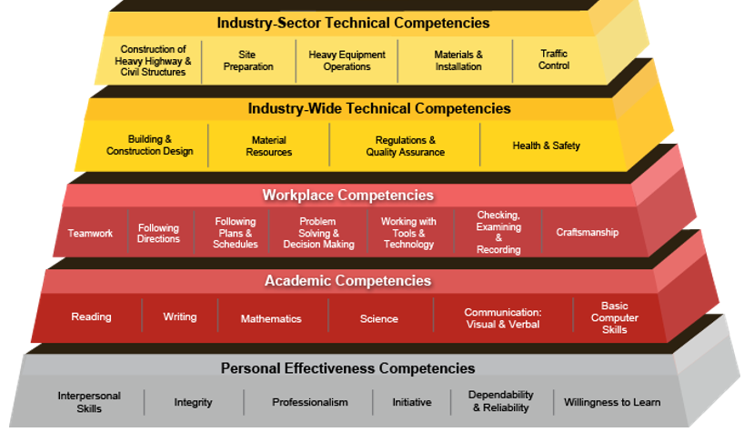

Requirements to enter program
Requirements
  Minimum Age: 18
  High School Diploma or GED or actively pursuing GED.
  TABE test – 6.5 equivalent grade level on new TABE test or ACT of 18 within last three years
  Drug Test by employer prior to acceptance to program
DOT HEAVY HIGHWAY CONSTRUCTION APPRENTICESHIP

Slide 7
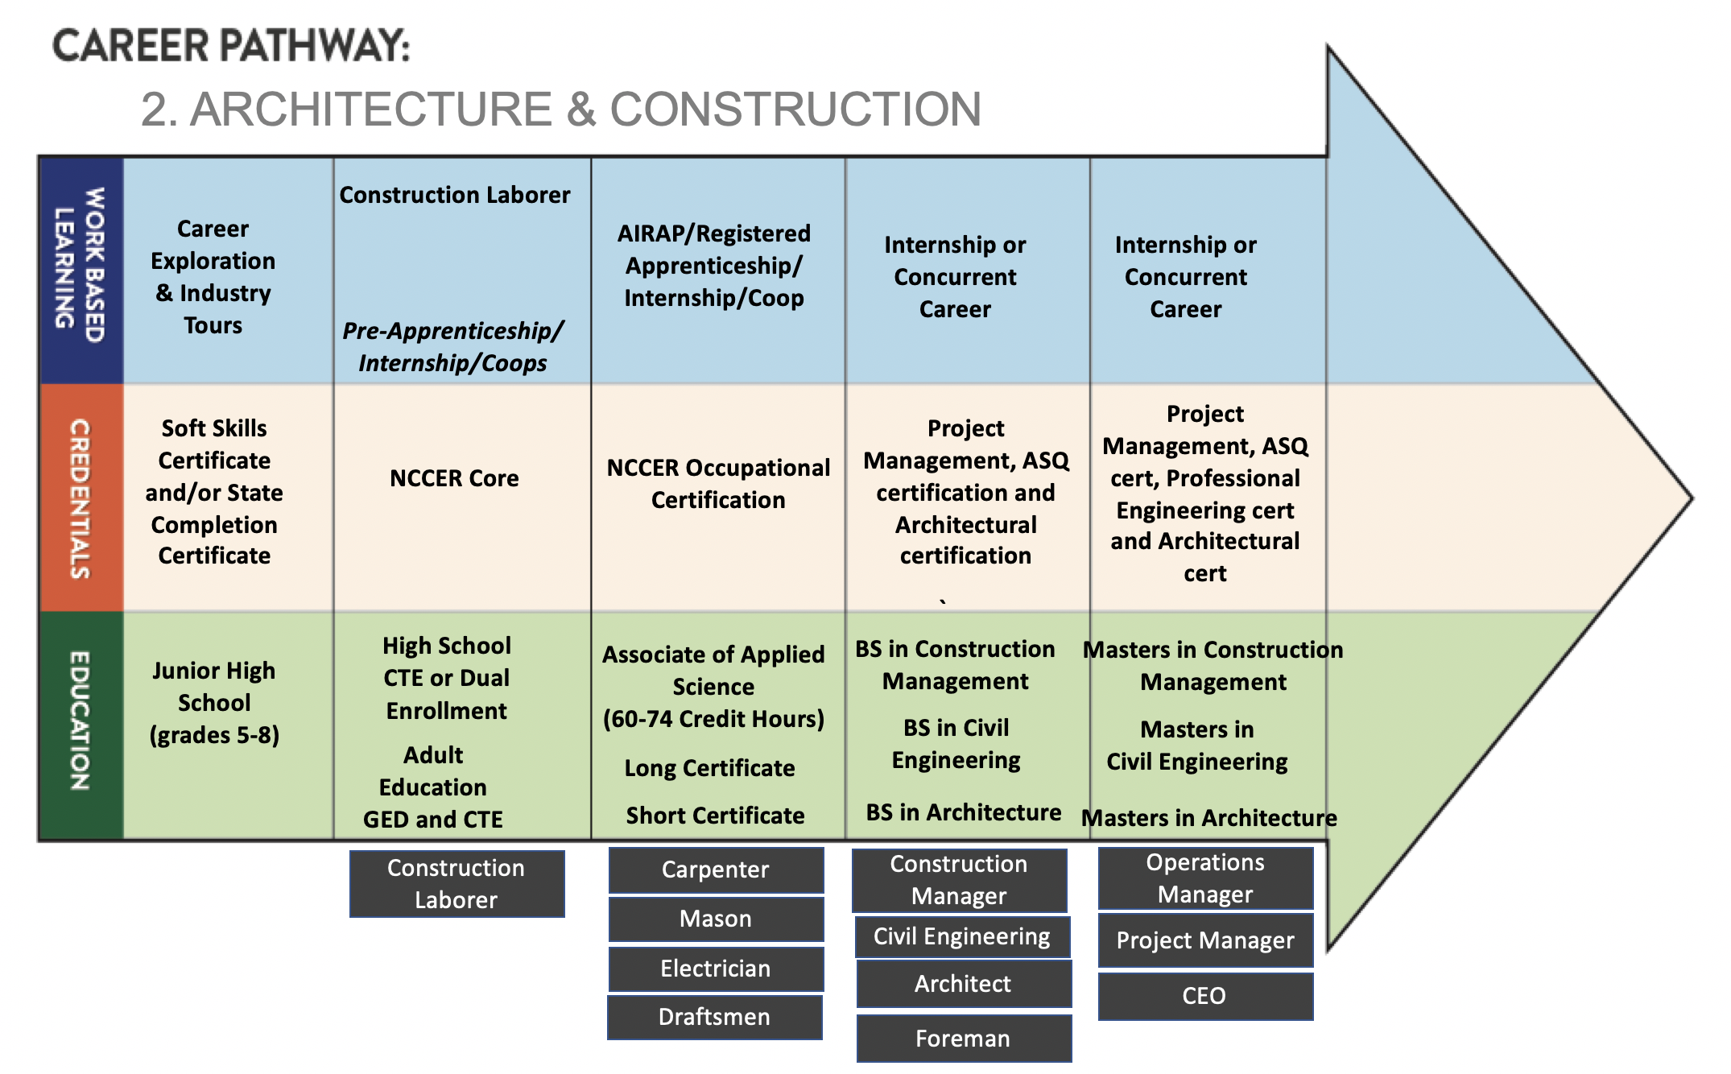
Curriculum model
DOT HEAVY HIGHWAY CONSTRUCTION APPRENTICESHIP

Slide 8
Program Instruction / OJT
 |  | PHASE 1
Week 1 | Week 2 | Week 3 | Week 4 | Week 5
- Drug Screen/ Orientation - TABE/ Soft Skills/ Financial Literacy - ATSSA Flagger Training / OSHA 10 - Company Orientation /OJT | - Soft Skills/Financial Literacy - NCCER Core - OJT | - Soft Skills/Financial Literacy - NCCER Core - OJT | - Soft Skills/Financial Literacy - NCCER Core - OJT | - Soft Skills/Financial Literacy - NCCER Core - OJT
 |  | PHASE 2
Week 6 | Week 7 | Week 8 | Week 9 | Week 10
-NCCER Heavy Highway Construction -OJT | -NCCER Heavy Highway Construction -OJT | -NCCER Heavy Highway Construction -OJT | -NCCER Heavy Highway Construction -OJT | -NCCER Heavy Highway Construction -OJT
 |  | PHASE 3
Week 11 | Week 12 | Week 13 | Week 14 | Week 15
-NCCER Heavy Highway Construction -TABE -OJT | -NCCER Heavy Highway Construction -OJT | -NCCER Heavy Highway Construction -OJT | -NCCER Heavy Highway Construction -OJT | -NCCER Heavy Highway Construction -OJT
 |  | PHASE 4
Week 16 | Week 17 | Week 18 | Week 19 | Week 20
- NCCER Heavy Highway Construction - Final TABE - Final Evaluations - OJT Introduce CDL (10 Hours) | CDL (19 hours) | CDL (19 hours) | CDL (19 hours) | CDL (19 hours)
 |  | PHASE 5
Week 21 | Week 22 | Week 23 | Week 24
CDL (19 hours) | CDL (19 hours) | CDL (19 hours) | CDL (19 hours)
On-the-Job experiences are in the morning under the guidance of an assigned mentor. Class instruction will be in the afternoon. 19 hours each week, 24 weeks total.
DOT HEAVY HIGHWAY CONSTRUCTION APPRENTICESHIP

Slide 9
NCCER Core Curriculum 80hrs, - prerequisite to all other Level 1 craft curriculum
Module One (00101-15) Basic Safety (Construction Site Safety Orientation) - explains the importance of safety in the construction and industrial crafts. NOTE: The successful completion of this module will award a Construction Site Safety Orientation credential.
Module Two (00102-15) Introduction to Construction Math - introduces trainees to basic math skills needed in the construction environment.
Module Three (00103-15) Introduction to Hand Tools - instructs trainees in the identification, use, and care of hand tools.
Module Four (00104-15) Introduction to Power Tools identifies - describes some of the power tools used by construction workers.
Module Five (00105-15) Introduction to Construction Drawings - provides trainees with the information and skills needed to read and understand construction drawings.
Module Six (00106-15) Introduction to Basic Rigging - identifies different types of rigging slings and hardware and describes how those items are used. It explains how to properly inspect slings and hardware items.
Module Seven (00107-15) Basic Communication Skills - provides trainees with the information and skills needed to communicate effectively and clearly.
Module Eight (00108-15) Basic Employability Skills - provides trainees with guidance related to finding and securing a position in the construction trades.
Module Nine (00109-15) Introduction to Material Handling - provides safety guidelines for workers handling materials on the job site.
DOT HEAVY HIGHWAY CONSTRUCTION APPRENTICESHIP

Slide 10
NCCER Heavy Highway Construction Level 1 - 160 hrs.
Module One (36101-17) Orientation to the Trade - introduces the trainees to careers, equipment, and processes used in the construction of highways and bridges.
Module Two (36111-17) Heavy Equipment in Highway Construction - describes the types of heavy equipment, utility equipment, and cranes used in the construction of bridges and highways. Trainees will be expected to recognize the equipment and describe its use.
Module Three (36110-17) Highway and Bridge Safety - Reviews the safety hazards and precautions associated with construction of highways and bridges. It also emphasizes the importance of following safety procedures in order to prevent accidents and injuries associated with working in hazardous places/conditions.
Module Four (75104-13) Work-Zone Safety - introduces the signs, signals, and barricades found on various job sites. It also covers highway work-zone safety requirements.
Module Five (22308-12) Soils - introduces trainees to the various types of soils, their properties, and how these properties affects the heavy equipment operator.
Module Six (22210-13) Site Work - describes the work involved in preparing a site for excavation and construction. The module first identifies important site safety practices. Other key topics include controlling water on a site, establishing grades, and laying pipe.
Module Seven (22207-12) Excavation Math - provides training on the formulas and calculations used to determine the amounts of soil and other material to be removed from or added to a job-site excavation, focusing on volume and weight calculations.
Module Eight (22209-13) Interpreting Civil Drawings - introduces trainees to the types of drawings used in highway and building site construction projects. Drawing interpretation and a review of common specifications are also presented.
Module Nine (38102-18) Rigging Practices - presents basic rigging, which refers to the preparation of a load for movement, as
well as the preparation of hardware and other components used to connect the load to the crane. Rigging must be completed safely and effectively, resulting in a reliable connection to the load. An understanding of rigging fundamentals is essential to safely operate cranes and move/position heavy equipment, components, and structures.
Module Ten (21106-18) Crane Safety and Emergency Procedures - emphasizes safety as the highest priority. Crane operators and other members of a lift team must embrace their responsibility as the manager of a powerful machine that can both accomplish great things and destroy property and lives. Thousands of successful crane operations occur each day without incident; all of the lifts in the future can end the same way. The goal of this module is to present a wide variety of safety information related to crane operation and prepare lift team members for their role in a safe workplace.
Module Eleven (21102-18) Basic Principles of Cranes - focuses on the types of mobile cranes and their common components. A fundamental
understanding of crane types and how they move from place to place is important to riggers and signal persons as well as to crane operators. Cranes also have different types of lifting booms, each of which has its own strengths and weaknesses. This module presents specific features of various cranes and booms, and introduces the basic principles of lifting and leverage.
Module Twelve (53101-18) Crane Communications - provides a formal introduction to methods, modes, and specifics of communications required in crane operations. The principles that crane signal persons must use to guide safe and efficient crane operations are addressed.
DOT HEAVY HIGHWAY CONSTRUCTION APPRENTICESHIP

Slide 11
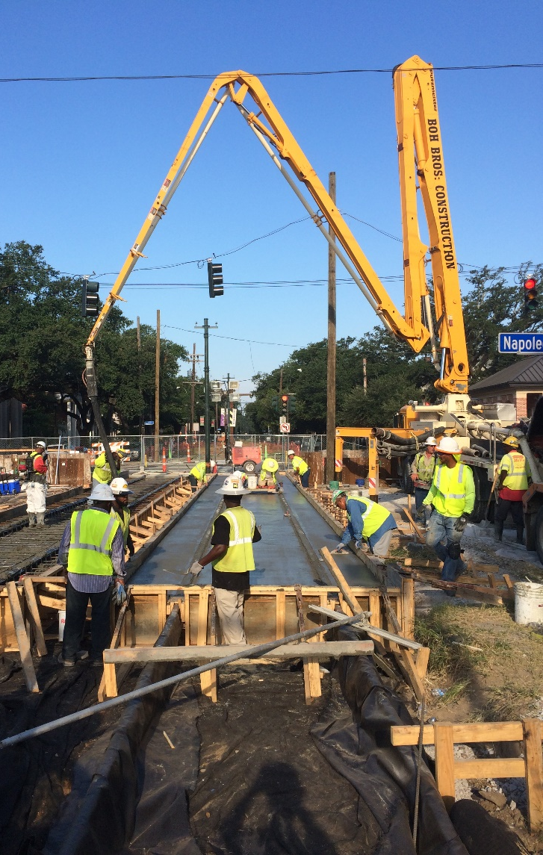
NCCER Heavy Highway Construction Level 1
contact Hours
NCCER Heavy Highway Construction, Level 1
Curriculum | Hours
Orientation to the Trade | 7.5
Heavy Highway Construction Equipment | 10
Heavy Highway Construction Safety | 5
Work-Zone Safety | 5
Soils | 10
Site Work | 20
Excavation Math | 17.5
Interpreting Civil Drawings | 20
Rigging Practices | 15
Crane Safety & Emergency Procedures | 25
Basic Principles of Cranes | 15
Crane Communications | 10
Total | 160
DOT HEAVY HIGHWAY CONSTRUCTION APPRENTICESHIP

Slide 12
grant Budget
Instructor costs are covered
Miscellaneous costs can cover recruiting/promotions
Supportive cost can help trainees with such things as travel costs/child care.
DOT HEAVY HIGHWAY CONSTRUCTION APPRENTICESHIP

Slide 13
Program partnership
Employer Responsibilities
  Provide On-the- Job
  Training (OJT) Paid Work
  Works Mornings
  Provide assigned OJT Mentor
  Drug Testing
  Equipment Seat Time
  Member Program Advisory Board
  to help guide the pilot program.
  Help identify industry
  experienced instructor.
  Help plan a sustaining training
  program after the Pilot Project
College Responsibilities
  Training - Afternoons
  Tuition funded by grant
  Manage Employer/Program
  “Paperwork”
  Manage Student “Paperwork”
  Credentialing (NCCER)
  Onsite Instructor Observations
  Equipment Seat Time
  Manage Advisory Board Meetings
  Program Reporting
  Develop plan: Sustaining Apprentice
  program (after Pilot Project)
For this pilot project, 15 students/college will be shared amongst
multiple employers. Will do screening process for applicants and
employer interviews, employers will make offers to selected
applicants meeting employer and program requirements.
DOT HEAVY HIGHWAY CONSTRUCTION APPRENTICESHIP

Slide 14
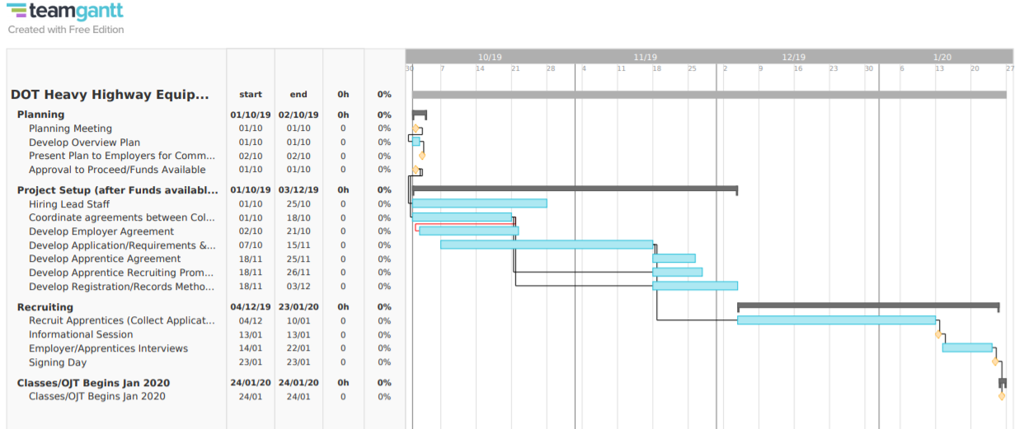
schedule
DOT HEAVY HIGHWAY CONSTRUCTION APPRENTICESHIP

Slide 15
Next steps
Employers: *Express Interest
  Provide Paid On-the-Job
  Training (OJT) Work
  Work in the Mornings
  Provide assigned OJT Mentor
  Drug Testing
  Equipment Seat Time
  Member Program Advisory Board
  to help guide the pilot program.
  Help identify an industry
  experienced instructor.
  Help plan a sustaining training
  program after the Pilot Project
College begins Project
  Finalized Curriculum
  Develop Employer and Student
  Agreements
  Develop student selection
  requirements and processes
  and execute.
  Recruit Industry Experienced
  Instructor.
  Develop program processes
  and reporting systems
  Confirm class/OJT start date.
* Employer provide “Interest Participation” letter with above verbiage due by October 12th on company letterhead, addressed to: Bishop State, Attn: David F. Felton, Dean of Workforce & Economic Development. Subject: Heavy Highway Construction OJT Training Pilot Project.
DOT HEAVY HIGHWAY CONSTRUCTION APPRENTICESHIP

Slide 16


WORLD CLASS TRAINING
Last Slide
WORKFORCE DEVELOPMENT

