Slide 1







Idaho Highway Construction Workforce Pilot

Slide 2
Idaho-First Program with National Recognition
Wounded Warrior I (10/01/09-2/15/11)
  Competitive Grant, received $165.5K
  CDL, Flagger School
  Partnered with IDOL
Wounded Warrior II (3/11/11 – 5/30/12)
  Competitive ARRA Grant for $442K, again partnered with IDOL
  Over 100 certified and over 85% reported working shortly thereafter
  Idaho Receives AASHTO President’s Transportation Award for Administration at the end of 2011

Slide 3
Ladders of Opportunity 8 State Pilot Program
Call via Grants.gov, by NOFO
Kicked off 7/12/16
The 8: CA, CO, FL, ID, MO, MT, PA
Nearly complete-over
Lessons learned
  Leveraging resources
  Partnerships take time, and
  FHWA &State DOTs must lead the effort
8 State Pilot Obligations vs. Expenditures
Obligations Amount | Expenditure Amount | Remaining (16.5%)
$2,996,829.00 | $2,489,019.60 | $495,511.71

Slide 4
Highway Construction Workforce Pilot
The Idaho Wounded Warrior Programs original concept for pilot
Extension of the 8 State Pilot incorporating partnership framework
Championed by Tony Furst
Via Call for SOWs to State DOTs
Kicked off 7/12/16
The 8: CA, CO, FL, ID, MO, MT, PA nearly complete over
Lessons learned
  Leveraging resources
  Partnerships take time, and
  FHWA &State DOTs must lead the effort

Slide 5
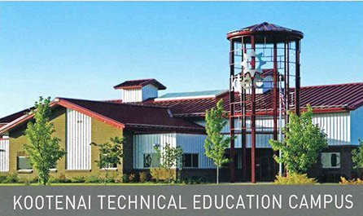

Highway Construction Workforce Pilot
ID Inaugural Heavy Equipment Operator School (HEO)
  Partnered with Kootenai Technical Education Campus (KTech)
  15 Native American’s 5 Tribes, women and men
  100% graduation work, all working as HEOs
  Included CDL training
  Teamed up with AGC, Non-Profit Veterans Groups
  Native American tribes

Slide 6
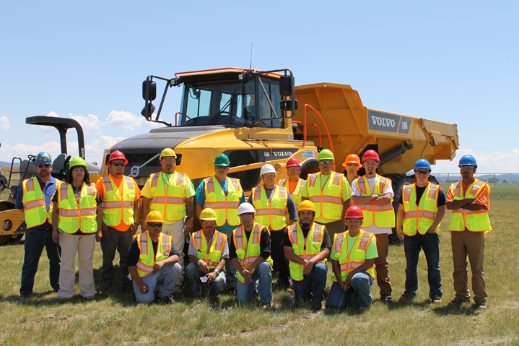
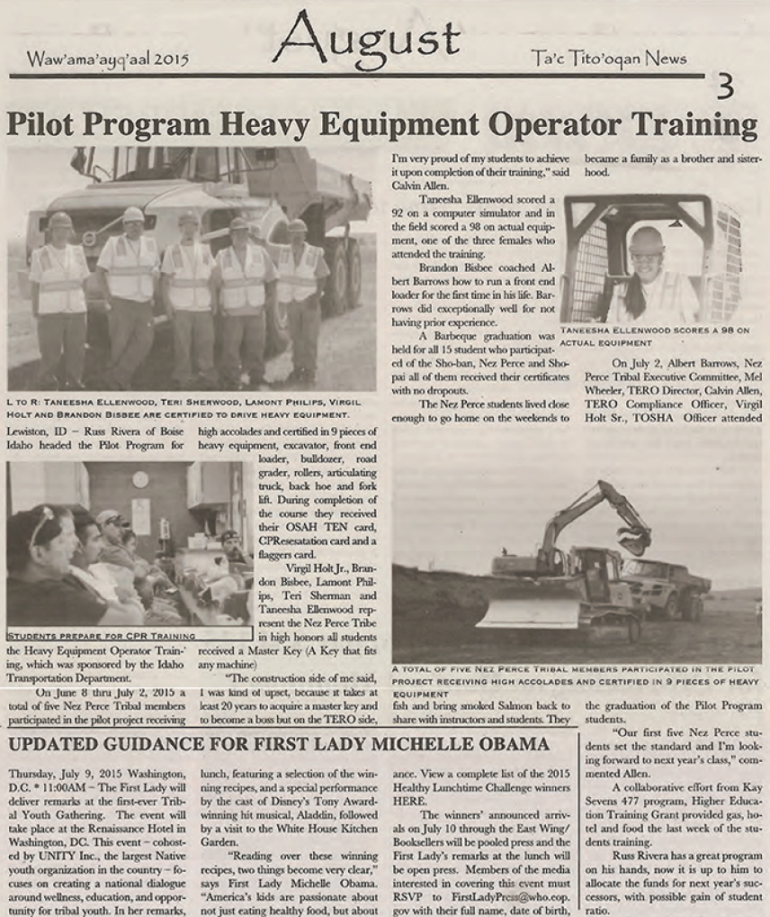
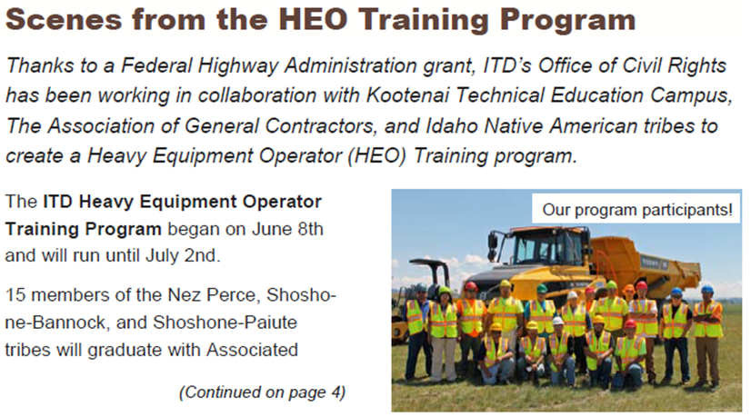

Slide 7
Second HEO School
Again partnered with KTech
20 Students comprised of Native American’s, women, other minorities, men & Women, Veterans
95% graduation rate, one fell out to medical condition
All now working as HEOs (Contractors, State DOTs, Counties, other companies
Included CDL training
  https://www.youtube.com/watch?v=beBGj-MI6M4&feature=youtu.be

Slide 8
Idaho Highway Construction Workforce Pilot
Infra Grant to Widen I-84, $90M
Demographic study as a result of EJ
Grant gave us a perfect opportunity to merge our resources
IDWC worked with AGC on $250 grant (Cranskstart)
ITD commissioned contractor needs survey with OJT/SS funds
Put together timeline & framework

Slide 9
Highway Construction Workers Pilot
Timeline | Activity | Investment
Feb – Apr 2019 | Build Survey (ITD, WDC, IDOL, Utah State) | $50,000
May – June 2019 | Conduct Survey 3 distinct groups – Impacted Residents, Refugees, Veterans (Utah State)
July – Sept 2019 | Develop Report (Utah State)
Sept – Dec 2019 | Build Training Program (AGC?, CWI?) | $25,000
Jan – Apr 2020 | Deliver Training (IRC, AGC, CWI) | $60,000
ITD = Idaho Department of Transportation
WDC = Idaho Workforce Development Council
IDOL = Idaho Department of Labor
AGC = Idaho Chapter of the Associated General Contractors
CWI = College of Western Idaho
IRC = International Rescue Committee

Slide 10
Recruiting/Training Pipeline
Impacted Residents
Veterans*
Corrections*
International Rescue Committee/College of Western Idaho
Associated General Contractors
Pre-employment Math & Language*
We Build Idaho Career Launcher*
Highway Construction Training
*Leveraged Resources
Idaho Department of Labor Veterans Programs - $ in WIOA funding
Idaho Department of Corrections – $ in ABC grant funds to improve transition support among individuals who received construction vocational training.
International Rescue Committee/College of Western Idaho – replication of Environmental Technician “Pre Apprenticeship” program which is supported through WIOA Title II Adult Education and Family Literacy funding and a $ Crankstart grant. Program provides contextualized math and language training in advance of entering skills-training programs.
Associated General Contractors - $250,000 in state workforce development training funds and $249,000 in private/foundation match to deliver 4-week construction basics course.
Hiring Pool

Slide 11
Idaho HCWP:
“I-84 Corridor Expansion”
Partnership between: Idaho FHWA, Idaho Transportation Department, Idaho Workforce Development Council & Department of Labor), Idaho Associated General Contractors

Slide 12
Heavy Equipment Operator Training
“If you train them, I’ll hire them.”
NEED: Equipment Operators and Truck Drivers
ITD: Heavy Equipment Operator Program
Fielded 2015 and 2017
Notes:
5 Week Intensive Offsite Program
Housing, and training included
Supportive Services: PPE and safety gear, resume writing, soft skills training, case management, other training to reduce or eliminate barriers.

Slide 13
Results
2017
780 Applicants, (17 states, 3 countries).
90% employment during construction season.
A female trainee went from earning $26,000/year to $110,000 in 2018 after certification.

Slide 14
Build Upon Previous Successes
2017 Clark Martin contacted ITD about the HCWP.
2017-2018 ITD struggled with identifying compatible projects.
June 2018 ITD awarded a $90M INFRA grant to widen I-84.

Slide 15
Goals of Idaho HCWP:
Develop Partnerships
Identify Skills Gaps
Create and Field Training Program
Work with Contractors to Place Trainees
Build a Career Ladder

Slide 16


Highway Construction Workforce Partnership
October 31, 2019

Slide 17

Expected Labor Force Gap
Projected Growth in Jobs and Labor Force, 2016-26
Jobs
+105K
Labor Force
+90K

Slide 18
Highway Construction Skills Gap Report
Universe of 893 contractors
  ITD & AGC supplied contact lists
123 responses – broken down by region (6)
Partners can help the most by promoting trade schools and encouraging young workers to pursue jobs in the construction industry.
Notes:
48% of our high school students go-on immediately after high school…
18% graduate within 100 percent of time to degree…36% graduate within 150 percent of time to degree.
How do we ensure that those who do go-on, but don’t complete, have a valuable credential to help them compete in the labor market?
What do we do with the 9,000+ seniors who do not go on.

Slide 19
Highway Construction Skills Gap Report
Key Findings
More than half of the Idaho contractors responding to the survey have had difficulty hiring in the past 12 months, with two-thirds of those having greater difficulty now than in the past.
Lack of experience, not enough applicants and lack of occupation-specific skills are the most common contributors to hiring difficulties.
Heavy equipment operation skills and a commercial driver’s license (CDL) are the top two skills expected.
Specific skills missing from the current pool of applicants include concrete-finishing, tile-setting, carpentry and certain industry certifications.

Slide 20
Highway Construction Skills Gap Report
Key Findings
Contractors report the greatest success in attracting workers through apprenticeship programs, however some report challenges getting started.
Employers in southwestern Idaho have the most challenges hiring professional positions such as foremen, supervisors, and officials.
Sixty-six percent of anticipated hires for the 2021 construction season are in southwestern Idaho.

Slide 21
Craft Positions
Regional difficulty hiring specific craft positions
Craft Position |  | Northern | North Central | Southwestern | South Central | Southeastern | Eastern
Equipment Operator
Mechanic Truck Driver
Mason Worker
Carpenter
Laborer
Welder
Traffic Control / Flagger
Difficulty Hiring: | ◆ Extremely  Moderately – Extremely  Somewhat – Moderately
Craft Positions Ranked by Difficulty Hiring
Craft Position | Difficulty Hiring
Equipment Operator | Extremely
Mechanic Truck Driver | Extremely
Mason Worker | Extremely
Carpenter | Extremely
Laborer | Moderately – Extremely
Welder | Somewhat – Moderately
Traffic Control / Flagger | Somewhat – Moderately
Note - same data points available
for professional positions.

Slide 22
Craft Positions
Skills with a “less than adequate” applicant pool by region
Skill | Northern | North Central | Southwestern | South Central | Southeastern | Eastern
Active Listening
Reading Comprehension
Coordination
Written Communication |  | ✓ |  |  | ✓
Verbal Communication
Mathematics |  | ✓
Critical Thinking | ✓ | ✓ | ✓ | ✓ | ✓ | ✓
Computer | ✓ | ✓
Judgment & Decision Making |  |  | ✓ | ✓ | ✓ | ✓
Time Management | ✓ | ✓ | ✓ |  | ✓
Quality Control Analysis | ✓ | ✓ | ✓ | ✓ | ✓
Troubleshooting | ✓ | ✓ | ✓ | ✓ | ✓ | ✓
Maintenance & Repair | ✓ | ✓ | ✓
Equipment Operation | ✓ | ✓ | ✓ | ✓ | ✓ | ✓
Process / Operation Monitoring |  |  |  |  | ✓ | ✓
Ability to Work Independently |  | ✓ | ✓ | ✓ | ✓ | ✓
Ability to Work in a Team |  |  |  |  |  | ✓
Share of the Applicant Pool having “Less than Adequate” Skills
Skill | Share Reflected in Applicant Pool
Troubleshooting | 83%
Judgment & Decision Making | 70%
Critical Thinking | 68%
Ability to Work Independently | 66%
Equipment Operation | 59%

Slide 23
Craft Positions
Less Common Expected or Missing Skills
Skill | Expected | Missing
Asbestos / Lead Certification | ✓
AutoCAD | ✓ | ✓
Blueprint Reading | ✓ | ✓
Carpentry Skills | ✓ | ✓
Concrete Setting & Finishing | ✓ | ✓
Crane Operation (NCCCO) | ✓
Crusher |  | ✓
Estimation | ✓
Framing / drywall | ✓
Hot Plant Operation |  | ✓
Low-Voltage | ✓ | ✓
Masonry / Tile-Setting | ✓ | ✓
Paving / grading | ✓
Pipe-laying | ✓
Rope Access Certification | ✓ | ✓
Surveying | ✓ | ✓
Traffic Control / Flagger Certification | ✓
WAQTC / ACI Certification | ✓ | ✓
Welding | ✓
† Western Alliance for Quality Transportation Construction / American Concrete Institute

Slide 24
Craft Positions
Most frequently reported hiring requirements for craft positions
Craft Position | Typical Education Required | Typical Qualification Required | Typical Experience Required
Equipment Operator | None | None / Special Training | 1–2 years
Mechanic Truck Driver | None / High School | License | 1–2 years †
Mason Worker | None / High School | None / Special Training | 6 months – 1 year †
Carpenter | None / High School | None | 6 months – 1 year
Laborer | None | None | None
Welder | Technical Certificate | Special Training / Certificate | 1–2 years †
Traffic Control / Flagger | Varied * | Certificate | None
* No significant differences found amongst no formal education, High School diploma / GED, or Technical Certificate † No significant difference found between 6 months – 1 year versus and 1—2 years

Slide 25
Next Steps
Work with training/education providers to develop training to support I-84 Expansion project.
Share regional variations with existing training providers.
  Example:
  Ninety percent of southwestern Idaho’s applicant pool struggles with troubleshooting skills.
  North & North Central Idaho struggle with computer skills, maintenance / repair & mathematics while other regions do not
Align recruitment strategies.

Slide 26
Questions? & Contacts
Michael Caliendo, CR Specialist/PMA
FHWA
Michael.Caliendo@dot.gov
208-334-9180 x 131
Russ Rivera, Civil Rights Program Manager
ITD
Russ.Rivera@itd.Idaho.gov
208-334-8884
Wendi Secrist, Executive Director
Idaho Workforce Development Council
wendi.secrist@wdc.idaho.gov
208-488-7561
Wayne Hammon, CEO
Idaho AGC
whammon@idahoagc.org
208-334-8884

