Slide 1
Federal Highway Administration
State of P3s (Public Private Partnerships) in New York
Presented by
NY Division Administrator
Peter Osborn
Notes:
- This is the Introduction Slide; speaker name can be changed as needed.
It may feel appropriate to identify the upcoming Power Point Presentation as a “Fusion Document,” that merges information from the National Perspective as
Supplied from our USDOT/Build America Bureau, Merged
with local insights from the NY Division of FHWA

Slide 2
Federal Highway Administration
Outline
-Why state and local governments consider P3s
-P3 projects in the U.S.
-P3 Success in NYS
-Potential for PPPs in our NY State
Notes:
- This is the Outline Slide
Not much more to say beyond the text within the slide.

Slide 3
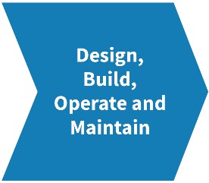
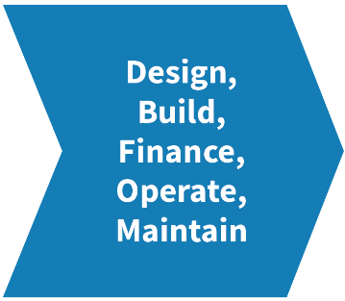
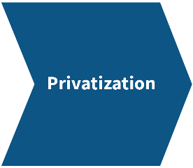
Federal Highway Administration
Highway Public-Private Partnerships (P3s)
Infrastructure Delivery Options
Public Sector
Private Sector
Risk
Degree of ownership, development integration, risk transfer and the extent of private financing
Notes:
Key Message
P3s are contracts between public agency and a private entity that enable greater private sector participation in project delivery.
Background Information
P3s are an additional tool in the toolbox to encourage investments in infrastructure. The private sector provides assets and services for the use of the public to prescribed performance-based specifications linked to contract terms. The private sector accepts an increased level of financial, technical, and perhaps even operational risk!
HISTORY
Information on how P3 projects have developed in the U.S: There are many historical examples of P3 in the US, including the original Pennsylvania Turnpike and the Brooklyn Bridge. In terms of highways, the current P3 trend in the US is fairly recent, dating to the 1990s. When the Dulles Greenway opened in 1995, it was the first private toll road in Virginia since 1816. California’s 1989 P3 law enabled the SR-125 and SR-91 projects, two of the first in the current P3 trend. In the past 20 years, the US has seen more than a dozen highway P3 projects come to fruition and many more are under preparation or planning.
Local INput
The Port Authority has raised the bar of P3 performance in our NY Metro community, enabling the “Design/Build/Finance and Maintain” contract on the Goethals Bridge; and without federal funding assistance, at LaGuardia Airport, and under development at JFK Airport.

Slide 4
Federal Highway Administration
Risk Transfer by Project Delivery Method
Project Delivery Method | Design Risk | Construction Risk | Financial Risk | O & M Risk | Traffic & Revenue Risk
Design-Bid-Build (DBB) |  | Partly
Design-Build (DB) | X | X
Design-Build-Finance (DBF) | X | X | X
DBFOM w/Availability Payment | X | X | X | X
DBFOM w/Toll Concession | X | X | X | X | X
Notes:
Many of today’s conversations on project and program delivery are focused on Risk.
This slide shows the differences in risk allocation between public sector and private sector for different types of P3 projects.
- The design-bid-build project model, our tradition, retains the greatest levels of risk within the public sector. Our tradition, only conveys shared risk during construction.
- However PPPs can enable a more complete transfer of the majority of project risk including; financing, operating, and maintaining to private concessionaires.

Slide 5
Federal Highway Administration
Key Differences: Conventional vs. P3
Conventional Projects (design-bid-build) | P3 Projects (design-build-finance-operate-maintain)
Public sector takes on all risks (except construction) | Risks shared between public and private sector
Public Financing | Public/Private Financing
Lowest bidder | Best suited/best value
Operations and maintenance (O&M) and ongoing rehabilitation (if any) carried out by public agency once constructed | O&M carried out by private sector; ongoing rehabilitation overseen by public sector stewardship of P3 agreement
Notes:
This table offers a second illustration comparing traditional design-bid-build approach to a sample P3 approach.
Other key differences between traditional and P3 approaches include:
Streamlined and concurrent project phases
Private upfront financing
Obligation to maintain a facility at an equal if not higher standard than publicly maintained facilities
KEY NY Input
P3 financing enables our NY Public Benefit Corporations (Authorities) to execute more projects outside of limits resulting from pooled fund/pooled debt obligations.
P3 constructs can protect existing Authority bondholders and existing political commitments, while enabling Authorities to do more.

Slide 6
Federal Highway Administration
Types of P3s by Payment Model
Availability Payment Concessions
Payments made by the public sector sponsor to the developer based on meeting milestones and/or facility performance standards, such as a fixed annual payment for the operation and maintenance of a highway for a term of years
Toll Concessions
Authorizes the developer to collect and retain tolls from motorists for the term of years as defined in the P3 agreement
Notes:
As mentioned earlier, there is no “one-size fits all” P3 structure. P3s are also not “free money” and private partners must repay debt and equity investments.
Availability Payments are payments made by the public sector partner to the private sector partners based on particular milestones, dates, or facility performance standards.
Toll Concessions allow the private partner to collect tolls on a facility directly from the road users.
KEY LOCAL EXPERIENCE:
The Goethals Bridge Replacement is an excellent example of an Availability Payment Concession, supplemented by 5 bonus payments for milestone completion.
The Bonus Payment supplement model was developed during the Port Authority’s procurement process to incentivize private sector performance towards achieving important public sector deliverables!

Slide 7
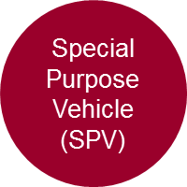
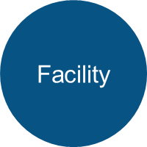
Federal Highway Administration
Typical Availability Payment P3 Structure
Agency
Milestone and Availability Payment
Bank/ lenders
Equity Investments
Bonds, Loans
Debt Service
Dividents
Funds to Build, Maintain and Operate
Toll and Other Revenue
Notes:
Key Message
Explain roles, responsibilities and risks assumed with availability P3 structure.
Background Information
With this approach, the public sponsor makes periodic payments to the concessionaire on condition that the facility meets defined performance specifications. Revenues are not dependent on tolls. If the project is a tolled facility, the public partner retains the revenues from the tolls as well as the risk that revenue forecasts will not be realized.
KEY LOCAL INPUT
We are here in NY; and the World comes to NY for infrastructure financing. The number of potential Project Sponsors, the Potential for Equity Partners, for Bank/Lenders, and ideally for multiple public pension fund managers who desire predictable, solid ROI (return on investments) are without peer.

Slide 8
Federal Highway Administration
Why Consider Public-Private Partnerships?
FHWA and the NY Division want to do more… Add value, deliver more projects, expand programs…
“Help us to…Help you!”
Notes:
This is an introduction slide.
Recommend that we celebrate our NY Division’s forward leaning posture. We seek new partners, we seek private sector engagements, we seek innovation to ensure that our Agency and our Transportation system are the best in the World.
Key Difference in FHWA’s NY Division: FHWA recognizes the practical limits of our highway network, and the NY Division demonstrates unsurpassed support for our modal partners in Maritime, Transit, Passenger and Freight Rail in keeping with our goal to encourage modal transfer in relief of the congestion highway network.

Slide 9
Federal Highway Administration
P3 Potential Benefits
To public sector:
Expedited project delivery
Allocation of risk, where private sector can save money/manage better
Improved cost and schedule control
Incentives to manage life cycle costs
Conservation of public sector debt capacity
To private sector:
Return on investment that is long-term, predictable, and perceived moderate risk
Opportunity to increase return through efficiencies, innovation and managing risks
Notes:
We will go through the benefits first starting with the benefits to the public sector:
A P3 can assist in accelerating a project.
A P3 allows the public sector to share or avoid some of the risks.
A P3 contract typically specifies performance and maintenance standards for the private sector and may result in the facility being maintained in better condition than if the public sector was responsible, as facility maintenance is often deferred due to budget constraints.
If a private partner is responsible for both building and maintaining a facility, then there are incentives to use materials or practices that may reduce life cycle costs
The public sector doesn’t necessarily need to issue debt for a P3 project.
From the private sector standpoint, the benefits of P3s include:
If a private partner’s investors are managing funds such as pension plans, then a P3 may represent a sound, predictable long-term investment option

Slide 10
Federal Highway Administration
Addressing P3 Challenges Matching Debt and Revenues
Use Federal credit programs (GARVEE, TIFIA and PABs) provide long-term, low-cost financing to the developer comparable to public sector cost of financing
Match Debt to Revenues and Explore. Yes consider tradition of tolls, add the value of Real Estate, add the value of Freight, add the value of Service.
Any deal on Congestion Pricing
HOT lane opportunities
Real Estate Development( Build Over Examples)
Fees for Services and Value Capture
Notes:
NYS and NYC host many revenue opportunities, both those revenue streams already tapped (say by tolls), as well as, new revenue opportunities.
Examples of new revenue possibilities may include;
-Congestion pricing as proposed by the “Fix NYC” panel recommendations
-Real Estate Build Over/Deck Over Opportunities such as Moynihan Station, Harlem River Railyard, 61st Street Rail Overbuild
We have the experience of Brookhaven, the Air Rights building and multiple extensions of the Street Network Grid over historic transportation corridors
-We also have multiple opportunities for fees for service such as NYC Department of Sanitations fees used to support modal shifts off highways and towards rail and water usage
- We have leases of key public properties for freight, commerce, and private use (examples include much of the Port Complexes, Air Terminals, Markets)
We have Value capture and new housing such as the Residents within Brooklyn Bridge Park providing funds for long-term maintenance needs
- We have the ability to consider conversion of some of our HOV corridors to HOT lane facilities
*The Key seems to be to leverage the strengths of our highly desired population centers with the thirst for ever densification of residential and office properties.
In addition, that densification and the resulting consumption, as well as, the natural maritime freight advantages of NYC bring a second, massive stream of revenue opportunities from our multiple Maritime/Freight/Light Manufacturing, and Warehouse/Distribution services.

Slide 11
Federal Highway Administration
Public-Private Partnership Projects in the U.S.
Where is the National State of Practice regarding Enabling Legislation, P3 Concessions, and Conversions of Existing Facilities?
Notes:
An Introduction Slide

Slide 12
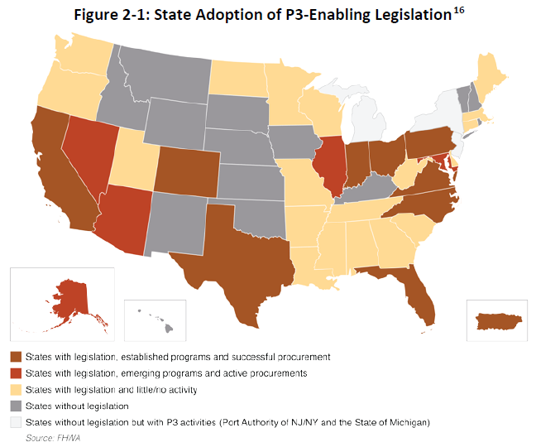
Federal Highway Administration
Legislation
Legislation & Policy
Procurement
Performance Monitoring & Oversight
Project Development
Figure as of March 2016.
Up to date status (1/2018) at
https://www.ncppp.org/resources/research-information/state-legislation/
Notes:
The map is good, although slightly outdated.
However; The weblink identified here has been vetted by USDOT, Build America Bureau as containing the latest information available
The link to NYS will identify the lack of Enabling Legislation and discuss how those efforts for enabling legislation have stalled since 2014
The summary score card remains that 35 States have enabling legislation for PPPs for horizontal projects (transportation projects).

Slide 13
Federal Highway Administration
Notes:
FHWA is excited to share in the Port Authority’s PPP progress on the Goethals Replacement:
FHWA is equally excited to have assisted NYSDOT and the NYS Thruway in their Tappan Zee project:
The FHWA NY Division has
- Validated to the USDOT Secretary satisfaction that Tolled Interstates are “public facility” and eligible for allocations of Private Activity Bonding
- Assisted the PANYNJ in securing the first Allocation of PABs for a tolled interstate (signed by our own Polly Trottenberg in her Prior Deputy Secretary Role)
- Also demonstrated that the NY Division can oversee compliance with Buy America and DBE goals as requested in order to secure that bond allocation.
- Fostered and developed a FHWA/Port Authority relationship to oversee a private concessionaire
- Assisted the Port Authority in their internal restructuring effort necessary to conform to Title VI (Civil Rights) requirements
- Addressed the Port Authority, (or the challenges of any future Authorities) presented by pooled fund/pooled debt benefit corporation to establish conformity in the use of “excess revenues” for future title 23 eligible activities. (The so called “Toll Agreement” or MOU governing the use of Excess Revenues)
- Participated with the Port Authority to secure a TIFIA loan that ultimately remains among debt enabling tools held by the private concessionaire.
- Participated with NYSDOT and NYS Thruway to secure the largest TIFIA loan in the Nation
- Blind to mode: FHWA led training efforts with Federal Railroad to enable Moynihan Station’s TIFIA Loan
- Blind to mode: FHWA led training efforts with US Maritime to enable future TIFIA loan(s) for Port Development
- The NY Division of FHWA retains a “get it done” philosophy and we are well staffed and experienced

Slide 14
Federal Highway Administration
P3 Concessions in the U.S. – Existing Facilities
Chicago Skyway
Illinois
Indiana Toll Road
Indiana
Northwest Parkway
Colorado
Pocahontas Parkway / Richmond Airport Connector
Virginia
PR-22 & PR-5
Puerto Rico
Notes:
The above P3 concessions discuss those that have used federal aid assistance while converting an existing public facility to a private concessionaire.
NYS and the Port Authority’s more recent experiences at LaGuardia Airport, and the future proposal for JFK Airport are not captured as yet among National practice.
The Indiana Tool Road deserves a separate discussion. The original P3 of Cintra-Macquarie filed for bankruptcy in September 2014, citing lower that expected traffic volumes and associated revenues. This resulted in a re-procurement and selection of IFM Partners. The Indiana Toll Road remains a reminder that P3 deals require due diligence of both the public and the private sector to achieve mutual success.

Slide 15
Federal Highway Administration
Federal and State Roles

Slide 16
Federal Highway Administration
Federal and State Legal Framework
Federal Law
Sets Federal requirements for projects or facilities utilizing Federal funding or credit assistance
State/Local/Authority
Select P3 projects
Choose project funding/financing strategies
Select P3 approach
Negotiate P3 contract terms
Notes:
FHWA does not serve as “owner” of P3s – owner agencies are typically states or sometimes local governments.

Slide 17
Federal Highway Administration
History of Enabling P3 Legislation in NYS
Senate Transportation Committee Passed Innovative Infrastructure Development Act (S5445) – June 5, 2012, failed in 2014
FHWA always supportive, we have added our Nat’l perspective and provided technical assistance and FHWA remains available for additional technical assistance as may be requested.
Notes:
The Slide says it all.

Slide 18
Federal Highway Administration
USDOT’s Build America Bureau
Consolidates and administers DOT’s key finance programs and finance expertise
Provides a one-stop shop for streamlining credit processes
Provides project outreach and development assistance
Promotes public-private partnerships (P3s)
Advances large, complex, multi-modal, multi-jurisdictional projects

Slide 19
Federal Highway Administration
Build America Bureau Financing
TIFIA
Provides loans to public and private sector borrowers for transportation projects at low interest rates and flexible terms
Addresses challenges such as revenue and ramp up risk
Private Activity Bonds (PABs)
Allocation of tax-exempt financing that addresses high interest rates generally paid by private sector
TIFIA and/or PABs have been used in the financing of all large transportation P3 projects in the U.S.
Notes:
FHWA plays a role by facilitating P3s by lowering financing costs with financing tools such as:
Transportation Infrastructure Finance and Innovation Act (TIFIA)
Credit assistance program that allows direct loans, loan guarantees, lines of credit, up to 49 percent of eligible project costs. TIFIA is particularly important for projects such as toll roads, where revenues may be uncertain, particularly in early years. TIFIA allows flexible repayment schedules and provides better and longer terms than are generally available in the capital markets.
Private Activity Bonds (PABs) Allocation
Authority to issue tax exempt bonds to be issued by a conduit issuer. SAFETEA-LU allowed USDOT Secretary to allocate $15 billion/ year to qualifying highway facility or freight transfer facility. Eligibility for the tax exemption makes the financing interest rate cheaper than what the private sector can usually obtain.
Other Innovative Financing Tools are
State Infrastructure Banks (SIBs) – States can create SIBs using Federal-aid funds, and provide loans or other forms of credit assistance to eligible projects, including P3s.
Section 129 Loans – States can lend Federal-aid directly to eligible bridge, highway, and tunnel projects, including those that are undertaken as P3s.
Grant Anticipation Revenue Vehicles (GARVEEs) – States can use GARVEESs to borrow in anticipation of future Federal-aid.

Slide 20
Federal Highway Administration
Grant Anticipation Revenue Vehicles
Definition: Bonds, generally tax-exempt, sold by States and backed by and repaid with specific Federal-aid funds
Purpose: Issued to provide new funding to an eligible project or to refinance existing bonds
Key Provisions:
No Federal guarantee of repayment; any pledges or obligations must come from State legislation and/or executive authority
Local match is required with every debt service repayment
Advantages: Acceleration of construction; low interest rates for new money bonds and re-financings; leveraging of Fed funds
Disadvantages: Cost of interest; loss of future flexibility
Administration: FHWA establishes rules on GARVEEs; States issue the debt and establish the terms of the bonds
Notes:
Grant Anticipation Revenue Vehicles = GARVEEs
GARVEEs are (generally) tax-exempt bonds sold by States or local governments, backed by and repaid with specific Federal-aid funds
GARVEEs are not guaranteed by the Federal government. Eligibility for reimbursement with future Federal-aid highway funding does not constitute a commitment. An explicit Federal guarantee would invalidate the tax-exempt status of GARVEE bonds.
Benefits of GARVEEs:
Accelerates Construction
Better Funds Management
Avoided Costs
Large Project Financing
Efficiency
Relatively Low Interest Rates

Slide 21
Federal Highway Administration
TIFIA
NY Metro TIFIA Wins!
$474M – Goethals Bridge Replacement
$1,600M – Tappan Zee Bridge Replacement
$159M Staten Island Ferries and Terminals
Moynihan Station, $537million
Possible win for Maritime Port Development
Availability: Considerable Capacity! (Over $300 million/year available to cover subsidies for loans.)
Today’s TIFIA loan rate (as of 1/24) is 2.8%
Notes:
These are the TIFIA wins that our NY Division has participated in, or assisted our fellow Modal Administrations.
In addition, LIRR and Metro North (within our MTA partner) have a loan, the largest in the Nation, at $967 million from the Railroad Rehabilitation & Improvement Financing (RRIF)

Slide 22
Federal Highway Administration
PABs, Private Activity Bonding wins in the NY Metro Area
$1.2 billion allocation to the Goethals Bridge (Developer choose to access $460 million through Jersey City Muni Bonds)
Availability: $4 billion of PABs

Slide 23
Federal Highway Administration
GARVEE
Not used in NYS… yet
Availability: Fitch rating agency recommends that States secure GARVEE debt of some 34% of 10 years of their future federal-aid allocations.
in NY State the GARVEE tool might enable an infrastructure debt pool of $6.2 billion
If desired; this tool could create debt necessary to support a new State Revolving Infrastructure Bank

Slide 24
Federal Highway Administration
FHWA P3 Toolkit
Fact Sheets | Primers | Guidebooks | Analytical Tools
FHWA P3 Toolkit Risk Valuation & Allocation Value for Money Analysis Financial Structuring Analytical Studies Conducting Procurements Monitoring & Oversight | Establishing a P3 Program Risk Assessment Value for Money Assessment Financial Structuring & Assessment | Risk Assessment Value for Money Assessment Benefit-Cost Analysis for P3 Delivery P3 Project Financing Model Contracts Successful P3 Practices | P3-SCREEN P3 viability evaluation prior to project development P3-VALUE Risk Assessment Value for Money Benefit-Cost Analysis Financial Viability Assessment

Slide 25
Federal Highway Administration
CONCLUSIONS!
While FHWA supports progress within the current NYS legal framework, State Enabling Legislation would be helpful
USDOT/FHWA and all your federal modal partners have the tools to help you access debt
- The posture of the NY Division remains engaged, open to new partnerships, faithful to traditional partners, open to new constructs, and open to new revenue opportunities that will make PPPs infrastructure deals!

Slide 26
Federal Highway Administration
Websites
P3 Website: http://www.fhwa.dot.gov/ipd/p3/
P3 Toolkit Website:
https://www.fhwa.dot.gov/ipd/p3/toolkit/
State of State Enabling Legislations
https://www.ncppp.org/resources/research-information/state-legislation/
Contacts:
- DA Peter Osborn and Director of Finance, James Griffin at (518) 431-4125 or james.griffin@dot.gov
- Senior Advisor John Formosa at (212) 668-2205 or john.formosa@dot.gov

