Slide 1


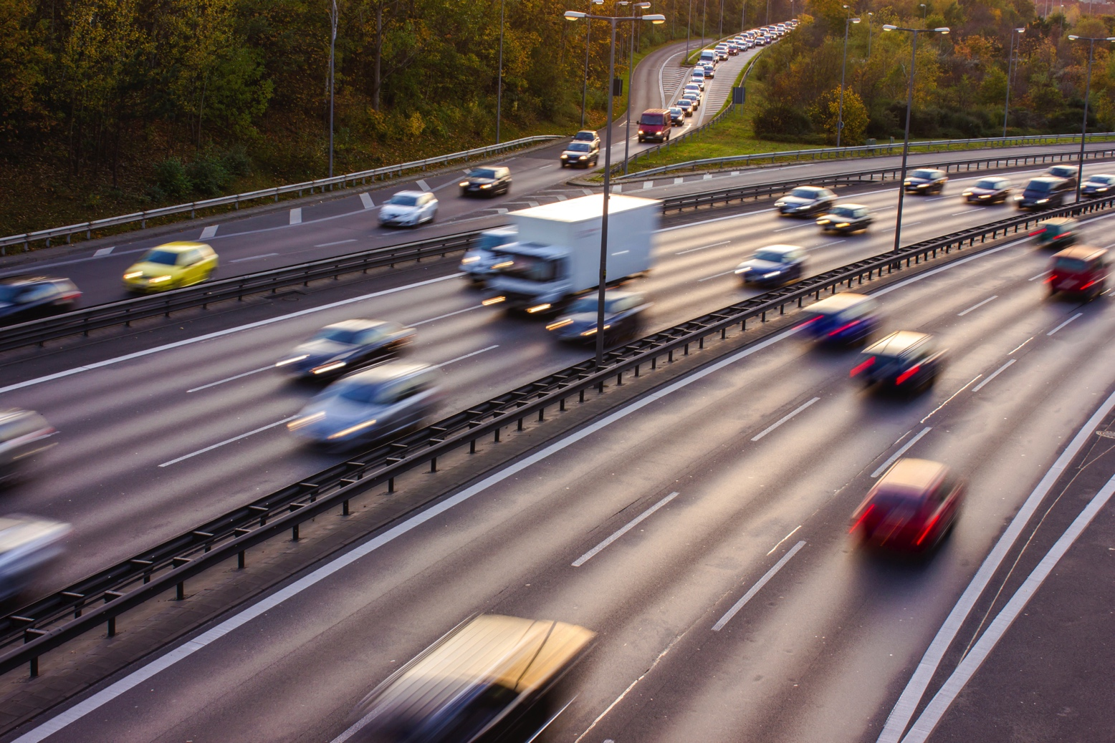



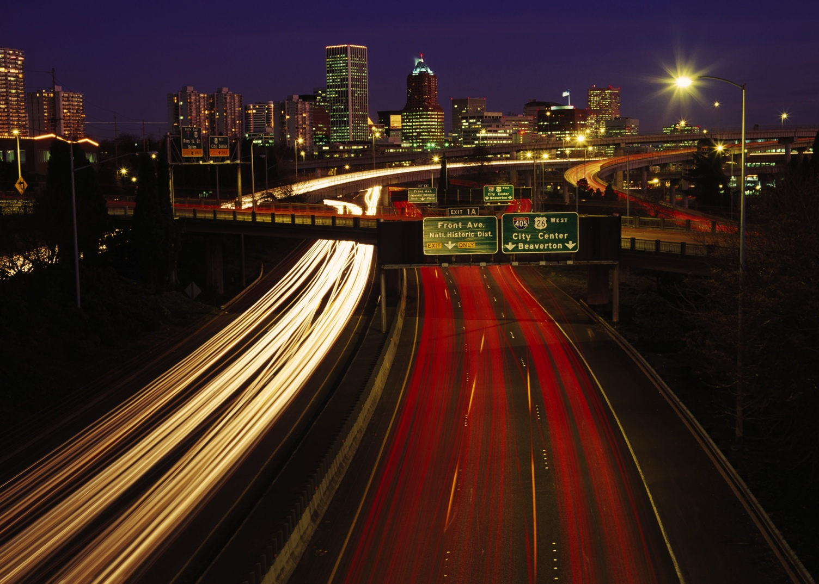
How to Submit HPMS Vehicle Summary Data: meeting federal requirements
Office of Highway Policy Information
June 2015
Notes:
Welcome. This video will instruct state highway agencies about how to meet federal requirements to submit annual Highway Performance Monitoring (or HPMS) Vehicle Summary Data.
This 15-minute video will be broken into four parts.
Part one describes the characteristics of vehicle summary data.
Part two then outlines the process and approach for using the FHWA method to prepare the vehicle summary data.
Part three presents basic HPMS data items and other related concepts important to understanding how to prepare the vehicle summary data.
In the final part, you will see an example of how to compute the vehicle summary data.

Slide 2
Your Objective
Define the needed data elements.
List data sources used to prepare the vehicle summary data.
Calculate vehicle summary data elements using your existing data sources
Notes:
This presentation will show you how to compute the H-P-M-S Vehicle Summary Data by defining the needed data elements. You will be able to list data sources used to prepare the vehicle summary data. And you will be able to calculate vehicle summary data elements using your existing data sources.

Slide 3
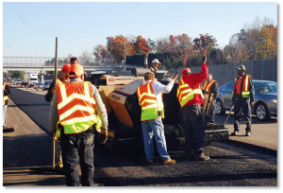
Why Do This?
Mandated by Congress in Title 23 U.S. Code 502 for surface transportation
Notes:
Why do you need to follow these procedures? Congress mandated in Title 23 U.S. code 502 for surface transportation that States adopt the procedures outlined in this presentation. The only exception is for States with methods and approaches that are equal to or superior to this approach.

Slide 4
Part 1
Understand What the Vehicle
Summary Data Is
Notes:
Let’s first understand what Vehicle Summary Data is.

Slide 5
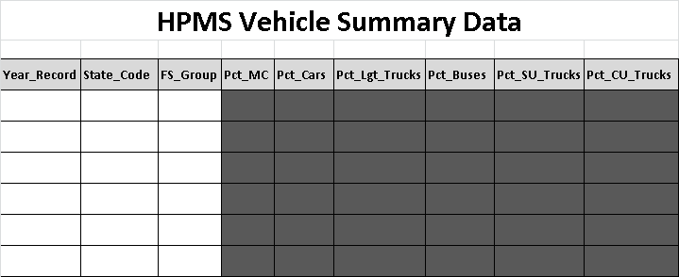
HPMS Vehicle Summary Data
Notes:
The Vehicle Summary Data is a tabular summary of Annual Vehicle Miles of Travel, or VMT, for six Vehicle Groups and six Functional System Groups .

Slide 6
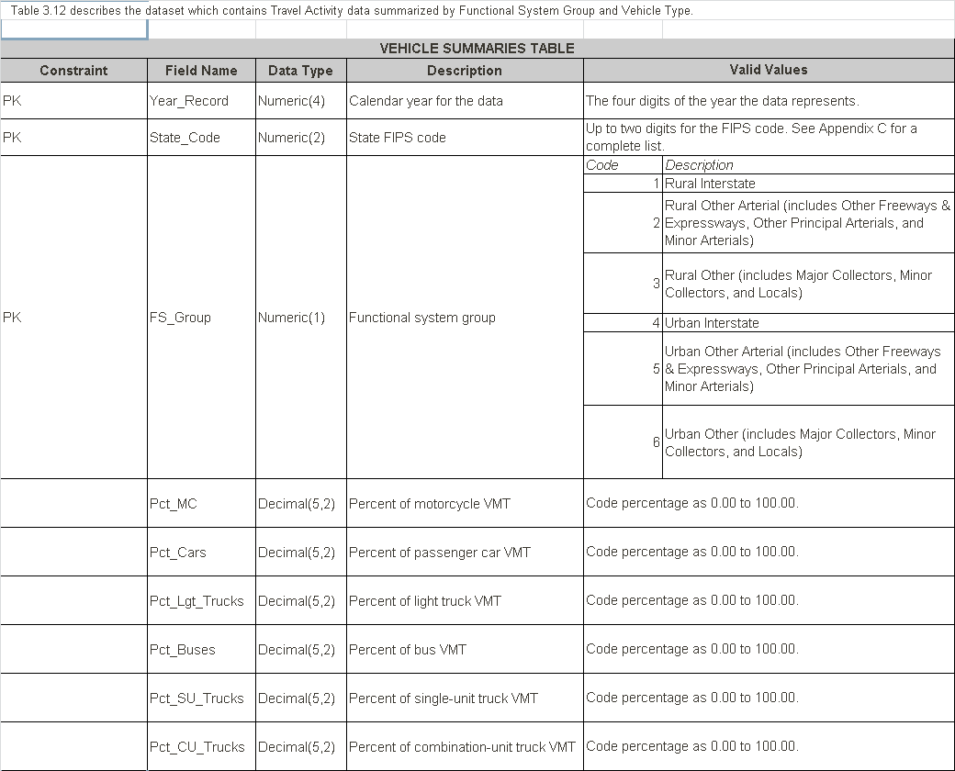
HPMS Vehicle Summary Data
Notes:
The six vehicle groups include Motorcycles. Passenger Cars. Light Trucks. Buses. Single Unit Trucks. And Combination Trucks.
Please remember that percentages for six vehicle groups are coded to two decimal places. For example, zero point zero zero and 100 point zero zero.

Slide 7
HPMS Vehicle Summary Data
Notes:
Please include in your HPMS Vehicle Summary Data submissions
The year of the data.
The State Federal Information Processing Standard or FIPS code.
And six Highway Functional System Groups.
The percentage of your Annual Statewide Vehicle Miles of Travel (or VMT) by Vehicle Group is needed for each of the Functional System Groups.
Percentages are needed for Motorcycles, Passenger Cars, and Light Trucks.
As well as Bus, Single Unit Trucks, and Combination Trucks.

Slide 8
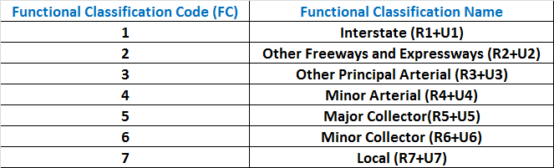
FHWA Roadway Functional Classification
Notes:
The six Functional Groups are aggregations of 7 roadway functional classifications. Be sure not to confuse functional groups with functional classifications. They are different.
The seven functional classifications include:
Interstates (Call it FC code 1).
Other Freeways and Expressways (FC code 2).
Other Principal Arterials (FC code 3)
Minor Arterials (FC Code 4)
Major Collectors (FC Code 5)
Minor Collectors (FC Code 6),
and Locals (FC Code 7)
Each functional classifcation is subdivided into rural or urban depending on the location of the highway.
For example, all Interstate highways are made up of roadways located in rural areas. Here we show them as R.1. And they are roadways located in urban areas. We show them as U.1.

Slide 9
Functional Systems Groups
Notes:
The six HPMS Functional System Groups include Functional System Group 1, which is made up of roadways functionally classified as rural interstates. Here we call them Rural Interstate.
Group 2 includes roadways classified as other rural freeways and expressways, other principal arterials, and minor arterials. We call Group 2, Rural Other Arterial.
Group 3 includes roadways classified as major collectors, minor collectors, and local streets. We call them, Rural Other.
Group 4 is comprised of roadways classified as urban interstates. This functional system group is called Urban Interstate.
Group 5 includes roadways classified as other urban freeways and expressways, other principal arterials, and minor arterials. We call group 5, Urban Other Arterial.
And Functional System Group 6 is comprised of roadways functionally classified as major collectors, minor collectors, and local streets. Please call this group, Urban Other.

Slide 10
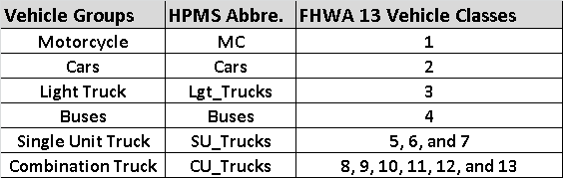
HPMS Vehicle Types
Notes:
Each of the six Vehicle Groups maps to one, or several, of the 13 F-H-W-A Vehicle Classes.
The six Vehicle Groups include
Motorcycles. (Vehicle Class 1).
Passenger Cars. (Vehicle Class 2).
Light Trucks. (Vehicle Class 3).
Buses. (Vehicle Class 4).
Single Unit Trucks. (Combines Vehicle Classes 5, 6, and 7). and
Combination Trucks. (which combines Vehicle Classes 8 through 13).

Slide 11
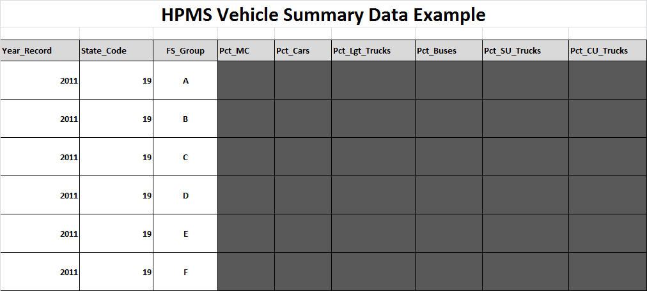
HPMS Vehicle Summary Data Example
Notes:
Now let’s discuss a specific Vehicle Summary Data Example. The Year and State Code are the same for all rows in the table as displayed here. In this example, the year is 2011 and the State Code is 19. One line is provided for each of the six Functional System Groups. They are designated here as group A, B, C, D, E, and F. These letter designations can be identical to the numeric designations we just discussed as vehicle class groups. For example, group A can be thought of as Rural Interstates, group B as Rural Arterial Other and so forth. What you’re trying to do, therefore, is to complete this table by calculating the percentage of total statewide VMT for each Functional System Group. And you’re adding to the table, the percentage of total VMT for each Vehicle Group. For both data points you use data available from HPMS and other sources.

Slide 12
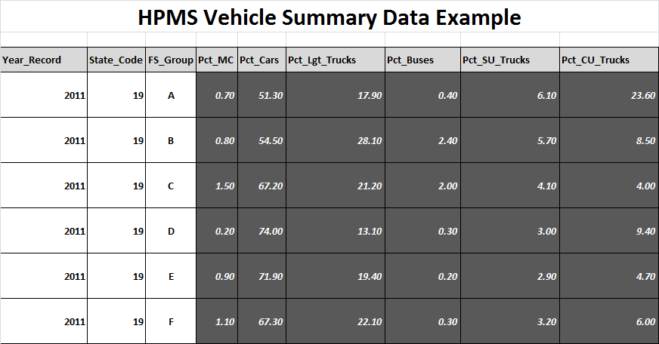
HPMS Vehicle Summary Data Example
Notes:
You need a total of 36 percentage values, rounded to two decimal places, to complete this table. You add one value for each combination of six Vehicle Groups and six Functional System Groups.
Note that each percentage is rounded to two decimal places.
For example, for roadways in 2011 within Functional System Group A, a total of 51.30 percent of the VMT are attributable to Passenger Cars.

Slide 13
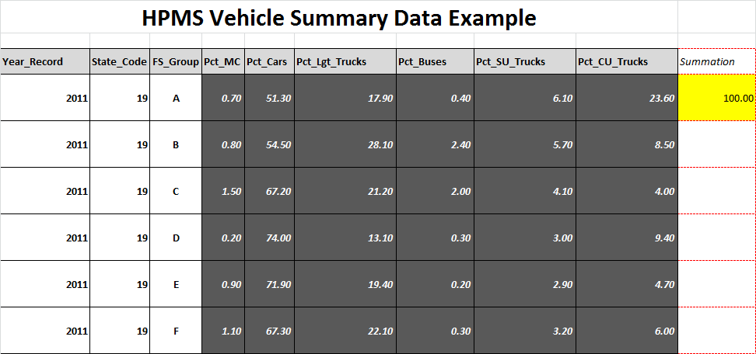
HPMS Vehicle Summary Data Example
Notes:
The row percentages for each Functional System group must total to 100 percent. This example shows a total for Functional System A.

Slide 14
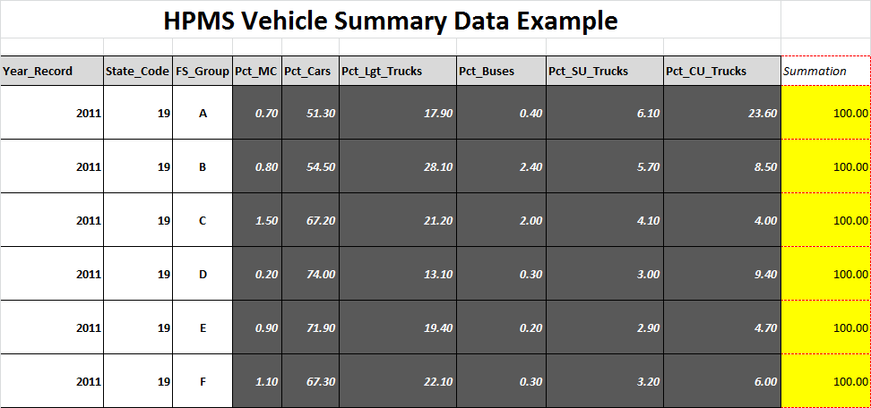
HPMS Vehicle Summary Data Example
Notes:
A completed Vehicle Summary Data table is shown here for all rows.
Note that all rows add up to 100 percent.
Observe how the percentages vary depending on the row or Functional System Group.

Slide 15
HPMS Vehicle Summary Data
The HPMS Vehicle Summary Data is a set of
State-wide average percentage data on
vehicle miles traveled by six vehicle groups for
a given roadway functional group.
Every state needs 36 numerical values annually.
Notes:
The HPMS Vehicle Summary Data is a set of State-wide average percentage data for vehicle miles traveled. We look at it by six vehicle groups for a given roadway Functional System Group.
Every state needs 36 numerical values annually.
The remaining sections of this presentation describe how to accomplish this task.

Slide 16
Summary
HPMS Vehicle Summary Data Characteristics
  1: State-wide average
  2: Percentage
  3: VMT weighted
  4: Six Vehicle Groups
  5: Six Roadway Functional System Groups
  6: Roadway Functional Group Specific
A Total of 6 x 6 = 36 entries
Notes:
HPMS Vehicle Summary Data includes six data points. One, Statewide averages. Then Percentage values. (displayed to two decimal places).
VMT weighted.
Summarized data for six Vehicle Groups and six Functional System Groups.
And data that are roadway Functional System Group specific.
You will have a total of 36 entries.

