Slide 1
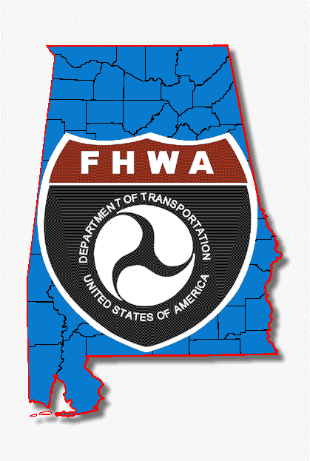
Federal Land Transfers in Alabama
Tammy Keeley-Wright
June 4, 2019

Slide 2
Federal land transfer

Slide 3

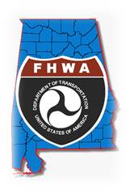
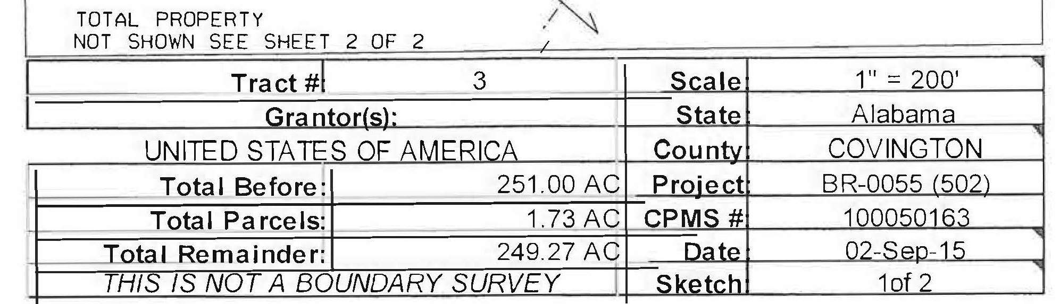
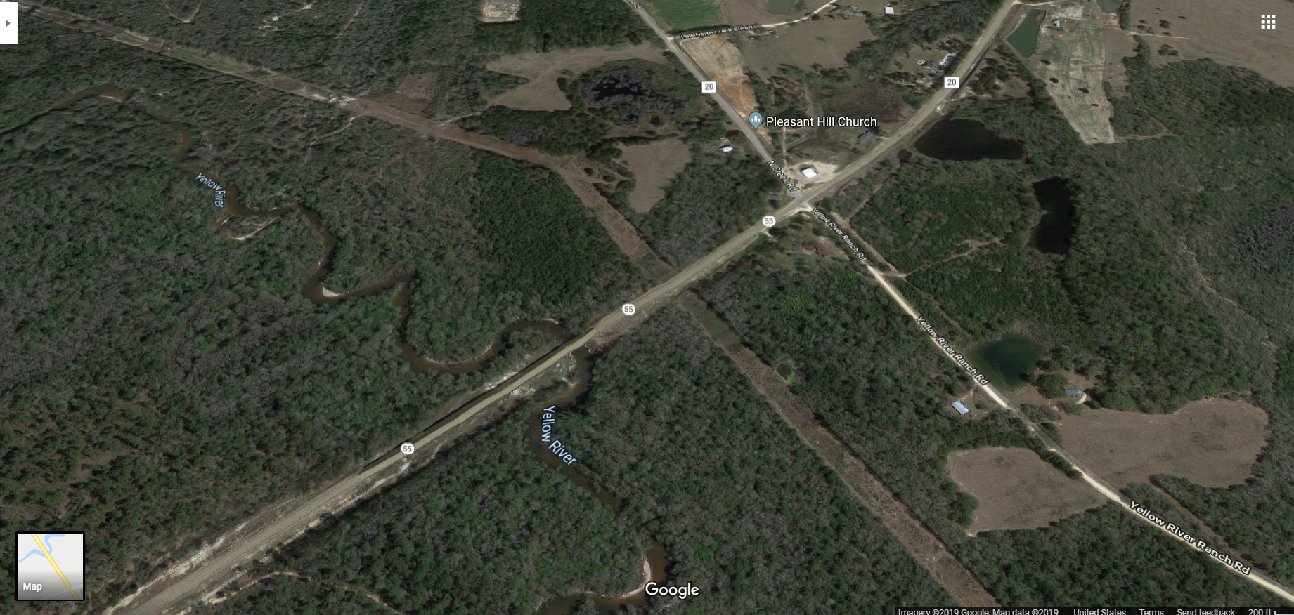
Bridge Replacement
SR 55 Yellow River
Southwest Region
Project under construction
  1.15 miles in length located just northwest of the community of Huckaville on SR-55 over Yellow River in south central Alabama in Covington.
  The present condition of the project area is mostly rural

Slide 4
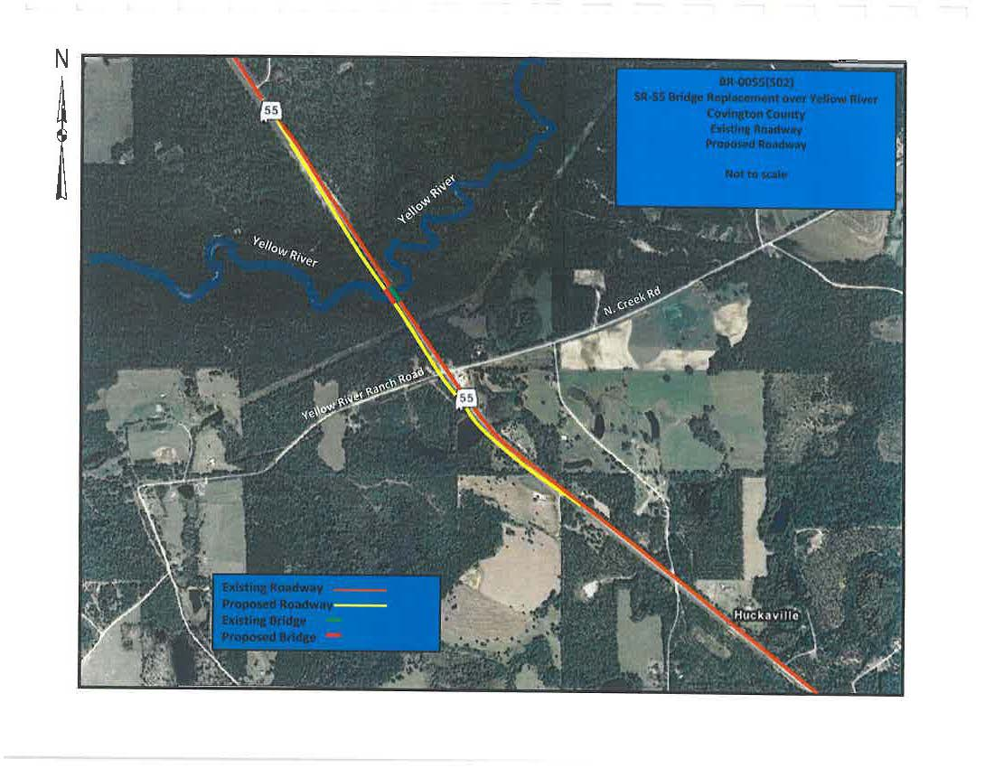
Map

Slide 5
The conditions of the transfer
Before any clearing of the right-of-way or construction of the highway commences:
  The fire plan shall be made available to all bidders prior to letting contract and the Grantee shall cause its contractors.
  Prepare, in cooperation with the Forest Supervisor,
      (1) all clearing and disposal of merchantable timber and young growth in the right-of-way and
      (2) payment by the Grantee or its contractors for the merchantable timber on lands of the United States to be cut, used, or destroyed in the construction of the highway or in clearing of said right-of-way.
      Payment for merchantable timber shall be at appraised value as determined by the Forest Supervisor.
  There were others …..the above are things delay a project and the land has been acquired.

Slide 6
Federal Land Transfers In Alabama
Tammy Keeley-Wright
June 4, 2019

Slide 7
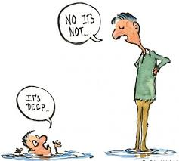

My Perspective
  Early internal & external coordination
  Maintaining a listing of Controlling Agencies staffing and locations
  More reference in the environmental documents about the federal land transfers

Slide 8

Thanks for the time!!

